Slide 1

Observable properties ontology – alignment and usability
Simon Cox, Bruce Simons, Jonathan Yu | Environmental Information Systems
12 June 2014
Land and water

Slide 2
Healthy Headwater - NGIS Terms
alt names
hierarchy
collection
cas_rn number | ANGDTS Code | ANGDTS Description | Units_used | WDTF Parameter | chemical name | ADWG name | IUPAC name | Group | Ion
EC | EC | ease at which conduction current can be caused to flow through material in microSiemens/centimetre | us/cm ms/cm mg/L | ElectricalConductivityAt25C_uScm | Electrical Conductivity |  |  | Conductivity
PH | pH | negative logarithm of hydrogen ion concentration in ph units | pH units | WaterpH_pH | pH | pH |  | pH, alkalinity, acidity
16887-00-6 | 16887-00-6 | concentration of chloride as Cl in milligrams/litre | mg/L mg/kg |  | Chloride |  | Chloride | Chloride | Anion
TDS | TDS | the portion of total solids that passes through filter and deemed to have been dissolved in sample in milligrams/litre | mg/L |  | Total Dissolved Solids | Total Dissolved Solids |  | Salinity
TOTALALKALINITY | ALKT | concentration in milligrams/litre CaCO3 of titratable bases using a methyl-orange endpoint of about pH 4.3 | mg/L |  | Total Alkalinity (as CaCO3) |  |  | pH, alkalinity, acidity
HARDNESS_CACO3 | HARD | the ability of water to precipitate soap and is sum of calcium and magnesium concentrations as milligrams/litre CaCO3 | mg/L |  | Hardness (as CaCO3) | Hardness (as calcium carbonate) |  | Hardness (as calcium carbonate)
SAR | SAR | ratio of sodium to magnesium and calcium and used to assess risk of excess sodium in irrigation water | Ratio |  | Sodium Adsorption Ratio |  |  | Salinity
3812-32-6 | ALKC | alkalinity ascribed to carbonate in milligrams/litre CO3 | mg/L %MOL |  | Carbonate Alkalinity (as CaCO3) |  | Carbonate | pH, alkalinity, acidity
NITRATE | 14797-55-8 | concentration of nitrate as N in milligrams/litre | mg/L mg/kg |  | Nitrate | Nitrate and Nitrite |  | Nitrate and Nitrite | Anion
7439-89-6 | 7439-89-6 | concentration of iron as Fe in milligrams/litre | mg/L mg/kg ug/L |  | Iron |  | Iron | Metal | Cation
Notes:
Example of the data mapped between the HH and NGIS databases.
Pretty good:
Mostly separates Units and methods from the observable property
Maps to terms from other related vocabularies (CAS, IUPAC, WDTF)
Some grouping (simple hierarchy) and collections
Not modular
difficult to incorporate vocabularies not governed by that discipline (e.g. ‘units of measure’)
Inconsistent Governance
same concepts (different terms?) appear in multiple vocabularies,
no relationships between terms and collections from different data providers,
Not interoperable
local, non-resolvable identifiers,
lack of a formal definitions,
lack of an ontology describing the relationship between concepts
Ambiguity
concepts are poorly defined,

Slide 3
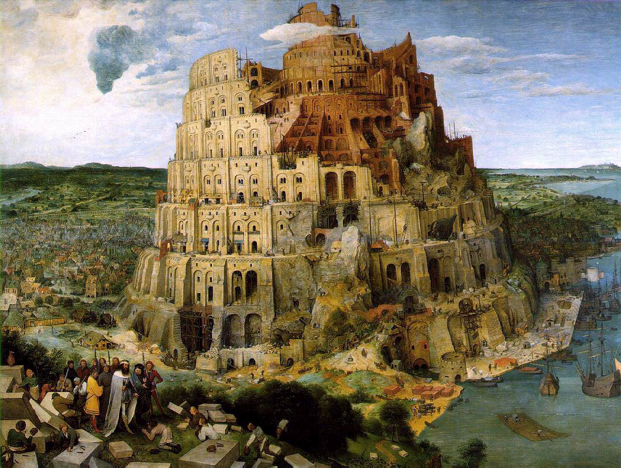
Are these the same?
“nitrogen”
“dissolved nitrogen”
“Total nitrogen, water, filtered, milligrams per liter”
“Concentration of nitrogen (total) per unit volume of the water body [dissolved plus reactive particulate phase] by oxidation and colorimetric autoanalysis“
“Concentration of nitrogen (total) per unit mass of the water body [dissolved plus reactive particulate <GF/F phase] by filtration and high temperature Pt catalytic oxidation”
“Concentration (moles or mass) of total nitrogen (i.e. nitrogen in all chemical forms) in suspended particulate material per unit volume of the water column.”
“Concentration of nitrogen (total) {'PON'} per unit volume of the water body [particulate 2-10um phase] by filtration, acidification and elemental analysis”
“Dissolved total and organic nitrogen concentrations in the water column”

Slide 4
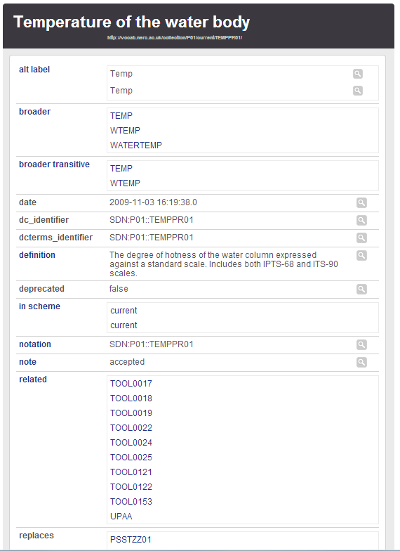
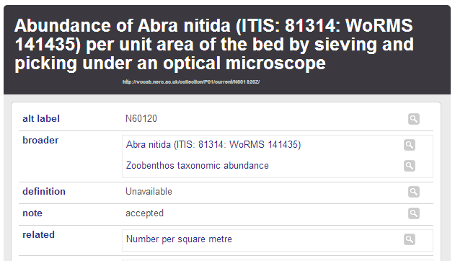
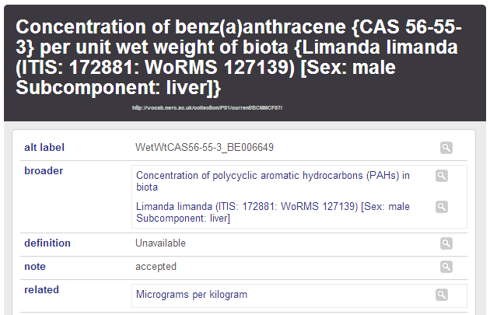
‘Parameters’ in an environmental science vocabulary (NVS)
http://vocab.nerc.ac.uk/collection/P01/current/N601S20Z/
http://vocab.nerc.ac.uk/collection/P01/current/BCMMCF07/
Notes:
NVS is probably the most widely used large vocabulary service.
The “P01” vocabulary contains an inventory of observed properties from the oceanography community.
It contains 30,000+ entries, most of which have long names because they are very specific.
More later …

Slide 5
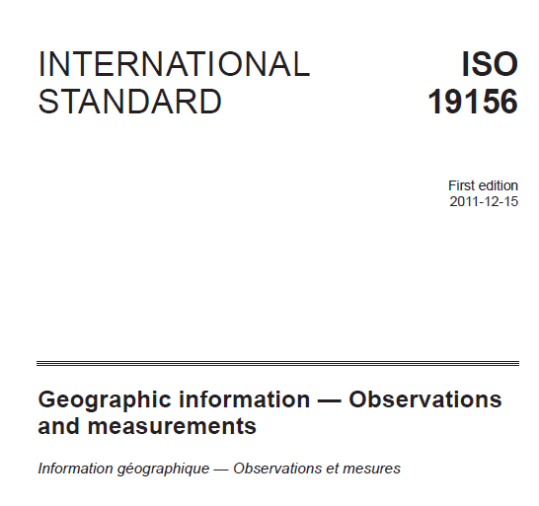
O&M
GFI_Feature
+featureOfInterest
1
0..*
OM_Observation
GF_PropertyType
+
phenomenonTime
1
+
resultTime
+observedProperty
+
validTime [0..1]
+
resultQuality [0..*]
+
parameter [0..*]
0..*
1
+procedure
+result
OM_Process
Any
An Observation is an action whose result is an estimate of the value of some property of the feature-of-interest, obtained using a specified procedure
Cox, OGC Abstract Specification – Topic 20: Observations and Measurements 2.0 ISO 19156:2011 Geographic Information – Observations and measurements

Slide 6
Requirements
Simple properties
Constrained properties
Compound properties
Property series
Composite properties
Cox, OGC Implementation Specification – Observations and Measurements 1.0 – Part 1 – Observation Schema

Slide 7
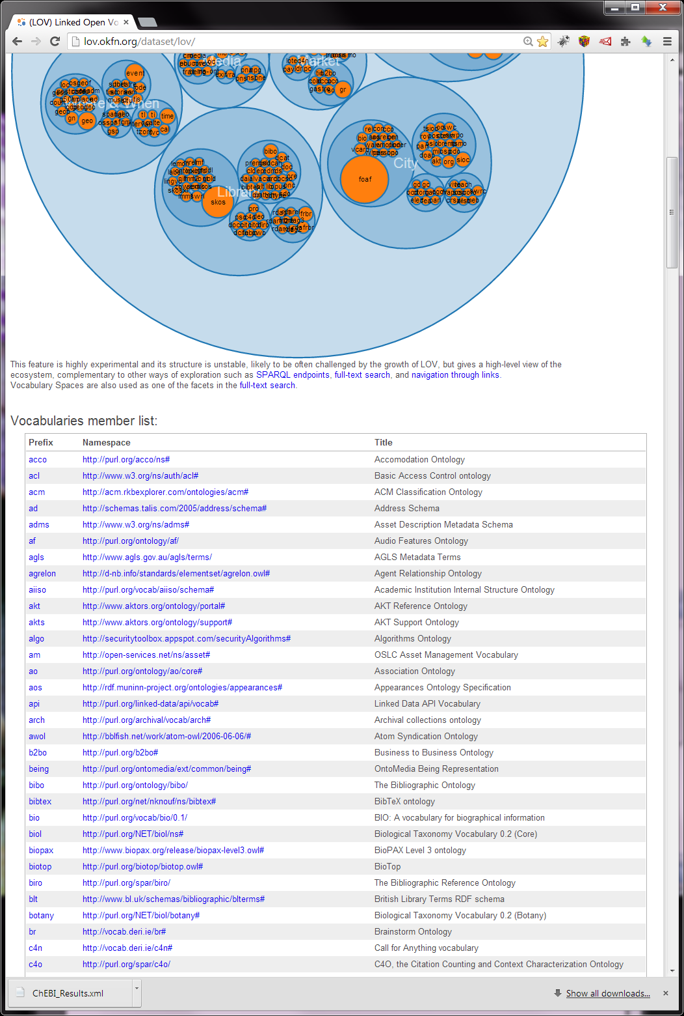
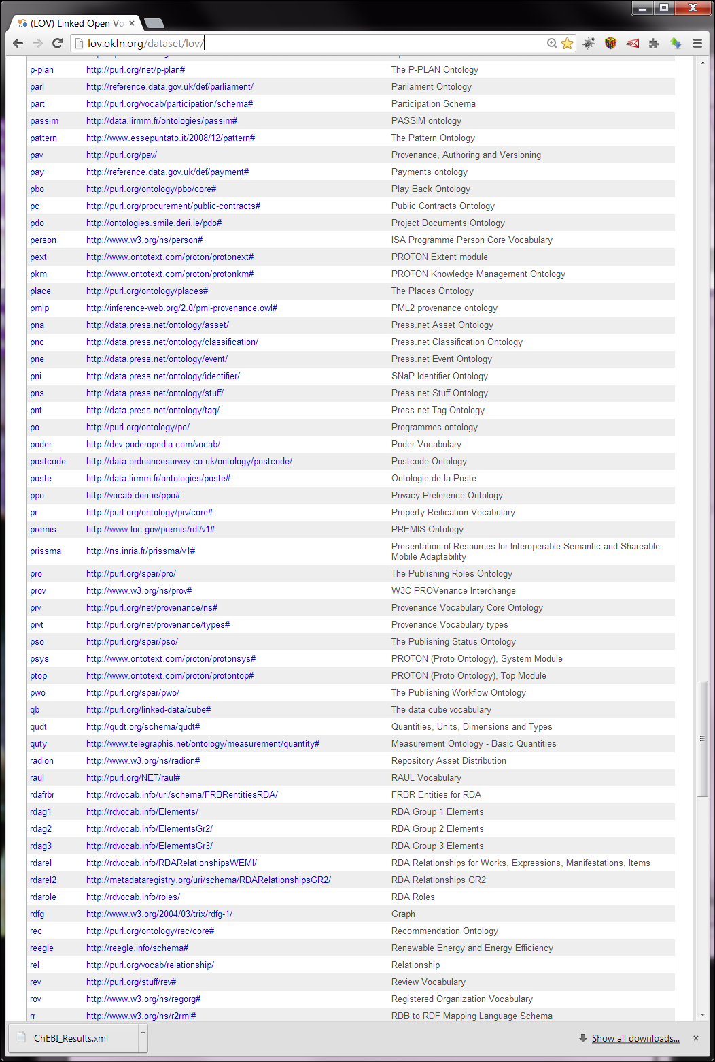
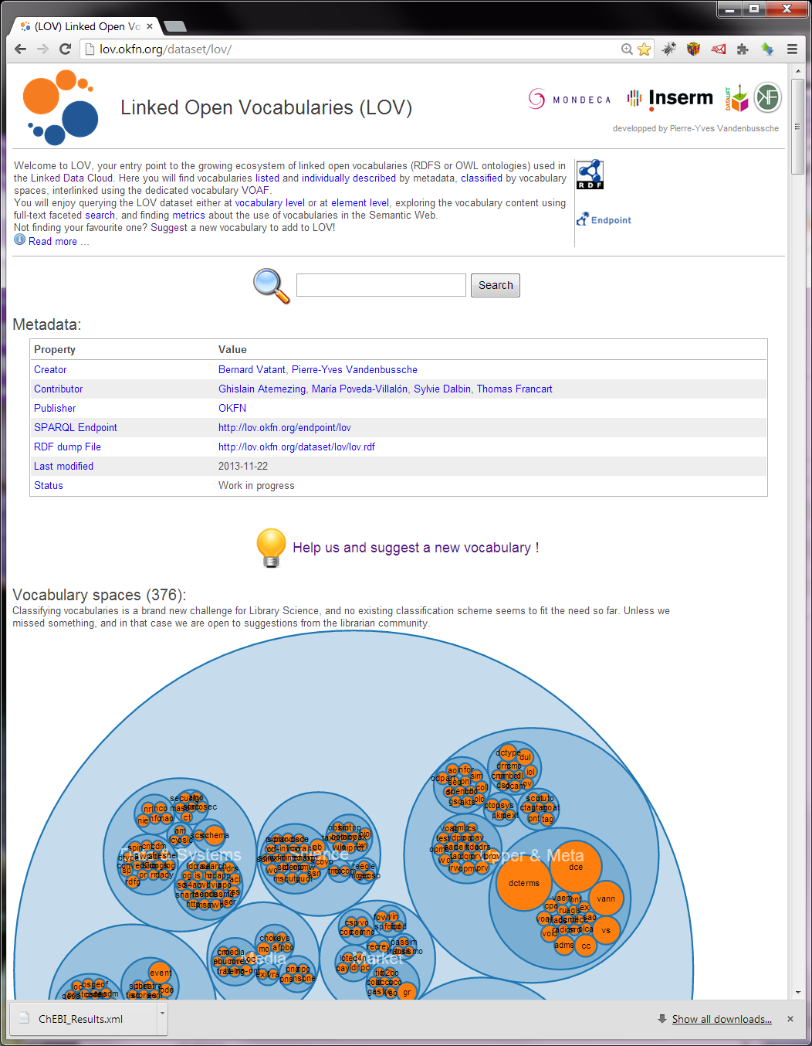
We are not alone!
OKFN Linked Open Vocabularies
http://lov.okfn.org/dataset/lov/

Slide 8
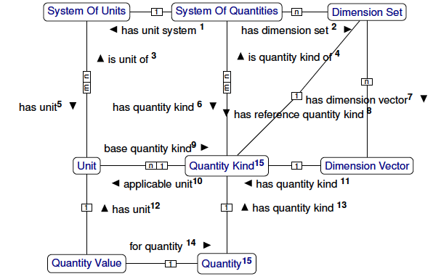
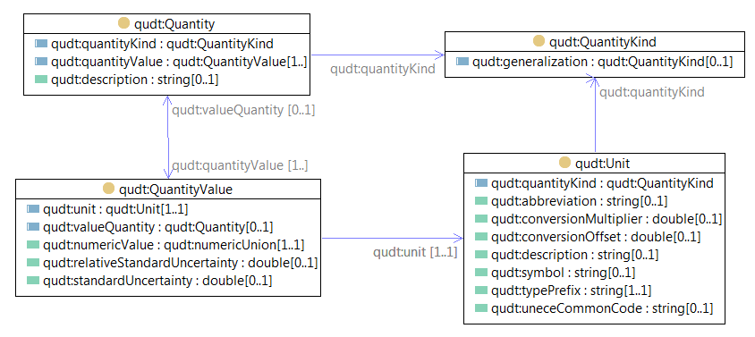
Conceptual Model of QUDT

Slide 9
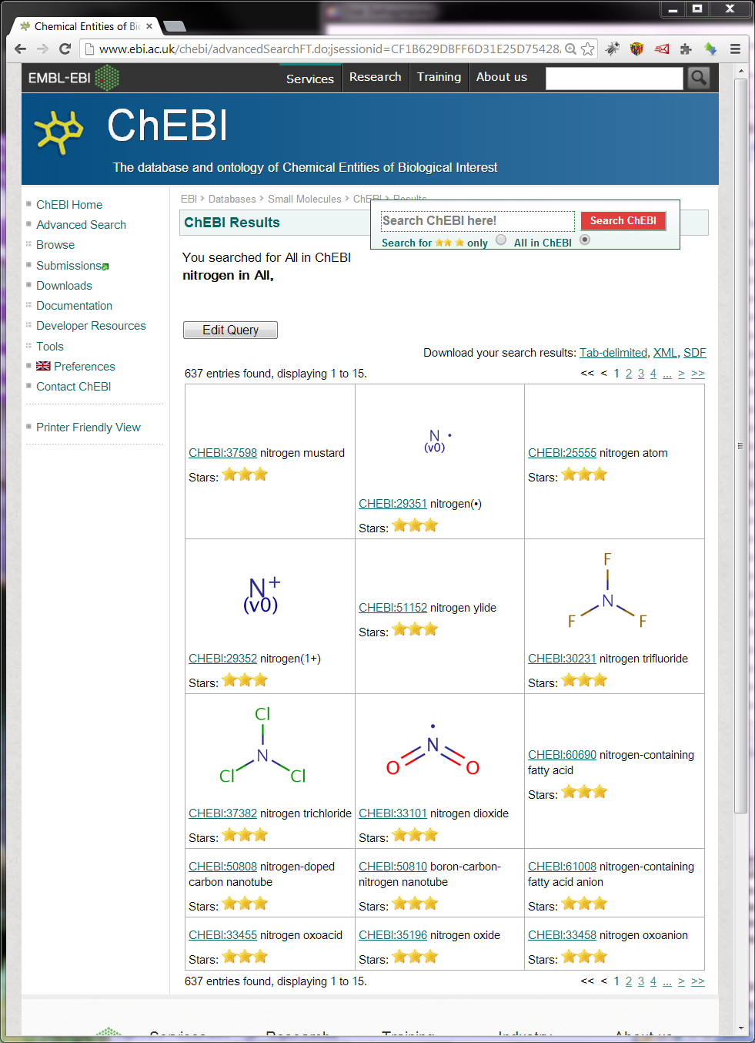
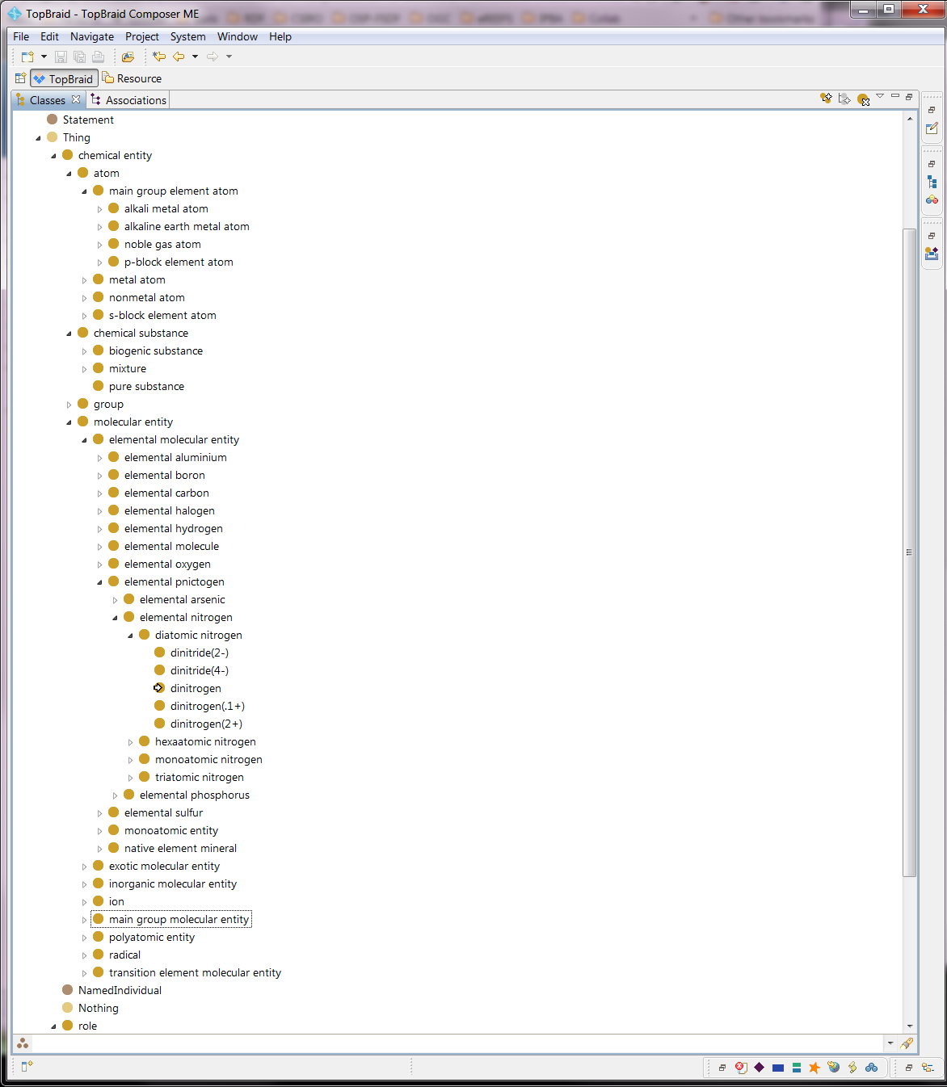
Standard ontology of chemicals
>36 000 chemical entities
http://purl.obolibrary.org/obo/chebi.owl

Slide 10
Dissolved nitrogen concentration objects
SubstanceOrTaxon
ScaledQuantityKind
Unit
Notes:
If we look at a ‘nitrogen’ example we have the ScaledQuantityKind “dissolved nitrogen concentration” which has the more general concept “nitrogen concentration”, which in turn is a specialization of “Concentration”.
“dissolved nitrogen concentration” can be measured in “MolPerCent” units, which can be used for “Concentration” QuantityKinds, or “MilliGramsPerLitre” which can be used for “AmountOfSubstancePerUnitVolume” QuantityKinds.
“dissolved nitrogen concentration” is a measure of the “nitrogen” SubstanceOrTaxon, which is an exactMatch of the ChEBI “elemental nitrogen” concept.

Slide 11
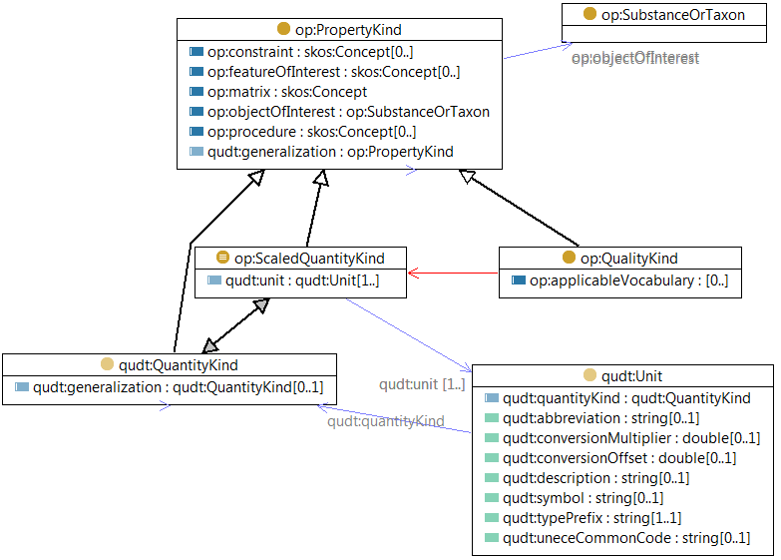
Water Quality extension to QUDT
WQOP
QUDT
Notes:
A number of formal units of measure systems exist:
‘The Unified Code For Units of Measure’ (UCUM; Schadow and McDonald, 2009),
‘Ontology of units of measure’ (OM; Rijgersberg et al., 2013),
‘Measurement Units Ontology’ (MUO; Berrueta and Polo, 2009),
‘Ontology of Units of Measurement’ (UO),
‘Semantic Web for Earth and Environmental Terminology’ (SWEET v2.2),
‘Quantities, Units, Dimensions, Values’ (QUDV; de Kooning et al. 2009)
‘Quantities, Units, Dimensions and Data Types’ (QUDT; Hodgson and Keller, 2011).
These all use different modelling approaches and formalisms ranging from simple vocabularies enumerating units of measures, to alignment of measurement related concepts to upper ontologies. They also differ in their coverage of the set of unit of measures. Of the established and well-governed unit of measure ontology options, QUDT is well-aligned with our understanding of the relationships between measurements and units of measure.
Our extension to QUDT recognised that QuantityKinds are the subset of all PropertyKinds that can be measured. We created the ScaledQuantityKind class as an equivalent class to allow specifying the units associated with the QuantityKind via the qudt:unit property. I understand that QUDT v2 intends to add this property to QuantityKind, making ScaledQuantityKind redundant.
The objectOfInterest property allows specifying what the substance (or taxon if biological) is that is being measured.
Vocabularies for the units of measure (instances of the ‘qudt:Unit’ concept) and the kinds of quantities (instances of the ‘qudt:QuantityKind’ concept) were imported from QUDT, supplemented with units of measure from the existing water quality vocabularies and any additional required quantity kinds.
QUDT contains 1484 instances of units of measure and 236 quantity kinds.
However, it is missing some units of measure and kinds of quantities required for the water quality data. To rectify this, we added 41 additional units of measure, and 17 quantity kinds, all in separate namespaces to the original QUDT.
The conversion factors between these new units and the existing QUDT units still need to be defined using the QUDT mechanics.

Slide 12

Mix-n-match parameter definitions
Concentration of / benz(a)anthracene {CAS 56-55-3} / per unit wet weight of biota / {Limanda limanda (ITIS: 172881: WoRMS 127139) [Sex: male / Subcomponent: liver]}
Substance | matrix-relationship | context of matrix (taxon) | matrix | method
Notes:
Going back to the NVS parameters:
The name is a combination of facets.
For example, most of the ‘concentration of’ or ‘abundance of’ parameters are specified in terms of
The substance (benzanthracene)
The matrix (liver)
Matrix context (Limanda limanda – male)
Matrix relationship (per unit weight of biota)
A method (sensor, instrument, protocol – not specified in this case)
With even small numbers of these facets, in combination you can get to a large number of specialized parameters
Roy Lowry (NVS) refers to the combination of multiple facets as ‘one armed bandit wheels’
In terms of the OP ontology, these facets are all ‘constraints’, but the specific ones used in NVS could be pointers to a refinement or specialization of OP.

Slide 13
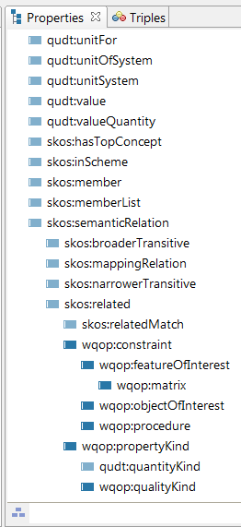
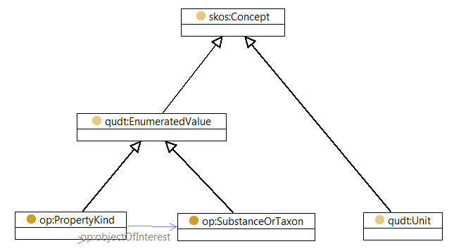
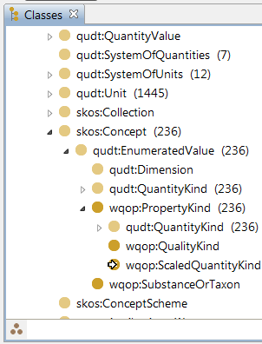
Linked to SKOS

Slide 14
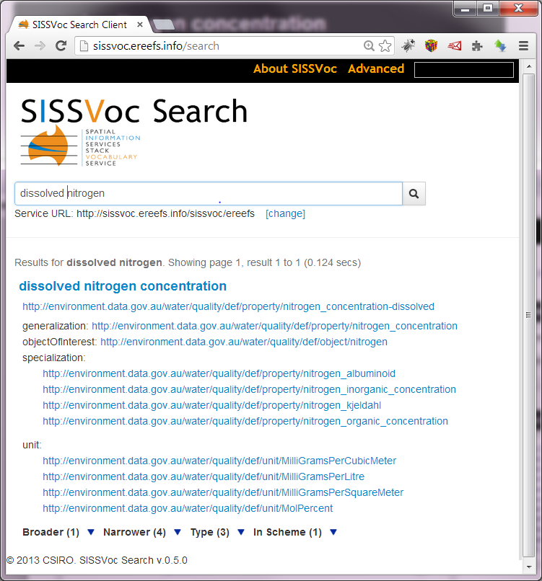
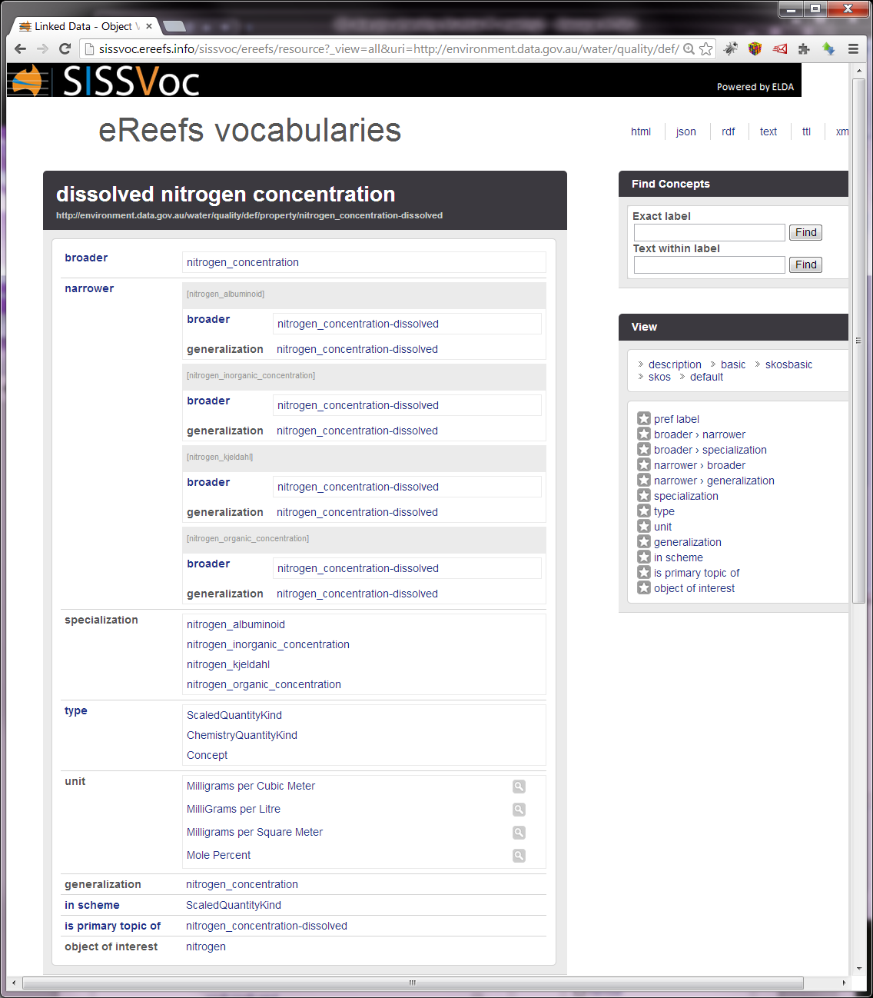

Slide 15
How does this relate to O&M?
PropertyKind
qudt:generalization
“Concentration”
op:constraint
[Scaled]QuantityKind
op:procedure
op:matrix
op:objectOfInterest
“nitrogen”
op:featureOfInterest
Cox, S. J. D. (ed.) (2007). Observations and Measurements – Part 1 - Observation schema. OGC 07-022r1, Open Geospatial Consortium Inc.
Notes:
Looking at these properties:
The model for observable properties can be mapped to the model for Property Types described in Observations and Measurements v1.0.
The key concept from O&M for our purposes is the ConstrainedPropertyType class.
This specializes a generic PropertyType by modifying a base with the addition of constraints.
In the implementation described here, ‘base’ is mapped to qudt:generalization, which we have asserted is equivalent to skos:broader.
‘singleConstraint’ is implemented as wqop:constraint, with a subProperty wqop:objectOfInterest.
So a ScaledQuantityKind, such as “nitrogen concentration”, may be a narrower concept of “concentration” with a “nitrogen” objectOfInterest.

Slide 16
Summary
Observable property vocabularies should be
Standardized
Published
Extend / re-use existing vocabularies where possible
Publish it somewhere good
http://environment.data.gov.au/def/property/
http://environment.data.gov.au/def/object/
http://environment.data.gov.au/def/unit/
http://environment.data.gov.au/def/op
http://sissvoc.ereefs.info/search
Notes:
Also links to
SWEET
DBPedia
QUDT units and quantity instances
X-walk to NERC
*match predicates

Slide 17
Thank you
CSIRO Land and Water
Simon Cox Research Scientist
t +61 3 9252 6342
e simon.cox@csiro.au
w www.csiro.au/people/simon.cox
Land and water

Slide 18
Mapping chemical substances to ChEBI
Alternative approach to map skos concepts to ChEBI classes
manually create
skos:exactMatch
statements
chebi.owl
transform subset of owl:Class
to skos:Concept
add prov:hadPrimarySource
object.ttl
Subset of
SubstanceOrTaxon
chebi_skos.ttl
imports
into
imports
into
object-chebi
-mapping.ttl
imports
into
manually create
skos:exactMatch
statements
wq.ttl
Notes:
Most of the identified objects in our water quality vocabulary are chemical entities. It was therefore important to align these with chemistry definitions, which we took from the Chemistry Entities of Biological Interest (ChEBI) ontology.
This provides access to definitions, synonyms, relationships and properties created as a result of considerable domain expertise input.
However, the chemical entities and substances in ChEBI are defined as OWL Classes.
This presents a challenge as our observable property model includes properties which are to apply at the level of instances or ‘individuals’, rather than classes.
There are two potential responses to this:
1. Mirror the relevant external ChEBI owl:Classes as skos:Concepts in a new namespace, convert required properties such as: rdfs:subClassOf converted to skos:broader;
obo2:Definition converted to skos:definition;
rdfs:label converted to skos:prefLabel;
use skos:exactMatch to map between the ChEBI and Water Quality skos:Concepts
prov:hadPrimarySource was added to provide a reference to the URI of the original ChEBI owl:Class.
2. The alternative approach we probably should have taken was to accept the use of SKOS relations between instances and classes, and rely on the ‘punning’ capability of OWL2-DL
Linking to the ontology, rather than replicating it, ensures that governance and currency concerns are addressed.

