Slide 1
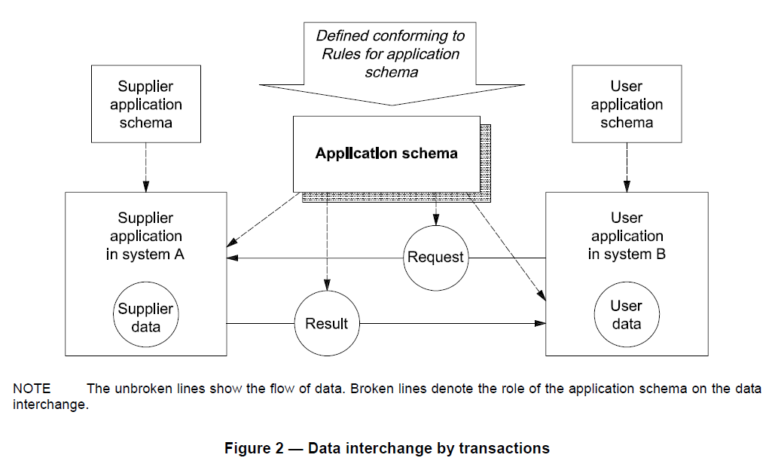
Here we stand in August 2014
HY_Features
ISO19109: Rules for application schema.
TimeSeriesML
Property (Variable)
WaterObservation
WML2
WML2
WML2
WML2
WML2
WML2
Supplying Service
Requesting Service
SOS 2.0 Hydrology Profile
NOTE: Blue dashed lines denote the import relationship to the application schema whose concepts are to be imported.
Notes:
Using WaterML2, both user an supplier application will conform the rules for application schema (ISO 19109).
Data request and response may be generated using the specific Hydrology Profile of the SOS2 implementing WaterML2 (under development).

Slide 2
Application schemas conform to ISO 19109
Hydrology-specific application schemas,
using GFM and applying a conceptual schema language
WaterObservation
WML2P1:
Water Quantity Observation
(OGC10-126rX)
WML2P2: Gauging Observation
(OGC13-021rX)
WML2P3: Water Quality Observation
(OGC14-003rX)
HY_Features, common hydrol. feature model
(OGC11-039r3)
RiverML:
channel geometry observation
GWML2: groundwater observation
…..
…..
ISO19123
TimeSeriesML
(under development)
…..
…..
Property (Variable)
“SoilML”:
water component ?
CSML3:
water component ?
Forecasting observation
(re-initiated ?)
Application level
Notes:
requires a re-factoring of the WaterML2 Part 1 in terms of a (water) observation model using (special hydrologic) feature model and a (special time-series) coverage model

Slide 3
Suite of Water Information Standards
What do we hope to get from the water suite of standards ?
D-Suite (Data): Tools and services for the exchange of hydrologic data using Web services (→ technical interoperability)
F-Suite (Features): Tools and services for referencing hydrologic features, for the “mapping” of semantic concepts to preserve context and meaning across applications and domains (→ mediation)
G-Suite (Geographic Water Information): Tools and services to share water-related geographic information using Web services (→ semantic interoperability)

Slide 4
Suite of Water Information Standards
WaterML2Part2: Gauging Observation
(OGC13-021rX)
WaterML2Part3: Water Quality Observation
(OGC14-003rX)
WaterML2Part1:
Water Quantity Observation
(OGC10-126r4)
TimeSeriesML (under development)
HY_Features, common hydrologic feature model
(OGC11-039r3)
Suite of Water Information Standards: towards the identification, observation and representation of hydrologic features using standards
WaterML2Part5: River Channel
(RiverML, under development)
WaterML2Part4: Groundwater
(GWML2, under development)
SoilML:
Soil-water component
CSML3:
Atmospheric-water
component

Slide 5
Are there common use cases for D, F, G ?
Data-Suite:
Feature-Suite:
G-Suite:

Slide 6
Possible common use cases ?
Data-Suite:
SOS2.0 Hydro Profil (UC: ………………….)
Convert Waterml2-exports into netCDF (UC: ………………….)
Convert waterML2-exports into JSON (UC: ………………….)
Feature-Suite:
Formal mapping of the information models of the „WaterMLs“ to HY_Features to assist the generation of resolvable uris
(UC: continue the Mediation UC of the OWS10)
Mapping of „WaterMLs“ to the TimeseriesML
G-Suite:
Feature type catalogues / hydro ontology based on the HY_Features to assist model mapping
Linked Data, Referencing hydrologic features (UC: Hydro Geofabric)

Slide 7
A couple of challenges for the HDWG
Does HDWG have a framework for future standards development?
What does our suite of water data standards look like in a few years time?
WaterML2: Part 1, 2, 3, …N?
How can HDWG influence take-up of developed standards?
Can we assist with capacity building and implementation of standards-compliant technologies for hydrological data sharing in countries around the world?
For discussion during the workshop…

Slide 8
HydroDWG 2015 workshop
Suggested timing: September 2015
Suggested location: Europe
Rome, Italy
Host: Silvano Pecora
Venue: ?
Orléans, France
Host: Sylvain Grellet
Venue: Bureau of Geological and Mining Research (BRGM)
Aarchen, Germany
Host: Michael Natschke
Venue: Kisters

