Slide 1
WMO feedback to HDWG Workshop
Tony Boston, BoM, Australia
Silvano Pecora, ARPA, Italy
11 August 2014
WMO Commission for Hydrology
Notes:
Slides with contributions by Bruce Stewart, WMO CHy Secretariat

Slide 2
Outline
WMO and Commission for Hydrology (CHy) background
WMO information systems; and global data sharing
Projects relevant to HDWG:
WIGOS metadata standard
TimeSeriesML proposal
WaterML2 adoption
WMO Hydrological Observing System (WHOS)
HDWG challenges
Conclusions

Slide 3
World Meteorological Organization (WMO)
191 Member States and Territories
Mission (summarised):
To facilitate worldwide cooperation in meteorology, hydrology and related fields by:
establishing networks of observing stations
maintaining centres providing meteorological and related services
establishing systems for data exchange
defining standards for observational data and its publication
application of meteorology to aviation, water issues, agriculture, shipping and other human activities
promotion of operational hydrology and cooperation
encouraging research, training and coordination

Slide 4
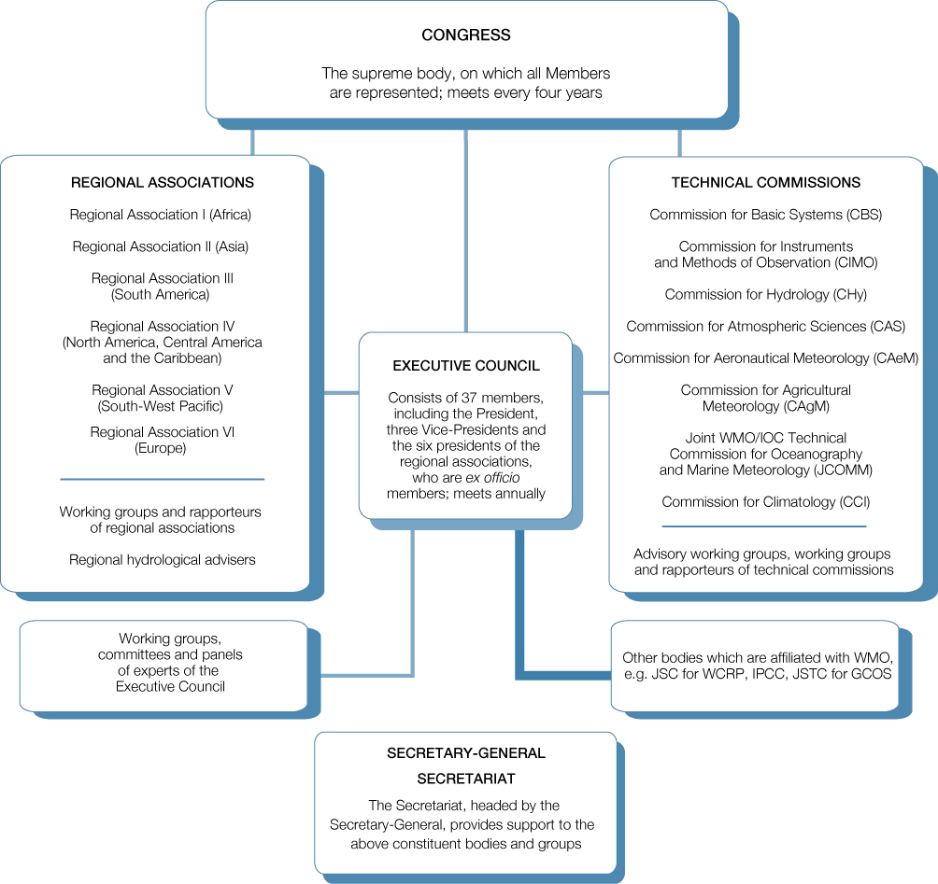

Slide 5
Commission for Hydrology (CHy)
Mission:
To design and execute the water related activities of WMO,
including promoting the exchange of technology and
capacity building. In particular, CHy provides guidance
to WMO Member countries and the WMO Secretariat for
the implementation of the Hydrology and Water Resources
Program of WMO.
Website: http://www.wmo.int/pages/prog/hwrp/chy/

Slide 6
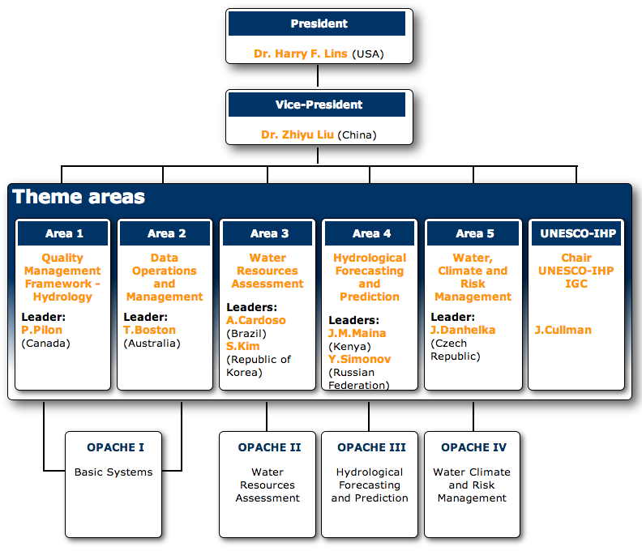
CHy Structure

Slide 7
Commission for Hydrology (CHy)
Data Operations and Management
Guide the implementation of CHy-14 Resolution 7/1 that began “a
process, including testing, that could see the potential adoption of
the WaterML 2.0 as a WMO standard for information exchange
managed by WMO (supported by the WMO/OGC MOU) and to
register this standard as a joint WMO/ISO standard”;
Monitor and report on new developments dealing with data
management issues, such as observations, data exchange and
protocols, data transfer formats, and WIS and WIGOS;
Review progress with respect to the exchange of hydrological data
and products, and propose additional guidance on data that should
be exchanged, including harmonization of exchange practices.

Slide 8
INTERNATIONAL RESOLUTIONS
WMO Res. 40 (Cg-XII) - WMO policy and practice for the exchange of meteorological and related data and products.
Members shall provide on a free and unrestricted basis essential data and products which are necessary for the provision of services in support of the protection of life and property and the well being of all the nations…
WMO Res 25 (Cg-XIII) - Exchange of hydrological data and products.
Members shall provide on a free and unrestricted basis those hydrological data and products which are necessary for the provision of services in support of the protection of life and property and the well being of all the nations…
WMO Congress of 2012 noted the considerable work being undertaken internationally with respect to the development and agreement on standards for the transfer of hydrologic data between data servers (databases) and users.
WaterML 2.0 was proposed for adoption as a WMO standard for information exchange.

Slide 9
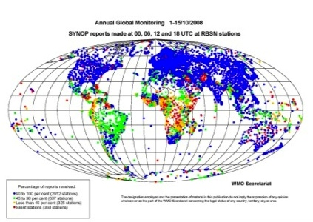
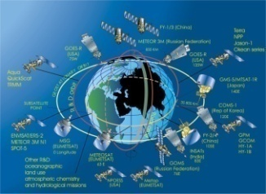
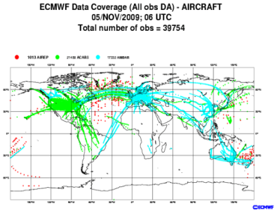
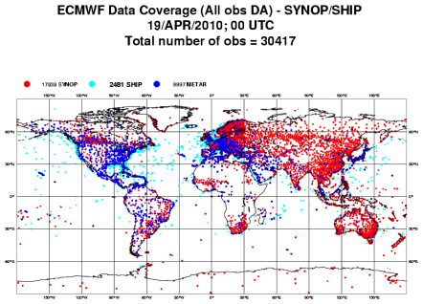
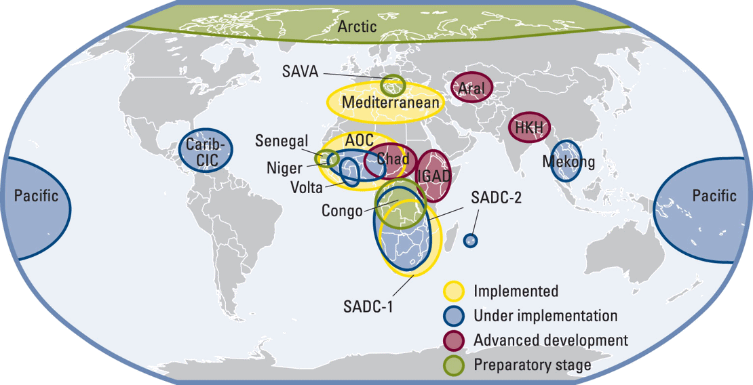
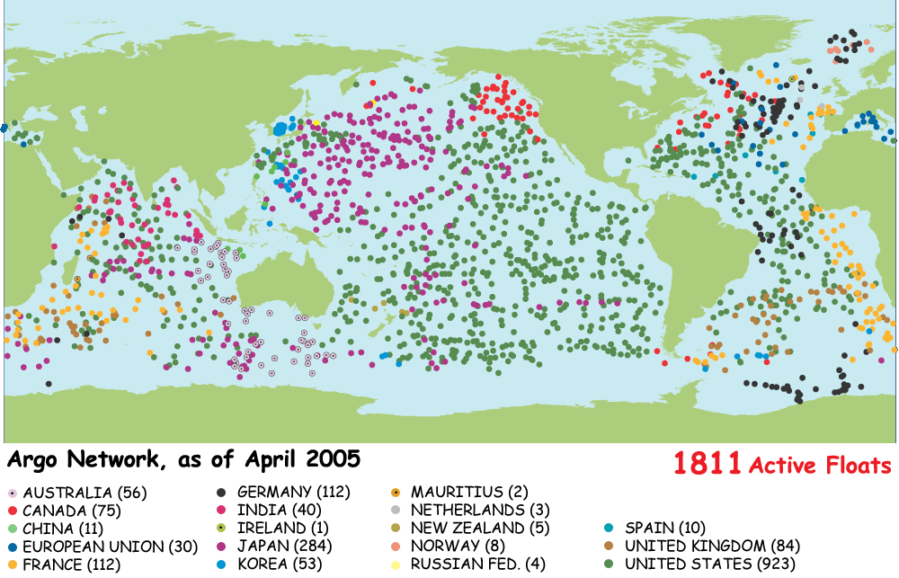
WIGOS WMO Integrated Global Observing System
WIGOS Global Observing Components
Global Observing Systems (WWW/GOS)
RBSN, RBCN (>10,000 stations,1,000 upper-air)
AMDAR (39,754/day)
Ship & Marine obs (30,417/day)
Surface-based remote sensing
Meso-scale networks
WMO Space Programme
Observing component of Global Atmospheric Watch (GAW)
Hydrological Observations (including WHYCOS and WHOS)
Observing component of Global Cryosphere Watch (GCW)
Notes:
Regional Basic Synoptic Networks (RBSN)
Regional Basic Climatological Networks (RBCN)
AMDAR = Aircraft Meteorological Data Relay – World Weather Watch aircraft-mounted observing network

Slide 10
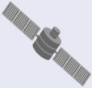
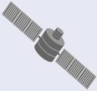
WIS WMO Information System
WIS distinguishes centres as Global Information System Centres (GISCs), Data Collection or Production Centres (DCPCs) and National Centres (NCs). NCs and DCPCs collect, generate, or distribute data, forecasts, and other processed information. NCs are national in scope. DCPCs are international in scope and each is associated with a particular WMO Programme. GISCs support all WMO and co-sponsored Programmes, maintain the comprehensive metadata catalogue, and help to ensure the accessibility of WMO data and information globally.
Telecommunication Centres
Volcanic Ash Advisory Centres
Tropical Cyclone Centres
Tsunami Warning Service
Regional Ozone Centres
Numerical Weather Prediction Centres
DCPCs
NCs
NCs
DCPC
GISC
World Data Centres
Aviation Weather Centres
Radar Centres
DCPCs
GISC
GISC
NCs
DCPCs
DCPC
GISC
GISC
DCPC
EUMETSAT
Satellite Two-Way
Satellite Dissemination
NCs
NCs
NCs
DCPCs
Internet
Notes:
GISCs – Currently (10 August 2014) 15 GISCs worldwide
DCPCs – Currently 125 DCPCs worldwide
NCs – Currently 223 worldwide

Slide 11
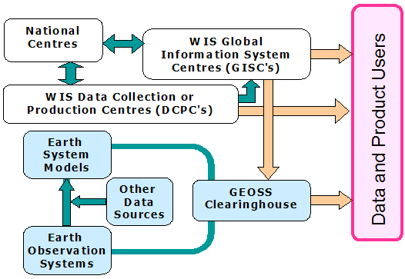
GEOSS and WIS
WIS is an exemplar contributing component of the GEOSS for weather, water, climate and disaster. WMO users can discover information in GEOSS via their GISC. Similarly, GEOSS can discover information in WIS via the GISC catalogues through the GEOSS common infrastructure

Slide 12
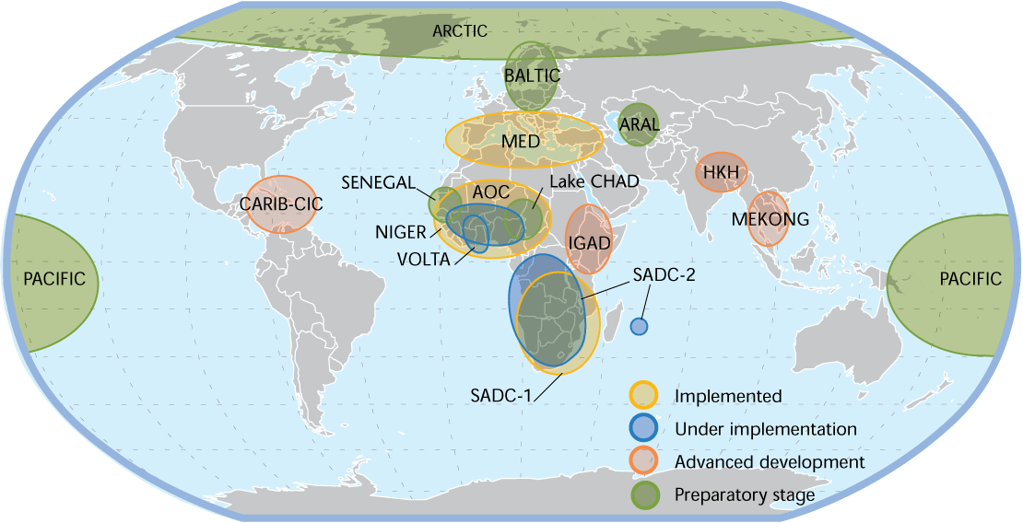
HYCOS HYdrological Cycle Observing System
Project Initiation Stages
Stage A: Request stage
Stage B: Concept stage
Stage C: Project proposal stage
Project Implementation Stages
Stage D: Preparatory implementation stage
Stage E: Field implementation stage
Post Project Stage
Stage F: Project maintenance stage

Slide 13
ICG-WIGOS – Task Team on WIGOS Metadata (TT-WMD)
Terms of reference:
To identify the information that is needed to allow the majority of users to use WIGOS observations in appropriate contexts and in a defensible way.
To create the WIGOS Core Metadata Standard that allows the essential information to be exchanged unambiguously, regardless of the format used for the transfer…
Principles:
Include the information that enables users to make adequate use of observational data [also for climate applications]
Every piece of metadata shall have date/time information associated with it
All metadata associated with internationally exchanged data shall be made available
Metadata shall be updated in a timely manner to support adequate interpretation of data
Standard should be applicable to all disciplines forward-looking but also respect legacy (e.g., Vol. A)
Standard should be acceptable and applicable to all Members
Notes:
INTER-COMMISSION COORDINATION GROUP on the WMO Integrated Global Observing System (ICG-WIGOS)
Metadata types:
Discovery (WIS metadata, ISO 19115)
Observations (WIGOS metadata)
Provenance etc…
Environmental observations/data types considered:
Atmosphere, ocean, land, water
Ground-based, airborne, ship-based, satellite
In-situ, remote
Physical, chemical
Work of WMO TCs considered including GRDC Hydrologic Metadata

Slide 14
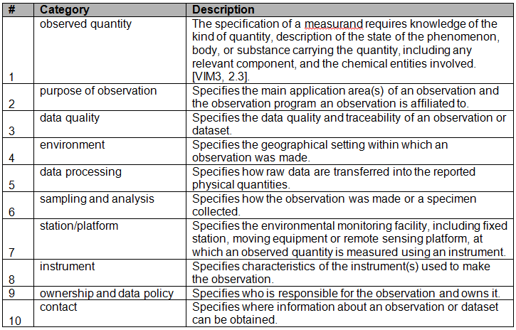
Draft WIGOS metadata categories

Slide 15
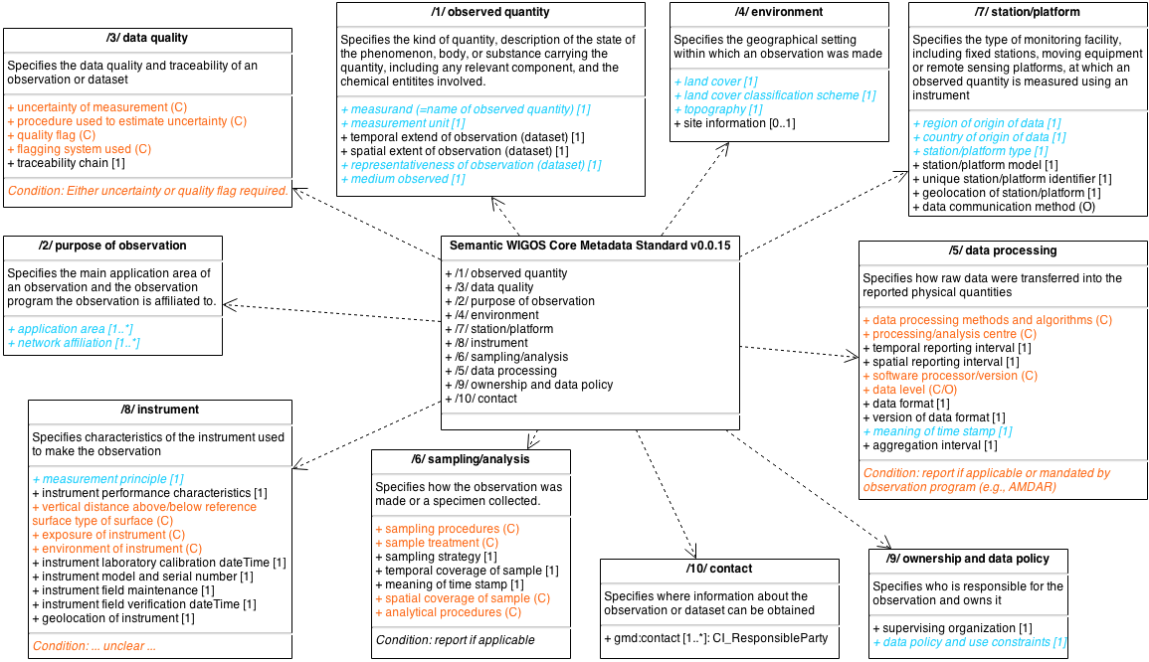
Draft WIGOS Metadata Standard ‘model’
Notes:
Blue: code lists
Orange: conditional or optional
March 2013 - Work commenced – first face to face meeting defined scope, principles, ten metadata categories
2013-14 - ~60 metadata elements, definitions, examples plus code-lists defined within 10 categories; informal feedback incorporated
February 2014 - considered at ICG-WIGOS-3
March-April 2014 – formal feedback on draft WIGOS metadata sought from WMO Technical Commissions
May 2014 – Second face to face meeting incorporated feedback from TCs
2014-15 - TT-WMD to finalise a ‘semantic standard’ for submission to WMO Congress (Cg-17)
TT-WRM to ensure WIGOS metadata requirements are incorporated into WIGOS regulatory material (Technical Regulations, Manual and Guide on WIGOS)
CBS IPET-MDRD tasked to define an information model and exchange format for WIGOS metadata based on existing standards such as ISO 19159 (O&M)

Slide 16
TimeSeriesML proposal
2012 – CHy recommends testing of WaterML2: Part 1 for data exchange and progress towards adoption as a WMO/ISO standard
2013 – CBS IPET-MDRD is tasked with carriage of the standardisation process
2013-14 – IPET-MDRD recognised benefits of a generic time series model for weather, climate, water… (observational) data
March 2014 – IPET-MDRD proposes development of TimeSeriesML based on WaterML2: Part 1
June 2014 – Initial scoping work: BoM, CSIRO, Met Office. CHy consulted
To be further discussed on Thursday

Slide 17
WaterML2 adoption
Architecture
Documentation
Pilot regions
Sava River Basin
Latin America
WMO Hydrological Observing System (WHOS)

Slide 18
‘Architecture’ to support international water data sharing
Agreed data exchange formats (WaterML2: Part 1, 2, …)
Agreed web service endpoints (WMS, WFS, SOS) and configurations
Documentation of commercial and non-commercial systems supporting agreed implementation architecture on WMO web site
Pilot implementations using a variety of systems in a variety of countries
Training on water data sharing using standardized data formats and service endpoints
Support in the development of Central Web Service Registries for National Hydrological Services shared globally through the WMO Information System
Promotion as WHOS, the WMO Hydrological Observing System

Slide 19
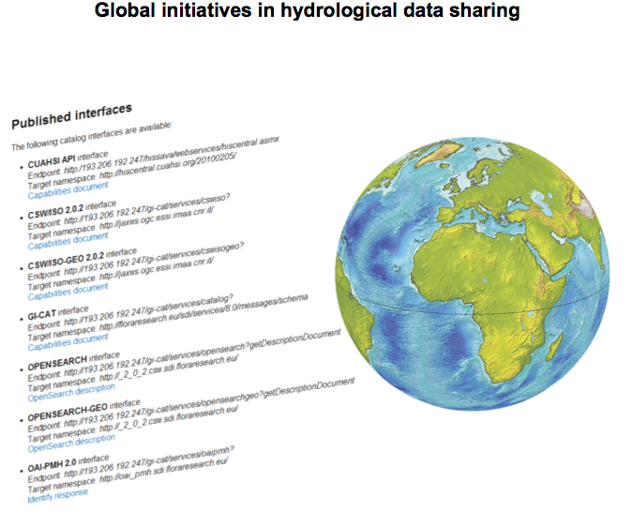
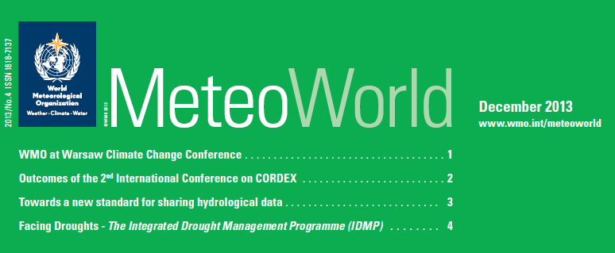
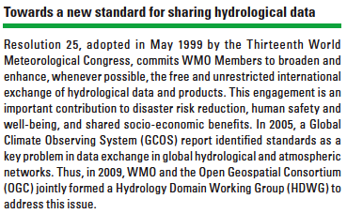
Documentation on WMO website

Slide 20
Demonstrations of water data sharing
CHy has identified priority regions for demonstration services:
Sava Basin, Europe
Latin America
Arctic-HYCOS
Niger-HYCOS, Africa
SADC-HYCOS, Africa
New Zealand
China
Other areas implementing sharing through water data services include:
USA
Italy
Canada
Australia
...

Slide 21
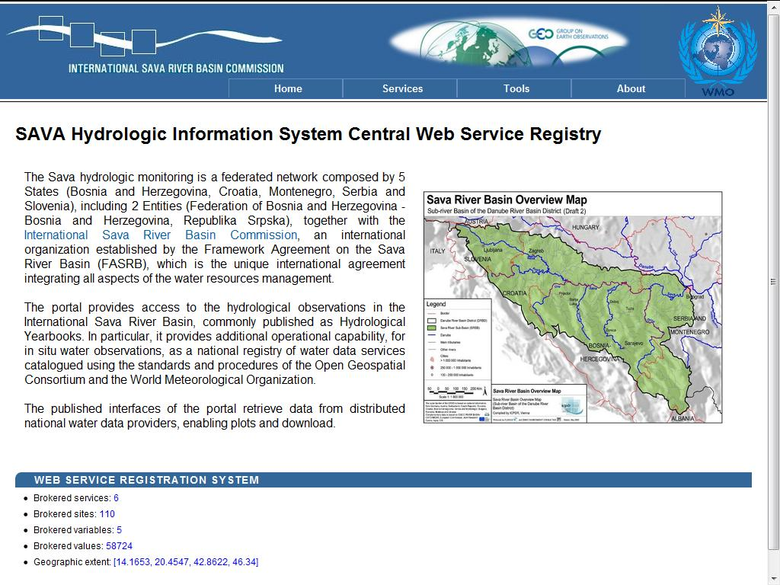
HIS in the SAVA River Basin

Slide 22
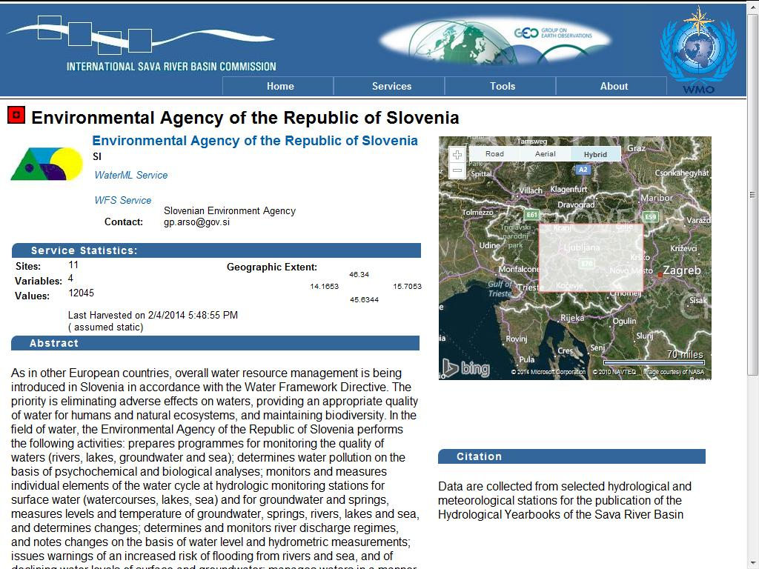
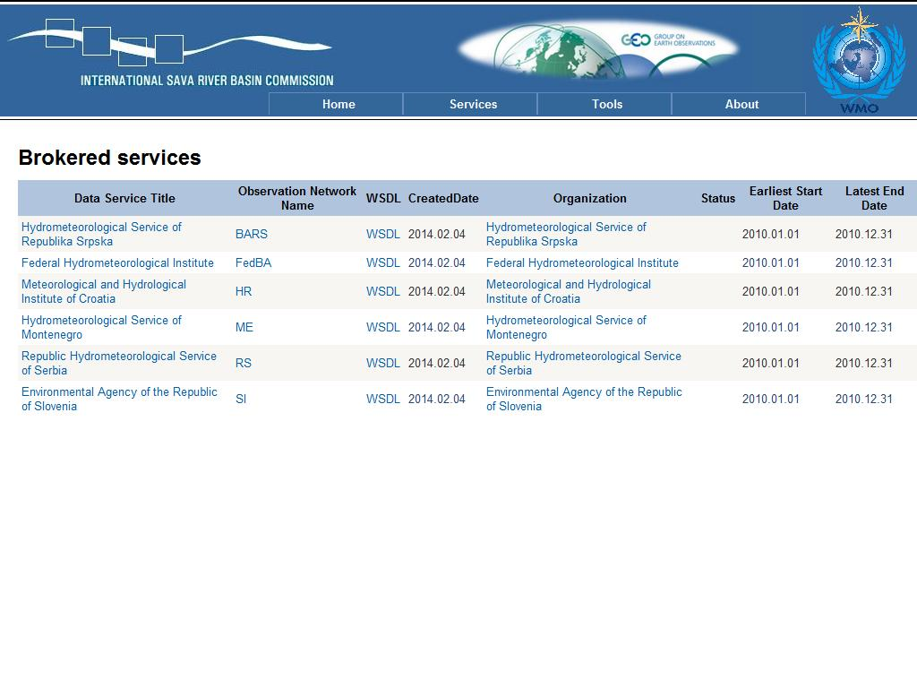
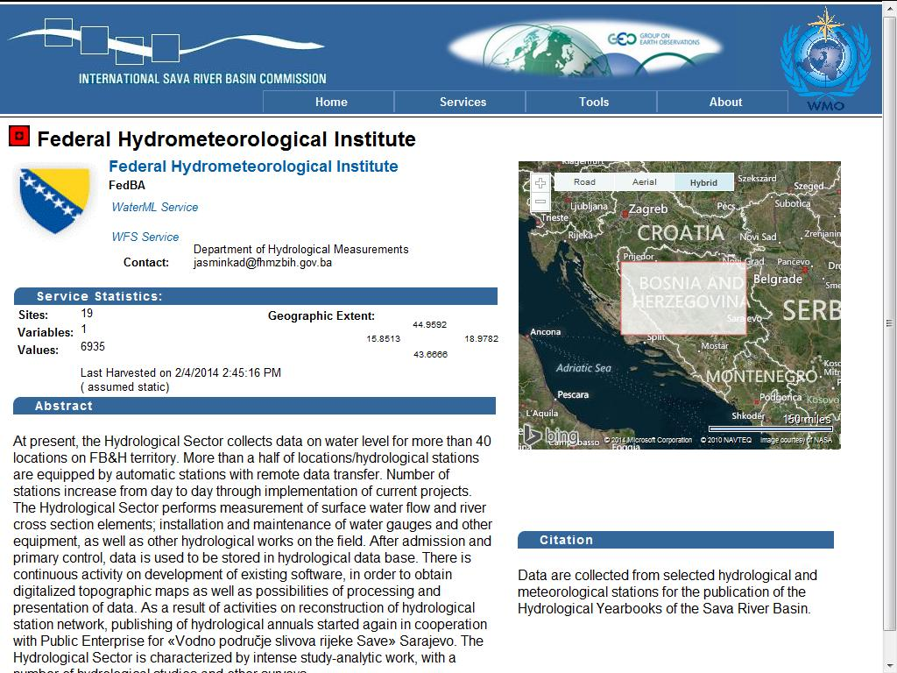
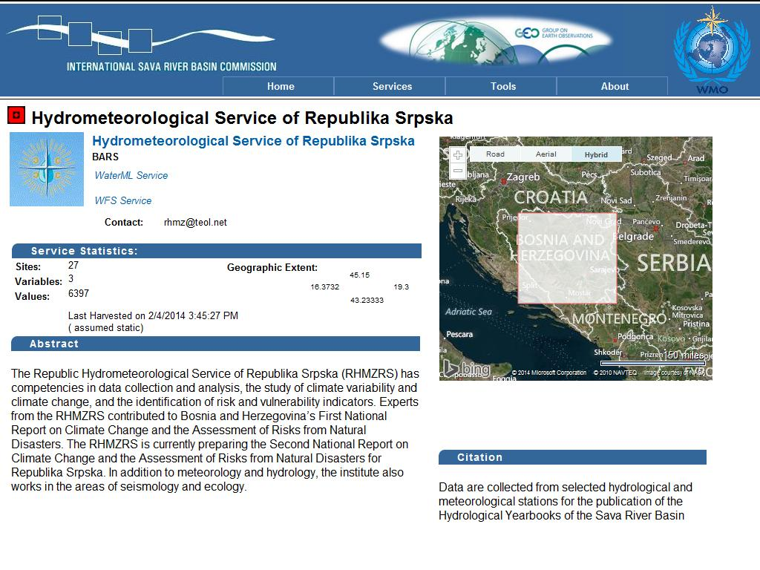
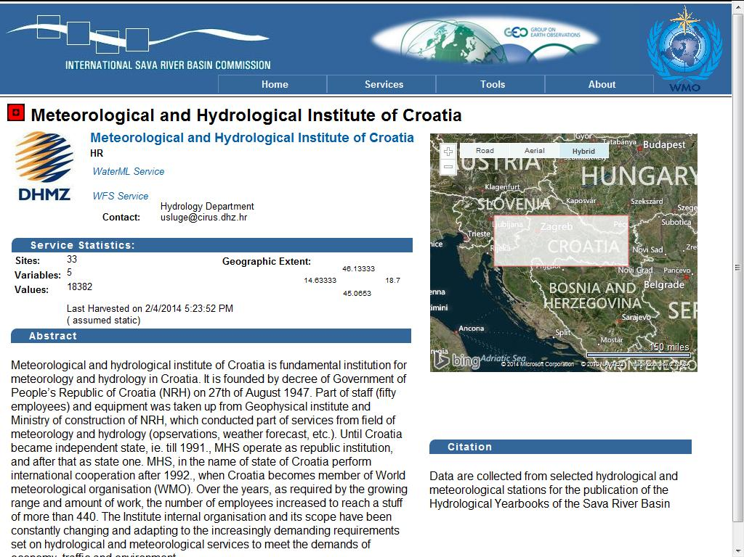
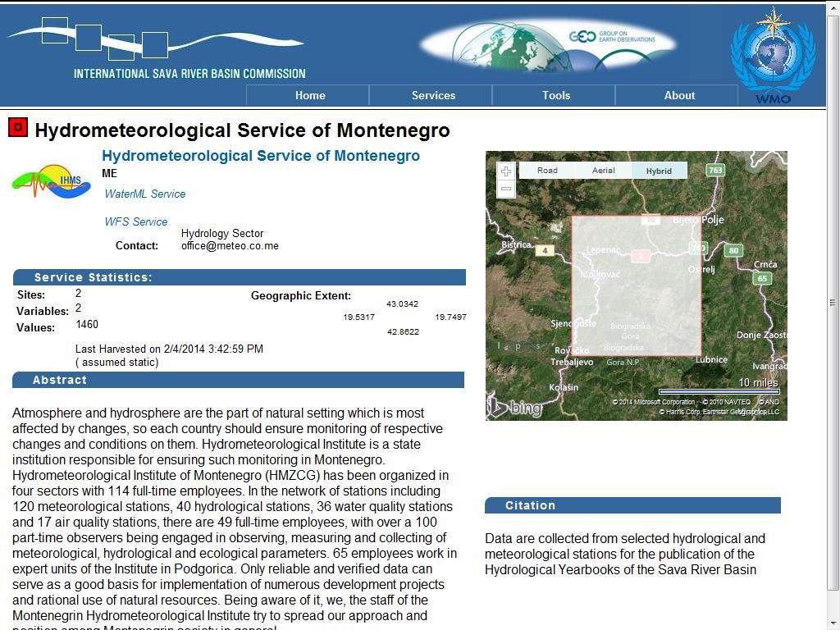
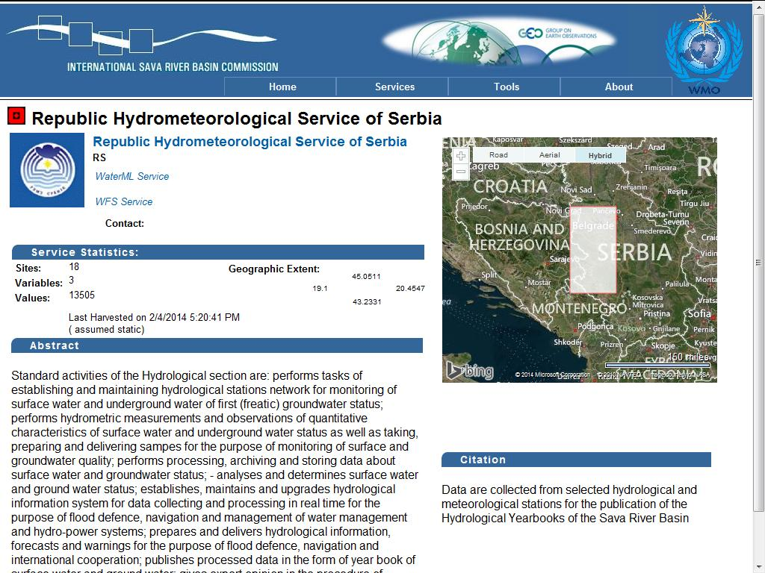

Slide 23
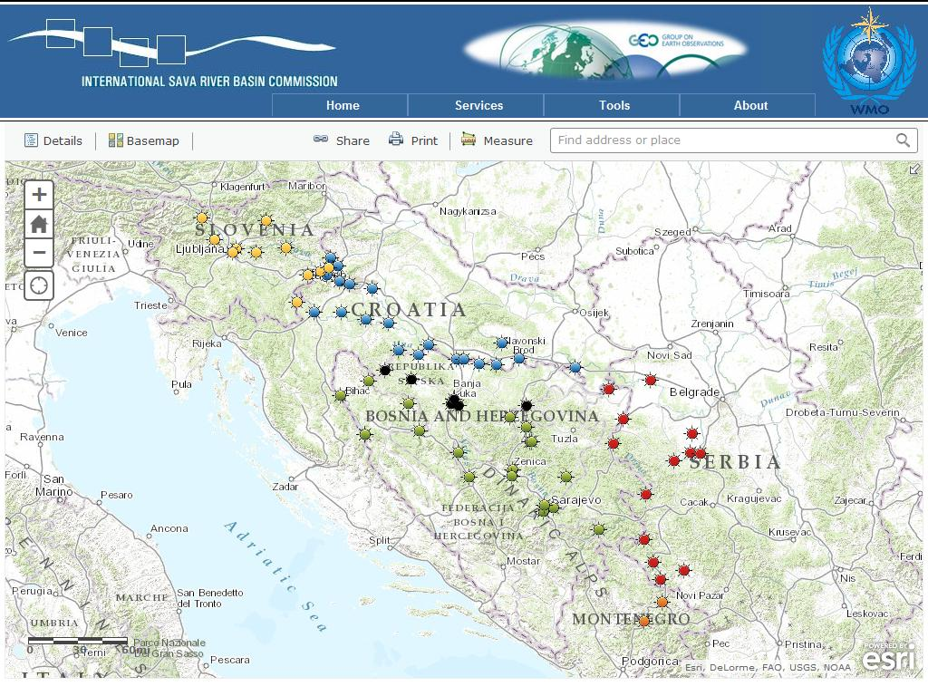
HIS in the SAVA River Basin

Slide 24
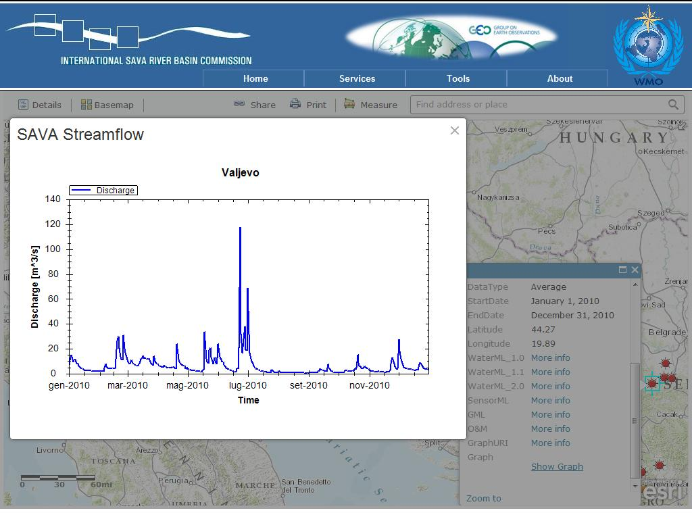

Slide 25
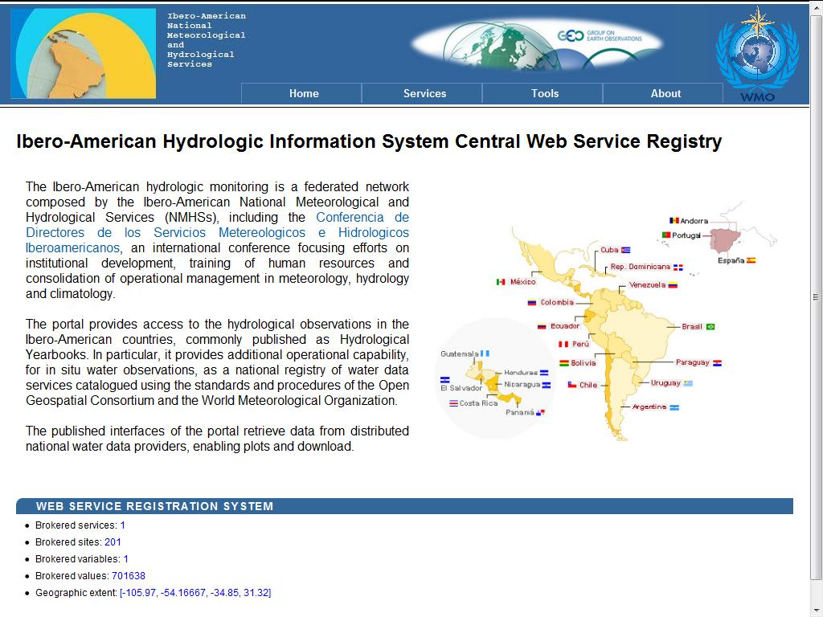
HIS in the Ibero-American Countries

Slide 26
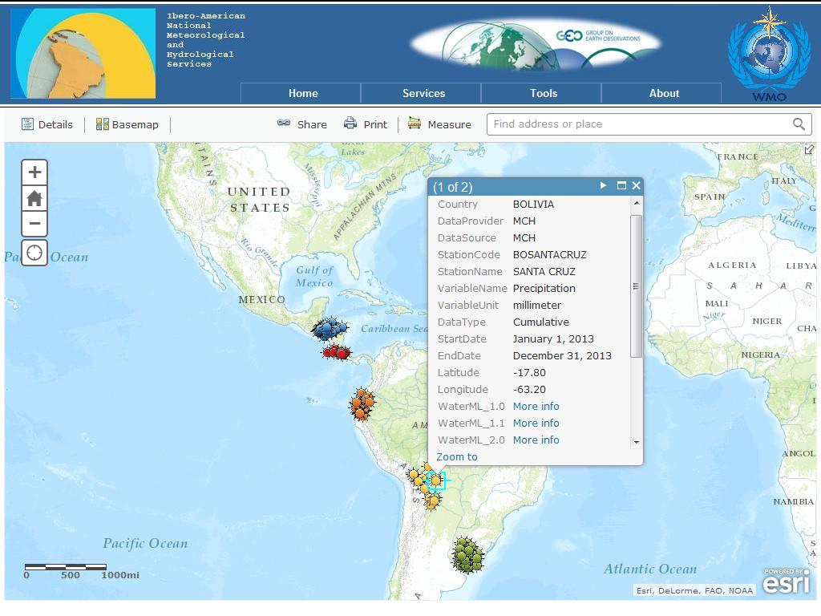
HIS in the Ibero-American Countries

Slide 27
WHOS WMO Hydrological Observing System
In 2013 a WMO Hydrological Observing System (WHOS) was proposed by the CHy Advisory Working Group as the means to provide the most comprehensive hydrological component in fulfillment of the WIGOS objective of “an integrated, comprehensive, and coordinated system which is comprised of the present WMO global observing systems”.
WHOS is conceived as a portal to facilitate access to already available on-line real-time and historical data, drawing from the water information systems of countries around the world that make their data freely and openly available, including HYCOS projects.

Slide 28
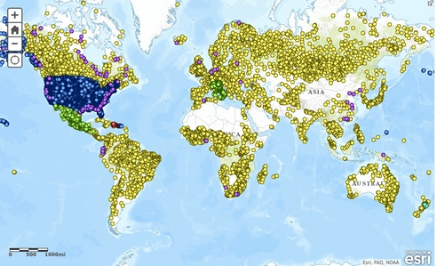
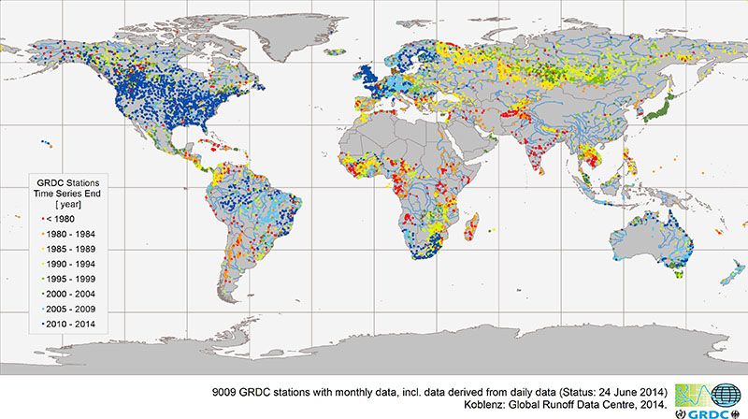
Commission for Hydrology (CHy)
World Hydrological Observing System (WHOS)

Slide 29
A couple of challenges for the HDWG
Does HDWG have a framework for future standards development?
What does our suite of water data standards look like in a few years time?
WaterML2: Part 1, 2, 3, …N?
How can HDWG influence take-up of developed standards?
Can we assist with capacity building and implementation of standards-compliant technologies for hydrological data sharing in countries around the world?
For discussion during the workshop…

Slide 30
Conclusions
Water data sharing is essential for improved and more transparent water resources management
The exchange of hydrological and related data needs to be increased at national, regional and international levels
Tools and techniques need to be made available for the optimization of hydrological data collection and related networks of National Meteorological and Hydrological Services
Internationally agreed standards, formats and protocols will be adopted by WMO to underpin the transfer of hydrological data and information
Increased hydrological data availability will support more value added products and services

Slide 31
Thank you for your attention

