Slide 1
Hydro DWG Workshop
Summary of HDWG activities since
the Quebec workshop
Uli Looser
Ilya Zaslavsky
Tony Boston
11 August 2014
Copyright © 2014 Open Geospatial Consortium

Slide 2
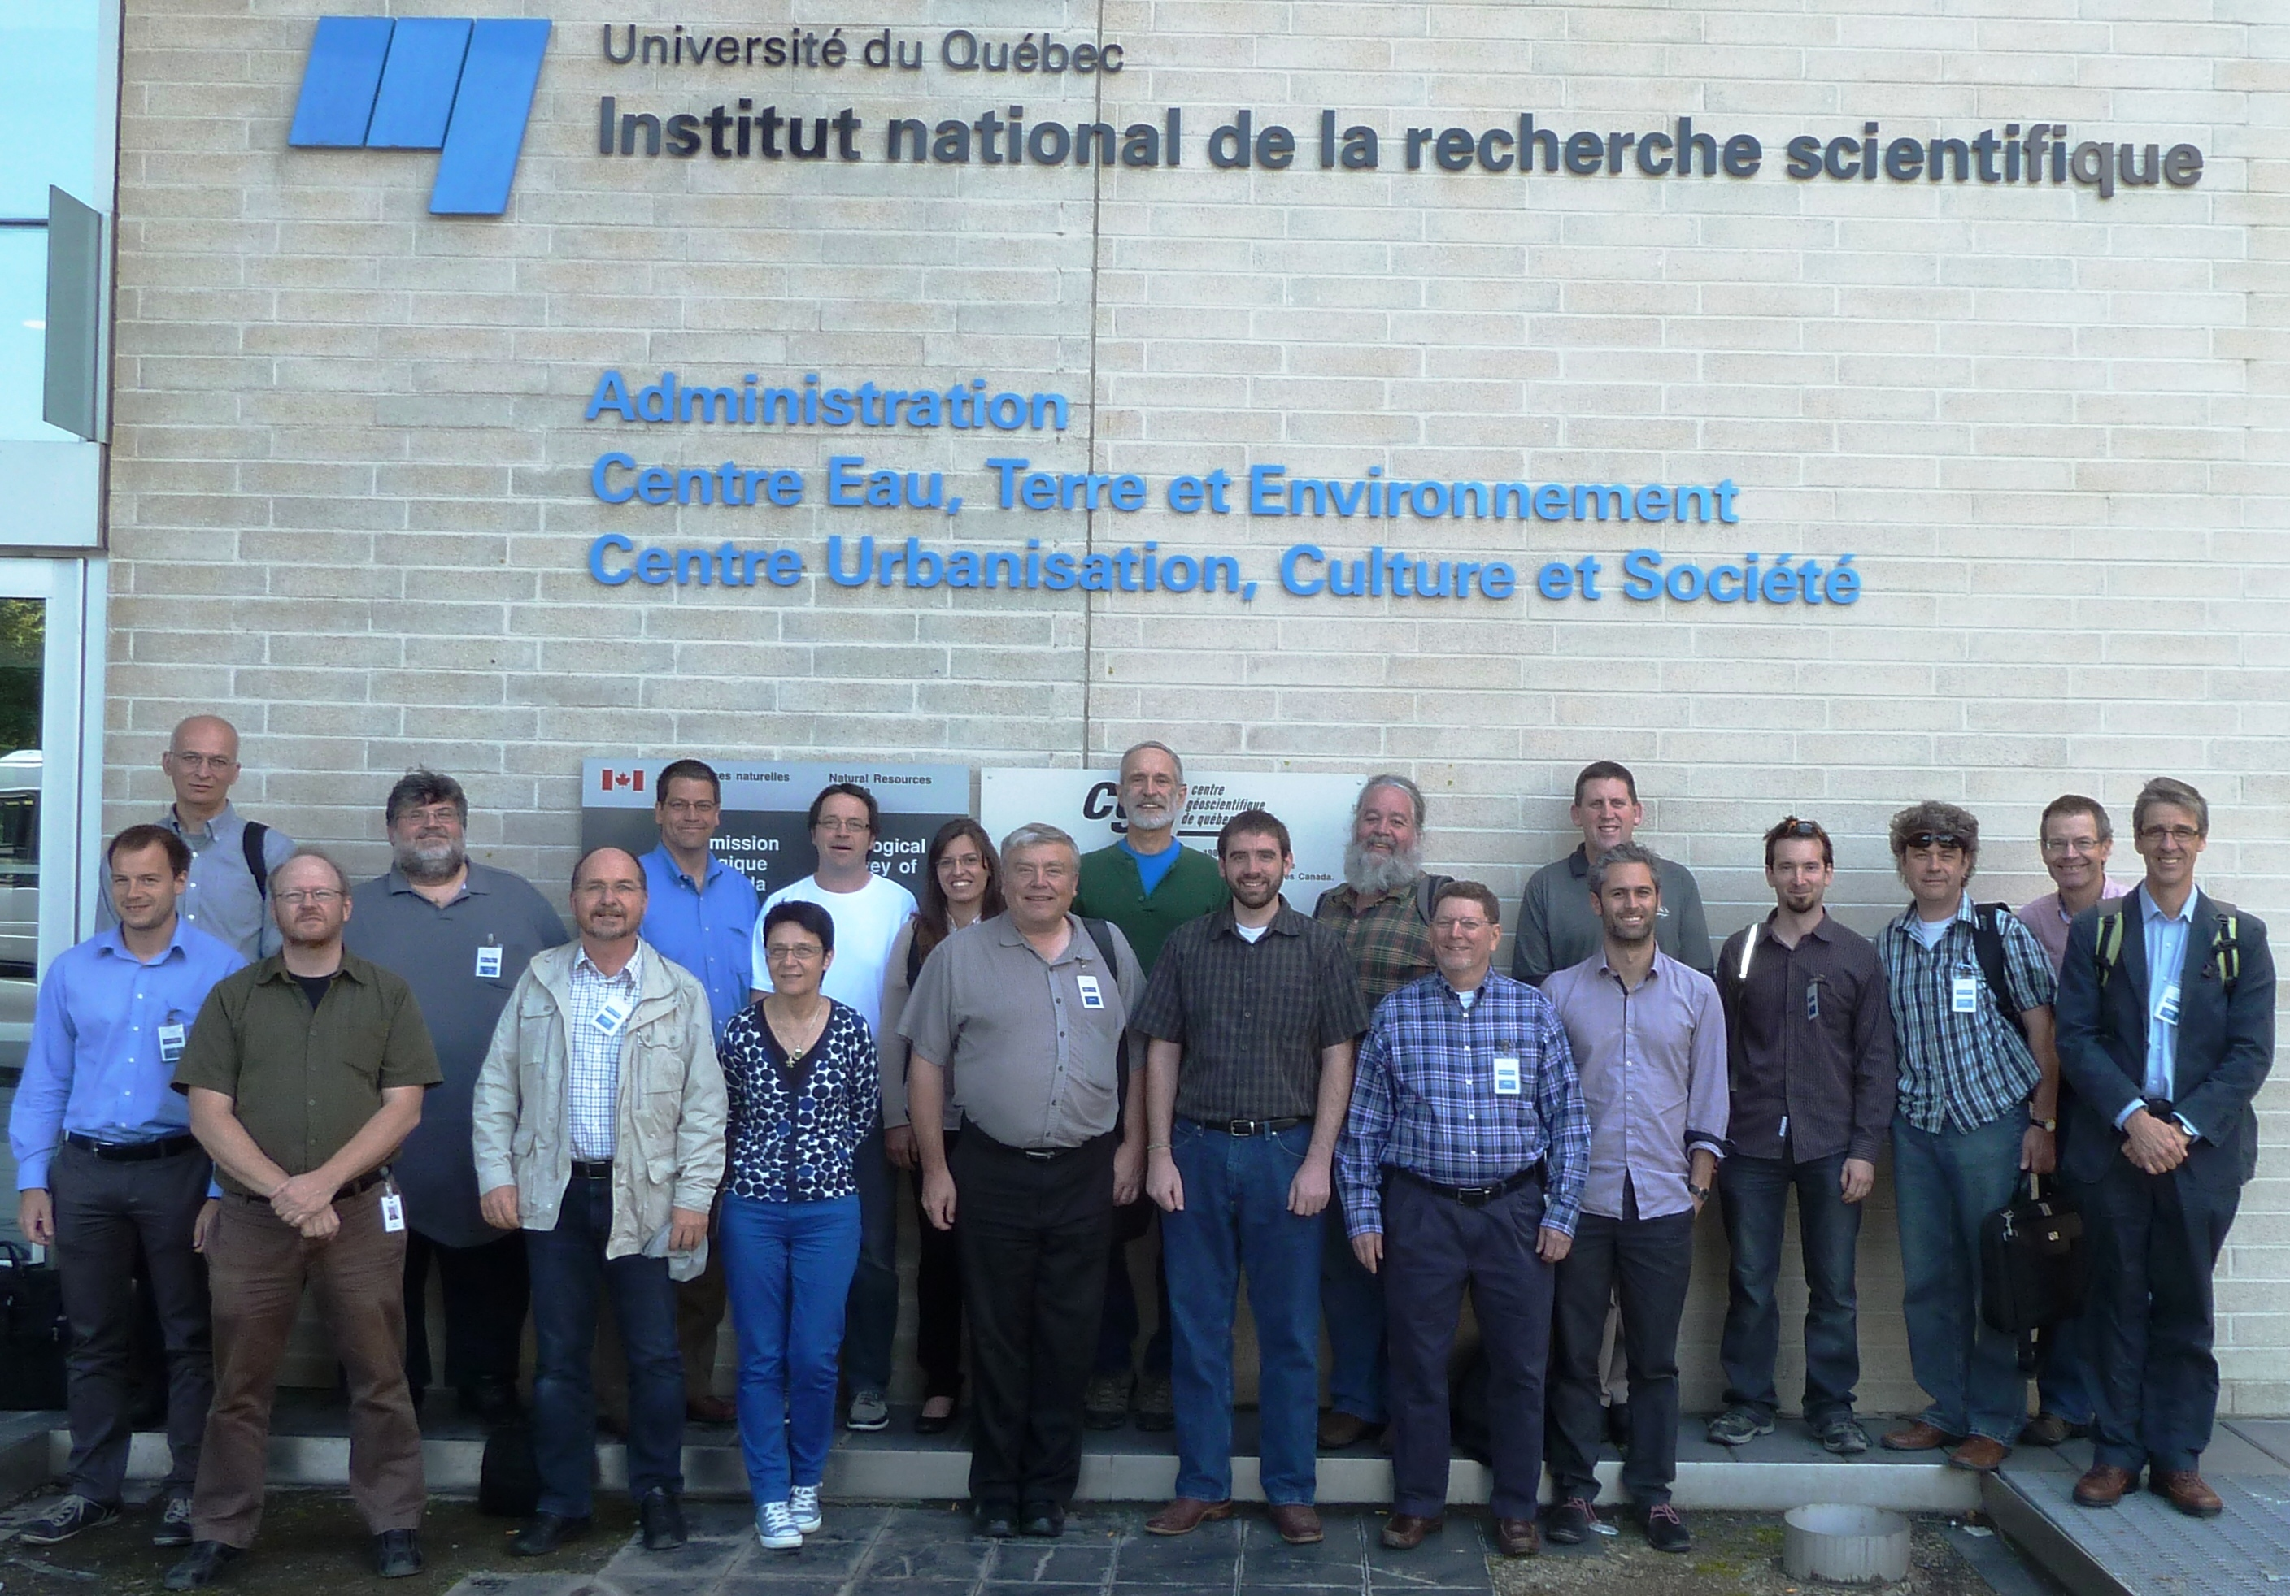
Quebec workshop – 17-21 June 2014

Slide 3
Quebec workshop outcomes:
Summary and Actions
RiverML
Harmonisation Paper on current implementations and use cases
Outreach to stakeholders (agencies, developers, engineers)
GWIE2
Scoping completed (99%)
Conceptual modelling to begin
WML2 Part 2 (Ratings, gaugings and cross sections )
IE Planning well underway (US; AU; GB; CA; DE)
Standard development (2014/15)
SOS2
Compare SOS profiles - Publish best practice paper
SOS2 Profile: Best practice paper in 2014

Slide 4
Summary and Actions (2)
HY_Features
Review with respect to RiverML and WML2P2
Review with respect to Groundwater
Revise discussion paper for Frascati OGC/TC
Possible testing of HY_Features in N-America through OGC/OWS-10 CCI
Others
CUAHSI survey to support the harmonisation paper for RiverML
  Define Survey goals
  Draft survey
  Target CUAHSI Conf. 18-19 July 2013

Slide 5
Hydro DWG 2013-14 achievements
Completion of:
Three Engineering Reports
Two Discussion Documents
Two Best Practice Documents
One Interoperability Experiment (almost)
…and a lot more work in progress
Copyright © 2014 Open Geospatial Consortium
Notes:
OGC Engineering Reports – 2*CHISP-1; OWS-10
OGC Discussion Documents – HY_Features; SOS2 Hydro Profile
OGC Best Practice Documents – WQ; SOS2 Hydro Profile
OGC One Interoperability Experiment – WML2: Part 2

Slide 6
Hydro DWG 2013-14 meetings
OGC TC meetings:
23 – 27 September 2013, Frascati, Italy
02 – 06 December 2013, Mumbai, India
  HDWG did not meet
24 – 28 March 2014, Washington, USA
09 – 13 June 2014, Geneva, Switzerland
Copyright © 2014 Open Geospatial Consortium

Slide 7
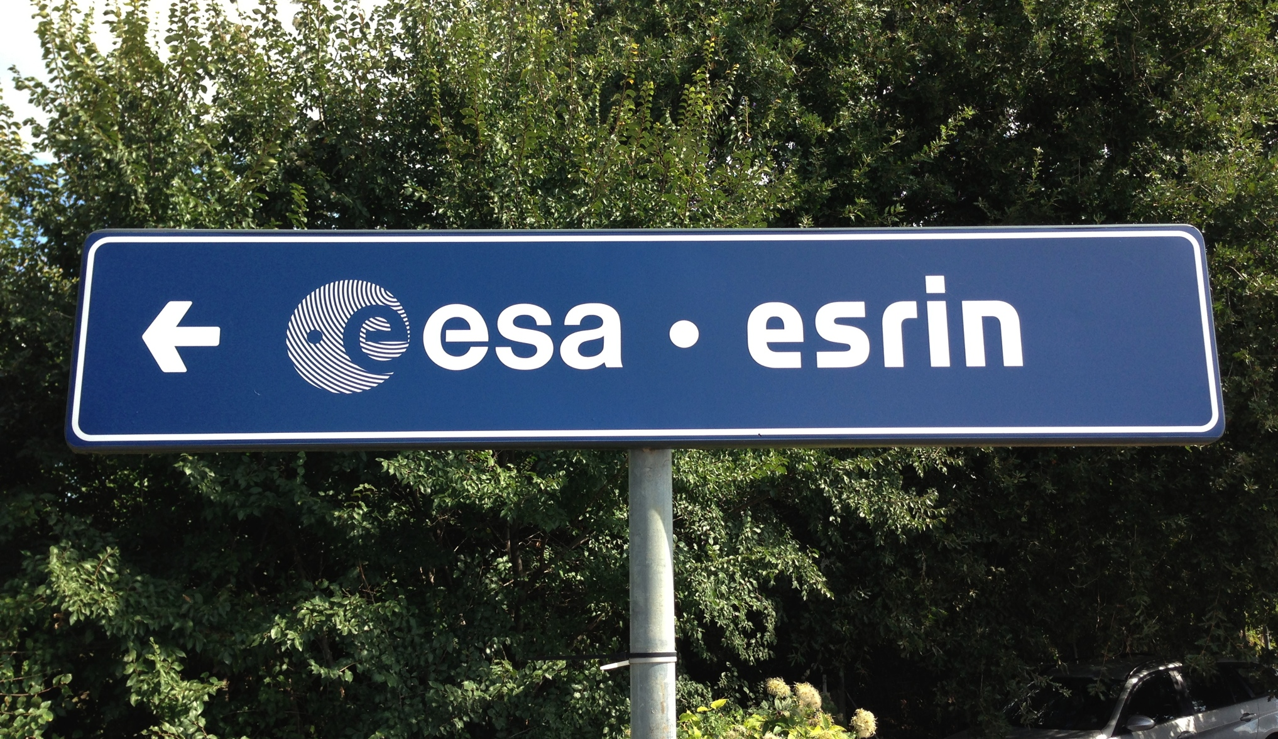
Frascati – Sept. 2013
Copyright © 2014 Open Geospatial Consortium

Slide 8
Agenda - 1
Monday 23 September 2013, 15:45 - 18:40, Room E
Introduction, agenda, review of the Quebec workshop outcomes (HDWG co-chairs) (10 min)
Update on GEOSS AIP-6 Water Services project (David Arctur, 30 mins)
CHISP-1 Brief Review - Architecture, Achievements and Future Work (summary of ER) (Lew Leinenweber, 15 min)
WaterML2.0: Part 1: Usage by hydrological organisations and system vendors (Tony Boston, 15 mins)
Open source solutions for federated hydrologic information systems (Silvano Pecora, 15 min)
Copyright © 2013 Open Geospatial Consortium

Slide 9
Agenda - 2
Representing physical and semantic environment for flow simulation in CityGML - towards a joint use case (Steve Smyth, 20 mins)
Ratings, gaugings and cross sections (WaterML2.0 part 2) Interoperability Experiment - status update (Simon Cox, 15 mins)
WaterML -WQ - a WaterML2 profile for water quality, with a water quality vocabulary (Simon Cox, 20 Mins)
Progress on HY_Features (Irina Dornblut, 15 min)
  Motion to recommend to the TC to release OGC Doc. 11-039r3 as an OGC Discussion Paper
Progress on WMO (GRDC) Hydrologic Metadata (Irina Dornblut, 15 min)

Slide 10
Document Approval Motion #1
The Hydrology DWG recommends that the OGC Technical Committee approve release of OGC 13-053r1, CHISP-1 Engineering Report as an OGC Public Engineering Report
  Pending final edits and review by OGC staff
  Motion: Simon Cox
  Second: Uli Looser
  There was no objection to unanimous consent
This report provides technical results of OGC’s Climatology-Hydrology Information Sharing Pilot, Phase 1 (CHISP-1). The objective of this initiative was to develop an inter-disciplinary, inter-agency and international virtual observatory system for water resources information from observations in the U.S. and Canada, building on current networks and capabilities such as WaterML 2.0 and SOS.

Slide 11
Document Approval Motion #2
The Hydrology DWG recommends that the OGC Technical Committee approve release of OGC 13-046r2, CHISP-1 Summary Engineering Report as an OGC Public Engineering Report
  Pending final edits and review by OGC staff
  Motion: Simon Cox
  Second: Uli Looser
  There was no objection to unanimous consent
This report summarizes the results of OGC’s Climatology-Hydrology Information Sharing Pilot, Phase 1 (CHISP-1).

Slide 12
Document Approval Motion #3
The Hydrology DWG recommends that the OGC Technical Committee approve the 3rd release of OGC 11-039r3 “HY_Features: Common Hydrological Feature Model” as an OGC Discussion Paper
  Pending final edits and review by OGC staff
  Motion: Tony Boston
  Second: David Medyckyj-Scott
  There was no objection to unanimous consent
This document describes requirements and a proposed design for a domain model of hydrologic features as a set of interrelated Application Schemas using the ISO 19109 General Feature Model

Slide 13
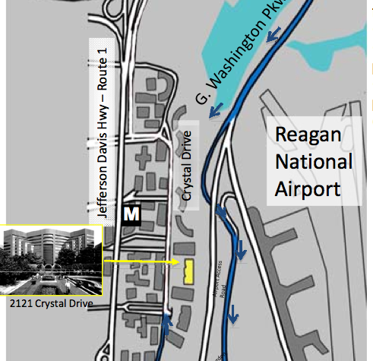
Washington - March 2014
Copyright © 2014 Open Geospatial Consortium

Slide 14
Agenda - 1
SOS 2.0 Profile for Hydrology - GEOWOW project (52N/Kisters, Michael Utech, remotely)
  Motion for release as public Discussion Paper
USGS’s progress on WaterML2 /SOS services (David Blodgett, USGS)
OWS-10 Hydro Model Semantic Interoperability – First Steps, CHISP-2 ideas (Lew Leinenweber, OGC; Chen Yu Hao, GIS.FCU)
Discussion of “WaterML-WQ - an O&M and WaterML 2.0 profile for water quality data” (Simon Cox, CSIRO – remotely)
  Motion for release as Best Practice
GEOSS AIP-6 Water Services project (David Arctur, UT-Austin)
Restarting the Forecasting IE (David Maidment, UT-Austin)
RiverML update (David Arctur, Stephen Jackson)
New Zealand Environmental Observation Data Profile (Jochen Schmidt, NIWA)
Copyright © 2014 Open Geospatial Consortium

Slide 15
Agenda - 2
Two presentations involving restarting WaterML 2.0 SWG (in process) with scope to include the following:
WaterML 2.0: Part 2 - Ratings, gaugings and sections – ready for SWG (BoM/CSIRO - Paul Sheahan/Peter Taylor, remotely)
Discussion of proposal to rename WaterML 2.0 Part 1 to TimeSeriesML – motivated for WMO adoption (Jeremy Tandy, UK Met Office; Frédéric Guillaud, Meteo-France)
Discussion of HydroDWG workshop in August in NYC
(deferred to email)
Copyright © 2014 Open Geospatial Consortium

Slide 16
Motion: “WaterML-WQ - an O&M and WaterML 2.0 profile for water quality data” as BP
The Hydrology DWG recommends that the OGC Technical Committee approve release of 14-003 “WaterML-WQ - an O&M and WaterML 2.0 profile for water quality data” as an OGC Best Practice Document
  Pending and final edits and review by OGC staff
  consider narrowing the title to point to initial WQ result types
  Motion: Simon Cox
  Second: David Maidment
  There was no objection to unanimous consent
This Standard describes how to configure XML documents for single and time series water quality measurements. It is intended to complement WaterML 2.0 as part of a suite of standards for water observation data
Copyright © 2014 Open Geospatial Consortium

Slide 17
Motion: “Sensor Observation Service 2.0 Hydrology Profile” as DP
The Hydrology DWG recommends that the OGC Technical Committee approve release of 14-004 “Sensor Observation Service 2.0 Hydrology Profile” as an OGC Discussion Document
  Pending and final edits and review by OGC staff
  Motion: Michael Utech (KISTERS)
  Second: David Maidment (UT-Austin)
  There was no objection to unanimous consent
This Discussion Paper proposes Hydrology profile of SOS 2.0
Copyright © 2014 Open Geospatial Consortium

Slide 18
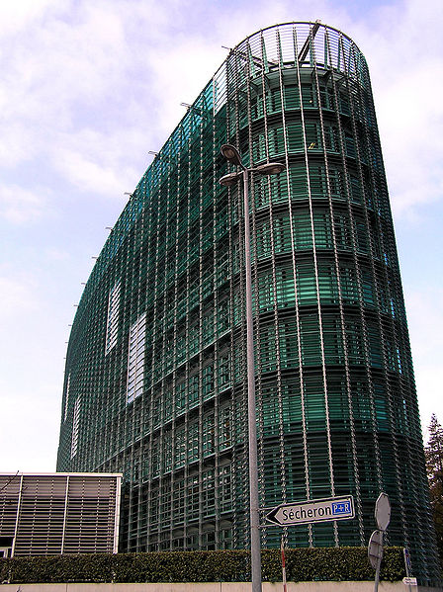
Geneva – June 2014
Copyright © 2014 Open Geospatial Consortium

Slide 19
Agenda
Feedback from the WMO CHy - Uli Looser
WMO Information System (WIS) and WMO Integrated Global Observing System (WIGOS) - Steve Foreman
SOS 2.0 Hydrology Profile - update and motion for release as OGC Best Practice - Simon Jirka, Michael Utech
GEOSS Water Services update: activities related to flood monitoring & prediction - David Arctur
Water data exchange using standards - towards a suite of standards - Irina Dornblut
Integration of hydrologic activities with Government Linked Data initiatives - Australian Example - Simon Cox
OWS-10 CCI Hydro Model Interoperability Engineering Report - update and motion for release as OGC Engineering Report - Liping Di
WatERP-Where Water Supply meets demand (FP7 Project) – Andreas Abecker
Discussion of HydroDWG workshop and HIC 2014 Tutorial in August in NYC - All
Copyright © 2014 Open Geospatial Consortium

Slide 20
Motion: “OGC Sensor Observation Service 2.0 Hydrology Profile ” as BP
At the March Geneva TC meetings, the Members approved an electronic vote to approve release of OGC document 14-004r1 “OGC Sensor Observation Service 2.0 Hydrology Profile” as an official Best Practice. There is evidence of implementation.
  Pending and final edits and review by OGC staff
  Motion: Simon Jirka Jirka (52°North)
  Second: David Arctur
  There was no objection to unanimous consent
This document is intended to describe a best practice how the SOS 2.0 standard can be applied to server WaterML 2.0 encoded hydrological observations in an interoperable manner.
https://portal.opengeospatial.org/files/?artifact_id=58916&version=1
Copyright © 2014 Open Geospatial Consortium

Slide 21
Motion: “OWS-10 CCI Hydro Model Interoperability Engineering Report” as ER
The Hydrology DWG recommends that the OGC Technical Committee approve release of 14-048 “OWS-10 CCI Hydro Model Interoperability Engineering Report” as an OGC Engineering Report
  Pending and final edits and review by OGC staff
  Motion: Liping Di
  Second: David Arctur
  There was no objection to unanimous consent
This OGC® document gives guidelines for enabling interoperability among different hydro data models and services. The demonstration specifically gives out best practices for supporting interoperability among the National Hydrographic Network (NHN) of Canada, the National Hydrographic Dataset Plus (NHD+) of United States, and the OGC HY_Features model developed and proposed by the World Meteorological Organization (WMO). The discussed version of OGC HY_Features was adopted as the mediation bridge model to exchange information among heterogeneous hydrological models.
https://portal.opengeospatial.org/index.php?m=public&orderby=default&tab=2
Copyright © 2014 Open Geospatial Consortium

Slide 22
HDWG co-chair change
Changes to the WMO nominated co-chair in agreement with WMO CHy President and WMO Secretariat
Ulrich Looser will step down as WMO nominated co-chair after the June 2014 OGC TC meeting
Silvano Pecora has been nominated by WMO CHy President as the new WMO nominated co-chair
Copyright © 2014 Open Geospatial Consortium

Slide 23
Hydro DWG Workshop
and now…
New York
11-15 August 2014
Copyright © 2014 Open Geospatial Consortium

