Slide 1
NHD and the Open Water Data Infrastructure
Al Rea
ahrea@usgs.gov

Slide 2
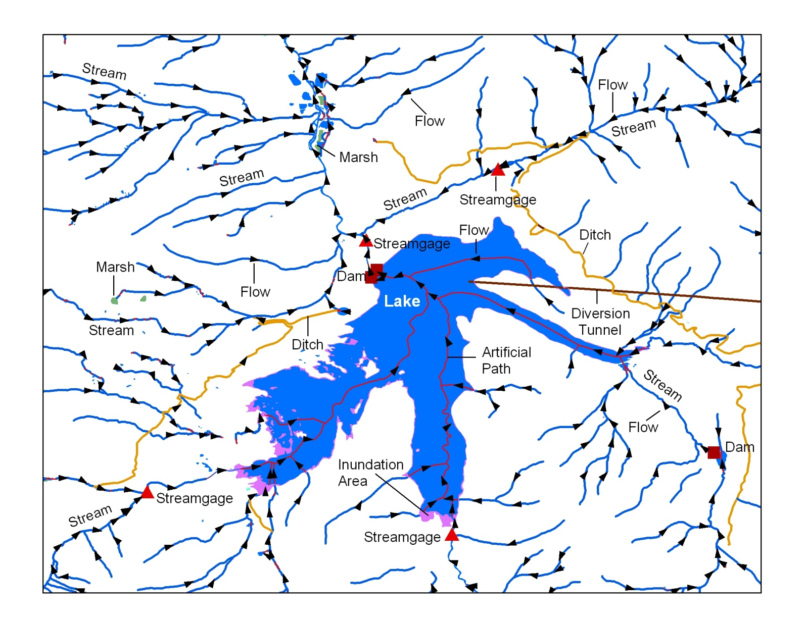

What is the National Hydrography Dataset?
Essentially the surface water features found on topographic maps

Slide 3
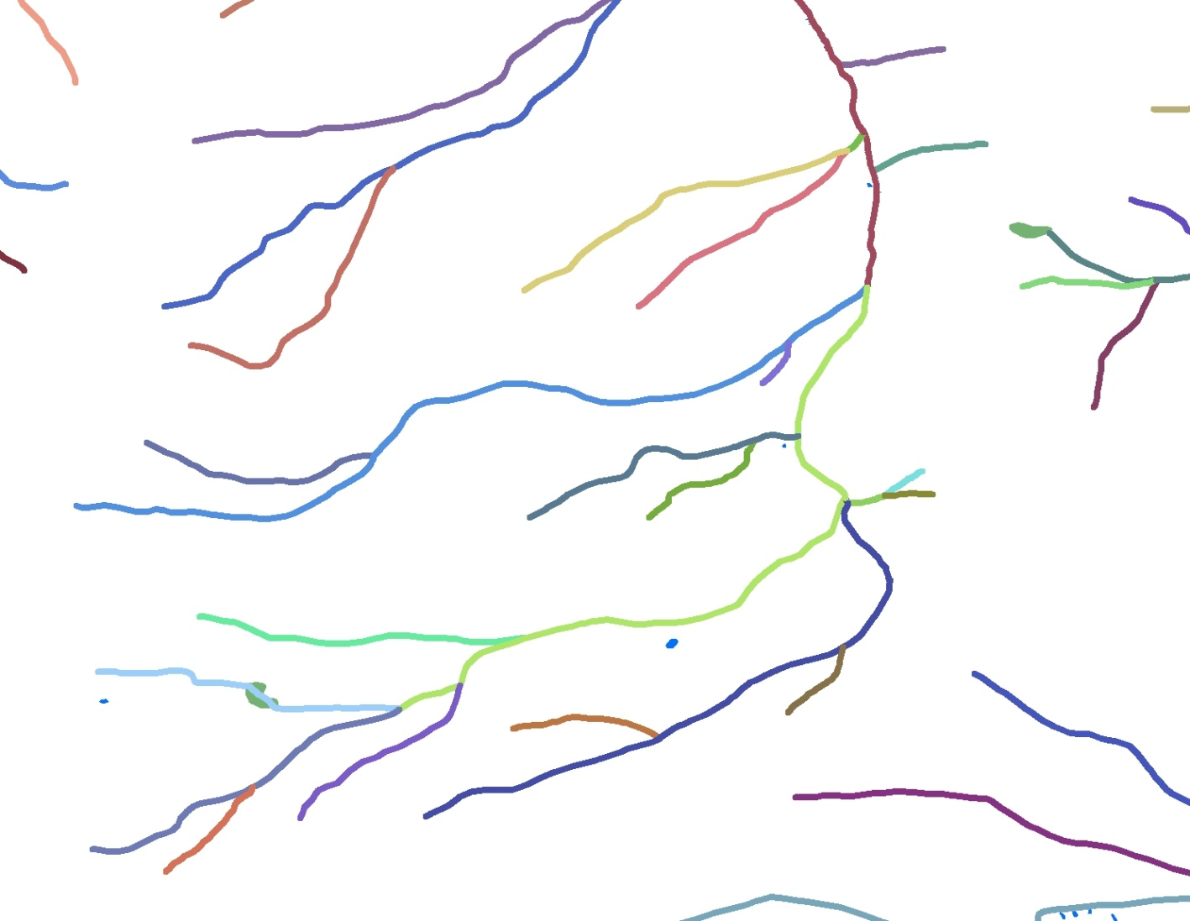
The fundamental component is the drainage network of rivers and streams
7.5-million mile network

Slide 4
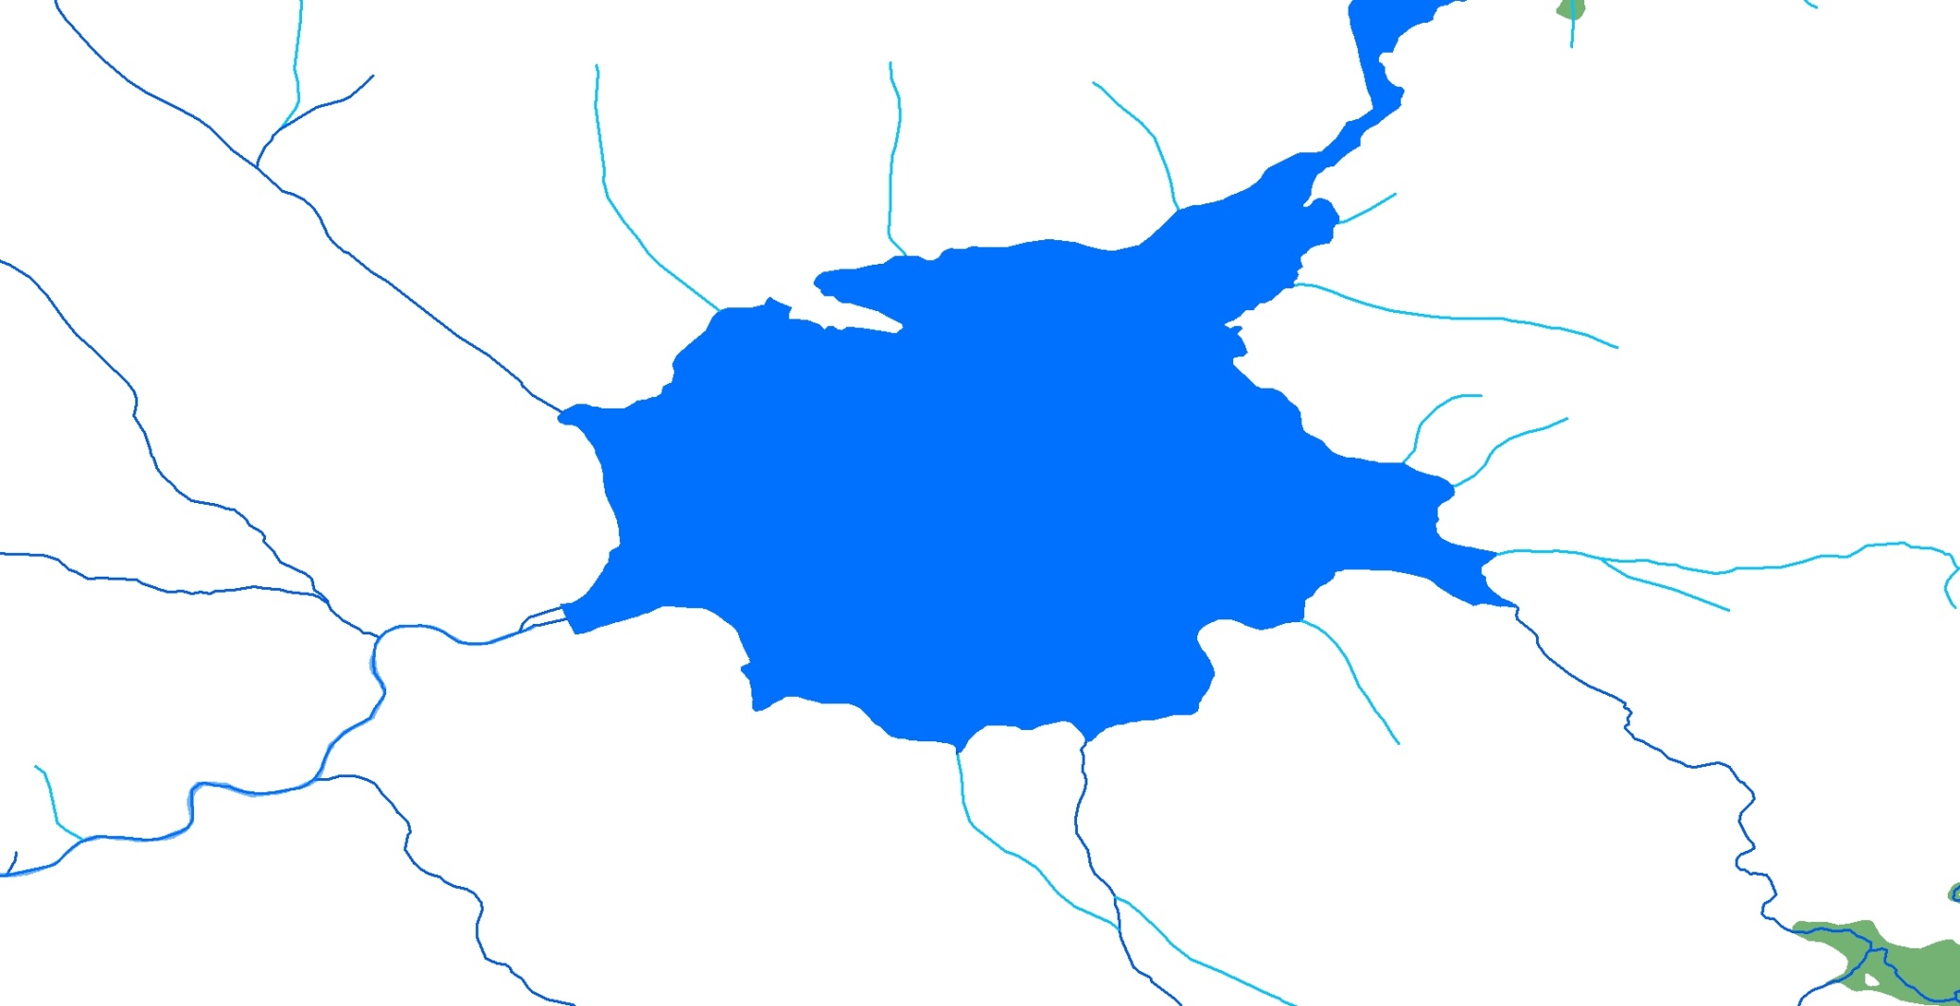
Completing the network through waterbodies

Slide 5
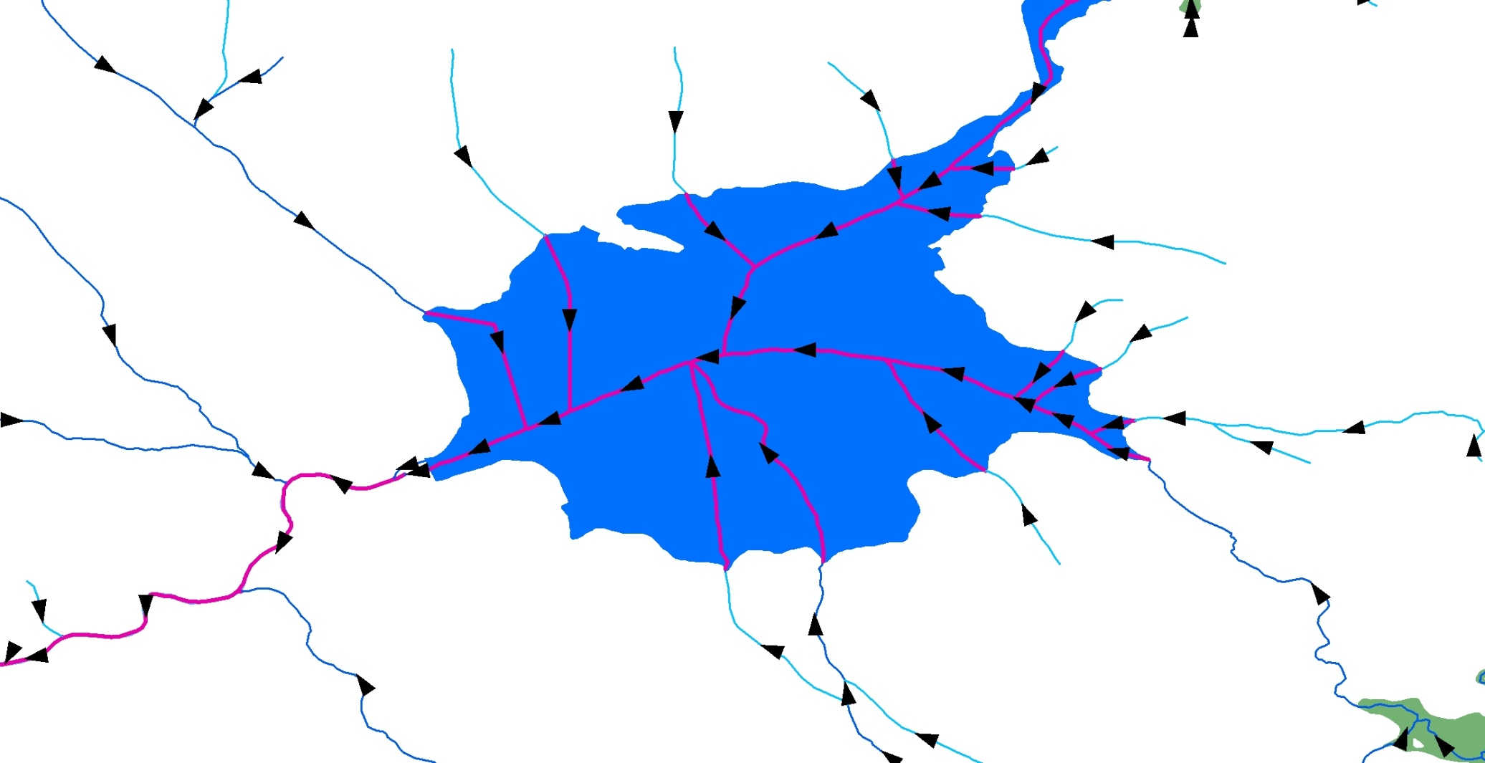
Completing the network through waterbodies
with artificial paths
6.5 million waterbodies

Slide 6
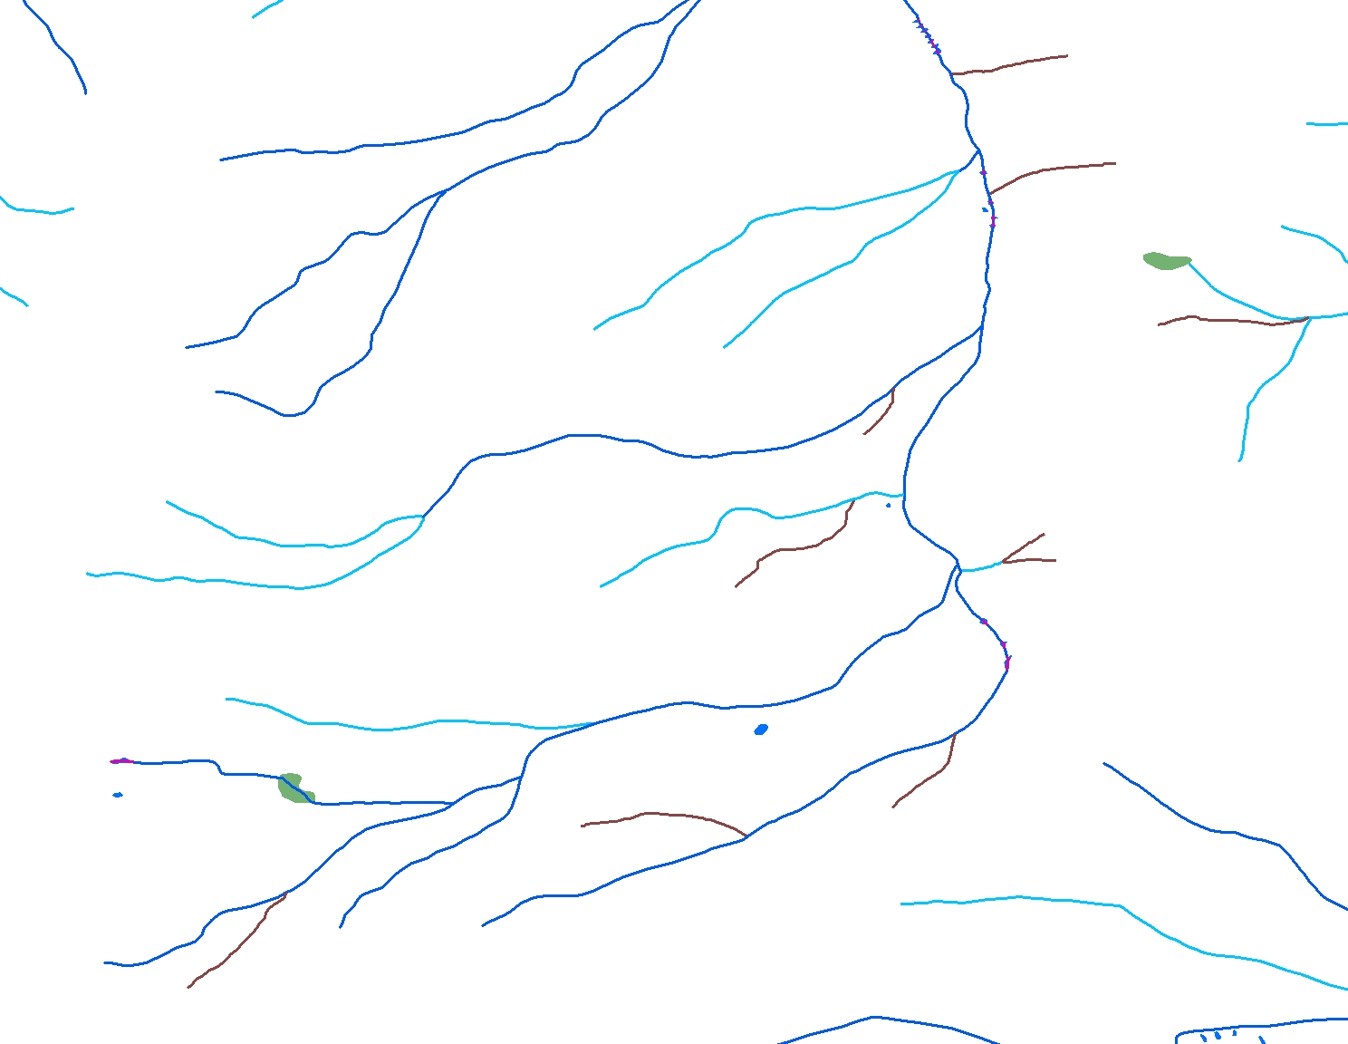
Attributes provide basic intelligence
Perennial
Swan Creek
Intermittent
Ephemeral

Slide 7
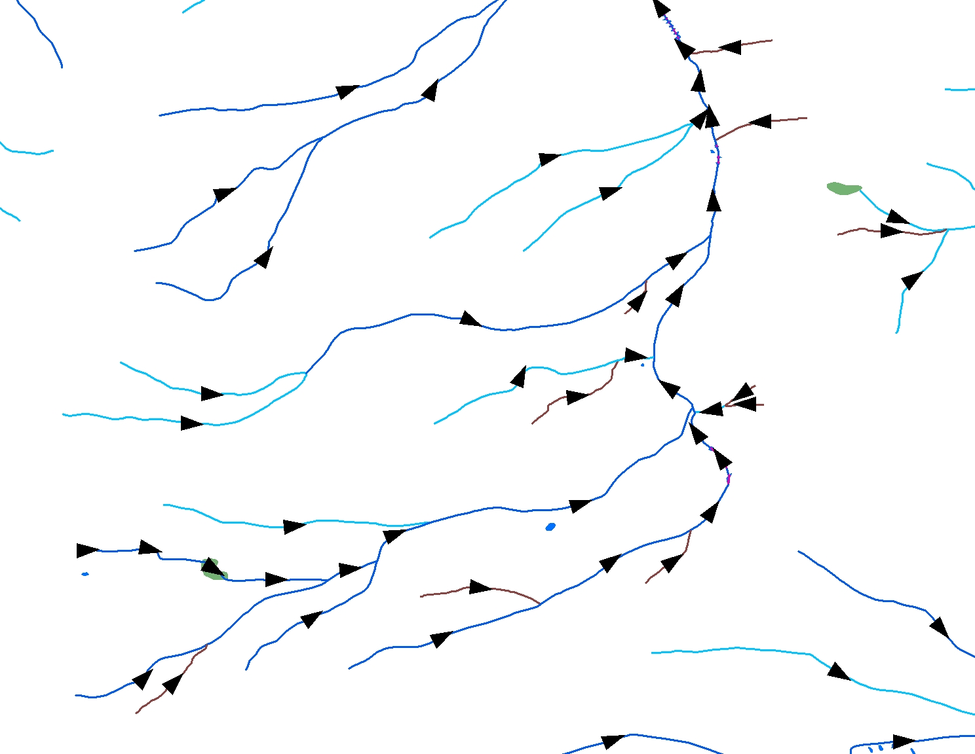
Flow Direction – A key piece of intelligence

Slide 8
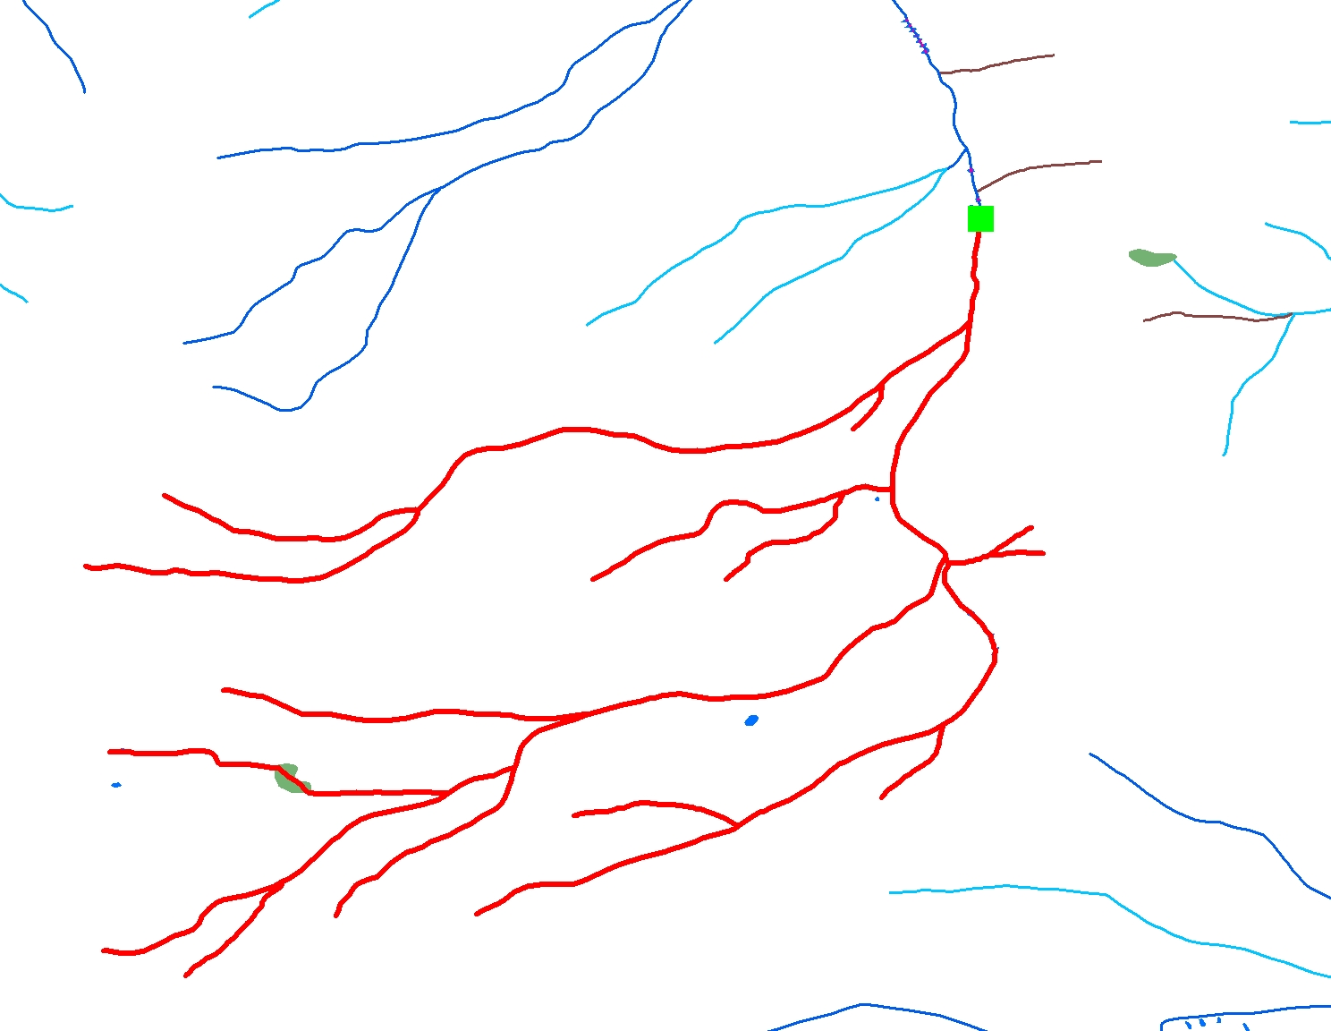
Navigation – The basis for analysis

Slide 9

Linear Referencing – Stream “Reaches”
Reach
14010002000421
Reach
14010002003345

Slide 10
Linear Referencing – Stream addresses
14010002000421
0
50
25
100
75

Slide 11
Linear Referencing – Data “Events”
USGS Streamgage
09050000
Coordinate
106 05 13.955 W
39 32 43.472 N
Address:
Reach – 14010002000421
Measure – 19.8392

Slide 12
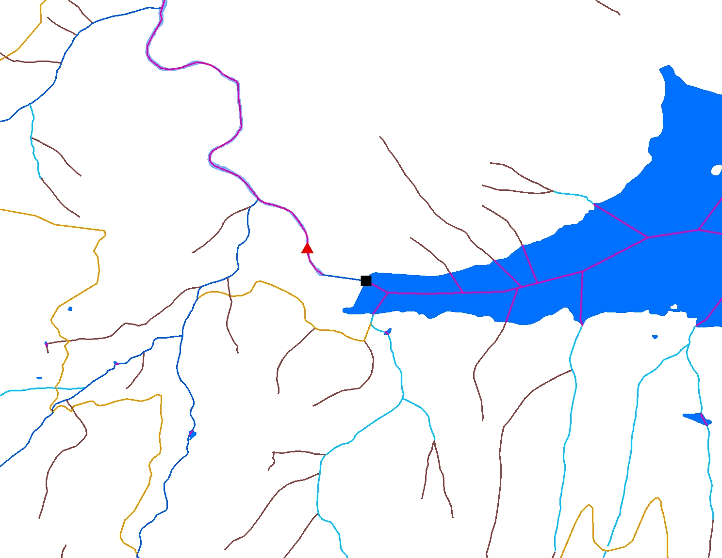
Connecting the streamgage to the network
Blue River
Artificial Path
(Blue River)
Streamgage
Downstream
Dam
Green Mountain
Reservoir
Upstream
Notes:
Linking events to the NHD makes the NHD more intelligent. The streamgage makes the network more intelligent and the network makes the streamgage more intelligent. We know that upstream of the streamgage there is a dam, with regulated flow, we know all about the dam – who runs it, its construction material, its height, how many acre-feet it can hold, etc.; we know there is a reservoir behind the dam, we know its name, we know its area, we know the spillway elevation; we know how many miles of stream flow into the streamgage, we know how many miles of that is perennial, intermittent, and ephemeral flowing streams; we know there is a diversion upstream diverting 300 cfs out of the basin and thus reducing the flow through the streamgage; we know there is a heavy metals tailings pond upstream; we know what fish species live upstream; we know the water chemistry at various points upstream; we know the names of all the streams and lakes upstream, and on and on.

Slide 13
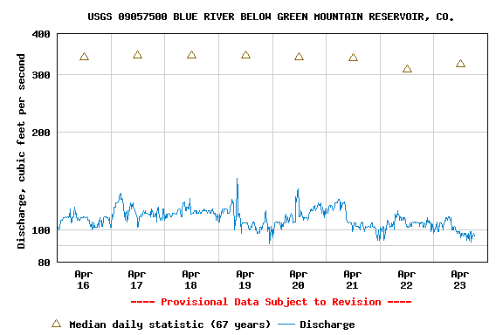
Adding geospatial context to streamflow data

Slide 14
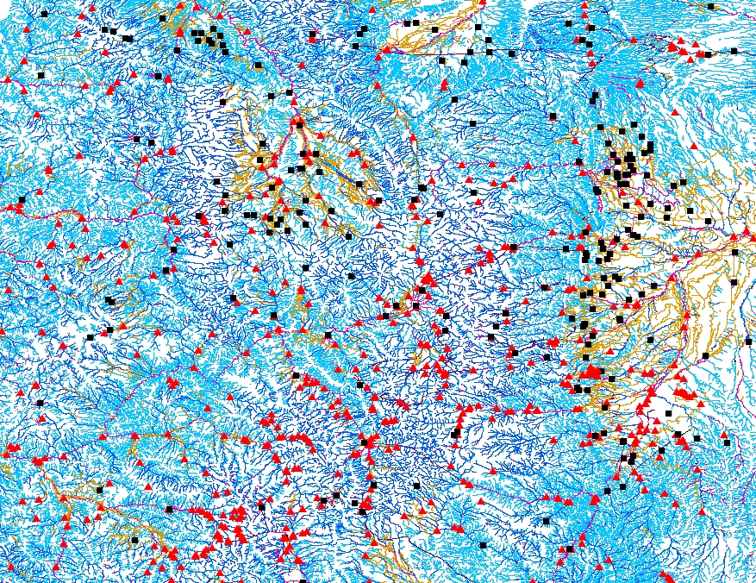
Dams and Streamgages Integrated with the NHD

Slide 15
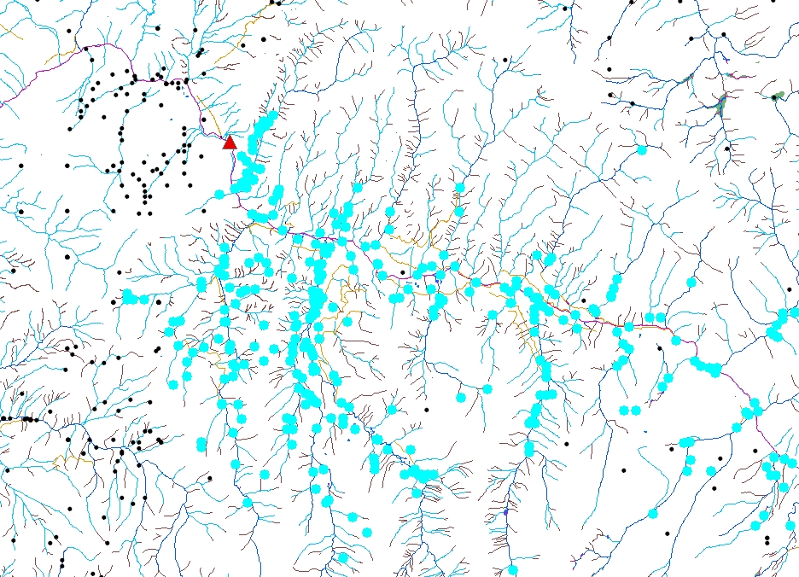
Analyzing Relationships
Identifying diversions upstream of a streamgage
Easily accomplished with a good database and a GIS
Gage
Diversions

Slide 16
Common Hydrographic Frames of Reference
RF-1
1:500,000 scale
Developed in 1980’s
National or large regional studies/models
Medium-Resolution NHD
1:100,000 scale
Completed 2001
Basis of NHDPlus
Regional studies/models
High-Resolution NHD
Multi-scalar, 1:24,000 scale or better
Nationally complete 2007
Current maintenance, many improvements

Slide 17
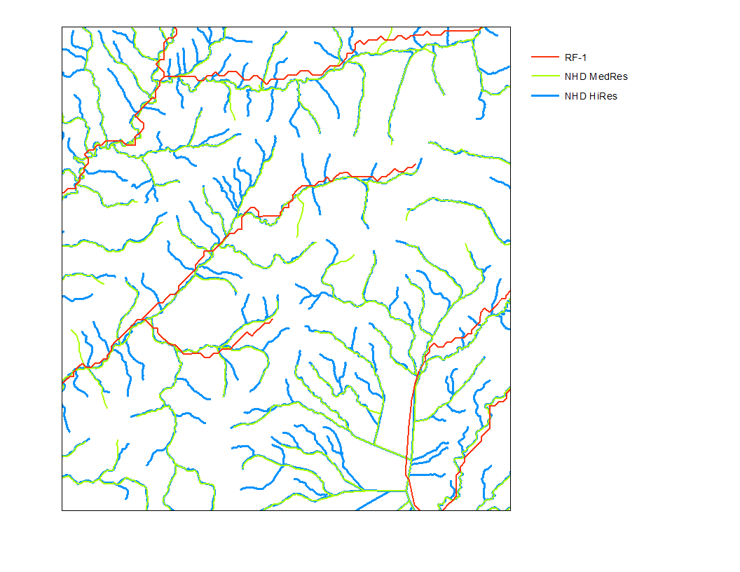
Notes:
Note it is difficult to reference sites of interest that are on tributaries not represented in the stream network being used. Therefore a site on one of the green or blue streams would be difficult to reference to the red RF-1 streams. This is why it is better to reference things to the most detailed network available, then use generalization rules to determine how to represent the things being referenced if a more general network is desired.

Slide 18
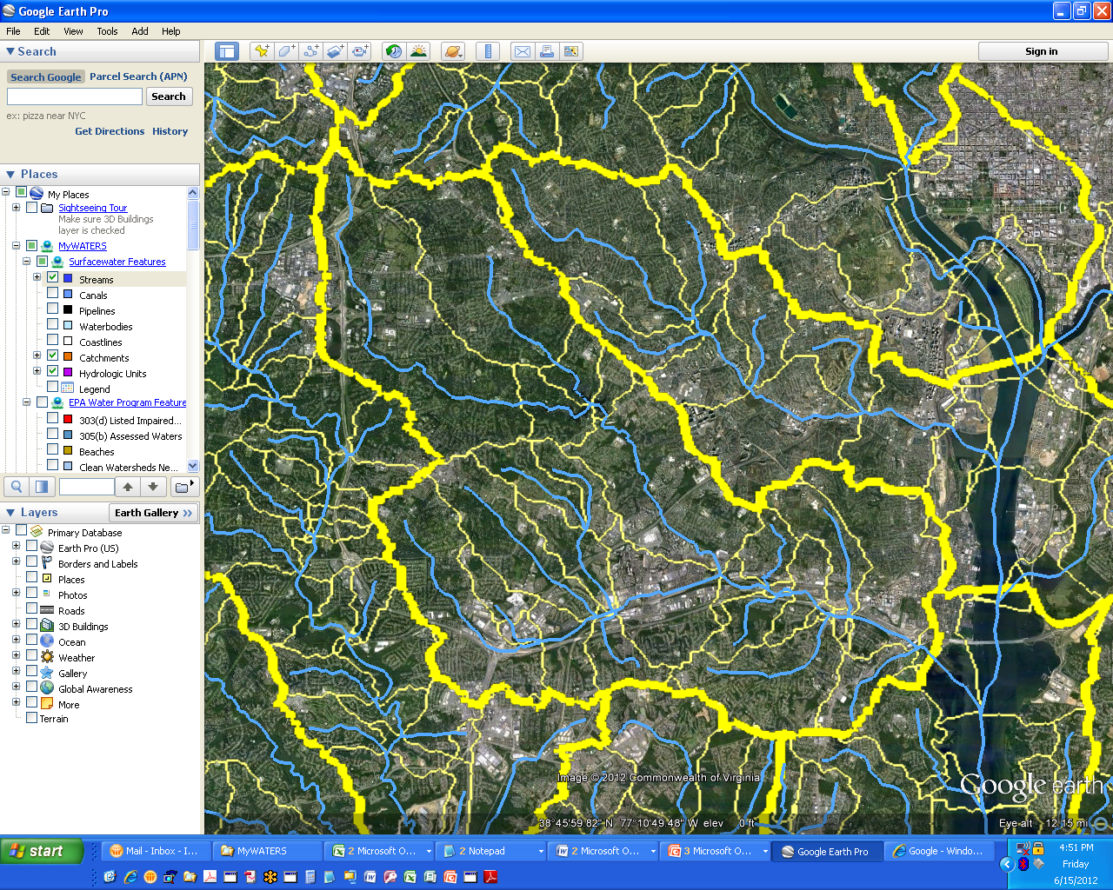
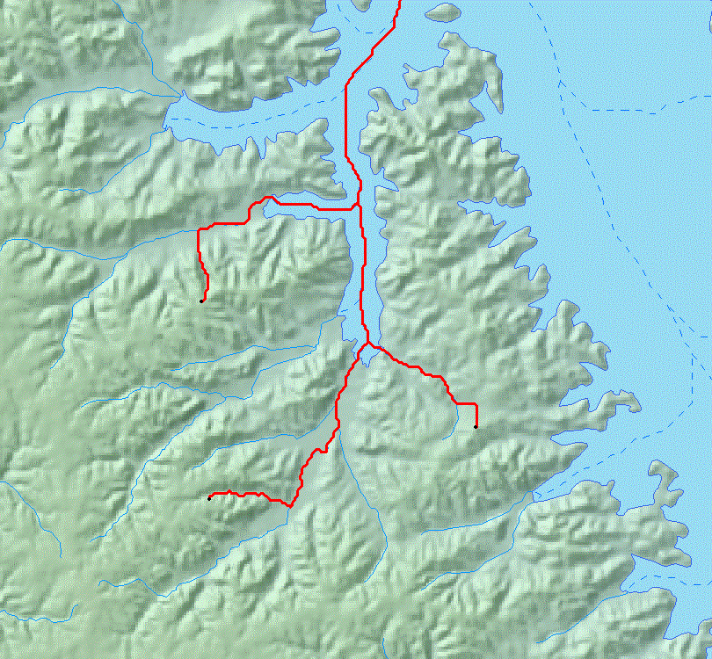
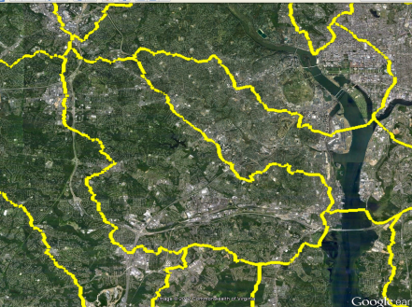
NHDPlus provides a Surface Water Geospatial Framework
Elevation
NHDPlus catchments link the landscape to the stream network forming a surface water geofabric
Hydrologic Units
(HUC12)
Stream Network
Stream Network | Map Scale | Map Accuracy | Total Stream Miles (mi) | # of Stream Segments | Stream Segment Average Length (mi) | # of Lakes | Catchment Average Area (sq mi)
Reach File Version 1 (RF1) | 1:500K | +/- 254m | 600,000 | 60,000 | 10 | 4,100 | 50
Medium Resolution NHD | 1:100k | +/- 50m | 3,200,000 | 2,600,000 | 1.2 | 38,000 | 1.1
High Resolution NHD | 1:24K or better | +/- 12m | 7,500,000 | 20,000,000 | 0.37 | 537,000 | do not exist

Slide 19
EPA WATERS Data:
Public Access
Listed Impaired Waters
Assessed Waters
Beaches
Clean Watershed Needs
Combined Sewer Overflows
CWSRF Benefits Reporting
Permitted Dischargers
Fish Consumption Advisories
Fish Tissue Data
Impaired Waters with TMDLs
Sewage No Discharge Zones
Nonpoint Source Projects
Water Quality Standards
Water Quality Stations
Internal Access Only
Drinking Water Intakes
Source Water Areas
Special Appropriations Projects
~6,000,000 events tied to 100K NHD

Slide 20
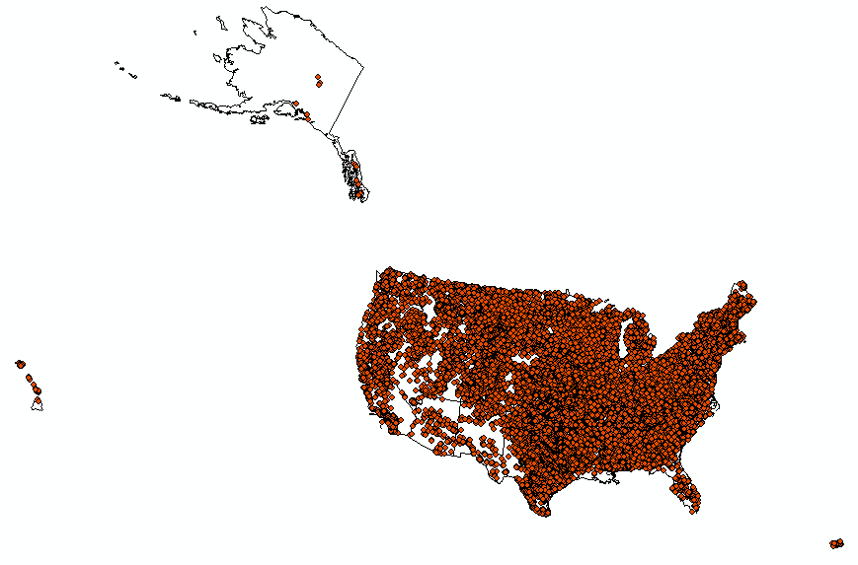
HR NHD Type 1, Gaging Station: 127,659

Slide 21
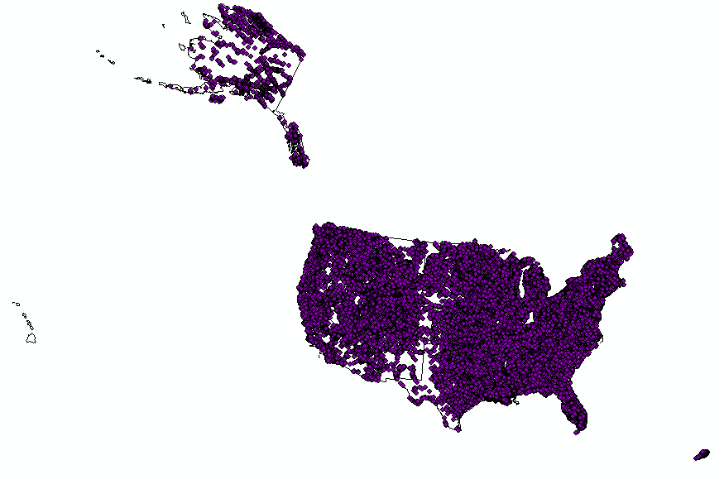
HR NHD Type 6, Water Quality Station: 93,787

Slide 22
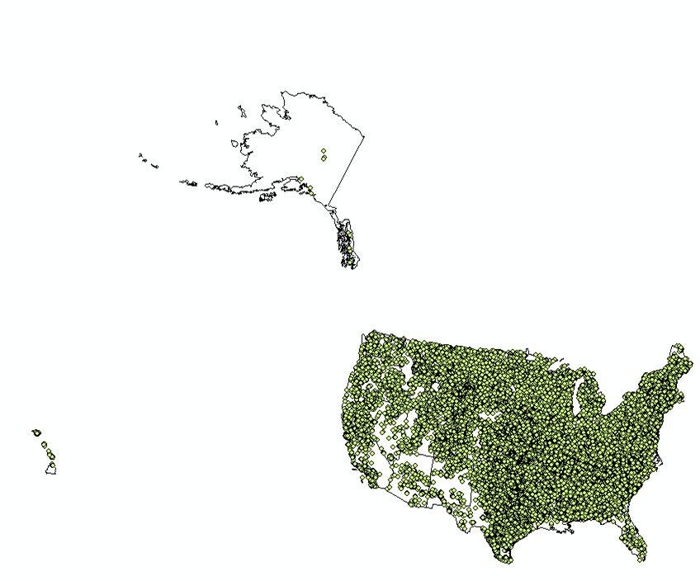
HR NHD Type 2, Dam: 60,311

Slide 23
Point Events in NHD March 4, 2014
Type
1 | Gaging station | 127,659
2 | Dam | 60,311
3 | Divergence Structure = General | 25
4 | Divergence Structure = Withdrawing | 1,236
5 | Divergence Structure = Contributing | 63
6 | Water Quality Station | 93,787
ALL |  | 283,081

Slide 24
A Single Hydrographic Frame of Reference
Based on High-Res NHD
Single addressing system
Single dataset to maintain
High-Res NHDPlus
Currently in development
Network Value Added Attributes (VAA’s), catchments, rasters, flow estimates
Generalization scheme
Several generalized scales based on High-Res NHD
NHDPlus derivatives for each scale

Slide 25
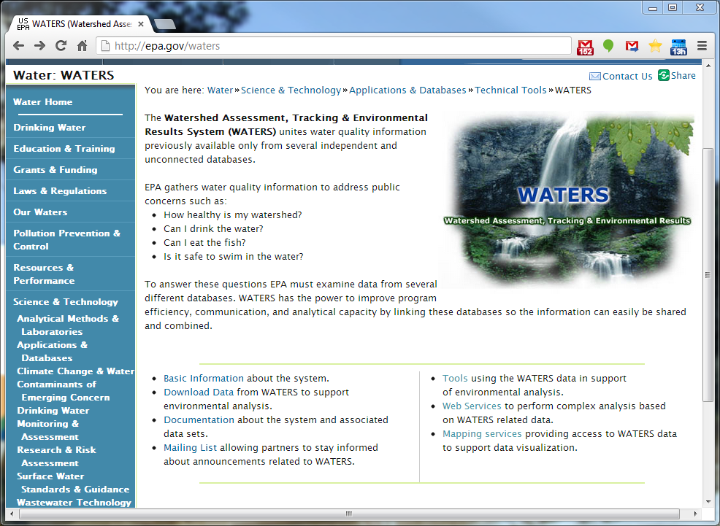

Slide 26
Existing web services (EPA WATERS NHDPlus 100K-based)
EPA WATERS Web and Database services
Event indexing
Point indexing
Name service
Navigation service
Navigation delineation service
RAD event info service
Lookup services
Results queue service
Spatial assignment service

Slide 27
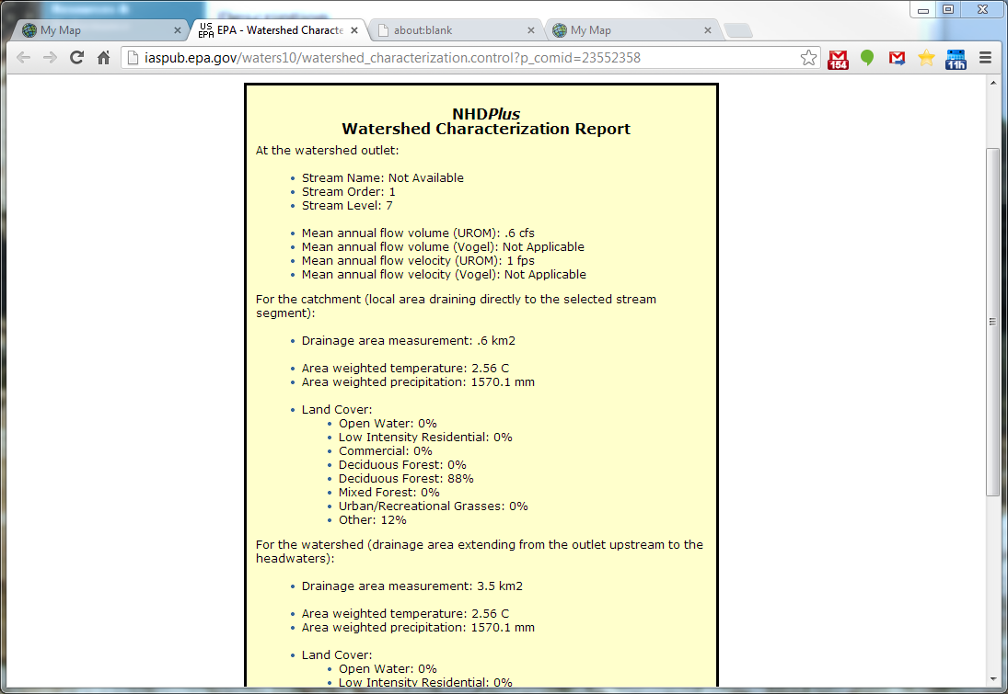
Incremental
Cumulative

Slide 28
HEM Web Initial Release
Release date – April 30th, 2014
SOE
HiRes NHD Read-Only Web Map Service (AGS)
National Coverage
Updated Daily
Enables display/query and snapping
Sample JavaScript API Code
Configuration Documentation
http://nhd.usgs.gov/tools.html#hem
Contact: hem@usgs.gov

Slide 29
Open Water Data Initiative
June 26, 2014
Steering Committee Meeting
Kevin T. Gallagher
USGS, Associate Director, Core Science Systems

Slide 30
Open Water Data Vision
Foundational National Data Sets with Data Services to support a wide variety of water user applications
Water data metadata, web services and a community accessible on the Federal Geospatial Platform
Access to integrated real-time monitoring data
Data Assimilation for a National Modeling capability
Water Maps and other Derivative Products that integrate geospatial & water observations
Such as: current conditions, precipitation estimates, reservoir storage
Marketplace of open source applications (models, data visualizations, etc.) built upon Open Water Web Services

Slide 31
Foundational Water Data Sets
Streamflow
Groundwater levels
Aquifers
Water quality
Reservoir storage
Elevation
Hydrography – NHD/WBD
Landscape Variables
Climate/Weather/ET
Soil moisture
Human water use
Withdrawals
Return flows
Diversions
Losses

Slide 32
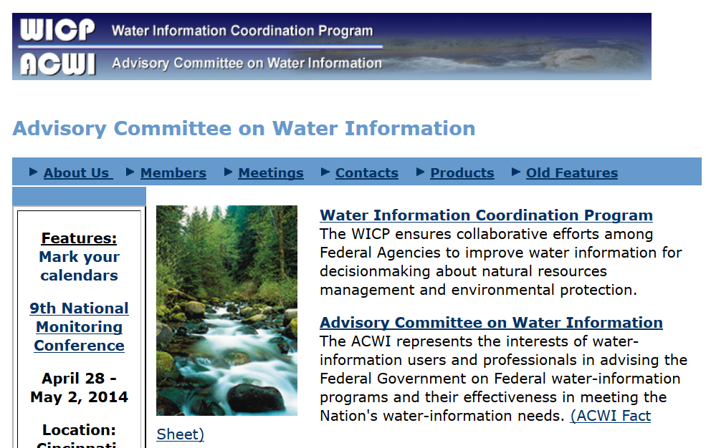
ACWI – Advisory Committee on Water Information
Established in 1991
Notes:
ACWI through its subcommittees, including the joint ACWI / FGDC committee on spatial water data, has long had the objective of more effectively sharing comparable water data across the federal water sector. Several significant capabilities now exist through ACWI that include water-quality and groundwater data portals with web services. These capabilities will be leveraged and integrated within the proposed architecture.

Slide 33
Proposal
We are proposing an Open Water Data Initiative that will:
integrate currently fragmented water information into a connected, national water data framework
leverage existing shared infrastructure and tools to provide a platform for innovation, modeling, and data sharing and solution development.
capitalize on cross-government interest in big data, IT innovation, Open Data, Data.gov, etc.
Build on the ground-breaking work of the FGDC, OGC, IWRSS, CUASI, ACWI, and others.

Slide 34
Charge for the FGDC
In collaboration with the ACWI and other partners – Advance an Open Water Data Initiative, including:
Reviving and populating the joint Subcommittee on Spatial Water Data to design a national open water data infrastructure;
Supporting IWRSS consortium members in the scoping and implementation pilot activities;
Creating an integrated water data portfolio for specific hydrologic regions or basins;
Developing a technical reference architecture that supports the sharing of water data and links observations to geospatial data;
Leveraging the Geospatial Platform to make water data more accessible and to support water data community collaboration;

Slide 35
Charge for the FGDC cont.
Identifying how existing investments in water data sharing can be integrated and leveraged;
Engaging the international community in standards and technology development including the Open Geospatial Consortium;
Identifying and prioritizing improvements to relevant framework geospatial data (National Hydrographic Dataset, Watershed Boundary Dataset, National Elevation Dataset, National Geologic Map Database, and the National Cooperative Soil Survey);
Utilizing the FGDC coordination and governance structure to support related activities in the federal water sector.

Slide 36
Next Steps
Endorse revival and re-populating of Subcommittee on Spatial Water Data
Issue charge to the subcommittee
Work with IWRSS consortium members to:
Refine charge going forward
Define and implement Pilot Projects
Schedule “periodic” check-ins with the Steering Committee

Slide 37
Use Cases
NFIE
Short Term Networks/temporary gages (Marie Peppler)
Data from Sandy, other floods
Project underway now
Can exercise the services
Main goal: NHD indexing (events)
Secondary goal: navigation, event discovery
Hydro Geospatial Fabric/National Hydrology Model (Roland Viger)
West Virginia chemical spill

Slide 38
West Virginia Chemical Spill
Spill one mile upstream from water treatment plant
Incident Command Tool for Drinking Water Protection (ICWater) used to warn downstream water suppliers
Uses NHDPlus flows and velocities
Adjusts with real-time gage data
Provided accurate travel-time estimates
Protected Cincinnati water supply and others

Slide 39
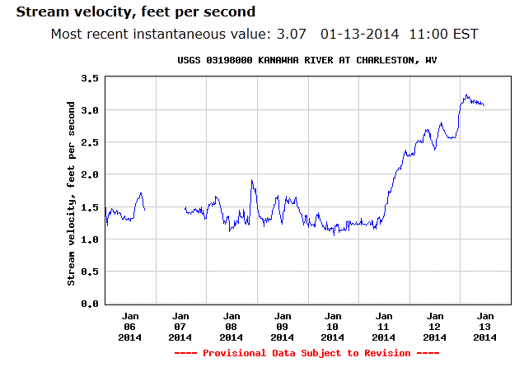
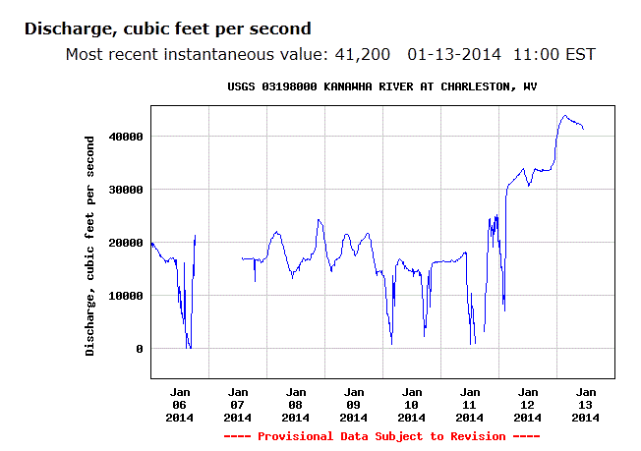
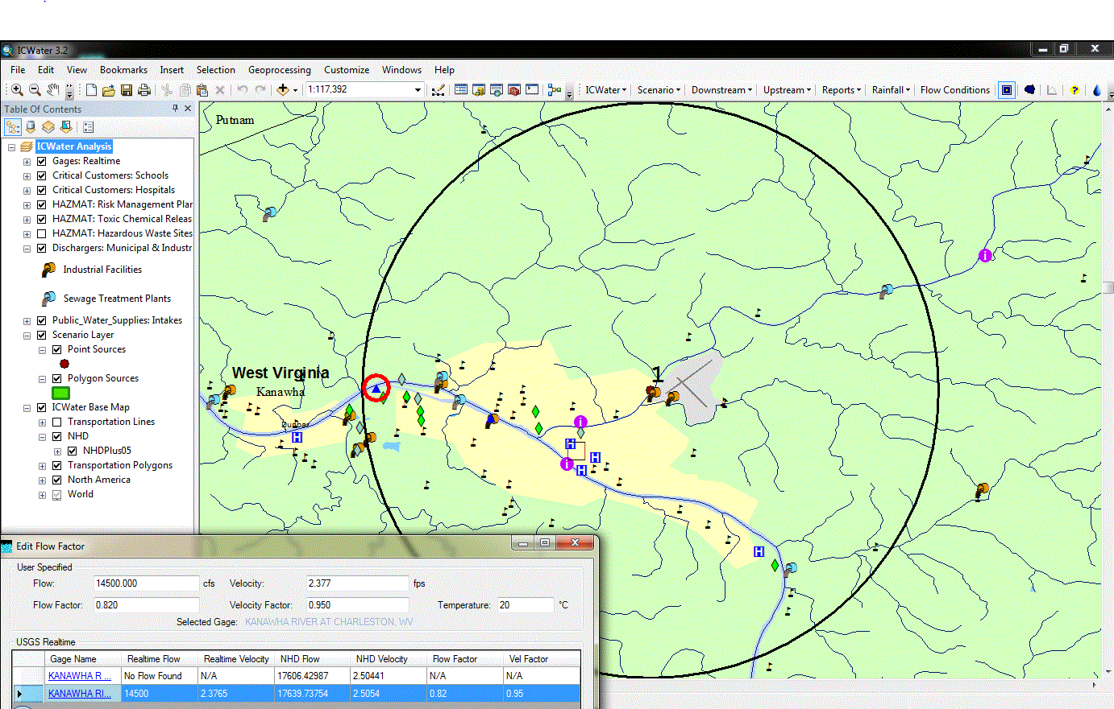
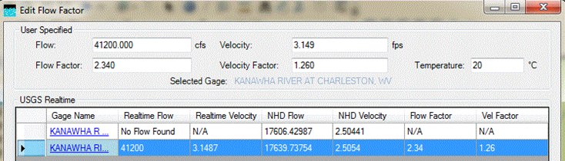
Measured
velocity
Intake
Spill site
Model velocity

Slide 40
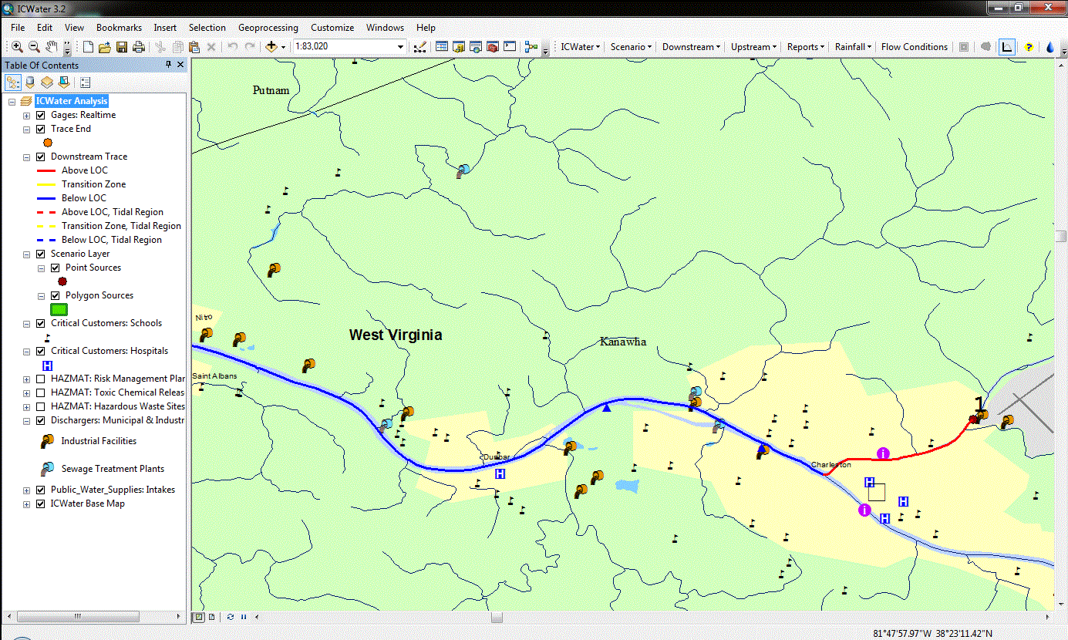
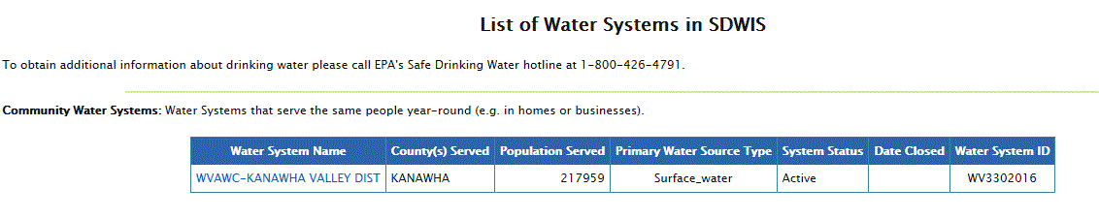
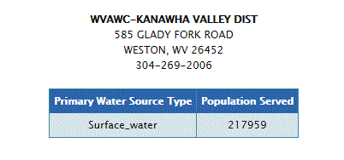
Downstream trace
Spill site

Slide 41
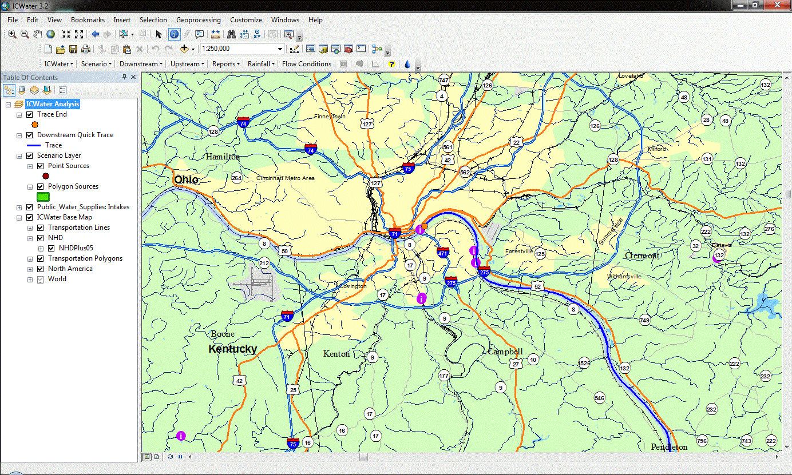
Intakes near Cincinnati
120 hours

Slide 42
Potential Future NHD Services
Expose most/all data as features/related tables
Up/Downstream navigation with event discovery
Event clearinghouse(s)
Open – federated catalog
Service-based
Discoverable
Initial hosted community via ScienceBase
Event management services
Event synchronization
Event migration between scales

Slide 43
What services are needed for NFIE?
Do WATERS services do everything needed?
Event indexing
Up/Downstream navigation?
Others?
Does NFIE need to reference any network other than NHDPlus?
What supporting services are needed?
WFS? Which features?
WCS for elev?
2D to 3D line service?

Slide 44
What are recommended processes?
Scoping of pilots?
Development of standards?

