Slide 1
Hydro Interoperability Initiatives – CHISP, Testbed 10 and Testbed 11 (planned)
Lew Leinenweber Initiative Director, Testbed 11
12 Aug 2014

Slide 2
TOPICS
CHISP-1
completed April 2013
Hydro in Testbed 10 and 11
Semantic Interoperability across Hydro Models (NHN and NHD+) Using HY-Features
Testbed 11
Hydro and Climate Resilience Thread

Slide 3
CHISP-1 Pilot Objectives
Create a virtual observatory system for surface and subsurface water resources observations in parts of the U.S. and Canada, building on current networks and capabilities
Link observations data to the stream network, enabling queries of conditions upstream from a given location to return all relevant gages and well locations.
Model and calculate nutrient loads for Great Lakes by accessing water-quality data from multiple cross-border agencies integrating stream flow and discrete sampled water quality observations.
Notes:
This Pilot project was conceived, in this initial phase, to develop and demonstrate a virtual observatory system to integrate the use of
water resource observations for the U.S. and Canada,
While building on existing networks and capabilities, and exploring opportunities for enhancement of these networks using geospatial standards.
This project aimed to link water resource observations, encoded using OGC’s Water Markup Language Version 2, or WaterML2, with river and stream network resources.
This linkage with stream network resources
Enabled queries of surface and ground water conditions upstream in a watershed from a given location to
Identify sensors for relevant surface gauges and and groundwater well locations and then
Retrieve historical and real-time sensor measurements

Slide 4
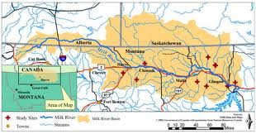
Selected Basins
Upstream Monitoring and Event Notification
Milk River Basin
Nutrient Load Modeling and Assessment
Great Lakes
Notes:
To focus the efforts for test and demonstration, this project considered two basins with portions in both the U.S. and Canada. The Milk River basin includes parts of Alberta, Saskatchewan, and Montana and the Souris River basin includes parts of Manitoba, North Dakota, and Saskatchewan. This project selected the Milk River basin to demonstrate the systems functions and capabilities.

Slide 5
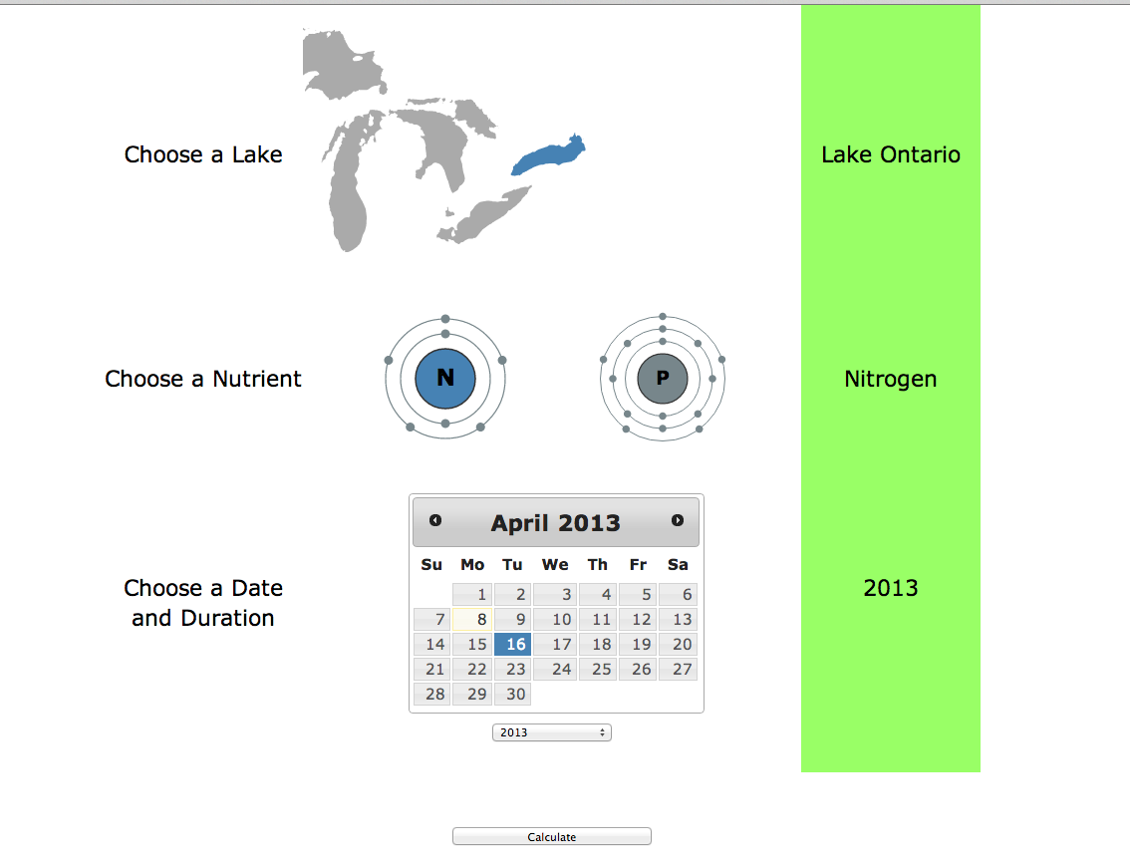
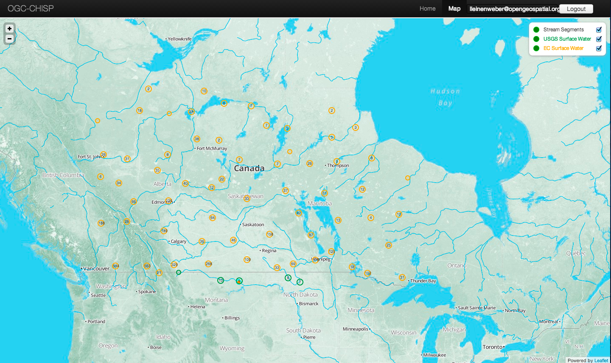


CHISP-1 Functions
Upstream monitoring and alerting system for historical and current stream flow and groundwater conditions & simulations of past flooding events.
Modeling and assessment of nutrient loads into the Great Lakes.
Notes:
There are two main functions performed in this system.
First – Alerting system using sensor measurements for historical and current US and Canadian stream flow and groundwater conditions. Capabilities for this function were developed by Explorus Data Systems, GIS-FCU and RPS ASA; and supported by sponsor-provided services and data
This capability included
Integration of trans-boundary stream flow and groundwater well data, as well as national river networks from the US National Hydrography Dataset (NHD) and Canada’s National Hydro Network (NHN) and from multiple agencies.
The project focused on retrieval and processing of time-series stream flow data for real-time conditions and simulation of flooding events using historical data; and an event notification system and interface to an emergency management alert system.
Second - Modeling and assessment of nutrient loads, such as nitrogen and phosphorous, flowing into the Great Lakes. Capabilities for this function were developed by RPS ASA and supported by sponsor-provided services and data.
This capability included
Retrieval of water-quality data from multiple agencies and integrating this data with stream flow information for calculating nutrient loads entering the Great Lakes.
The emphasis of this function is on discrete sampled water quality observations, linking those to specific NHD stream reaches and catchments, and additional metadata for sampled data.

Slide 6

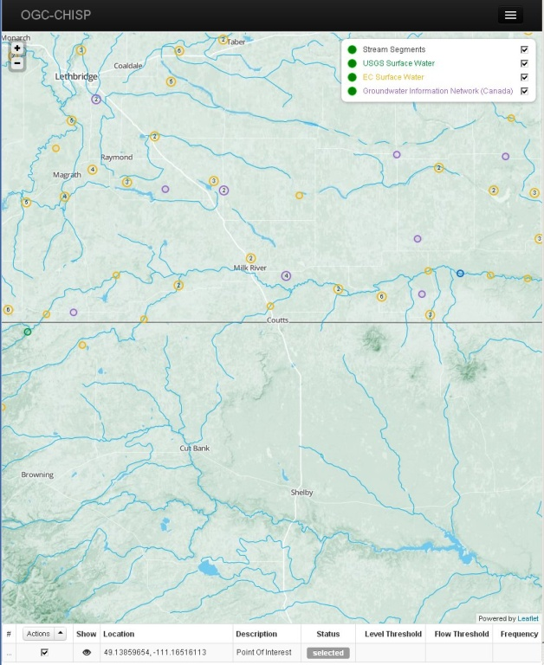
Cross-Border Upstream Monitoring & Alerting
SOS /WML2
(Water Level, Flow)
EC/NRCan
CSW
Explorus
WFS
(Station Info)
USGS
Event Notification
Service
(GIS-FCU)
Harvester
SOS / WML2
(Water Level, Flow)
USGS
WPS
(Upstream Gauges)
RPS-ASA
+ NRCan
Broker
SOS / GWML
(GW Level)
NRCan
WNS
RSS Feed
Upstream Monitoring Web Client
(Explorus)
CAP Info Editor
GIS.FCU
Multi-Agency Situational
Awareness System (MASAS)

Slide 7
Technical Achievements - Details
SOS GetDataAvailability Implementation
Harvester method (store time-series values and trigger on last-value threshold exceeded)
Notification broker
CAP alert client for Multi-Agency Situational Awareness System (MASAS)
Map-based subscription web client
Integrated display of cross-border streamflow, groundwater and water level information
Subscription and Notification capabilities and interfaces (CAP and MASAS)
Notes:
This slide and the next provides a brief summary of the Achievements that were realized during this project
Map-based subscription web client
Displays a map and allows client to choose flood monitoring point/gauge
Python implementation of CSW (PYCSW)
Deployed and tested open source CSW server
Found and corrected a number of bugs (community service)
GetDataAvailability
Not yet an approved operation of the SOS standard.
Developed and used a prototype implementation for the operation and tested during CHISP-1
Extends 52-North source to include GDA operation
Plan to migrate this code into the existing 52North code base for community use
Harmonize GDA response across all servers in CHISP-1
Notification broker
Coordinating service that interacts with multiple services in the CHISP-1 architecture
Upstream WPS, WNS, NRCAN/USGS SOS’s, CSW, Harvester Module
Checks sensor reading to see if they exceed thresholds set during subscription
Performs notification using the Web Notification Service (WNS)
CAP Alert client
Web-based client to enter parameters necessary to send information for a CAP alert
Interfaces with the MASAS system to form and send the alert
Harvester Module
Reads and stores last value from sensors/gauges in order to perform threshold tests
Stores last value in the catalog (CSW) along with station metadata

Slide 8
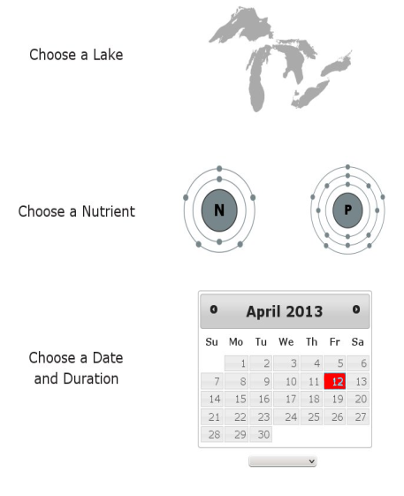
Great Lakes Nutrient Load Calculation Service
SOS2/WML2
(EC/NRCan)
Catalog
(RPS ASA)
SOS2/WML2
(USGS)
Stream Flow
Nutrient
Concentrations
WPS
Nutrient Load
Calculation Service
(RPS ASA)
SOS2/WQX
(RPS ASA)
Canadian
WQ Server
Nutrient Load Web Client
(RPS ASA)
SPARQL Server
(NRCan)
USGS/EPA
WQ Server
Notes:
SPARQL Server deployed by sponsor, but ontology data not loaded due to sponsor time constraint; alternatively, used an simple internal cross-reference database to accommodate differences in terminology.

Slide 9
Technical Achievements - Details
WPS to discover Upstream gauges/wells
SOS facade on existing non-OGC sources of water quality information
Provincial Water Quality Monitoring Network (PWQMN) Canadian WQ
USGS/EPA Water Quality Portal / Water Quality (WQX) data
WPS to provide Nutrient load calculation service
SPARQL server for mediation of analyte vocabularies (partial)
Web-based NLCS client
Notes:
First:
NLCS client
Deployed as a Web-based client that allows the user to choose a Great Lake and analyte in order to compute nutrient loads entering the lake
Water quality SOS façade was created to:
Integrate existing non-OGC water quality source data services
Using an OGC compliant Sensor Observation Service (SOS) API (i.e. façade) for access to those sources
Nutrient Load Calculation Service (NLCS) was developed
Given the selection of a Great Lake and an analyte, the NLCS computes the nutrient loads using
An Indexing service that
Identifies stream flow gauges and water quality stations – and tributaries and lakes with which they are associated
The Indexing service was deployed as a local data store
2. Upstream service
Identifies upstream gauges and sensors given a selected point of interest
Deployed as a WPS
Lastly:
SPARQL server
Deployed to serve as a semantic mediator of analyte vocabularies between US and Canada
Loading of ontology data was not yet completed in time for this demo
In the meantime, the NLCS uses a local, internal mapping of vocabularies for mediation

Slide 10
Challenges – Future Work
GDA extension for SOS
Developed service operation enhancement for GDA in 52North code
Update of sponsor’s SOS code base with new GDA operation ready and awaiting database migration between version updates of database.
Large networks of sensors are not sufficiently supported in SOS standard
Listing of procedures and features of interest not manageable due to size of GetCapabilities result
Service performance and stability
Robust error handling needed for Harvester component to mitigate network and service outages
SPARQL server
deployed but not populated due to limitation of resources
Data and software issues implementing Nutrient Load Calculation model
Improvements needed in open source calculation model to fix bugs
Need access to more complete data for cross-border nutrients to perform scientifically valid results
Notes:
Service performance and stability
There were issues of stability and performance with some of the backend services necessitating the development of more robust error handling
Large networks of sensors are not sufficiently supported in SOS standard
Listing all procedures and features of interest is not usually manageable for large networks
Catalogue issues
The initial deployement using GeoNetwork CSW was not stable or complete; moving to pycsw – developed by Tom Kralidis from EC resolved most of the issues
SPARQL server
Deployed but never populated with ontologies because of time constraints
NLCS WPS
Bugs with the open source software libraries used to implement the model and the lack of data on the Canadian side necessitated the move to a simpler model
Harvester module issues
The last-value harvester module was impacted by the previously mentioned performance issues with the SOSs
It is very difficult to demonstrate a back-end service and the client that was demonstrated by GIS-FCU was developed to step through in processing actions
GDA extension for SOS
As a community service, the GetDataAvailability operations conforming to the NRCan profile was implemented using the latest 52North code base
However, since the current 52North SOS code base did not yet include the necessary database migration scripts to move the existing data to the newer SOS to be able to demonstrate the operation with real data

Slide 11
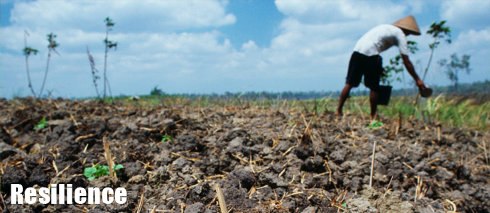
Testbed 11 - Climate Resilience

Slide 12
Testbed 11 - Climate Resilience
Open Climate Data
Provide access to open climate data using OGC Web Services
Enhancements to existing OWS standards and consideration of revisions.
Climate Decision Tools
Deploy applications and toolkits that access open climate data
Support decision-making relevant to Climate Resilience Scenario.
Climate Processes Models
Provide access to pre-computed outputs from IPCC Climate Model runs
Provide access to prediction algorithms and integrated environmental models for decision makers
Conduct “what-if” studies in their geographic region of interest.
Decision Provenance
Apply Provenance capture techniques to the decision making needed for Climate Resilience Scenario.
Cloud Scalability
Apply cloud resources to scale OGC Web Services, applied here to climate data and process models

Slide 13
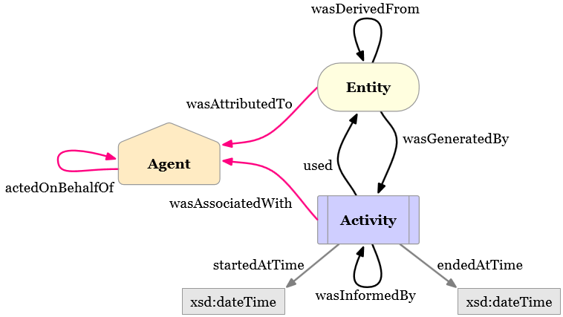
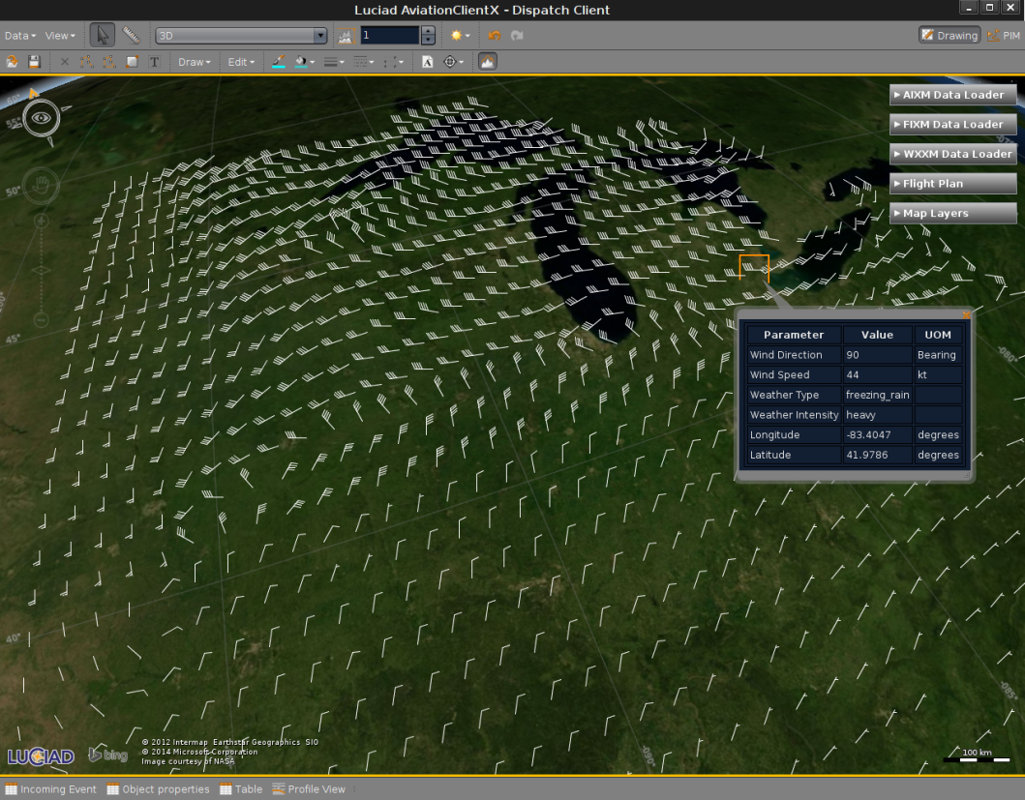
Testbed 11 - Climate Resilience
Climate / Big Data processing and analysis
Provenance – query and data optimization
Support the emerging NWS WCS application profile
Deliver data in WXXM format
Data sets in the National Forecast Database (NFDB)
National Digital Guidance Database (NDGD)

Slide 14
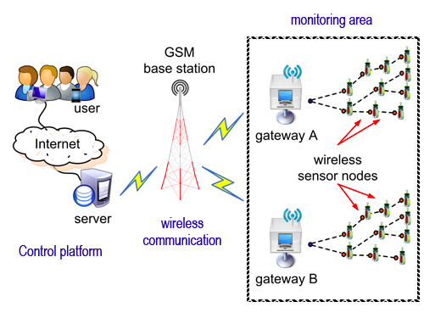
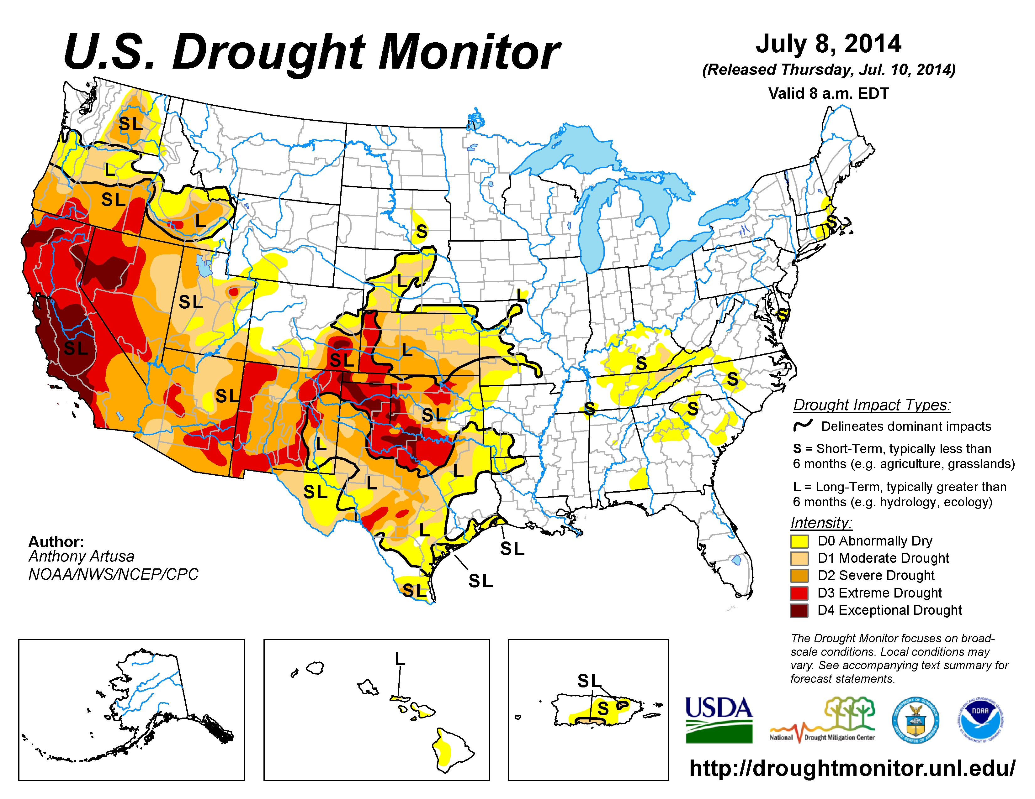
Testbed 11 Climate Resilience – for Agriculture
Agriculture - Weather and Climate Change
Yield performance (via crop selection, maintenance, etc)
Weather Monitoring and forecasts
Short-range and Long-range forecasting
information exchange, analysis, display and decision support
Service APIs, protocols and encodings (for CWB, WMO, NOAA-NWS)
Sensors, data collection, processing capabilities
Climate modeling for long-range impacts and prediction
cloud processing and analysis
Interfaces, protocols and encodings for Information storage, processing and retrieval

Slide 15
Tracking Agricultural Impacts of Climate Variability and Change
Develop and test services to track effects of climate change and climate variability on US agriculture, a critical sector of the US economy and global food system that is uniquely susceptible to climate impacts
http://weather.msfc.nasa.gov/nca/NASA_NCA_Indicators_Solicitation_-_Ruane_Synopsis.html

Slide 16
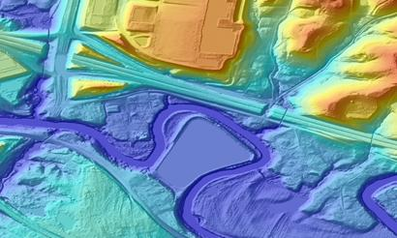
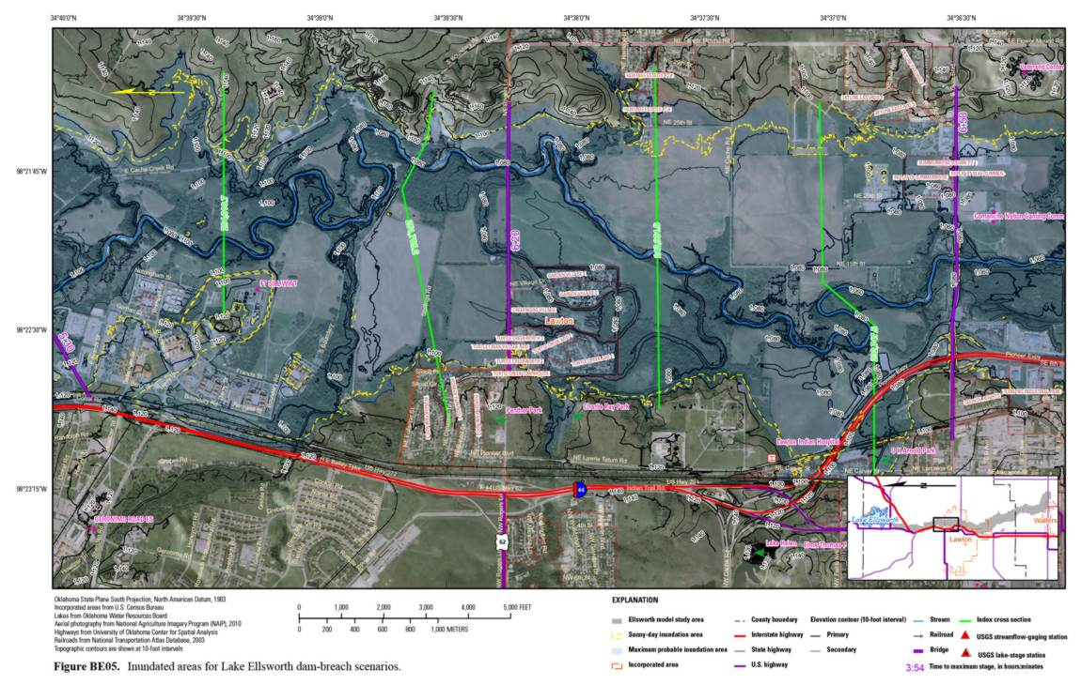
High-Resolution DEMs for LIDAR
Prototype high resolution DEM based on LIDAR data for flood inundation modeling
DEMs are voluminous (particularly high resolution ones)
Useful for state or local emergency management agencies
Provide service interfaces for access to National data sets to support flood modeling
Investigate and demonstrate use of derivative products to integrate geospatial with existing water resource observations
USGS The National Map – Elevation
http://nationalmap.gov/elevation.html
USGS @ccess Summer 2013
http://www.usgs.gov/core_science_systems/access/summer_2013/article-6.html
DOI Dam Breach Analysis and Flood Inundation for Lakes Ellsworth and Lawtaonka near Lawton, OK

Slide 17
High-Resolution DEMs for LIDAR
Web Coverage Tile Service
Test and demonstrate use with filtering
Ex. retrieve only areas where elevation is less than “X” feet.
Background
12-155, OWS-9 OWS Innovations WCS for LIDAR ER
Revisit formation of Web Coverage Tile service SWG?
Prepare a GeoPackage containing a selected set of tiles from a LIDAR dataset that matches the filter requirements.
Provide to another user who can use the GPKG in a disconnected or low bandwidth network environment (ex. for use in the field for survey and analysis)

Slide 18
NASA & EPA Climate Indicators
Develop Services and analysis for climate indicators
Climate indicator data sets
Currently there are no standard processes for managing, distributing, or visualizing them
Program Resources
US Global Change Research Program
http://www.globalchange.gov/what-we-do/assessment/indicators
NASA’s Activities for the National Climate Assessment
http://weather.msfc.nasa.gov/nca/NASA_NCA_Indicators_Solicitation_-_Selected_Proposals.html

Slide 19
NASA & EPA Key Climate Indicators
Indicators take a variety of forms—maps, time series, arbitrary measures per country/region/state/zip code/etc
http://climate.nasa.gov/key_indicators/
http://www.epa.gov/climatechange/science/indicators/
http://www.climate.gov/maps-data
Currently indicators are 'owned' by their PI and distributed/visualized/etc. only by them
Investigate various ways to represent, harvest, distribute, visualize
Particular interest in bringing them together
Ex. which regions have indicator X and indicator Y exceeding some threshold?
Develop standards for the indicators
Adopting/encapsulating existing standards where possible

Slide 20
EPA Climate Change Indicators
30 indicators to help understand observed long-term trends related to the causes and effects of climate change
describes the significance of these trends and their possible consequences for people, the environment, and society
Most indicators focus on the United States, but some include global trends to provide context or a basis for comparison
Link and report:
http://www.epa.gov/climatechange/science/indicators/

Slide 21
Climate Resilience Scenario
Coastal Inundation / flooding event resulting from climate change that affect population centers and infrastructure
NASA
Taiwanese Ministry
Australia
Others to provide ideas

Slide 22
Hydrology Mapping and Semantics
Develop hydrology model (ex. NHN and NHD+) descriptions using semantic technologies (ontologies, RDF/OWL) (build on Testbed 10 results)
semantic mappings of concepts from model to model
Integrate Hydrologic features and model mapping concepts with Gazetteer storage and discovery
Develop and demonstrate semantic mediation service
based on SPARQL
support queries by users for concepts across different models
return associated concepts and features in selected target model

Slide 23
Weather Harmonization – SGIP & NIST
Major standards efforts to harmonize information models for weather and environmental data
WMO/METCE/IWXXM
largest body of work on information content, phenomena, and code lists
IEC 62325
new top down look at weather information modeling covering alerts as well as weather and environmental information and several non-aviation related phenomena
IEC 61850/61400
adds a SCADA view to weather information of interest for distributed energy resources (DER)
National Mesonet Consortium
large volume mesonet scale weather data models with rich “metadata” model offering quality of data focus

Slide 24
Weather Harmonization – SGIP & NIST Use Cases
Microscale weather and climate data
Business Case: Use of Micro-scale Weather Data for More Precise Forecasting
Renewable and/or distributed energy resources
Business Case: Use of More Accurate Weather Data to Bid Renewable Distributed Energy Resources into the Market with More Confidence
Federation of sources and uses of weather data
Business Case: Development of Services that Provide Federated Sources for Users of Weather Data
Utility Operations and Markets
Business Case: Utility Reduces Operational and Market Costs through More Accurate Forecasts
Climate change
Predict Impact More Accurately of Storms and Flooding due to Climate Change

Slide 25
Weather Harmonization – SGIP & NIST
Define information models for weather and environmental data
Bring together WMO/IEC and other efforts at weather and environmental data standardization to achieve the greatest degree of harmonization possible
Proponents:
SGIP and PAP’s are
Stakeholders in the weather and environmental information exchange ecosystem
Potential to involve a utility and perhaps a facility manager in a Use Case implementation

Slide 26
THANK YOU QUESTIONS?

Slide 27
Background / BACKUP

Slide 28
US Climate Data Initiative Resources to support Climate Resilience
Broad effort to leverage Federal Government’s, freely-available data resources to stimulate innovation in support of national climate-change preparedness.
Current emphasis on Coastal Inundation
Future: Agriculture, Health/heat, Biodiversity, Water
Commitments
Administration:
climate.data.gov; NASA and NOAA Innovation Challenge on Coastal Vulnerability; USGS, DHS, DoD/NGA datasets, NOAA RFI on Increasing Access to Environmental Data; Support for Climate Data & Tools in the President’s Budget
Private Sector:
Esri, Google, CartoDB, Intel, Climate Central, Microsoft Research, Circle of Blue, Rockefeller Foundation, Code for Philly, World Bank, MIT Climate CoLab, Alliance for Water Efficiency
http://m.whitehouse.gov/the-press-office/2014/03/19/fact-sheet-president-s-climate-data-initiative-empowering-america-s-comm

Slide 29
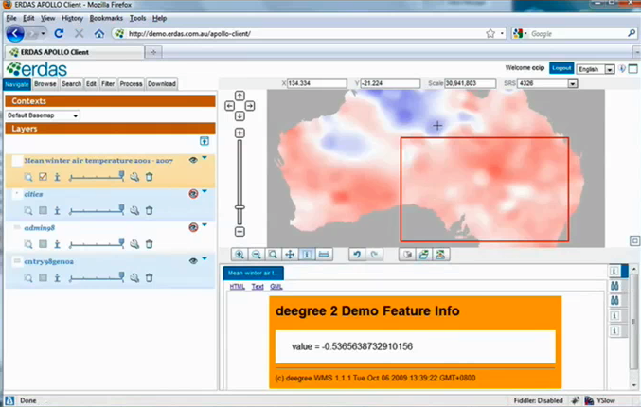
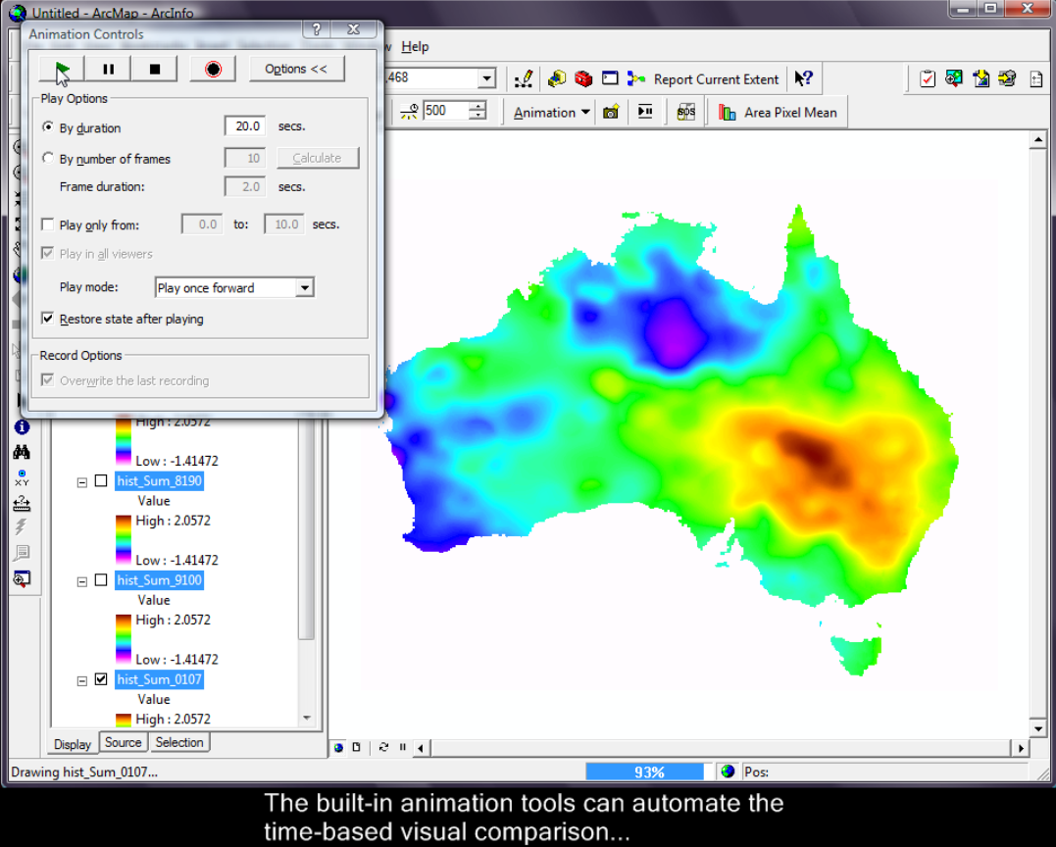
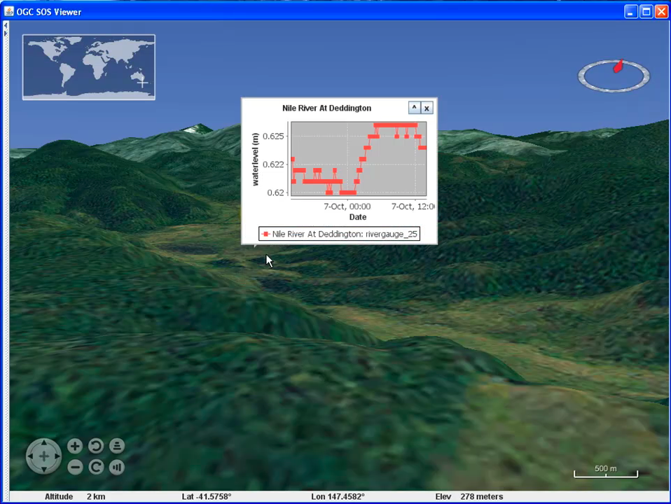
Climate Challenge Integration Plugfest – 2009 Background for Climate Resilience
CCIP 2009 demonstrated standards-based interoperability between applications for Climate Change analysis
Network of online data services (WCS, WFS, SOS), online analysis services (WPS, WCPS, WMS), and geospatial client applications that exercise those services
Plugfest launched at FOSS4G Conference 2009
But participation was welcomed from all whether open or proprietary
See report and video at http://www.opengeospatial.org/projects/initiatives/ccip2009

Slide 30
CHISP-1 Achievements
View trans-boundary upstream hydrometric (and groundwater) data via the web in near real-time
Monitor all available upstream stations independent of location or jurisdiction to generate an alert in case of flood and/or drought
Demonstrated use of GetDataAvailability (GDA) operation for SOS v2 for retrieval of time-series WaterML2 encoded stream flow data
Used Catalog to store and update last-value SOS time-series data encoded in WaterML 2.0 to monitor for potential flood event thresholds
Demonstrated integration and interoperability of international data services using the SOS and WaterML2 for stream flow and water quality data in order to execute a web-based nutrient load model

Slide 31
Coordinated set of observed and constructed climate normals
Climate Normal A (Observations)
previous 30 growing years of daily climate uses a bias-corrected version of the NASA Modern-Era Retrospective-Analysis for Research and Applications (MERRA)
Output from a pDSSAT simulation output driven by this climate normal forms the core indicator of simulated crop production.
Analysis allows the previous year to be placed in the context of the current climate normal and enables examination of regional performance and climate-induced trends.
Climate Normal B (Smoothed Observations)
previous 30 growing years of daily climate smoothed to remove sub-seasonal climate variability and extreme events but maintaining mean radiation, mean temperatures, and seasonal rainfall totals.
compare this indicator to the indicator above to determine the effects of sub-seasonal climate variability and extremes in comparison to the signal of mean climate change and major modes of interannual variability.
Climate Normal Set C (GCM Scenarios)
Subset of climate scenarios generated by combining observations with changes projected by CMIP5 climate models to represent the preceding 30-year climatology and the upcoming 30-year climatology
Comparison of these indicators (and the trend between the two periods) to the observed record places recent agricultural events and trends in the context of past and near-future climates
assessment of the changing probabilities of events and the performance of climate model projections against the observed trends.

