Slide 1
Requirements for System Interoperability and Data Synchronization
Ed Clark
Hydro Domain Working Group
August 14th 2014

Slide 2
Briefing Outline
Review of the chartered task
Methodology & Findings
Interoperability and Data Synchronization Requirement areas:
Interoperability and Integration
Authoritative and Consistent Streamflow
Supporting USACE and NWS models (hydro-meteorological and water management data.)
Recommendations and Next Steps

Slide 3
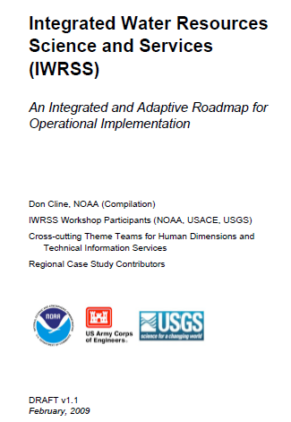
Integrated Water Resources Science and Services (IWRSS)
Aligns multiple agencies with complimentary water-related missions to:
Integrate services and service delivery
Improve river and flood forecasts
Provide new summit-to-sea water resources analyses and forecasts
Enable more effective use of resources
Roadmap Document
(February 2009)
Purpose, Scope, Vision and Goals
Cross-Cutting Themes
National and Regional
Operations and Business Concepts
http://www.nohrsc.noaa.gov/~cline/IWRSS/IWRSS_ROADMAP_v1.0.pdf
3

Slide 4











Innovative Federal Consortium
New business model for interagency collaboration
Share technology, information, models, best practices
Operations focused
Started with three agencies, designed to expand
Members agree to work towards:
Interoperability of key systems and data synchronization
Standardized data formats
Enhanced geospatial information and visualization
Common Operating Picture
Coordinated R&D portfolio investments
Leverage multi-disciplinary skills to formulate effective solutions
Federal Tool Box – one stop shopping for federal water data and information
Joint governance structure – shared leadership model
Joint stakeholder outreach, educational efforts
“It is amazing what you can accomplish if you do not care who gets the credit.” Harry S. Truman

Slide 5
System Interoperability and Data Synchronization Requirements Team Charter
System Interoperability: Standardized mechanisms by which individual operational systems are better able to communicate and collaborate with one another at all intersection points within their respective processes.
Data Synchronization: Information coherency across all system processes, among all IWRSS partners. Complementary with System Interoperability.
Chartered Task: Scope the requirements for Interagency System Interoperability and Data Synchronization that enhances the ability of the consortium members to complete their water resources related mission and facilitates new services.
Adopted Terminology: Interoperability and Data Synchronization (IDS)

Slide 6
Scoping Methodology
Deconstructed 3-existing workflows, leveraging agency Subject Matter Experts, to identify the essential data sets that require synchronization achieved through the adoption of system-interoperability and advanced data-handling practices.
Past
Current
Future
Water Resources Analysis (e.g. Water Census and Model Calibration)
Common Operating Picture for Water Resources
Water Resources Forecasting
USGS:
Historic Streamflow, Lake Levels and Ground Water (SLG) Observations
Geospatial Datasets
Hydrography
USGS:
Current (SLG) Obs.
Rating Shifts
USGS:
Projected Geospatial Data
NOAA:
Forecasted Weather and Surface Conditions
Forecasted Water Resources States
NOAA:
Current Weather and Surface Observations and Estimates
River Flows Estimate
NOAA:
Historic Weather and Surface Observations
USACE:
Projected Water Management Operations
USACE:
Historic Regulation and Water Management Observations
USACE:
Water Management and Infrastructure States

Slide 7
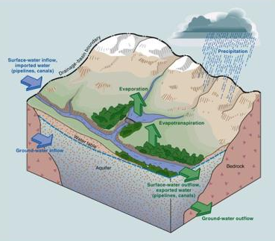
Methodology: Water Resources Analysis and a National Water Census
The USGS National Water Census aims to provide best available nationally consistent water budget data and tools
It will rely on a national hydrologic hydrofabric to cross scales and provide common reference framework for a nationally consistent water budget.
The long-term data needed to calibrate the hydrologic and hydraulic models used by USACE and NOAA/NWS, is very similar to the data requirements for the National Water Census
Image courtesy of USGS

Slide 8
Methodology: Common Operating Picture for Water Resources (COPWR)
Streamflow Observations, Measurements & Studies
Reservoir Operations & Regulation
Wx driven
Unregulated Runoff Processes
COPWR provides consistent information to managers and operators responsible for water resources quantification, prediction, and management. Including:
Hydro/met forcings
Consistent streamflow observational data (stream stage decoding, rating table)
Water Management infrastructure status and conditions
Consistent information about data provenance and standards conformity
Reliable real-time notification of process and data events
Consistent list of good/bad in-situ observation gages and ratings
A robust COPWR allows agencies whose mission is to predict water-resources conditions the best available input data, and increases confidence in decisions.

Slide 9
Methodology: Water Resources Forecasting
The water resources forecasting workflow extends information exchanges for the COPWR and includes:
Integrating predicted natural runoff prediction with predicted water management operations
Awareness of uncertainty in natural runoff predictions
Operation of water control structures
Metadata associated with forecasts, including the meteorological forcings, reservoir operations or specific streamflow forecasts provided by the NWS or USACE hydrologic models.

Slide 10
Methodology: Constraints and Assumptions*
Constraints:
Must comply with the agencies authorizations identified in their respective organic acts and other relevant sections of the U.S. Code.
Must comply with agency operational guidelines, policy, and best practices.
In some cases, must comply with the proprietary or embargoed nature of particular data sets.
Must comply with Agency IT security policy and procedures.
Assumptions:
Requirements are not to be limited to existing current practices of workflows within the tri-agencies (Parties), nor the missions of the Parties themselves.
Solutions for requirements must extend to future IWRSS consortium members who could have a role in one or more of the workflows.
Requirements for addressing the nuances of water quality data were not considered.
*See report for full list of constraints and assumptions

Slide 11
Findings: Requirement Categories
Deconstructing the workflows, identified 5 key categories for requirements development:
Hydro-meteorological Forcing Data
Stream Flow Observational Data and Ratings
Water Management
Information Exchange to support Flood Inundation Mapping (FIM)
Integration and Interoperability

Slide 12

Requirements: Interoperability and Integration
Adopt community-accepted standards for data and meta data.
Develop and adopt a geofabric to characterize the locations of obs., fcsts., water budget variables, and model parameters and states.
Define authoritative data sources for shared information (e.g. stream flow and hydro-met forcings).
Data | (Recommended) Standard
Time-series | WaterML2.0 (OGC), CF-netCDF
Vector geospatial data (point, line and polygon) | OpenGIS (OGC) Suite TBD
Grid | CF-netCDF, HDF5
Sensor | SensorML, Sensor Observation Service (SOS)
Extended Shift Adjusted Rating Tables | WaterML2.0 – part 2.
Metadata | ISO-19156, 19157 (O&M), 19115 (geo), WaterML2.0

Slide 13
Requirements: Interoperability and Integration
Develop or adopt standard communication protocols and services to facilitate automated intersystem information exchange.
IWRSS partners leverage improved information exchange capabilities to communicate: data- availability and change status, data- quality and consistency status, and system and process status, etc.

Slide 14
Requirements: Streamflow
Gage owner/operator will provide reliable and timely access to all metadata required to process telemetered data independently including DCP decoding information, initial/datum corrections to stage data, base and shift-adjusted rating curves, details of onsite flow measurements used in rating development, as well as masking of erroneous data periods for use by partner agencies.
Gage owner/operator must be the authoritative data source and will provide reliable and timely access to its best estimate of stream stage and flow for use in all public displays (and potentially modeling activities) by partner agencies.

Slide 15
Requirements: Streamflow
IWRSS consortium end-users can submit formal electronic notification of suspicious gage observation, status, or rating to the gage owner/operator triggering system action. This non-public, nationally consistent communication system will track and log all entries and will have notification capabilities to alert interested parties as to relevant information regarding gage operations.

Slide 16
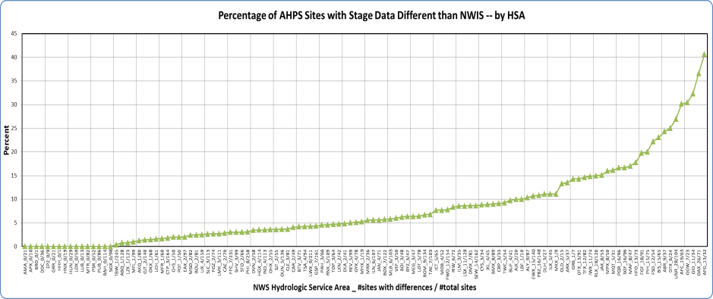
NWIS / AHPS Stage Differences

Slide 17
USGS: DECODES Info Availability
UNIX> report_EDDN_compliance --wsc all
Total sites
| Sites with data in NWIS
| | Sites with config in EDDN
| | | Sites in NWIS but not EDDN
WSC | | | | Percent sites in NWIS but not EDDN
AK 171 120 163 8 6.7%
AL 200 173 175 25 14.5% NC 389 269 345 44 16.4%
AR 215 159 188 27 17.0% ND 168 141 124 44 31.2%
AZ 296 224 263 33 14.7% NE 177 120 154 23 19.2%
CA 567 458 501 66 14.4% NJ 252 203 244 8 3.9%
CO 393 298 330 63 21.1% NM 191 152 146 45 29.6%
FL 868 534 823 45 8.4% NV 194 154 187 7 4.5%
GA 399 311 392 7 2.3% NY 401 231 381 20 8.7%
HI 110 67 103 7 10.4% OH 287 239 242 45 18.8%
IA 227 196 218 9 4.6% OK 231 188 213 18 9.6%
ID 221 200 167 54 27.0% OR 284 224 235 49 21.9%
IL 249 228 118 131 57.5% PA 494 326 465 29 8.9%
IN 270 219 264 6 2.7% PR 347 125 303 44 35.2%
KS 264 191 264 0 0.0% SC 226 143 225 1 0.7%
KY 231 210 190 41 19.5% SD 191 145 190 1 0.7%
LA 355 240 348 7 2.9% TN 181 135 153 28 20.7%
MA 474 413 337 137 33.2% TX 769 528 728 41 7.8%
MD 198 178 106 92 51.7% UT 156 145 156 0 0.0%
MI 194 178 131 63 35.4% VA 269 188 252 17 9.0%
MN 161 146 113 48 32.9% WA 365 286 328 37 12.9%
MO 413 243 394 19 7.8% WI 287 256 51 236 92.2%
MS 201 142 198 3 2.1% WV 193 141 182 11 7.8%
MT 276 214 205 71 33.2% WY 122 105 114 8 7.6%

Slide 18
USGS: Ratings Depot Update Frequency
2013-08-27 11:00:00 SHIFT USGS 12323760 2 4.1 STGQ 11-JUL-2013 16:45:00
2013-08-27 11:00:00 SHIFT USGS 12323760 2 4.1 STGQ 30-MAY-2013 00:15:00
2013-08-27 11:00:00 SHIFT USGS 12323760 2 4.1 STGQ 21-AUG-2013 21:30:00
2013-08-27 11:30:00 SHIFT USGS 12323760 2 4.1 STGQ 11-JUL-2013 16:45:00
2013-08-27 11:30:00 SHIFT USGS 12323760 2 4.1 STGQ 30-MAY-2013 00:15:00
2013-08-27 11:30:00 SHIFT USGS 12323760 2 4.1 STGQ 21-AUG-2013 21:30:00
2013-08-27 11:30:00 SHIFT USGS 12323840 2 2.0 STGQ 21-AUG-2013 20:00:00
2013-08-27 11:45:00 SHIFT USGS 12323840 2 2.0 STGQ 21-AUG-2013 20:00:00
2013-08-27 12:00:01 SHIFT USGS 12323840 2 2.0 STGQ 21-AUG-2013 20:00:00
2013-08-27 12:15:00 SHIFT USGS 12323840 2 2.0 STGQ 21-AUG-2013 20:00:00
2013-08-27 13:00:00 CORR USGS 06207500 7 3 13-MAY-2013 06:00:00
2013-08-27 13:15:00 CORR USGS 06207500 7 3 13-MAY-2013 06:00:00
2013-08-27 13:15:00 CORR USGS 06207500 7 3 08-MAY-2013 06:00:00
2013-08-27 13:45:00 RAT USGS 12323750 3 9.0 STGQ -2147483647
2013-08-27 13:45:00 SHIFT USGS 12323750 3 9.0 STGQ 21-AUG-2013 18:15:00
2013-08-27 14:15:00 SHIFT USGS 12323770 1 7.1 STGQ 20-AUG-2013 23:00:00
2013-08-27 14:30:00 SHIFT USGS 12323770 1 7.1 STGQ 20-AUG-2013 23:00:00
2013-08-27 14:45:00 SHIFT USGS 12323770 1 7.1 STGQ 13-AUG-2013 22:00:00
2013-08-27 14:45:00 SHIFT USGS 12323770 1 7.1 STGQ 13-AUG-2013 18:00:00
2013-08-27 14:45:00 SHIFT USGS 12323770 1 7.1 STGQ 20-AUG-2013 23:00:00
2013-08-27 14:45:00 SHIFT USGS 12323770 1 7.1 STGQ 14-AUG-2013 19:30:00
2013-08-27 16:30:01 SHIFT USGS 12323800 2 6.1 STGQ 20-AUG-2013 21:30:00
2013-08-27 17:00:00 SHIFT USGS 12323800 2 6.0 STGQ 28-MAY-2013 22:15:00
2013-08-27 17:00:00 SHIFT USGS 12323800 2 6.0 STGQ 10-JUL-2013 20:00:00
2013-08-27 17:00:00 SHIFT USGS 12323800 2 6.1 STGQ 28-MAY-2013 18:00:00
2013-08-27 17:00:00 SHIFT USGS 12323800 2 6.1 STGQ 10-JUL-2013 20:00:00

Slide 19
USGS: DCP to Public Latency
Summary: 250 transmissions/hour Montana NWIS server
Seconds from DCP arrival to ADAPS finish
| Seconds from ADAPS finish to web retrieval finish
| | Seconds to transmit to web and load
| | | Total seconds
Pct 0.05 : 19 10 60 89
Pct 0.10 : 24 13 69 98
Pct 0.25 : 34 30 61 125
Pct 0.50 : 50 62 61 173 << 2 min 53 sec
Pct 0.75 : 64 96 62 222
Pct 0.90 : 76 112 65 253
Pct 0.95 : 82 117 65 264 << 4 min 24 sec

Slide 20
Requirements: Hydro-meteorological Forcings
NOAA/NWS routinely provides, meeting the requirements and specifications for interoperability, the following data and information to partner agencies in a timely manner for use in their DSS or analysis platforms.
Observation data from meteorological stations observations
Estimate data (radar, and satellite estimates) used to establish essential gridded meteorological forcings
Essential gridded forcing data developed in real-time by NOAA National or Regional Centers (RFCs) (e.g. Freezing Level, QPE, QTE QPF, QTF).
High-resolution numerical weather prediction (NWP) model guidance including the Rapid Refresh (RAP) and High Resolution Rapid Refresh (HRRR).
The agencies define a methodology and initial version of a long-term analysis of record for hydro-meteorological forcing data.
Notes:
Obs data: (including temperature, dew-point, precipitation, wind speed and direction, snow depth, and radiative fluxes)

Slide 21
Requirements: Hydro-meteorological Forcings and Model States
NWS provides normalized carry-over states from hydrologic models (including variable mapping between conceptual and physically based hydrologic models) to IWRSS partners for initialization of hydrologic models (e.g. HEC-RAS within CWMS)
IWRSS partners who develop streamflow forecasts for discretized points, make these deterministic or probabilistic time-series available to IWRSS partners DSS.

Slide 22
Requirements: Water Management Data
Reservoir operators provide the following data and information to partner agencies in a timely manner:
Design Characteristics and Operational Constraints
min/max elevations, storages, outlet capacities, etc…
changes these items due to maintenance, dam safety concerns, etc…
Current Operational Parameters
releases, elevations, inflows, pumpages, diversions, etc…
Anticipated Operational Parameters and Effective Times
whether generated by model output or steady state prediction
Decision Support Conditions for Current and Anticipated Operations
weather, temporary operational constraints, etc…

Slide 23
Requirements: Water Management Data
Operators of hydraulic control structures provide the following to partner agencies in a timely manner:
Design Characteristics and Operational Constraints
alignments, min/max elevations, durations, storages, capacities, etc…
changes these items due to maintenance, structure safety concerns, etc…
Actual, Likely, or Anticipated Structure Failure
overtopping, piping, planned blasting, etc…
Agencies notify partner agencies in a timely manner when operational water resource staffing is extended beyond normal
River Forecast Center Extended Shifts
USACE Emergency Operations Centers

Slide 24
Risks
Cultural Buy-in: Operational and forecasting practices with regards to exchange and application vary across the IWRSS agencies. IDS solutions must engender user buy-in (and adoption) through demonstrated improvement over legacy methods.
Legal Constraints: Service Level Agreements for proprietary/embargoed data may be necessary for IWRSS partners
Operations and Maintenance: O&M tail was not scoped. IDS solutions may result in increased data load during evaluation and early implementation.

Slide 25
Recommendations
Begin with a subset of requirements to better understand the impacts IDS capabilities on current workflows and operational. The team suggest addressing Streamflow as a first step.
Adopt an incremental or spiral process for continued definition of requirements and design/development activities to meet these requirements.
Demonstrate IDS solutions and objectively evaluate the impact of these capabilities against current concept of operation. For example, demonstrate the improvement in stream flow synchronicity between AHPS and NWIS between the IDS solution and NWS legacy rating curve acquisition and applications methods.
As part of a limited regional demonstration, engage in the OGC Interoperability Experiment for Rating, Gaugings and Sectionings (WaterML2.0 part 2). Suggestions for the agencies are included in Appendix D.

Slide 26
Questions?
Prepared by:
Dave Blodgett, Nate Booth, Dave Briar (USGS)
Ed Clark, Kelley Eicher (NOAA-NWS)
Mike Perryman, Mike Smith (USACE)

Slide 27
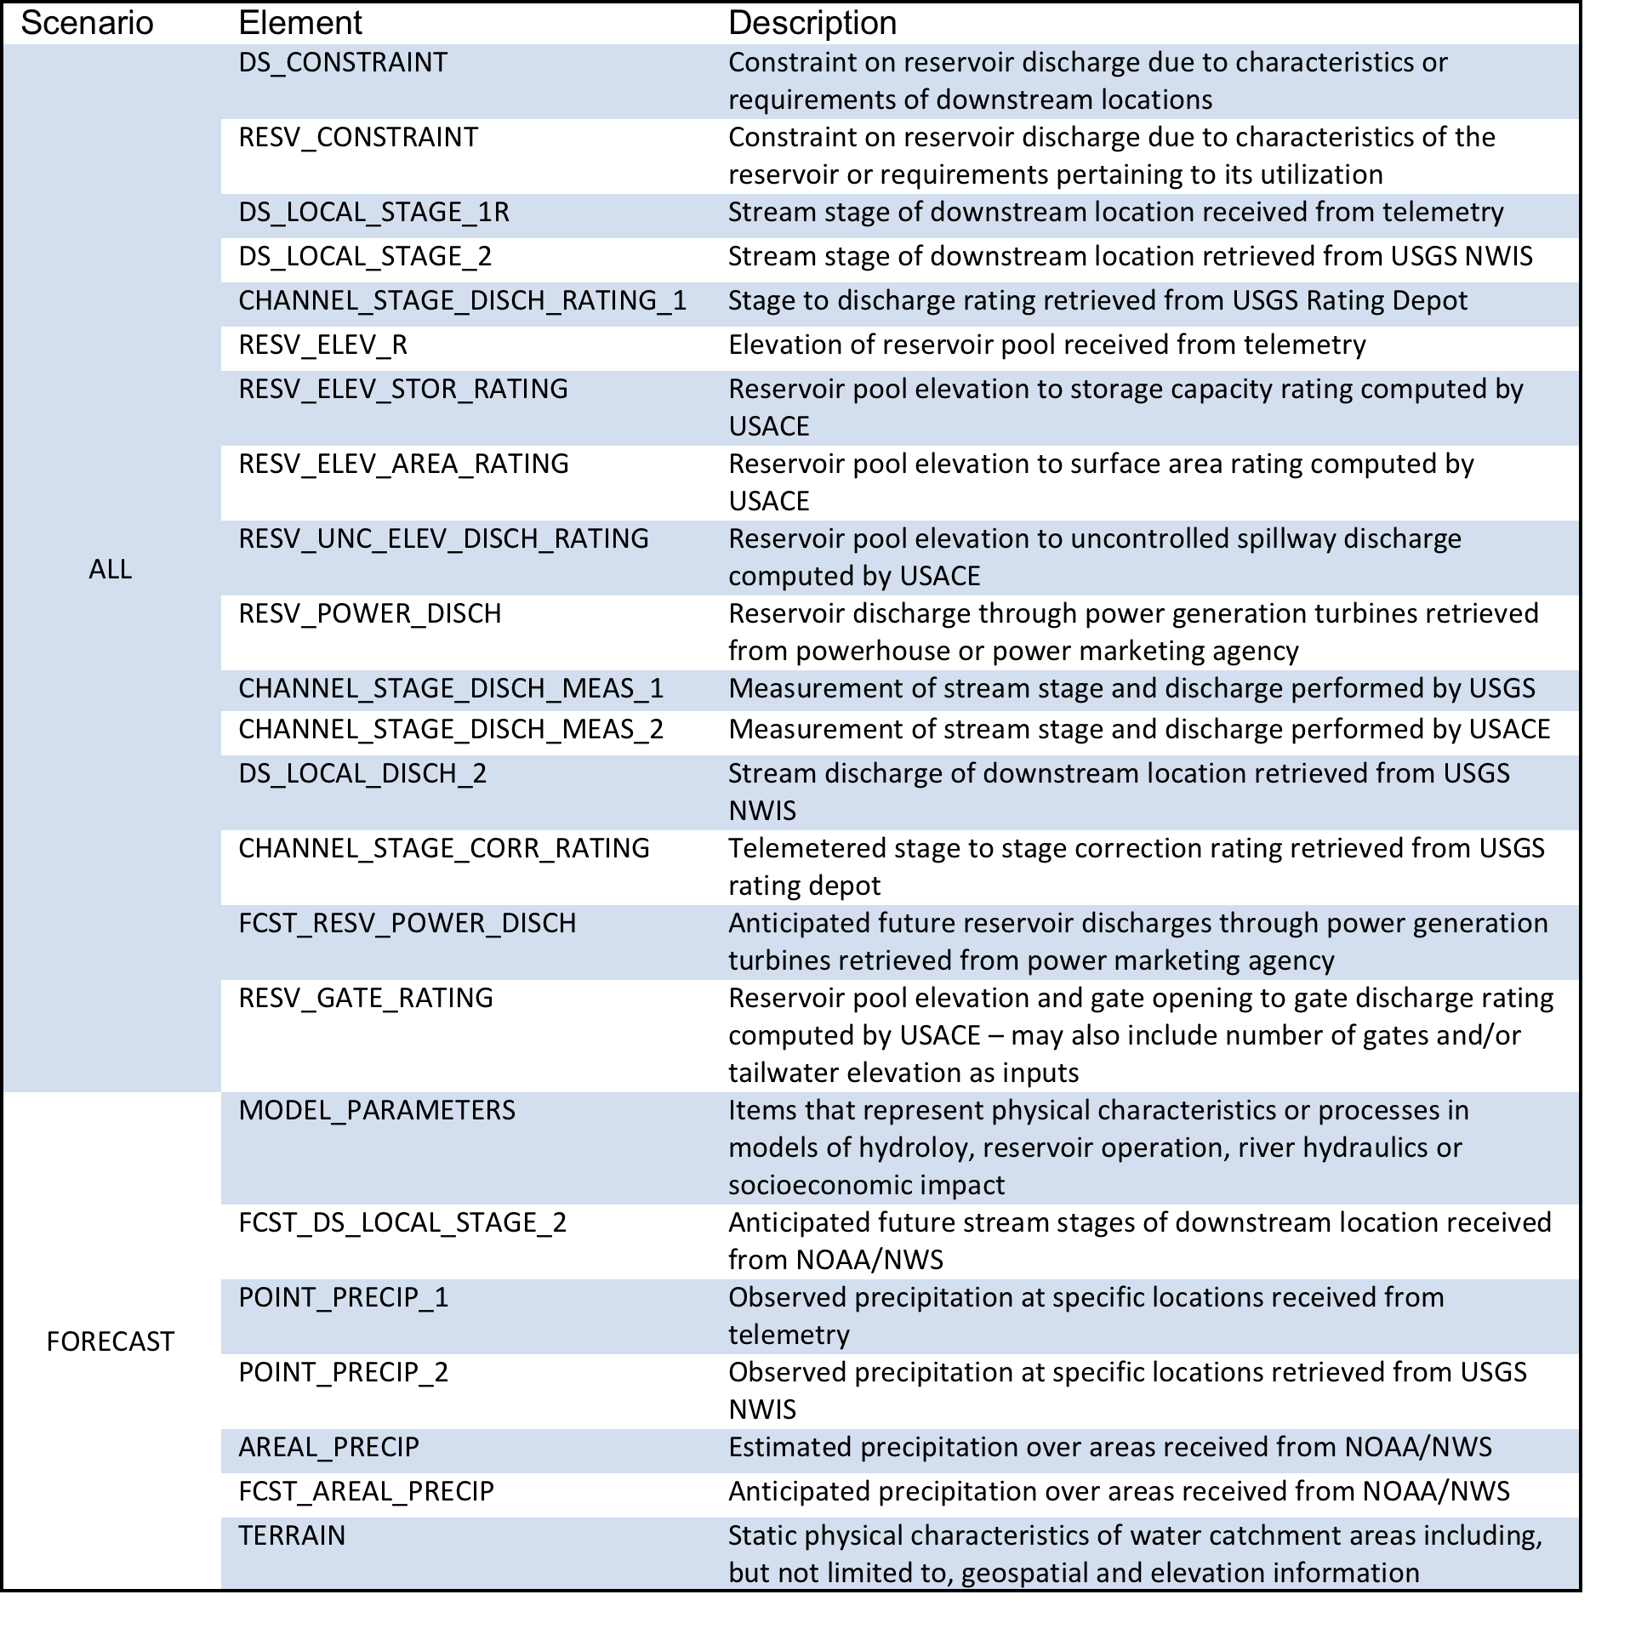

Slide 28
