Slide 1



RiverML: A Harmonized Transfer Language for River Hydraulic Models
Presented to OGC/WMO Hydrology DWG Workshop 2014, New York City
August 15, 2014
Stephen R. Jackson
David R. Maidment
David K. Arctur
Center for Research in Water Resources
The University of Texas at Austin
OCI-1148453 (2012-2017)
OCI-1148090 (2012-2017)

Slide 2
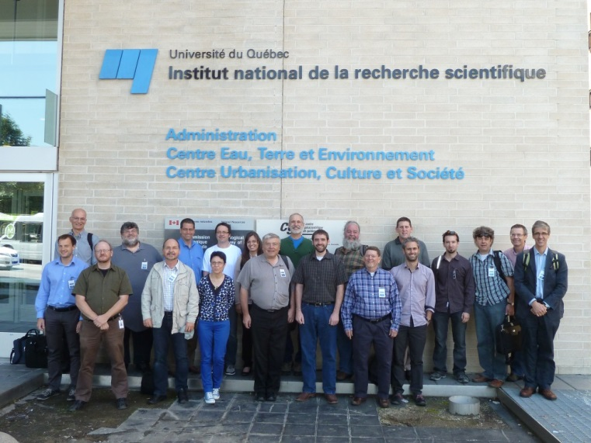
Acknowledgements
RiverML is a collaborative effort that has already benefited greatly from the input of many people, including:
David Maidment (UT Austin, USA)
David Arctur (UT Austin, USA)
David Tarboton (Utah State University, USA)
Ulrich Looser (Federal Institute of Hydrology, Germany)
Irina Dornblut (Federal Institute of Hydrology, Germany)
David Valentine (UC San Diego, USA)
Alva Couch (Tufts University, USA)
Peter Taylor (CSIRO, Australia)
Rob Atkinson (CSIRO, Australia)
Simon Cox (CSIRO, Australia)
Dean Djokic (ESRI, USA)
Venkatesh Merwade (Purdue University, USA)
OGC Hydro DWG Working Group
HydroShare Development Team
Funding for this research has been provided by the National Science Foundation [OCI-1148453 (2012-2017) OCI-1148090 (2012-2017)]

Slide 3
HydroShare Channel Data
From the NSF project proposal: “As an exemplar for advancing data access, we will establish a national repository within HydroShare for river channel cross section data: a new data type not presently supported by CUAHSI HIS. Since 2003, the United States has spent more than $2 billion on digital flood map modernization. A great deal of river channel cross-section, morphology and hydraulic modeling data has been developed to support this mapping and some of that could be repurposed to advance water science. This repository will include a mechanism for voluntary submission of information and it will provide access to this data in a standard way such that it is easy to run hydraulic models that use this data on either local or HPC environments.”

Slide 4
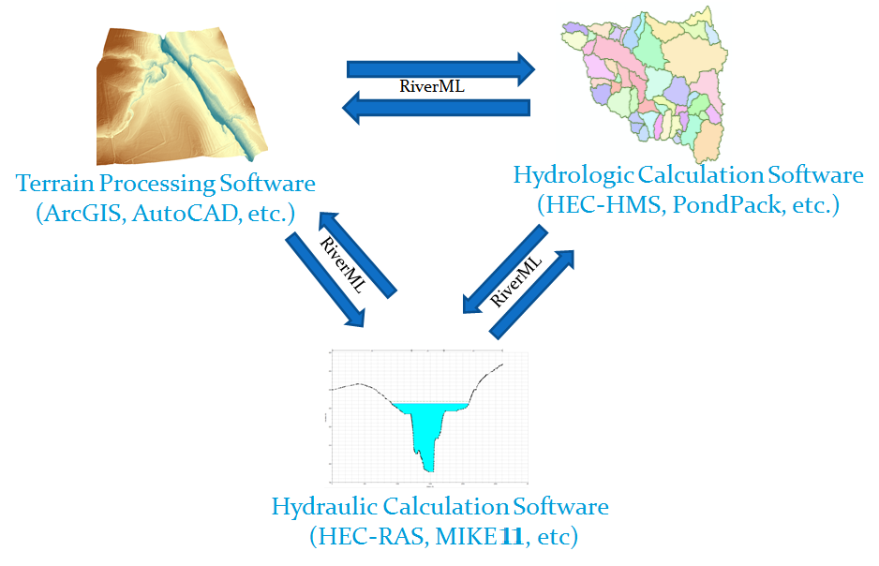
Interoperability in Hydraulic Modeling

Slide 5
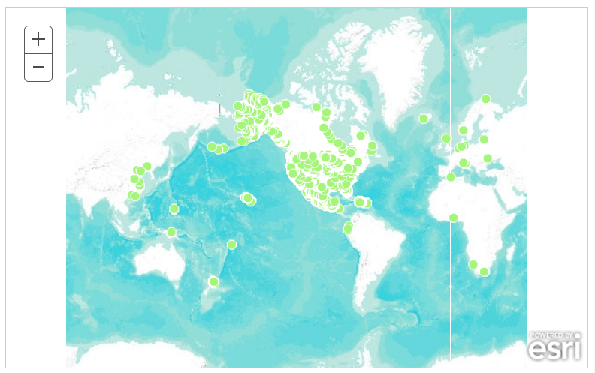
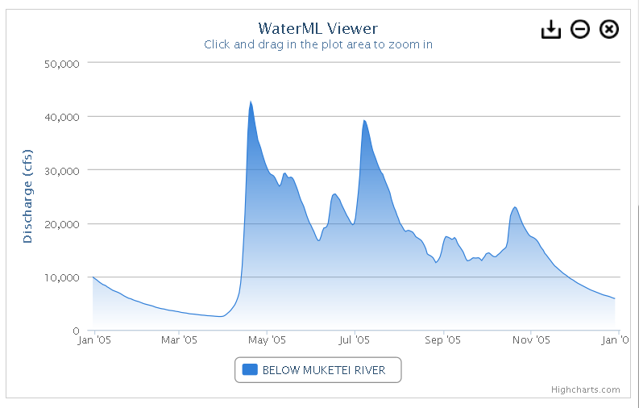
Building on WaterML 2.0

Slide 6
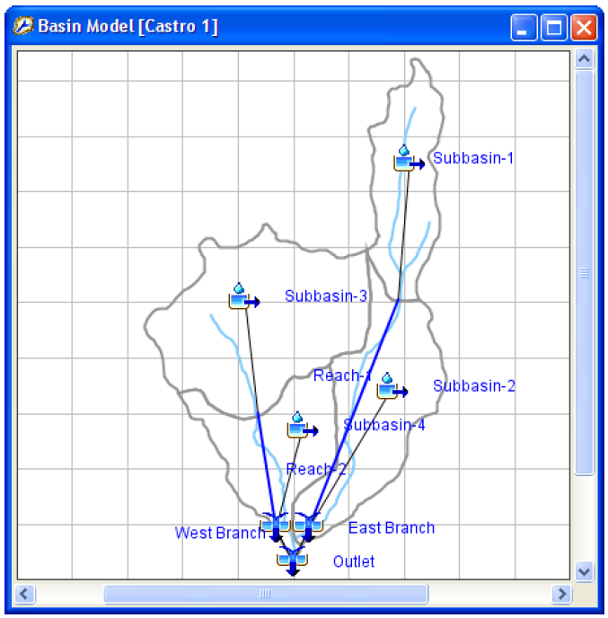
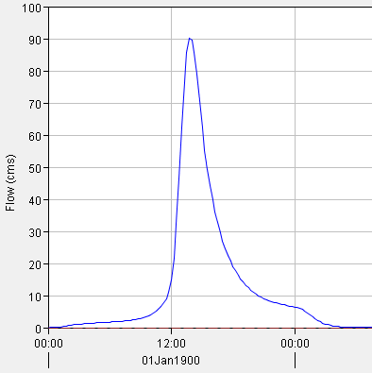
Hydrologic Data
(Scharffenberg, 2013)

Slide 7
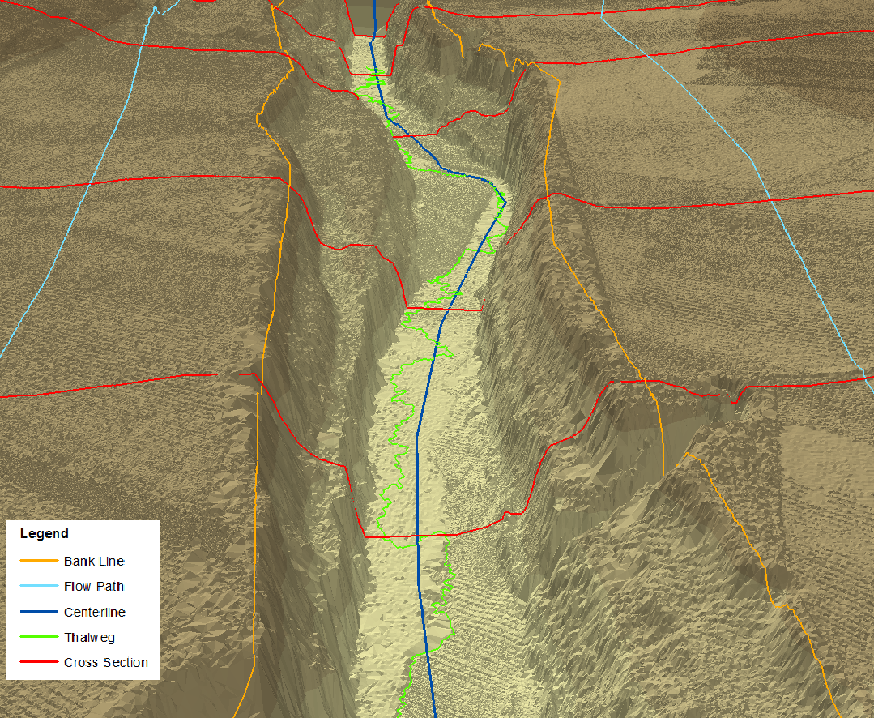
Hydraulic Data

Slide 8
RiverML: First Look
Advantages of building from WaterML 2.0:
Proven development process through Hydrology DWG
Proven framework (O&M Observations + GML)
Ready mechanism for time series (discharge, WSEL, etc.)
New challenges:
Geometry rather than point locations
Need to support Scenario-based workflows (snapshots in time)
Need a clear mechanism for relating features to one another (i.e. Upstream/Downstream relationships)
Content of observations is much more complex than a time/value pair.
2D vs. 3D representations
Attributes which vary along geometry (Manning’s N coefficient)

Slide 9
River Modeling: Relevant Initiatives
Name | Organization | Category
Arc Hydro | GIS in Water Resources Consortium | Data Model
Arc River | Dankook University | Data Model
Geofabric | Australian Bureau of Meteorology | Data Model
GML | Open Geospatial Consortium | Exchange Format
HEC-GeoRAS / SDF | USACE | Exchange Format
HEC-HMS | USACE | Software
HEC-RAS | USACE | Software
HillTop | Hilltop Software | Data Model
HY_Features | Open Geospatial Consortium | Data Model
LandXML |  | Exchange Format
ICPR | Streamline Technologies, Inc. | Software
MIKE 11 | DHI | Software
MIKE Flood | DHI | Software
NHDPlus | US EPA, USGS, Horizon Systems | Data Model
OpenMI | OpenMI Association | Exchange/Interface Format
Shapefile | ESRI | Exchange Format
Simulation Program for River Networks (SPRNT) Netlist | University of Texas & IBM | Exchange Format
WaterML 2.0 | Open Geospatial Consortium | Exchange Format

Slide 10
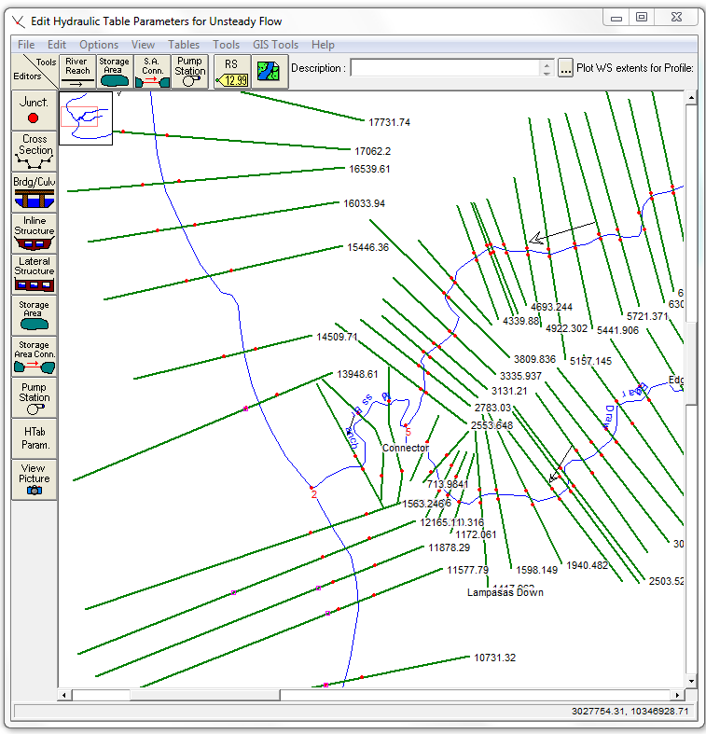
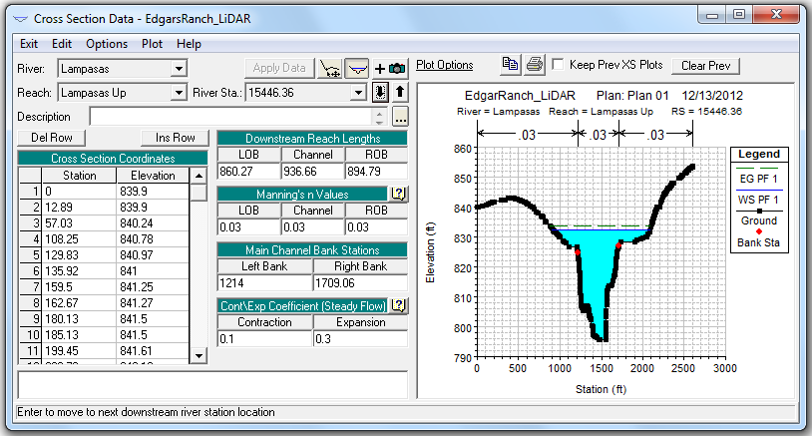
HEC-RAS

Slide 11
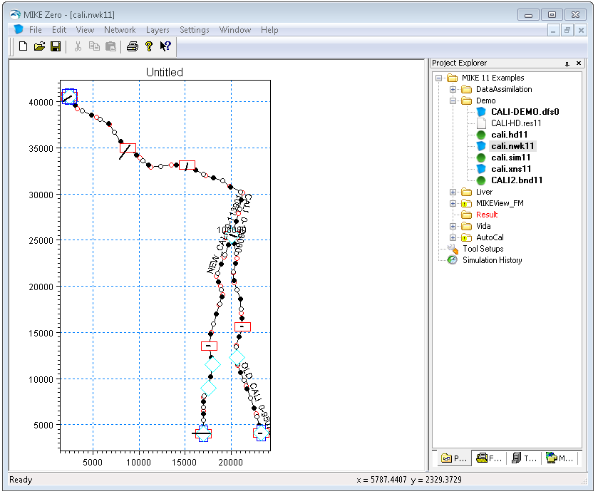
MIKE 11 / MIKE FLOOD
(DHI, 2012 d)

Slide 12
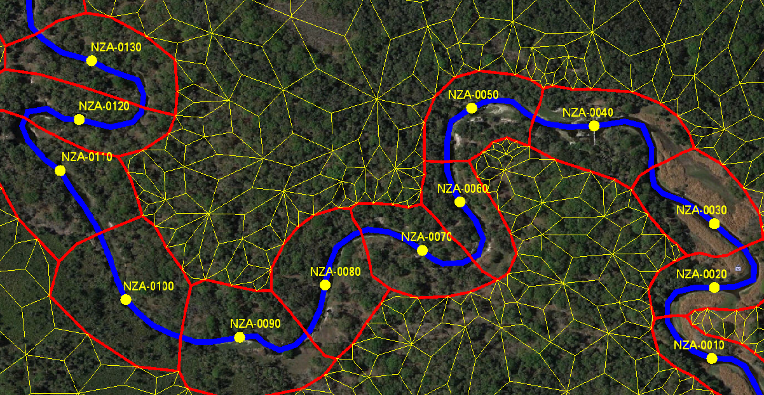
ICPR
(Streamline Technologies, 2014 b)

Slide 13
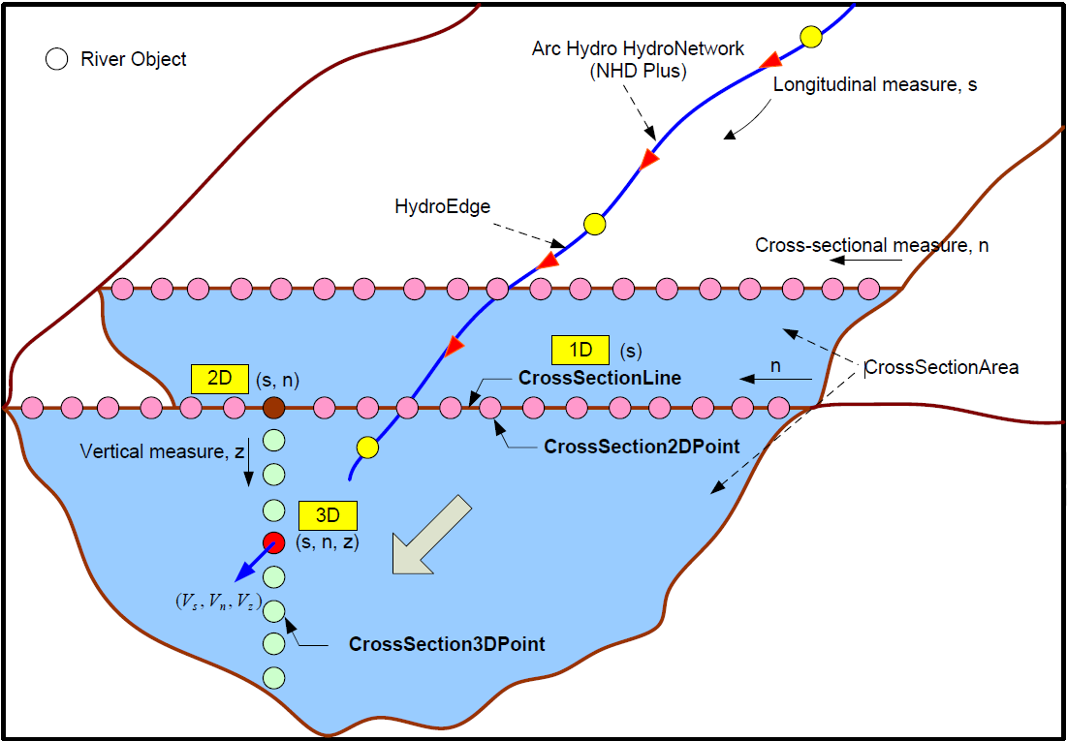
Arc Hydro / Arc River
(Kim et al., 2014)

Slide 14
Harmonization Findings
Fairly close agreement among key features such as cross sections and linear attributes
Differences are mostly matter of conventions
GML shapes plus clearly defined properties should allow high degree of interoperability
Challenges:
How complex to make the model (balancing simplicity with completeness)
How many alternate representations to support (2D geometry, 3D geometry, tabular, processed).
Which features should have their own Observations? (Surfaces, structures, linear attributes)
Features which vary across time or scenario
Relating a wireframe model of cross sections and profile lines to a complete DEM which could be used for coupled 1D-2D models.
Relating features to one another in a way that supports hydraulic modeling

Slide 15
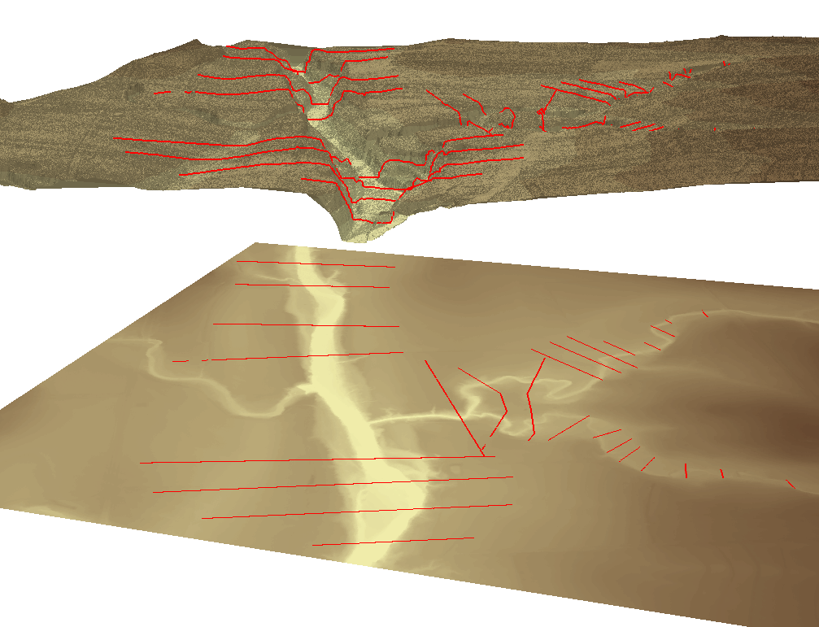
2D and 3D Representations
Georeferenced Cross Sections
With and without elevation data

Slide 16
Tabular and Processed Representations
Tabular Cross Sections
(non-georeferenced station/elevation)
Processed Cross Sections
(non-georeferenced area/hydraulic radius)

Slide 17
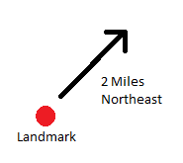
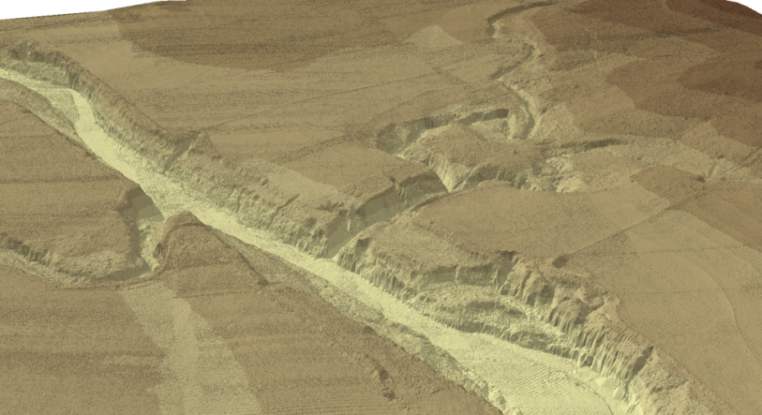
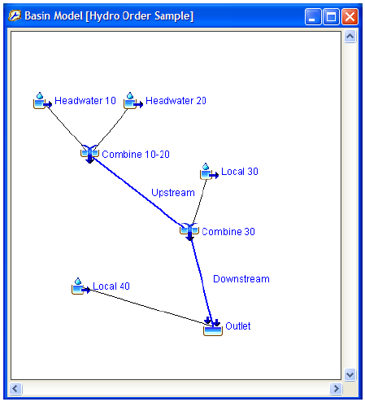
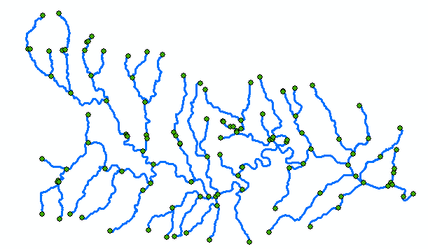
Reference Systems
Relative
Topographic
Topological (Schematic) Network
Geometric Network
(Scharffenberg, 2013)

Slide 18
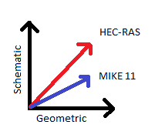
Reference System Spectrum
ICPR
HEC-RAS
Arc Hydro
MIKE 11
NHDPlus
Schematic
Geometric
SPRNT
HY_Features
Geofabric

Slide 19
RiverML 0.2 Prototype
RiverML 0.2:
Demonstrates a feasible approach to addressing the identified challenges.
Rough around the edges
May require significant overhaul to align with OGC best practices and HY_Features

Slide 20
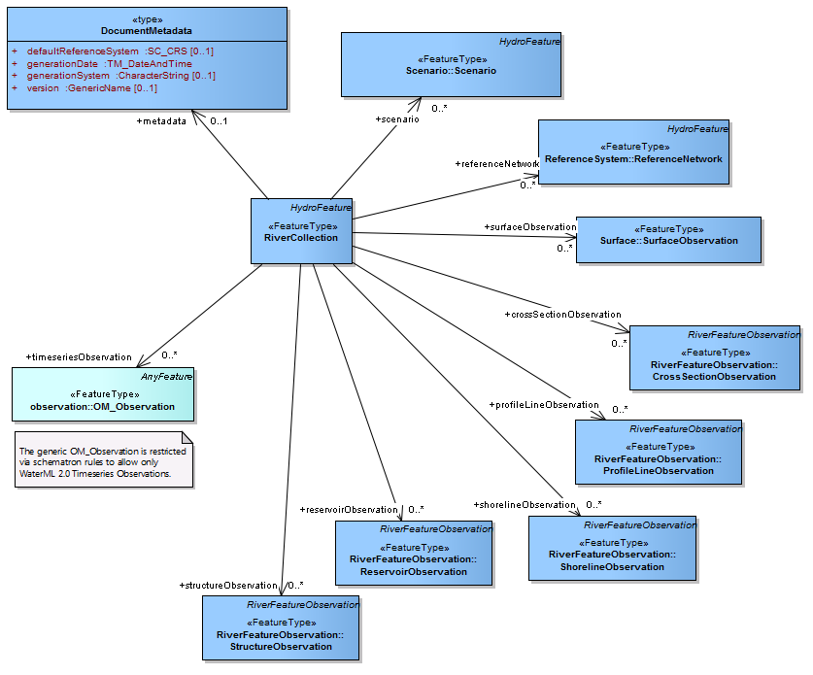
RiverML 0.2 Overview

Slide 21
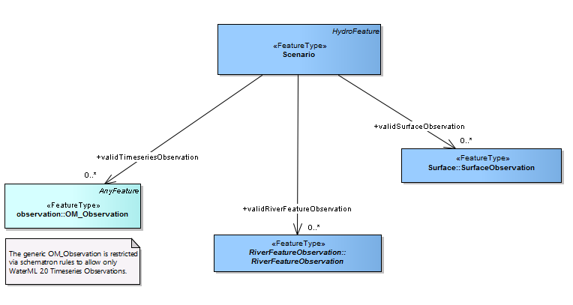
RiverML 0.2 Scenario

Slide 22
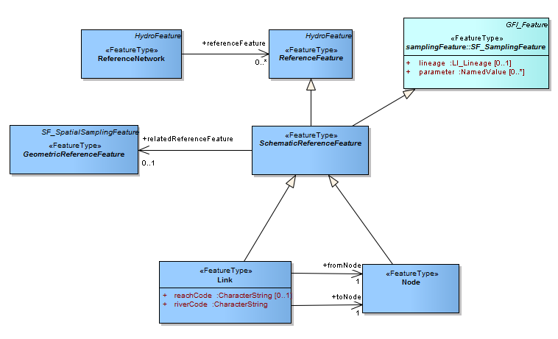
RiverML 0.2 Schematic Reference

Slide 23
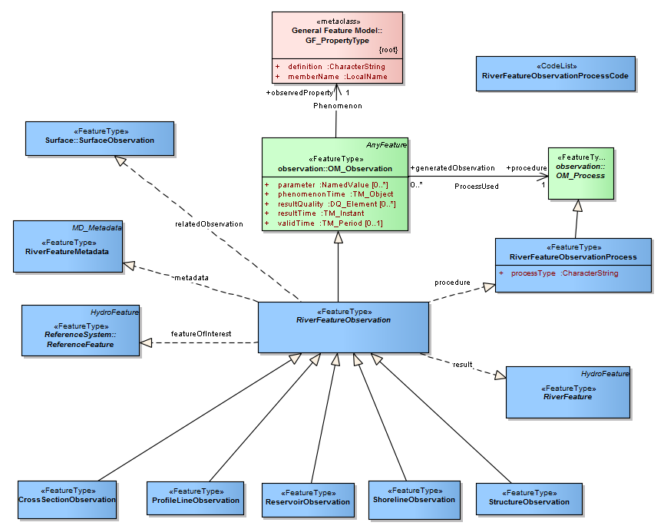
RiverML 0.2 RiverFeatureObservation

Slide 24
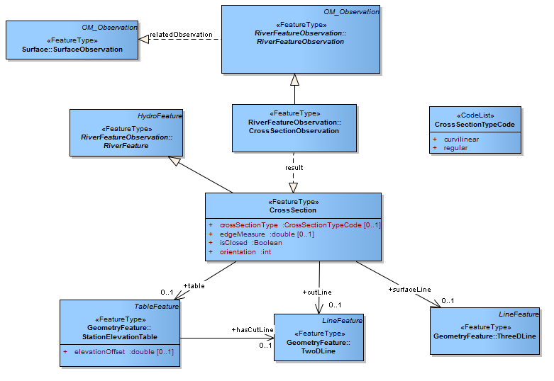
RiverML 0.2 CrossSectionObservation

Slide 25

RiverML: Roadmap for Development
RiverML 0.1 Prototype
Focus on 1D Inundation Mapping Use Case
Demonstrate plausible information structure
Harmonization Paper
RiverML 0.2 Prototype
OGC Review/Revise Prototype to create RiverML 0.3
OGC Interoperability Experiment (RiverML 0.3)
Organize a larger scale test of RiverML with multiple agency/industry participants
OGC Standards Working Group (RiverML 1.0)
Modify based on results of Interoperability Experiment
Expand to additional Use Cases
Create rigorous design ready for OGC adoption
2013 - 2014
2014 - 2015
2015 - 2016

Slide 26
Questions?
Stephen Jackson
Graduate Research Assistant
Center for Research in Water Resources
The University of Texas at Austin
srj9@utexas.edu
Harmonization Report Location:
http://www.crwr.utexas.edu/reports/2014/rpt14-5.shtml
XML Schema Location: http://tools.crwr.utexas.edu/RiverML/index.html

Slide 28
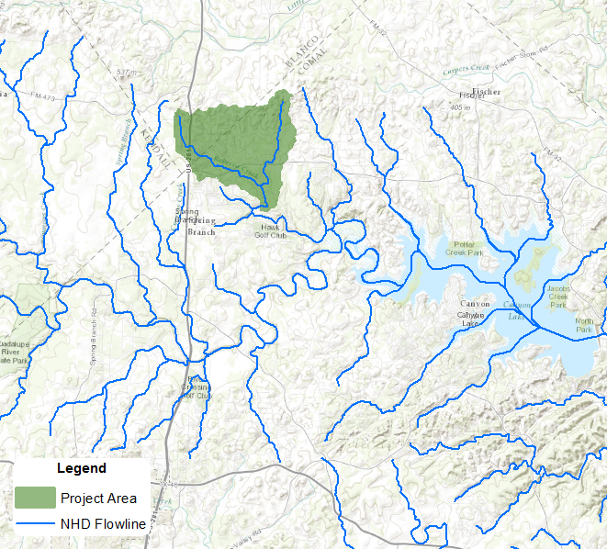
Sample Project: Rebecca Creek

Slide 29
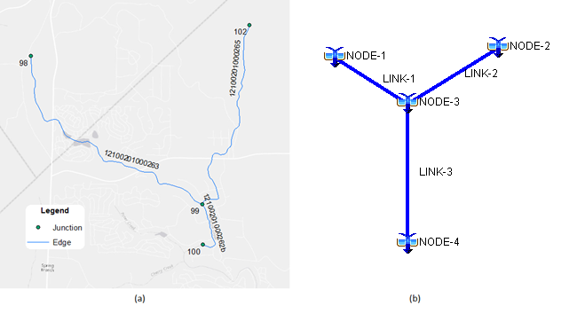
Sample Project: Rebecca Creek
Geometric Network
(NHDPlus)
Schematic Network

Slide 30
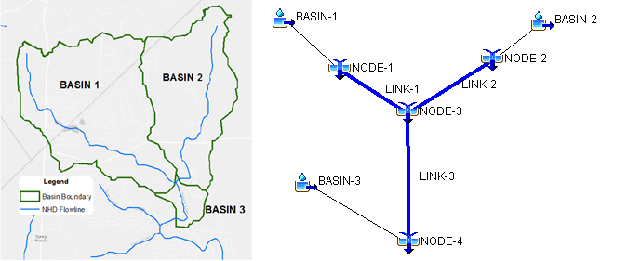
Sample Project: Rebecca Creek
Hydrologic Data

Slide 31
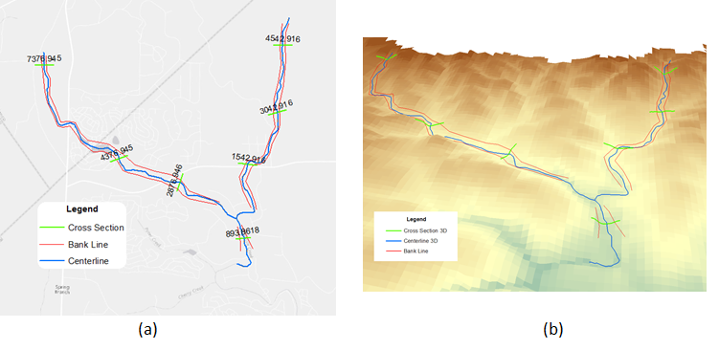
Sample Project: Rebecca Creek
Hydraulic Data

Slide 32
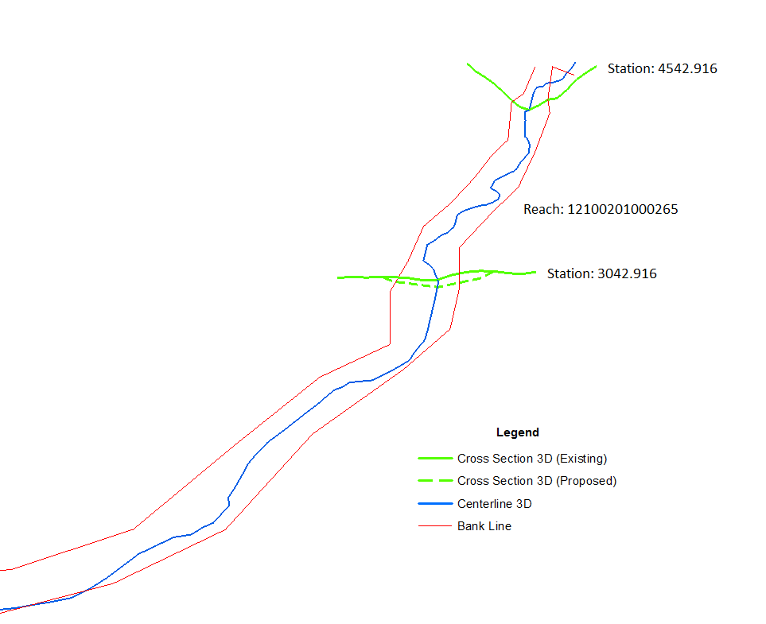
Sample Project: Rebecca Creek
Existing and Proposed Scenarios

Slide 33
Sample Project: Rebecca Creek
Simplistic example still has many key qualities:
Schematic & Geometric network
Schematic for hydrology
Geometric for hydraulics
Junction of two streams
Authoritative geometric network (NHDPlus)
Two-dimensional cross sections (auto generated)
Three-dimensional cross sections (extracted from terrain)
Two types of profile lines:
Center lines (derived from NHDPlus)
Bank lines (manually drawn)
Linear attributes (Manning’s N Coefficient)
Scenarios (Existing and Proposed)
Risk-based discharge values

Slide 34
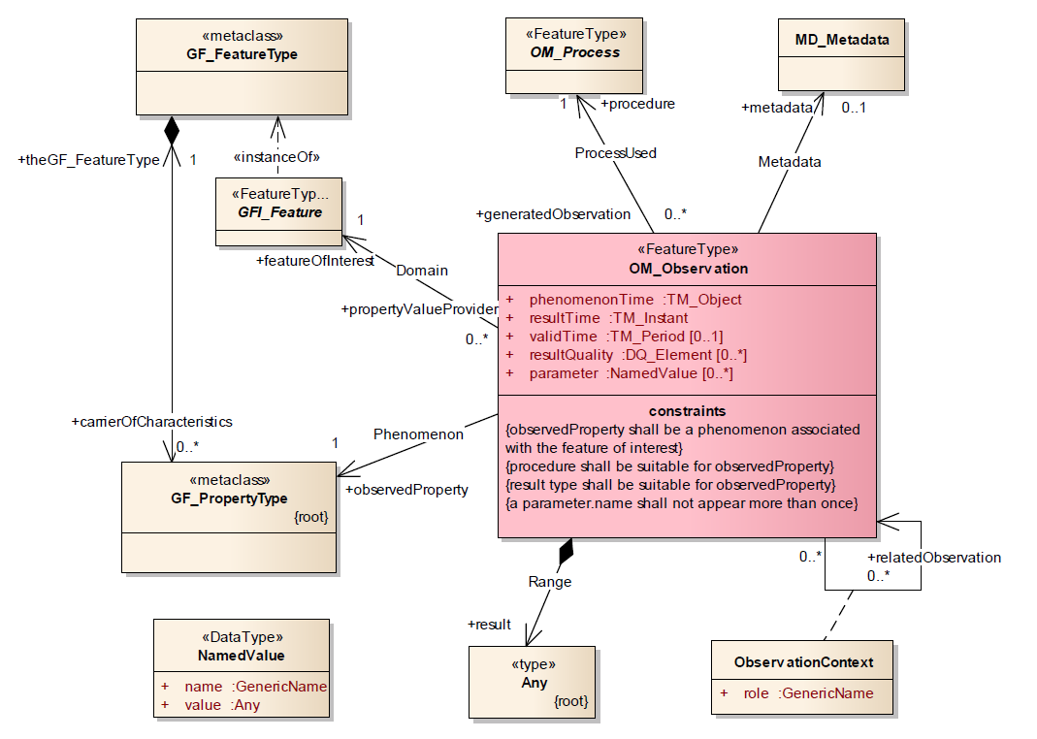
(Taylor, 2012)

Slide 35
Overview

Slide 36
Scenario

Slide 37
SchematicReferenceFeature

Slide 38
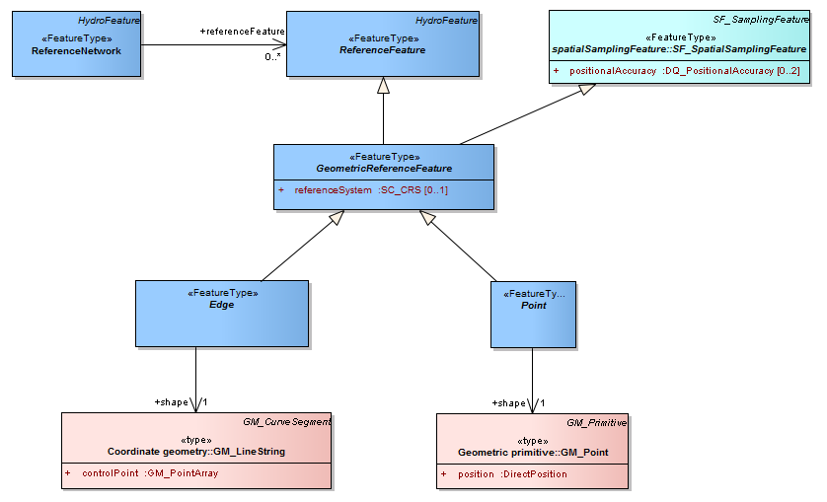
GeometricReferenceFeature

Slide 39
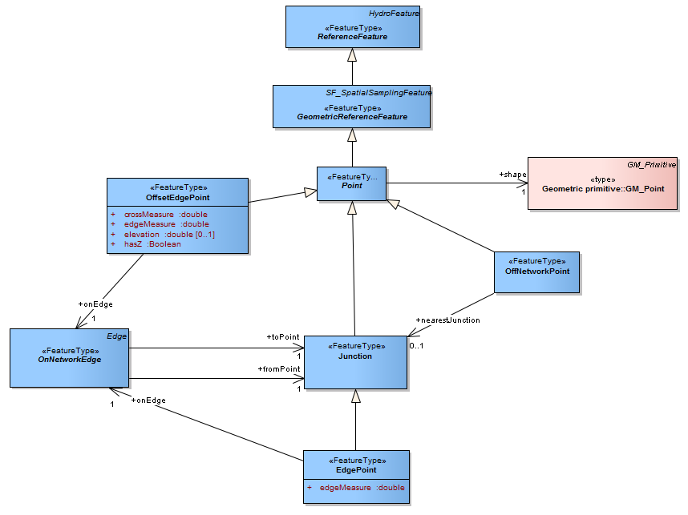
GeometricReferenceFeature - Point

Slide 40
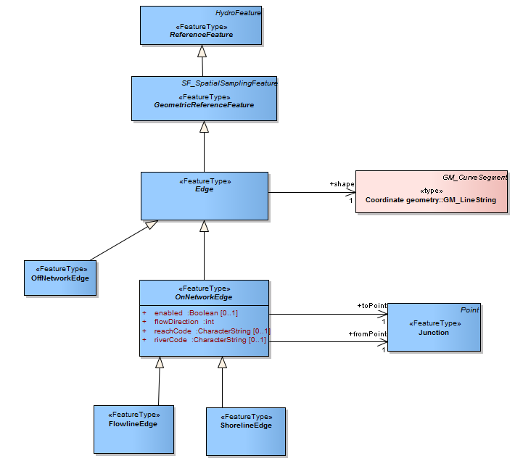
GeometricReferenceFeature - Edge

Slide 41
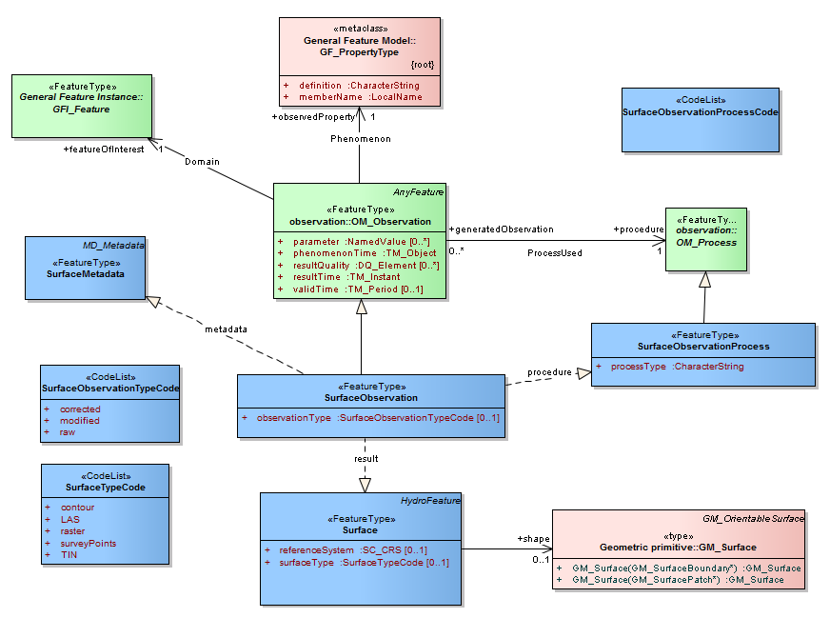
SurfaceObservation

Slide 42
RiverFeatureObservation

Slide 43
CrossSectionObservation

Slide 44
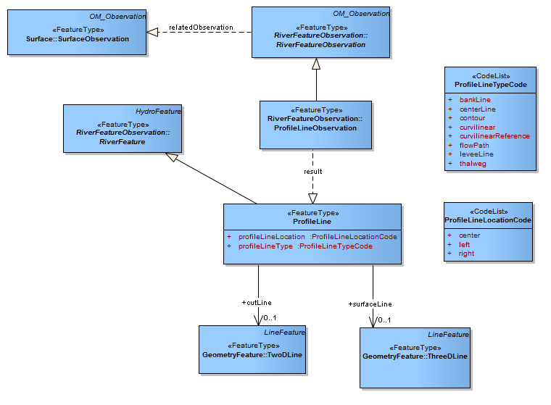
ProfileLineObservation

Slide 45
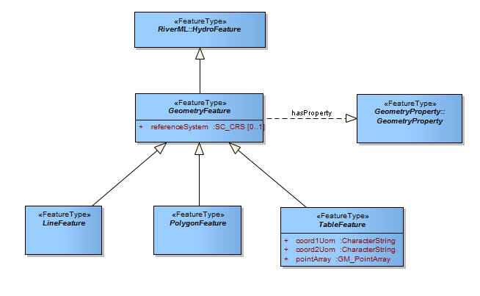
GeometryFeature

Slide 46
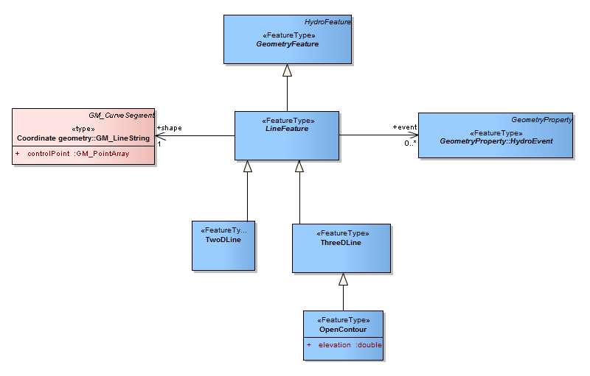
GeometryFeature - LineFeature

Slide 47
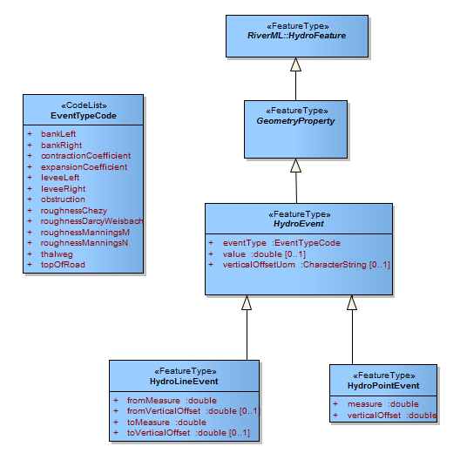
GeometryProperty

