Slide 1
OWS-10 CCI – Hydro Model Interoperability
90th OGC Technical Committee
Washington, DC
Chen-Yu Hao (“How”), Feng Chia University
Lew Leinenweber, OGC
26 March 2014
Copyright © 2014 Open Geospatial Consortium

Slide 2
CCI Hydro Model Interoperability Task
Objectives
Use the HY_Features model to enable access to hydro data from multiple sources (NHD+, NHN)
Use the HY_Features model to mediate between multiple hydro conceptual feature models (NHD+, NHN)
Would a HY_Features profile be required for each data source?
Demonstrate a hydrographic and hydrologic data source mediation system based on the HY_Features model to support interoperability across jurisdictions, between various data models, and data structures.
Copyright © 2014 Open Geospatial Consortium

Slide 3






Sponsors and Participants
Copyright © 2014 Open Geospatial Consortium

Slide 4
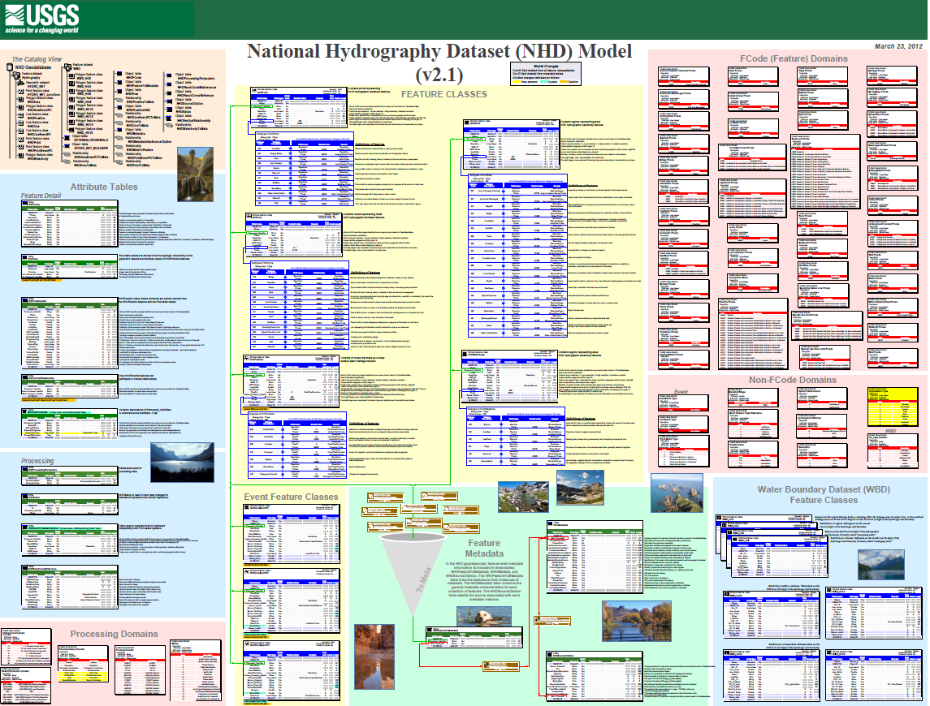
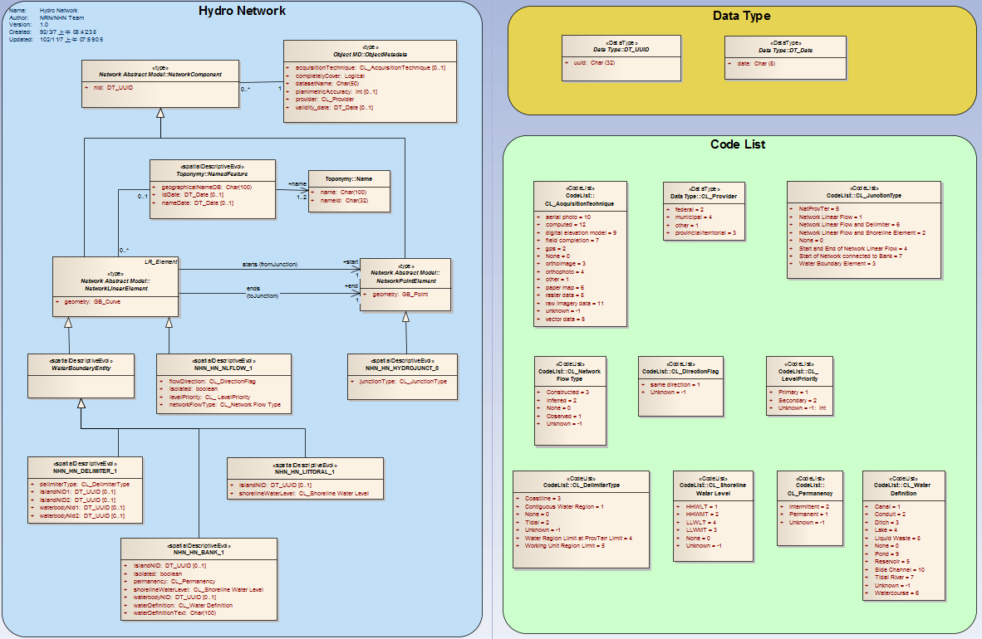
US and Canadian Hydro Models
USGS NHD+
USGS Model and data for surface water in the US as a component of The National Map
Drainage network with features
Features information includes delineation, geographic name, position, a "reach code”, and direction of water flow.
Canadian NHN
Geometric description and attributes describing Canada's inland surface water
Geospatial vector data describing hydrographic features
Linear drainage network and geographical names
Copyright © 2014 Open Geospatial Consortium

Slide 5
HY_Features Model
Use for Model to Model Mapping
Conceptual model for the identification of hydrologic features independent from geometric representation
Provides commonly agreed upon concepts for the fundamental relationships between hydrologic features (such as catchment and basin)
Use as a basis for referencing hydrologic features that have persistent identity across multiple data products and systems
Copyright © 2014 Open Geospatial Consortium

Slide 6
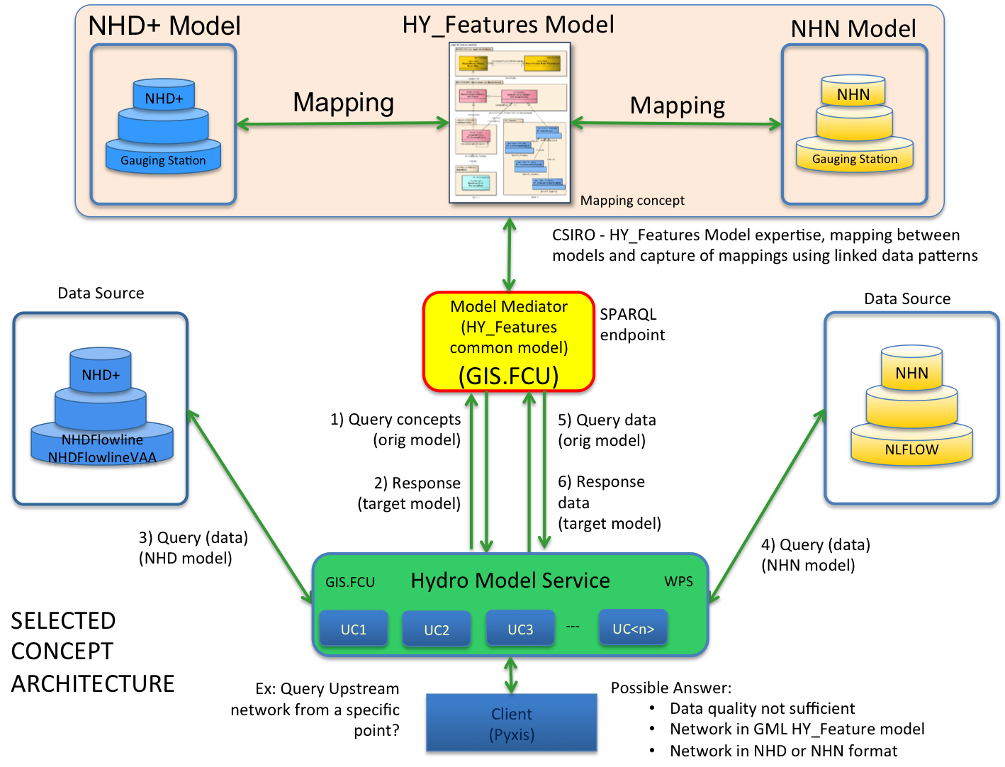
Conceptual Architecture - Kickoff
Copyright © 2014 Open Geospatial Consortium

Slide 7
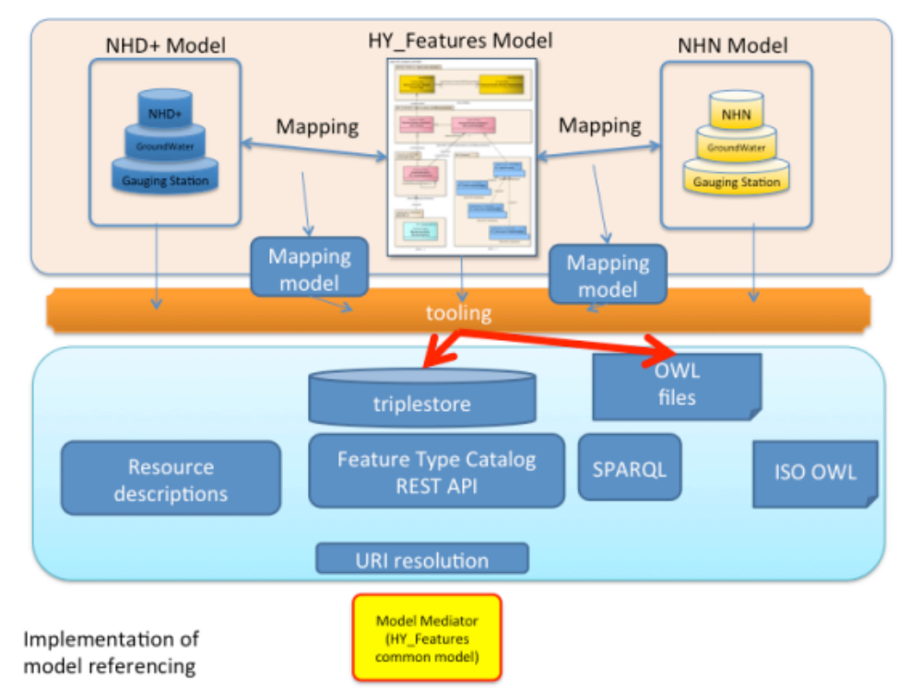
Hydrology Model Mapping
Copyright © 2014 Open Geospatial Consortium

Slide 8
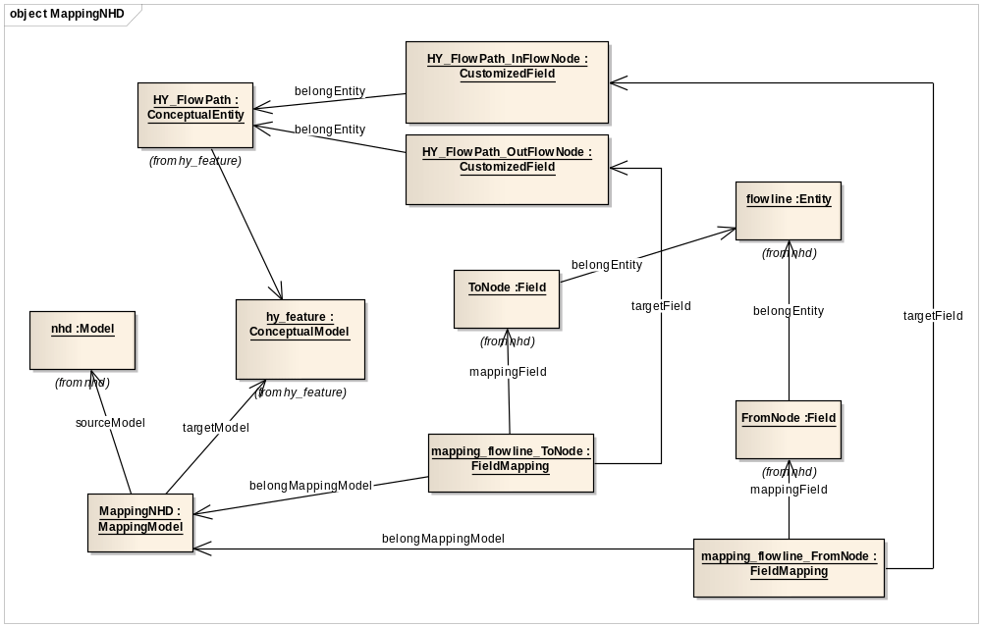
Mapping Framework
HY_Features to NHD+
Copyright © 2014 Open Geospatial Consortium

Slide 9
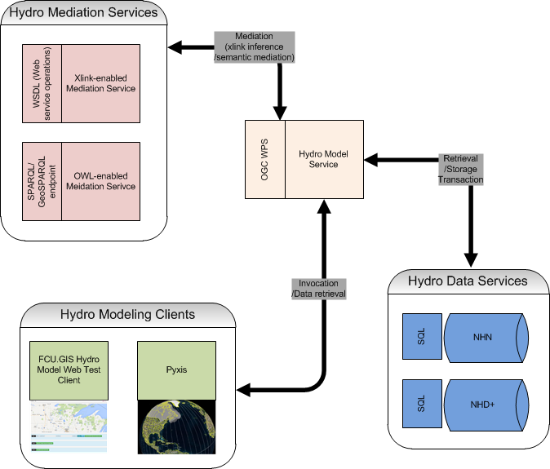
Implemented Architecture
Copyright © 2014 Open Geospatial Consortium

Slide 10


Hydro Model Service
A WPS interface for client to query flow line and upstream information.
  GetFlowlinebyBbox {bbox, output data model}
  GetUpstreambyPOI {POI, output data model}
1. Query data model info
2. Query model trans info
3. Query broader co-junc
1. Query by bbox
2. Query by POI
Client
（pyxis）
Hydro model service(WPS)
Data source
Mapping instruction
Connected juctions
Hydro Mediation service
(SPARQL endpoint)
NHD GML
NHN GML
Copyright © 2014 Open Geospatial Consortium
Notes:
Add data service

Slide 11

Hydro Mediation Service
Created a simple ad-hoc mapping framework
Used Protégé to encode semantic model relationships (ttl)
SPARQL endpoint for querying mapping info
1. Query data model info
2. Query model trans info
3. Query broader co-junc
Mapping concepts
Cross broader junction relationship
Hydro model service(WPS)
Data source
Mapping instruction
Connected juctions
Hydro Mediation service
(SPARQL endpoint)
Copyright © 2014 Open Geospatial Consortium
Notes:
(wikipedia) Turtle (Terse RDF Triple Language) is a format for expressing data in the Resource Description Framework (RDF) data model with the syntax similar to SPARQL. RDF, in turn, represents information using "triples", each of which consists of a subject, a predicate, and an object. Each of those items is expressed as a Web URI. Filename extension .ttl. Internet media type, text/turtle
Turtle provides a way to group three URIs to make a triple, and provides ways to abbreviate such information, for example by factoring out common portions of URIs. For example:
<http://example.org/person/Mark_Twain>
<http://example.org/relation/author>
<http://example.org/books/Huckleberry_Finn> .

Slide 12
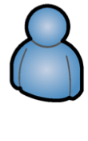
Model mapping transformation process
Queried parameters
Researchers
Client
（pyxis）
GML in specific data model
GetNHN/NHD data
Data in json format
Hydro model service(WPS)
Data access information
Data service
Mapping instructions
Model, entities, and fields
Source and target model
Hydro Mediation service
(SPARQL endpoint)
Copyright © 2014 Open Geospatial Consortium
Notes:
Queried parameters,
Source and target model
Data access information
Get NHD/NHN data
Data in Json format
Model, entity and field
Mapping instruction
Mapped data(pseudo procedure)
Gml in specific data model

Slide 13
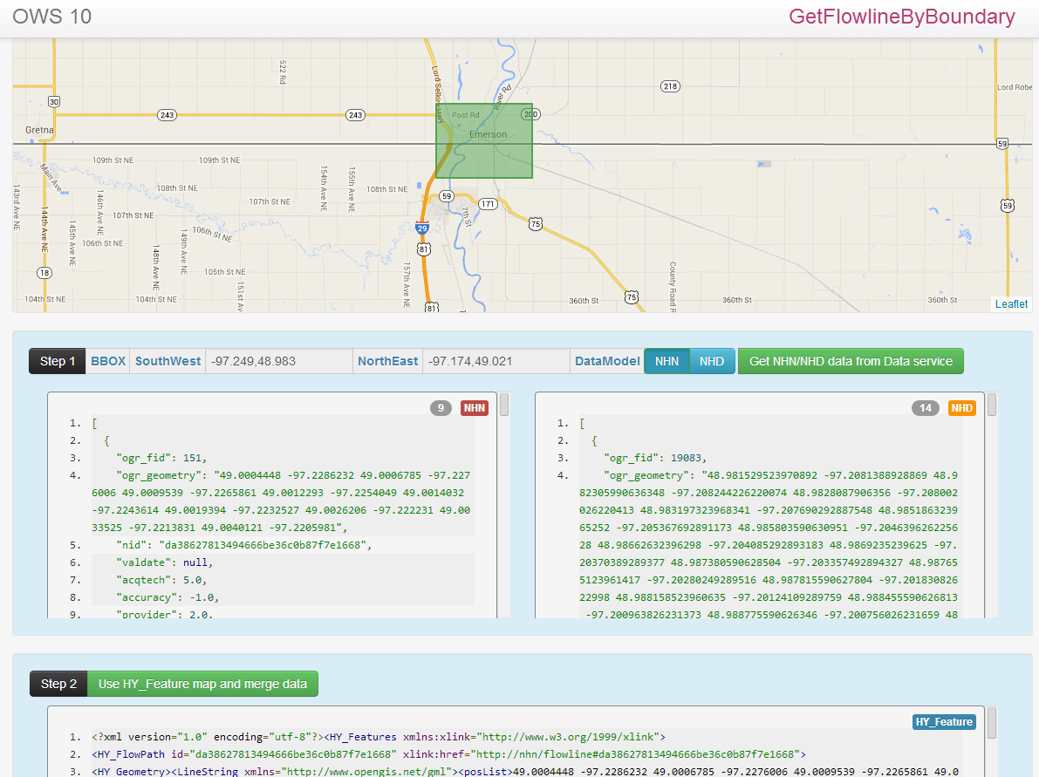
Use Cases Demonstration
Copyright © 2014 Open Geospatial Consortium

Slide 14
Achievements and Challenges
Achievements
  Implemented using a standard WPS
  Used HY_Feature as the metamodel bridge of different data models
  Designed a simple ad-hoc semantic mapping concept for NHN/NHD
  Implemented a SPARQL endpoint for querying data model mapping information
Challenges
  Selected a representative feature for testing and implementation to demonstrate concepts and approach.
  Complete mapping implementation could be much more complex since this task only used flowline as instance in this project.
  A formal/standard mapping framework is needed for reducing the differences of mapping concepts

Slide 15
Resources
Usecases client
  http://59.125.87.213/hydro/
WPS client
  http://59.125.87.213/WPSClient/
Sparql endpoint client
  http:// 59.125.87.213:3030/hy_feature_mapping/query
Copyright © 2014 Open Geospatial Consortium

Slide 16
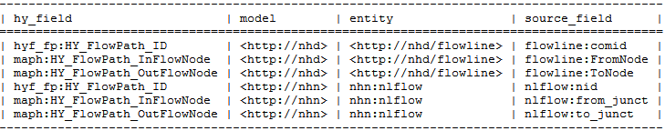
Sparql Endpoint Query
Find the fields of HY_FlowPath and their mapping information
SELECT distinct ?hy_field ?model ?entity ?source_field
WHERE {
?mapping rdf:type mapf:FieldMapping.
?mapping mapf:targetField ?hy_field.
?mapping mapf:mappingField ?source_field.
?hy_field mapf:belongEntity hyf:HY_FlowPath.
?source_field mapf:belongEntity ?entity.
?entity mapf:belongModel ?model.
} orderby ?model

Slide 17
Thank you!
Any questions, comments?
Copyright © 2014 Open Geospatial Consortium

