Slide 1
OccViz status anddirection
Saurav Kumar (saurav@vt.edu)
Research Associate
Occoquan Watershed Monitoring Laboratory (OWML),
Manassas, VA
Notes:
I am going to talk about some of the work we have done and are doing at the OWML to make our data and modeling tools more accessible to the stakeholders and hopefully how the work we are doing at OWML may be extended to other places.

Slide 2
OccViz
Demo (Occoquan System Implementation)
https://wqdata.owml.vt.edu

Slide 3
OccViz
Web-based, interactive solutions for water/watershed data management, curation, visualization, analytics, and modeling
Notes:
OccViz was designed as a solution to manage, curate, and analyze water resources data, including water quantity and quality data.
The schematic shows the key components and functionalities of the OccViz.
<c>
First objective of OccViz to collect various water quality data from all sources field stations, Rain gauge, LIMS, etc.. Into a central repository.
<c>
Central Water Resources Data Warehouse is that central repository
<c>
From the central repository we mine the data that will be analyzed through the web tools and put it in the web database server optimized for web retrieval and analysis.
Several statistical parameters that may be helpful in analysis, such as percentile are computed in this step, and the data also goes through a curation scheme to flag outlier for further verification.
<c>
There are other databases in this Web database server to manage the users, their login and preferences etc. Configuration of the web front-end, things like description of the sites, pictures of the site etc.
<c>
The data is also made available through web-services for others to consume. This component is still a work in progress and eventually we will serve data in WaterML and JSON formats.
<c>
And Finally the webserver.
<c>
Webserver facilitates all interactions through the web browser including data management, configuration and visualization. We will see this component in detail in the demo pretty soon.

Slide 4
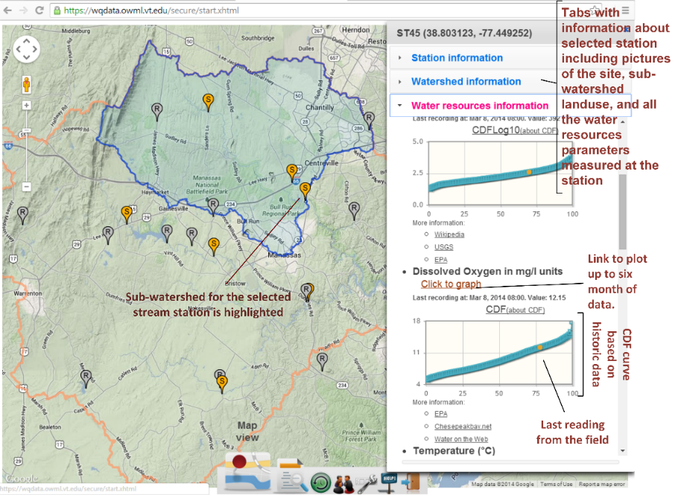
Map View

Slide 5
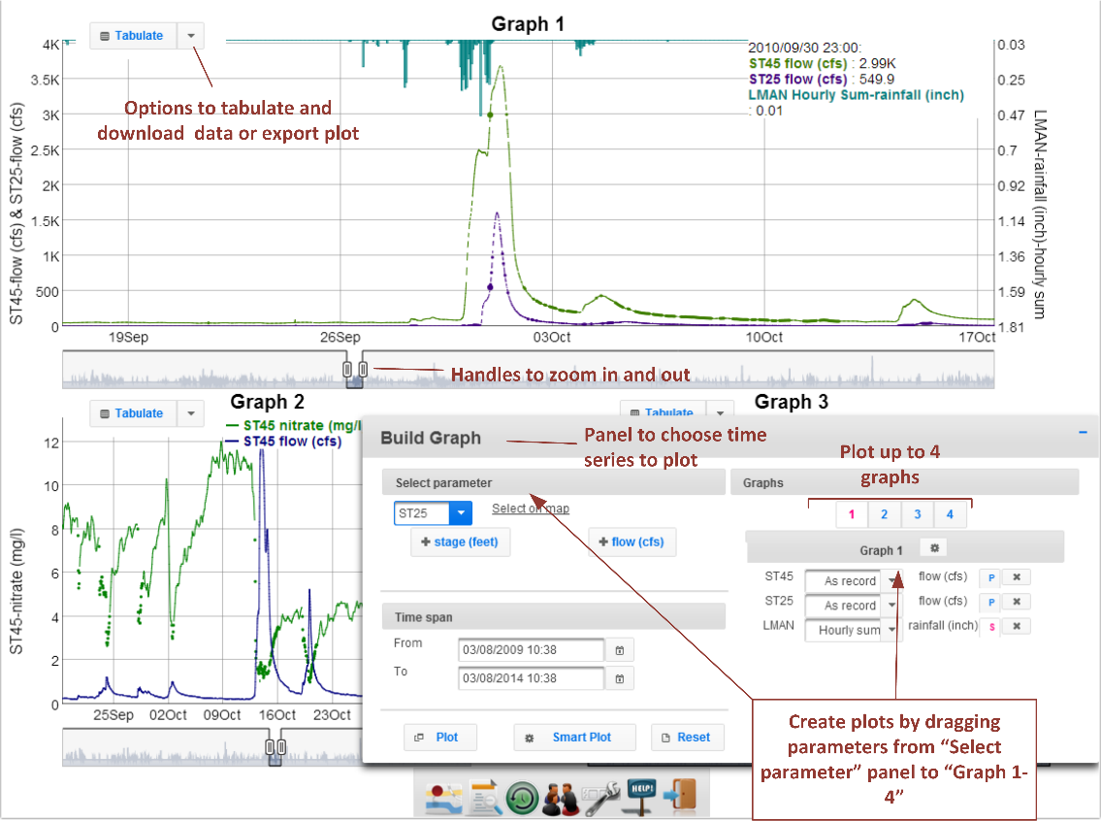
Graph View

Slide 6
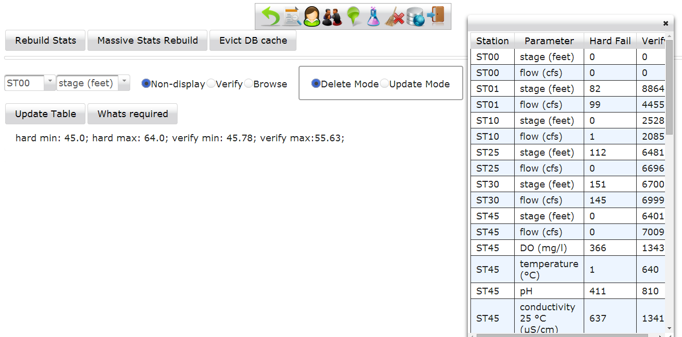
Administrator Mode

Slide 7
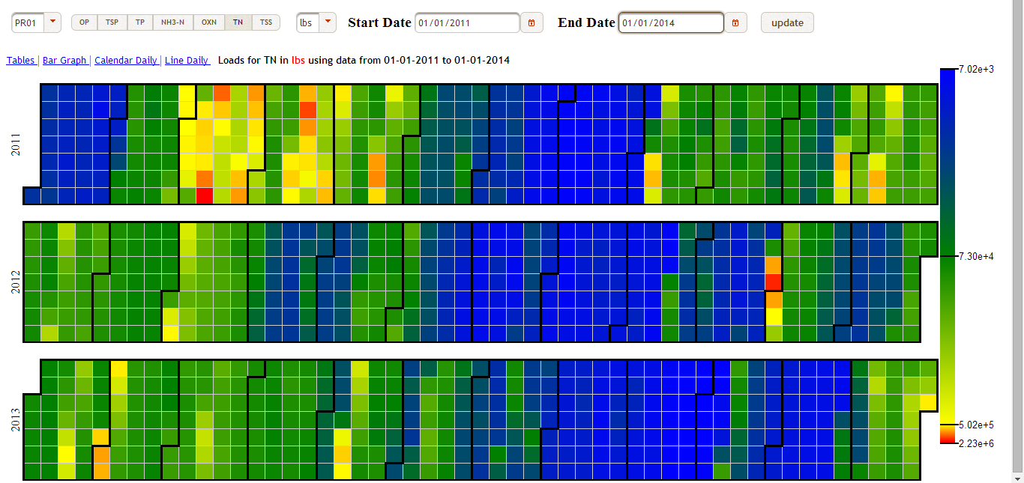
In works: Visualization

Slide 8
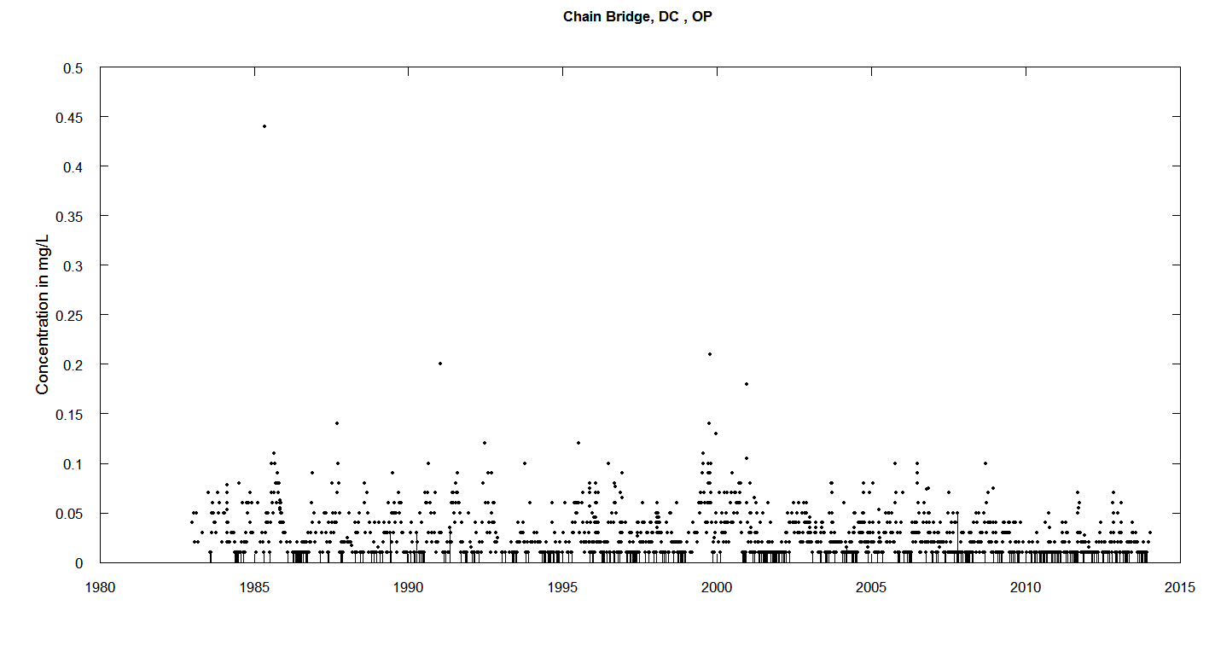
In works: Below Detect

Slide 9
In works: Modeling and Forecasting
Forecasting using meteorological data
Simple Rainfall-Runoff models
Precipitation
Rainfall-Runoff Model
Flow
Statistical Models
WQ

Slide 10
Smarter-Data Curation
Parameter property
Spatio-temporal relations
Outlier?
Outlier?
Auto-correlation
Outlier?
Expert Weighted
Statistical Model
Surrogates
Verify ?
Outlier?
Neighbors

Slide 11
In Works: User Feedback
Triggers for kayakers
Computed parameters
Thiessen average rain for the watershed
DO percentage saturation
Explore relations among parameters using scatter plots
More map based (snapshots in time) visualization
Notes:
We started using the OccViz implementation as the primary data distribution portal since December of 2013.
And in the short term we also have gotten some request for features, these include:

Slide 12
OccViz – version 2
Emphasis on web-services and adopting standards

Slide 13
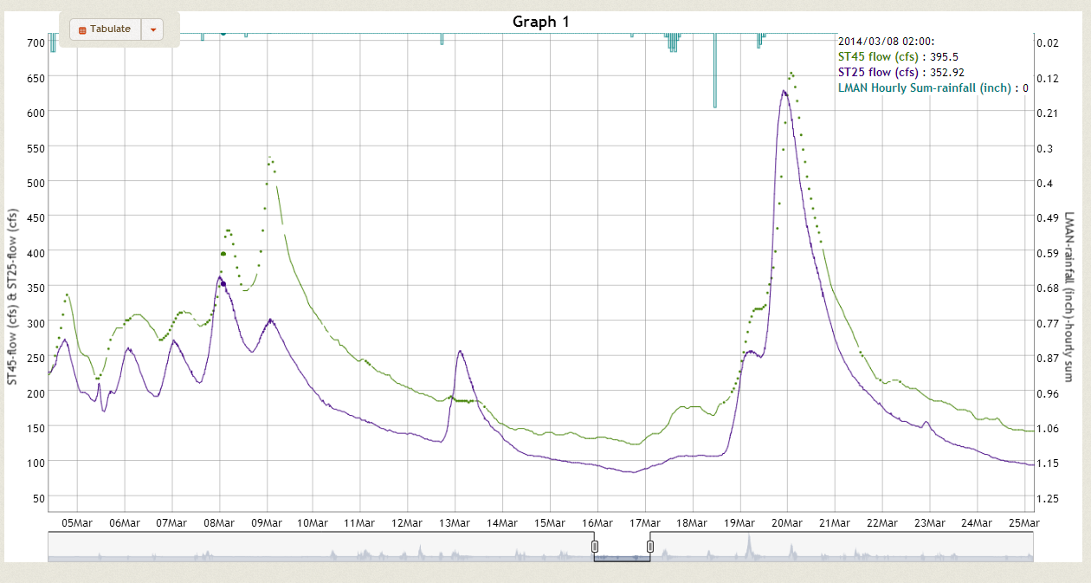
JSON for Plot – v1
[
[new Date('2013/08/14 00:00:00'), 95.50, 12.84, 0.00],
[new Date('2013/08/14 01:00:00'), 99.40, 12.44, 0.00],
[new Date('2013/08/14 01:44:00'), 116.40, null, null],
[new Date('2013/08/14 01:45:00'), 116.40, null, null],
[new Date('2013/08/14 02:00:00'), 123.40, 12.84, 0.00],
[new Date('2013/08/14 02:15:00'), 131.90, null, null],
[new Date('2013/08/14 02:30:00'), 138.80, null, null],
[new Date('2013/08/14 02:45:00'), 147.80, null, null],
[new Date('2013/08/14 03:00:00'), 159.00, 12.44, 0.00],
...
]#SPLIT#{ ['Record Date','ST45 flow (cfs) ','ST25 flow (cfs) ','LMAN Hourly Sum-rainfall (inch) ']}#SPLIT#'1'#SPLIT#{[0,0,4]}#SPLIT#{[24,13,42]}#SPLIT#'1'

Slide 14
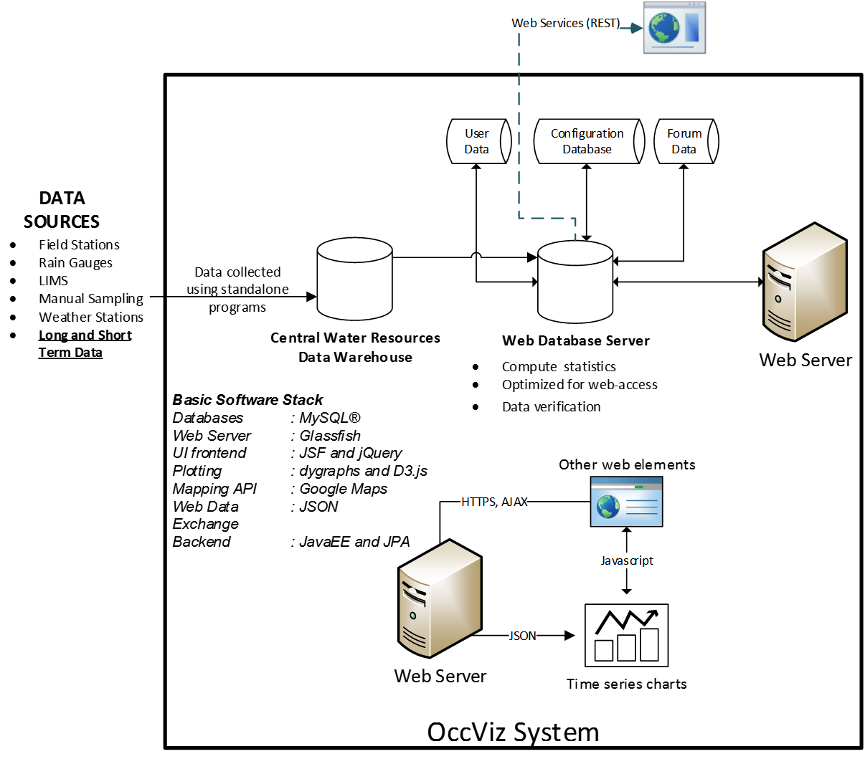
Metadata, User and Station

Slide 15
Current version
JAVA Universe
JSF
Eclipselink- JPA
MySQL

Slide 16
Planned version
Javascript
Browser Universe
Web Services
JAVA Universe

Slide 17
Using standards
TimeseriesML / WaterML
TimeseriesML → JSON →Plotting
JSON standard?
Directly visualize and process with JavaScript easily.
Potentially faster.

Slide 18
Collaboration
Eventually Open Source

Slide 19
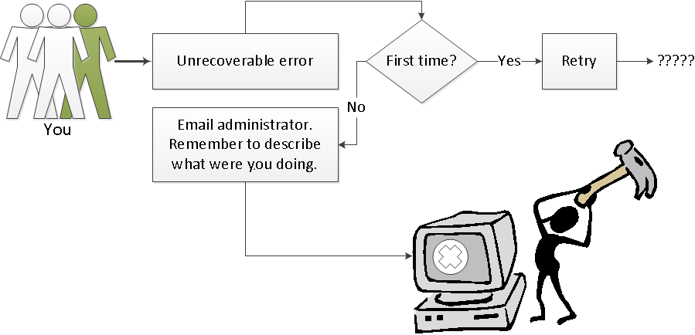
Questions/ Comments
SAURAV@vt.edu

