Slide 1
HY_Features Part 3 - OWL encoding: rhyme and reason
96th OGC Technical Committee
Nottingham, UK
Rob Atkinson
17 September 2015
Copyright © 2015 Open Geospatial Consortium

Slide 2
Outline
Context
What is an OWL encoding?
Why should we care about it now?
How would we use it?
What are the challenges/issues?
Copyright © 2015 Open Geospatial Consortium

Slide 3
Context
HY_Features can be used to:
  Categorise existing data products
  Implement interoperable data transfers (part 2,3 encodings)
  Document existing data products
  Create a common schema to collate data products
  Describe the relationships between features found in multiple data products
  Define mappings between existing data products
Copyright © 2015 Open Geospatial Consortium

Slide 4
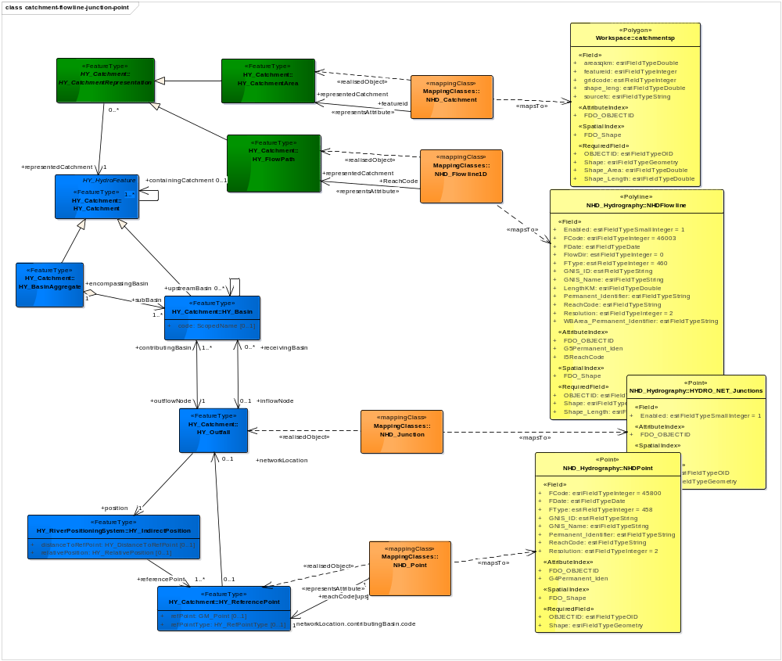
Mapping
HY_Features
Geometric Representations
Mappings
(as things!)
Product
(flat tables)
HY_Features
Topologic Relationships
Copyright © 2015 Open Geospatial Consortium
Notes:
Mapping products to HY_Features allows us to validate the model

Slide 5
N x N Mappings
ESRI global water map
NHD+
HydroSHEDS
NHN
Open Street Map
INSPIRE Hydrography
Australian Hydrographic
Geofabric
NFIE
Each schema may be expressed differently, and hence each mapping may use a different approach, and there is no logical place to go find these mappings
Copyright © 2015 Open Geospatial Consortium

Slide 6
Versus N Mappings
HY_Features
NHN
HydroSHEDS
NHD+
Open Street Map
ESRI global water map
INSPIRE Hydrography
Australian Hydrographic
Geofabric
NFIE
Copyright © 2015 Open Geospatial Consortium

Slide 7
HY_Features Part 3: OWL encoding
We can describe features, their attributes and relationships, as an ontology.
This means every element has an unique URI
And we can then share references to these elements
Copyright © 2015 Open Geospatial Consortium

Slide 8
Mapping
Mappings
(as things!)
A description of how elements of data products relate to each other,
Expressible as an ontology.
HY_Features
Topologic Relationships
Product
(flat tables)
Copyright © 2015 Open Geospatial Consortium
Notes:
Mapping products to HY_Features allows us to validate the model

Slide 9
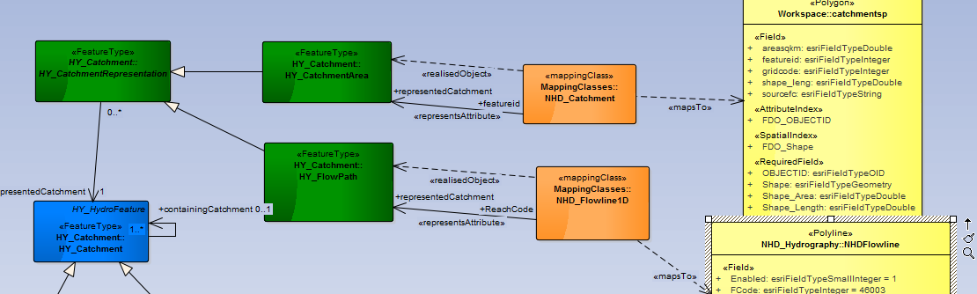
Practical purpose
Can be read as:
The value of property “featureid” of a catchmentsp object can be matched to an equivalent value of the property “Reachcode” of a NHDFlowline if they both represent the same catchment.
Or
Datasets implementing the NHDFlowline Feature Type contain an attribute that is semantically equivalent to the featureid property of a catchmentsp (i.e. the domains match- if we can match the range too then we can infer that the datasets can be linked, and have a recipe to do this.)
Copyright © 2015 Open Geospatial Consortium

Slide 10
Issues
We can use OWL encoding and build up useful metadata about real data products using it as a starting point.
We don’t really need the “ISO metamodel” – a lightweight OWL class model will do for these purposes – we need encoding rules for this.
We can build an extended ontology include ISO (or any other upper ontology) – but need some tooling to support this
We need a standard schema mapping ontology – ideally one able to support data transformations
We will have a powerful “graph” of metadata if we describe data products – will need simple APIs to traverse this
Just having all the mappings means we need APIs to support getting the ontology we need, not the entire graph
Copyright © 2015 Open Geospatial Consortium

Slide 11
In conclusion
A plan for HY_Features part 3, ontology encoding is in train
Looking to see how we can use it for testing Part 1
Ontology can support documentation, discovery and data transformation. But only if we design the publication methodology to support practical use of the ontologies.
A range of basic practices need to be worked through in the wider OGC, or maybe W3C, context, and tooling developed to meet key use cases.
Copyright © 2015 Open Geospatial Consortium

