Slide 1
Water Standards
Interoperability Experiment
96th OGC Technical Committee
Nottingham, UK
Joan Masó
17 September 2015
Copyright © 2015 Open Geospatial Consortium

Slide 2


WaterInnEU
WaterInnEU is a H2020 project that will last 2 years
It is a Coordinate and Support Action (CSA)
It is formed by 8 partners from 7 different countries: Spain, Netherlands, Germany, Belgium, Italy, Slovakia and United Kingdom
Apply European market leadership to river basin networks and spreading of innovation on water ICT models, tools and data.

Slide 3
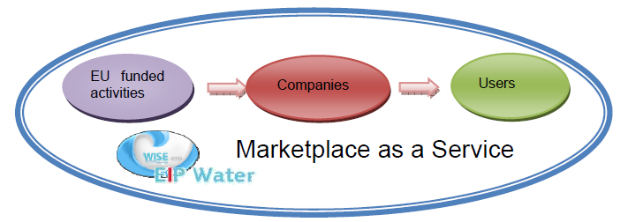
Two primary goals:
Connect the outcomes developed in previous EU funded activities with the already existing data available at European level.
Offer an independent marketplace as a service for users that allows them to access products and services best fitting their priorities, capabilities and procurement processes.

Slide 4
Strategic Objectives
Engage with river basin practitioners and stakeholders to understand the current status of management know-how and capability in order to identify priority needs and requirements for innovation support.
Aggregate and screen the outcomes of previously unexploited European funded projects to identify those that potentially address the market need, and actively promote their dissemination and exploitation.
Assess the level of standardization and interoperability of these tools and models, and promote opportunities for open source platforms to support data sharing processes.
Create The Market Place as a service: This includes both the virtual platform plus provision of supporting and enabling services from the Consortium Partners.
Operate The Market Place to efficiently support the matchmaking of products/services with delivery agents and end users whilst providing appropriate capacity building support.
Actively demonstrate the applicability of The Market Place in two trans-national selected river basins by working directly with river basin managers to match their needs with appropriate products and services from the platform and benchmark the effectiveness of individual tools in the marketplace. Emphasis will be given to the European Innovation Partnership on Water’s priority area of flood and drought risk management.

Slide 5
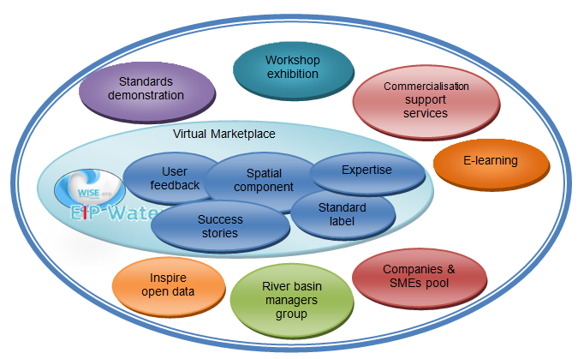
Marketplace components
The marketplace vision as a community that goes beyond the virtual marketplace

Slide 6
The IE
Copyright © 2015 Open Geospatial Consortium

Slide 7
Summary
There is a lot of water information and tools in Europe but fragmentation and a lack of coordination between countries exists.
The European Commission and the member states have financed several research and innovation projects in support of the Water Framework Directive.
Only a few of them are using the recently emerging Hydrological standards, such as OGC WaterML 2.0, and there is a lack of interoperability between tools making the adoption of them difficult.
The purpose of this experiment is to assess the difficulty of applying OGC standards in the Water community and to demonstrate their applicability.
This experiment will also identify potential gaps in OGC standards.
The demonstrated solution will combine different geospatial standards as defined by the Open Geospatial Consortium (e.g., WaterML 2.0, SOS, WPS, WFS, WCS, etc.). The region of interest of this experiment is the Scheldt river basin in Europe.
Copyright © 2015 Open Geospatial Consortium

Slide 8
Participant Organizations
Universitat Autonoma de Barcelona - CREAF
52°North
A complete list of participating organizations will be added after the 30-day Participation Notification period ends.
Participation will be in-kind
Copyright © 2015 Open Geospatial Consortium

Slide 9
Primary Focus
To demonstrate the applicability of OGC standards for the water domain, as follows:
  Applicability of WaterML 2.0 to Scheldt river basin. Use of SOS 2.0 Hydrology Profile for providing WaterML 2.0 data access.
  Combination of WaterML 2.0 and WPS 2.0 to execute flooding modeling.
  Download and presentation of Water models results.
  Alerting/notification services
Copyright © 2015 Open Geospatial Consortium

Slide 10
Outcomes:
Successfully demonstrate that OGC standards are applicable in water domain in Europe and assess the difficulty of migrating current tools to the OGC WaterML 2.0 exchange format.
If areas are identified in the IE where OGC standards have gaps attempt to develop a technical solution to resolve the incompatibility and rerun that portion of the experiment to successfully demonstrate the new approach compatibility and support for the areas previously shown not to be supported.
Move forward in the Service Notification mechanisms.
Copyright © 2015 Open Geospatial Consortium

Slide 11
Use cases
Extract data from river gauges data in OGC WaterML 2.0 format using SOS services (preferably compliant to the OGC SOS 2.0 Hydrology Profile Best Practice).
Model floods using a WPS 2.0 and WaterML 2.0 data as input.
Evaluate the applicability of Sensor Notification Services (interface to be defined) in water emergencies
Copyright © 2015 Open Geospatial Consortium

Slide 12
Scenario
An extreme weather situation is forecasted. River gauges data is continuously monitored. An increase in water flow is detected. Flooding models are executed and affected areas are determined. Emergency services are mobilized, lives are saved and damages on property and crops are estimated.
Copyright © 2015 Open Geospatial Consortium

Slide 13
Experiments
Experiment #1: Extract WaterML 2.0 from the SOS 2.0 Hydrology Profile for the desired area and time
Experiment #2: If the readings exceed a threshold, start a WPS 2.0 execution with a hydrological model.
Experiment #3: Expose the results of the model using geospatial services for download a visualization.
Experiment #4: Notify alerts to the relevant emergency services using Sensor Notification Services or similar. This might be more experimental, since there is a lack of official standards. Current work of the OGC Pub/Sub Standards Working Group can be an alternative to take into consideration.
Copyright © 2015 Open Geospatial Consortium

Slide 14
Technological approach
WaterML translator
WaterML SOS
Services
Gauge
data source
WCS
WaterML WPS
Notification/Event Services
Meteo
alert
WMS
Clients
WPS user interface
SOS WaterML client
Visualization client
Emergency response control
Copyright © 2015 Open Geospatial Consortium

Slide 15
Components
Description | Sponsor / Implementor(s)
WaterML 2.0 translator | CREAF
SOS compatible with Water ML 2.0 model and implementing the OGC SOS 2.0 Hydrology Profile Best Practice | 52°North
WPS 2.0 with WaterML2.0 input | CREAF
Sensor Notification Service | 52°North
WFS, WMS Server | TBD
SOS Client/viewer | 52°North
WPS Client interface | 52°North
Visualization client | CREAF
Notification client | TBD
Copyright © 2015 Open Geospatial Consortium

Slide 16
Schedule
Startup Activity Plan submission: September 30th, 2015 OGC Review Board approval: October 31st, 2015 Start of participation notification period: November 15th, 2015
Execution Planned kickoff date: January 8th, 2016 (30-day post press release) Development, testing and bug fixing January – June 2016 Planned end date: June 30th, 2016
Wrap-up and Reporting Technology Demonstration June 2016 Final report submission August 2016
Copyright © 2015 Open Geospatial Consortium

Slide 17
If you are interested in participate please contact us
Thanks
Joan.Maso@uab.cat
Copyright © 2015 Open Geospatial Consortium

