Slide 1
Hydrology DWG – Groundwater level forecast using SensorWeb flows : "MétéEAU des nappes"
106th OGC Technical Committee
Orléans, France
BESSIERE Hélène
22 March 2018

Slide 2
Plan
Introduction
Crises situation : drought or flood (climate change context)
Importance of groundwater level information for decision makers
La « MétéEau des nappes »
Objectives of the project
The data workflow
The web interface

Slide 3
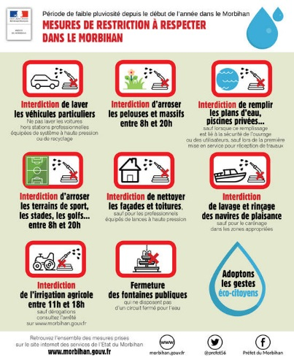
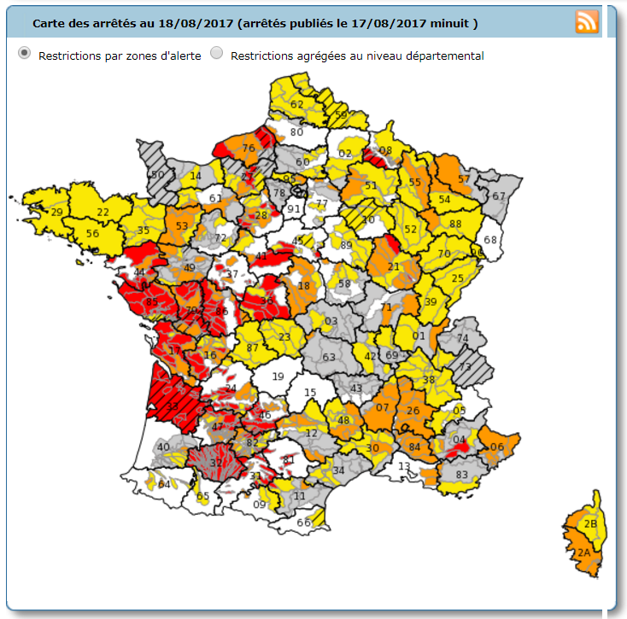
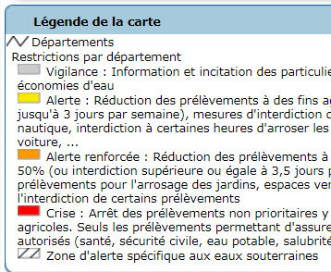

Crises situation – summer 2017
The state of emergency was declared in 30 departments of France because of drought
Three quarters of groundwater was running a deficit
84 departments in restriction (beyond vigilance)
213 drought decrees
Vigilance : water saving
Alert : decrease water consuming 3 days per week
Heightened alert : reduction of water abstraction
Crisis : stop of no priority abstraction
http://propluvia.developpement-durable.gouv.fr/propluvia/
BRGM THE FRENCH GEOLOGICAL SURVEY WWW.BRGM.EU
Notes:
The state of emergency was declared in 30 departments of France because of drought
Three quarters of groundwater was running a deficit
84 departments in restriction (beyond vigilance)
213 drought decrees :
Vigilance : water saving
Alert : decrease water consuming 3 days per week
Heightened alert : reduction of water abstraction
Crisis : stop of low priority abstraction
In grey : vigilance -> water restriction
In red : crisis – stop of no priority abstraction of groundwater
In yellow : alert -> restriction – decrease of water consuming 3 days per week
In orange : heightened alert.

Slide 4
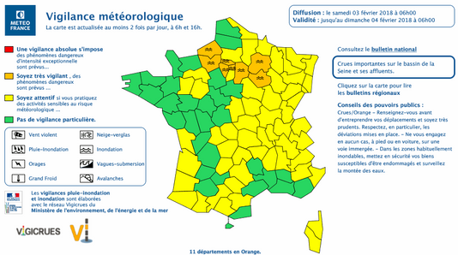
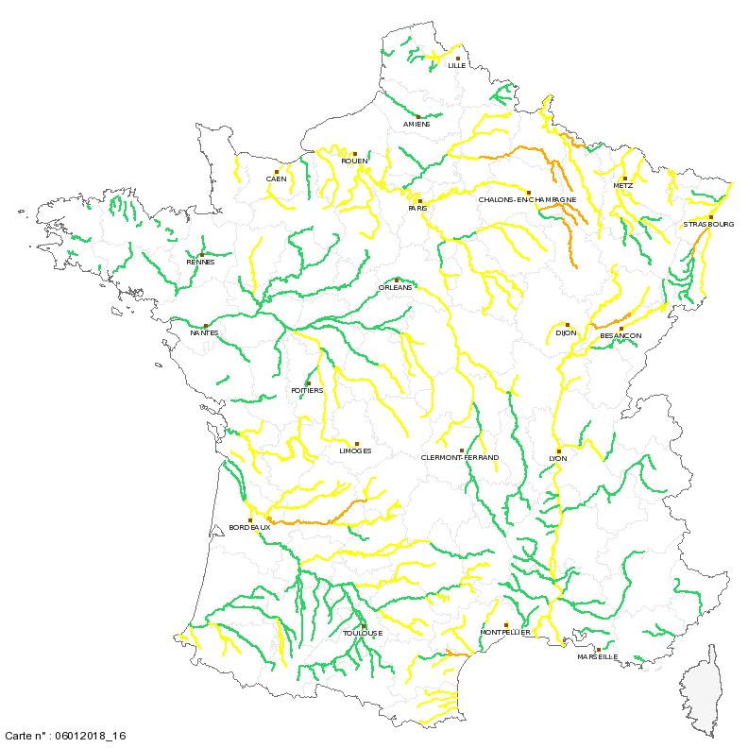
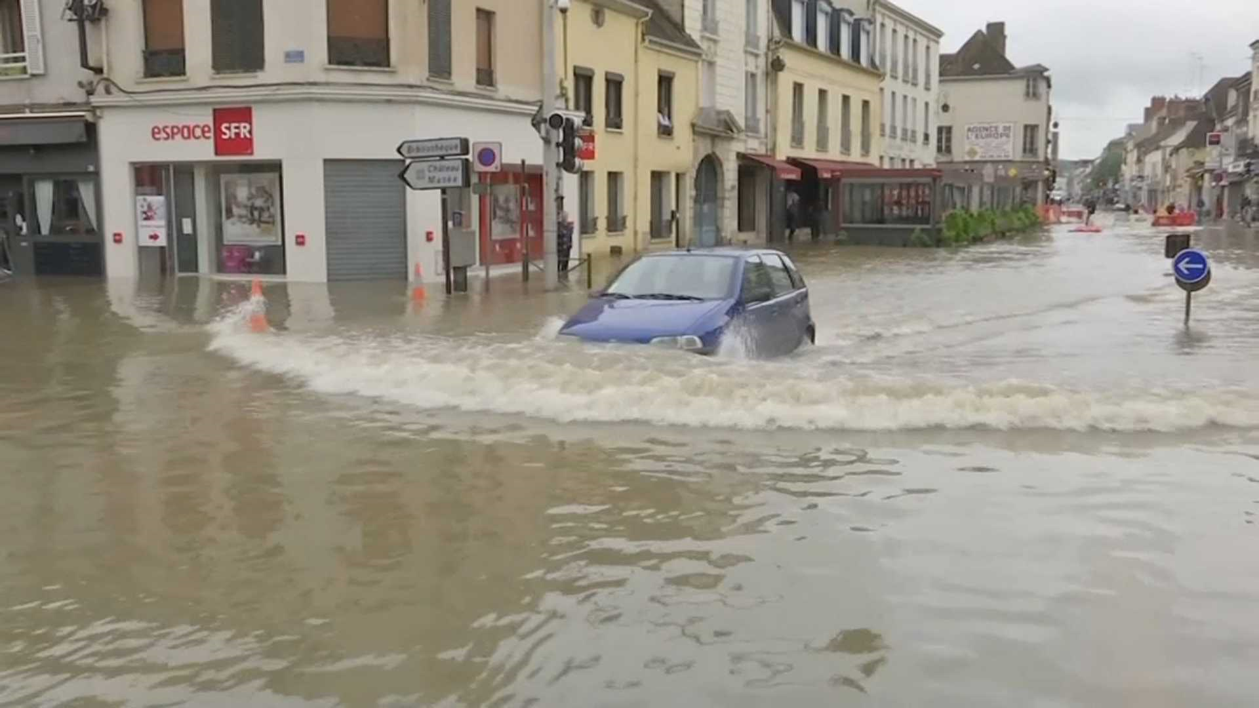
Crises situation – winter 2018

Slide 5
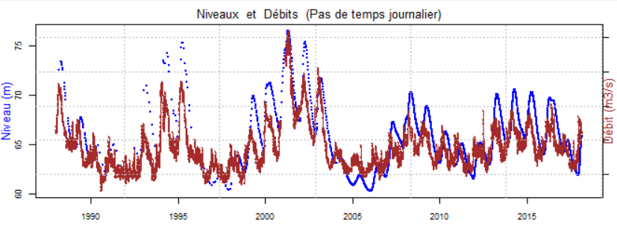
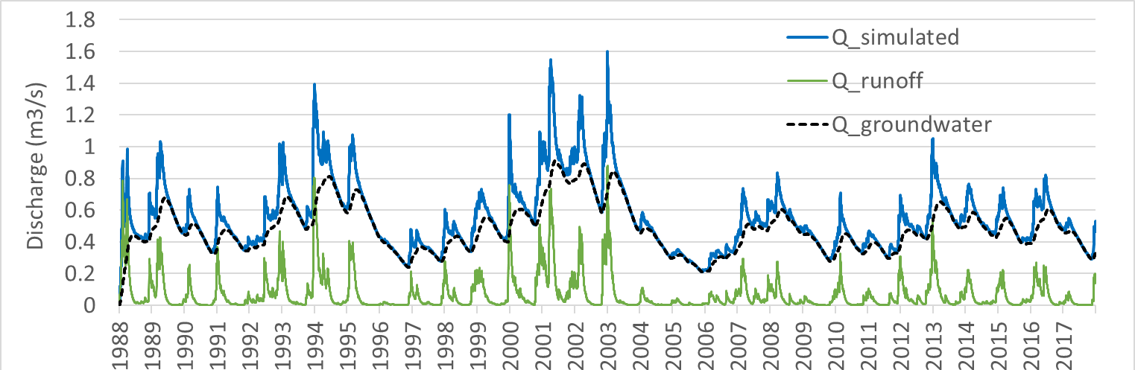
Interaction between river and aquifer drought and flood
Analysis of cross correlation between discharge and piezometric level
Importance of contribution of groundwater to the discharge
Hydrometric station :
la Somme à Abbeville
Piezometer : Senlis le sec
00471X0010/H1
Chalk aquifer

Slide 6
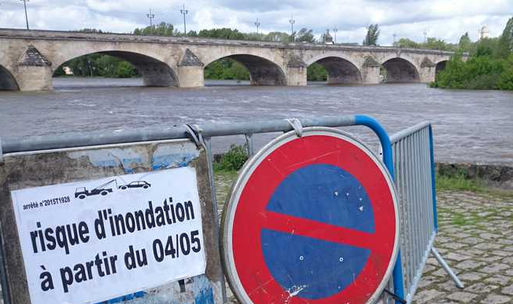
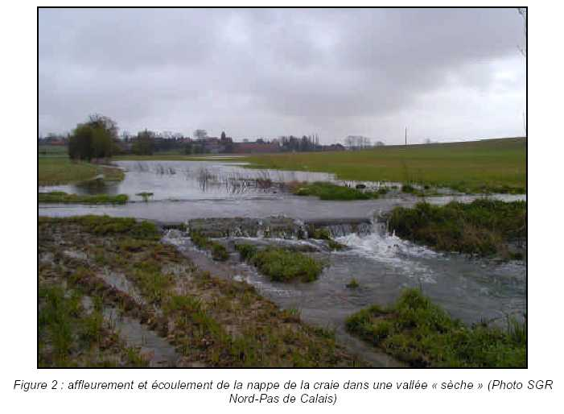

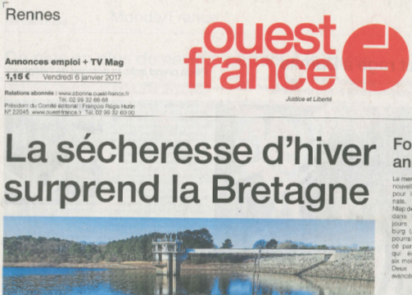

Groundwater level information : a response to identified need
In a climate change context, the availability of real time and forecast piezometric data is essential information for decision makers
Associated with threshold values those data can indicate if a crisis situation is expected, either drought or flooding episodes
BRGM THE FRENCH GEOLOGICAL SURVEY WWW.BRGM.EU
Notes:
In grey : vigilance -> water restriction
In red : crisis – stop of no priority abstraction of groundwater
In yellow : alert -> restriction – decrease of water consuming 3 days per week
In orange : heightened alert.

Slide 7




“MétéEau des nappes”,
a decision making tool to characterize in almost real-time groundwater quantitative state
Bessière Hélène h.bessiere@brgm.fr
Mougin bruno, Vigier Yannick, Nicolas Jérôme, Loigerot Stéphane

Slide 8
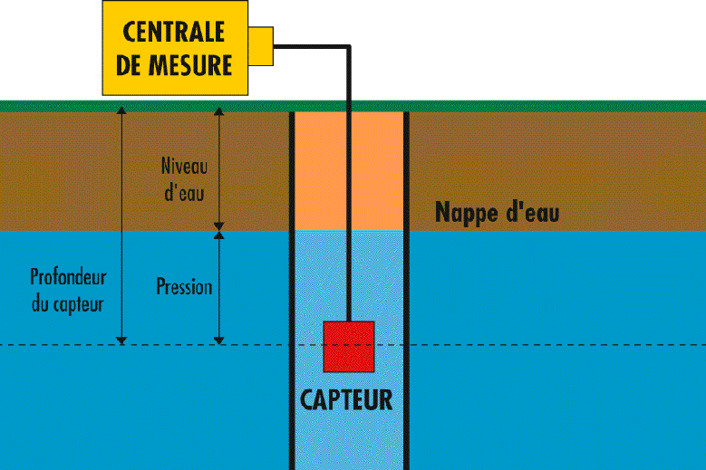
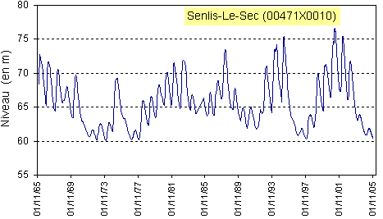


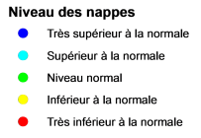


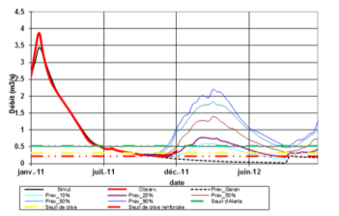


The objective of “MétéEau des Nappes”
Deployment of an interoperable communication tool unable to cross data from different networks (meteorology, river flow, piezometric) in order to characterize in almost real-time groundwater quantitative state
Forecast the evolution of groundwater levels by improving national piezometric network’s data, and provide public access to almost real-time data (maps and curves)
From the sensor to measured data dissemination : “la MétéEau des nappes”
GPRS
Very high level
High level
Around medium level
Low level
Very low level
Rising
Stable
Decreasing
BRGM THE FRENCH GEOLOGICAL SURVEY WWW.BRGM.EU
SOS
Notes:
GPRS : General Packet Radio Service
SOS (Sensor Observation Service)
OGC SWE (Open Geospatial Consortium, Sensor Web Enablement)

Slide 9
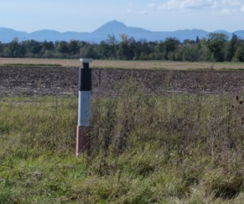


SWEing the groundwater data workflow
FTP
Observation SOS
RawDB
Observation files
O&M
GPRS Piezometers
One pivotal exchange mechanism/format
Compliant with Inspire Requirements and Recommendations
SOS 2.0 output, WaterML2.0 encoding
already presented during the HydroDWG workshop 2015 (https://external.opengeospatial.org/twiki_public/pub/HydrologyDWG/OrleansWorkshop2015/20150922_BRGM_sensor.ppt )
BRGM THE FRENCH GEOLOGICAL SURVEY WWW.BRGM.EU
Notes:
The introduction of the standard Sensor Web Enablement in the data collection procedure took place at the same time as a technical evolution
Indeed, the deployment of GPRS protocol allowed us to rethink the storage conditions of the raw data itself and its availability.
The workflow presented here corresponds to what is now in operation for sets of GPRS sensors.
We created a central database, called raw database, which concentrate hourly data collected on FTP repository which are pushed piezometers equipped with GPRS
The creation of this raw database was an opportunity to introduce the concepts of observation and measurement to prepare for a given exposure in the standard SOS.

Slide 10
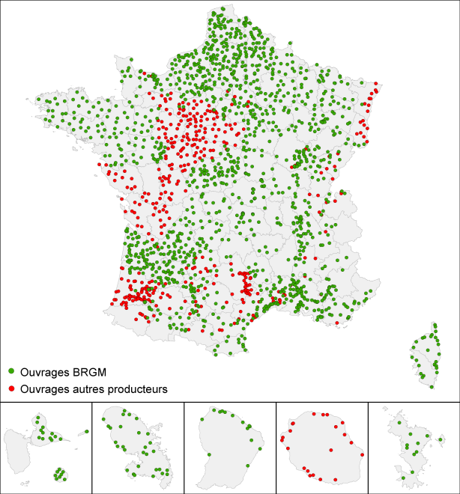
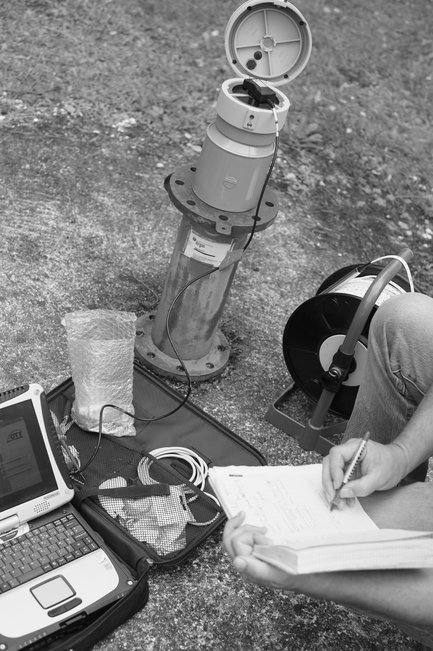
French national piezometric network
BRGM works on improving its national piezometric data network
Raw data from sensors are exposed in interoperable formats and services in accordance with international open standards for sensorWeb interoperability and European rules
INSPIRE directive guidance on the use of Observations & Measurements and OGC SWE - Sensor Web Enablement Framework
Borehole equipped with real-time data transmission sensor (GPRS)
Nicolas et al., 2013
1700 stations including 1450 managed by the BRGM
BRGM THE FRENCH GEOLOGICAL SURVEY WWW.BRGM.EU

Slide 11
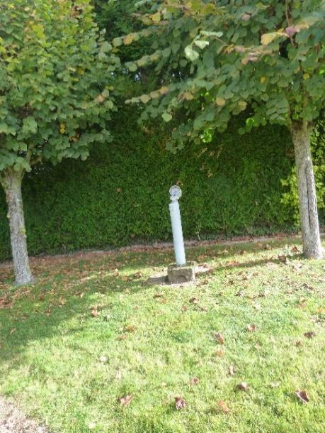
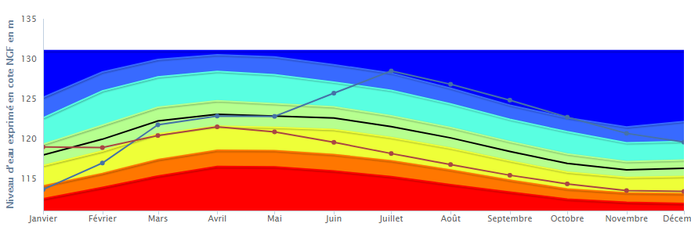
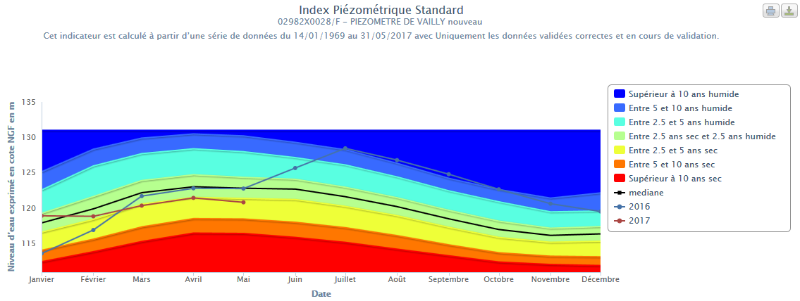
Piezometer of Vailly (Aube)
Max high levels
(02982X0028/F)
Chalk aquifer
IPS Standard Piezometric Level Index
Vailly (02982X0028/F)
“Observations & Measurements JSON”
More than 10 years wet
Between 5 and 10 years wet
Between 2,5 and 5 years wet
Between 2,5 y dry and 2,5 y wet
Between 2,5 and 5 years dry
Between 5 and 10 years dry
More than 10 years dry
Median
2016
2017
Notes:
This piezometer is located in a chalk aquifer
The maximum high level of 2017 is the lowest of the last 5 years
SPI standard piezometric level index indicate a situation between 2,5 and 5 years dry,

Slide 12

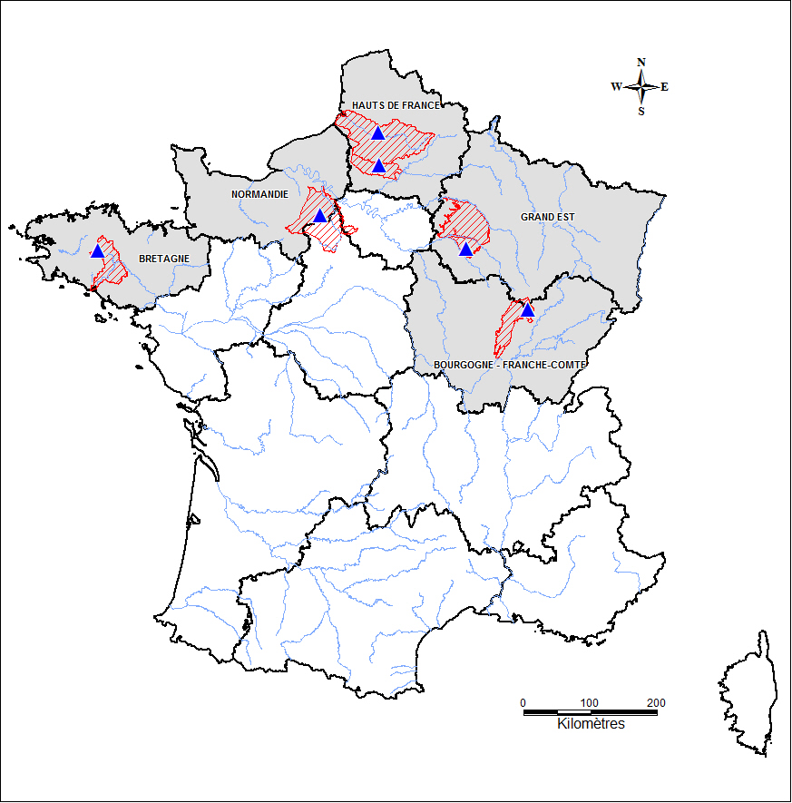
A regional participation
216 global models listed in french territory
6 case studies selected in 5 french regions (3 geological formations)
Nicolas et al., 2013
Rainfall/discharge/piezometric level modelisation
Hauts de France, drought (Tempo)
Hauts de France, flood (Gardénia)
Normandie, drought (both models)
Bretagne, drought (Gardénia)
Grand Est, drought (Gardénia)
Bourgogne Franche-Comté, climate change (Gardénia)
Catillon-Fumechon
00807X0015/S1
Senlis-le-Sec
00471X0010/H1
Moisville
01805X0036/S1
Rostrenen
03124X0088/F
Vailly
02982X0028/F
Bourberain
04398X0002/SONDAG
Mougin et al. 2016
BRGM THE FRENCH GEOLOGICAL SURVEY WWW.BRGM.EU
Notes:
Updating models and creation of forecasts

Slide 13
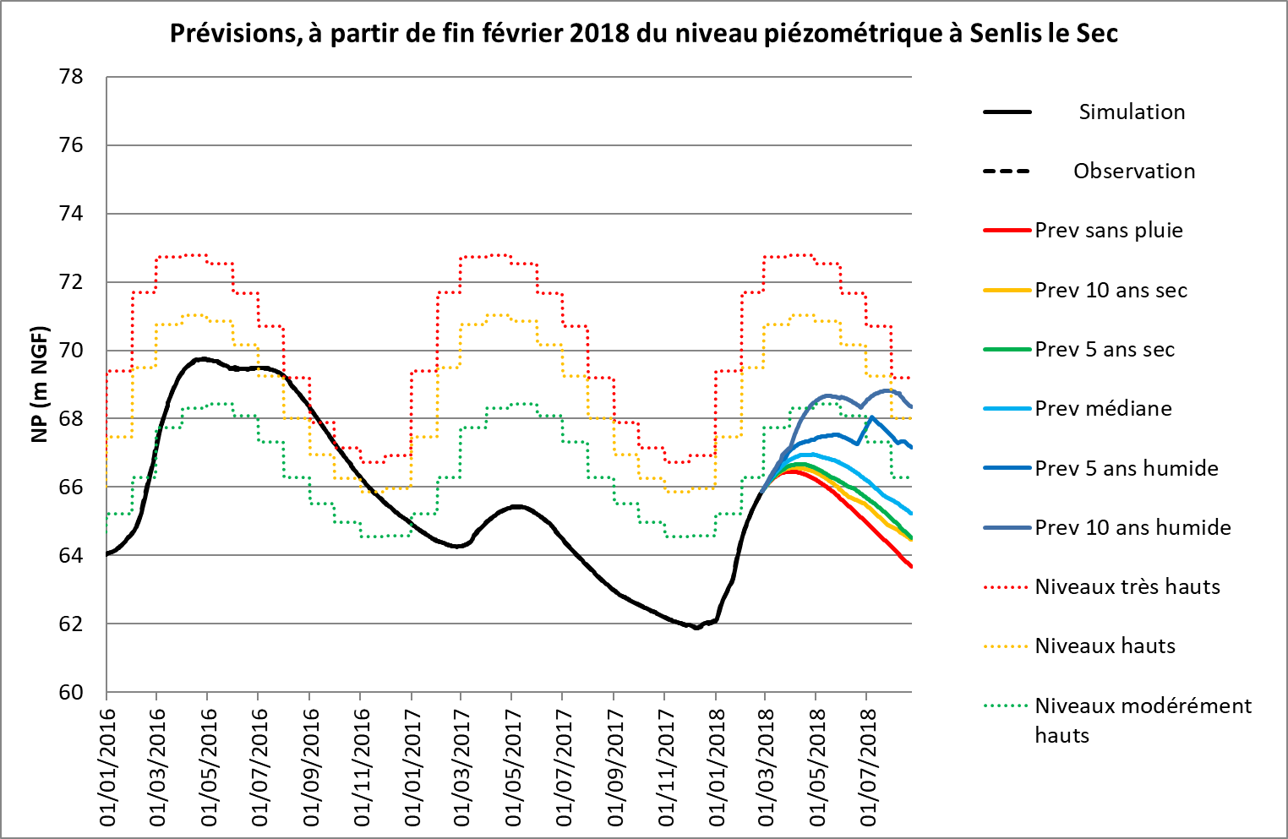
Expected curves
Updating model and creation of forecasts Comparison of real-times groundwater levels and forecasts.
charts drawing to thresholds values
model forecasts as a SensorObservationService in addition to the raw data flows
BRGM THE FRENCH GEOLOGICAL SURVEY WWW.BRGM.EU

Slide 14
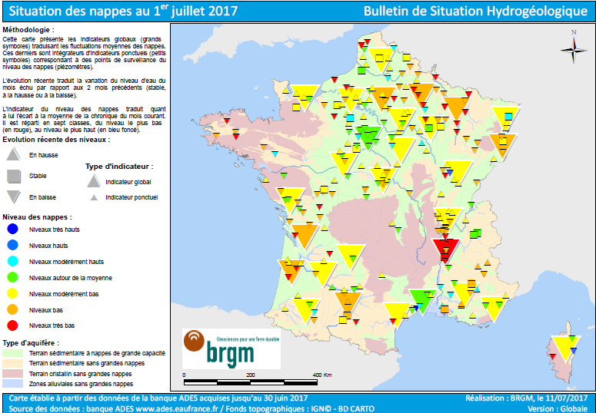
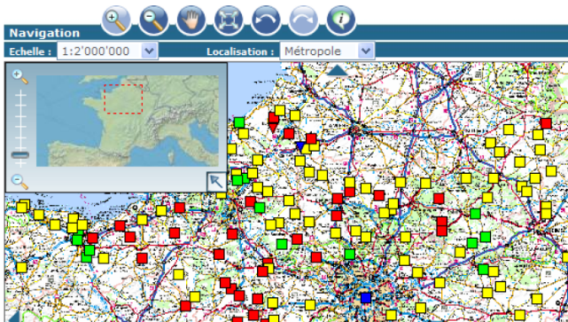
Expected maps
The national hydrological situation report
=> monthly evolution of water resources
made by BRGM on behalf of the French ministry of Environment
Rising
Stable
Decreasing
Very high level
High level
Moderately high level
Around medium level
Moderately low level
Low level
Very low level
Forecast in
2 months ?
BRGM THE FRENCH GEOLOGICAL SURVEY WWW.BRGM.EU
Notes:
Les
données du BSH à un instant donné, et le souhait d’afficher la même carte avec une prévision des niveaux 2 mois plus tard.

Slide 15
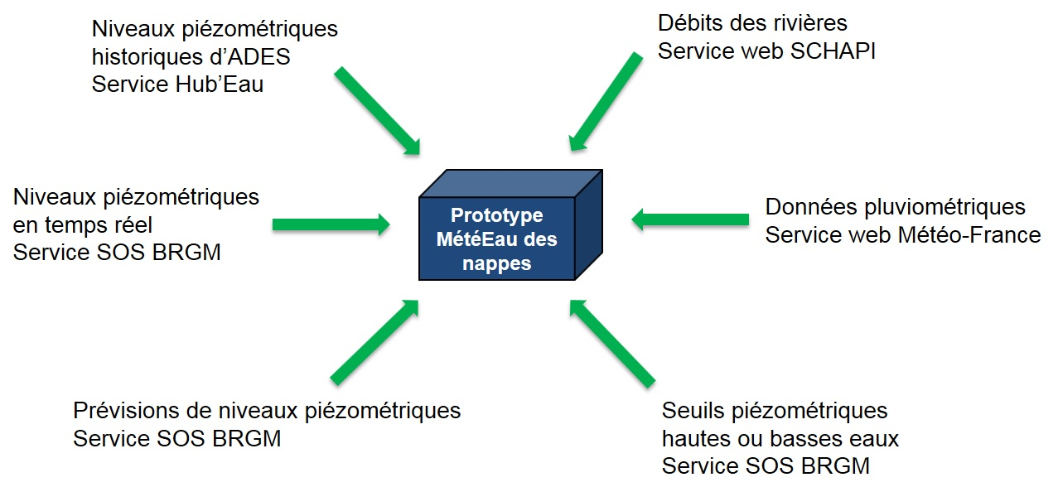
The data workflow of “Météeau des nappes”
BRGM : groundwater level
as a Sensor Observation Service (SOS)
SCHAPI : stream gauges
JSON
Météo-France :
weather
station SOS
BRGM : model forecasts SOS
Mougin et al., 2017
threshold values SOS

Slide 16
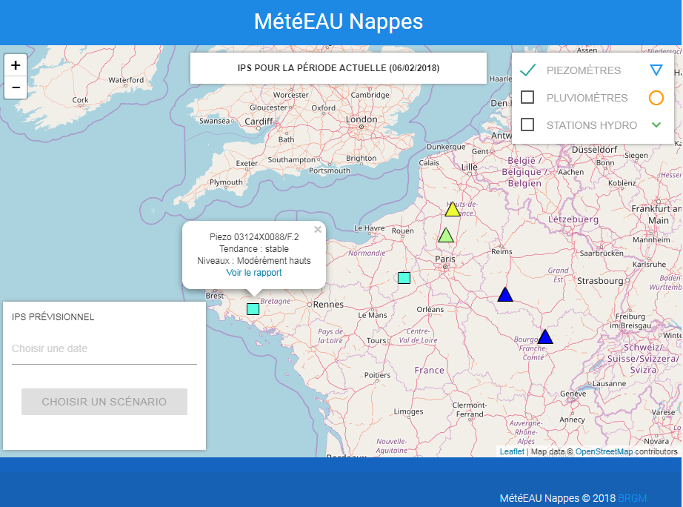
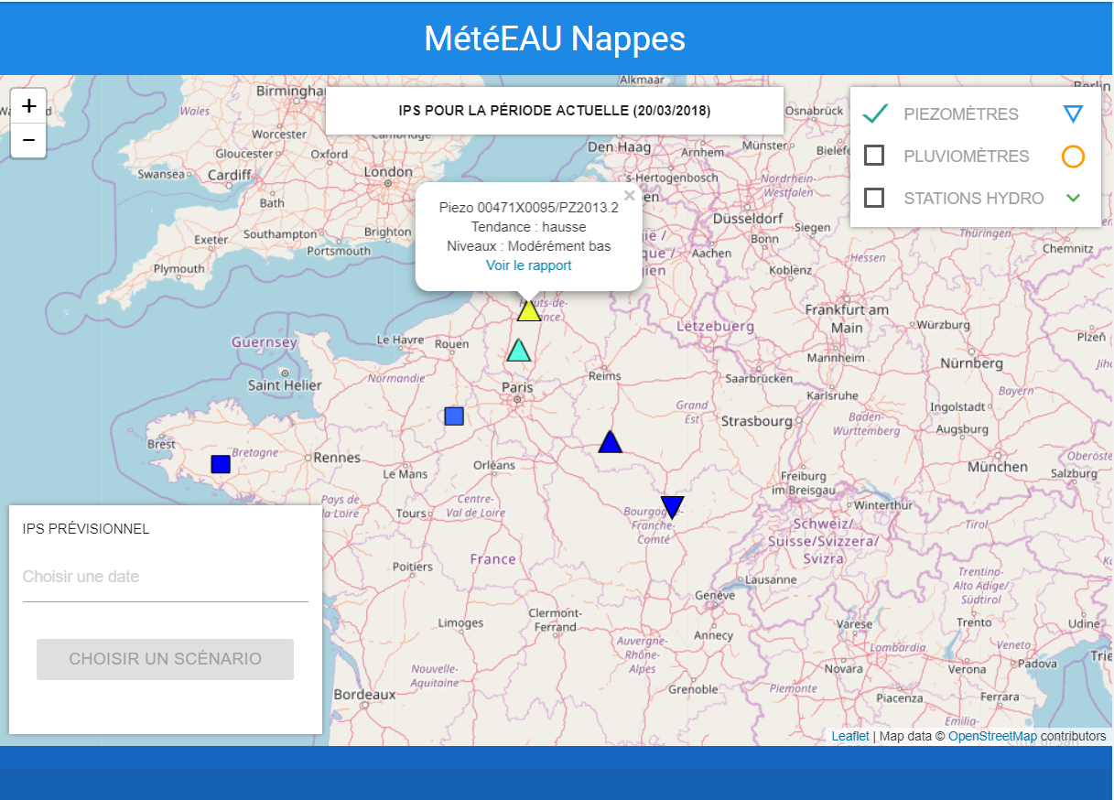
Screenshots of the prototype (1/5)
February 6th, 2018
MétéEAU Nappes © 2018 BRGM
March 20th, 2018
Notes:
maps giving the location of different measuring stations
a map showing specified indicators of the groundwater state and trends in a few months

Slide 17
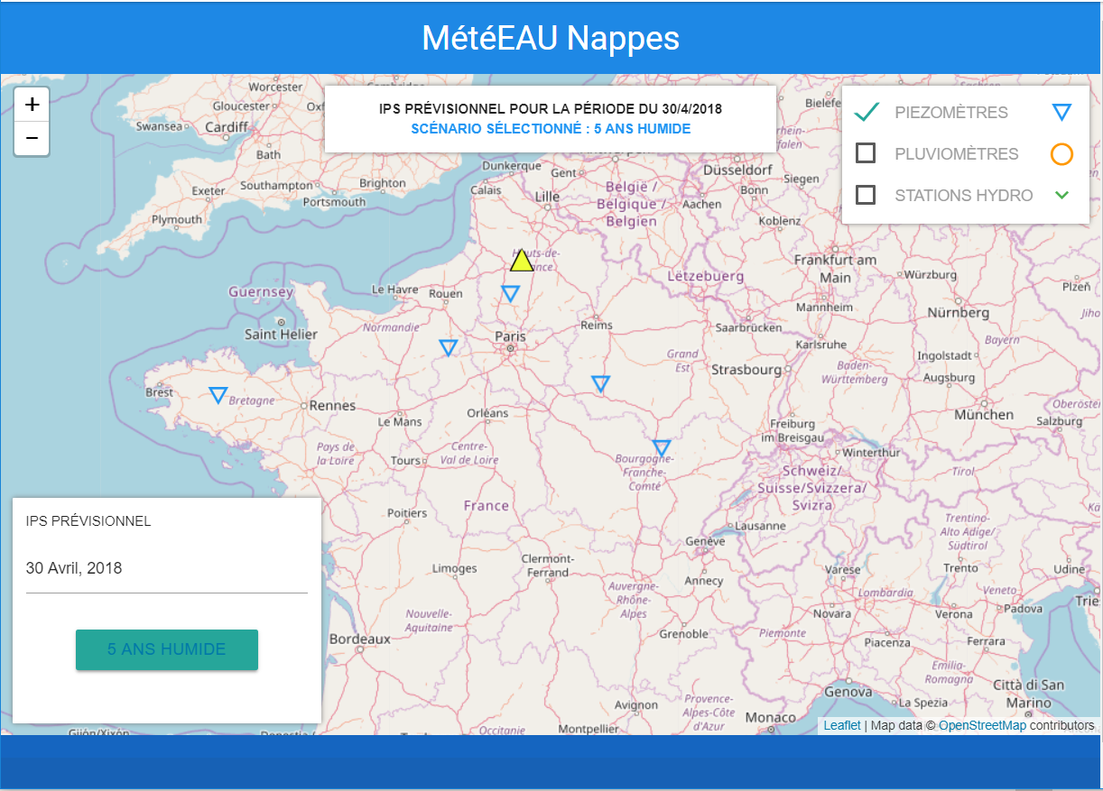
Screenshots of the prototype (2/5)
March 20th, 2018
MétéEAU Nappes © 2018 BRGM
Trends for April 30th, 2018
Notes:
maps giving the location of different measuring stations
a map showing specified indicators of the groundwater state and trends in a few months

Slide 18
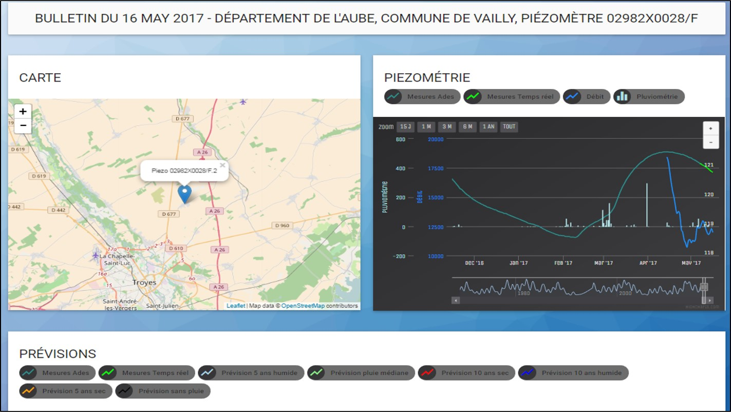
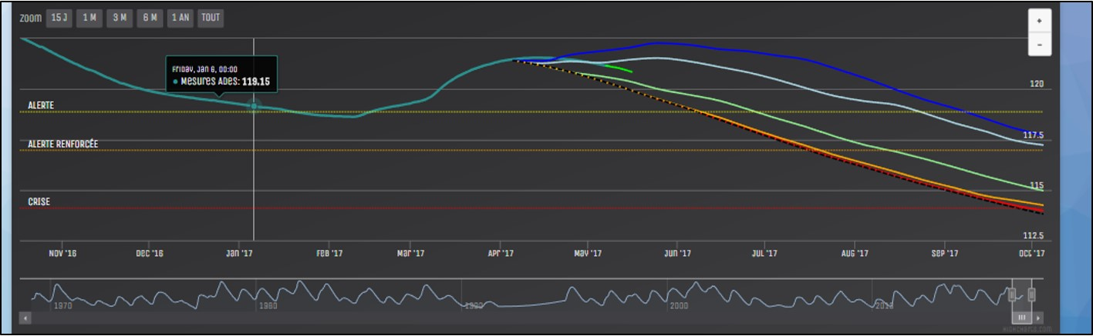
Screenshots of the prototype (3/5)
May 16th, 2017
MétéEAU Nappes © 2017 BRGM
Notes:
the tool shows :
dynamic graphs drawing to thresholds values
model forecasts as a SensorObservationService in addition to the raw data flows
anticipate and get ready to manage a summer drought situation

Slide 19
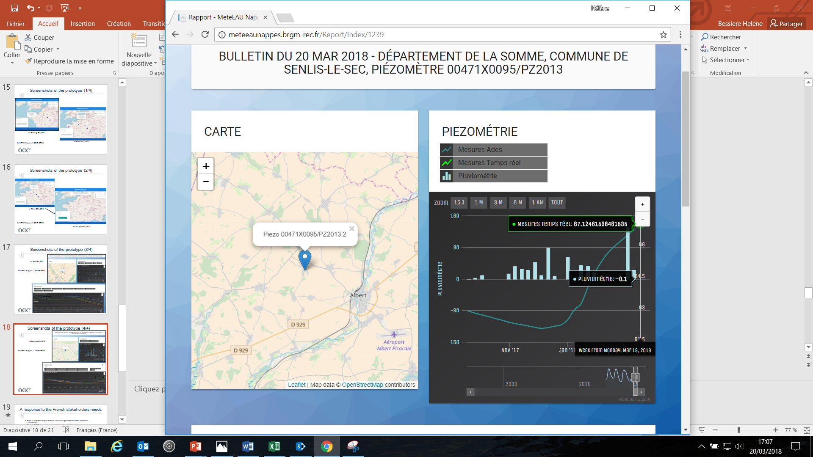
Screenshots of the prototype (4/5)
MétéEAU Nappes © 2018 BRGM
March 20th, 2018

Slide 20
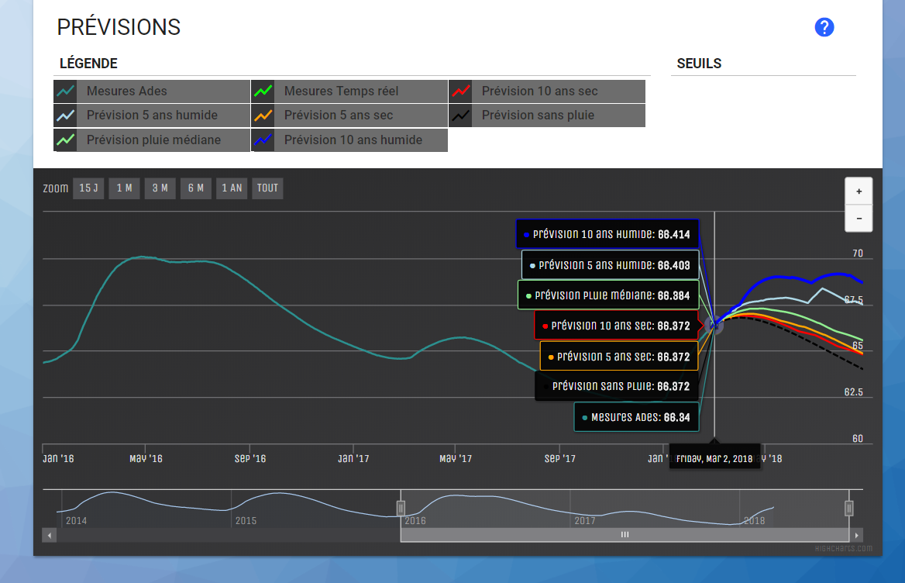
Screenshots of the prototype (5/5)
MétéEAU Nappes © 2018 BRGM
March 20th, 2018

Slide 21
A response to the French stakeholders needs
From a simple display of current and future groundwater level by water’s stakeholders (French SAGE’s moderators (Water Management and Planning Scheme) , technicians of river catchments)
to the improvement of the water use management during high or low water levels by State’s Services (for example : prefect order of water restriction)
Among the French stakeholders interested in this initiative, we can indicate :
Water agencies,
Decentralized services of Ministries (DREAL, DDT),
Regions and Departments,
Association of Municipalities,
Industrial water producers…
BRGM THE FRENCH GEOLOGICAL SURVEY WWW.BRGM.EU

Slide 22
Conclusions
an interoperable communication tool able to cross data in almost real-time (maps and graphs)
a tool able to show impacts of climate change on groundwater resource at local scale
a real decision-making tool (improvement of the water use management during high or low water levels by State’s Services)
in 2018 ?
a method for refreshing data
a public web site
BRGM THE FRENCH GEOLOGICAL SURVEY WWW.BRGM.EU

Slide 23
For more information
If you need more information :
b.mougin@brgm.fr, h.bessiere@brgm.fr, y.vigier@brgm.fr
j.nicolas@brgm.fr, s.loigerot@brgm.fr
Other topics :
Piezometric network :
Jérôme Nicolas : j.nicolas@brgm.fr
Interoperability and SOS :
Sylvain Grellet: s.grellet@brgm.fr
Stéphane Loigerot : s.loigerot@brgm.fr
Thank you for your attention
BRGM THE FRENCH GEOLOGICAL SURVEY WWW.BRGM.EU

