Slide 1
Global Water Information IG Joint Session with OGC/WMO Hydrology Domain Working Group
Berlin, 21 March, 2018

Slide 2
Agenda
Groundwater level forecast using SensorWeb flows : "MétéEAU des nappes" BRGM project (Hélène Bessière, Sylvain Grellet)
Summary of results and demonstration of ELFIE (ELFIE lead - Dave Blodgett, Sylvain Grellet)
Other recent OGC HDWG activities
ontology primers : HY_Feature, GWML2, GeoSciML (overlapping with GeoscienceDWG) : Eric Boisvert, Sylvain Grellet, Rob Atkinson
Water data standardization, and vocabularies (S. Grellet)
Other recent RDA GWIIG activities (I. Zaslavsky)
water data portals, water data citation, data rescue
Aligning priorities and roadmaps of OGC/WMO HDWG and RDA GWIIG (HDWG and RDA co-chairs; discussion)

Slide 3
RDA GWIIG Brief Review
Value proposition:
facilitate dissemination of water data standards from HDWG;
explore and compare eInfrastructures for water data sharing;
address infrastructure issues out of the scope of HDWG;
facilitate application of RDA recommendations in the water domain;
explore policies for water data sharing
understand best practices of data systems in other domains
coordinate with other RDA groups on addressing common issues
organize water data-related use cases;
attract academic researchers, and participants from outside HDWG

Slide 4
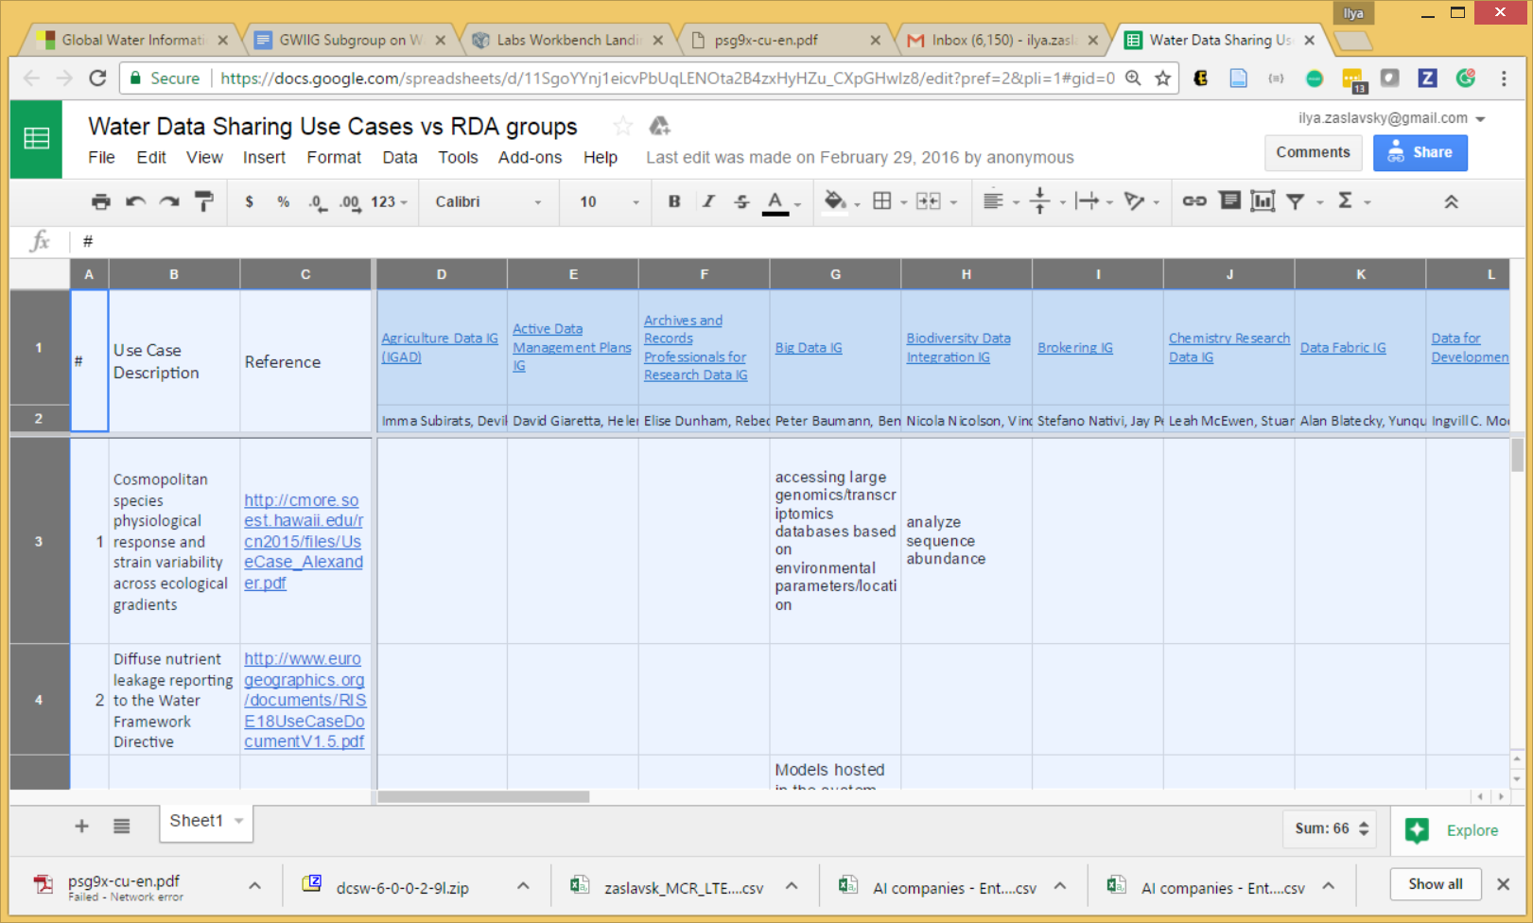
Water information use cases
https://docs.google.com/spreadsheets/d/11SgoYYnj1eicvPbUqLENOta2B4zxHyHZu_CXpGHwIz8/edit?pref=2&pli=1#gid=0
A matrix of use cases vs RDA groups
Avoiding a discussion of what a use case is, and a use case template…

Slide 5
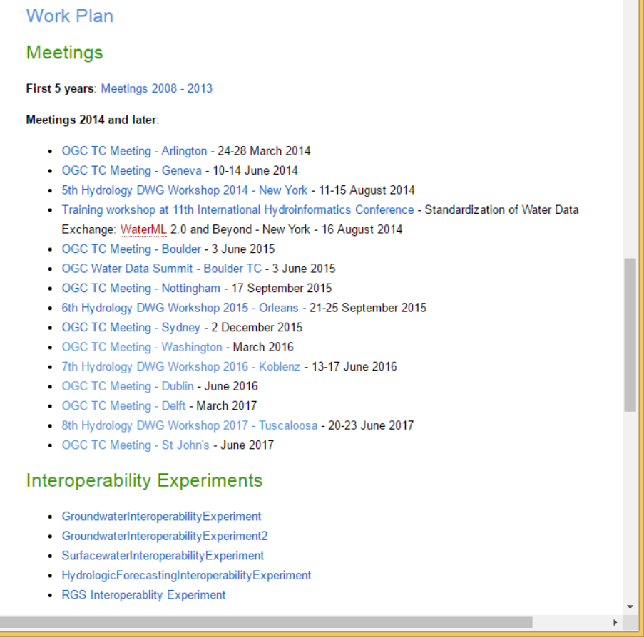
Websites
HDWG
Complements the mailing list
The place where all HDWG activity is announced / coordinated /reported
Meeting summaries; Interoperability experiments; Tools, …
A section dedicated to RDA GWIIG
http://external.opengis.org/twiki_public/HydrologyDWG/WebHome
GWIIG section of RDA website
Summary of GWIIG actions/organisation + link to its specific section under HDWG website
Purpose : To better intertwine both groups/communities and avoid people being lost between too many websites.

Slide 6
Water data portals and water data discovery
(started by Janet Hering and Harald von Waldow, EAWAG)
An initial list of water data portals:
from EAWAG: https://osf.io/8mn3q/
now maintained by CUAHSI: : https://www.cuahsi.org/data-models/portals/
A crowdsourced version:
Google sheet at https://docs.google.com/spreadsheets/d/1EgQqB7raI3wbKRB9Mdr4bj9t1PDsgK6crtFHKSs2B44/edit#gid=326880346
Linked visualization/analysis: http://demo.getsuave.com:3002/main/file=WaterDataPortals.config&view=grid

Slide 7
Water data portals: next steps
Add to the crowdsourced version, then analyze
Understand types of water data portals
by functions; types of objects; service interfaces
Best practices for different types of portals
Standards support and interoperability across portals
Expanding portal metadata:
An initial attempt at more structured representation: https://docs.google.com/spreadsheets/d/1AfuxRg4LIiDXsXnjagS3wD1VpO93naGXVgx9MmVxNDw/edit#gid=1919540330&fvid=1867225195)
Water-specific characteristics of WDPs?
Volunteers interested in this topic?

Slide 8
Water data portals - discussion
Shall we expand structural descriptions? Which of the following would be interesting?
Query interface: map search; time sliders; full-text; simple and advanced search; facets; semantic rewriting/term expansion; granularity levels (observations, samples, time series, datasets, etc.); etc.;
Construction of data discovery workflows;
Information models, encodings and protocols used, and their standards-compliance
Visibility to search engines;
How search results are presented: relevancy, links to related features, ability to transform results into other formats; show search results statistics; show provenance; preserve queries and show usage stats; show related queries and/or results;
Ability to annotate results; ability to incorporate results into workflows and/or publications, provide data previews and introspection; provide APIs into lower granularity levels; letting users subscribe to updates,…
Management aspects: data sources; life cycle; sustainability; funding; stewardship arrangements; curation; licensing and use restrictions
Technology platform for the portal
Stated success criteria, and portal evaluation; maximizing ROI in portals
An initial attempt of a more structured representation: https://docs.google.com/spreadsheets/d/1AfuxRg4LIiDXsXnjagS3wD1VpO93naGXVgx9MmVxNDw/edit#gid=1919540330&fvid=1867225195

Slide 9
Water data portals - discussion
Characteristics that <may be> specific to water portals
A set of hydrologic features and observations at several hierarchical levels
Special types of relationships (eg upstream, downstream, other relations in a hydrographic network) – may be time-dependent
Additional feature-of-interest relationships such as parameter proxies (these are context-dependent)
GWIIG notes: https://docs.google.com/document/d/13P2qtp42idYuDZ7vH0BFxk-1CXuZuUJ2GML07F1u2cs/edit#heading=h.f5o7xk8mf00m

Slide 10
Water Data Portals - Next Steps
Update the list of WDPs; coordinate with potential stewards of the list (GEO?) and portal owners
There is an interactive crowdsourcing system now:
Google sheet at https://docs.google.com/spreadsheets/d/1EgQqB7raI3wbKRB9Mdr4bj9t1PDsgK6crtFHKSs2B44/edit#gid=326880346
Linked visualization/analysis: http://demo.getsuave.com:3002/main/file=WaterDataPortals.config&view=grid
Settle on additional fields and create structured descriptions of WDPs (both general and water-specific)
Which groups need to be involved (in hydrology? In RDA?) How do other domains deal with this?
Towards developing best practices for domain portals

Slide 11
Hydrologic Vocabularies
Not started yet; several people are interested across RDA GWIIG and OGC HydroDWG
Goals:
Identify water-related ontologies
Engage with RDA Vocab Services IG
Use cases
Service and practice documentation
Recs on vocab publication and APIs
Encourage publication of exemplar water-related vocabularies using best practice methods

Slide 12
Hydrologic Vocabularies: Next Steps
Identify use cases and audiences for semantic dataset annotation and discovery; explore varying "annotation depth" as required for different use cases;
Create a list of available vocabularies and ontologies for water data, and their metadata model;
Explore overlaps and complementarity of available vocabularies and ontologies, identify gaps;
What belongs and what doesn't belong in a water ontology;
Standards-compliance, and relationship with Hy-Features/WaterML2
Tools for efficient semantic annotation;
Additional use cases beyond discovery, eg reasoning use cases and tools, and requirements to the data model

Slide 13
Dynamic Data Citation
Collaboration with the Dynamic Data Citation WG
UK National River Flow Archive:
Developed RDBMS-based versioning system and tested Dynamic Data Citation WG recommendations
Initial work presented at Denver P8 plenary GWIIG meeting
Presented as part of P8 DDC session
Further work hoped to be presented as part of DDC webinar series (TBC)
Call for other GWIIG examples of versioning / dynamic data citation (e.g. CUAHSI HydroShare)

Slide 14
Data Rescue Use Cases in Hydrology
Initiated discussion with Elizabeth Griffin of DR IG
DR IG is considering thematic focus on data rescue, with water being an option for a theme
GWIIG will identify past successes and future need for data rescue in hydrology
Presented at DR IG in Montreal

