Slide 1
Hydro related ontology primers
106th OGC Technical Committee
Orléans, France
S.Grellet, E.Boisvert, R.Atkinson
21 March 2018

Slide 2
Recent activities
GeoSciML: GeoSciML Basic, Borehole and Lite
19150-2 using Shapechange : making some choices
Then manual edits to maximize the expressivity of the ontology
=> documented here (with ontology and instances): https://github.com/opengeospatial/GeoSciML
HY_Features
Same ShapeChange configuration as above
Automatically generated files adjusted by Rob for OGC NamingAuthority discussions
https://github.com/sgrellet/HY_Features/tree/master/ontology

Slide 3
Recent activities
GroundWaterML2
Same ShapeChange configuration as above
All : https://github.com/denevers/geoscimlrdf/tree/master/gwml
GWML2 and HY_Feature ontologies ‘linked’ to ELFIE exercise
See : https://opengeospatial.github.io/ELFIE/FR/HY-WaterBody/sgwi/E6--009-
https://opengeospatial.github.io/ELFIE/FR/GW-HydrogeoUnit/sgwi/121AT01

Slide 4
OGC Definitions Server
Flexible infrastructure using open source components
RDF inferencing – currently using RDF4J and SPIN
OWL2SKOS
Then standard SKOS inferencing
Then Linked Data entailment (what alternatives ands access methods available)
A “Feature Type Catalogue”
Can join pieces up manually now.

Slide 5
Repository + CMS
RDF
mapping
Source
Document(s)
HYF
HYF_codes
CMS objects
Service Chain
REST API
REST API
inferencing
repository
public
repository
SPIN rules to extract SKOS
Linked Data
(SKOS
linked to
OWL etc.
artefacts)
SPIN rules for SKOS
SPIN rules for metadata and links

Slide 6
CONSTRUCT {
?this a skos:ConceptScheme .
?class a skos:Concept , ogc:FeatureType .
?class skos:prefLabel ?bestpreflabel .
?class skos:inScheme ?this .
?class skos:broader ?parent .
?this ogc:sourceGraph ?g .
?class ?skospred ?skosprop .
?class ogc:featureproperty ?classprop .
?classprop a skos:Concept , ogc:FeatureProperty .
?classprop rdfs:range ?proptype .
?classprop ?propskospred ?propskosprop .
}
WHERE {
?this a ogc:ApplicationSchema .
?this ogc:sourceGraph ?g .
GRAPH ?g {
?class a owl:Class .
OPTIONAL {
?class rdfs:subClassOf ?parent . ?parent a owl:Class .
OPTIONAL { ?parent rdfs:label ?parentlabel }.
} .
OPTIONAL { ?class ?skospred ?skosprop FILTER (STRSTARTS(str(?skospred),str(skos:))) }
OPTIONAL { ?class rdfs:subClassOf ?bn. ?bn a owl:Restriction . ?bn owl:onProperty ?classprop . ?bn owl:allValuesFrom ?proptype .
OPTIONAL { ?classprop ?propskospred ?propskosprop FILTER (STRSTARTS(str(?propskospred),str(skos:))) } }
OPTIONAL { ?class rdfs:label ?classlabel . }
OPTIONAL {
?class skos:prefLabel ?preflabel .
} .
} .
BIND (COALESCE(IF(bound(?preflabel), ?preflabel, (1 / 0)), IF(bound(?classlabel), ?classlabel, (1 / 0))) AS ?bestpreflabel) .
BIND (URI(CONCAT(str(?this), "?_view=skos")) AS ?skos_graph) .

Slide 7
As SKOS
hyf:HY_HydroNetwork
rdf:type ogc:FeatureType ;
rdf:type skos:Concept ;
ogc:featureproperty hyf:catchmentArea ;
ogc:featureproperty hyf:catchmentDivide ;
ogc:featureproperty hyf:flowpath ;
skos:broader hyf:HY_CatchmentRealization ;
skos:inScheme <http://hyfeature.org/def/hydrofeature/hyf> ;

Slide 8
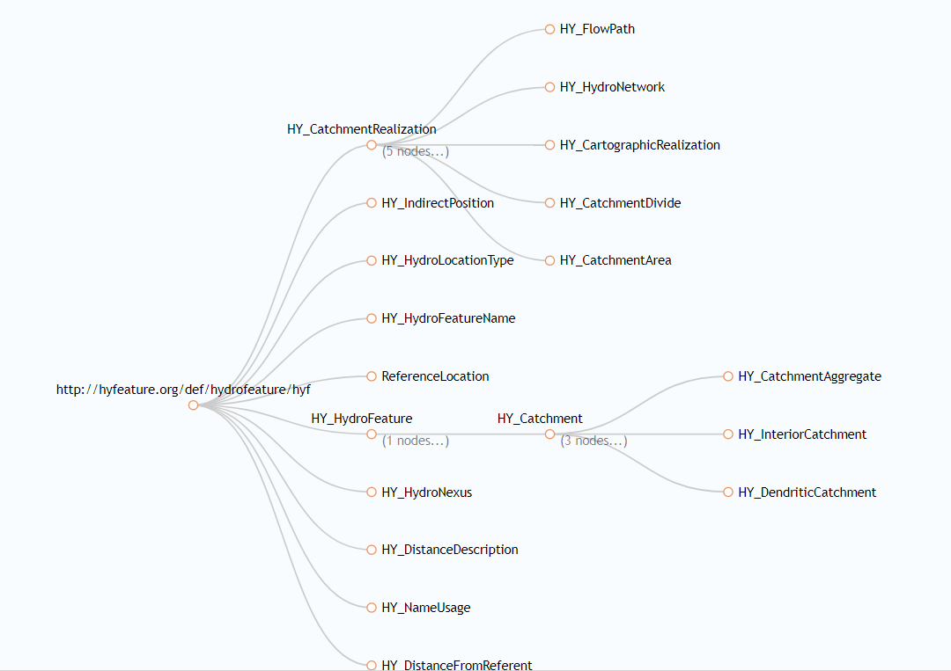
HYF as SKOS hierarchy

Slide 9
OWL encoding?
Can cope with variations
Painful to write and debug SPIN
Named graphs need to be consistently used in different steps
Maybe inferencing embedded in system makes this simpler
Current method flexible for any REST API however
Multiple formats can be offered
OWL profiles
What is actually most useful however?
Next round of IE should explore deeper linking use cases?

Slide 10
Component Architecture
DJANGO Admin UI
DJANGO Custom UI
URIrewriter
Redirection rules
Spec docs
ModSpec
FeatureTypes
(OWL encodings)
OWL
encodings
Register relationships
(metadata standards)
codelists
SKOS
Build useful views
Register
SKOS-API
VoiD-API
*-API
RDF-IO
SpecRef
Django module
REST API
SPARQL
LDA(lite)
LDA(lite)
RDF4J 3-store
Domain
Rules
SPIN reasoner
Semantics engine

Slide 11
Discussion
Also going on in GeoSciML SWG, ELFIE and ad’hoc meeting in BRGM with some TC survivors on Friday 23rd
What is the right approach ?
Pure tool oriented -> just a change of encoding
“OWLification” -> need some ‘ontologist’ curation of the above to benefit from OWL expressivity
Restarting from the blank page

