Slide 1
WaterML-WQ
A global use case

Slide 2
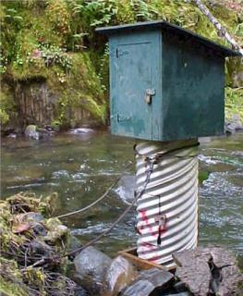

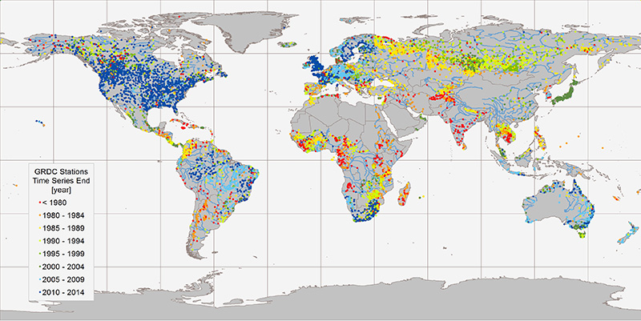

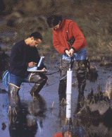

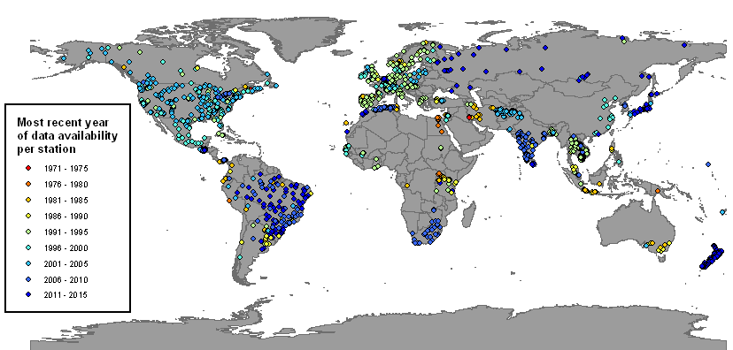

Global water data provision
Water Quantity
Water Quality

Slide 3
GEMStat
Consists of more than:
4.9 Mio records
100 parameters
5000 stations
100 countries
Web services
WFS

Slide 4
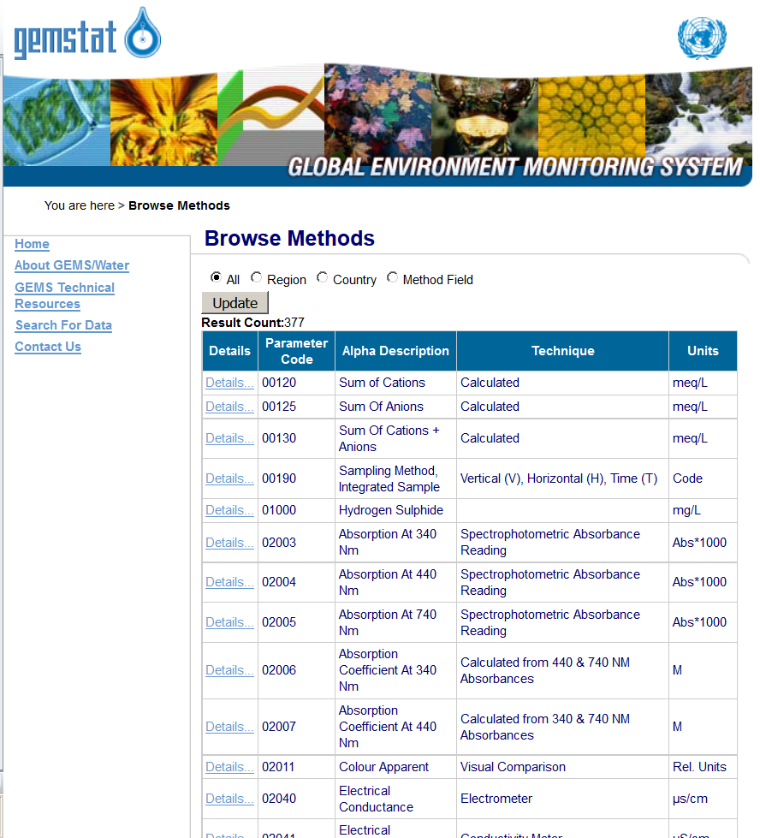
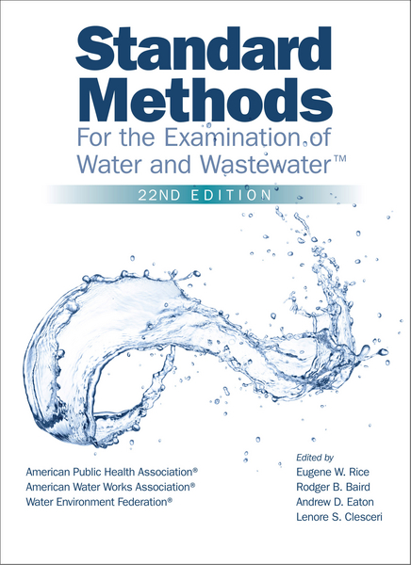
Analytical Methods Dictionary
Content
Title of analytical method
Instrumentation used
Principle of the method
Method Detection Limit (MDL)
Agency requesting the method
Literature reference
=> NAQUADAT: Dictionary of the National Water Quality Data Bank

Slide 5
Referencing water data
AMAZON
(Sampled Feature)
Target
WaterBody
Monitoring Point
OBIDOS
(Sampling Feature)
Observation
Where?
How?
Method
Result
What?
Parameter
HY_Features
AMMONIA
(Observed Property)
APHA 4500-NH3
(Procedure)
WaterML 2

Slide 6
Observable Properties
GFI_Feature
+featureOfInterest
1
0..*
OM_Observation
GF_PropertyType
+
phenomenonTime
1
+
resultTime
+observedProperty
+
validTime [0..1]
+
resultQuality [0..*]
+
parameter [0..*]
0..*
1
+procedure
+result
OM_Process
Any
Ontologies
Linked Data
S. Cox et al., 2014

Slide 7
Discussion
Approach: Extend WaterML –WQ with semantically enabled, linked method vocabulary
Ontologies
CMO: Chemical Methods Ontology
FIX: Physico-chemical methods and properties (inactive)
Governance
Samplings (WQX)

