Slide 1

Continuous Water Quality Sensor Data Exchange Interoperability
6th, WMO/OGC Hydrology DWG
Orleans, BRGM, September 21 – 23, 2015
David Blodgett – U.S. Geological Survey

Slide 2
Motivation
Generally, “Continuous Water Quality Sensor Data” (CWQSD) is becoming ubiquitous in research and operations. An exchange best practice is needed.
“… goal of the U.S. Environmental Protection Agency (EPA) to promote the use of innovative technology in the sharing and use of sensor data as part of the EPA Office of Water’s Technology Blueprint.”
Ostensibly, WaterML2 Part 1 and 2 will support CWQSD use cases. These use cases need to be explored, tested, and documented. Any refinements or extensions of standards should be pursued.

Slide 3
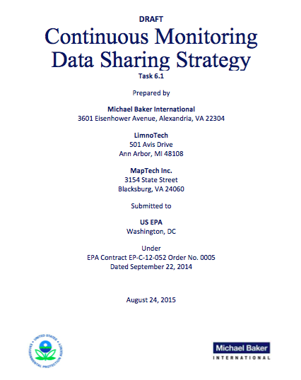

Slide 4
Concept and Timeline of EPA Pilots
From EPA study: “OGC will collaborate on the development of mechanisms for effectively tying CWQSD datasets to related QC data, such as pre‐, intra‐ and post‐deployment lab and site discrete sample measurements.”
2015 - 2016
Pilot and refine - establishing workflows and testing standards in the context of this network.
Opportunity (requirement?) to develop best practices that could be candidates for the OGC process.
2017 - 2018
Build and test working infrastructures
Opportunity to formalize (standardize?) documentation of best practices.
2019 and beyond
Scale up to operations

Slide 5
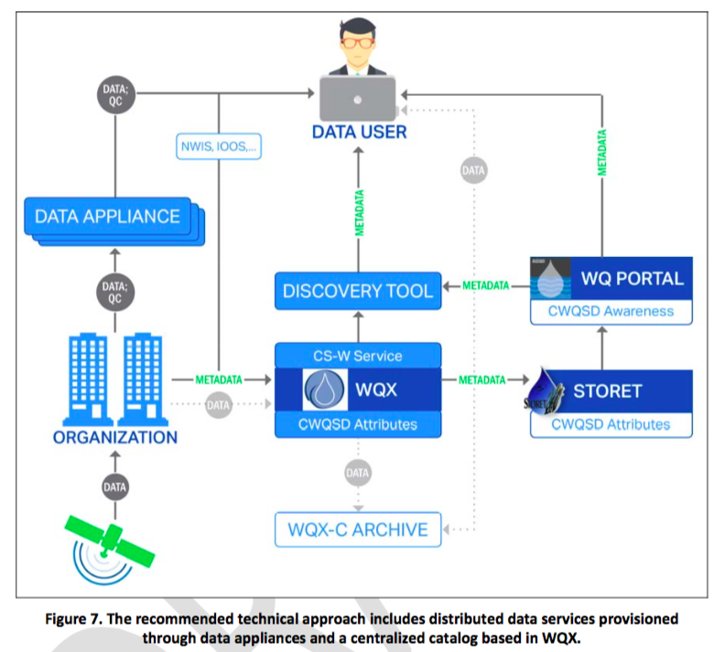
DRAFT Architecture for Pilot Evaluation

Slide 6
Draft Recommendation
“The data appliance will ingest and store observational data, perform a series of automated quality control steps, and make the data and relevant metadata available through data services compliant with the Open Geospatial Consortium (OGC) Approaches for Sharing Continuous Monitoring Data Sensor Observation Service (SOS) standard. OGC SOS provides access to data through the WaterML 2.0 standard and to metadata through the SensorML standard.”

Slide 7
Aspects of existing standards for discussion.
WaterML2 Part 1: Handling of (inherent and inherited) sensor properties associated with a time series.
WaterML2 Part 2 (?): Handling of reference to related discrete water quality samples and calibration information.
SensorML… Starfish Fungus Language? (For discussion)

Slide 8
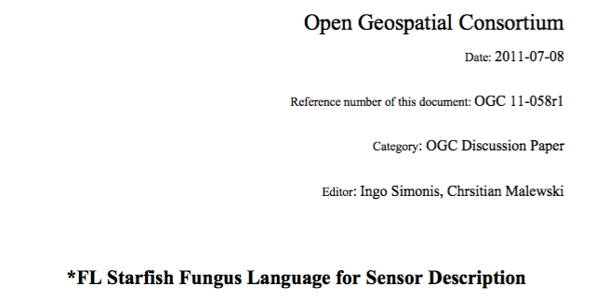
Finding a pragmatic approach… *FL ??
Two parts: Sensor and deployment/calibration
Inherent properties of a sensor of a given model. (Specified / guaranteed by the manufacturer)
Acquired properties of a deployed sensor.
(Specified by the sensor deployer or maintainer)

Slide 9
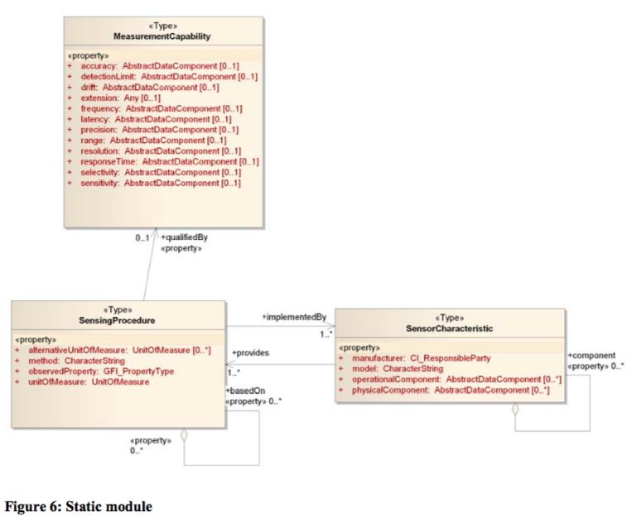
Static/Sensor Module

Slide 10
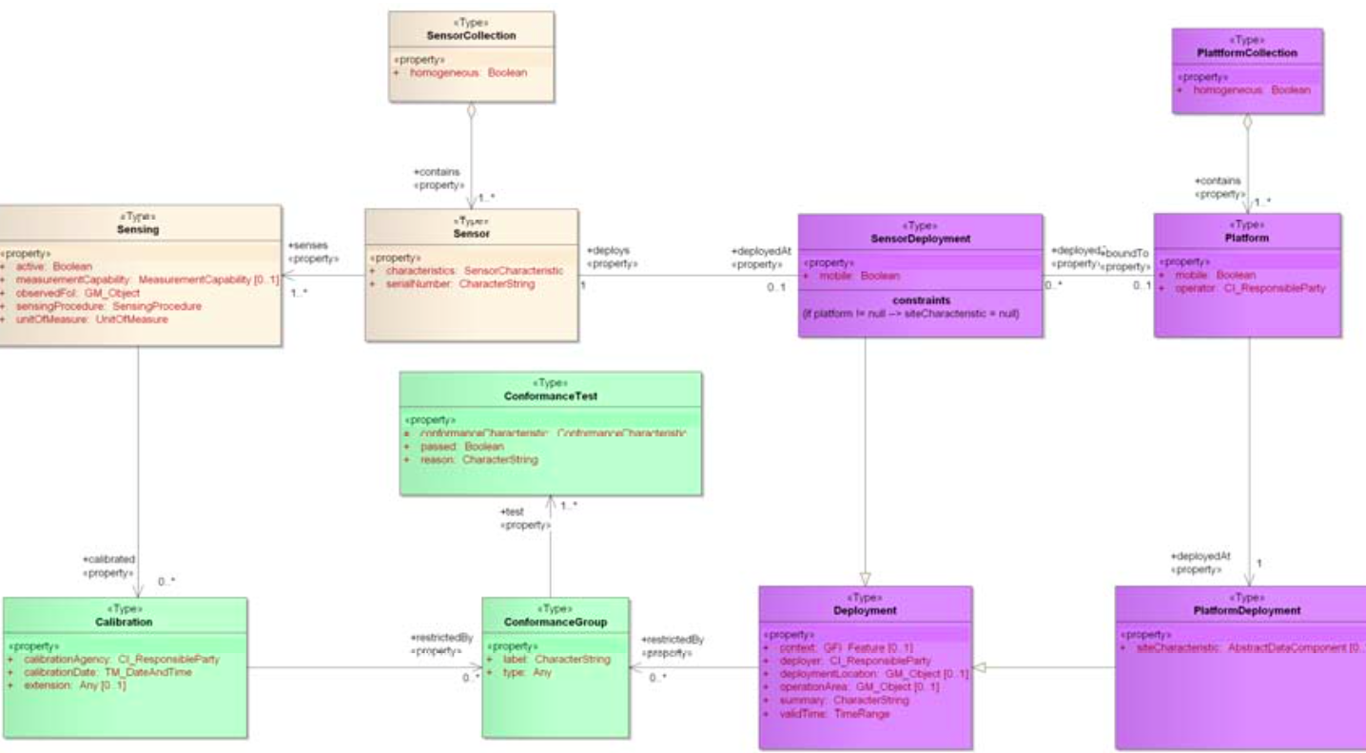
Dynamic (Deployment / Calibration)

Slide 11
A Proposed Activity
Evaluate existing system of standards for delivery of well documented CWQSD through use case and data analysis.
Hydrology Profile of SOS 2.0
WaterML2 Part 2
CSW / ISO metadata (?)
Outcome would be an ER summarizing the outcomes, what a best practice might look like, and what changes to existing specs may be warranted.

Slide 12
References
WaterML2 Water Quality: https://portal.opengeospatial.org/files/?artifact_id=59651&version=1
StarFish Fungus Language: https://portal.opengeospatial.org/files/?artifact_id=44438&version=2

