Slide 1
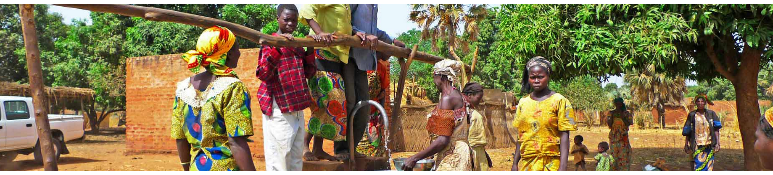



Water Sensor Monitoring in Kinshasa
stephane.barthon@aquasys.fr
09/2015

Slide 2
Presentation
IT Company
Since 1996
Solutions for Water ressource management
Provider for companies which manage water networks

Slide 3
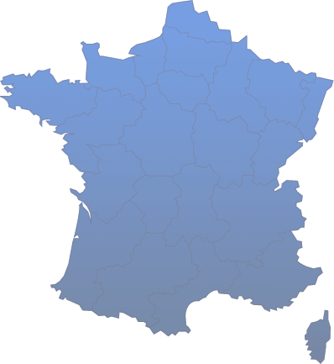







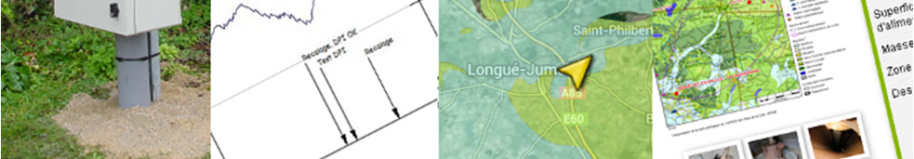
Sensor Network Management
Multiple data types: piezometers, rain sensors, quality, pumping volumes, …
Independent from equipment providers
Multichannels: modem, email, SMS, FTP
Internet solutions for publication
http://showcase.aquasys.fr

Slide 4
Water Sensor Monitoring in Africa
Functional requirements
Technical requirements
Getting a « real-time » snapshoot
Station description
Status of the equipment
Events
Gathering data automatically
Pumping
Piezometer
Sending feedback for financer
Be as transparent as possible
Indicators of running days
Hard working conditions
power supply
communication
Maintenance
Cost
equipments
data exchange

Slide 5
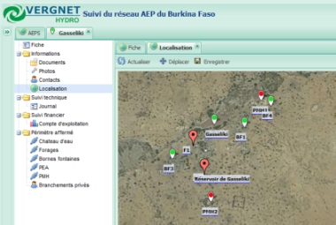




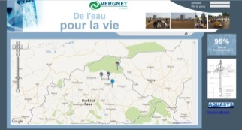

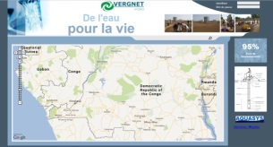








Water Sensor Monitoring in Africa
Aquasys Solution
Network
managers
Station
managers
Craftsmen
http://vergnet-hydro.aquasys.fr/demo/

Slide 6
Actual Status of the project
In production
2 dedicated servers in France
Kinshasa
1 SMS Server
25 equipments
Testing sensors for pumping volumes in Burkina
Internal WS and sensor transferts
Funders must go to the website
to check information
Burkina
5 networks
265 equipments
http://vergnet-hydro.aquasys.fr/burkina/
http://vergnet-hydro.aquasys.fr/rdc/
http://vergnet-hydro.aquasys.fr/demo/

Slide 7
Next steps
Step 1
Integrating new counters:
piezometer, water flow, …
Releasing data through public web services
Integrating data in the Unicef environment:
station description, status
Pushing SMS alerts

Slide 8
Next steps
Step 2
Exchanging data with standard protocols
Spreading the solution in different countries and create a uptodate map of the equipments monitored by the Unicef programs:
https://ecole-village-assainis-bdd.cd/
http://www.rgc.cd/
Step 3
Using realtime sensors with new channels:
GPRS, Sigfox
Spreading these solutions in our core applications

Slide 9
Aquasys Requirements
Normalizing the station description and data
Getting information about standards, protocols, web services, …
Technical supports for implementing these solutions
« Marketing » supports to decide our partners to get into these technologies

Slide 10

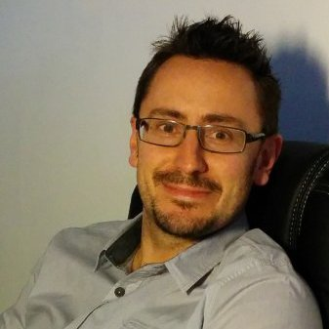
Supports
www.aquasys.fr
Stephane.barthon@aquasys.fr
+33 (0)6 70 75 41 97
2, Rue de Nantes
44710 PORT ST PÈRE - FRANCE
Stéphane Barthon

