Slide 1
UKEOF + Semantic linking of complex properties, monitoring processes and facilities
“Semantic linking of complex properties, monitoring processes and facilities in web-based representations of the environment”
LeadBetter and Vodden, International Journal of Digital Earth, 2015.

Slide 2

CEH “Monitoring & Observation Systems”
CEH runs a wide variety of monitoring activities:
Long term experimental catchments
Long-term biodiversity monitoring
Shorter term experiments
Lots of complex measurements
- Informing decision making, identifying trends and tipping points
- Requires robust evidence drawn from data-rich systems.
- Not to mention understanding and justification of what we do and how much it costs

Slide 3

Monitoring & Observation Systems
What do we want to know (currently):
“Where have we measured X” ?

Slide 4
Where have we measured “X” ?
What do you mean by “X” ?
What do you mean by “measured” ?
What do you mean by “where” ?
Need to know the environmental context.
As a first step, could we use metadata
to approach the problem?

Slide 5

What we have: UK EOF
Environmental Programmes
Monitoring Activities
Location of individual Facilities

Slide 6
UKEOF

Slide 7
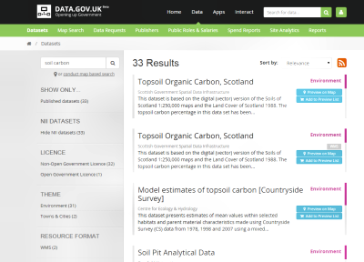
What we have: data.gov.uk
Data Publishers
Datasets
Data access services

Slide 8
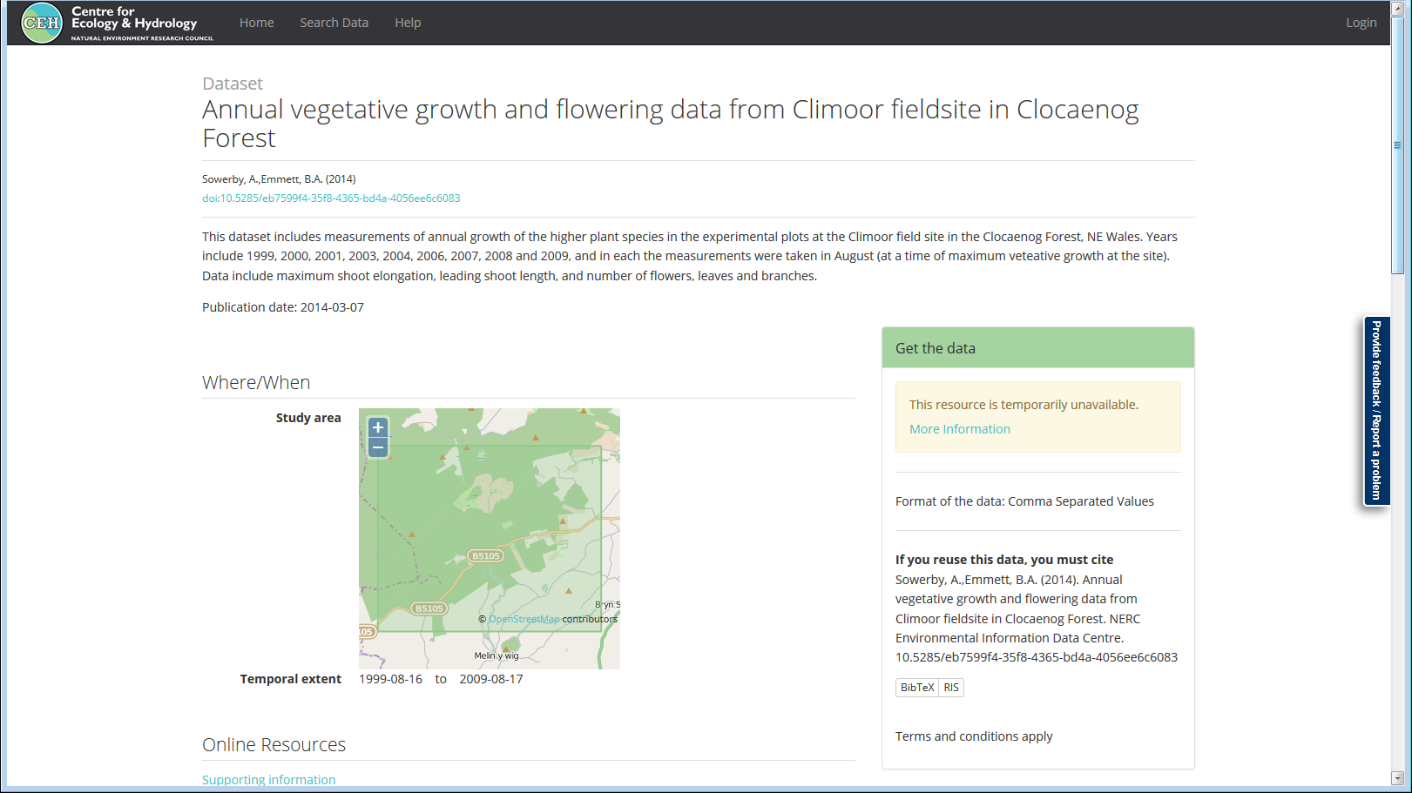
Metadata example

Slide 9
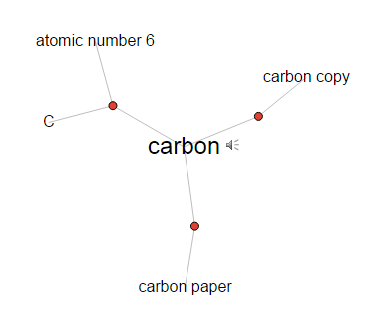
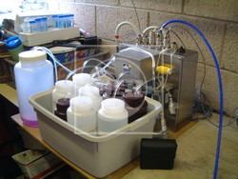

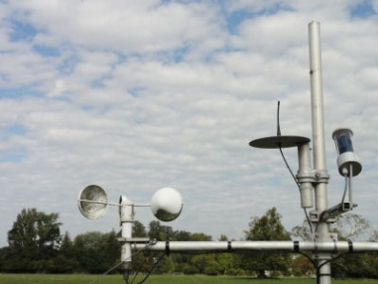
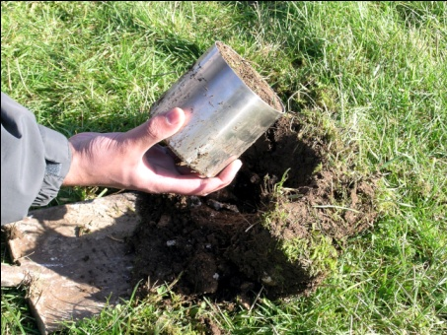
How to connect and exploit these ?
X = “DOC”
Process
Thesaurus: “Substance”
Activity
?
Data Access
Facility
Monitored
Property
Organic
Carbon

Slide 10
Proposed approach
Could trawl the metadata to discover:
What was monitored (the determinands & units).
Which monitoring facilities that the data came from.
Extract metadata and mark up using defined vocabularies.
Transform to RDF & load into a triple-store.
Use SPARQL & linked data to query via SKOS defined concepts, and “broader/narrower” semantics.

Slide 11
Bridging the concepts
Dataset
Metadata
INSPIRE O&M
Observable Properties
Datasets originate from facilities
INSPIRE Environmental Monitoring Facilities
Properties are
recorded in
datasets
Vocabularies are used to define
properties
Facilities
can be
located
SKOS
Determinand & Units
Vocabularies
Geo-location
Where have we measured “X” ?

Slide 12
Making use of:
Information from
UKEOF (INSPIRE EMF)
Metadata from catalogues (ISO19115)
NERC Vocabularies of parameters and methods
Describing measurements:
Complex Properties Model (BODC development of INSPIRE extension to O&M)
Linking complex properties to EMF instances:
Monitoring Properties “model”
Linking datasets to EMF monitoring activities:
- PROV

Slide 13
cpm:ObservableProperties
An observable property is a compound concept made up of “atomic” component concepts.
There will always be:
An Object of interest
The Property being measured
And optionally:
Units of Measure
Constraints
Statistical Measures
A Matrix
cpm: Observable Property
*
cpm:
matrix
cpm:
objectOf
Interest
cpm:
property
cpm:
UnitOf
Measure
cpm:
statistical
Measure
Matrix
*
Object
Of
Interest
*
Property
*
cpm:
restriction
UnitOf
Measure
*
Statistical
Measure
*
Mandatory
Constraint
*
Optional
* = rdf:type skos: Concept

Slide 14
Standard model for complex properties:
A Monitored Property is:
An Observable Property
of an Object Of Interest
is a Property
at a geographic Feature Of Interest
by a Standard Procedure
in a Unit Of Measure
with Constraints
as a Statistical Measure
from a Matrix

Slide 15
Begin with Compound Term
Monthly mean dissolved lead (ppb) in water taken from the river Thames by sampling
Term
Measure
Feature
Method
Statistical
Function
Constraint
Object Of
Interest
Property
Unit Of
Measure
Matrix

Slide 16
Isolate Feature
Monthly mean dissolved lead (ppb) in water taken from the river Thames by sampling
Term
River Thames
Measure
Feature
Method
Statistical
Function
Constraint
Object Of
Interest
Property
Unit Of
Measure
Matrix

Slide 17
Isolate Method
Monthly mean dissolved lead (ppb) in water taken from the river Thames by sampling
Term
River Thames
Measure
sampling
Feature
Method
Statistical
Function
Constraint
Object Of
Interest
Property
Unit Of
Measure
Matrix

Slide 18
Remainder = Measure
Monthly mean dissolved lead (ppb) in water taken from the river Thames by sampling
Term
River Thames
Monthly mean dissolved lead (ppb) in water
sampling
Measure
Feature
Method
Statistical
Function
Constraint
Object Of
Interest
Property
Unit Of
Measure
Matrix

Slide 19
Identify Statistical Function (if present)
Monthly mean dissolved lead (ppb) in water taken from the river Thames by sampling
Term
River Thames
Monthly mean dissolved lead (ppb) in water
sampling
Measure
Feature
Method
monthly
mean
Statistical
Function
Constraint
Object Of
Interest
Property
Unit Of
Measure
Matrix

Slide 20
Identify Matrix (if present)
Monthly mean dissolved lead (ppb) in water taken from the river Thames by sampling
Term
River Thames
Monthly mean dissolved lead (ppb) in water
sampling
Measure
Feature
Method
monthly
mean
water
Statistical
Function
Constraint
Object Of
Interest
Property
Unit Of
Measure
Matrix

Slide 21
Identify Object Of Interest
Monthly mean dissolved lead (ppb) in water taken from the river Thames by sampling
Term
River Thames
Monthly mean dissolved lead (ppb) in water
sampling
Measure
Feature
Method
monthly
mean
dissolved
lead
water
Statistical
Function
Constraint
Object Of
Interest
Property
Unit Of
Measure
Matrix

Slide 22
Identify Unit Of Measure
Monthly mean dissolved lead (ppb) in water taken from the river Thames by sampling
Term
River Thames
Monthly mean dissolved lead (ppb) in water
sampling
Measure
Feature
Method
monthly
mean
dissolved
lead
ppb
water
Statistical
Function
Constraint
Object Of
Interest
Property
Unit Of
Measure
Matrix

Slide 23
What is the Property ?
Monthly mean dissolved lead (ppb) in water taken from the river Thames by sampling
Term
River Thames
Monthly mean dissolved lead (ppb) in water
sampling
Measure
Feature
Method
monthly
mean
dissolved
lead
???
ppb
water
Statistical
Function
Constraint
Object Of
Interest
Property
Unit Of
Measure
Matrix

Slide 24
Supply Missing/Implied Concepts
Monthly mean dissolved lead (ppb) in water taken from the river Thames by sampling
Term
River Thames
Monthly mean dissolved lead (ppb) in water
sampling
Measure
Feature
Method
monthly
mean
dissolved
lead
Concentration
ppb
water
Statistical
Function
Constraint
Object Of
Interest
Property
Unit Of
Measure
Matrix

Slide 25
Review Concepts
Monthly mean dissolved lead (ppb) in water taken from the river Thames by sampling
Term
River Thames
Monthly mean dissolved lead (ppb) in water
sampling
Measure
Feature
Method
monthly
mean
dissolved
lead
Concentration
ppb
water
Statistical
Function
Constraint
Object Of
Interest
Property
Unit Of
Measure
Matrix

Slide 26
Identify Constraints
Monthly mean dissolved lead (ppb) in water taken from the river Thames by sampling
Term
River Thames
Monthly mean dissolved lead (ppb) in water
sampling
Measure
Feature
Method
monthly
mean
dissolved
lead
Concentration
ppb
water
Statistical
Function
Constraint
Object Of
Interest
Property
Unit Of
Measure
Matrix

Slide 27
Review Labels
Monthly mean dissolved lead (ppb) in water taken from the river Thames by sampling
Term
River Thames
Monthly mean dissolved lead (ppb) in water
sampling
Measure
Feature
Method
monthly
mean
dissolved
lead
Concentration
ppb ??
water
Statistical
Function
Constraint
Object Of
Interest
Property
Unit Of
Measure
Matrix

Slide 28
Adopt Preferred Labels
Monthly mean dissolved lead (ppb) in water taken from the river Thames by sampling
Term
River Thames
Monthly mean dissolved lead (ppb) in water
sampling
Measure
Feature
Method
monthly
mean
dissolved
lead
Concentration
micrograms per litre
water
Statistical
Function
Constraint
Object Of
Interest
Property
Unit Of
Measure
Matrix

Slide 29
Further Examples (3)
Empetrum nigrum leading shoot length (millimetres) in Clocaenog Forest from quadrat survey
Term
Clocaenog Forest
Empetrum nigrum leading shoot length (millimetres)
quadrat survey
Measure
Feature
Method
leading shoot
Empetrum nigrum
length
millimetres
Statistical
Function
Constraint
Object Of
Interest
Property
Unit Of
Measure
Matrix

Slide 30
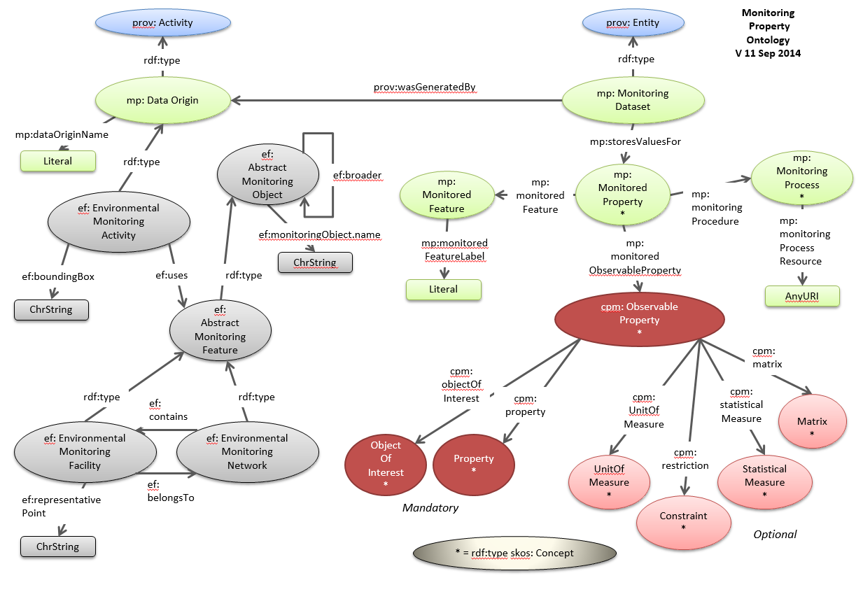

Slide 31
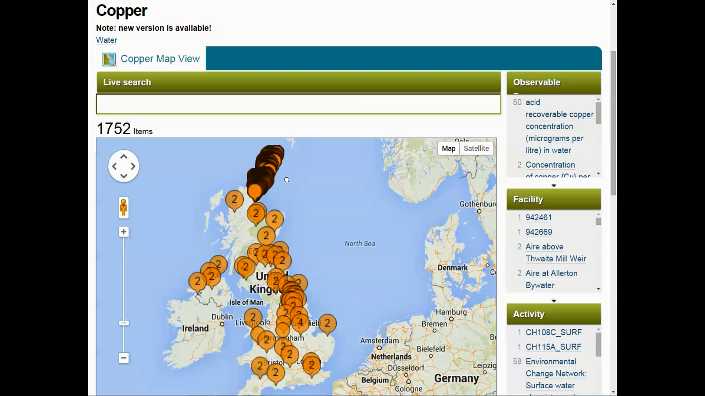
Searching for measurements of “Copper”

Slide 32
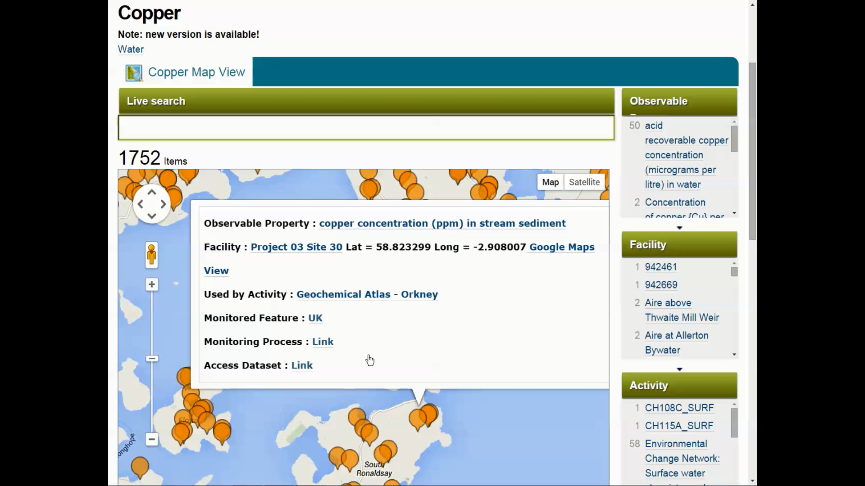

Slide 33
Benefits
Approach based on international standards (W3C, OGC, INSPIRE)
Leveraging existing information sources:
Monitoring facilities
Datasets
Related information
Relatively low cost
Fewer licensing issues with metadata

Slide 34
Issues
“Only” metadata
Having discovered the right dataset, you still need access services to the data itself if you want to go further.
Spatial relationships are complex - but could potentially be better represented using these techniques (e.g. “upstreamness”).

Slide 35
Moving on from the prototype:
Find a scalable infrastructure (how can we cope with millions of “facts”?
Bulk extract and mark-up tools will be needed
Properly answering “where?”
Develop trial applications to explore user interfaces.

