Slide 1
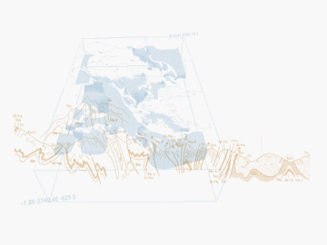
BRGM: Sensor Web feedback
BRGM, S.Grellet, S.Loigerot
OGC HydroDWG Orléans Workshop – 2015-09-20
Notes:
1

Slide 2


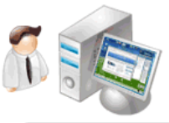


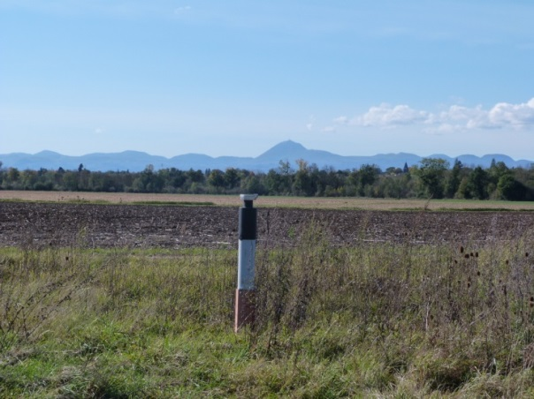

GroundWater Level
Now (2015)
Scientific Center
BSSEAU
National
database
Local Center
Local raw database
7 data/week
(1 a week)
GPRS / GSM/SMS
Every hour
1300 piezometers
> <number>
Notes:
The current process under the national piezometric network is:
- thousand three hundred stations (sensor for water column)
- sending time data, twice a week to the regional center via GPRS remote transmission,
- verification and validation of data by an operator
- storage of raw data in a local database
data available maximum daily, twice per week
hourly data
Efficient but expensive

Slide 3







Tomorrow
(2016 - 2017)
National Center
BSSEAU
Validated
data
Raw
database
Local database
SOS
SOS
Local Center
O&M
1 data per day
Processing
1300 piezometers
> <number>
Notes:
We need to transforme the native data format provide by sensor (we used a software call SIDEV from a french company DSA Technologies.
All sensors supply the rawdatabase (it’s a postgres database). The operators have to validate data series with the local
there remain “sticking points” in this mechanism : we have to transform native data

Slide 4

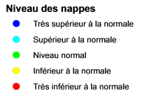
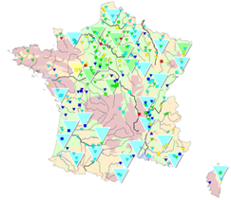




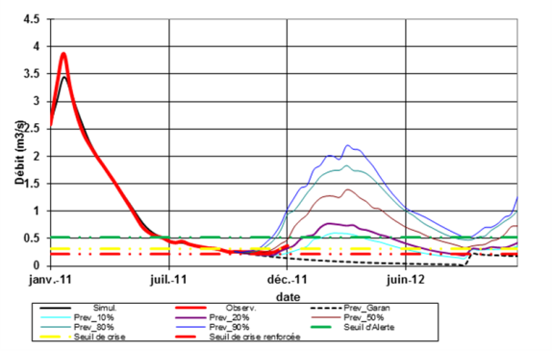
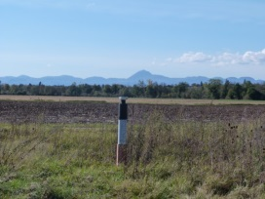
In the near future
Aquifers Weather
National
BSSEAU
Validated
data
Local Center
SOS-T
Raw
database
SOS-T
SOS
O&M
‘Soft’SensorML /
SensorWeb IoT
waterML
waterML
Water police
waterML
Sensor
Modeling
tools
> <number>
Notes:
Only one raw database for all piozometers,
web application as a validation tool
Real time data for modeling tools
For water police : restrictions on water use
For predictions map of the condition of the resource, like a weather prediction

Slide 5
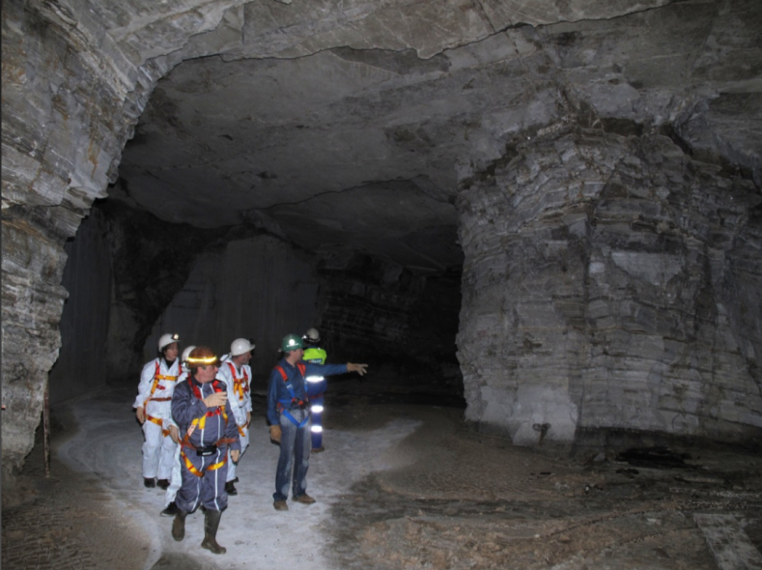
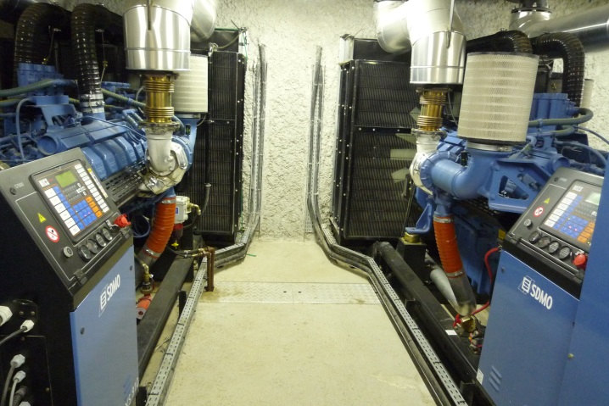
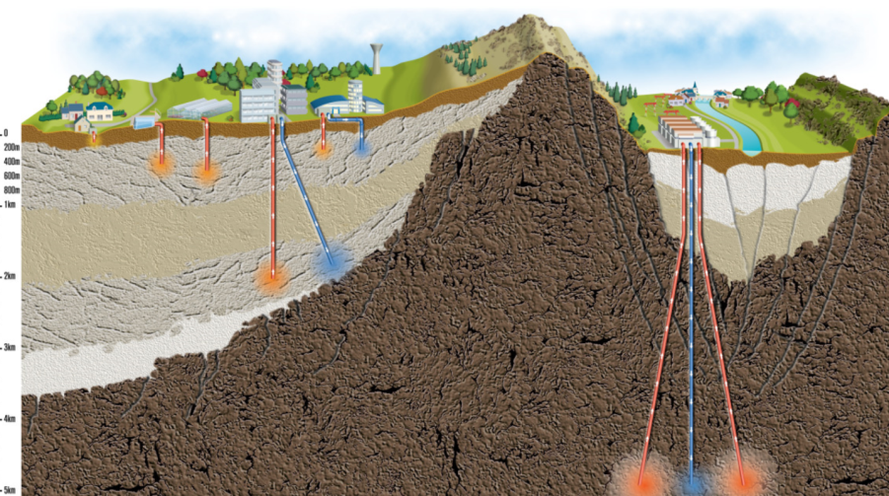
Remaining aspects
Connect all our other sensors
  Mines security, geothermy, other …
OGC HydroDWG Orléans Workshop – 2015-09-20
> <number>
Notes:
2
2

Slide 6

Remaining aspects
Sensors
  Remove the case by case adaptators from the system
  Can we have plug and play sensors ?
  Can we as big data producers and/or group enforce some sensor description standard
OGC HydroDWG Orléans Workshop – 2015-09-20
> <number>
Notes:
2
2

Slide 7
Remaining aspects
SOS Server
  3,5 are being tested -> decide which one to keep for production
  Directly connected to our infrastructure to avoid duplication of millions of measurements,
  Implement the GetObservationById :
  decide which external identifier for an Observation to use
  Implement GetDataAvailability
  Need to expose properly DataQuality according to the specific workflow of validation we have
OGC HydroDWG Orléans Workshop – 2015-09-20
> <number>
Notes:
2
2

Slide 8
Remaining aspects
Domain models
  Aquifer level forecast
BRGM : Groundwater level SOS
Modeling
tools
MeteoFrance :
weather station SOS
3 of them
to be opened
SCHAPI : stream gages
JSON
OGC HydroDWG Orléans Workshop – 2015-09-20
> <number>
Notes:
2
2

Slide 9
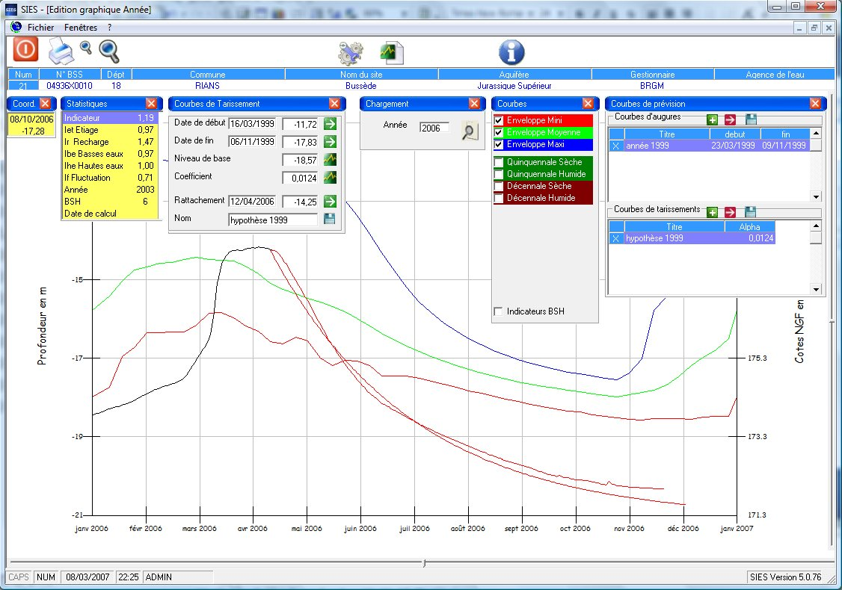
Remaining aspects
Provide tooleries to our experts
  Screenshot of the current tool used
Piezometer water
level statistics
(min water level,
max, …)
Depletion curve
Groundwater level
forecast
OGC HydroDWG Orléans Workshop – 2015-09-20
> <number>
Notes:
2
2

Slide 10
Remaining aspects
Provide tooleries to our experts
  Connect those tools to the standards
  Port them
    Online
    On common desktop tools such as QGIS.
OGC HydroDWG Orléans Workshop – 2015-09-20
> <number>
Notes:
2
2

