Slide 1
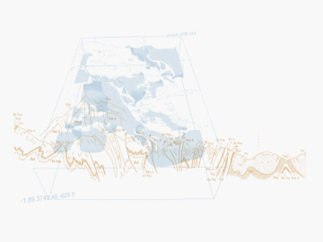
Inspire : O&M guidelines update, Inspire MIWP 7a work
BRGM, S.Grellet
OGC HydroDWG Orléans Workshop – 2015-09-20
Notes:
1

Slide 2
Cross-Thematic Working Group on O&M
Scope : Several Inspire themes included measured / modeled / simulated data
Inspire themes directly concerned
  Geology
  Oceanographic geographical features
  Atmospheric conditions and Meteorological geographical features
  Environmental monitoring facilities
  Soil
Other themes indirectly evoke Observations
  Land Cover, Habitats and biotopes & Species distribution, Human Health & Safety …
OGC HydroDWG Orléans Workshop – 2015-09-20
> <number>
Notes:
2
2

Slide 3
Cross-Thematic Working Group on O&M
Goals
  Determine requirements for O&M within INSPIRE
  Provide recommendations for
  Observations on INSPIRE features,
  Referencing of observations from INSPIRE features,
  Use of elements of Sensor Web Enablement.
Version actually published :
  http://inspire.jrc.ec.europa.eu/documents/Data_Specifications/D2.9_O&M_Guidelines_v2.0.pdf
OGC HydroDWG Orléans Workshop – 2015-09-20
> <number>
Notes:
2
2

Slide 4
Next steps
Inspire implementing rules have been voted
  By each Member States parliaments
Inspire now enters maintenance
  Several maintenance groups including MIWP-7a which targets:
    Updated the guidelines for the use of Observations & Measurements and Sensor Web Enablement-related standards in INSPIRE Annex II and III data specification development (D 2.9) – example in the following slides
    Updated technical guidance for INSPIRE download services, including sections on download services for observations
    Example applications (use cases) serving/consuming observation data through : INSPIRE/SOS
  MonitoringFacility + Observation cluster :
  https://themes.jrc.ec.europa.eu/groups/profile/207/environmental-monitoring-and-observations-cluster
Timeline : By Mid-2016
OGC HydroDWG Orléans Workshop – 2015-09-20
> <number>
Notes:
2
2

Slide 5
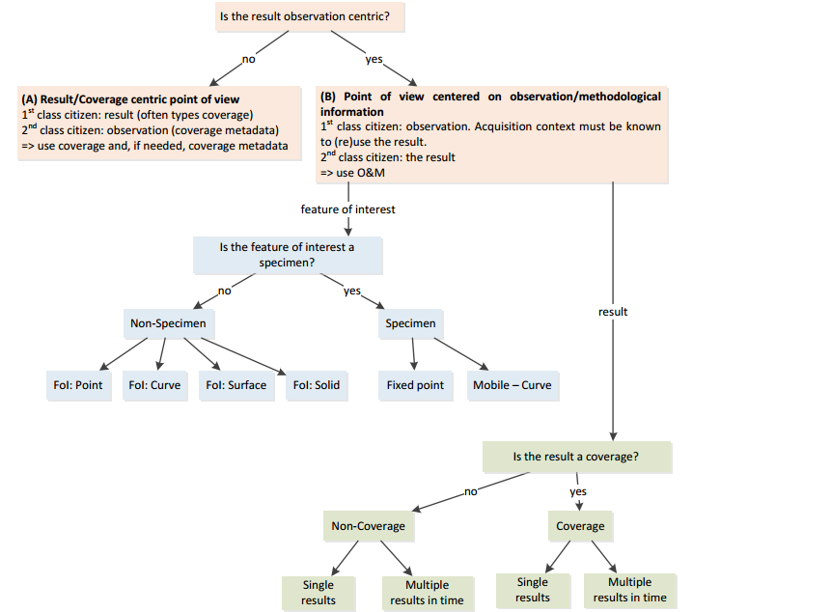
O&M decision tree
OGC HydroDWG Orléans Workshop – 2015-09-20
> <number>
Notes:
2
2

Slide 6
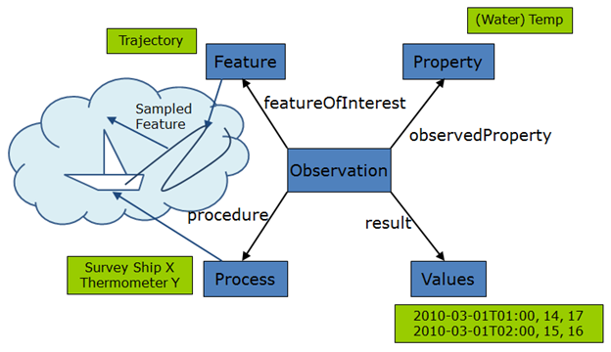
O&M design patterns
We produced several of them
  Theoretically designed
  Now we have plenty of questions to solve !
  guidance needs update
  One example below:
OGC HydroDWG Orléans Workshop – 2015-09-20
> <number>
Notes:
2
2

Slide 7
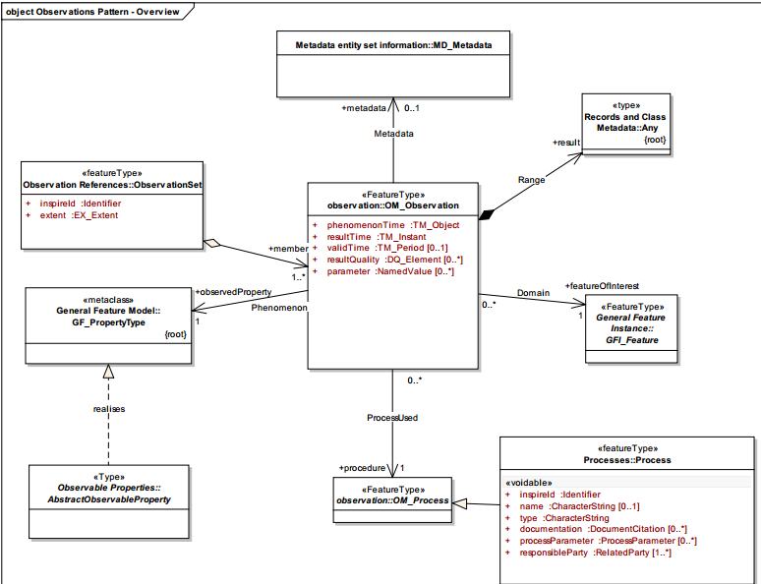
O&M extension for Inspire
Observation package
OGC HydroDWG Orléans Workshop – 2015-09-20
> <number>
Notes:
2
2

Slide 8
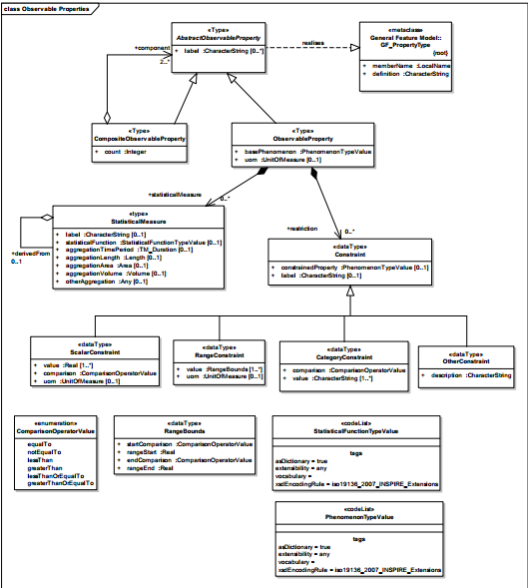
O&M extension for Inspire
Observable properties : D.Lowe work
OGC HydroDWG Orléans Workshop – 2015-09-20
> <number>
Notes:
2
2

Slide 9
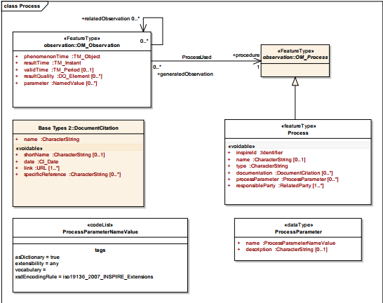
O&M extension for Inspire
Process
OGC HydroDWG Orléans Workshop – 2015-09-20
> <number>
Notes:
2
2

Slide 10
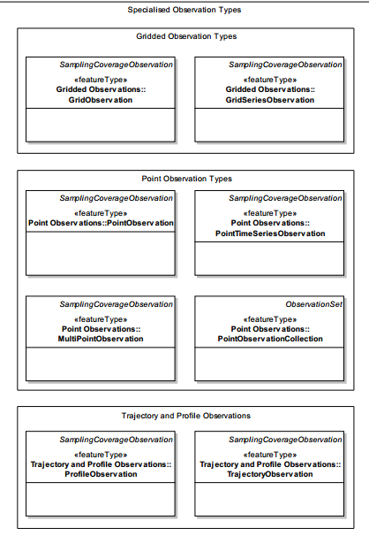
O&M extension for Inspire
Specialised observation
OGC HydroDWG Orléans Workshop – 2015-09-20
> <number>
Notes:
2
2

Slide 11
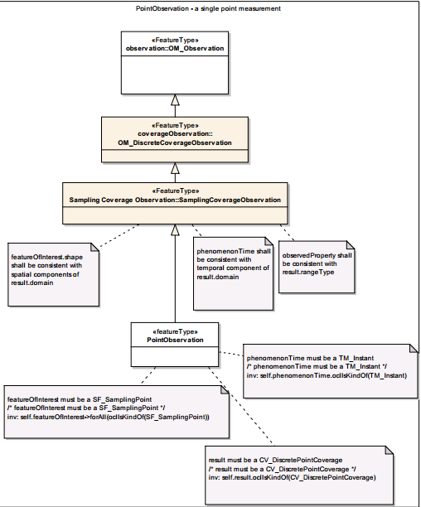
O&M extension for Inspire
Specialised observation
  Ex : PointObservation
OGC HydroDWG Orléans Workshop – 2015-09-20
> <number>
Notes:
2
2

Slide 12
Other aspects needing reclarification
Result encoding
  Example provided : SWE Result Encoding, WaterML 2.0 (?TimeseriesML ?), GML Feature, GML Coverage,
  Linking to external file containing the result encoded in proprietary, binary format : NetCDF, SEG-Y, LAS, WITSML…
  Still in annex : how can we advertise before hand what content will be retrieved when querying for Observation ? Solutions with pros / cons
  Need to find some consensus.
Patterns between WFS (Monitoring Facility) & SOS
OGC HydroDWG Orléans Workshop – 2015-09-20
> <number>
Notes:
2
2

Slide 13
Next steps
Might solicit hindsight from HDWG people on specific points
+
work more on existing experience: ex : NZ hydro information sys, *FL, …
OGC HydroDWG Orléans Workshop – 2015-09-20
> <number>
Notes:
2
2

