Slide 1
GEOSS Water Services: Federating Data, Maps & Processing Water Theme for GEOSS Architecture Implementation Pilots 2012-2015
David K Arctur
david.arctur@utexas.edu
University of Texas at Austin Open Geospatial Consortium (OGC)
Presented at the OGC HDWG Workshop
Orleans France, 21 Sept 2015
Acknowledgements: David Maidment, Fernando Salas,
Steve Kopp, Michael Natschke, Simon Cox,
Silvano Pecora, Sean Hodges, Brent Watson,
Peter Salamon, Dan Ames, Jim Nelson,
Alan Snow, Nathan Swain, Cedric David,
Kris Cauwenberghs, Angelica Gutierrez

Slide 2
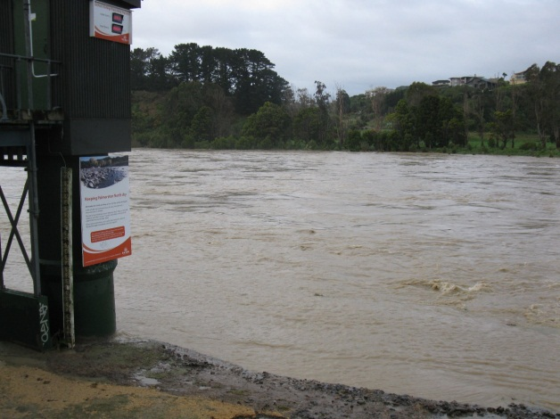
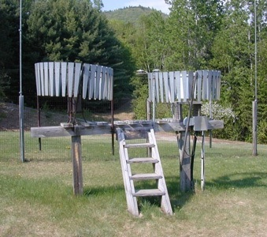
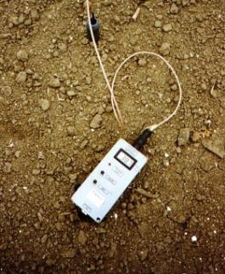
This is a story about millions of small datasets: each with a time series of a variable at a point location…
Water Quantity
Rainfall
Soil Moisture
Notes:
Many projects currently address the topic of Big Data. This project is more about Big Catalogues, to improve ease of discovery and access to time series from hundreds of thousands of stream gauges, rainfall monitors, and soil moisture model outputs, and millions of time series datasets. These are not the only measures of water resources, but are among the most critical.

Slide 3

Outreach through GEOSS Architecture Implementation Pilots (AIP)
WML2 Part 2 Ratings-Gaugings
AIP-6: CUAHSI HIS Central is
ported to open source. Italy, New Zealand, Canada host their own web maps and data services. CEOS Water Portal and Esri integrate their catalogs with GEOSS Broker. NASA generates WaterML time series for GLDAS, NLDAS products. Esri, Kisters develop web maps with time series.
Sensor Observation Service 2.0
Hydrology Profile
Best Practice
AIP-7: France, Belgium, Taiwan host WaterML data services. New Zealand, Belgium host public water data portals. ECMWF/JRC publish GloFAS flood predictions in WaterML. USGS converts NWIS to WaterML2.
AIP-5: Web map of GRDC, Mexico, Dominican Republic stream gage sites created, each site linked to data services where allowed, with web maps hosted at Univ of Texas at Austin.
2012
2013
2014
2015
Notes:
AIP-5:
WMO Global Runoff Data Centre (GRDC) stream gage sites with metadata but no data services.
Mexico, Dominican Republic stream gages mapped by Univ of Texas at Austin.
Kisters-developed coastal subset of GRDC gage sites was developed with WaterML2 data services, during OGC Surface Water Interop Experiment.
AIP-6:
Italy, New Zealand regional water data managers develop templates of WaterML plus web services for stream gage networks.
Canadian precipitation monitoring network of data services for Environment Canada.
AIP-7:
France BRGM develops WaterML data services for groundwater level monitoring network.
Belgium develops the Flemish Water Data Portal for public use.
New Zealand develops Land Air Water Aotearoa (LAWA) water / water quality public data portal.
Taiwan develops the Taiwan Monitoring Network of stream gages.
ECMWF/JRC adapt Global Flood Awareness System (GloFAS) to publish flood predictions in WaterML.
USGS converts its National Water Information System (NWIS) from (CUAHSI) WaterML 1 to (OGC) WaterML 2. (not part of AIP-7)

Slide 4
OGC Observations & Measurements: a way of relating features & phenomena
An Observation is an action whose result is an estimate of the value of some property of the feature-of-interest, obtained using a specified procedure
GFI_Feature
1
+featureOfInterest
0..*
OM_Observation
GF_PropertyType
+
phenomenonTime
1
+
resultTime
+observedProperty
+
validTime [0..1]
+
resultQuality [0..*]
+
parameter [0..*]
0..*
1
+procedure
+result
OM_Process
Any
Source: ISO 19156

Slide 5
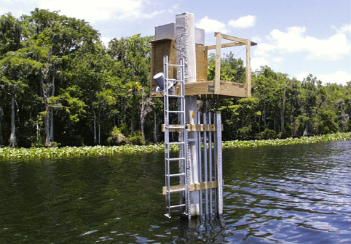
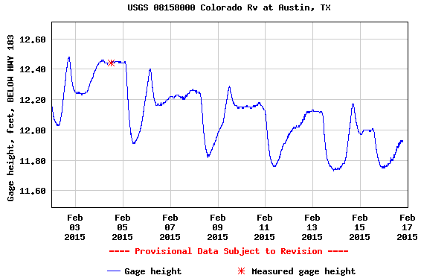
Using OGC O&M model for water level …
(WaterML2 Part 1)
GFI_Feature
Stream Gage
1
+featureOfInterest
sampling feature
River is a
sampled feature
0..*
Stage Height
OM_Observation
GF_PropertyType
+
phenomenonTime
1
+
resultTime
+observedProperty
+
validTime [0..1]
+
resultQuality [0..*]
+
parameter [0..*]
0..*
1
+procedure
+result
Time series of values
OM_Process
Any
Water level measurement
Source: USGS
An Observation is an action whose result is an estimate of the value of some property of the feature-of-interest, obtained using a specified procedure

Slide 6
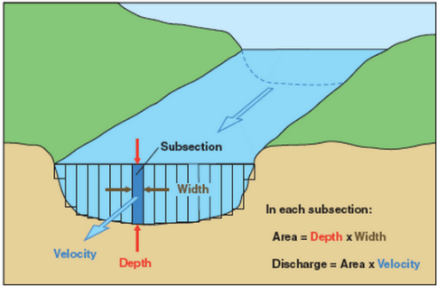
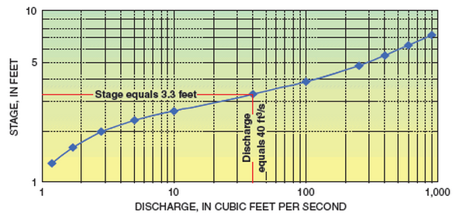
Treating rating curves as a measurement …
(WaterML2 Part 2)
GFI_Feature
Gage Location
1
+featureOfInterest
sampling feature
(Stage, Discharge) pair
0..*
OM_Observation
GF_PropertyType
+
phenomenonTime
1
+
resultTime
+observedProperty
+
validTime [0..1]
+
resultQuality [0..*]
+
parameter [0..*]
0..*
1
+procedure
+result
OM_Process
Any
(Stage, Discharge) tuples
Observation or Conversion Method
Source: USGS
An Observation is an action whose result is an estimate of the value of some property of the feature-of-interest, obtained using a specified procedure
Notes:
Rating curves are developed on a planned & as-needed basis, by taking direct measurements of depth and flow, and plotting the curve from this data. The curve is then used to convert real-time measurements of depth into real-time values of discharge.
The object of WaterML 2.0 Part 2 is to apply the OGC O&M conceptual model and WaterML XML schema to convey the set of (stage, discharge) values.
Source: http://water.usgs.gov/edu/measureflow.html
See also: OGC 13-021r3 WaterML 2.0 – Part 2.

Slide 7
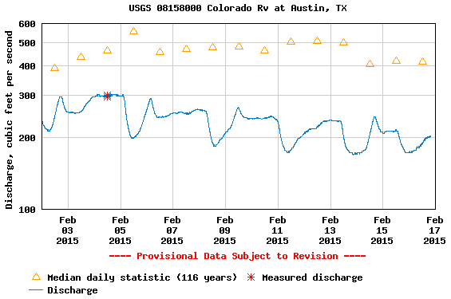
The stream flow can then be determined from the rating curve
(WaterML2 Part 1)
GFI_Feature
Stream Gage
1
+featureOfInterest
sampling feature
River is a
sampled feature
0..*
Discharge
OM_Observation
GF_PropertyType
+
phenomenonTime
1
+
resultTime
+observedProperty
+
validTime [0..1]
+
resultQuality [0..*]
+
parameter [0..*]
0..*
1
+procedure
+result
Time series of values
OM_Process
Any
Flow rate conversion
Source: USGS
An Observation is an action whose result is an estimate of the value of some property of the feature-of-interest, obtained using a specified procedure
Notes:
Graph source: http://waterdata.usgs.gov/nwis/uv?cb_00060=on&cb_00065=on&cb_00065=on&format=gif_default&site_no=08158000&period=&begin_date=2015-02-02&end_date=2015-02-16

Slide 8
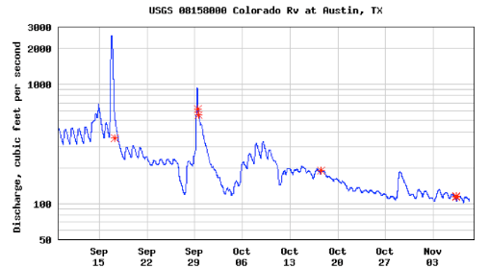

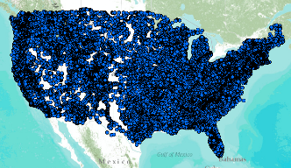
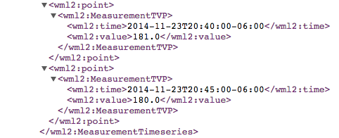
WaterML Web Services CUAHSI, USGS, OGC, WMO…
Water time series data on the internet
24/7/365 service
For daily and real-time data
. . . Operational water web services system for the United States
http://waterservices.usgs.gov/nwis/iv/?format=waterml,2.0&sites=08158000&period=P1D&parameterCd=00060
Notes:
Increasingly, national water data is being published using WaterML to describe time series of observations and model results. This is the current output from the US Geological Survey for one of their tens of thousands of river gauges (this one is on the Colorado River in Austin TX).

Slide 9
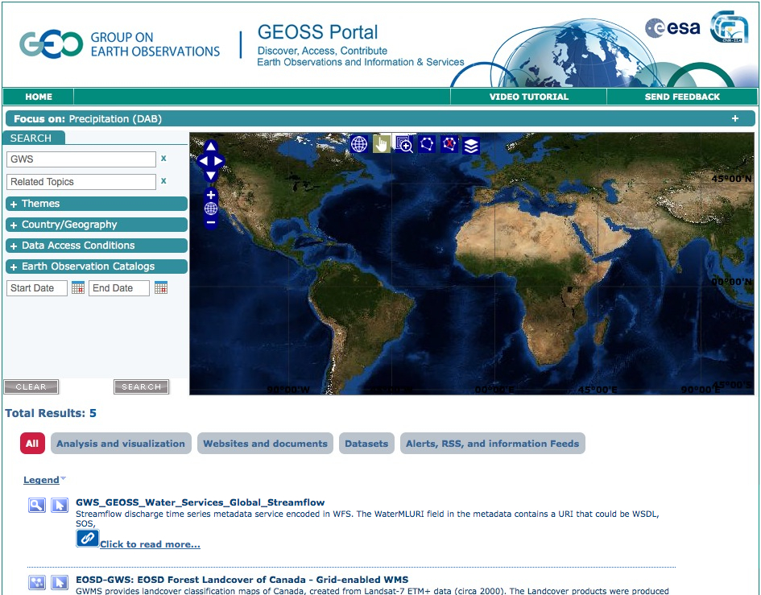
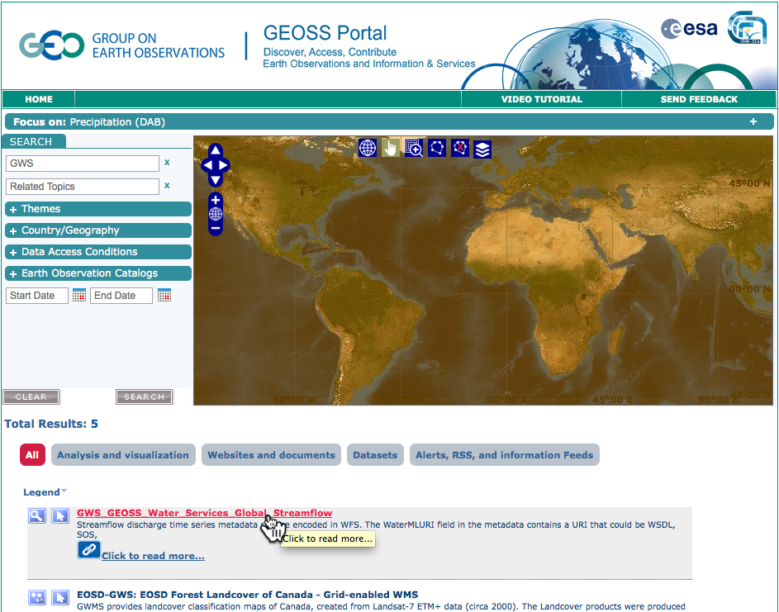
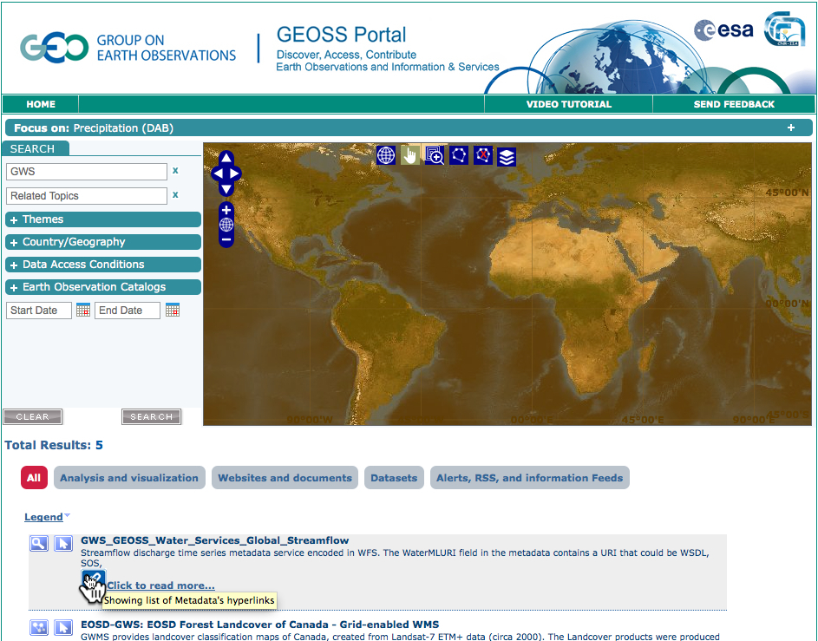
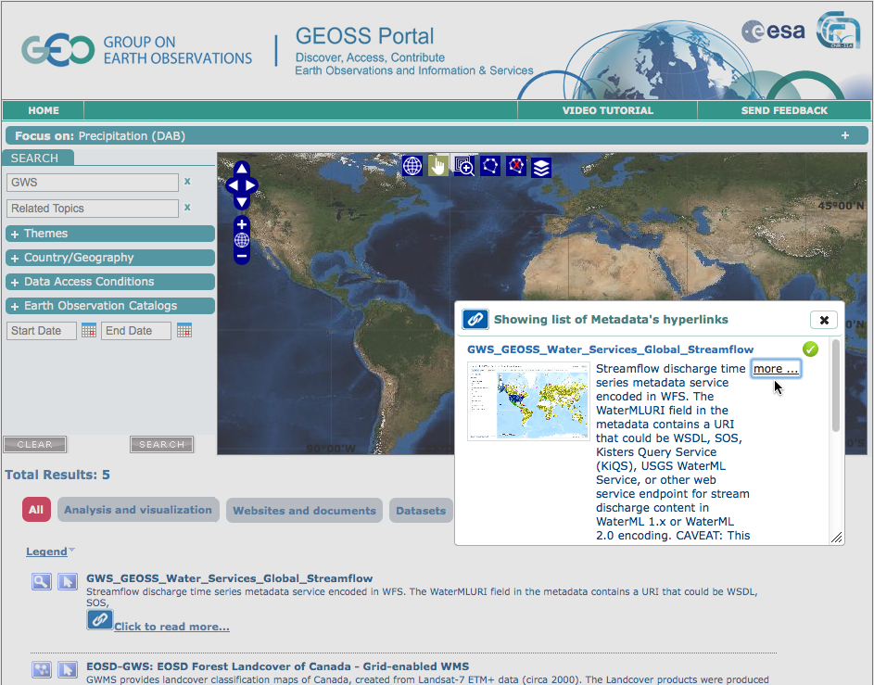
AIP-5 (2012): First resource in GEOSS
Notes:
This slide shows a sequence of steps for searching and accessing data through GEOSS Web Portal (www.geoportal.org)

Slide 10
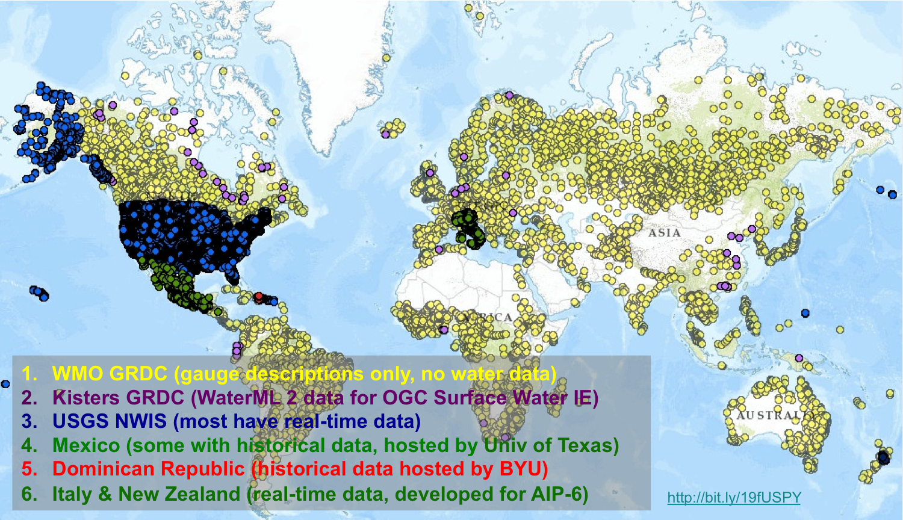
Web map of global stream gages
http://arcg.is/1Ahus75
Notes:
Source map: http://www.arcgis.com/home/webmap/viewer.html?webmap=5efcdfb27d744e3ea65eaf58c06f9d0c
Short URL: http://arcg.is/1Ahus75

Slide 11
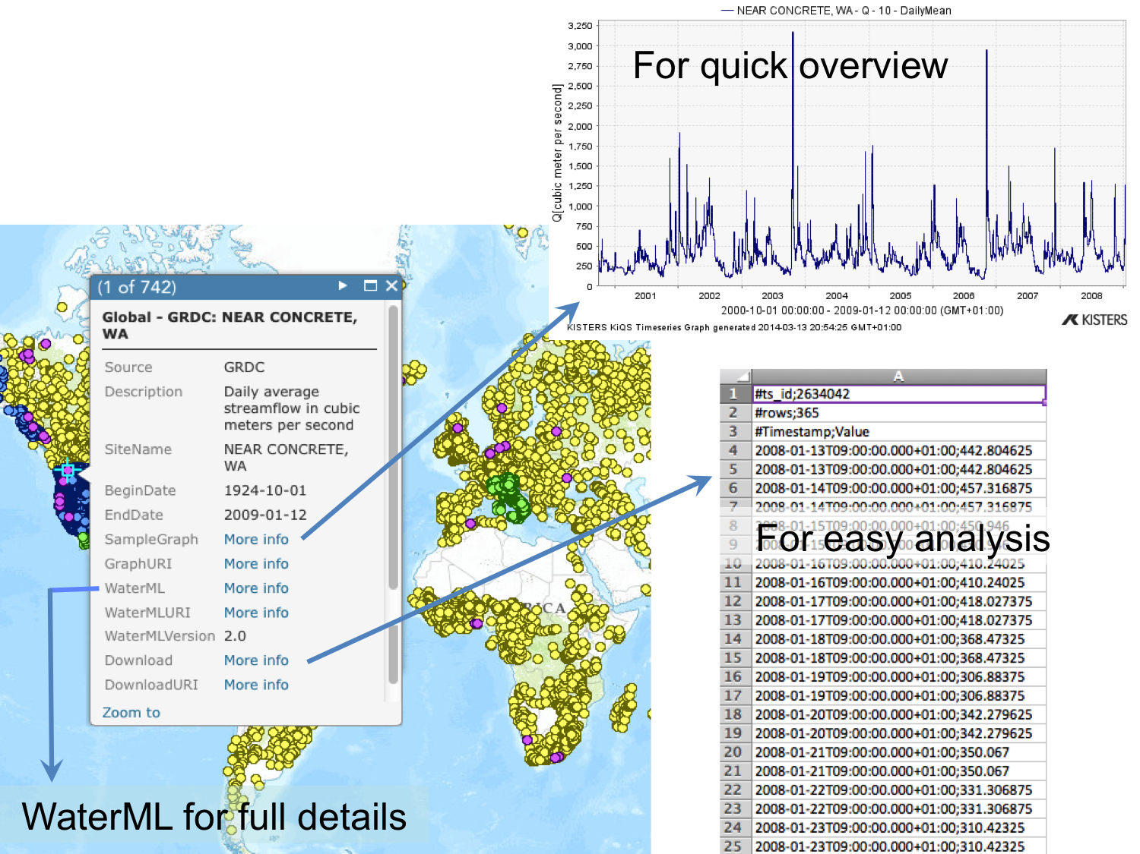
Stream Gage Data Services

Slide 12
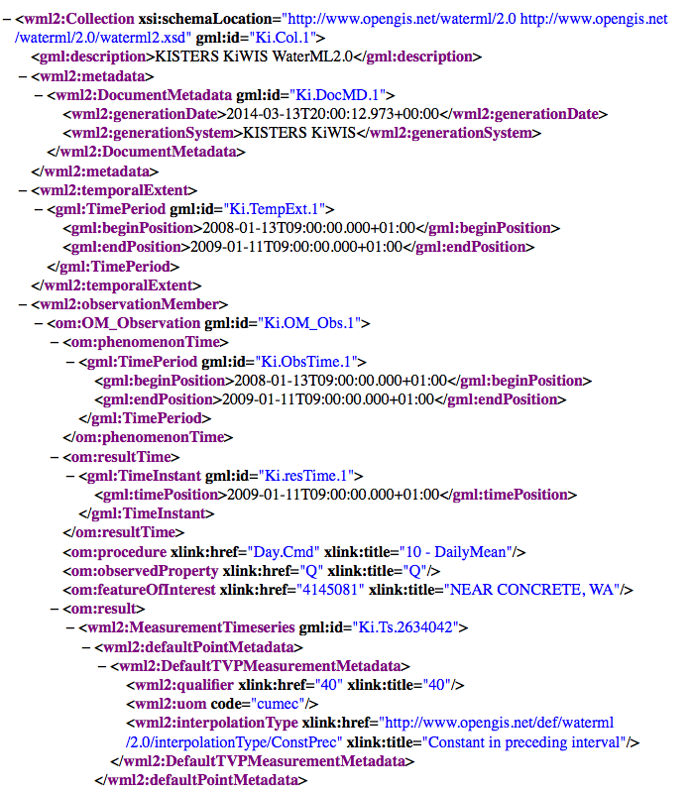
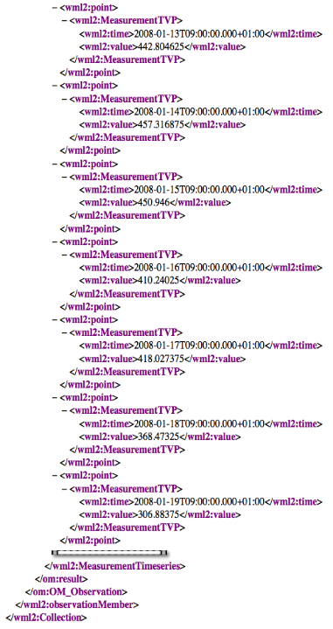
WaterML 2.0 Part 1 – Time Series
1. Document metadata
2. Observation description
Feature of interest (sampling feature)
Observed property (eg, stage height)
Procedure (method used)
Phenomena time (when it took place)
Result time (when it was requested)
3. Result
Time series metadata
Measured or categorical
Interleaved (TVP) or domain range
Interpolation type
Units of measure
Time series data
Potentially with instance metadata
GFI_Feature
1
+featureOfInterest
0..*
OM_Observation
GF_PropertyType
+
phenomenonTime
1
+
resultTime
+observedProperty
+
validTime [0..1]
+
resultQuality [0..*]
+
parameter [0..*]
0..*
1
+procedure
+result
OM_Process
Any
Notes:
Reference schema and examples: http://schemas.opengis.net/waterml/
The namespaces that appear throughout the WaterML document are defined at the beginning. Each namespace represents an information model for some portion of the WaterML content. Some of these are for basic Internet conventions (xsi, xlink); some are for ISO/OGC core content (gml); the rest are for OGC O&M content as profiled by the WaterML spec (swe, om, sa, sams, wml2)

Slide 13



















AIP-6 (2013) GEOSS Water Services Team
Notes:
The University of Texas Center for Integrated Earth System Science provided overall leadership.
CUAHSI, the Consortium of Universities for the Advancement of Hydrologic Science, provided core expertise for WaterML data and catalogue services. <click>
Brigham Young University conducted software development and outreach to Latin American countries. <click>
The University of Saskatchewan operates a national database of precipitation monitors for Environment Canada. <click>
ISPRA is the national water agency for Italy, and ARPA is one of 22 regional data providers. ARPA’s role in this project led to federation of all the regional water agencies in Italy. <click>
NIWA is the national water agency for New Zealand, and Horizons Regional Council one of 16 regional data providers. <click>
JAXA, the Japanese Space Agency and the University of Tokyo operate a global web-based water data portal for CEOS, the Committee on Earth Observation Satellites. <click>
The European Center for Midrange Weather Forecasting and the Joint Research Centre are developers of the Global Flood Awareness System. <click>
The NASA Hydrological Sciences division are developers of global soil moisture data from the Land Data Assimilation System. <click>
CNR-IIA is the Institute for Atmospheric Pollution Research of the Italian Research Council, and developers of the GEOSS Discovery and Access Broker framework that is key to this project. <click>
Esri, Kisters, and Pyxis are commercial software companies whose participation and products helped make this a success.

Slide 14
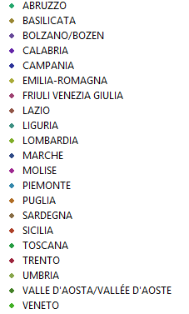
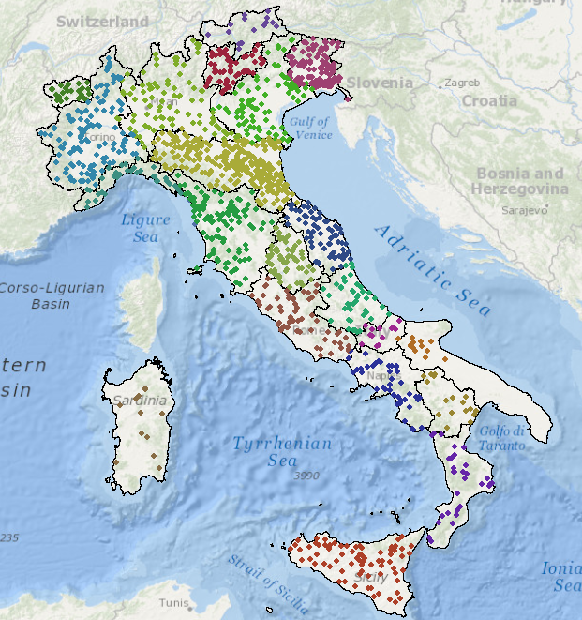

Italy – 21 regional authorities, 1530 hydrometric sites
National Institute for Environmental Protection and Research (ISPRA)
Istituto Superiore per
la Protezione e la Ricerca Ambientale
(ISPRA)

Slide 15
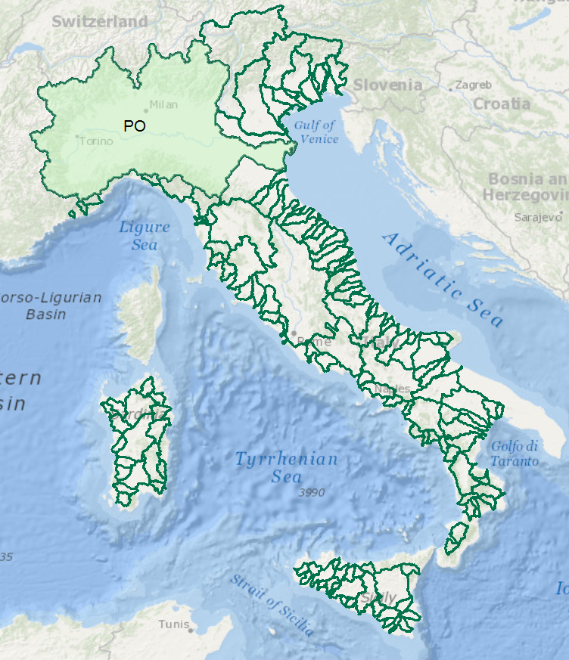
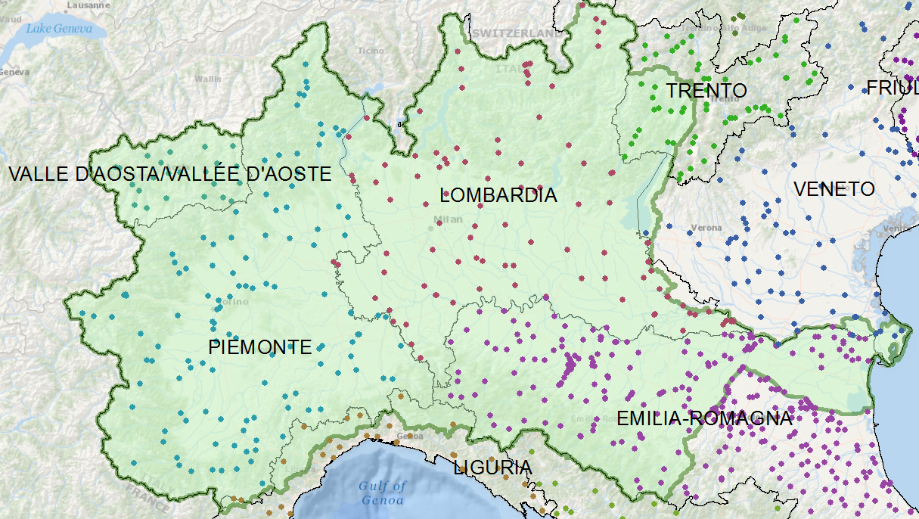
Italy – River Basins
Data for the Po River basin is managed by seven different regional authorities
Develop a federated hydrological information infrastructure . . .
. . . linking regionally collected data for a river basin

Slide 16
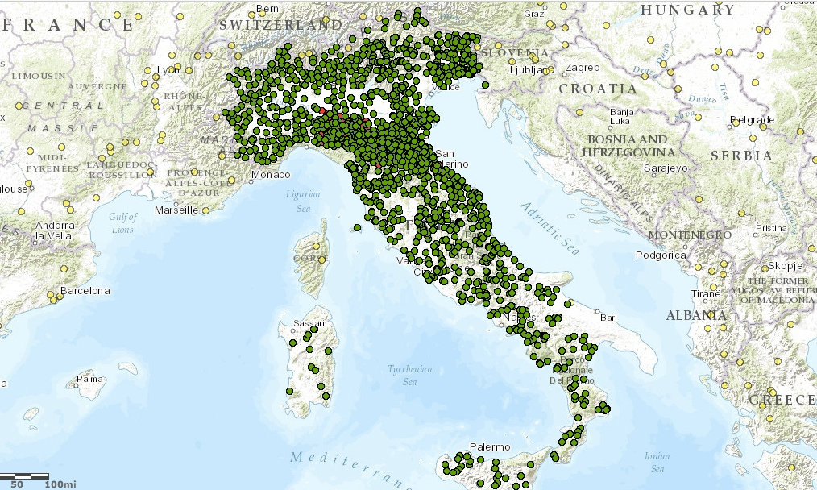
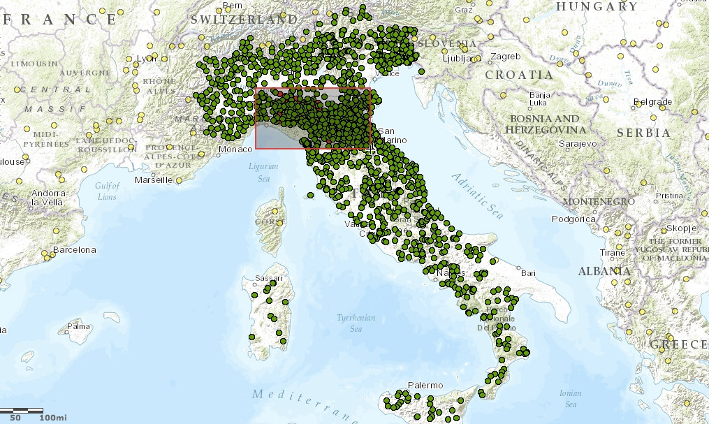
Water Data Maps: Italian Stream Gauges

Slide 17
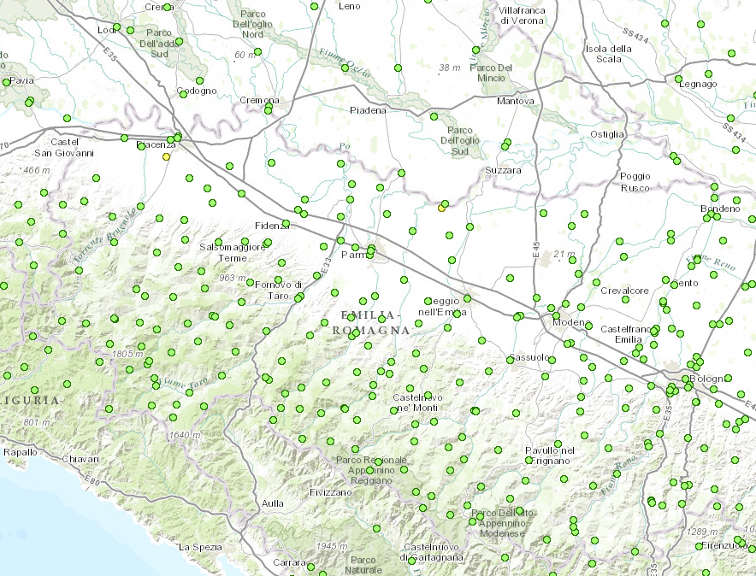
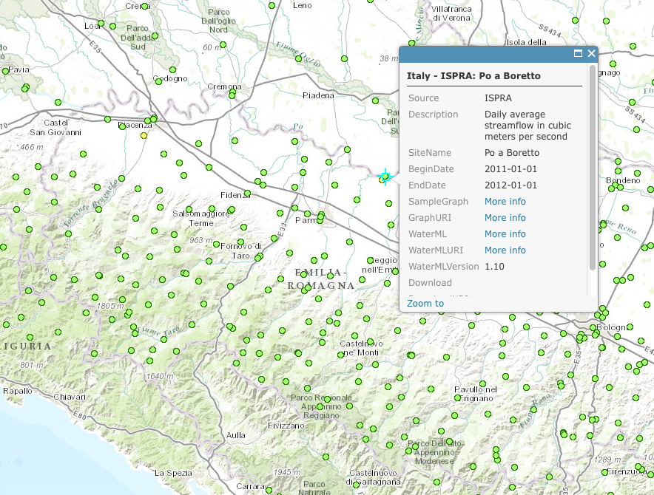
Water Data Maps: Italian Stream Gauges

Slide 18
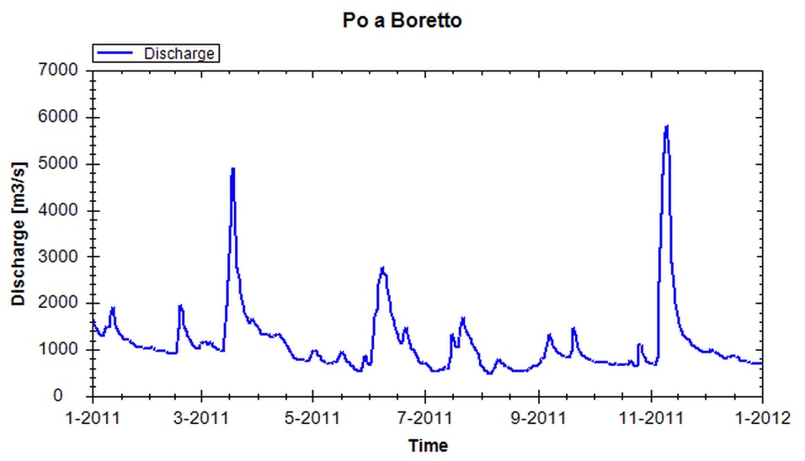
Water Data Maps: Time Series Data Access

