Slide 1














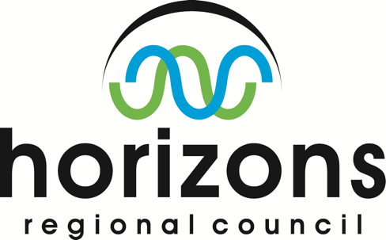


AIP-7 (2014) GEOSS Water Services Team
Notes:
We had a large team with over 20 participating organizations this year, including government and academic research centers, regional to national water data managers, and commercial and open-source software developers. We have a wide range of skills from hydrology and hydraulics science, to GIS and information technologies.
-------------------------- following is in case of q’s:
The University of Texas at Austin provided overall leadership.
CUAHSI, the Consortium of Universities for the Advancement of Hydrologic Science, provided core expertise for WaterML data and catalogue services. <click>
Brigham Young University conducted software development and outreach to Latin American countries. <click>
GIS.FCU is the GIS Research Center at Feng Chia University in Taiwan.
NIWA is the national water agency for New Zealand, and Horizons Regional Council one of 16 regional data providers. <click>
The European Center for Medium-range Weather Forecasting and the Joint Research Centre are developers of the Global Flood Awareness System (GloFAS). <click>
The NASA Hydrological Sciences division are providers of global soil moisture, runoff, evapotranspiration, and other data from the Land Data Assimilation System. <click>
CNR-IIA is the Institute for Atmospheric Pollution Research of the Italian Research Council, and developers of the GEOSS Discovery and Access Broker framework that is key to this project. <click>
Esri and Kisters are commercial software companies whose participation and products helped make this a success.
BRGM is the French geological survey agency.
WaterInfo.be is a portal for analytical & decision support in northern Belgium.
The Dartmouth Flood Observatory performs pre- and post-disaster mapping,

Slide 2
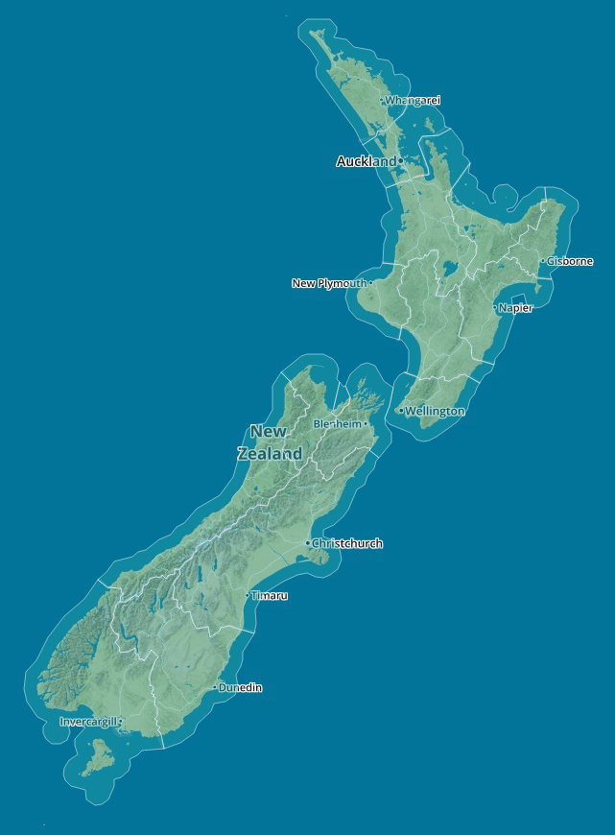
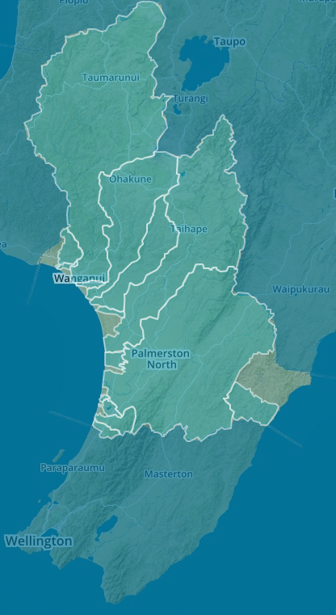
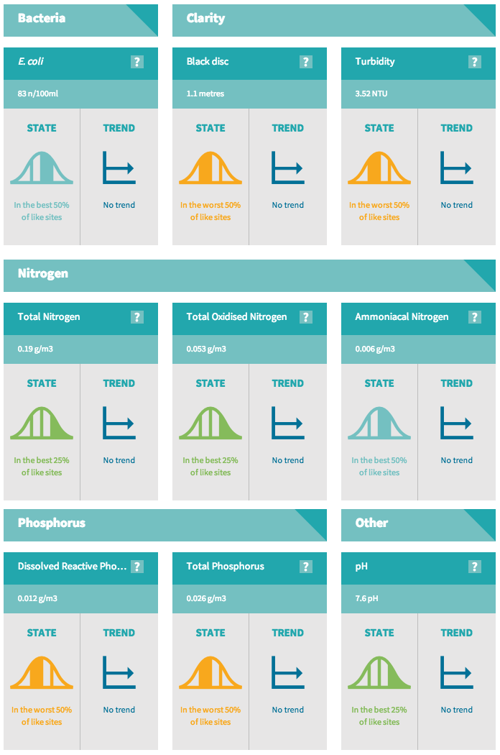
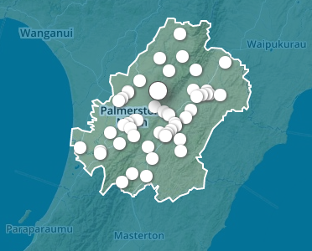
Land Air Water Aoteara: LAWA New Zealand
http://www.lawa.org.nz/
Notes:
These are screenshots from the LAWA portal, in this case showing water quality indicators at a particular sampling monitor.

Slide 3
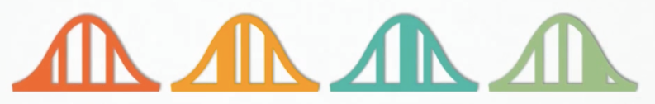

Land Air Water Aoteara: LAWA New Zealand
Video: AIP7-NewZealandClients (youtube)
Notes:
The link plays an 8-minute youtube video that describes this system and the use of standard data services.

Slide 4
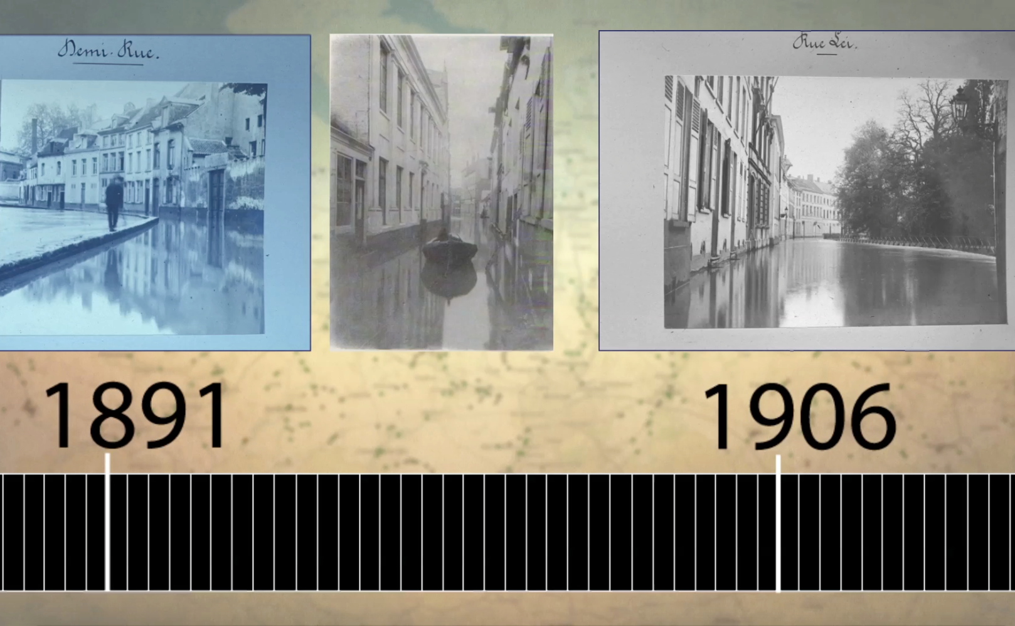
WaterInfo.be: Flemish Water Portal
Video: AIP7-FlemishWaterPortal (youtube)
Notes:
The link plays a youtube video about the Flemish Water Portal

Slide 5
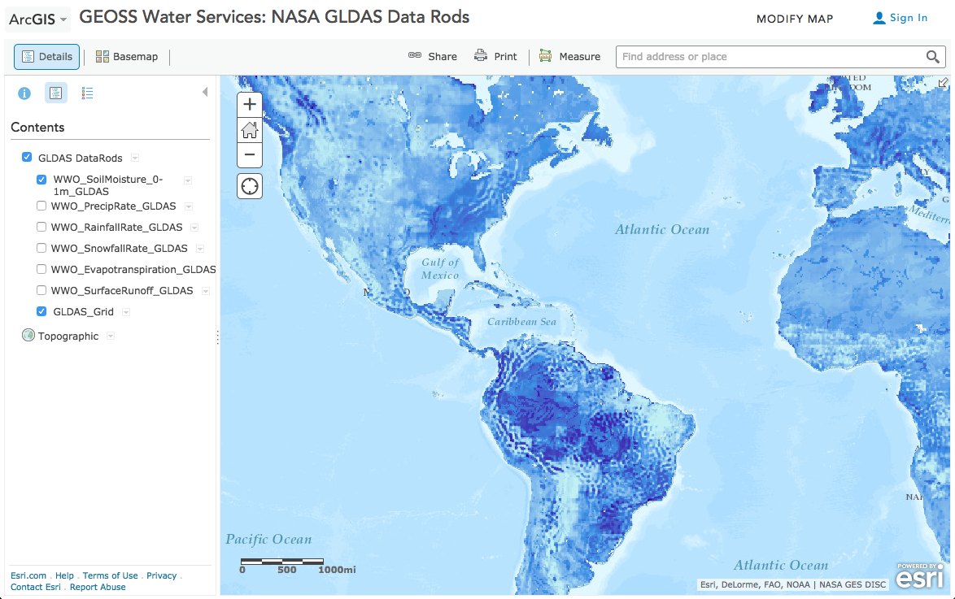
Time Series of Land Surface Modeling Outputs
http://arcg.is/1ETcY5s
Notes:
Source map: https://www.arcgis.com/home/webmap/viewer.html?webmap=93b7c28dca3b4c86863408a4a90f729f&extent=-180,-60.799,180,81.0806
Short link: http://arcg.is/1ETcY5s

Slide 6
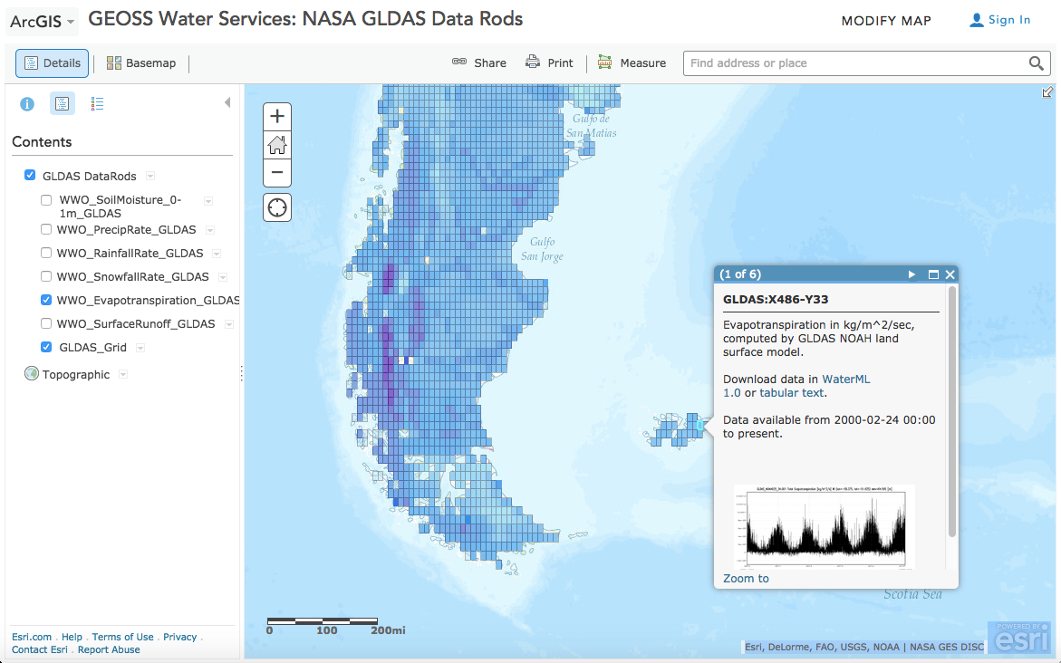
Time Series of Land Surface Modeling Outputs
http://arcg.is/1ETcY5s
Notes:
Source map: https://www.arcgis.com/home/webmap/viewer.html?webmap=93b7c28dca3b4c86863408a4a90f729f&extent=-180,-60.799,180,81.0806
Short link: http://arcg.is/1ETcY5s

Slide 7
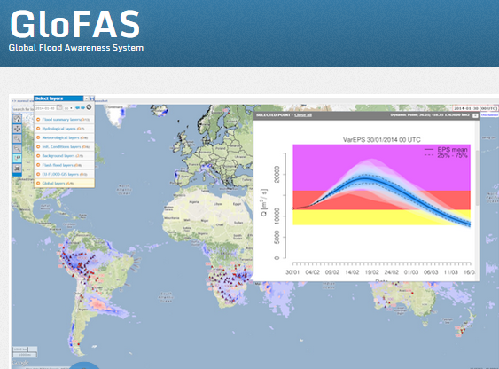
European Center for Medium Range Weather Forecasting and European Joint Research Commission
15 Day ahead forecast ensemble (50 models)

Slide 8
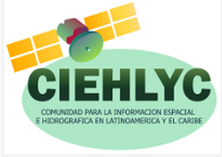


AIP-8 (2015) GEOSS Water Services Team
Notes:
We had a large team with over 20 participating organizations this year, including government and academic research centers, regional to national water data managers, and commercial and open-source software developers. We have a wide range of skills from hydrology and hydraulics science, to GIS and information technologies.
-------------------------- following is in case of q’s:
The University of Texas at Austin provided overall leadership.
CUAHSI, the Consortium of Universities for the Advancement of Hydrologic Science, provided core expertise for WaterML data and catalogue services. <click>
Brigham Young University conducted software development and outreach to Latin American countries. <click>
GIS.FCU is the GIS Research Center at Feng Chia University in Taiwan.
NIWA is the national water agency for New Zealand, and Horizons Regional Council one of 16 regional data providers. <click>
The European Center for Medium-range Weather Forecasting and the Joint Research Centre are developers of the Global Flood Awareness System (GloFAS). <click>
The NASA Hydrological Sciences division are providers of global soil moisture, runoff, evapotranspiration, and other data from the Land Data Assimilation System. <click>
CNR-IIA is the Institute for Atmospheric Pollution Research of the Italian Research Council, and developers of the GEOSS Discovery and Access Broker framework that is key to this project. <click>
Esri and Kisters are commercial software companies whose participation and products helped make this a success.
BRGM is the French geological survey agency.
WaterInfo.be is a portal for analytical & decision support in northern Belgium.
The Dartmouth Flood Observatory performs pre- and post-disaster mapping,

Slide 9
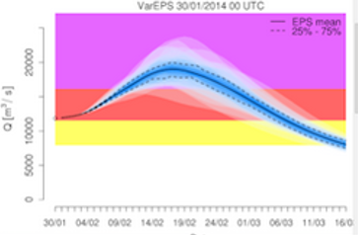
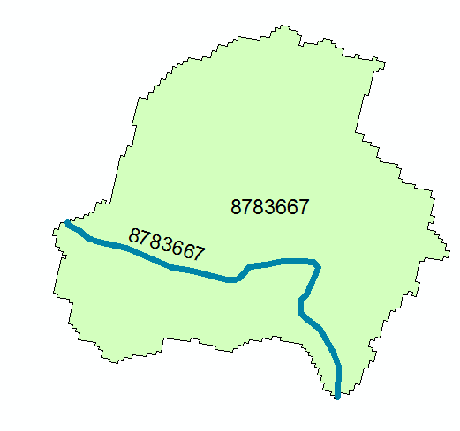
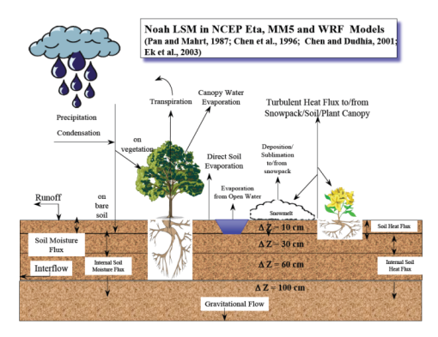
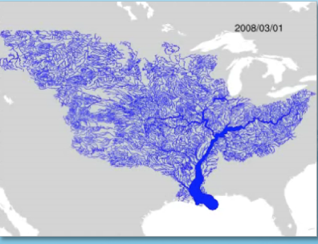
Models for Flood Forecasting
Weather model and forecasts
Probabilistic flood forecasts
Catchment-level forecasts
Weather
Precipitation
Streamflow
Surface & Subsurface Runoff
Land-Atmosphere Model
Channel flow routing (for continental US)

Slide 10
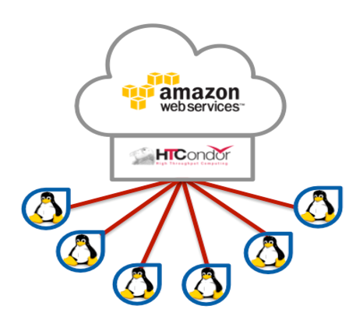
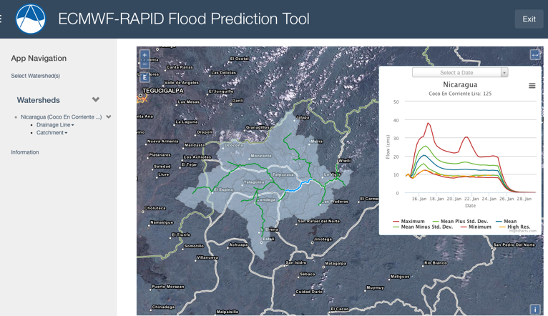
BYU Flood Forecasting Workflow
(1)
(4)
ECMWF Forecasts
50 simulations
In-stream Forecasts
50 simulations
15-Day Runoff Depth - Cumulative
(m)
15-Day Flow by Reach - Incremental
(cms)
(2)
(3)
Downscale ECMWF Forecast to Watershed
Run Forecast with RAPID
Downscaled Forecast
50 simulations
(5)
15-Day Runoff Volume by Reach -
Incremental (m³)
Runoff Weights Table
Other RAPID input Files for Watershed

Slide 11
The recipe for doing this (prototype):
Delineate watersheds with automated tools working from elevation models (GIS tools)
Create stream networks and catchments (GIS tools)
Download ECMWF forecast ensembles (ftp)
Downscale ensemble to local catchments (Esri toolkit)
Run RAPID streamflow routing model (cloud computing)
Store results in HydroShare (community portal)
Run Tethys app to access the results and display (browser)
We are working on ways to leverage current implementations for global use
Notes:
What would AIP-8 participants need to do, if they want a Tethys case study in their own country/region/watershed:
Setting up the watershed is easy but actually deploying is a little more complicated. Participants would need to set up a server with the necessary tools to download the ECMWF forecast from their ftp site (and Florian has given us permission to do this but I’m not sure if lots of others wanted connection how that would work???), process with the Esri scripts to downscale, run RAPID, and then have a Tethys Portal with our app installed to access the results and display. We expect all of this will be replicated for the NFIE, but right now it is only running on our server and not all the documentation is there to set it up on another server. At the Global Flood Partnership conference in Boulder Jim will meet with ECMWF & JRC about how to make BYU’s system more accessible to either GloFAS or as a more global version of BYU’s current system.

Slide 12
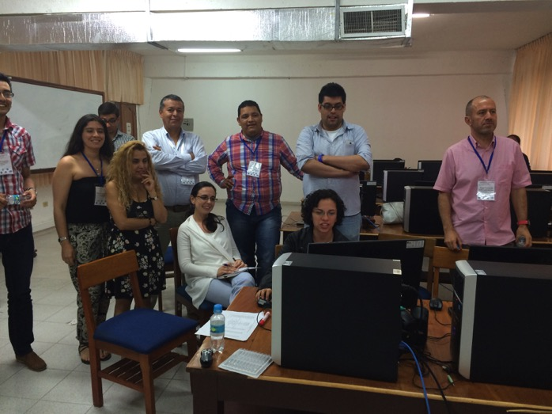
CIEHLYC Capacity Building Cartagena, Colombia 19-22 May 2015
Comunidad Para la Informacion Espacial e Hidrografica para Latinoamerica y el Caribe

Slide 13
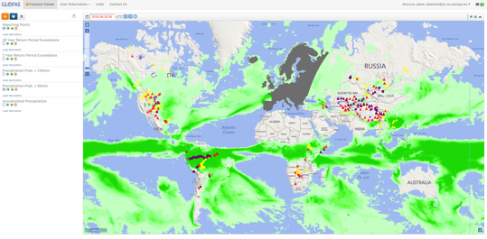
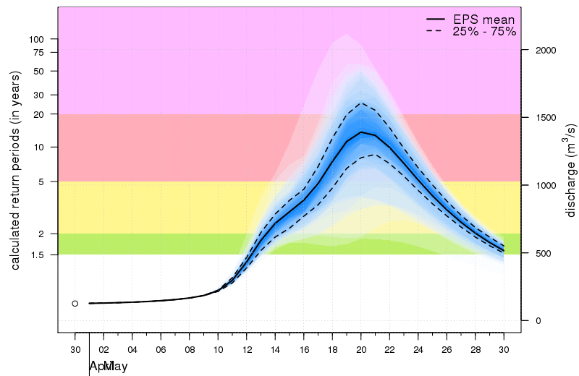
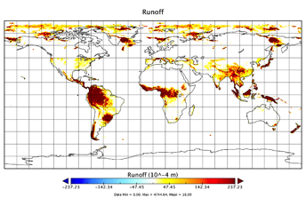
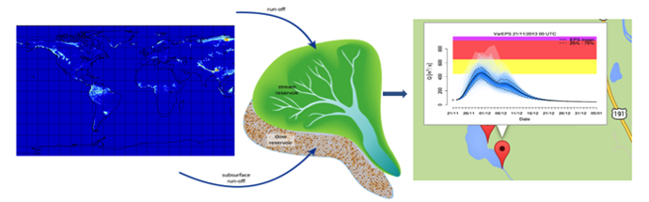
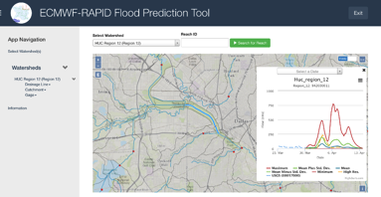
GloFAS: From Precipitation to Runoff to Discharge
Notes:
We began the workshop learning about the ECMWF/JRC GloFAS program that generates ensemble flood forecasts on a global scale for large watersheds. They were taught the basic theory behind the ensemble forecasts, the scale at which GloFAS operates, and how we were working with the RAPID model to downscale forecasts to higher resolution watersheds and stream networks.

Slide 14
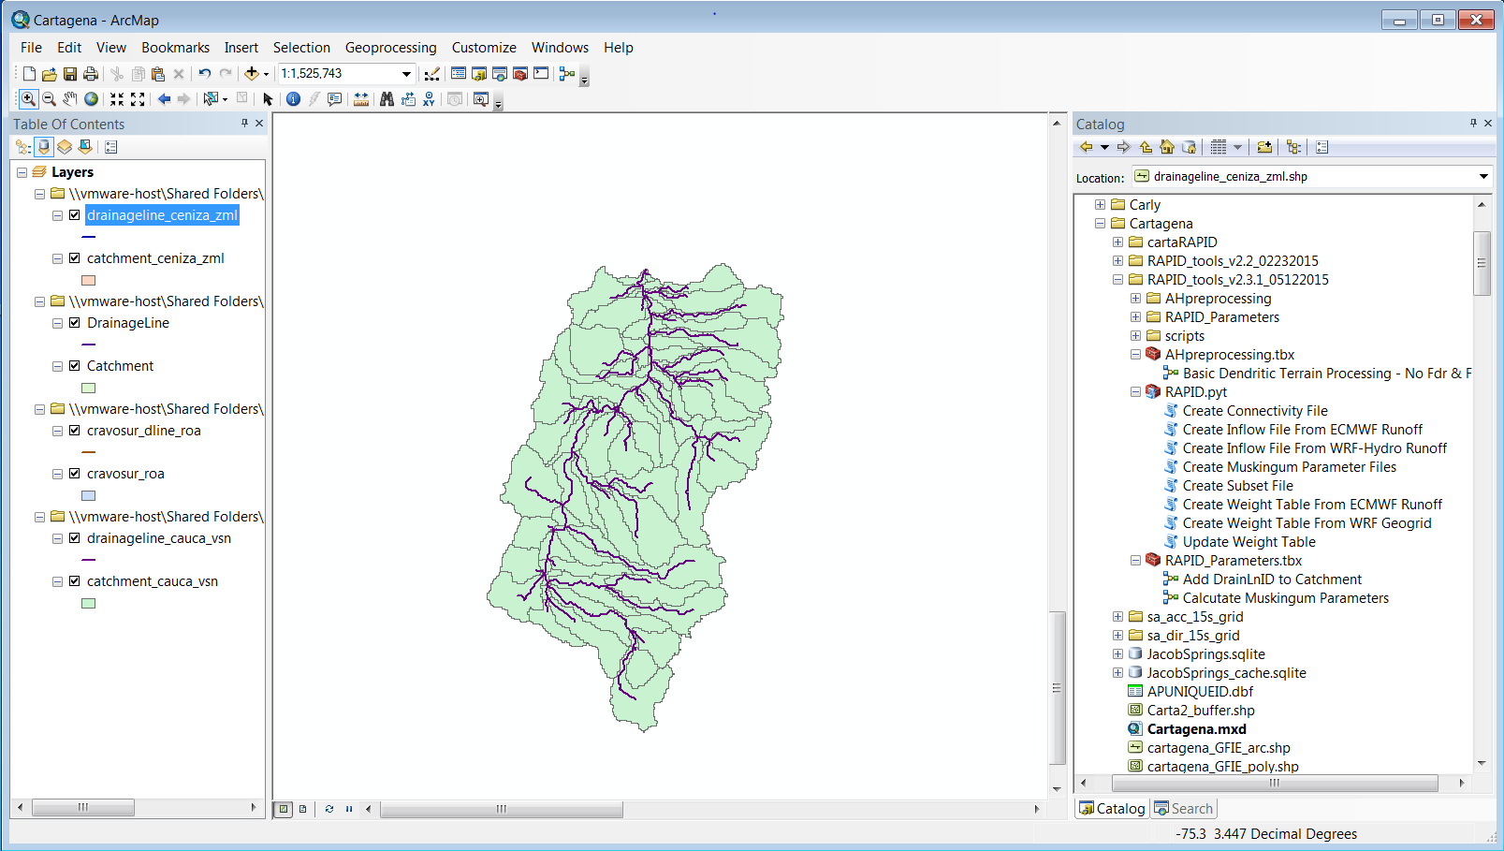
ArcGIS RAPID Toolbox
Esri Toolbox + BYU Tethys tool to create downscaled model for any scale watershed
Notes:
We then learned how to use the new Esri toolbox and BYU Tethys tool to create a downscaled model for any scale watershed globally. The data used in the workshop for elevations was coarse because of the time availability to instruct them on where to locate, download, and use higher resolution products. However, the tools worked well for these pilot watersheds and more information about better data sources was shared with them.

Slide 15
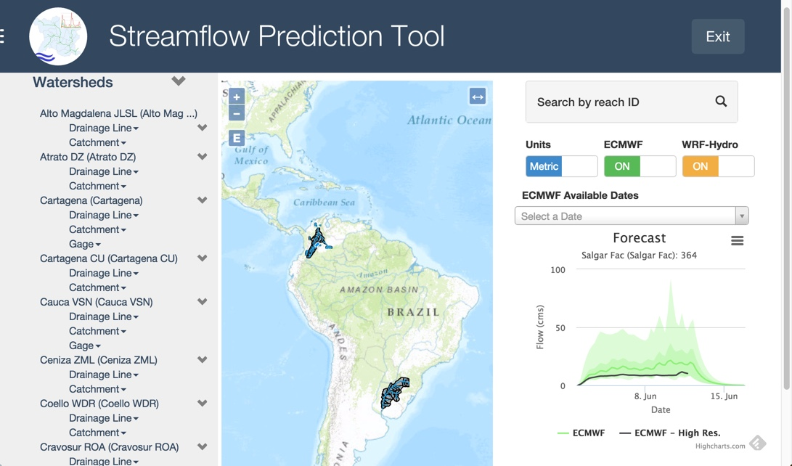
14 Watersheds with Forecasts
Notes:
The students created working forecasts for 14 different watersheds.

Slide 16
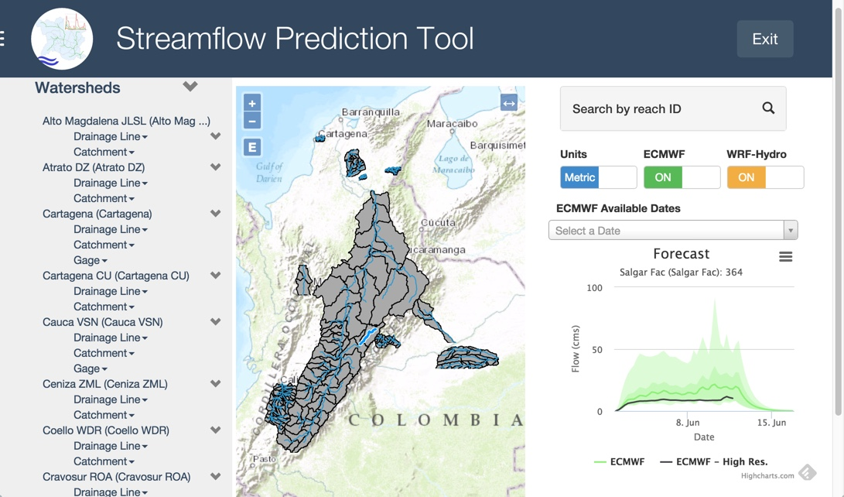
13 Watersheds in Colombia
http://apps.hydroshare.org/
Notes:
13 of the 14 were in Colombia.
You can access these watersheds at http://apps.hydroshare.org/

Slide 17
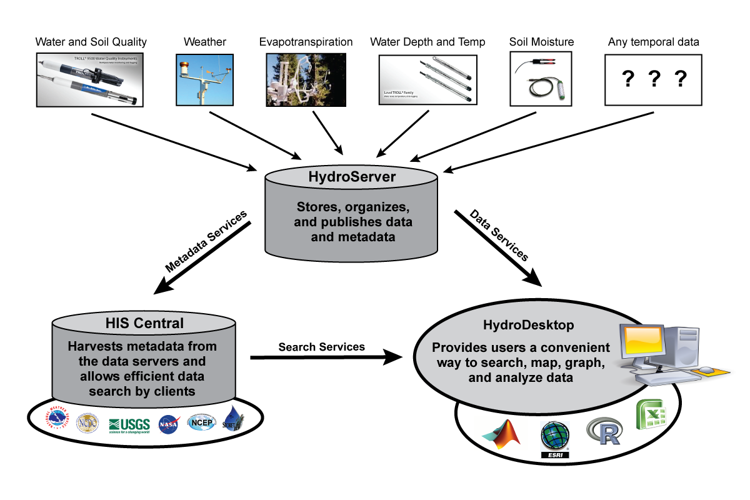
HydroServer - HydroDesktop
Notes:
We learned how WaterML allows HydroServers to be accessed by clients in the same way that a web browser accesses web pages. Further a catalog can be organized so that collections of HydroServers can be federated into a regional, national, or even global system.
We then organized into a few teams and set up several HydroServers and each of the participants learned how to manage the metadata, create stations, and upload time series values.

Slide 18
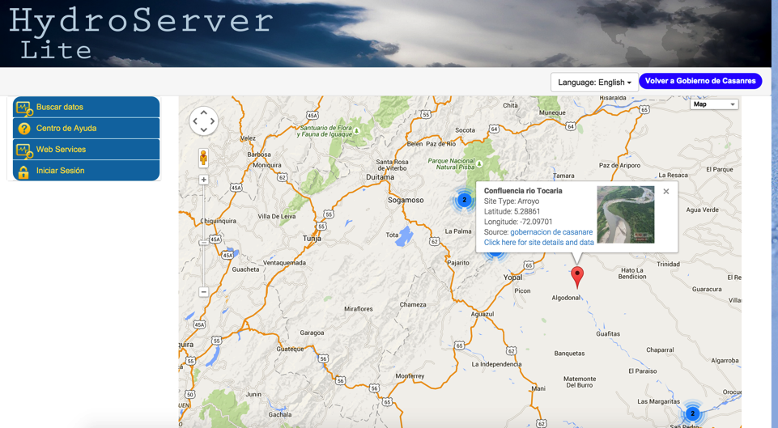
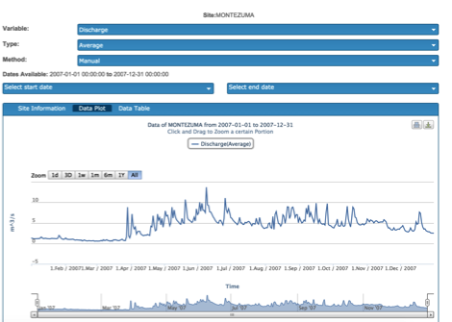
Creating Gauge Stations & HydroServers
Each watershed developer created gauge stations. Some associated a photo with each station. Some created a HydroServer for their watershed.
Notes:
The Cravosur group in Casanares (one of the departments or states of Colombia) also created a HydroServer. Besides the other data they learned how to associate a photo with each station.

Slide 19
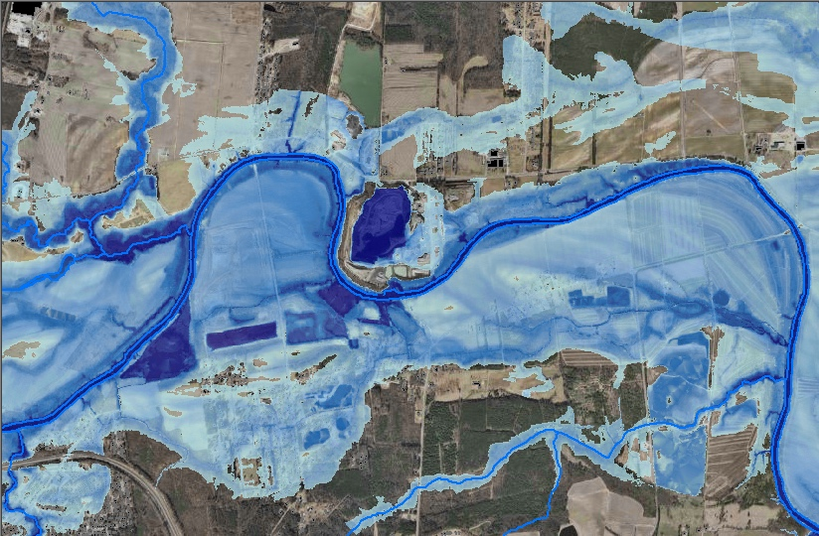
Next Step: Mapping Flood Depth

Slide 20
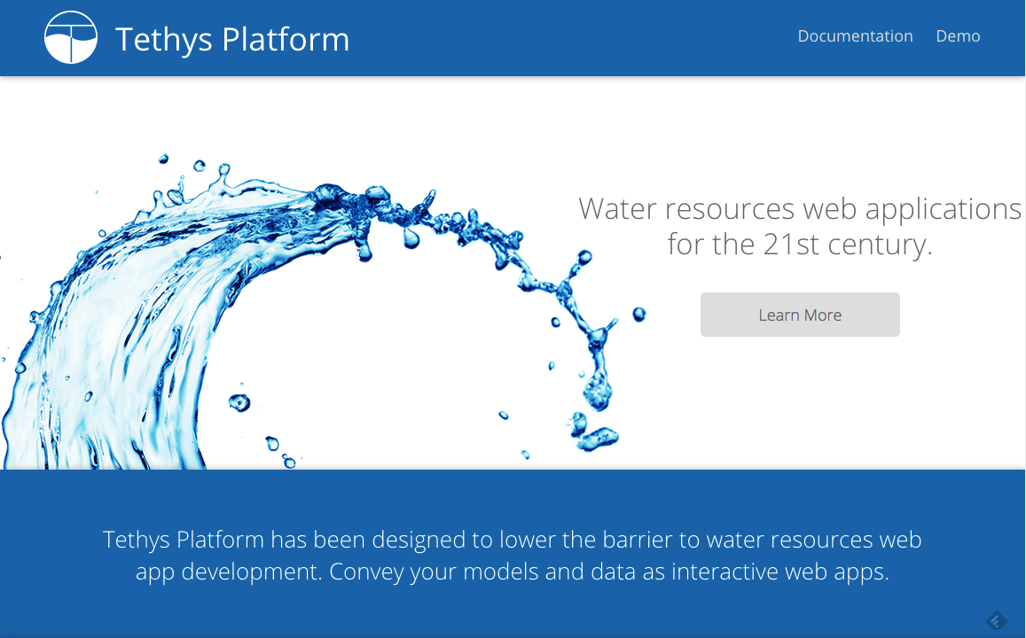
BYU Python Toolkit for Hydro Apps
http://tethys.ci-water.org/

Slide 21
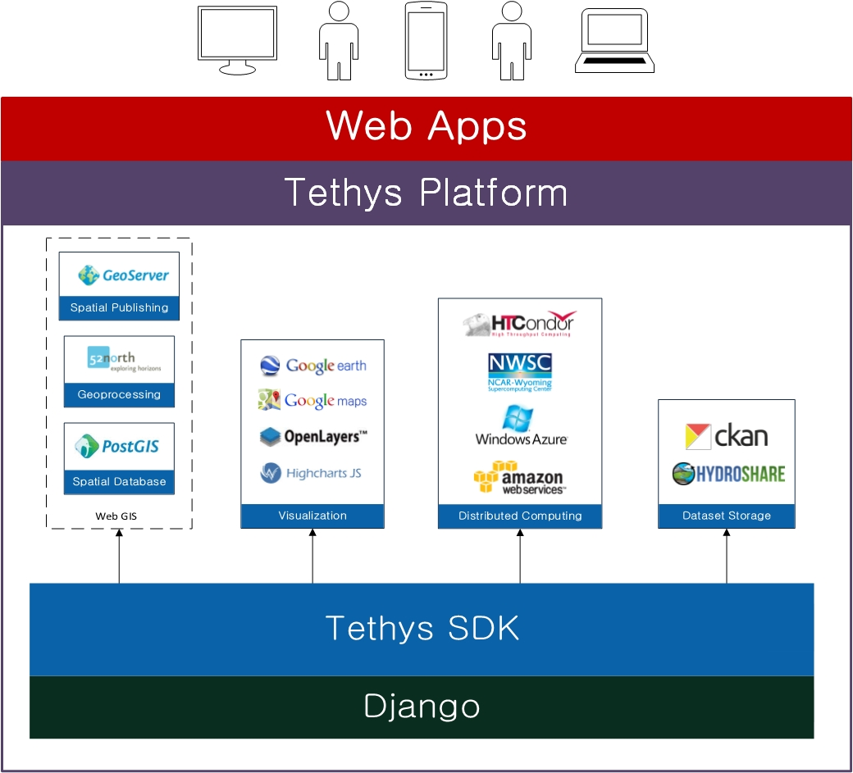

Slide 22
Thank you!
David K. Arctur
david.arctur@utexas.edu
University of Texas at Austin Open Geospatial Consortium (OGC)

