Slide 1

Comparison of National Geo-Fabrics:
USA, Canada, Australia, INSPIRE-Italy
David K. Arctur, David R. Maidment
Center for Research in Water Resources
University of Texas at Austin
OGC Hydro DWG Annual Workshop
BRGM, Orleans France, 20-23 September 2015
This research is supported in part by NSF EarthCube grant 1343785

Slide 2
Motivation
HY_Features can provide a common information model for describing national hydrologic-geospatial frameworks, sometimes called geo-fabrics
This could enable automated cross-border interoperability and database conversions for watersheds spanning adjacent countries in Europe, Latin America, Africa, etc.
However, the national geo-fabrics do not instantiate all the same concepts, so mapping between them can be problematic and lossy.
HY_Features is not the cause of this issue, but could help document it

Slide 3
Outline
This presentation focuses on selected core feature classes of 4 national geo-fabrics
USA National Hydrographic Dataset (NHDPlus)
Australia Hydrographic Geo-Fabric (AHGF)
Canada National Hydrographic Network (NHN)
European INSPIRE as implemented in Italy
These are based on sample ArcGIS geodatabases, representing a subset of the full specifications.
We’ll compare these with each other, and with HY_Features

Slide 4
USA National Hydrographic Dataset (NHDPlus)
Australia Hydrologic
Geo-Fabric (AHGF)
Canada National Hydrographic Network (NHN)
EU INSPIRE Hydrology: Italy Idrografia

Slide 5
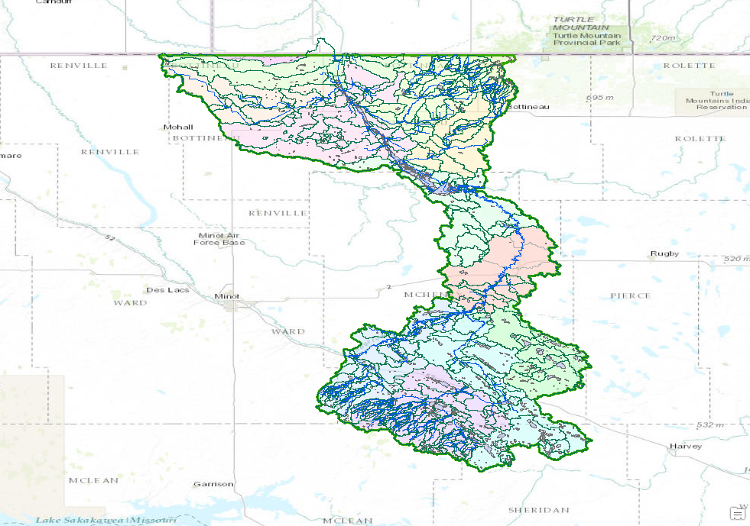
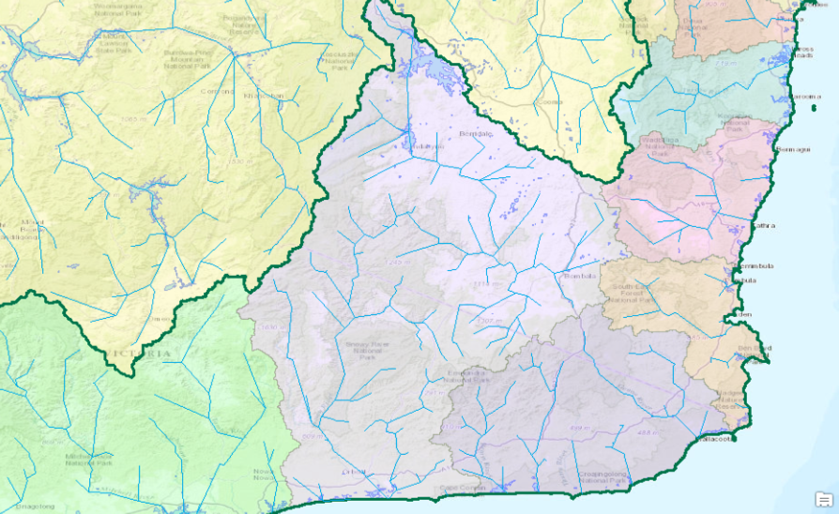
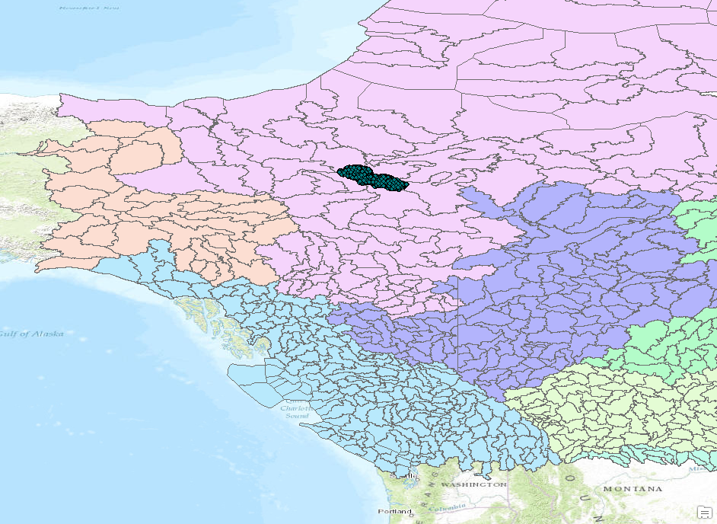
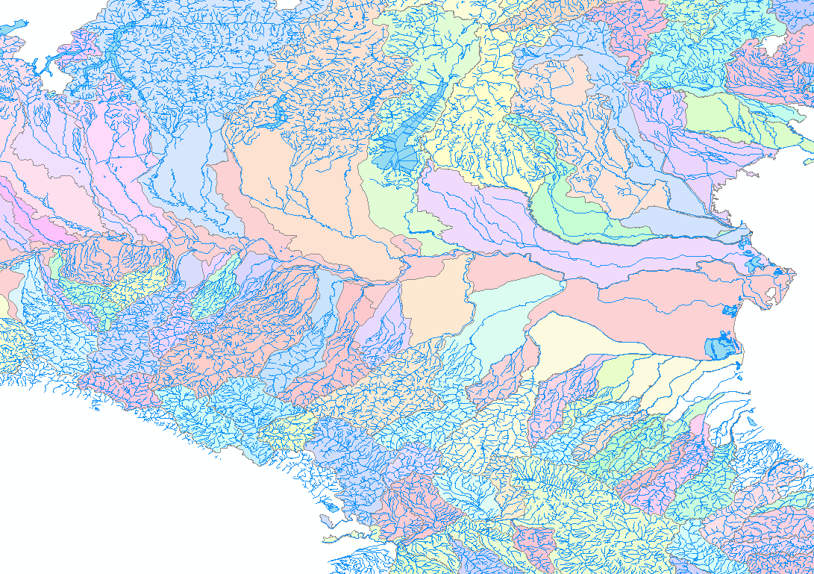
Souris River Basin N. Dakota, USA
Southeast Coast
Australia
NHDPlus
AHGF
NHN
INSPIRE-Italy
Mahoney Lake Basin NW. Canada
Po River Basin N. Italy

Slide 6
Flowlines and Waterbodies
All four data models have flowlines and waterbodies
NHDPlus flowlines have reliable network topology
AHGFNetworkStreams have topology, but AHGFLinks and AHGFNodes have “contracted” topology which is stable and reliable, at a coarser scale than NetworkStreams
Notes:
AHGF doesnt in fact have a "reach" implemented in the same sense as NHD. It has a DEM derived stream network - but these are not reliable (for many reasons) - they are artifacts of scale and processing, not necessarily hydrology. Contracted catchments are the highest level of granularity at which something equivalent makes sense, and these are far coarser than NHD.
Contracted catchments are really only available in the latest product for the Murray Darling and Tasmania. The rest is really just a slightly improved stream netowrk - and there are major problems with these too - not including channelised streams in the network for example!

Slide 7
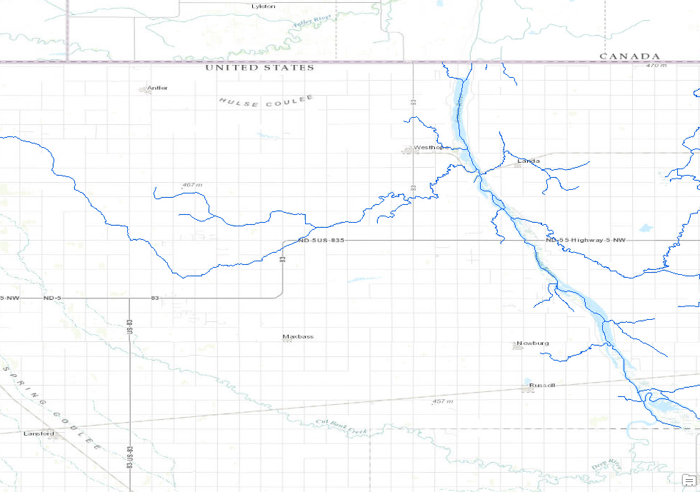
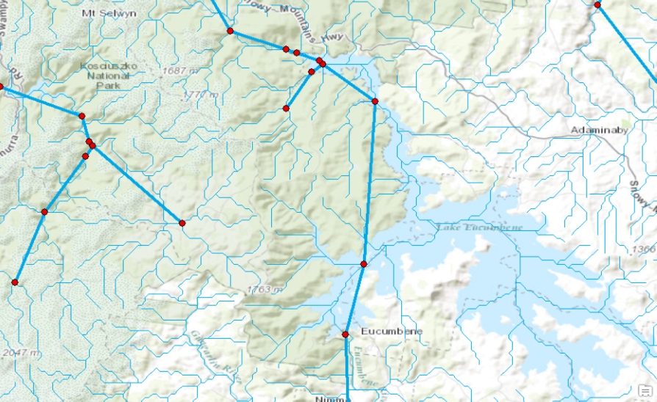
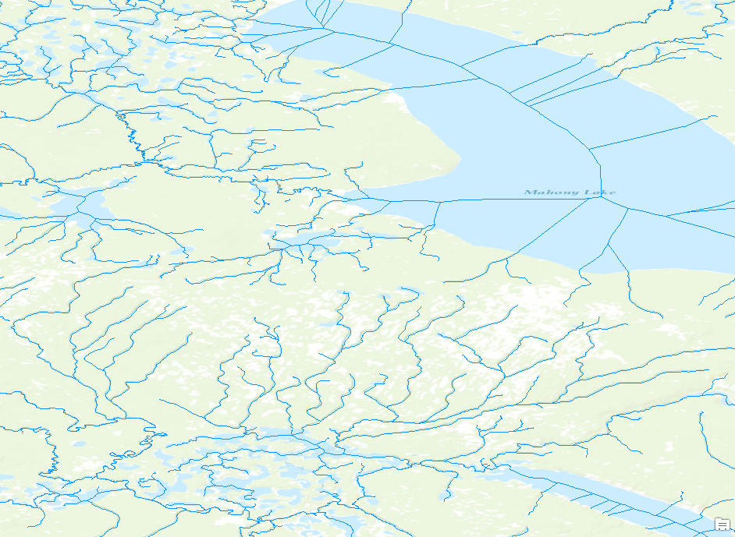
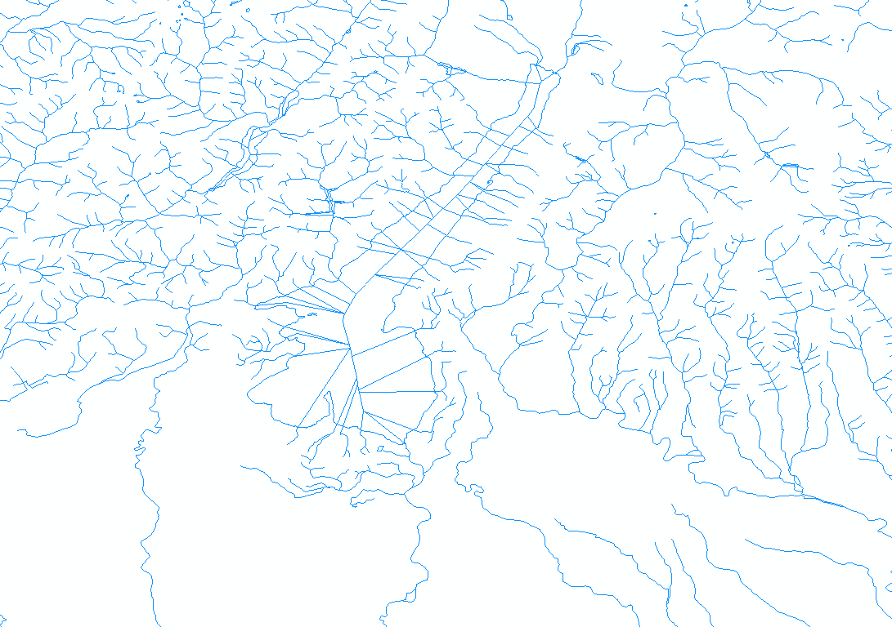
AHGFLink
AHGFNode
Flowline
AHGFNetworkStream
NHDPlus
AHGF
NHN
INSPIRE-Italy
NHN_HN_PrimaryDirectedNLFlow
hy-p:SurfaceWaterL

Slide 8
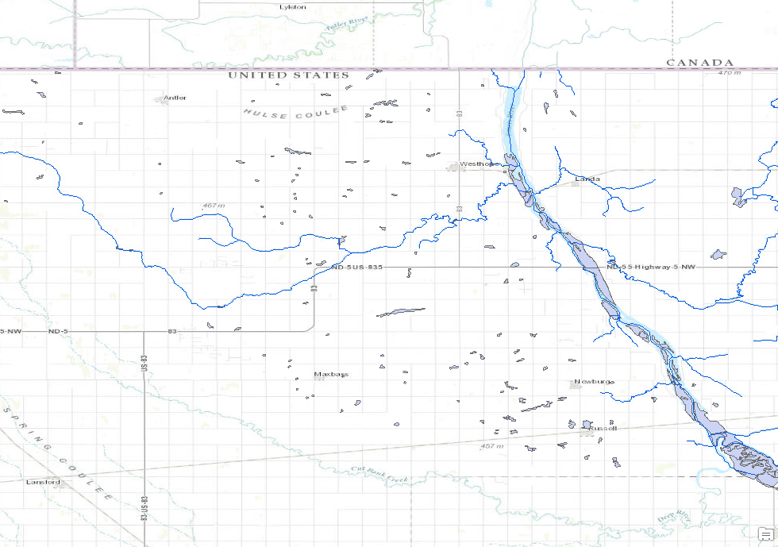
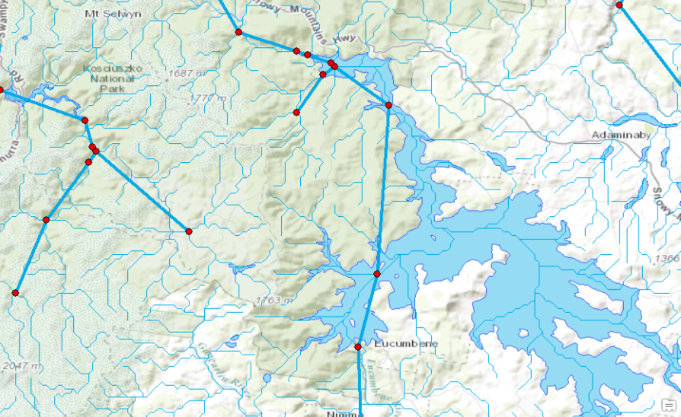
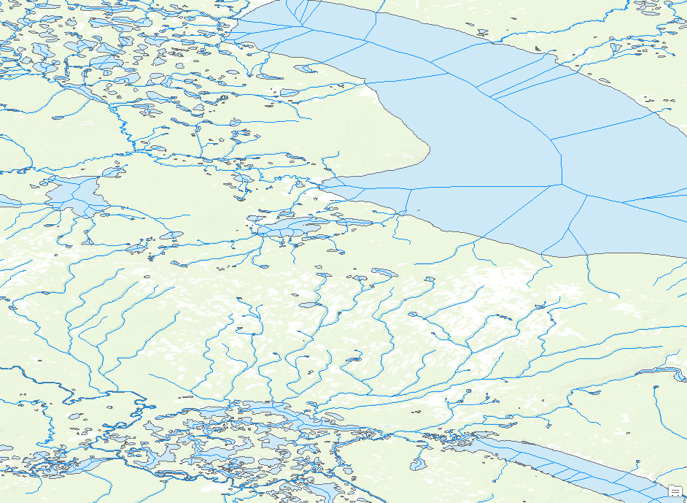
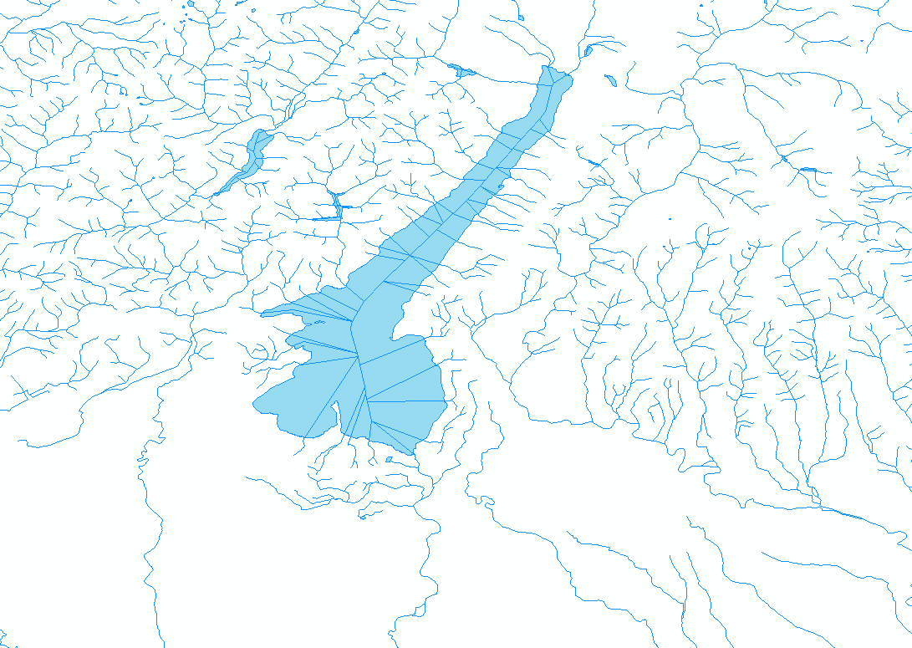
AHGFLink
AHGFNode
Flowline
AHGFNetworkStream
Waterbody
AHGFWaterbody
NHDPlus
AHGF
NHN
INSPIRE-Italy
NHN_HN_PrimaryDirectedNLFlow
hy-p:SurfaceWaterL
NHD_HD_Waterbody
hy-p:SurfaceWaterS

Slide 9
Catchments vs. Basins to a hydrologist
NHDPlus and AHGF have the concept Reach Catchment to mean the local drainage area of a single flowline.
NHDPlus uses the term Basin to mean a drainage area defined by human means like HUC units.
Catchment is considered to be a synonym of Basin.

Slide 10
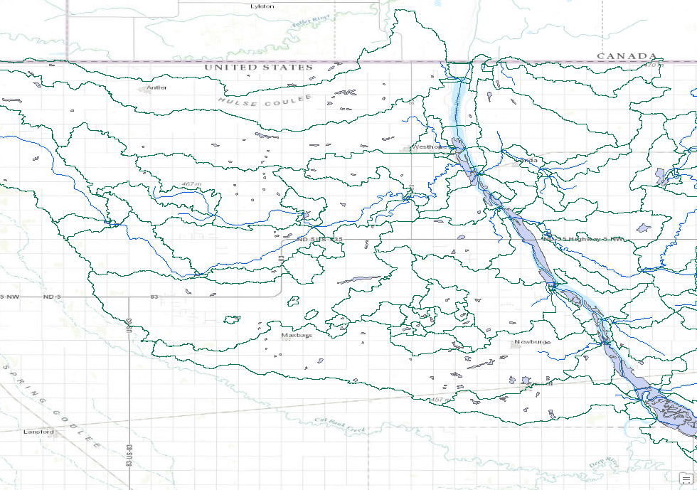
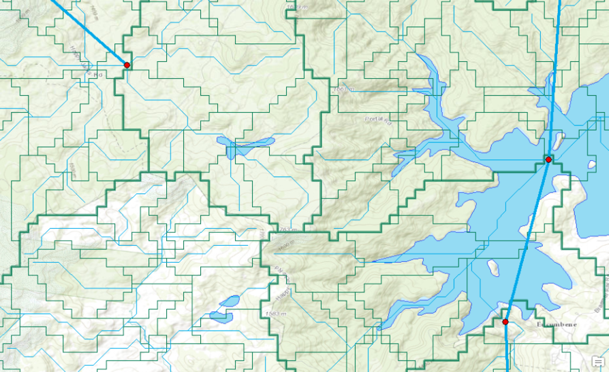
Catchment
AHGFLink
AHGFNode
Flowline
AHGFNetworkStream
AHGFCatchment
Waterbody
AHGFContractedCatchment
NHDPlus
AHGF
NHN
INSPIRE-Italy
No Reach-Catchments
No Reach-Catchments

Slide 11
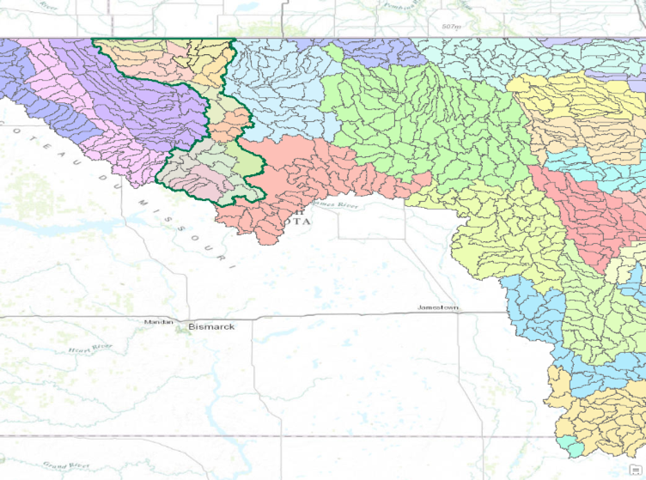
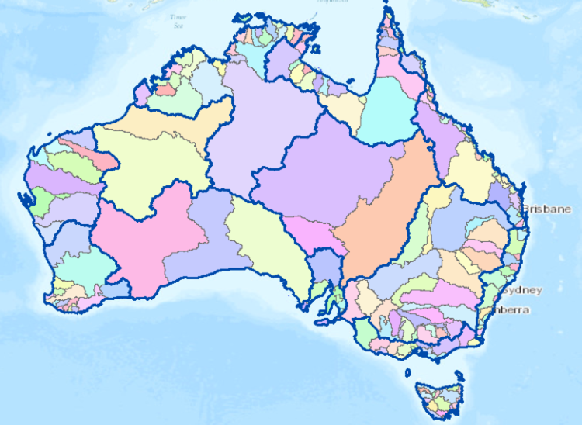
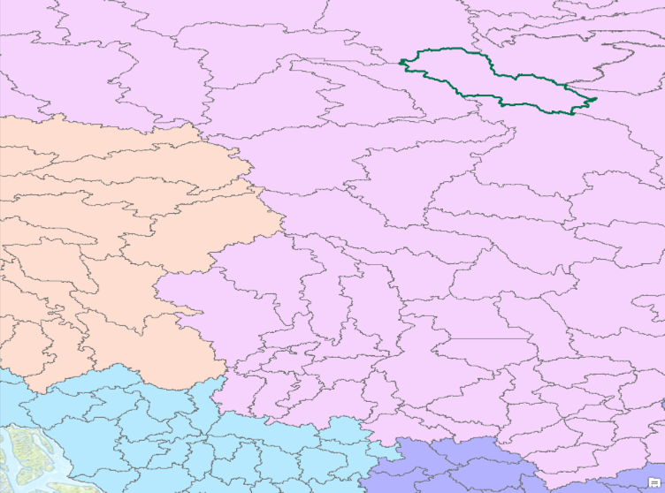
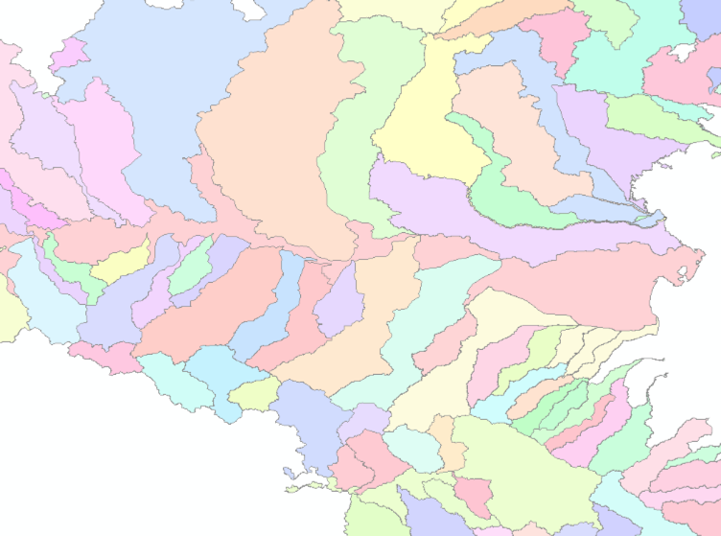
NCBLevel1DrainageDivision
HUC Region 9
(all Basins)
Basin
NCBLevel2DrainageBasinGroup
HUC = Hydrologic Unit Code
NHDPlus
AHGF
NHN
INSPIRE-Italy
NHN_Workunit_Limit_2
hy-p:DrainageBasinS
NHN_Index_15
(groups of Workunits)

Slide 12
Relating a Catchment with its Reach
NHDPlus defines a unique catchment for every reach
NHDPlus has a direct reference between each flowline and its catchment
Catchment:FeatureID = Flowline:COMID

Slide 13
Why Does This Matter?
Flood Forecasting:
Requires workflow to convert precipitation forecasts to runoff and then to streamflow discharge
Land Surface Models (LSM) such as ECMWF LIS and WRF-Hydro coupled with RAPID require catchment-to-flowline linkage
It may be feasible to work with catchment-flowline connectivity through a shared junction, but direct reference between catchments and their reaches is simpler and performs better

Slide 14
National Models vs. HY_Features

Slide 15
Hydrologic Representations Vary
Cartography and connectivity are two distinct types of representation in HY_Features
Relationships between network connectivity and cartographic representations vary by data product
INSPIRE distinguishes SurfaceWater (cartographic point, curve, surface) from NetworkElement (point, curve, surface) features
NHDPlus Flowlines and Catchments are both cartographic and topological
AHGF has a DEM-derived stream network. Contracted nodes and catchments are a coarser view of this network, where the connectivity is stable and accurate (see notes)
Notes:
AHGF doesnt in fact have a "reach" implemented in the same sense as NHD. It has a DEM derived stream network - but these are not reliable (for many reasons) - they are artifacts of scale and processing, not necessarily hydrology. Contracted catchments are the highest level of granularity at which something equivalent makes sense, and these are far coarser than NHD.
Contracted catchments are really only available in the latest product for the Murray Darling and Tasmania. The rest is really just a slightly improved stream netowrk - and there are major problems with these too - not including channelised streams in the network for example!

Slide 16
Basins vs. Catchments in HY_Features
All four national models have a similar concept of a Basin as a spatial unit for reporting purposes.
Typically organized around major river drainage areas
HY_Features distinguishes between arbitrary catchments (HY_Catchment) and catchments which are topologically connected by a stably-identified outflow (HY_Basin)
HY_Features allows multiple geometric representations for each catchment, eg, HY_CatchmentArea
NHDPlus Catchments would thus be described in terms of both HY_CatchmentArea and HY_Basin, for both geometric and flow concepts

Slide 17
Automating Database Conversions
One role of HY_Features could be to facilitate data model and database translations across national borders. This would be of great utility, such as supporting applications for countries that have not developed their own national data models
INSPIRE countries may not need this at European-interior borders, but may benefit from mapping to non-INSPIRE countries
HY_Features was not considered initially for transforming physical databases, but for describing the relations between components of a data model, and between data models, in a machine-usable way
By itself, HY_Features does not fix semantic mismatches between national data models, but helps make them explicit
Better, more mature tools are needed to make physical data conversion productive, eg, to make up for lack of river catchment topology
While GIS can create and maintain river topology very well, it does not link the topology with other feature types, which would be of use to more applications than just hydrology

Slide 18
NHDPlus to HY_Features Mapping - 1
HYF2NHD-catchment-flowline-junction-RA.pdf

Slide 19
NHDPlus to HY_Features Mapping - 2
HYF2NFIE-catchment-flowline-midpoint-streamgage.pdf

Slide 20
GML / GIS Integration Challenges
Typical Complex GML Requirements
Nested objects
Series / list elements
Multi-geometries / representations
Unique ids needed for each level / geometry
Many required elements not available from source
Result: Single GML object maps to many child records in multiple related tables

Slide 21
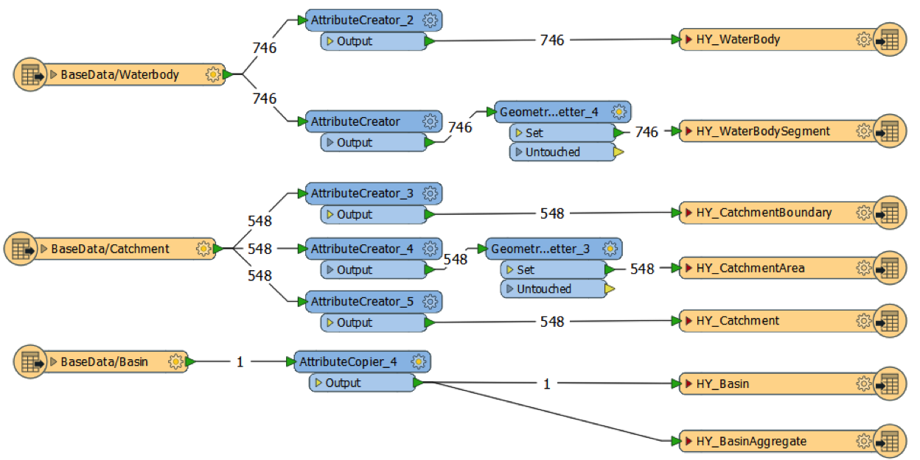
GIS to GML: Feature Type Mappings in FME: NHDPlus to HY_Features
Some feature classes from the GIS database are described by more than one HY_Features class… this makes the meaning of each source feature class more explicit, but HY_Features is more like metadata about the GIS database model,
not another GIS database model itself…

Slide 22
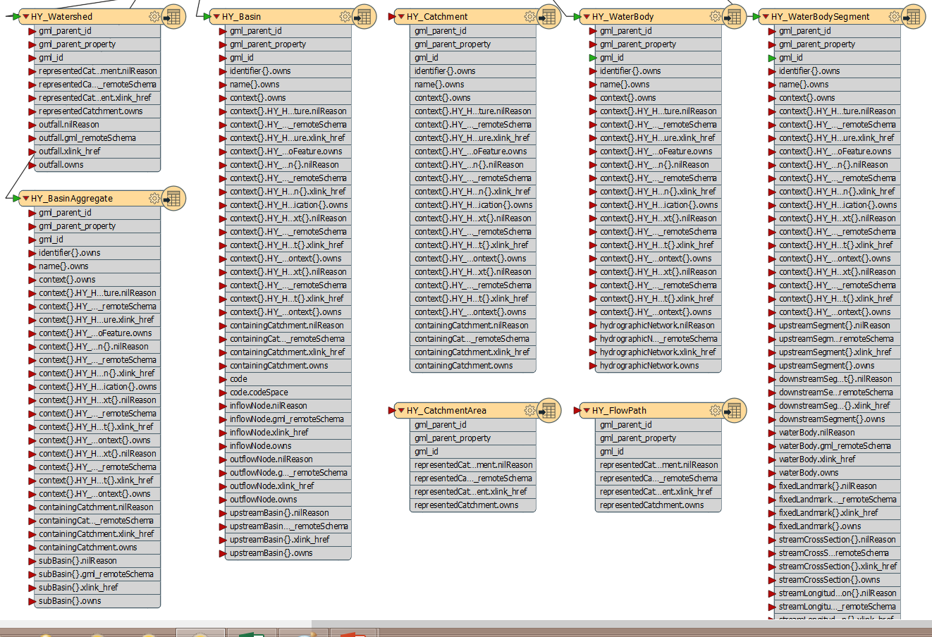
HY_Features GML Schemas (FME import)
Many properties of HY_Features schema are for lists of GML-related entities… what should be done with these?

Slide 23
Conclusions: If we want to take flood forecasting global…
We need the concepts of reach-catchments and stream network connectivity to be generally available
Some national models do not currently implement these
HY_Features could be used to clearly & crisply describe river network connectivity for automated use where geometric topology networks have not been created
But HY_Features lacks tools & visualization to make mappings easily understood and automated
Neo4J integration for fast river network connectivity
In the meantime, current GIS database mapping & processing tools can be used, eg, ArcGIS and FME

Slide 24
Thanks!
Some work to do yet…
David K. Arctur, David R. Maidment
Center for Research in Water Resources
University of Texas at Austin

