Slide 1


Standard representation of hydrologic features The OGC HY_Features model in support of geographic water information
6th, WMO/OGC Hydrology DWG
Orleans, BRGM, September 22, 2015
Irina Dornblut, GRDC of WMO at BfG

Slide 2

Standard representation and encoding of hydrologic features The OGC HY_Features model in support of geographic water information
HIC-11 Tutorial: Standardization of Water Data Exchange
WMO/OGC Hydrology Domain Working Group
New York, CCNY, August 16, 2014
Irina Dornblut, GRDC of WMO at BfG

Slide 3
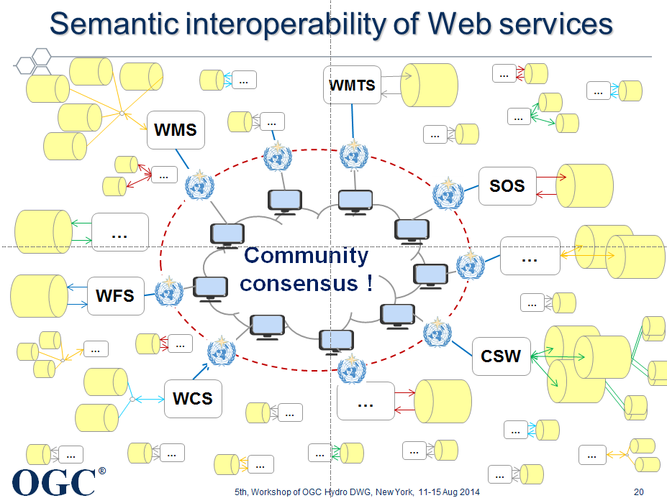

Slide 4
concensus based on common concepts

Slide 5
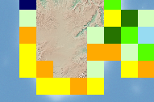
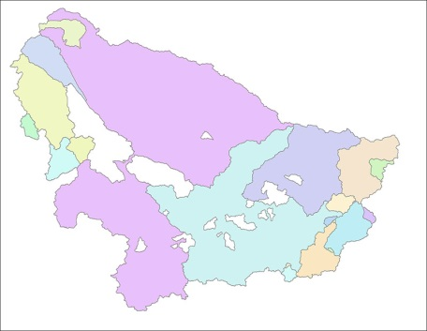
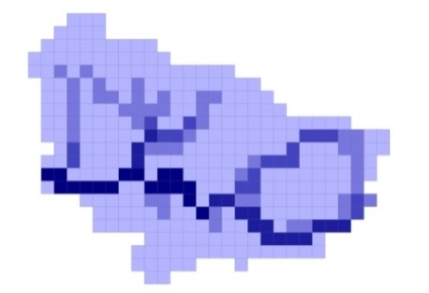
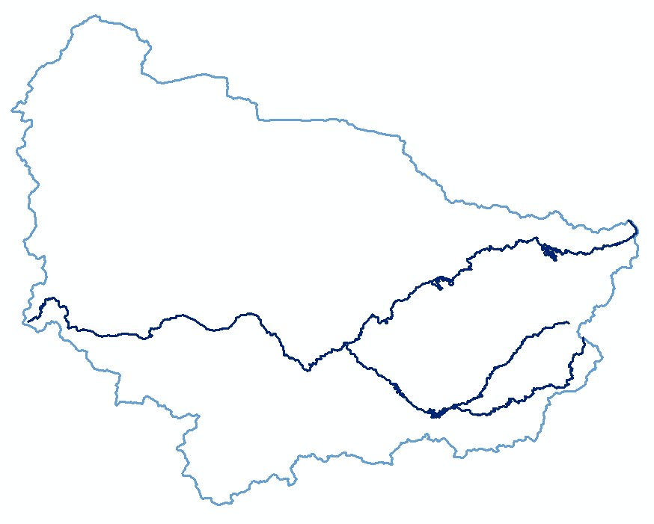
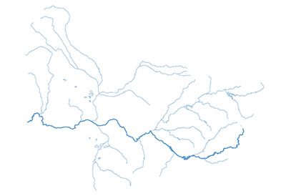
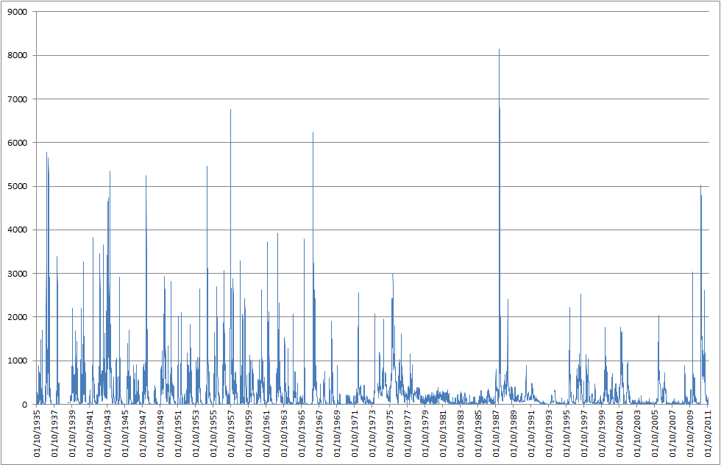
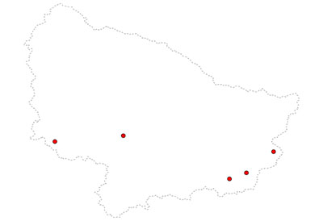
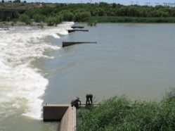
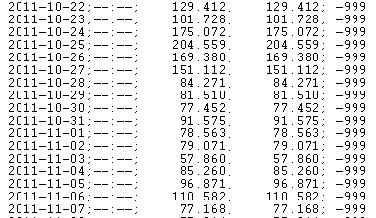
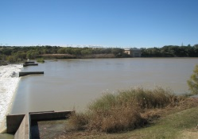
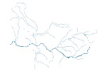
Link data via common concepts
Basin
Notes:
… representing a Basin, the unit wherein all waters are flowing to a common outlet

Slide 6
Make common concepts accessible !
Hydrologic data in the Web
Notes:
This is the principle objective of the HYF to formalise the definitions provided in the Glossary of Hydrology to provide a means to relate data products to unit shared across disciplines, and applications.

Slide 7
The OGC HY_Features model in support of geographic water information
Same challenge !!
6th, WMO/OGC Hydrology DWG
Orleans, BRGM, September 21 – 23, 2015
Irina Dornblut, GRDC of WMO at BfG

Slide 8
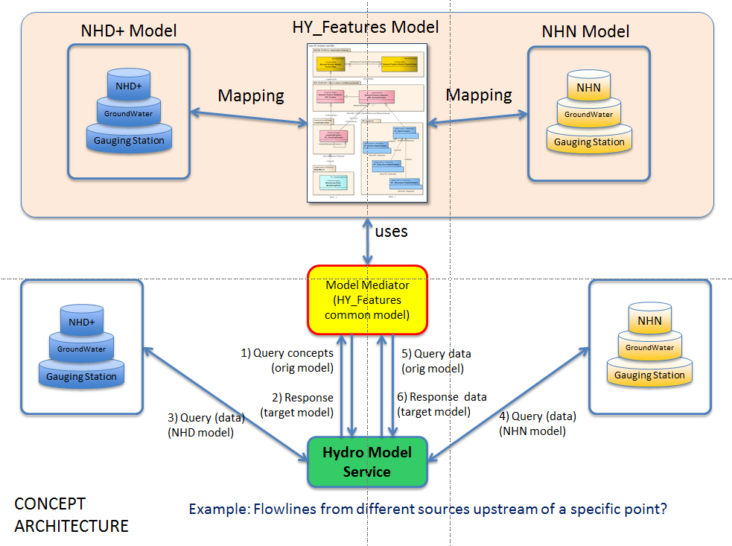
Same challenge !! 2014, OWS-10 CCI Hydro thread
Source: OGC-ER 14-048, modified.
Notes:
Problem caused by the mapping and the lack of tools for transfer these, rather than by the conceptual model, i.e. defined relationship between hydro features

Slide 9
Same challenge !! 2014, OWS-10 CCI Hydro thread
“ … further work is recommended …“
Semantic support for mediation between systems / services
beyond simple equivalence, particularly overlapping semantics Example: meaning basin when saying catchment, or vice versa
using the topological relationships defined in the HY_Features model
Semantic mapping framework (conform to ISO baseline)
re-usable, consistent mappings using HY_Features relationships
identify common patterns from such example mappings
appropriate tooling to make mapping a sustainable process

Slide 10
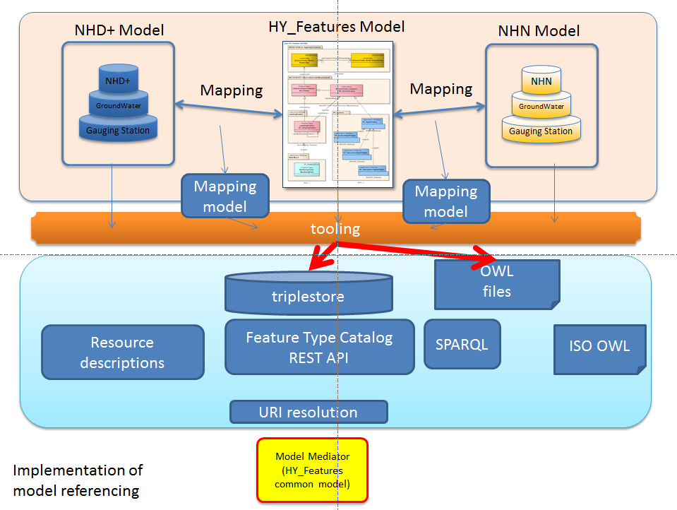
Same challenge !! CSIRO SIRF project
Source: OGC-ER 14-048, modified.
Spatial Identifier Reference Framework - SIRF, 2014

Slide 11
Same challenge !! New chance !!
Referencing hydrologic features
OWS-10 CCI Hydro “Mediation” use case:
use case of the test bed suggested as a test case for a future standardization activity for model mapping frameworks
further developed for the description of data that represent
hydrologic features in different implementation contexts
CSIRO SIRF project results:
Describe and link geospatial data via content documentation
Feature Type Catalog realising HY_Features relationships
Meta-model for (UML) schema mapping, incl. mapping vocabulary
Tooling: FTC, URI-binding pattern, mapping encoding, query language, ...
Do we have a NFIE mediation scenario ???

Slide 12
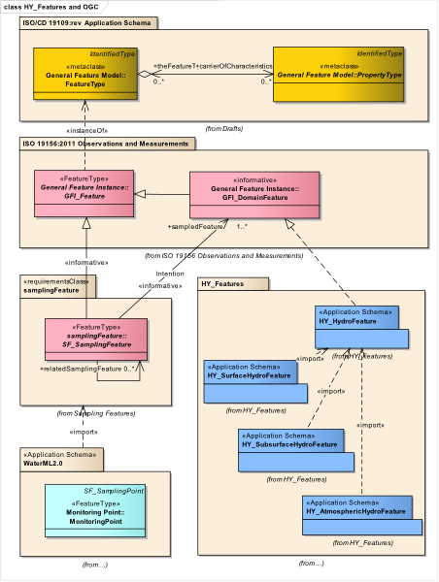
Same challenge !! New chance: NFIE ?
NHD+ Service
HY_Features Model
NHD+ Service
NHD+
NHD+
Flowline
Catchment
Flowline
Catchment
Gauging Station
Gauging Station
NHD+ Mapping
NHD+ Mapping
Spatial Identifier Reference Framework
(CSIRO SIRF)
NHD+
NHD+
1) Query concepts (reference model)
5) Query context
Polyline
Polygon
Polyline
Polygon
6) Response data and context
Flow data
2) Response
(target model)
Flow data
3) Query (data)
NFIE Service
4) Query (data)

Slide 13
Same challenge !! Mapping of concepts !!
* NHD and WBD data models derived from an ArcGIS GDB workspace export or from SHP files retrieved via WFS operated by USGS
Notes:
Map the realised common concept to a particular implementation, i.e. set context-related “defaults”. Example: NHD+ flowline (= linear representation of a catchment) is set to Flowpath with a property “representedCatchment”.

Slide 14
N x N Mappings
*In: HY_Features Part 3 - OWL encoding: rhyme and reason / Rob Atkinson. Presentation at 96th OGC TC, Nottingham, UK
ESRI global water map
NHD+
HydroSHEDS
NHN
Open Street Map
INSPIRE Hydrography
Australian Hydrographic
Geofabric
NFIE
Each schema may be expressed differently, and hence each mapping may use a different approach, and there is no logical place to go find these mappings

Slide 15
Versus N Mappings
*In: HY_Features Part 3 - OWL encoding: rhyme and reason / Rob Atkinson. Presentation at 96th OGC TC, Nottingham, UK
HY_Features
NHN
HydroSHEDS
NHD+
Open Street Map
ESRI global water map
INSPIRE Hydrography
Australian Hydrographic
Geofabric
NFIE
mapping each to a common reference model
conceptualise the mapping to store, find and resolve these mappings

Slide 16
Mapping to a common reference model
Background: HY_Features core concepts
catchment representation ; basin hierarchy ; outfall – indirect position – reference point ; water – water accumulation – storage
catchment as the basic common denominator, commonly understood as the abstract unit wherein the hydro processes take place, as reporting and management unit

Slide 17
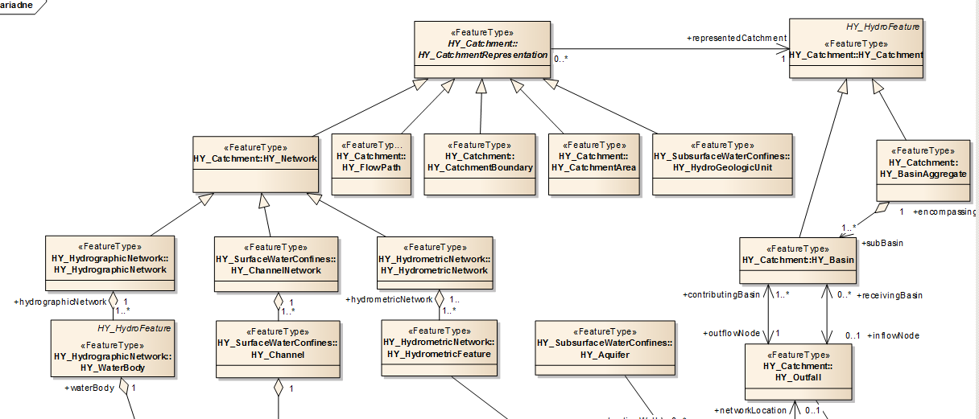
Background: HY_Features – Basic concepts, 1(3)
containingCatchment
0..1
Multiple represented catchment
Basin hierarchy
Basin and its common outlet (outfall)

Slide 18
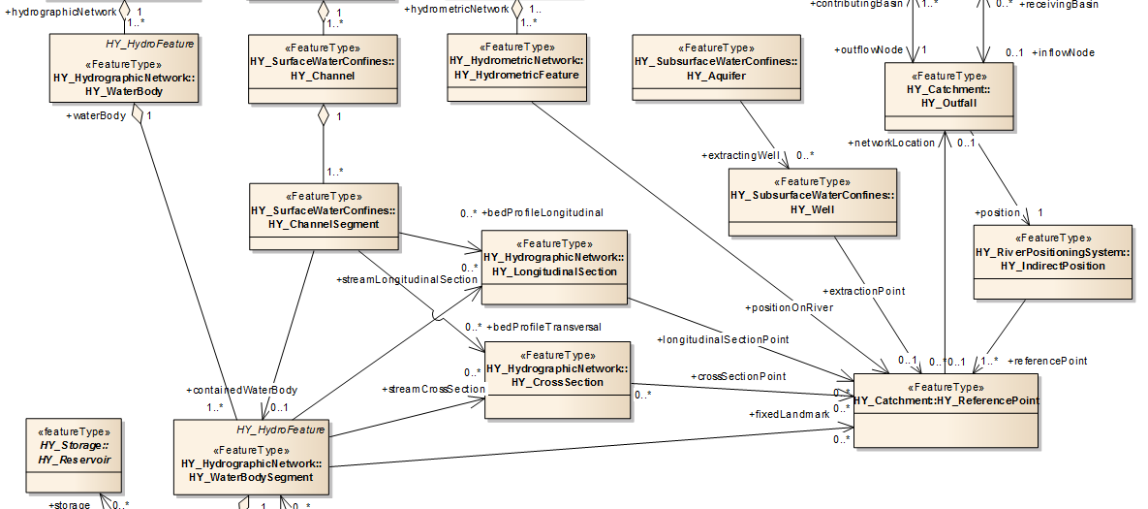
Background: HY_Features – Basic concepts, 2(3)
+well
+ wellLocation
Outfall, indirect position and reference point

Slide 19
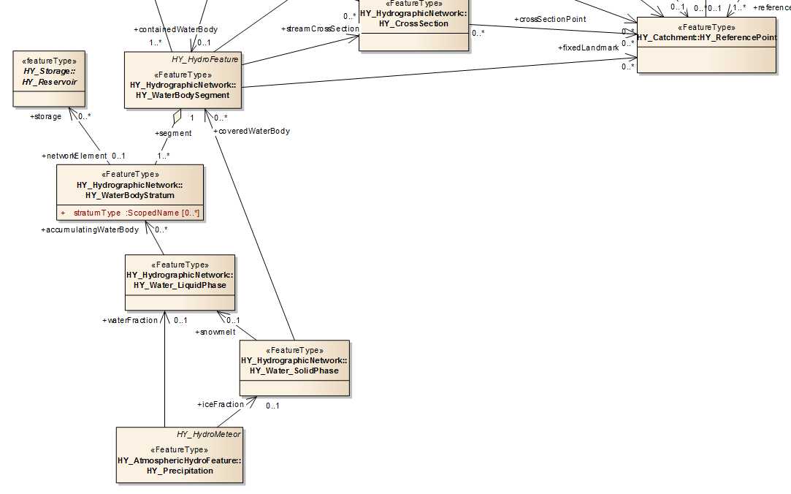
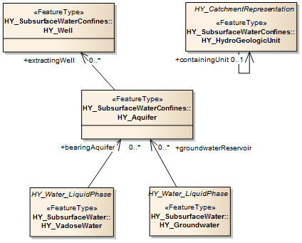
Background: HY_Features – Basic concepts, 3(3)
+ well
Water, water accumulation and storage

Slide 20
Mapping to a common domain model
each mapping is a specific approach to define context-related assumptions of the domain concept
determined by the particular implementation scenario
1:1 relationship between the implemented concept and the reference concept in the domain model
Mapping examples

Slide 21

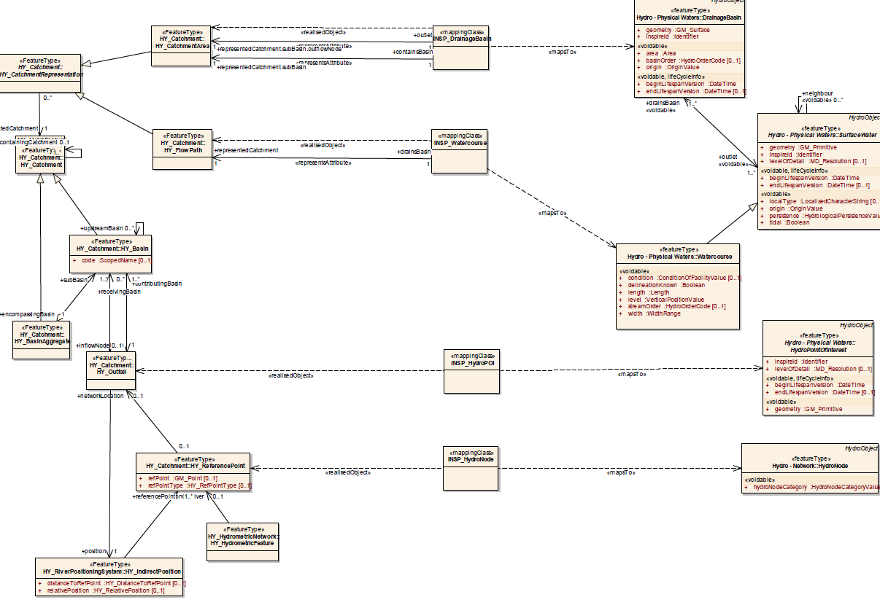
Example: HYF – INSPIRE Hydro (2nd, SIRF)
n alternative mappings, depending on the implementation

Slide 22
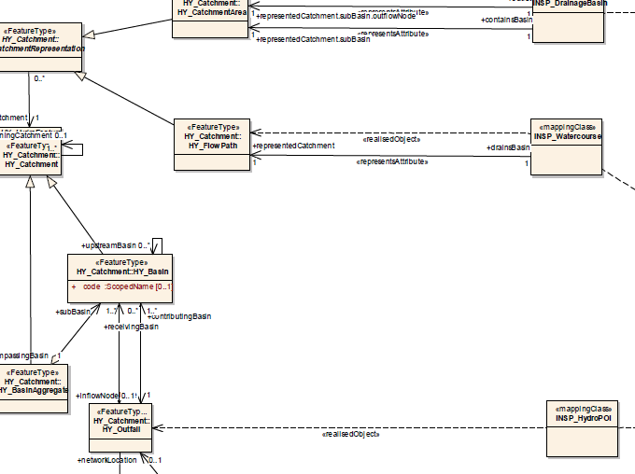
Example: INSPIRE Watercourse (alternative views)
realises Flowpath
→ drains representedCatchment

Slide 23
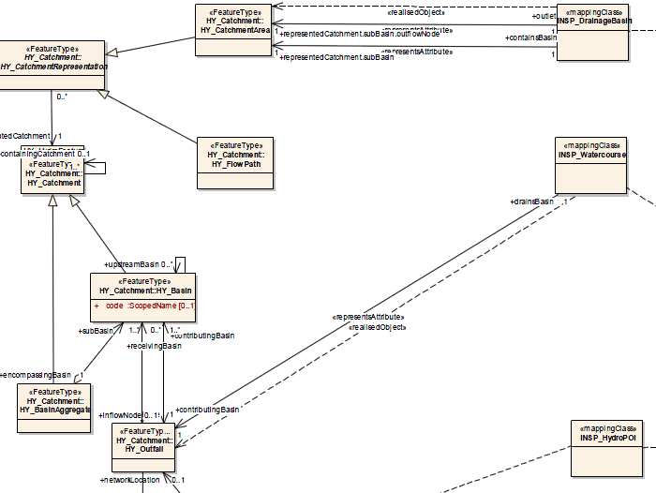
Example: INSPIRE Watercourse (alternative views)
realises Outfall
→ drains contributingBasin

Slide 24
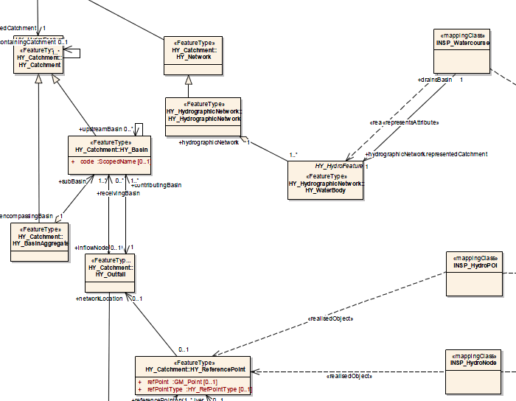
Example: INSPIRE Watercourse (alternative views)
realises WaterBody (part of network)
→ drains … representedCatchment

Slide 25
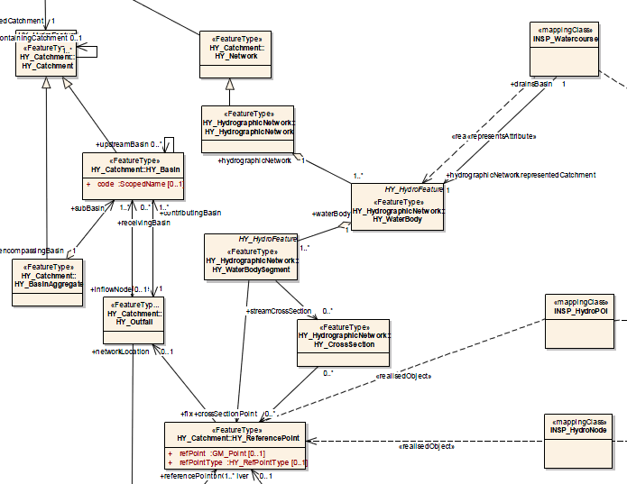
Example: INSPIRE Watercourse (alternative views)
realises WaterBody …
→ drains ….. . contributingBasin

Slide 26
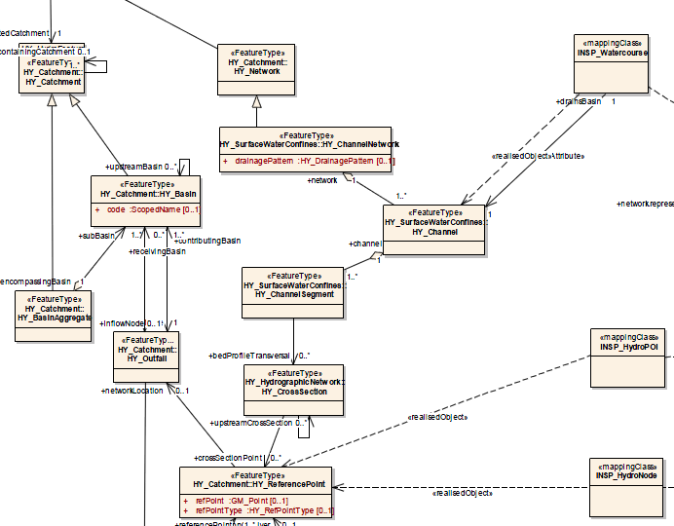
Example: INSPIRE Watercourse (alternative views)
realises Channel …
→ drains ….. . contributingBasin

Slide 27
Example: NHD+, flowline and catchment
NHDFlowline, FID |  | COMID
polyline12345 |  | 12345
polyline23456 |  | 23456
polyline34567 |  | 34567
NHDCatchment, FID |  | FID
polygon12345 |  | 12345
polygon23456 |  | 23456
polygon34567 |  | 34567

Slide 28
Example: NHD+, flowline and catchment
NHDFlowline, FID |  | COMID
polyline12345 |  | 12345
polyline23456 |  | 23456
polyline34567 |  | 34567
WBD HUC12, FID
polygon xxx12345x
polygon xxx23456x
polygon xxx34567x
?
NHDCatchment, FID |  | FID
polygon12345 |  | 12345
polygon23456 |  | 23456
polygon34567 |  | 34567

Slide 29
Example: NHD+, flowline and catchment
NHDFlowline, FID |  | COMID
polyline12345 |  | 12345
polyline23456 |  | 23456
polyline34567 |  | 34567
realises Flowpath
realises Catchment
realises CatchmentArea
WBD HUC12, FID
polygon xxx12345x
polygon xxx23456x
polygon xxx34567x
NHDCatchment, ID |  | FID
polygon12345 |  | 12345
polygon23456 |  | 23456
polygon34567 |  | 34567

Slide 30
Example: NHD+, flowline and catchment
NHDFlowline, FID |  | COMID
polyline12345 |  | 12345
polyline23456 |  | 23456
polyline34567 |  | 34567
WBD HUC12, FID | containingCatchment (nesting) | encompassingBasin (aggregation) | subBasin (aggregation)
polygon xxx12345x
polygon xxx23456x
polygon xxx34567x
representedCatchment
representedCatchment
NHDCatchment, FID |  | FID
polygon12345 |  | 12345
polygon23456 |  | 23456
polygon34567 |  | 34567

Slide 31
Example: NFIE, NHDFlowline realises Flowpath
NHDFlowline, ID |  | representedCatchment
polyline12345 |  | 12345
polyline23456 |  | 23456
polyline34567 |  | 34567
flowlineHasCatchment
NHDCatchment, ID | outflowNode | inflowNode
polygon12345
polygon23456
polygon34567
NHDJunction, ID |  | contributingBasin | receivingBasin
point12345 |  | 12345 | 23456
point23456 |  | 23456 | 34567
point34567 |  | 34567

Slide 32
Example: NFIE, NHDFlowline realises Flowpath
Flowline, ID |  | representedCatchment
polyline12345 |  | 12345
polyline23456 |  | 23456
polyline34567 |  | 34567
catchmentOwnedByFlowline:
where
receivingBasin = reprepresentedCatchment
Catchment, ID | outflowNode | inflowNode
polygon12345
polygon23456 |  | 12345
polygon34567 |  | 23456
Junction, ID |  | contributingBasin | receivingBasin
point12345 |  | 12345 | 23456
point23456 |  | 23456 | 34567
point34567 |  | rc34567

Slide 33
Example: NFIE, NHDFlowline realises Flowpath
Flowline, ID |  | representedCatchment
polyline12345 |  | 12345
polyline23456 |  | 23456
polyline34567 |  | 34567
Catchment, ID | outflowNode | inflowNode
polygon12345 | 12345
polygon23456 | 23456 | 12345
polygon34567 | 34567 | 23456
upstreamFlowline:
where
contributingBasin = reprepresentedCatchment
Junction, ID |  | contributingBasin | receivingBasin
point12345 |  | 12345 | 23456
point23456 |  | 23456 | 34567
point34567 |  | rc34567

Slide 34
Example: NFIE, NHDFlowline realises Flowpath
Flowline, ID |  | representedCatchment
polyline12345 |  | 12345
polyline23456 |  | 23456
polyline34567 |  | 34567
Catchment, ID | outflowNode | inflowNode
polygon12345 | 12345
polygon23456 | 23456 | 12345
polygon34567 | 34567 | 23456
downstreamFlowline:
where
receivingBasin = reprepresentedCatchment
Junction, ID |  | contributingBasin | receivingBasin
point12345 |  | 12345 | 23456
point23456 |  | 23456 | 34567
point34567 |  | rc34567

Slide 35
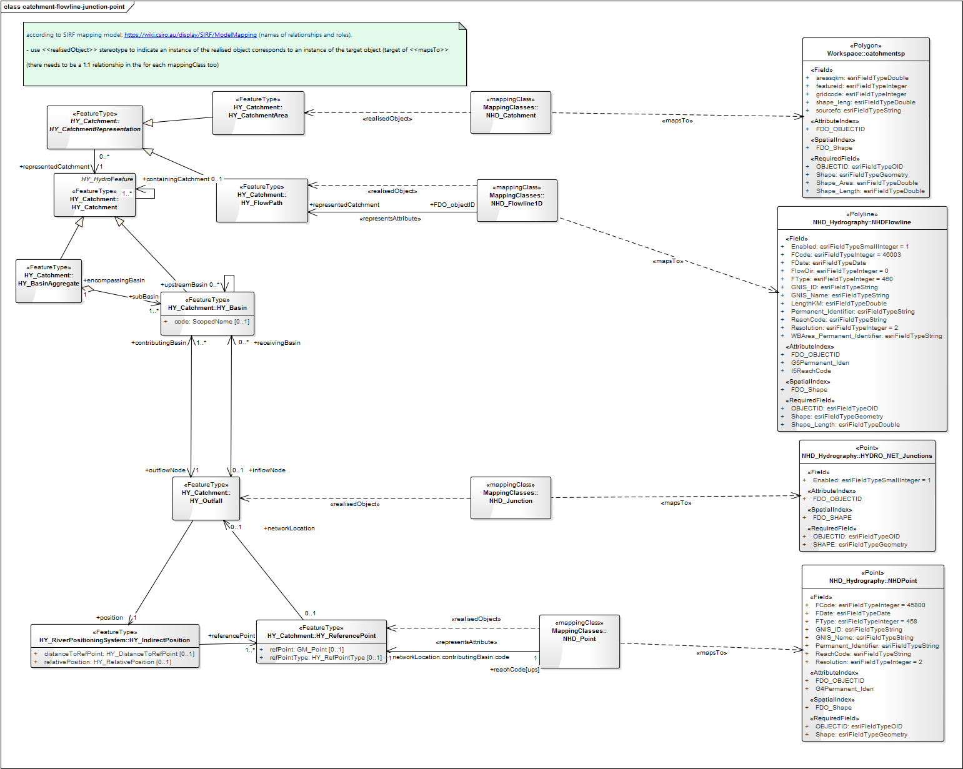
Example: HYF – NHD+ (parts of, 2nd, SIRF)

Slide 36
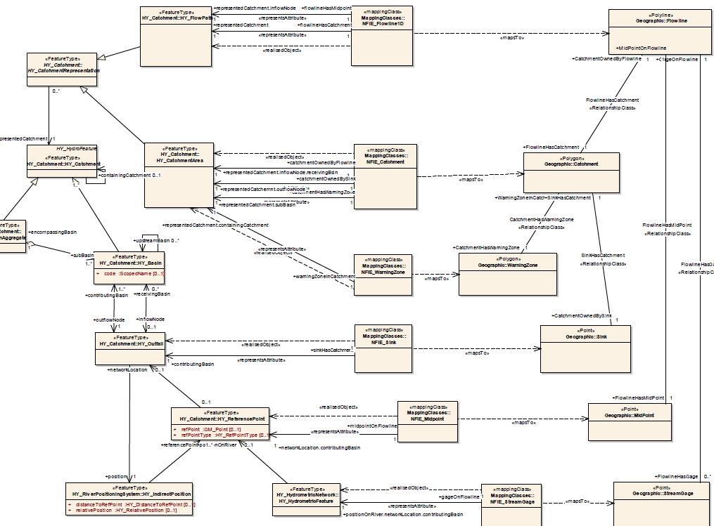
Example: HYF – NFIE (parts of, 1st, SIRF)
mapping class (= NFIE_Flowline1D)
mapsTo implementation class (= Flowline)
realisedObject (= Flowpath)
catchmentHasFlowline → representedCatchment.inflowNode.receivingBasin

Slide 37
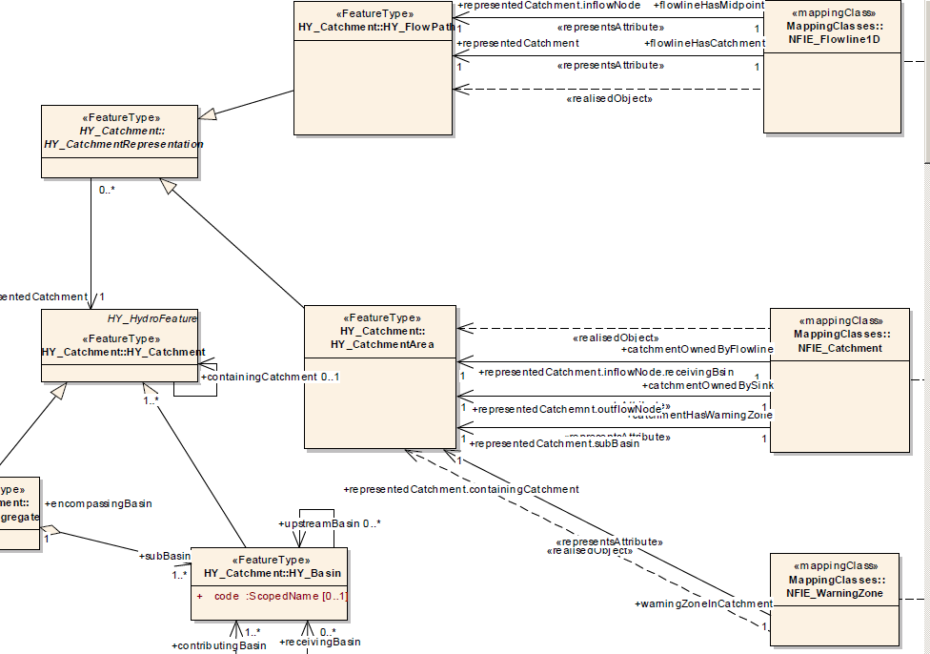
Example: HYF – NFIE (parts of, 1st, SIRF)

Slide 38
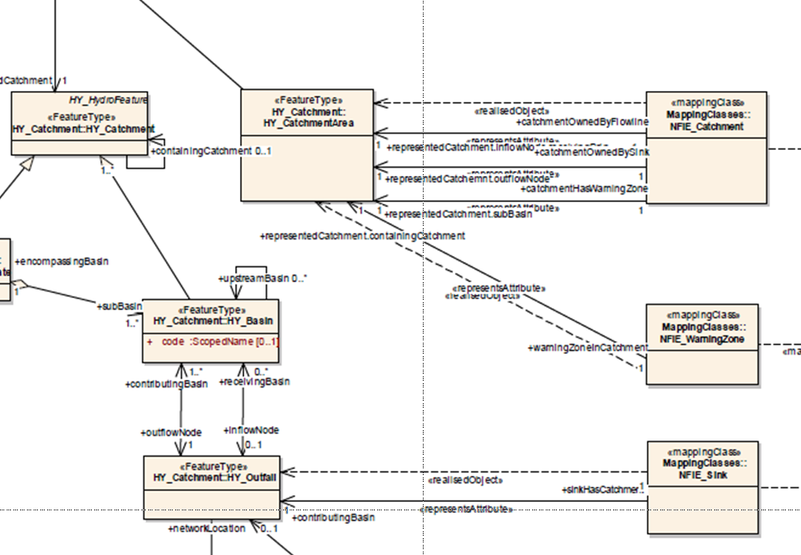
Example: HYF – NFIE (1st, SIRF)
mapping class (= NFIE_WarningZone)
mapsTo implementation class (= WarningZone)
realisedObject (= CatchmentArea)
warningZoneInCatchment → representedCatchment.containingCatchment

Slide 39
Example: HYF – NFIE (1st, SIRF)

Slide 40
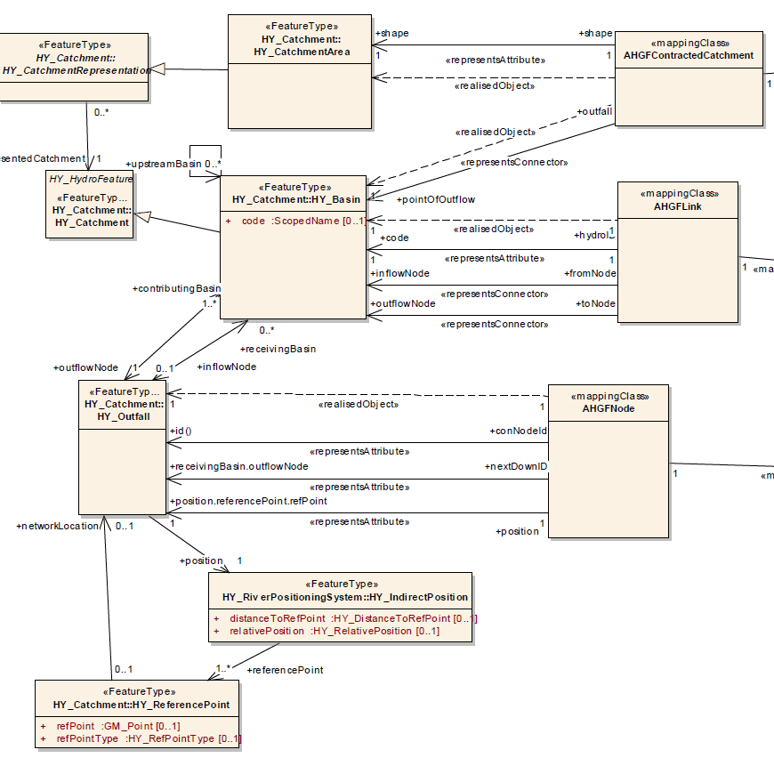
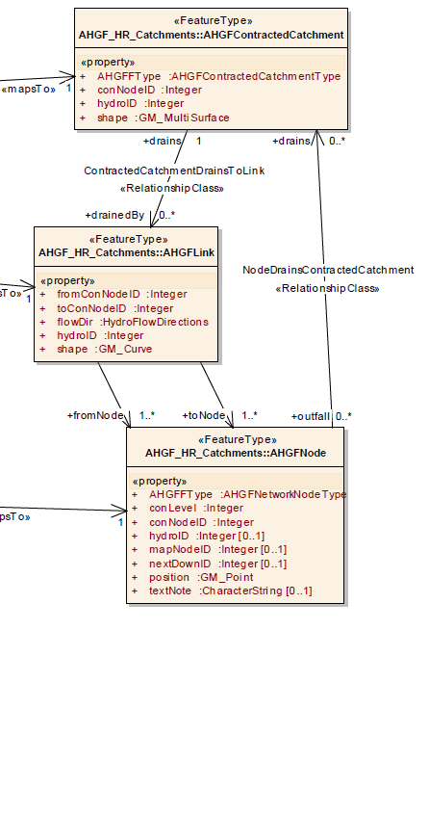
Example: HYF – AHGF (2014, Rob Atkinson)

Slide 41
Example: HYF – WaterML2
relate monitoring point / feature to the sampled feature, e.g. waterbody → basin or catchment

Slide 42
Example: HYF – GWML2

Slide 43
Discussion points
Requirements from a hydrologists view point
Requirements from an informatics perspective
Conceptualise the mapping based real implementations
Derive Stereotype mapping relationships
adjustments to the conceptual model, e.g. relax cardinalities, maybe some renaming
Aside
Define a use case from the watERP scenario
standardise the REST interface (easy convert from XML to JSON) → convention on this
HY_Features JSON encoding (part 4 of HYF)

Slide 44
Conceptualise mapping
Requirements from a hydrologists view point (to discuss)
reflect the relationships between hydrologic features such as catchment and basin hierarchy, or linear stream network
representedCatchment
contributingBasin
do we need reflect equivalence, compatibility or typicality of the mapped concept
“sameAs” (same idea, same term)
“similarTo” (same idea, different term)
“typical” (same key properties, matching a type)
do we need adequacy of mapping in the given context (i.e. express how mapped attributes conforms to the reference): e.g. “exact”, “fundamental”
do we need reflect gaps detected in the target model
how to communicate / share mappings across systems
Others

Slide 45
Conceptualise mapping
Requirements from an informatics perspective (to discuss)
syntax to bind typical geospatial data to the realised concept
syntax to support a “concept-aware discovery” of geospatial data,
find data that represent the same catchment across representations
store mapping relationships
syntax to resolve the mapping relationships
Others

Slide 46
Thank you !
6th, WMO/OGC Hydrology DWG
Orleans, BRGM, September 21 – 23, 2015
Irina Dornblut, GRDC of WMO at BfG
Rob Atkinson, Metalinkage

