Slide 1
GroundWater 2 IE
GWML2
96th OGC Technical Committee
Nottingham, UK
Boyan Brodaric and the GW2IE Team
17 September 2015
Copyright © 2015 Open Geospatial Consortium

Slide 2
Agenda
Introduction
Prior Work
Recent Progress
Next Steps
Wrap-up
---------------------------------------------------------------------------------------
Use-cases
Conceptual Model
Logical Model
XML encoding
Use case implementations
Eng Report
Copyright © 2015 Open Geospatial Consortium

Slide 3
GW2IE Introduction
Objectives
  Develop and test a GML groundwater information model and encoding from existing international initiatives (GWML1, INSPIRE)
  Prepare an engineering report as a draft OGC data specification
Participants
  13 initiating agencies: NA, EU, AU, NZ
  9 submitting agencies: NA, EU, AU, NZ
  E.Boisvert (NRCan), B.Brodaric (NRCan), P.Dahlhaus (FedUni), S.Grellet (BRGM), A.Kmoch
  (GNS/UZ), F.Letourneau (NRCan), J.Lucido (USGS), B.Simons (CSIRO/BOM), B.Wagner (GSG)
Activities
  43 meetings since June 2012 Kick-off (1 in-person, 2014)
OGC Wiki Documentation
  http://external.opengis.org/twiki_public/HydrologyDWG/GroundwaterInteroperabilityExperiment2
Copyright © 2015 Open Geospatial Consortium

Slide 4
GW2IE Prior Work
Pre-OGC TC Boulder (June 2015):
Conceptual Model: complete
Logical Model: complete
XML Examples: significant progress
Use-case Implementations: significant progress
Eng Report: significant progress
Copyright © 2015 Open Geospatial Consortium

Slide 5
GW2IE Recent Progress
Post-OGC TC Boulder (June 2015):
XML Examples: complete
  Full examples: see GWML2 SVN (https://xp-dev.com/svn/gwml2/Documents/instance/)
  Fragments: see GW2IE report
Use-case Implementations: complete
  Five use-cases: successful
  Nine agencies: NA, EU, AU, NZ
  14 web services: WMS, WFS, SOS, WPS
  17 change requests
Eng Report: complete
  Release to OGC Portal (01 Sept 2015, OGC 15-082, 175 pp)
  Draft GWML2 specification + implementation report
  Public release pending approval by HDWG & OGC (under review)
Copyright © 2015 Open Geospatial Consortium

Slide 6
GW2IE Next Steps
GW2IE Eng Report public release
  HDWG: vote at 2015 Annual Workshop (Orleans, 20-23 Sept 2015)
  OGC TC: electronic vote of OGC TC following HDWG acceptance
  OGC TC: public release via OGC Portal
Groundwater SWG (GWML2) initiate
  HDWG: vote at HDWG session at OGC TC (Nottingham)
  OGC TC: request SWG initiation at OGC TC Plenary (Nottingham)
  HDWG: develop charter at 2015 Annual Workshop (Orleans)
  OGC TC: 3 month public comment then HDWG / OGC approval vote
Copyright © 2015 Open Geospatial Consortium

Slide 7
GW2IE Use Cases
Five use cases to guide GWML2 design and testing
  Commercial - find water wells, estimate cost of water supply well
    http://external.opengis.org/twiki_public/HydrologyDWG/UseCase1
  Policy - meet EU Water Framework Directive requirements
    http://external.opengis.org/twiki_public/HydrologyDWG/UseCase2
  Environmental - assess risks to gw dependent ecosystems
    http://external.opengis.org/twiki_public/HydrologyDWG/UseCase3
  Scientific - determine flow of groundwater via gw modeling
    http://external.opengis.org/twiki_public/HydrologyDWG/UseCase4
  Technologic – map GWML2 to existing info models
    http://external.opengis.org/twiki_public/HydrologyDWG/UseCase5
Copyright © 2015 Open Geospatial Consortium

Slide 8
GWML2 Conceptual Model
Technology-neutral conceptualization
Consolidated Entity List
    http://external.opengis.org/twiki_public/HydrologyDWG/Gwml2FinalFeaturesList
Groundwater features
  GW_HydrogeoUnit [aquifer, confining bed, basin, aquifer system]
  GW_FluidBody, GW_Constituent
  GW_HydrogeoVoid
  GW_Flow, GW_FlowSystem
  GW_Well, GW_Spring, GW_MonitoringSite
Documentation
    http://external.opengis.org/twiki_public/HydrologyDWG/GWML2-CM-Model
Model Comparison
    http://external.opengis.org/twiki_public/HydrologyDWG/GWIE2-Model-Comparison
Copyright © 2015 Open Geospatial Consortium

Slide 9
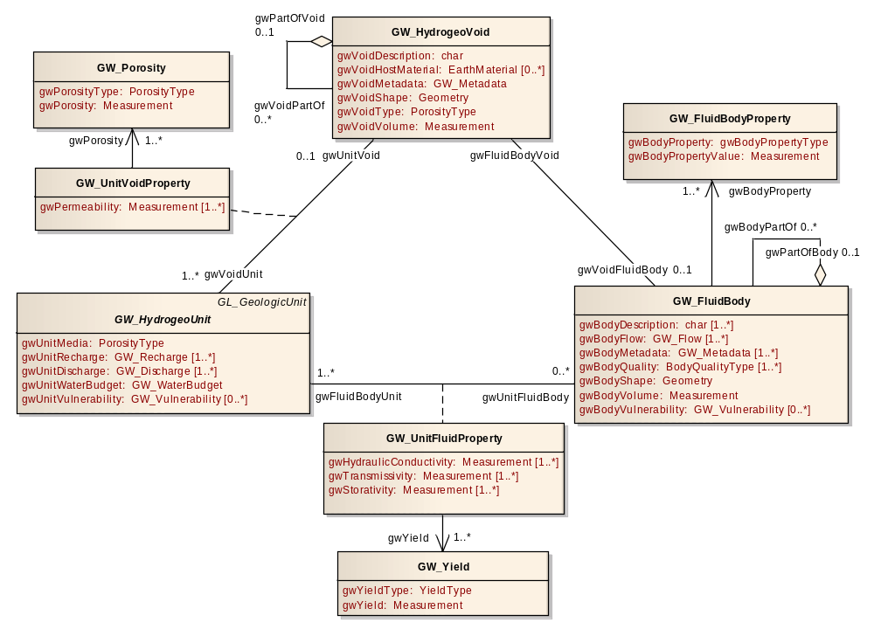
GWML2 Conceptual Model – ‘holey trinity’
Hydrogeological units host voids; both contain fluid bodies
Copyright © 2015 Open Geospatial Consortium

Slide 10
GW2IE Logical Model
GML, O&M (e.g. OM_Measurement), GeoSciML, WaterML
GML-UML representation of Conceptual model
    http://external.opengis.org/twiki_public/HydrologyDWG/GWML2-UML-Model
  5 application schema (GWML2-Main, Well, WellConstruction, Flow, Constituent)
  External dependencies:
    ISO19115, 19107, 19108, 19103, 19156, 19123, OGC SWE
  Extends:
    Observations & Measurements (O&M), GeoSciML (v3.2), InterleavedCoverages
  Adapts:
    GWML1 well construction
  Cardinalities all [0..x]
Significant change request to O&M
Copyright © 2015 Open Geospatial Consortium

Slide 11
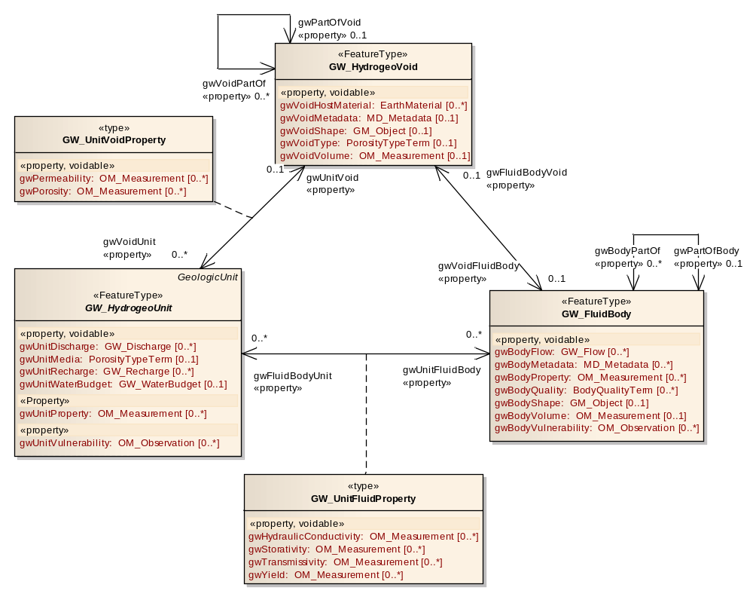
GWML2 Logical Model – GML specific
Copyright © 2015 Open Geospatial Consortium

Slide 12
GWML2 XML encoding
developed custom O&M and SWE patterns
O&M Pattern
  Most numeric values for subtypes and provenance (OM_Measurement*)
  Analytical results (waterbody constituents, aquifer properties)
  Aquifer test (aquifer properties)
SWE Data Record: lithology and stratigraphy log
    http://external.opengis.org/twiki_public/HydrologyDWG/GwmlSweDataRecord
  Defined GWML2 data records for stratigraphy and lithology
    Extend to other downhole logs (geophysical, geochemistry, geochronology)
  WFS coverages verbose, but explicit
Copyright © 2015 Open Geospatial Consortium

Slide 13
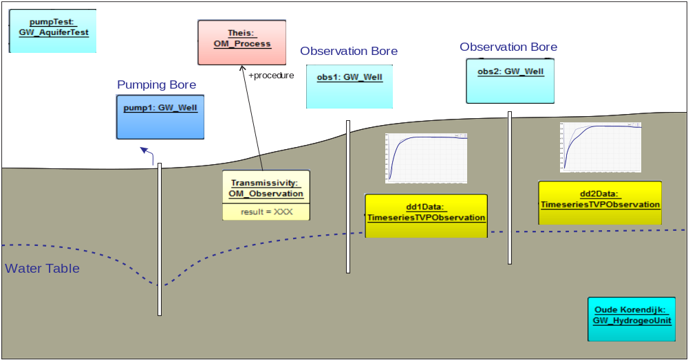
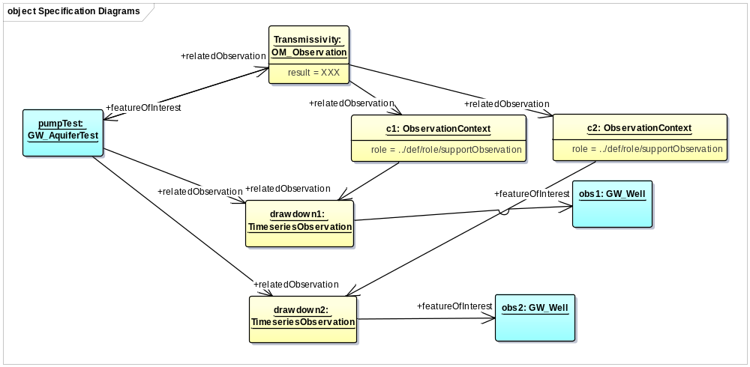
GWML2 XML encoding – Aquifer test
Copyright © 2015 Open Geospatial Consortium

Slide 14
GW2IE Implementation
Successful test of GWML2
Use Case 1 (water wells, springs, aquifers)
  BRGM, CSIRO-BoM, FedUni, GNSS/UZ, NRCan, USGS (WFS, WMS)
Use Case 2 (management area)
  CSIRO-BoM, GNSS/UZ (WFS)
Use Case 3 (groundwater body, flow, constituents)
  FedUni, GNS/UZ (WFS, WMS, SOS)
Use Case 4 (water wells, aquifers, flow, groundwater body)
  GNSS/NZ, USGS (WFS, WMS, SOS, WPS)
Use Case 5 (map: GWML1*, INSPIRE-Hydrogeology, HY_Features*)
  BRGM, CSIRO, GSG, NRCan
  * designates incomplete mapping
Participants listed in alphabetical order
Copyright © 2015 Open Geospatial Consortium

Slide 15
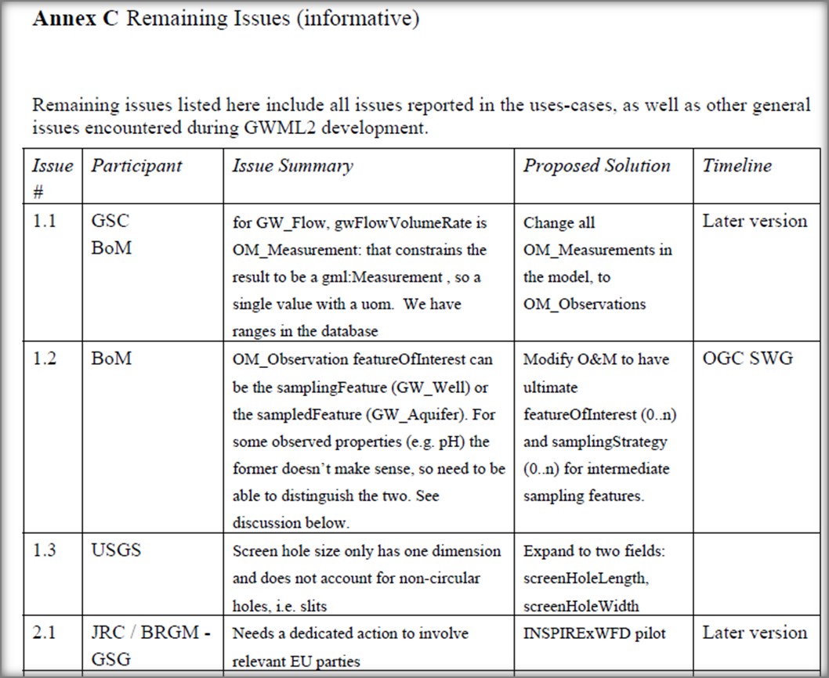
GW2IE Implementation – change requests (17)
Copyright © 2015 Open Geospatial Consortium

Slide 16
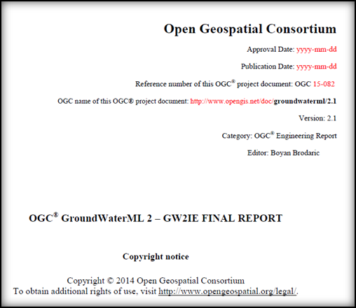
GW2IE Eng Report
Draft GWML2 specification + Implementation report
Release to public SVN (non-advertised) and OGC Portal
    http://xp-dev.com/svn/gwml2/Documents/GroundWaterML2_GW2IE-FinalReport.docx
Includes
  conceptual and logical models
  GML/XML encoding rules & tests
  example XML encodings
  use-cases and implementation results
  change requests (issues identified)
Copyright © 2015 Open Geospatial Consortium

Slide 17
GW2IE
Discussion
Vote to recommend public release of report
Copyright © 2015 Open Geospatial Consortium

