Slide 1
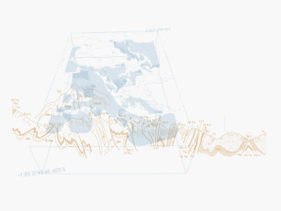
GWML2 UC 5 - mappings
BRGM, S.Grellet – NRCAN, E.Boisvert
OGC HydroDWG Orléans Workshop – 2015-09-20
Notes:
1

Slide 2
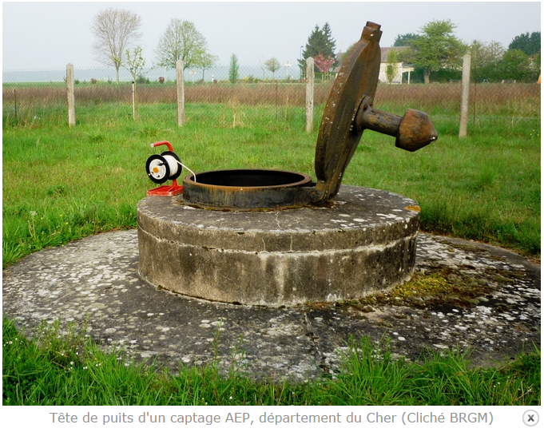
Context
1 real world feature
Stored in 1 dedicated
database
Exposed according to different
exchange scenarii
France | Europe | International
Sandre:PointEau | Inspire:GE:ActiveWell | GWML2.0:Well
OGC HydroDWG Orléans Workshop – 2015-09-20
> <number>
Notes:
Image puit

Slide 3

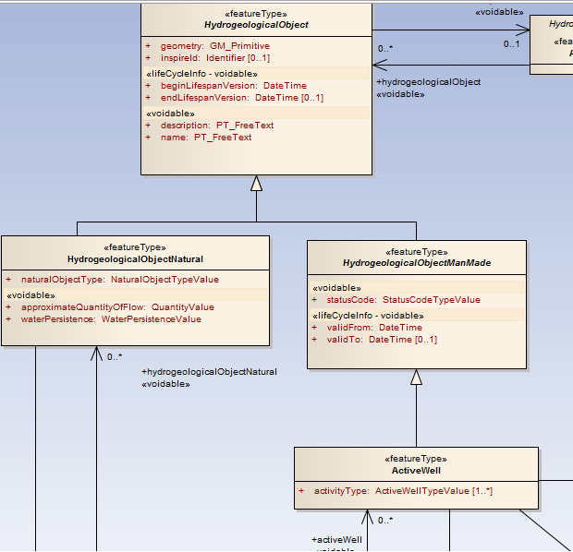
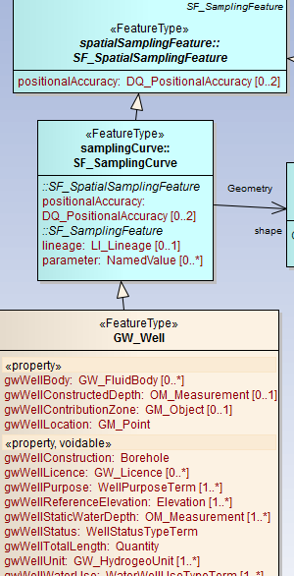
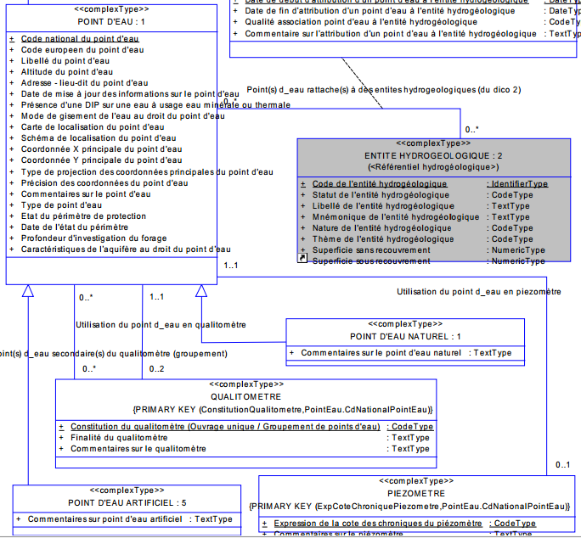
Context
France
International
Europe

Slide 4
Standardise the mapping ?
Could become a « standard »
  Ex : just do once GWML2 <-> Inspire-GE, or HY_Feature- <-> Inspire-Hy
Different communities / Different approaches
    GWML2 – UC5 : just a spreadsheet (with many columns)
    Express-X (iso10303-11) used in Energistics (Oil & Gas), since 20 ans
    R2RML : W3C recommandation (http://www.w3.org/TR/r2rml/), RDB to RDF Mapping Language. Used in InGeoClouds EU CIP project
    Use RFD/OWL to map UML ISO 191xx models ported to RFD/OWL as in OGC OWS-10
    xsd level mapping and xslt generation as in ETL tool HALE. Used in some Inspire community
    EDOAL (Expressive and Declarative Ontology Alignment Language) : INRIA (Euzenat). To map ontologies.
OGC HydroDWG Orléans Workshop – 2015-09-20
> <number>

Slide 5
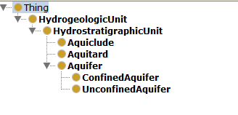
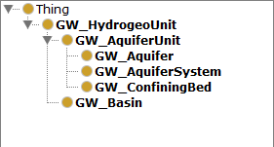
Standardise the mapping ?
EDOAL example
GWML1
GWML2
OGC HydroDWG Orléans Workshop – 2015-09-20
> <number>

Slide 6
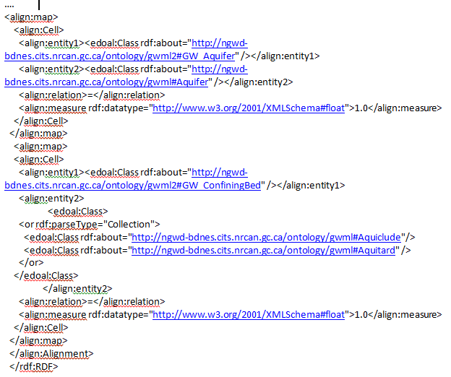
Standardise the mapping ?
EDOAL example
OGC HydroDWG Orléans Workshop – 2015-09-20
> <number>

Slide 7
Standardise the mapping ?
Could HyDWG raise this need to the OGC higher level ?
Keeping in mind that this is not always a 1 ← → 1 mapping exercise !
  Sometime (often) requiring filtering, aggregating !
Could be used in brokers / mediators
  At run time
OGC HydroDWG Orléans Workshop – 2015-09-20
> <number>

