Slide 1

National Flood Interoperability Experiment
David R. Maidment
Center for Research in Water Resources
University of Texas at Austin
Presentation to the OCG Hydrology Domain Working Group
Orleans, France, 22 September 2015
Acknowledgements: Fernando Salas, Marcelo Somos Valenzuela, David Gochis, Ed Clark,
Don Cline, Jack Dangermond, Andy Ernest, Richard Hooper
This research is supported in part by NSF EarthCube grant 1343785

Slide 2
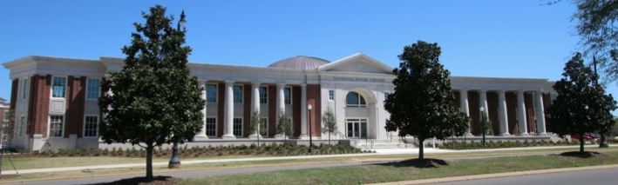
The Opportunity
New National Water Center established on the Tuscaloosa campus of University of Alabama by the National Weather Service and federal agency partners
Has a mission to assess hydrology in a new way at the continental scale for the United States

Slide 3
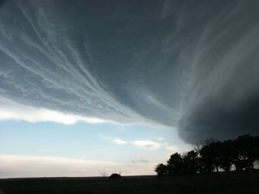
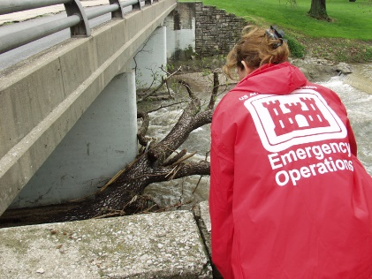

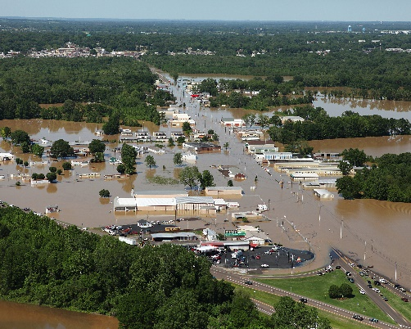


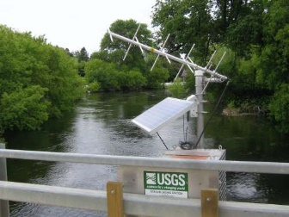

Integrated Water Resources Science and Services (IWRSS)
Formal partnership across these four agencies
Weather
Rivers
Impact
Data

Slide 4

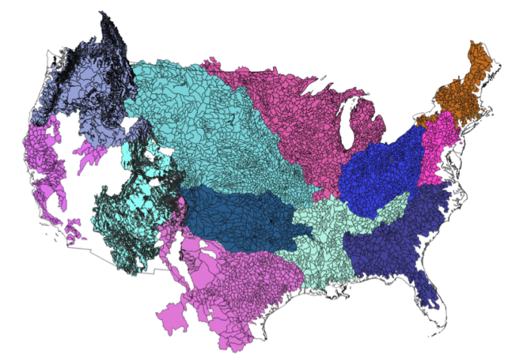
NWS River Forecast Centers (RFCs)
Prepare river and flood forecasts
Provide forecast guidance to Weather Forecast Offices (WFOs)
Issue daily stage and streamflow forecasts, and flash flood guidance
Work with water managers and other Federal Agencies
6600 sub-basins in continental US
4
Notes:
RFC Summary

Slide 5
100 million people on coast
No River Forecast
Notes:
THERE’S A MAJOR GEOGRAPHIC GAP – WE DON’T FORECAST ALONG THE COAST

Slide 6
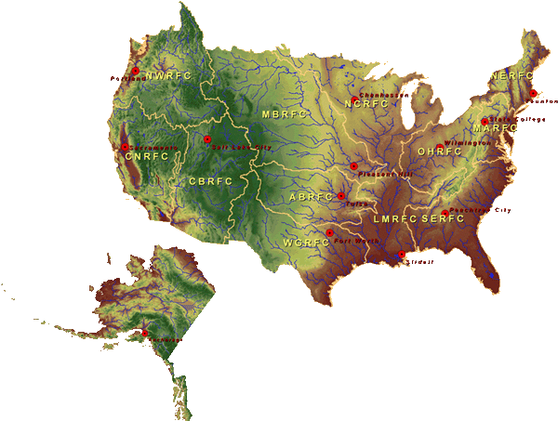

National Water Center
FY15 Centralized Water Forecasting
Centralized Data Archive – all RFC data
Modeling Testbed – new NWC capabilities
Notes:
TRANSITION INTO METHODS
FY15 PROJECT HAS FOUR CORE COMPONENTS
RFC archive
Model evaluation service
Modeling testbed
Centralized modeling demonstration

Slide 7
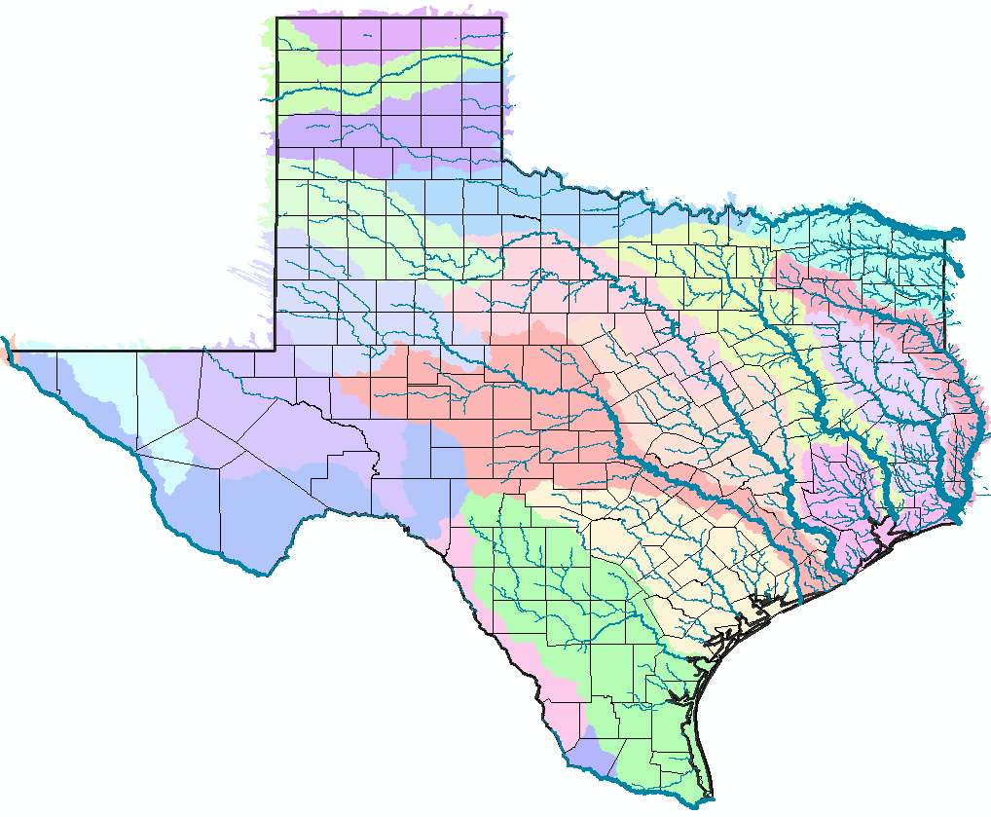
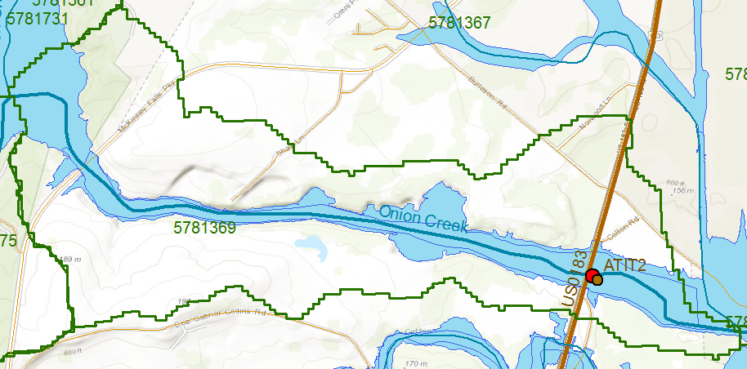
RFC Forecast Point: Onion Creek at Highway 183
National Flood Interoperability Experiment
Geospatial data framework for Texas
NFIE-Geo Texas
USGS Gage 08159000
NHDPlus Catchment 5781369
NWS Forecast Point ATIT2

Slide 8
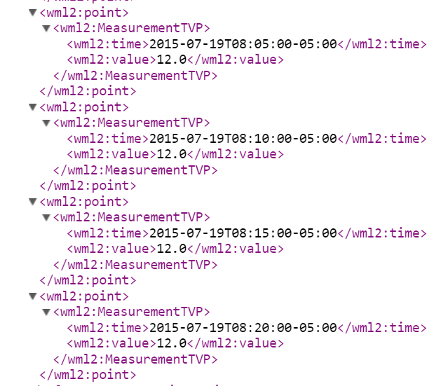
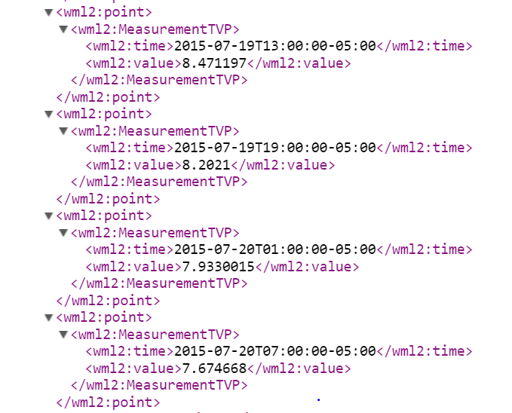
WaterML2 Observations from USGS and Forecasts from NWS for this location
USGS Gage 08159000
NWS Forecast Point ATIT2
USGS Observed Flows, July 19
NWS Forecast Flows, July 19-20
Past and Present
Future

Slide 9
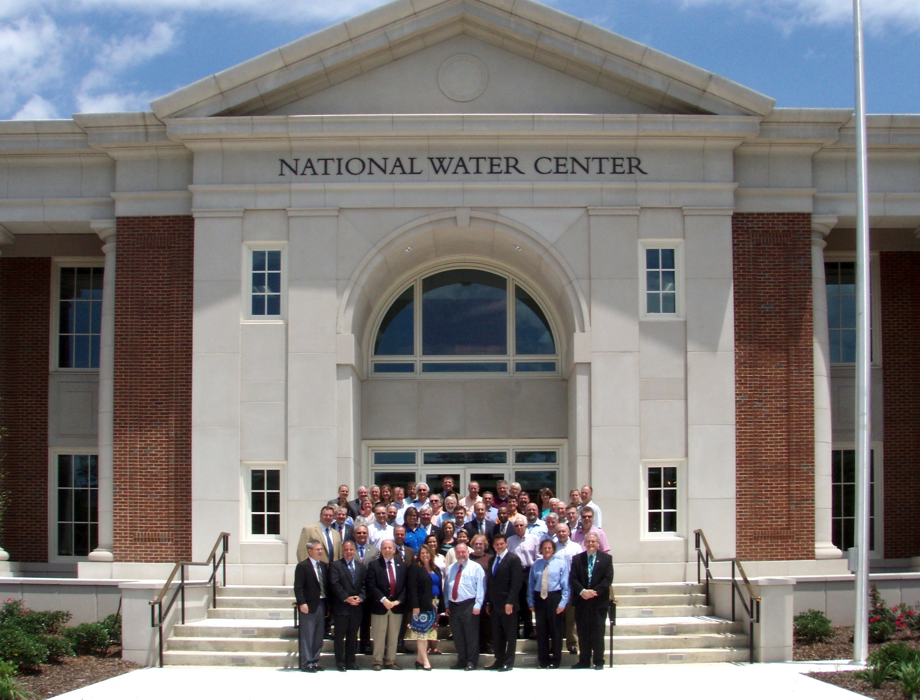
Inaugural Meeting – May, 2014

Slide 10
Transformative Research (NSF)
Transformative research involves ideas, discoveries, or tools that radically change our understanding of an important existing scientific or engineering concept or educational practice or leads to the creation of a new paradigm or field of science, engineering, or education. Such research challenges current understanding or provides pathways to new frontiers.
http://www.nsf.gov/about/transformative_research/definition.jsp
How to move from evolutionary change
to transformative change?

Slide 11


National Flood Interoperability Experiment (NFIE) (Sept 2014 to August 2015)
Partnership between NWS and the academic community (Interagency Agreement between NSF and NOAA)
Included a Summer Institute for 44 graduate students from 19 Universities at the National Water Center, June 1 to July 17, 2015

Slide 12
Goal of the Experiment
Close the gap between National Flood Forecasting and Local Emergency Response
Demonstrate forecasting of flood impacts at “stream and street level”
National
Weather and Hydrology
National Weather Service and federal agencies
National Water Center
River Flooding and Emergency Response
Local, State and Regional Agencies
Citizens
Local

Slide 13
NFIE Conceptual Framework
NFIE-Geo: National geospatial framework for hydrology
NFIE-Response: Community Flood Response System
NFIE-Hydro: National high spatial resolution hydrologic forecasting
NFIE-River: River channel information and real-time flood inundation mapping
NFIE-Services: Web services for flood information

Slide 14
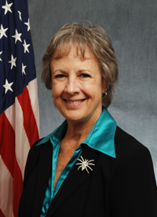

Open Water Data Initiative (OWDI)
Subcommittee on Spatial Water Data leads this effort
Al Rea (USGS) and Ed Clark (NWS) are co-chairs
This reports to both FGDC and ACWI
Sponsoring a series of “experiments” with water information services
NFIE is one of these experiments
Anne Castle, Former Asst Secretary for Water and Science, Dept of Interior
Chair

Slide 15
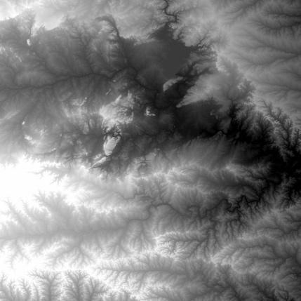
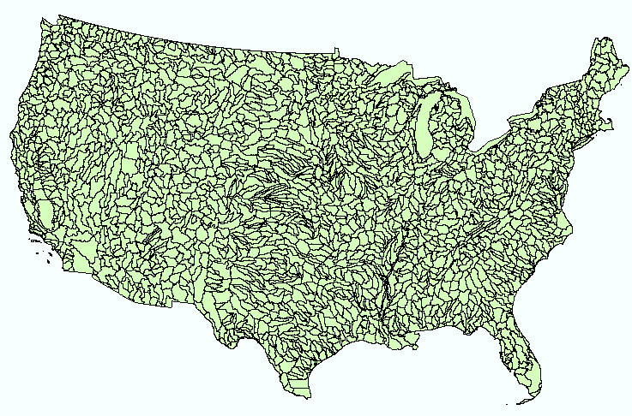
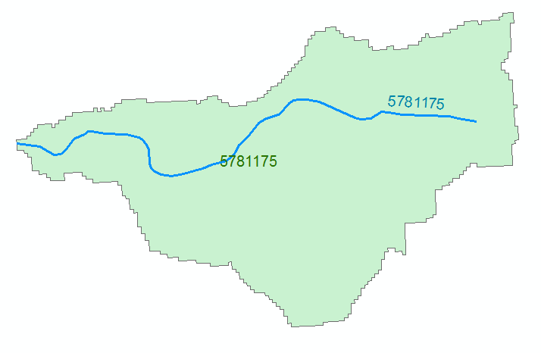
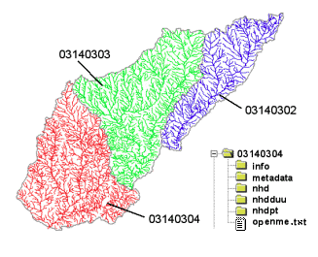
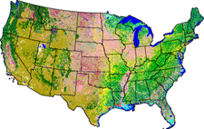
NHDPlus Version 2.1
Foundation for a Geospatial Hydrologic Framework for the United States
NHDPlus
2.7 million reach catchments in US
average area 3 km²
reach length 2 km
Uniquely labelled
National Elevation Dataset
Watershed Boundary Dataset
National Hydrography Dataset
National Land Cover Dataset

Slide 16
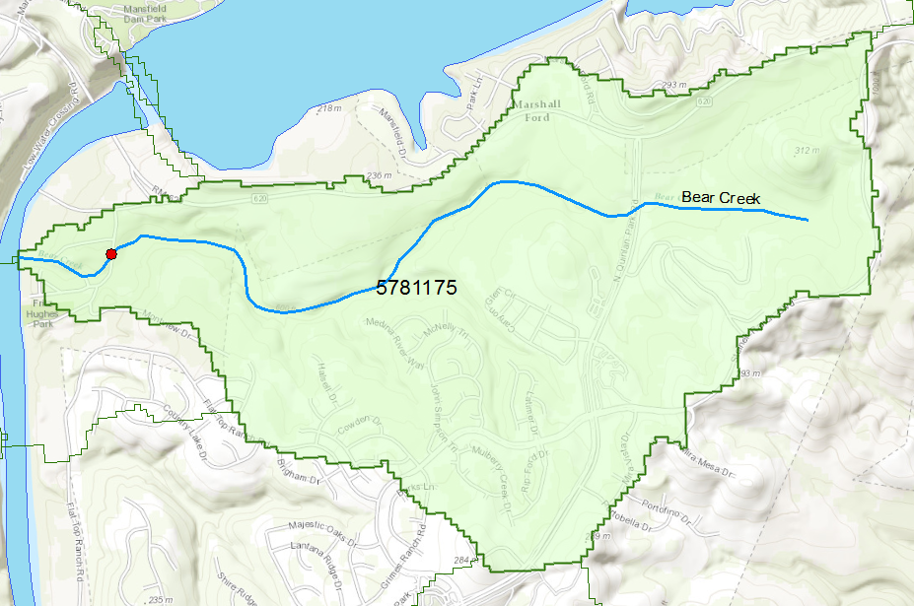
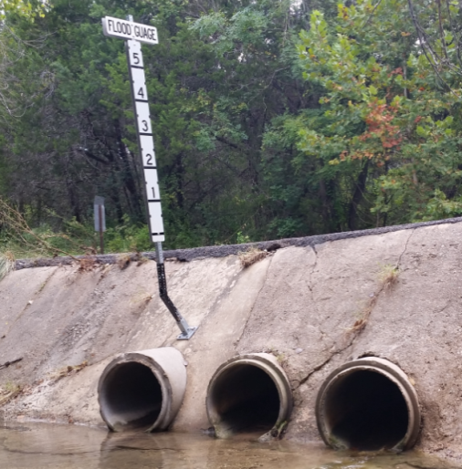
Flood Information for Fritz Hughes Park Rd
National Hydrography Dataset Plus
catchment for Bear Creek
(area = 5.71 km²)
Low water crossing at
3400 Fritz Hughes Park Rd

Slide 17

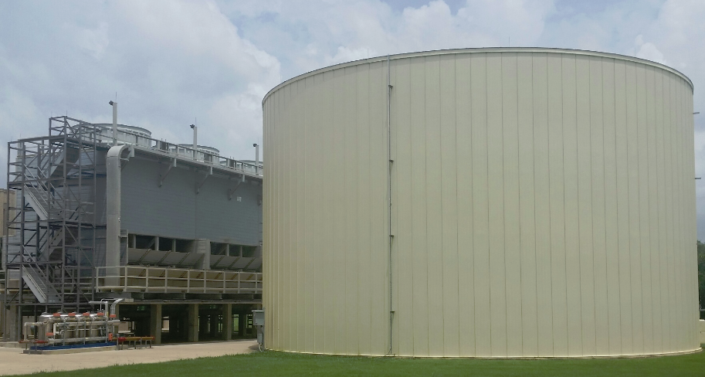
Stampede
1.2 million gallon cooling tank
500,000 processors operating in parallel

Slide 18
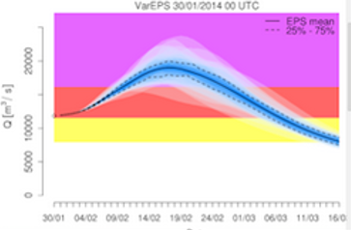
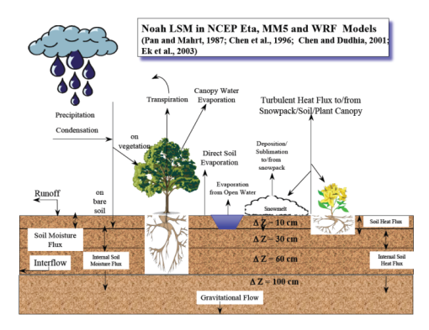
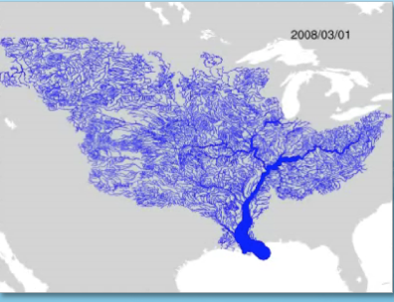
WRF-Hydro Forecasting Model
Computed for the continental US in 10 minutes at Texas Advanced Computing Center
Weather model and forecasts (HRRR)
Probabilistic flood forecasts
Catchment-level forecasts
Weather
Precipitation
Streamflow
Runoff
Land-Atmosphere Model (NOAH-MP)
RAPID flow routing (for continental US)

Slide 19
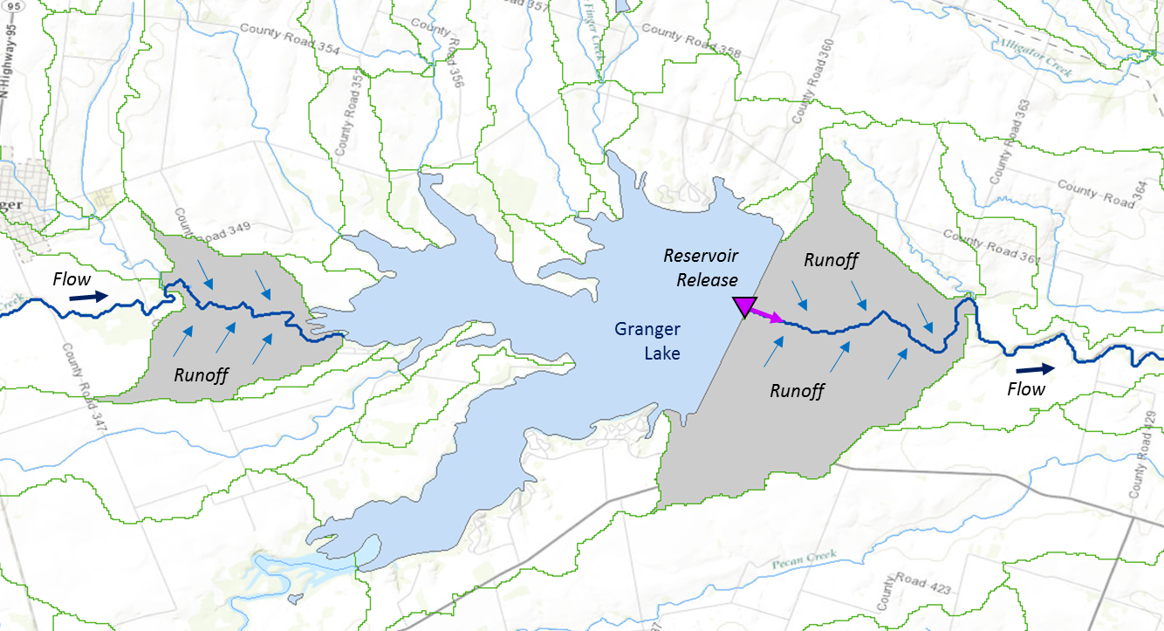
Muskingum
Method
RAPID River Routing Model
River Application for Parallel ComputatIon of Discharge
S_{prism} = KQ
S_{wedge} = KX (I – Q)
Computational Unit for Rivers
Forcing: Runoff and reservoir releases
NHDPlus Catchment
Flow
Legend
Dam
Junction
Catchment
http://rapid-hub.org/

Slide 20
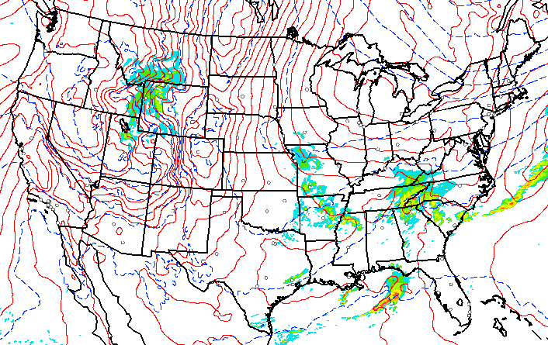
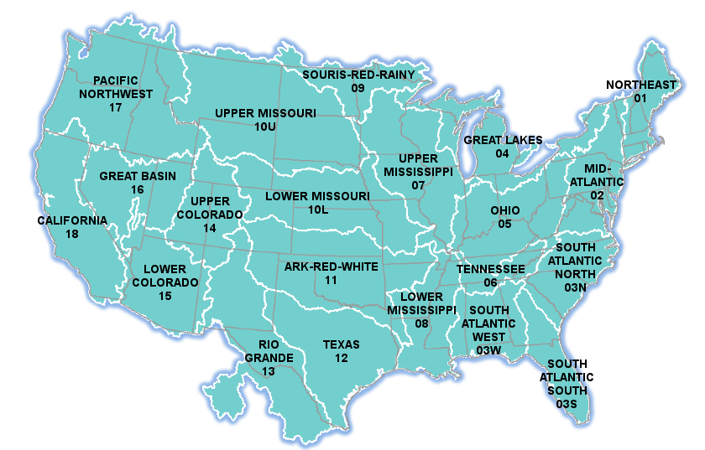

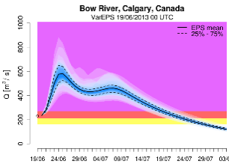
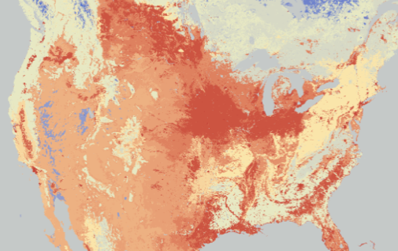
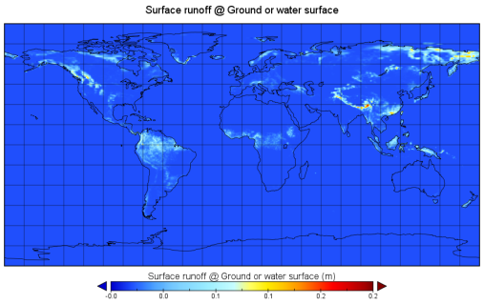

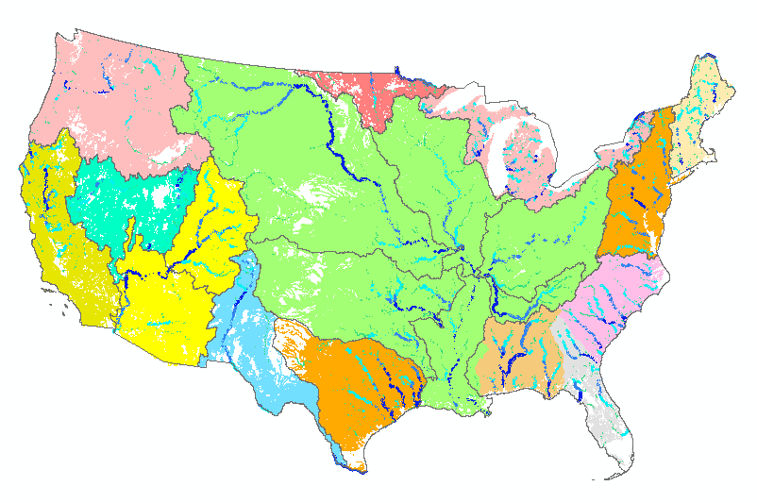

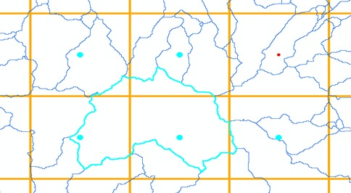

NFIE-Hydro
HRRR
Forcing
NHDPlus
to RAPID
WRF-Hydro
ECMWF
TACC
Grid to
catchment

Slide 21
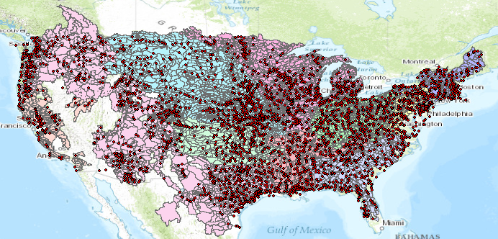
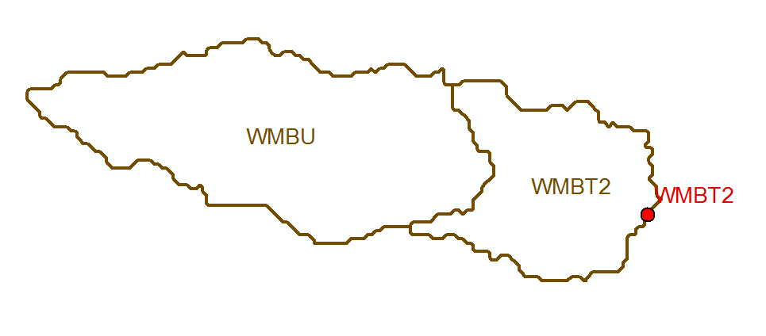
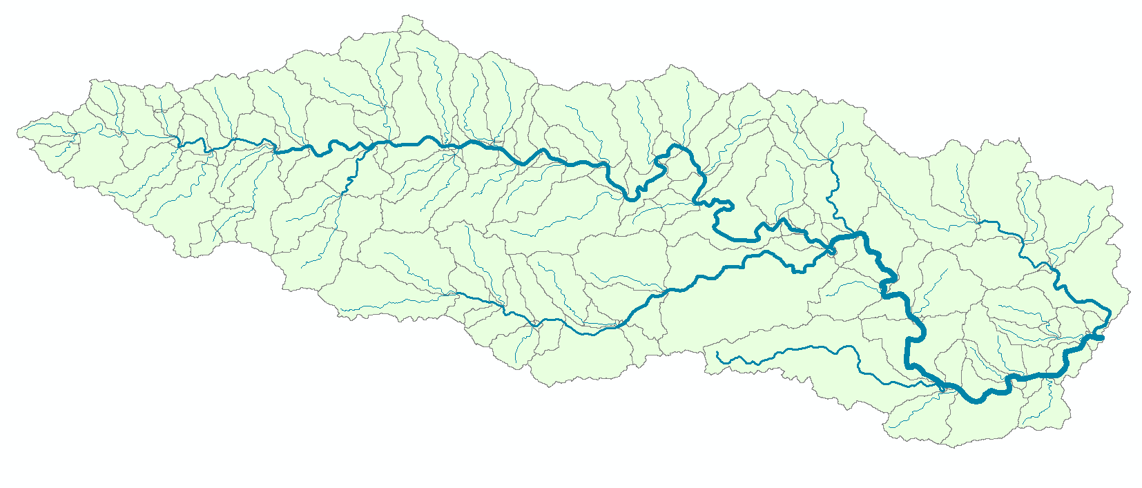
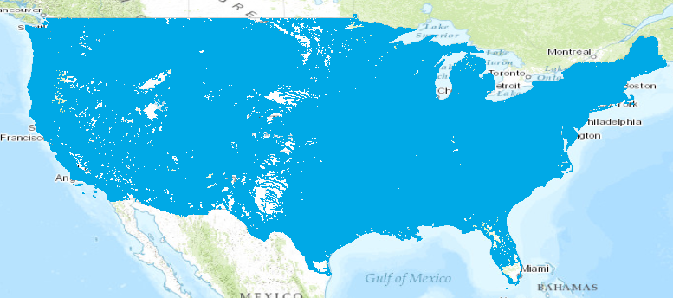
Current and NFIE Forecast Systems
Blanco River at Wimberley
Current: 6600 basins and 3600 forecast points
Two basins and one forecast point
Basin ~ 400 Sq Mile
becomes
NFIE: 2.7 million stream reaches and catchments
Reach Catchment ~ 1 Sq Mile
130 Catchments and Flowlines
uniquely labelled
A national flow network

Slide 22
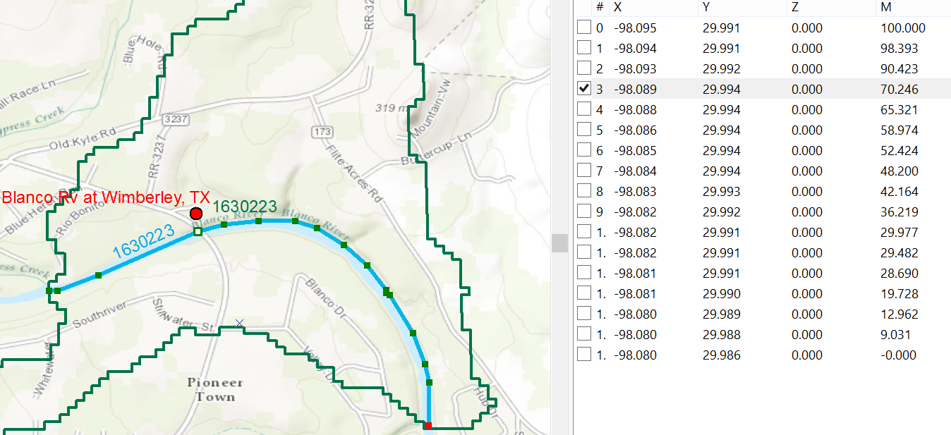
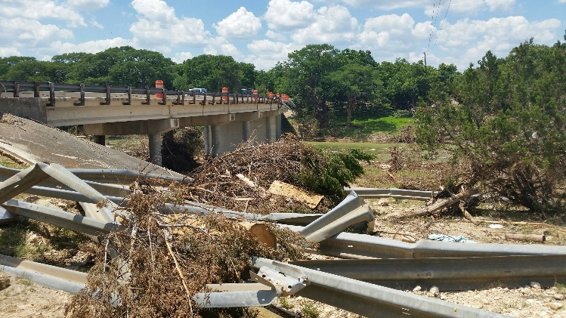
Linear Referencing on Flowlines
Using measures, the flow can be estimated at any point along the line
Bridge and Stream Gage at RR 12 is at Measure 70.246
on Flowline 1630223
Long.
Lat.
Measure
Measure is the % distance upstream from most downstream point on line

Slide 23
Basic Ideas
A catchment is receives runoff from
land-atmosphere cells
Catchment A drains to Flowline A
A
n₁
A
n₂
B
n₃
Objects are placed on flowlines using linear referencing
Each flowline has attributes “from-node” and “to-node”
Flowline A flows to Flowline B through node n₂

Slide 24
Next Step: National Water Prediction Model Configurations
WRF-Hydro IOC Configurations – May 2016
Analysis & Assimilation
Short-Range
‘Flood Prediction’
Medium Range
‘Flow Prediction’
Long Range
‘Water Resources’
Cycling Frequency
Hourly
3-Hourly
Daily
~Daily (x16)
Forecast Duration
- 3 hrs
0-2 days
0-10 days
0-30 days
Spatial Discretization & Routing
1km/250m/NHDPlus Reach
1km/250m/NHDPlus Reach
1km/250m/NHDPlus Reach
1 km/catchment /NHDPlus Reach
Meteorological Forcing
MRMS blend/ HRRR-NAM bkgnd.
Downscaled HRRR /RAP/NAM blend
Short-range + Downscaled GFS
Downscaled & bias-corrected CFS

Slide 25
Interest from China
Dear David, It's just a quick response to your enquiry about China's interest in your proposal. I confirm our interest in doing similar thing in China. And, I wish the similar system could be run in China National Forecast Center in near future. For the time being, we have the maps of land use, topography at scales of 30 or 90 meters, and the soil map is available at the grid size of 1km. To achieve the goal, I think your technical support is needed with thanks. With best regards, Zhiyu LIU
Vice-President of WMO Commission for Hydrology Director of Hydrological Forecasting Center, the Ministry of Water Resources.

Slide 26
Conclusions
The National Flood Interoperability Experiment has been a significant success in rapidly prototyping a high spatial resolution flood forecasting system for the continental US
This is a “flow continuum” model on the national stream network, like atmospheric and ocean models
China and Australia have indicated an interest in doing something similar
NHDPlus provides the geospatial information foundation in the US
What can we propose for a comparable international framework? Flows don’t stop at the border
Initiate a Geospatial Interoperability Experiment?

