Slide 1
Finding Water Resource Data: A Discussion
David Arctur
Ilya Zaslavsky
OGC Hydrology DWG Workshop
20-23 Sept 2015, Orleans France

Slide 2
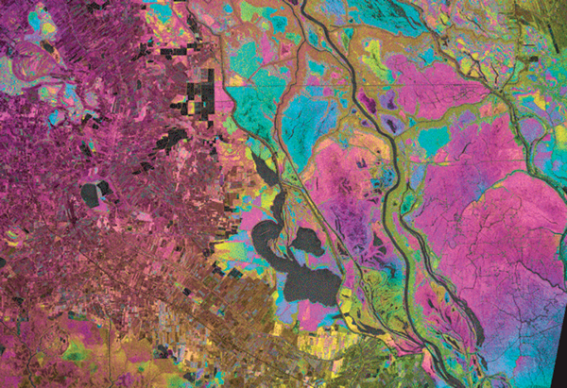
She was looking for SAR datasets mapping inundation… We searched catalogs, googled SAR inundation, etc… It took a personal response from someone who knew someone to find the Alaska Satellite Facility collection.
https://www.asf.alaska.edu/sar-data/insar/#prettyPhoto
Notes:
https://www.asf.alaska.edu/sar-data/insar/#prettyPhoto

Slide 3
The Situation
We have data, lots of it
We have catalogs, and catalogs of catalogs
It’s still hard to find specific data for a project
Not registered in a harvested catalog
Inadequate or inaccurate tags & other metadata
Not reachable by a web crawler
What kind of interventions could improve this?

Slide 4
Initiatives
Networks of Networks
GEOSS Discovery & Access Broker
Eye On Earth Global Network of Networks
Metadata enhancement
EarthCube CINERGI

Slide 5
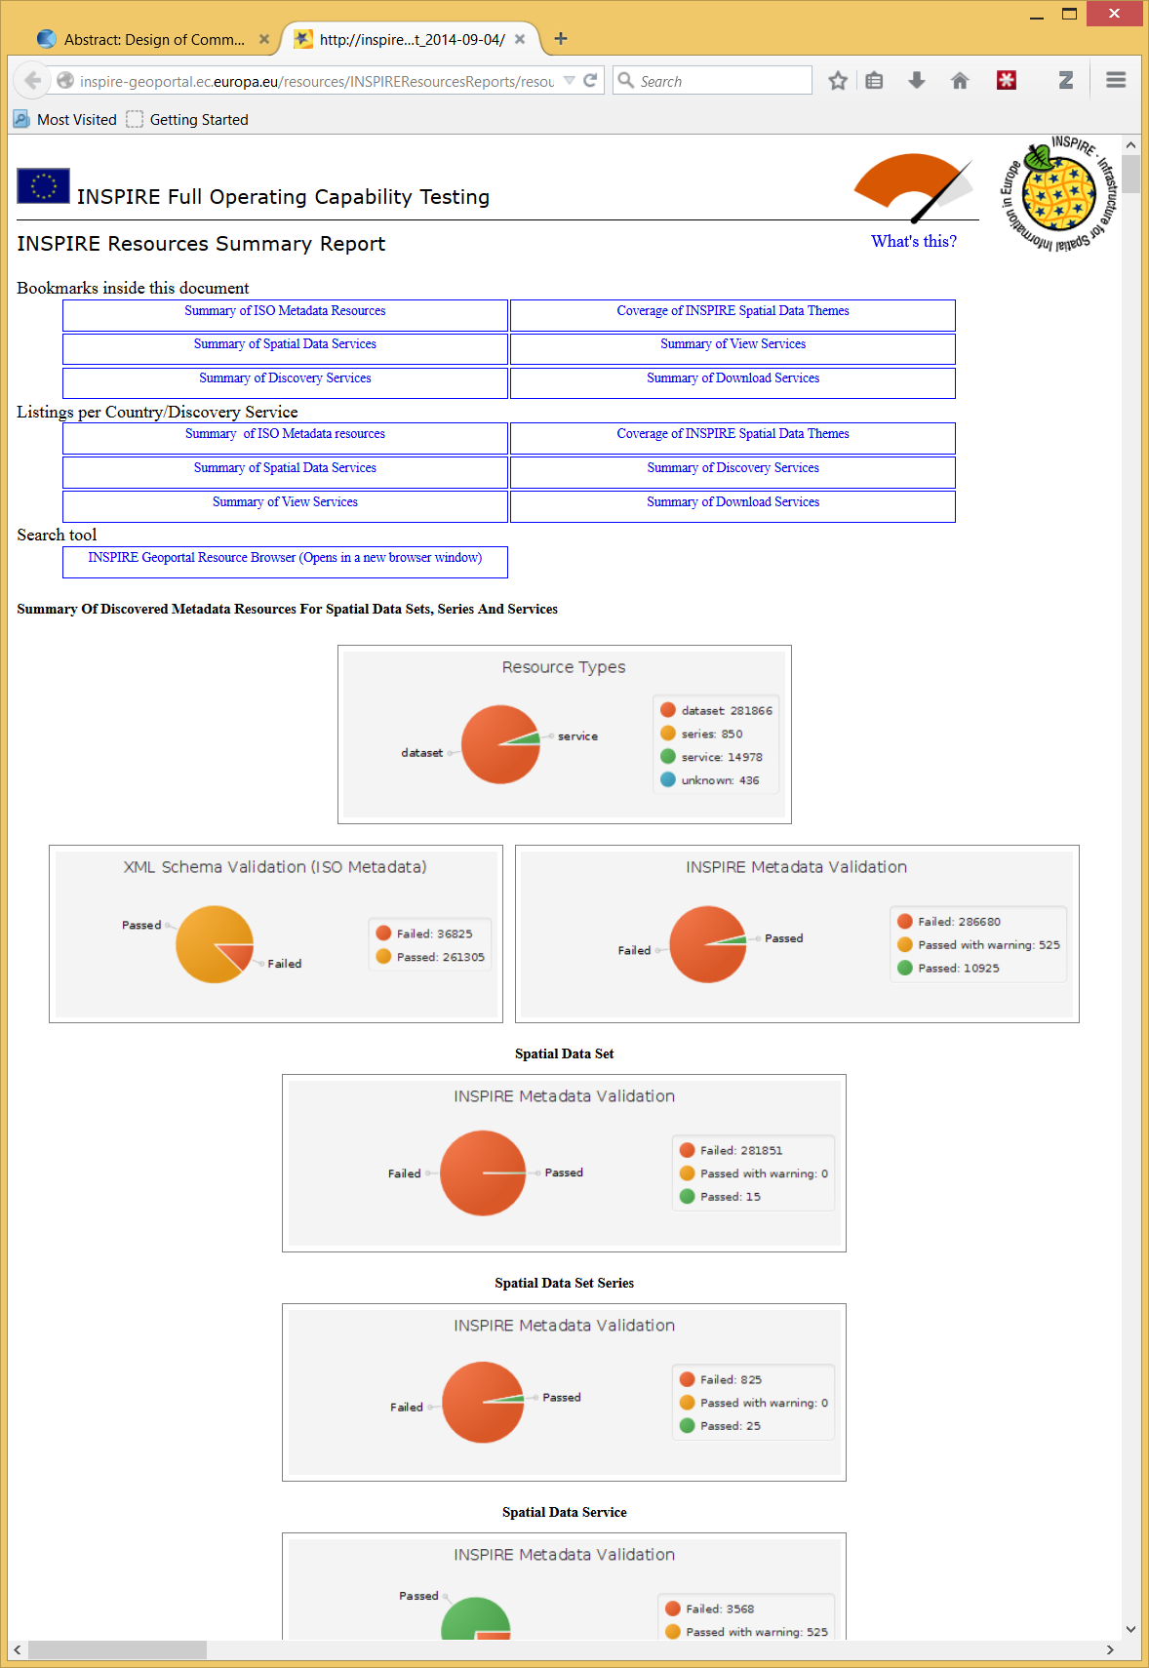
FROM: http://inspire-geoportal.ec.europa.eu/resources/INSPIREResourcesReports/resourcesReport_2014-09-04/

Slide 6
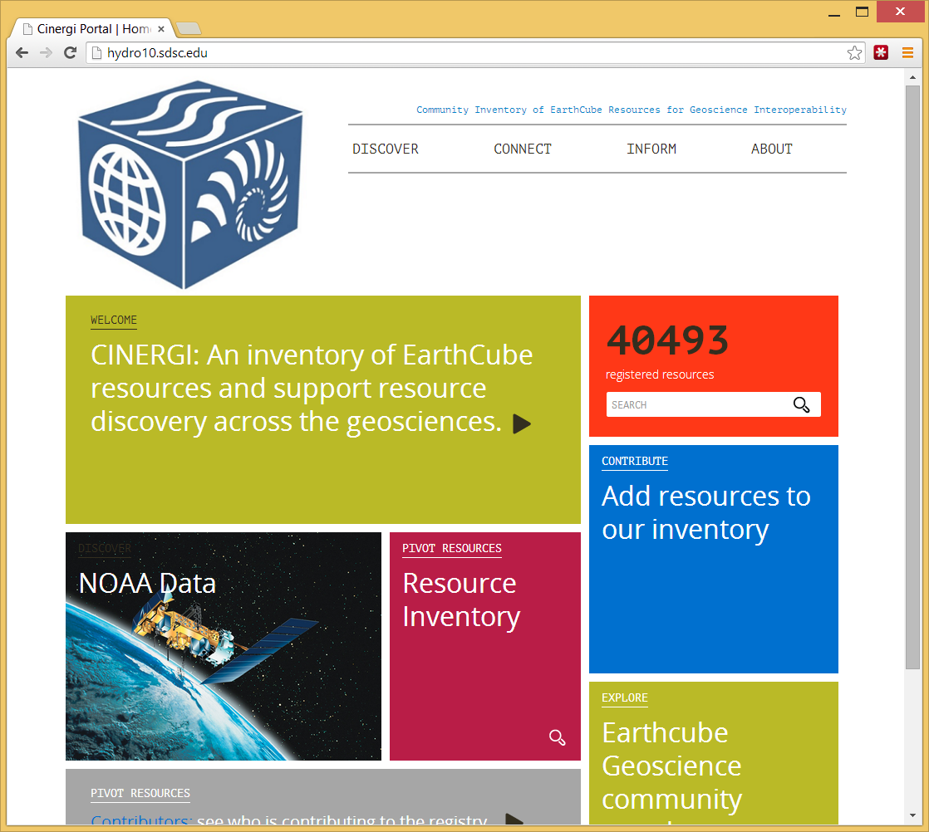
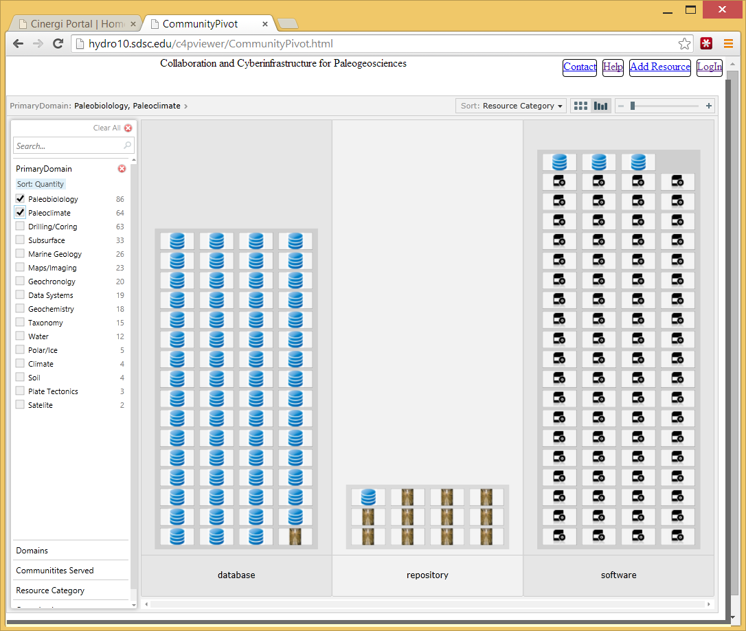
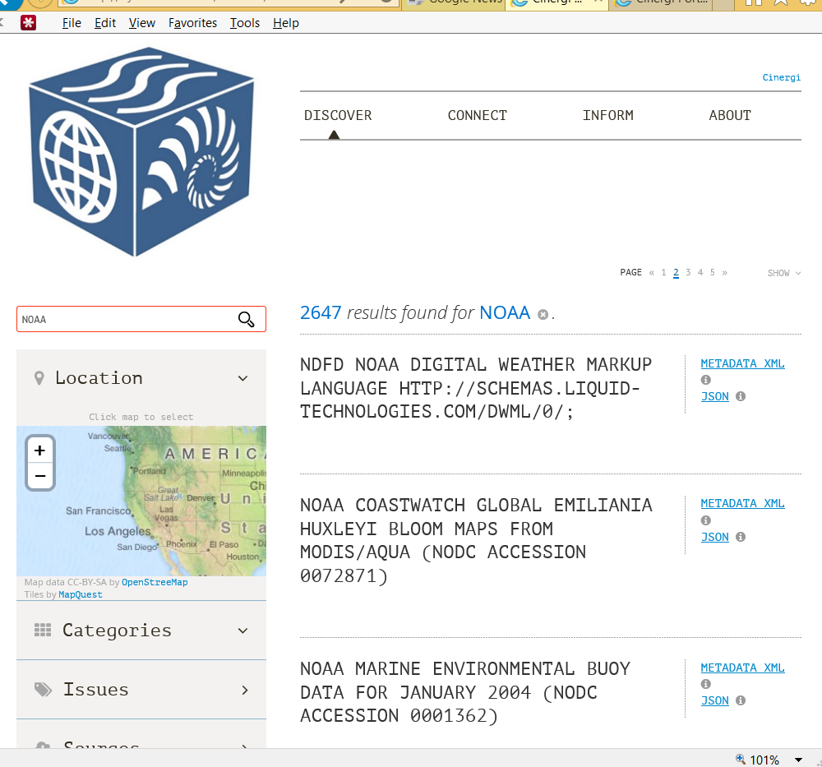
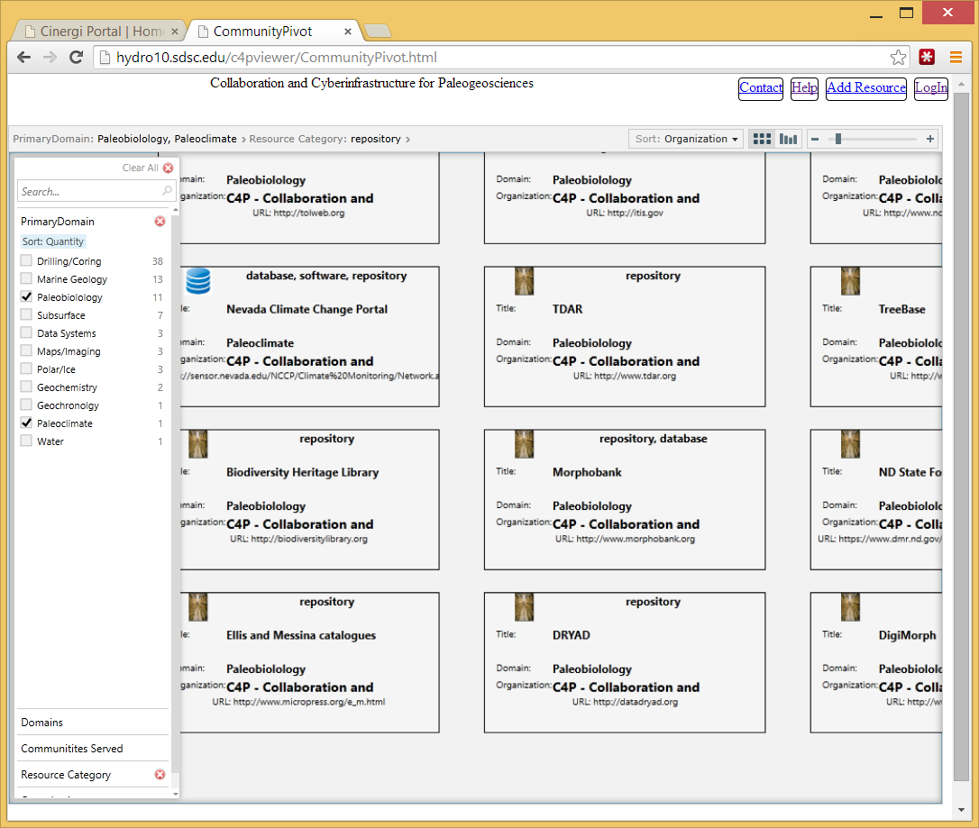
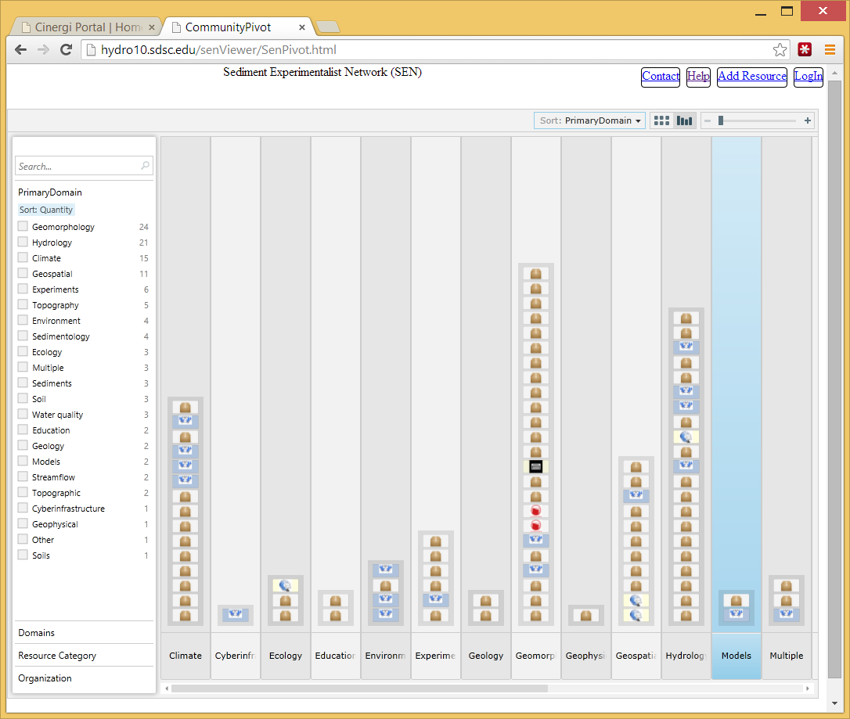
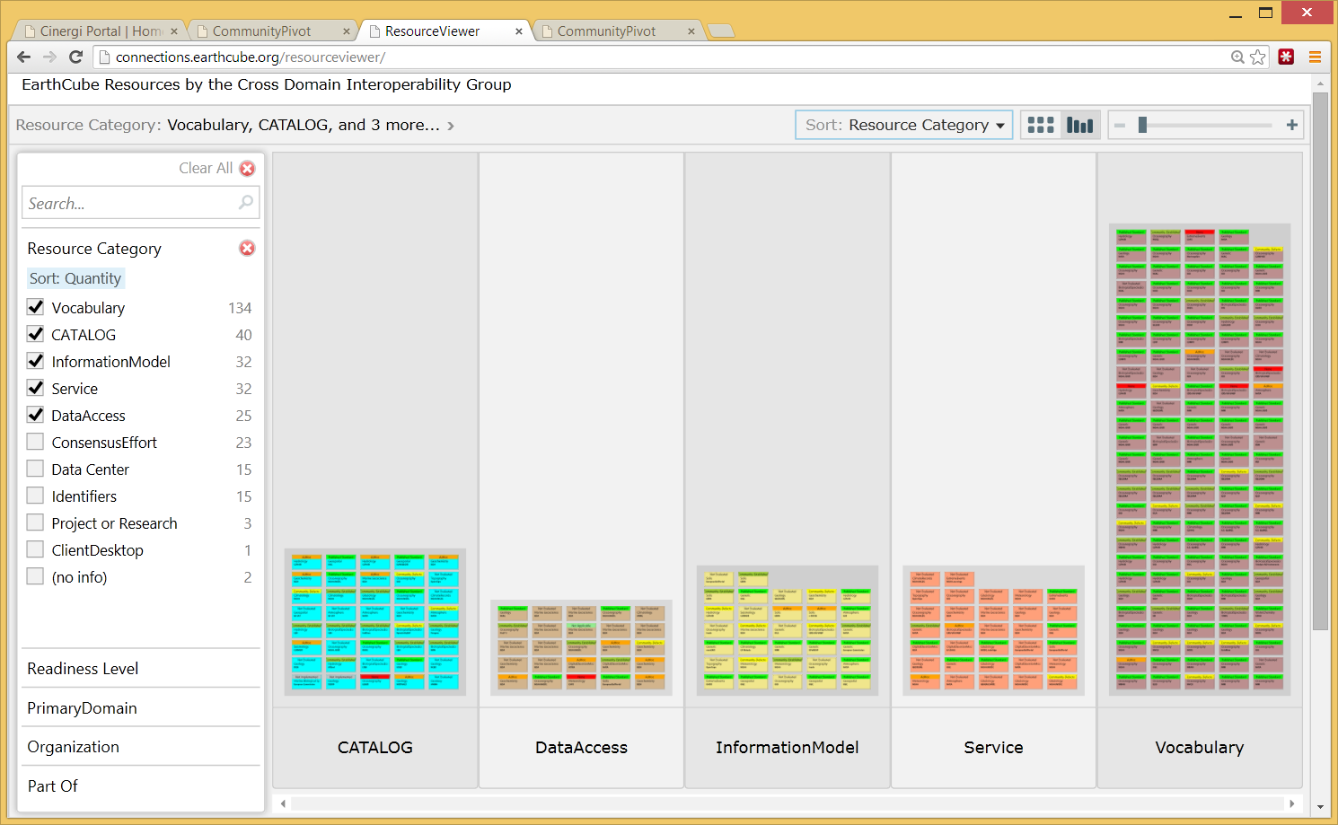
Metadata enhancing in CINERGI
Domain Inventories
CINERGI Metadata Pipeline
RCN (Research Coordination Networks)
Domain workshops
High-level assets
Catalogs

Slide 7
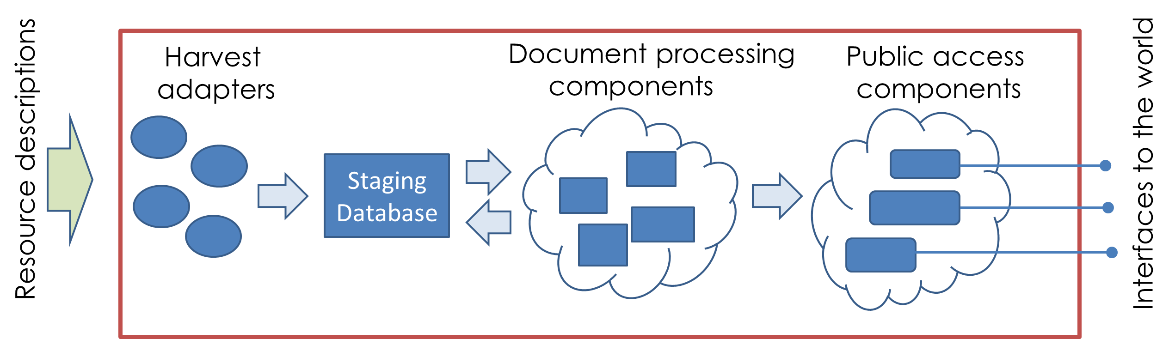
CINERGI metadata harvesting and content enhancement
Harvest adapters: description of information sources , allows connection and ingestion
Staging database: persist original harvested descriptions and updates from processing/curation
Document processing components: enhance content or presentation, update provenance record
Public access components: external interfaces to present content for users

Slide 8
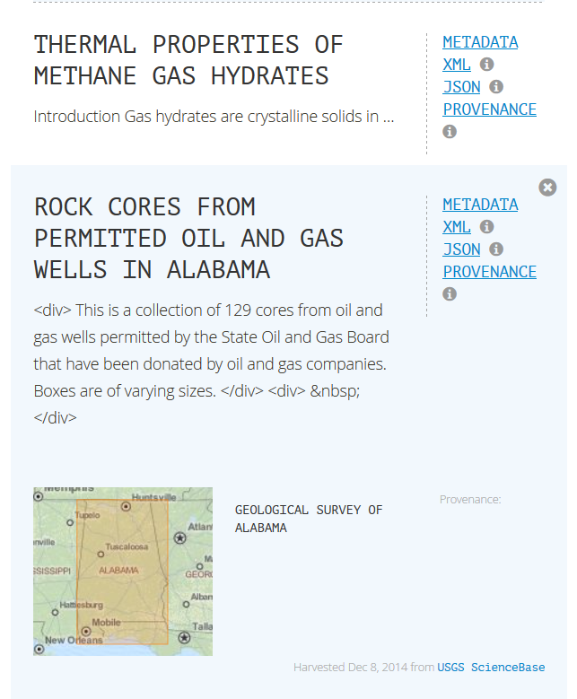
Content enhancement components
Common enhancer API
Provenance recording: W3C PROV and Neo4J
Spatial enhancer (bounding boxes)
Keyword enhancer
Based on domain vocabularies; instruments; organizations; themes; platforms; time; resource types; repositories
Uses SciGraph API for semantic processing
Validation and provenance components

Slide 9
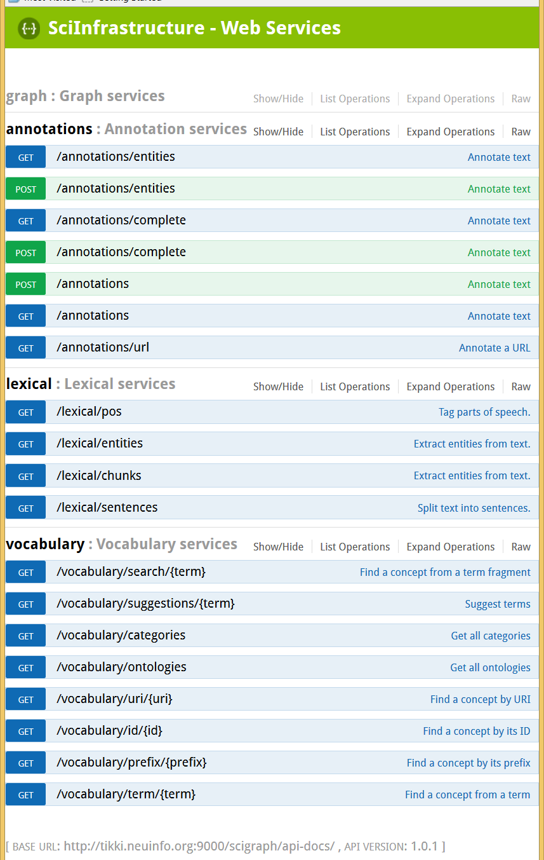
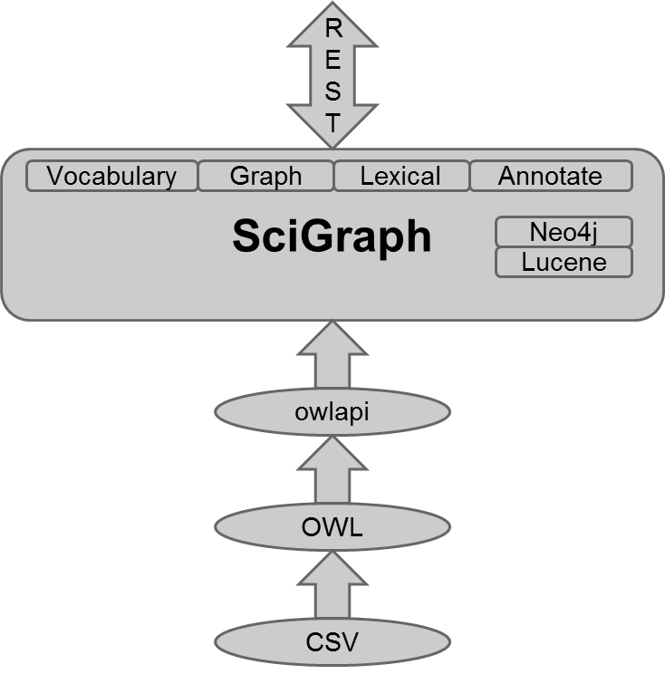
Keyword extraction workflow
http://tikki.neuinfo.org:9000/scigraph/docs/

Slide 10
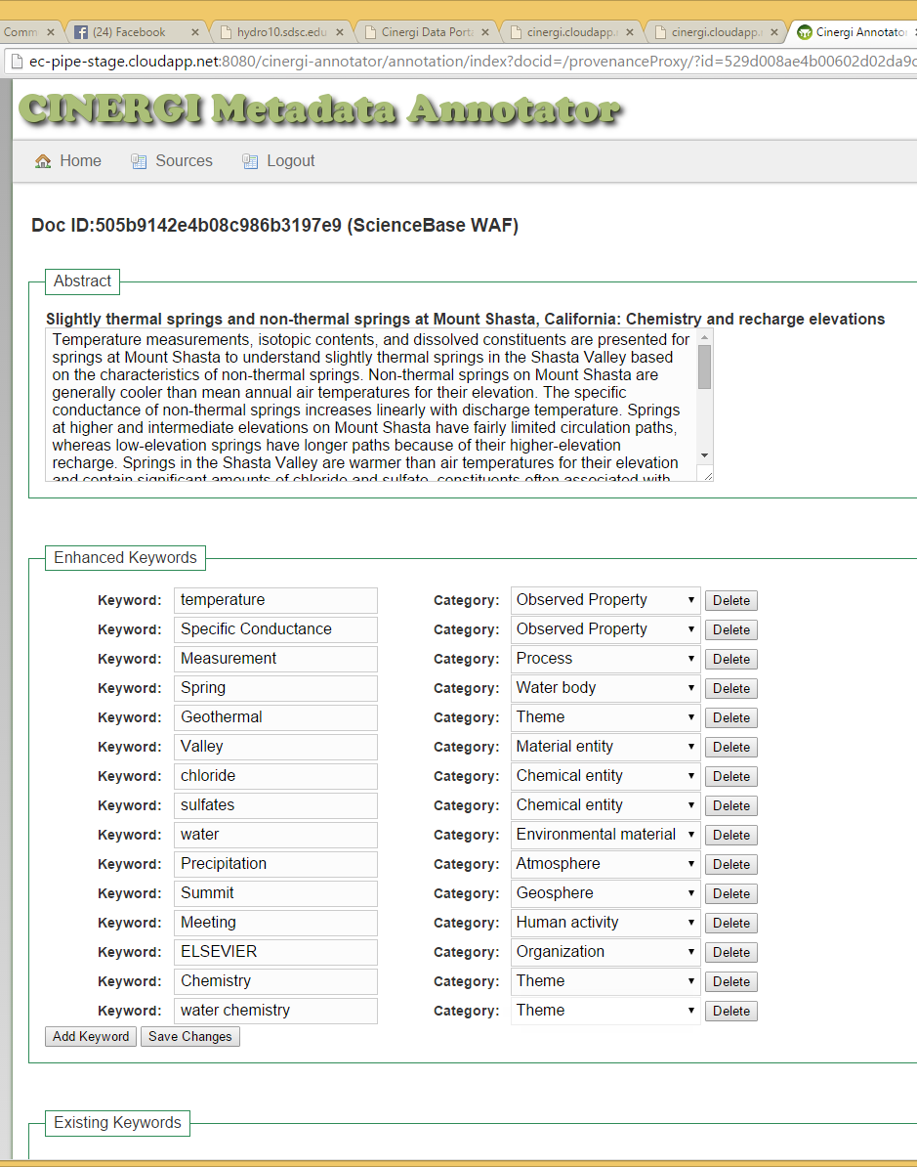
Manual Review of Keyword and Location Assignments for Machine Learning

Slide 11
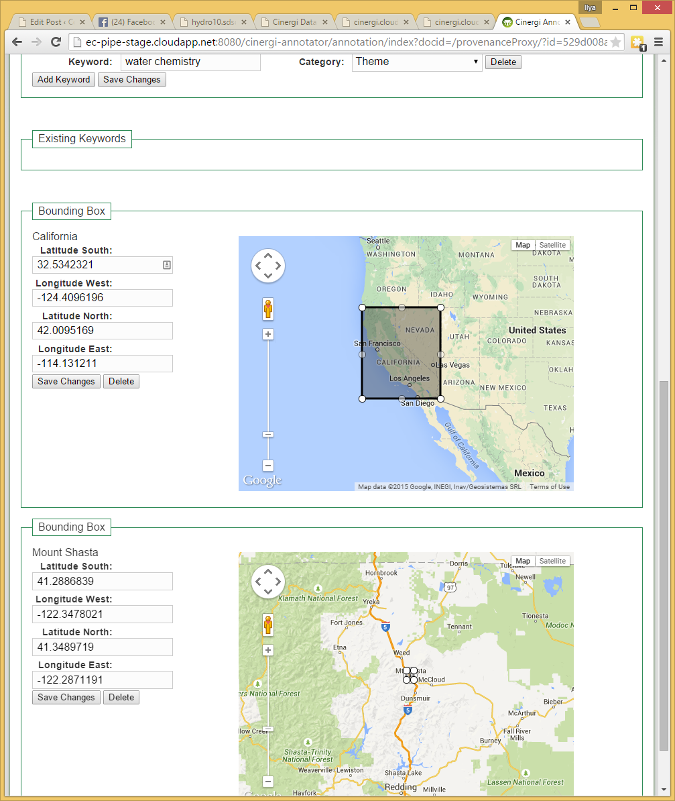
Manual Review of Keyword and Location Assignments for Machine Learning
http://ec-pipe-stage.cloudapp.net:8080/cinergi-annotator/annotation/index?docid=/provenanceProxy/?id=529d008ae4b00602d02da9cd

Slide 12
Working with geoscience communities
Community inventory sources:
End-user workshops
High-level functional components
EarthCube RCNs: “Collaboration and Cyberinfrastructure for Paleogeosciences (C4P)” and “Building a Sediment Experimentalist Network (SEN).” Demos here
YOUR INVENTORY!
Inventory viewer/ editor/faceted search online application

Slide 13
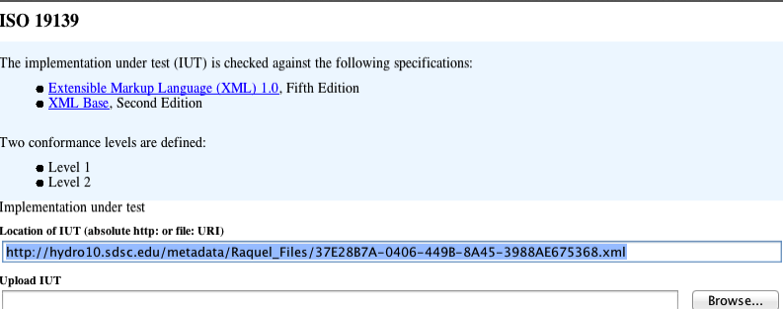
Metadata validation in CINERGI
Uses TEAM (Test, Evaluation And Measurement) Engine (OGC; in GitHub)
Level 1: schema test
Level 2: schematron A.2.1 By-Value or By-Reference or gco:nilReason, and A.2.2 Co-Constraints
Level 3: user provided schematron

Slide 14
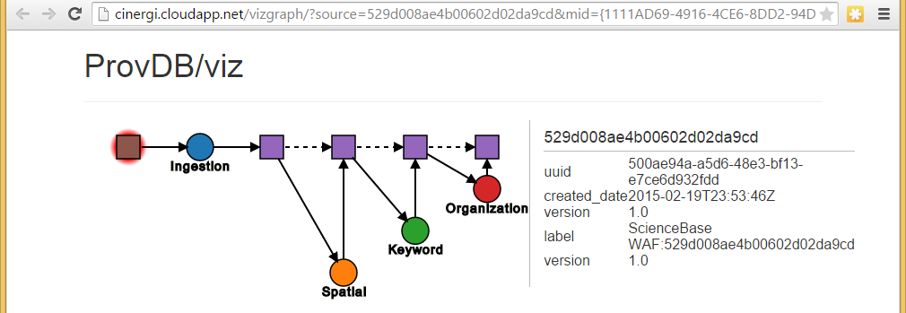
CINERGI Provenance
Resource harvested from a source, ingested into MongoDB, enhanced, and provenance recorded at each step in Neo4J
Versioning of Documents
Initial Source Document
Text description: how, why when, where
Enhancement
Activities

Slide 15
Resource discovery dilemmas
Not a high-level concern (not likely to attribute science results to discovery)– yet the most often cited need
What is missing in our understanding of discovery?
What we discover:
Databases? Datasets? Observations? Features of interest?
Other types of resources? People?
How we discover: Centralized vs distributed search architecture; iterative search and navigation
What is result of discovery? When are you done with the discovery phase and decide to experiment with data?

Slide 16
More challenging use cases: Extensibility
Get the stable isotopic measurements, from carbonates in North America of Silurian age, integrate them with all known fossil occurrences and geochronological estimates and rotate all of the data back to their proper paleocoordinates.
Look for all GCMs that have at least a 10 degree resolution, contain a coupled Sea Surface Model, are written in Fortran, Unix compatible, and were created at NCAR, Boulder.
Look for all tree-ring analysis MATLAB software written by Dave Meko.
Identify common patterns in complex queries
Define a mechanism for extending CINERGI pipeline to accommodate complex queries:
Registering and describing data resources
Adding ontology describing the domain
Specifying relationships between terms

Slide 17
CINERGI’s role in EarthCube
If your data facility does manual metadata curation: explore CINERGI pipeline and see if automatic metadata enhancement is useful; examine metadata provenance for your records, help us train the system
If you organize a domain community: consider setting up and using a CINERGI community resource viewer
If you maintain a domain catalog:
consider interfacing it with CINERGI
Have interesting discovery use cases: contribute use cases from your domain, see what we need to add to CINERGI to support them (eg additional vocabularies, data repositories, harvest adapters…)
Contribute to and help curate existing inventories, esp. high-level resources, functional components
this will be used in EC architecture development

Slide 18
Connection with HDWG
What are common discovery use cases
Create a compendium for hydrology
Run these on several search systems, and evaluate
Toward a compendium of hydrology data sources
Time series repositories (CUAHSI et al)
Hydrologic samples
Hydrologic features (NHDPlus, etc)
Other relevant data (SAR, LDAS, LSM, etc)
Hydrologic software and models
Etc!
How will we do this?
Google spreadsheet interface to create the inventory
CINERGI visualizes, harvests & enhances
Community engagement

Slide 19
Connection with HDWG - 2
Specific issues in hydrology
Search over time series, samples, datasets
What information shall be lifted to dataset level?
How to do indexing for deep cross-level search?
How do we know that search succeeded?
Semantics! (neck-deep…)
Search facets (in hydrology)
Types of keywords
Which ontologies to include?
Making existing ontologies amenable for search
Do we need to discern precisely which concepts to hook to?
Dealing with conflicting vocabularies, across domains

