Slide 1


Hydrologic Features SWG - status, scope, workplan -
6th, WMO/OGC Hydrology DWG
Orleans, BRGM, September 21 – 23, 2015
Irina Dornblut, GRDC of WMO at BfG

Slide 2
Purpose of the Hydrologic Features SWG
progress the HY_Features common hydrologic feature model to the state of an adopted OGC standard for a common and stable identification and referencing of hydrologic features,
multipart candidate standard:
Part 1: HY_Features conceptual model (OGC14-111). The normative model is a machine-readable UML artefact published by OGC,
Part 2: GML implementation schema suitable for data transfer of HY_Features object instances, based on ISO 19136 Annex E encoding rules for Application Schema,
Part 3: OWL and RDF representation suitable for defining links between features that implement the HY_Features model, based on ISO 19150 encoding rules.
publish a candidate standard doc for each intended part for public comment,
process comments received during a public comment period,
submit for consideration by the OGC membership for approval as an OGC standard and include contribution to the OGC Abstract Specification.
Notes:
so that conceptual issues can be addressed separate from the GML schemas and the machine-readable OWL versions

Slide 3
Scope of work
Coordinate the RFC process for each of the intended parts
Assist the development of example use cases to improve the semantic interoperability of web services
Example: discovery, access, and use of relationships between hydrologic features represented in data sets exposed as web services,
Prepare some explanatory material to define and handle the conceptual mapping of a realized domain feature concept to the concept of a particular feature of interest
Outline principles and requirements of a mapping framework (Part 1)
Develop guidelines for a mapping framework (Part 2 and 3)
Out of scope:
Specific communication technology or service interface

Slide 4
Participating organizations
Federal Institute of Hydrology (BfG), Germany
BRGM (French Geological Survey)
Bureau of Meteorology (BoM), Australia
US Geological Survey (USGS)
MetaLinkage, Australia
Commonwealth Scientific and Industrial Research Organisation (CSIRO), Australia
INCLAM S.A., Spain
Bdigital, Spain (now: Eurecat - Centro Tecnológico de Catalunya)
52°North, Germany

Slide 5
SWG Founding or Charter members:
The charter members agree to the SoW and IPR terms as defined in this charter. The charter members have voting rights beginning the day the SWG is officially formed. Charter Members will be shown on the public SWG page.
Name | Organization
Bruce Simons Simon Cox Peter Taylor | CSIRO, Australia
Darren Smith Bruce Bannerman Tony Boston | Bureau of Meteorology, Australia
Irina Dornblut | Federal Institute of Hydrology ( BfG), Germany
Rob Atkinson | Metalinkage, Australia
Gabriel Anzaldi Varas Aitor Corchero Rodriguez | Bdigital, Spain
Antonio Moya | INCLAM S. A., Spain
Simon Jirka | 52°North, Germany
Sylvain Grellet François Robida Anthony Mauclerc | BRGM, France
David Blodgett | USGS, USA
David Arctur | University of Texas at Austin, USA

Slide 6
Deliverables
Candidate standards documents for comment
Part 1:Conceptual model – HY_Features
Part 2: GML implementation of the Hydrologic Features specification
Part 3. RDF/OWL implemenation of the Hydrologic Features specification
Annotated list of comments submitted during the 30-day public comment period, including the comment, submitter, rationale, comment type/priority, and the response of the SWG.
Final versions of Part 1, 2 and 3 of the Hydrologic Features specification as well as ATS documents for submission to the TC.

Slide 7
Draft workplan to an adopted OGC Standard
The following activities are planned with respect to “Hydrologic Features, Part 1: Conceptual model”:
Prepare document incl. Annexes (ATS, Mapping, …). 2015 November
SWG vote to release Hydrologic Features, Part 1: Conceptual model for public comment (HYF-P1). 2015 November (e-mail vote)
Release HYF-P1 for public comment. 2015 November/December
Consolidation of comments and edits to HYF-P1 document based on comments. 2016 February/March
Recommendation of the candidate standard to the Membership. March 2016
60 day IPR review period and associated TC e-vote to approve “Hydrologic Features, Part 1: Conceptual model” candidate standard as an adopted OGC Standard.
The intended Part 2 and Part 3 may require further testing and will be scheduled by the SWG after the adoption of Part 1.

Slide 8
Status in September 2015
Discussion in Boulder June 2015 to initiate the HYF-SWG
Charter review process (July/August) → OGC15-070r2
TC-Vote for the formation of the HYF-SWG (quorum)
The first meeting:
select the lead for the RFC submission (OGC voting member),
primary editors for Part 1, 2 and 3 of the standard,
agree on scope and workplan, including regular meetings if required.
Starting point:
HY_Features common hydrologic feature model (DP11-039r3)
→ Hydrologic Features, Part 1: Conceptual model
use case from OWS-10 CCI Hydro that can be further developed
→ new test scenarios → Part 2:GML and Part 3:OWL
a few same-structured mappings of implementation concepts
→ framework for conceptual mapping using a domain model

Slide 9
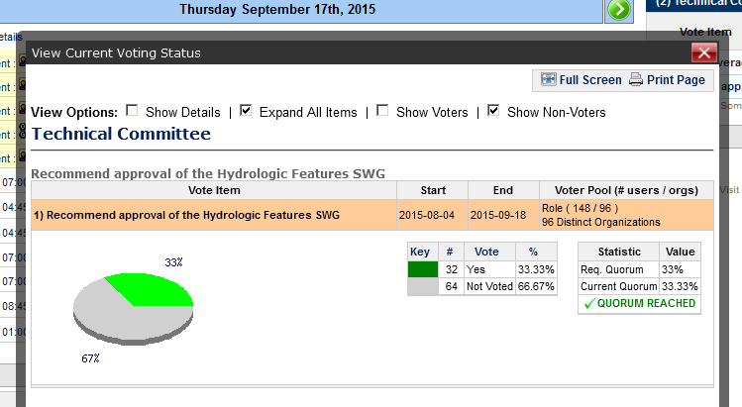
Thank you !
→ 1st, HYF-SWG, Orleans, Sep 23, 2015

Slide 10
1st, HYF-SWG, Orleans, Sep 23, 2015
Select the lead for the RFC submission (letter of intent)
CSIRO / BoM / BRGM / USGS
Select primary editors for Part 1, 2 and 3
Conceptual model – Irina, Rob, Bruce S
GML implementation –
OWL implementation –
Scope:
Workplan:
Meetings:

Slide 11
HY_Features – Where to find ?
OGC HY_Features: a Common Hydrologic Feature Model (OGC-DP 11-039r3)
https://portal.opengeospatial.org/files/?artifact_id=55157
HY_Features: a geographic information model for the hydrology domain (GRDC Report 43, 2013)
http://www.bafg.de/GRDC/EN/02_srvcs/24_rprtsrs/report_43r1.html?nn=201572
The HY_Features model is now available via a “Feature Type Catalogue Linked Data API” using a temporary namespace (for the time being at CSIRO).
Concepts in the HY_Features model may be accessed using the URI pattern: http://demo.sirf.net/def/schema/hydrology/{schemafilename}/{concept } , e.g. http://demo.sirf.net/def/schema/hy_features/abstracthydrofeature/HY_Basin or https://svnserv.csiro.au/svn/SIRF/public/def/schema/hy_features/abstracthydrofeature.rdf#HY_Basin
Atkinson, R., I. Dornblut and D. Smith (2012): An international standard conceptual model for sharing references to hydrologic features. Journal of Hydrology, 424-425(2012): p.24-36

Slide 12
some Definitions
Data: notion of a documented value of some characteristics of a phenomenon.
Dataset: identifiable collection of data. [ISO19115:2003]
Coverage: set of attribute values arranged with respect to a particular domain. – function to return values from its range for any direct position within its spatial, temporal or spatiotemporal domain. [ISO19123:2005]
Feature: abstraction (abstract notion) of real-world phenomena. [ISO19101:2002]; the fundamental unit of geographic information. [ISO19109:2005]
Hydrologic Feature: abstract notion of the hydrology phenomenon. [OGC 11-039r3]
Property: notion of a characteristic property of a real-world phenomenon.
Observation: act of observing a property or phenomenon, with the goal of producing an estimate of the value of the property. [ISO19156:2011]
Variable: feature properties whose values may change with Space, Time, or Observation. A variable may take any value in a range of possible values [WMO, 1992].

