Slide 1
Hydro DWG at the RDA Plenary BoF - Improve sharing of water resource data globally
24 September 2015- BREAKOUT 5 - 13:30-15:00

Slide 2
What is the OGC?
The Open Geospatial Consortium, Inc. (OGC) is a non-profit, international voluntary consensus standards organization that is leading the development of standards for geospatial and location based services.
The OGC facilitates a consensus process in which government, private industry, NGOs, and academia collaborate to create open and extensible software application programming interfaces for geospatial and other mainstream information technologies
Notes:
The OGC is a not for profit consortium dedicated to the development of specifications that enable geospatial technologies to “plug and play” across any device, platform or network. The OGC consists of 380+ members - geospatial technology software vendors, systems integrators, government agencies and universities - participating in a consensus process to develop, test, and document publicly available interface specifications and encodings for the geospatial industry. Open interfaces and protocols defined by OpenGIS® Specifications are designed to support interoperable solutions that "geo-enable" the Web, wireless and location-based services, and mainstream IT, and to empower technology developers to make complex spatial information and services accessible and useful to all kinds of applications.

Slide 3
OGC Snapshot
A Voluntary Consensus Standards Organization, founded in 1994.
480 members
38 adopted standards
Hundreds of product implementations
Broad user community implementation worldwide
Alliance partnerships with 30+ standards & professional orgs
OGC Membership Distribution

Slide 4
OGC Snapshot
A Voluntary Consensus Standards Organization, founded in 1994.
480 members
38 adopted standards
Hundreds of product implementations
Broad user community implementation worldwide
Alliance partnerships with 30+ standards & professional orgs
OGC Membership Distribution

Slide 5
Standards
An OGC standard is a document, established by consensus and approved by the OGC Membership, that describe rules, guidelines or characteristics for interfaces and encodings aimed at the achievement of the optimum degree of interoperability.
Domain Working Groups (DWG or WG) provide a forum for discussion of key interoperability requirements and issues, discussion and review of implementation specifications, and presentations on key technology areas relevant to solving geospatial interoperability issues.
Standards Working Groups (SWG) have specific charter of working on a candidate standard prior to approval as an OGC standard or on making revisions to an existing OGC standard.

Slide 6
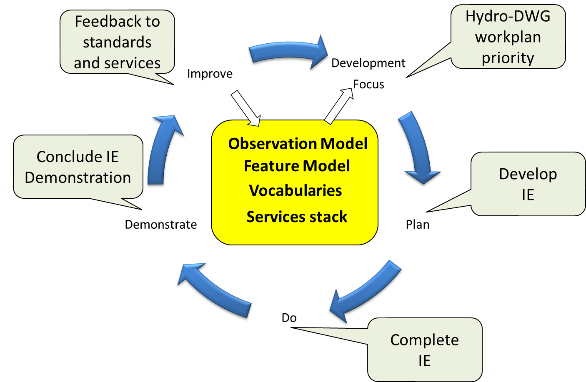

International Standardization for Water Data
Hydrology Domain Working Group
standards for water data: WaterML 2.0 suite
organizing Interoperability Experiments (IEs) focused on different sub-domains of water
Chairs:
Ilya Zaslavsky (USA)
Tony Boston (Australia)
Silvano Pecora (Italy)
Iterative Development
http://external.opengis.org/twiki_public/bin/view/HydrologyDWG/WebHome

Slide 7

Water Information Standards Suite
WaterML2Part2: Ratings, Gaugings & Sections
(OGC IS 15-018r1)
TimeseriesML1:
Timeseries
Observation
(OGC 15-042r1)
WaterML2Part1:
Timeseries
Observation
(OGC IS 10-126r4)
WaterML2Part3: Water Quality Observation
(OGC BP 14-003)
SOS 2.0
Hydrology Profile
(OGC BP 14-004r1)
Towards the identification, observation and representation of hydrologic features using standards
Groundwater:
Conceptual model (OGC IS 16-XXX)
Hydrologic Features Part1: Conceptual model
(OGC IS 15-XXX)
Hydrologic Features Part3: OWL and RDF representation (OGC IS 15-XXX)
Hydrologic Features Part2: GML schema
(OGC IS 15-XXX)
OGC

Slide 8
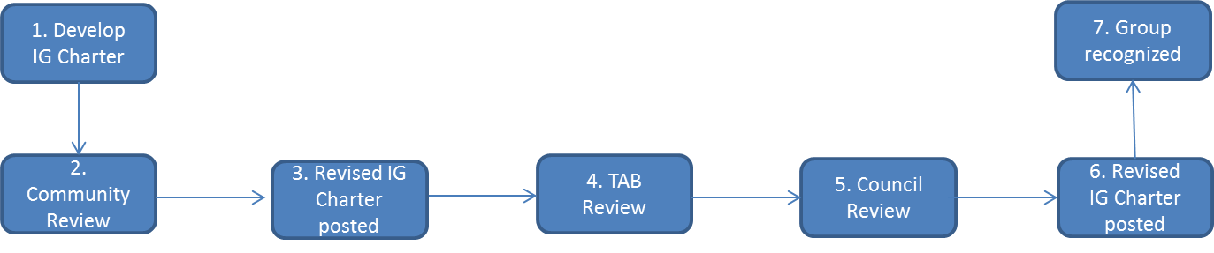
BoF: to assess interest to move to IG or WG, or retire
IG :
Charter
2-4 co-chairs
Members from 3 continents
Examples of IGs: agriculture data; biodiversity data integration; data fabric; data foundations and terminology; domain repositories; digital practices in history; geospatial; marine data; metabolomics data; vocabulary services; structural biology….
WG:
Case statement, proposed, plan, scope, 2-4 co-chairs, concrete deliverables
Examples of WGs: brokering governance, data citation, registry interoperability, metadata standards catalog, data type registry, publishing data workflow, wheat data interoperability

Slide 9
Towards a Water Resource Data Sharing IG
To represent stakeholders producing, managing, aggregating, sharing and consuming water data, globally
Explore existing infrastructures for water data, find commonalities and best practices
Promote use of international water standards developed by HWG, and standards-based eInfrastructure components
Re-use infrastructure components recommended by RDA or developed by RDA partners, including data type and other registries related to water data, PIDs, vocabulary services, linked data approaches, cross-scales catalogs…
Explore policies for water data sharing, recommend best practices

Slide 10
Hydro BoF: Questions to all
Does RDA and OGC have any formal relationship or MoU?
What are benefits of having an RDA IG (and possibly WGs)?
How RDA Hydro IG agenda would differ from HydroDWG?
What would be specific outcomes of potential WGs?
Who would be potentially interested in participating?
What are the expectations of BoF participants?

Slide 11
Potential working groups / specific issues for hydroIG-RDA
Dynamic Data Citation for hydrologic time series
Water data publication connected with articles
Use cases from other domains
Underpinnings of existing systems for water data sharing
Foundations: information models and registries – as being adopted in RDA
Making global hydro data sharing part of a bigger data sharing system

Slide 12
Pain points with water data where RDA can help
Scaling water balance and flow forecasting models
Integrating with land data
No water theme: lack of coordination (RDA cannot help, but can embarrass enough)
More complete ontologies for water, integrated with ENVO and others
Cross-validating hydro databases against other DBs – to ensure that physics is correct!
Get better user input, larger community, across domains

Slide 13
Connections with other RDA groups
Need use cases with them:
Agriculture
Biodiversity
Earth Systems Science
Technological:
PIDs, registry, metadata, data linking infrastructure, controlled vocabularies, etc…
Need better scheduling for plenaries
RDA as a way to bring back academics into hydro infrastructure development
“OGC for RDA” paper?

Slide 14
Need to outline potential WGs
Matt, Sylvain, Ilya, Tony

