Slide 1
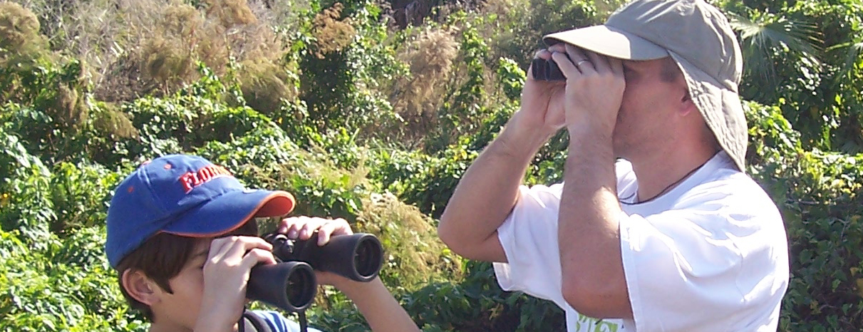
OM-JSON
a JSON implementation of O&M
Simon Cox | Research Scientist | Environmental Information Infrastructures
Peter Taylor | Engineer | Autonomous Systems
21st September 2015
Land and water, Data61

Slide 2


O&M
GFI_Feature
+featureOfInterest
1
0..*
OM_Observation
GF_PropertyType
+
phenomenonTime
1
+
resultTime
+observedProperty
+
validTime [0..1]
+
resultQuality [0..*]
+
parameter [0..*]
0..*
1
+procedure
+result
OM_Process
Any
An Observation is an action whose result is an estimate of the value of some property of the feature-of-interest, obtained using a specified procedure
Cox, OGC Abstract Specification – Topic 20: Observations and Measurements 2.0 ISO 19156:2011 Geographic Information – Observations and measurements

Slide 3
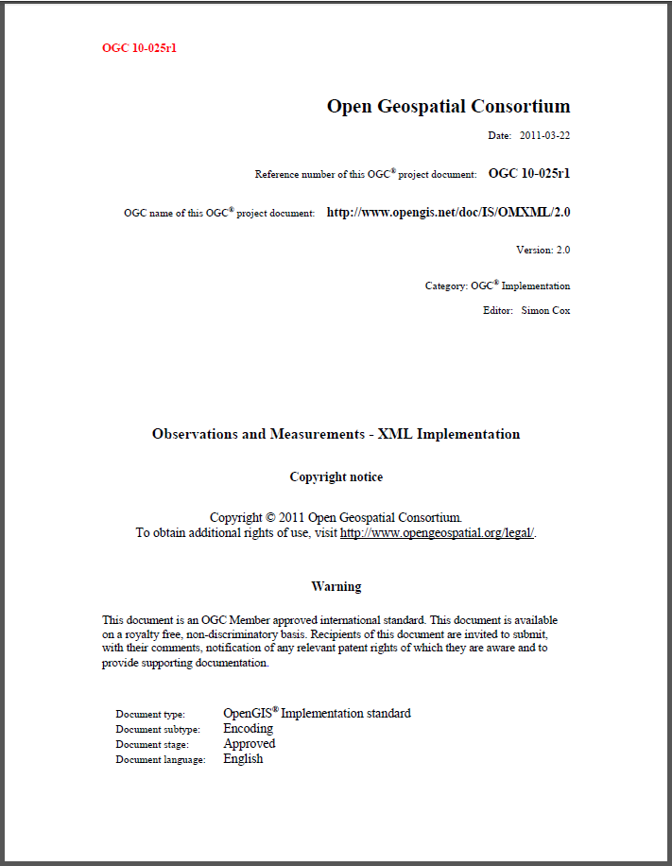
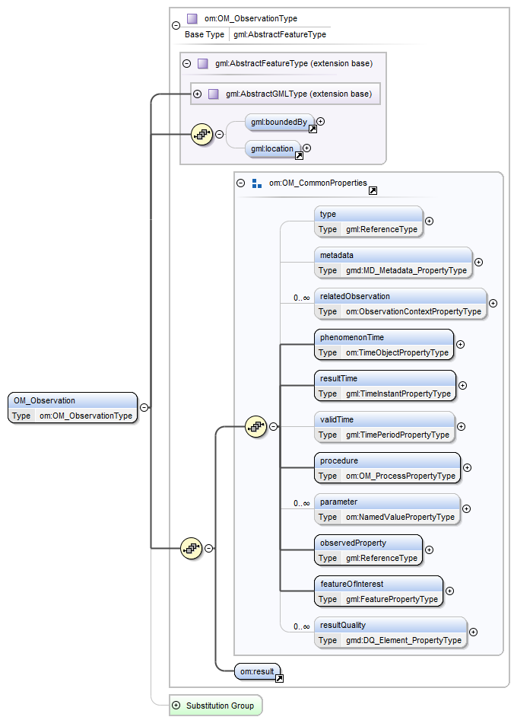
Cox, OGC Implementation – Observations and Measurements - XML Implementation

Slide 4
Why JSON?
“So these days, if you want to interchange tuples or tables of tuples or numbers and strings, you have JSON. If you want to do nontrivial publishing automation, use XML. If you want to interchange smart bitmaps of page images, there’s PDF. I personally think we’re probably done with inventing low-level textual interchange formats.”
Tim Bray http://www.tbray.org/ongoing/When/201x/2013/02/10/XML-at-15

Slide 5
OM-JSON
{ "id":"measure-instance-test", "type" : "Measurement", "phenomenonTime": { "instant":"2011-05-11T00:00:00+10:00" }, "observedProperty": {"href":"http://environment.data.gov.au/def/property/air_temperature"}, "procedure": {"href":"http://www.opengis.net/def/waterml/2.0/processType/Sensor"}, "featureOfInterest": {"href":"http://waterml2.csiro.au/rgs-api/v1/monitoring-point/419009/"}, "resultTime": "2011-05-12T09:00:00+10:00", "result": { "value": 3.2, "uom": "http://qudt.org/vocab/unit#DegreeCelsius" } }
O&M terminology
JSON syntax

Slide 6
OM-JSON – time-series
{ "id":"timeseries-instance-test", "type" : "http://www.opengis.net/def/observationType/OGC-OM/2.0/OM_DiscreteTimeSeriesObservation", "phenomenonTime": { "begin":"2015-08-03", "end":"2015-08-05" }, "observedProperty": {"href":"http://environment.data.gov.au/def/property/air_temperature"}, "procedure": {"href":"http://www.opengis.net/def/waterml/2.0/processType/Sensor"}, "featureOfInterest": {"href":"http://waterml2.csiro.au/rgs-api/v1/monitoring-point/419009/"}, "resultTime": "2015-08-05T09:00:00+10:00", "result": { "defaultPointMetadata": { "interpolationType": {"href": "http://www.opengis.net/def/waterml/2.0/interpolationType/Continuous"}, "uom" : "http://qudt.org/vocab/unit#DegreeCelsius" }, "points": [ { "time": { "instant": "2015-08-03" }, "value": 3.2 }, { "time": { "instant": "2015-08-04" }, "value": 3.5 }, { "time": { "instant": "2015-08-05" }, "value": 3.6 } ] } }
TimeseriesML encoding

Slide 7
OM-JSON
{ "id":"polygon-example", "phenomenonTime": { "instant":"2011-05-11T00:00:00+10:00"}, "observedProperty": { "href":"http://environment.data.gov.au/def/property/shape"}, "procedure": { "href":"http://www.opengis.net/def/waterml/2.0/processType/Sensor"}, "featureOfInterest": { "href":"http://environment.data.gov.au/water/id/catchment/100862", "title":"Observed catchment"}, "resultTime": "2011-05-12T00:00:00+10:00", "result": { "type": "Polygon", "coordinates" : [[ [-180.0, 10.0], [20.0, 90.0], [180.0, -5.0], [-30.0, -90.0], [-180.0, 10.0] ]] } }
GeoJSON for geometry

Slide 8
OM-JSON
{ "id": "spec1", "type": "Specimen", "sampledFeature": { "href": "http://example.org/featureA", "title": "test feature A" }, "complex": [ { "rel": "http://example.org/parent", "href": "http://example.org/sample2" }, { "rel": "http://example.org/child", "href": "http://example.org/sample3" } ], "samplingTime": { "instant": "2015-05-14" }, "relatedObservation": [ { "href": "http://example.org/obs99" } ], "samplingLocation": { "type": "Point", "coordinates": [ -30, -90 ] }, "currentLocation": { "href": "http://example.org/locations/store", "title": "bottom drawer" }, "size": { "value": 23.1, "uom": "http://www.opengis.net/def/uom/ogc/0/m" } }
Link model – href, rel, title

Slide 9
OM-JSON
{ "id": "sampling feature collection 77", "sampledFeature": [ { "href": "http://example.org/feature45", "title": "Derwent River" } ], "member": [ { "href": "http://example.org/sample23" }, { "id": "spec56", "type": "Specimen", "samplingTime": { "instant": "2015-05-14" }, "samplingLocation": { "type": "Point", "coordinates": [ -30, -90 ] }, "size": { "value": 2, "uom": "l" } } ] }
Sampling feature collection
Members
- by-reference or in-line
- inherit common properties

Slide 10
OM-JSON
{ "id": "observation collection a34", "phenomenonTime": { "instant":"2015-05-11" }, "featureOfInterest": { "href":"http://example.org/sighting345" }, "member": [ { "href": "http://example.org/o23" }, { "id":"o96", "type": "CategoryObservation", "observedProperty": { "href": "http://environment.data.gov.au/def/property/taxon" }, "procedure": { "href":"http://www.opengis.net/def/waterml/2.0/processType/Manual" }, "resultTime": "2015-05-12T09:00:00+10:00", "result": { "term": "johnstons-crocodile" , "vocabulary": "http://environment.data.gov.au/def/object/" } } ] }
Observation collection
Members
- by-reference or in-line
- inherit common properties

Slide 11
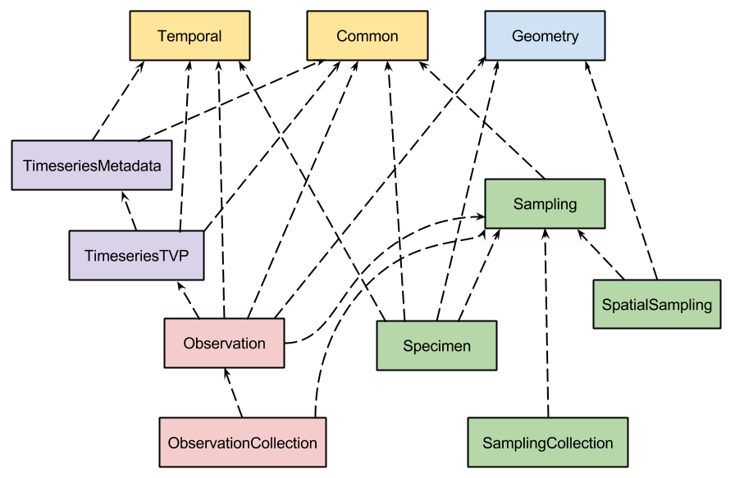
JSON Schema for OM-JSON
No external dependencies
Common types, for use in other OGC JSON encodings?
JSON-schema for TimeseriesML
Collection objects, carry common properties

Slide 12
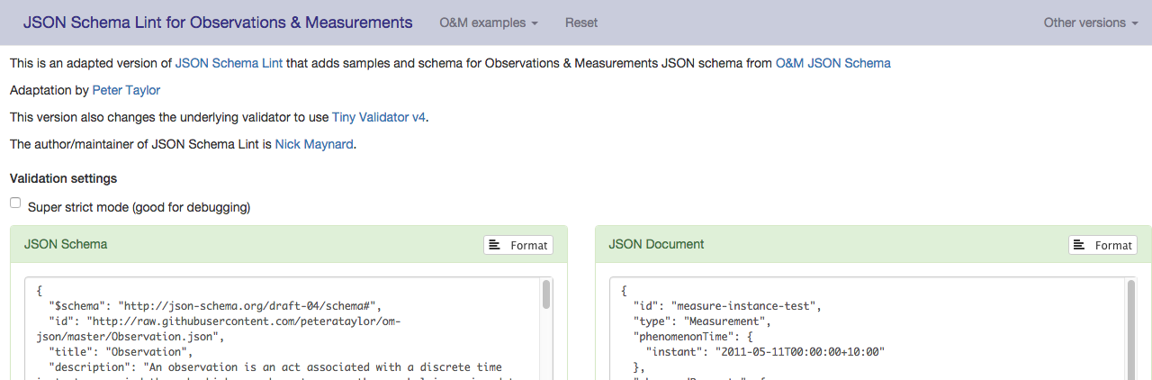
JSON Schema and validator
Adapted version of JSON Schema Lint here: http://waterml2.csiro.au/om-json/
JSON Schema available here: http://github.com/peterataylor/om-json

Slide 13
Issues
This encoding focuses on the information model
How best to wrap these for use in API/Services?
E.g. using SOS (52North), SensorThings, SensorCloud (CSIRO)
Some (minor) differences in approaches to schema inheritance and typing.
The 52North schema are quite similar and these could be harmonised

Slide 14
Changes required to Abstract Spec (O&M)
add samplingStrategy to Observation
featureOfInterest used only for the feature with observed property
ObservationCollection, for common properties of member observations
procedure, featureOfInterest, samplingStrategy, observedProperty, phenomenonTime, resultTime
add samplingElevation to Specimen
vertical offset from a 2-D location a common requirement
SamplingFeatureCollection, for common properties of member sampling features
sampledFeature

Slide 15
Discussion paper
OM-JSON – OGC 15-100rN Discussion Paper has been approved for publication at OGC.

Slide 16
Discussion points
JSON Schema?
base types for OGC JSON implementations
52North version of JSON for SOS
OM-JSON vs SensorThings
use of GeoJSON for geometry, alternatives
UML→JSON rules

Slide 17
Thank you
CSIRO Land and Water
Simon Cox Research Scientist
t +61 3 9545 2365
e simon.cox@csiro.au
w people.csiro.au/C/S/Simon-Cox
CSIRO Data61
Peter Taylor Engineer
t +61 3 6232 5530
e peter.taylor@csiro.au
w http://people.csiro.au/T/P/Peter-Taylor
Land and water

