Slide 1
Using (testing?) the HY_Features model,
95th OGC Technical Committee
Boulder, Colorado USA
Rob Atkinson
3 June 2015
Copyright © 2015 Open Geospatial Consortium

Slide 2
Background
AHGF conceptual model
Copyright © 2015 Open Geospatial Consortium

Slide 3

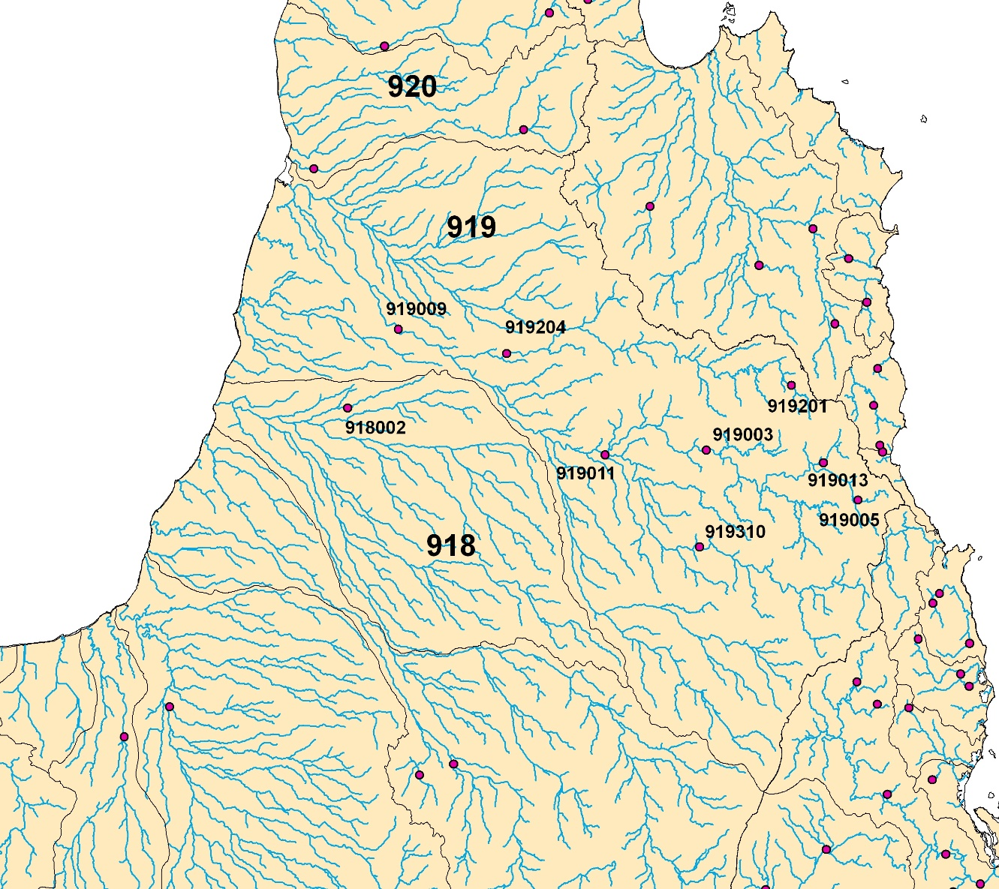
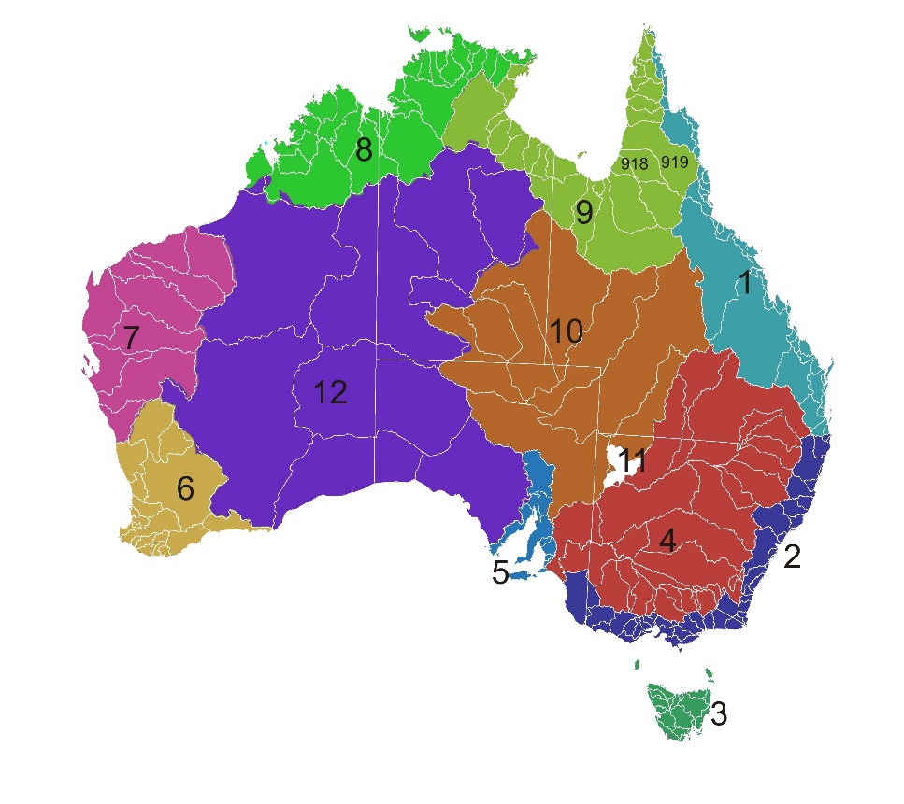
Different representations at different scales

Slide 4
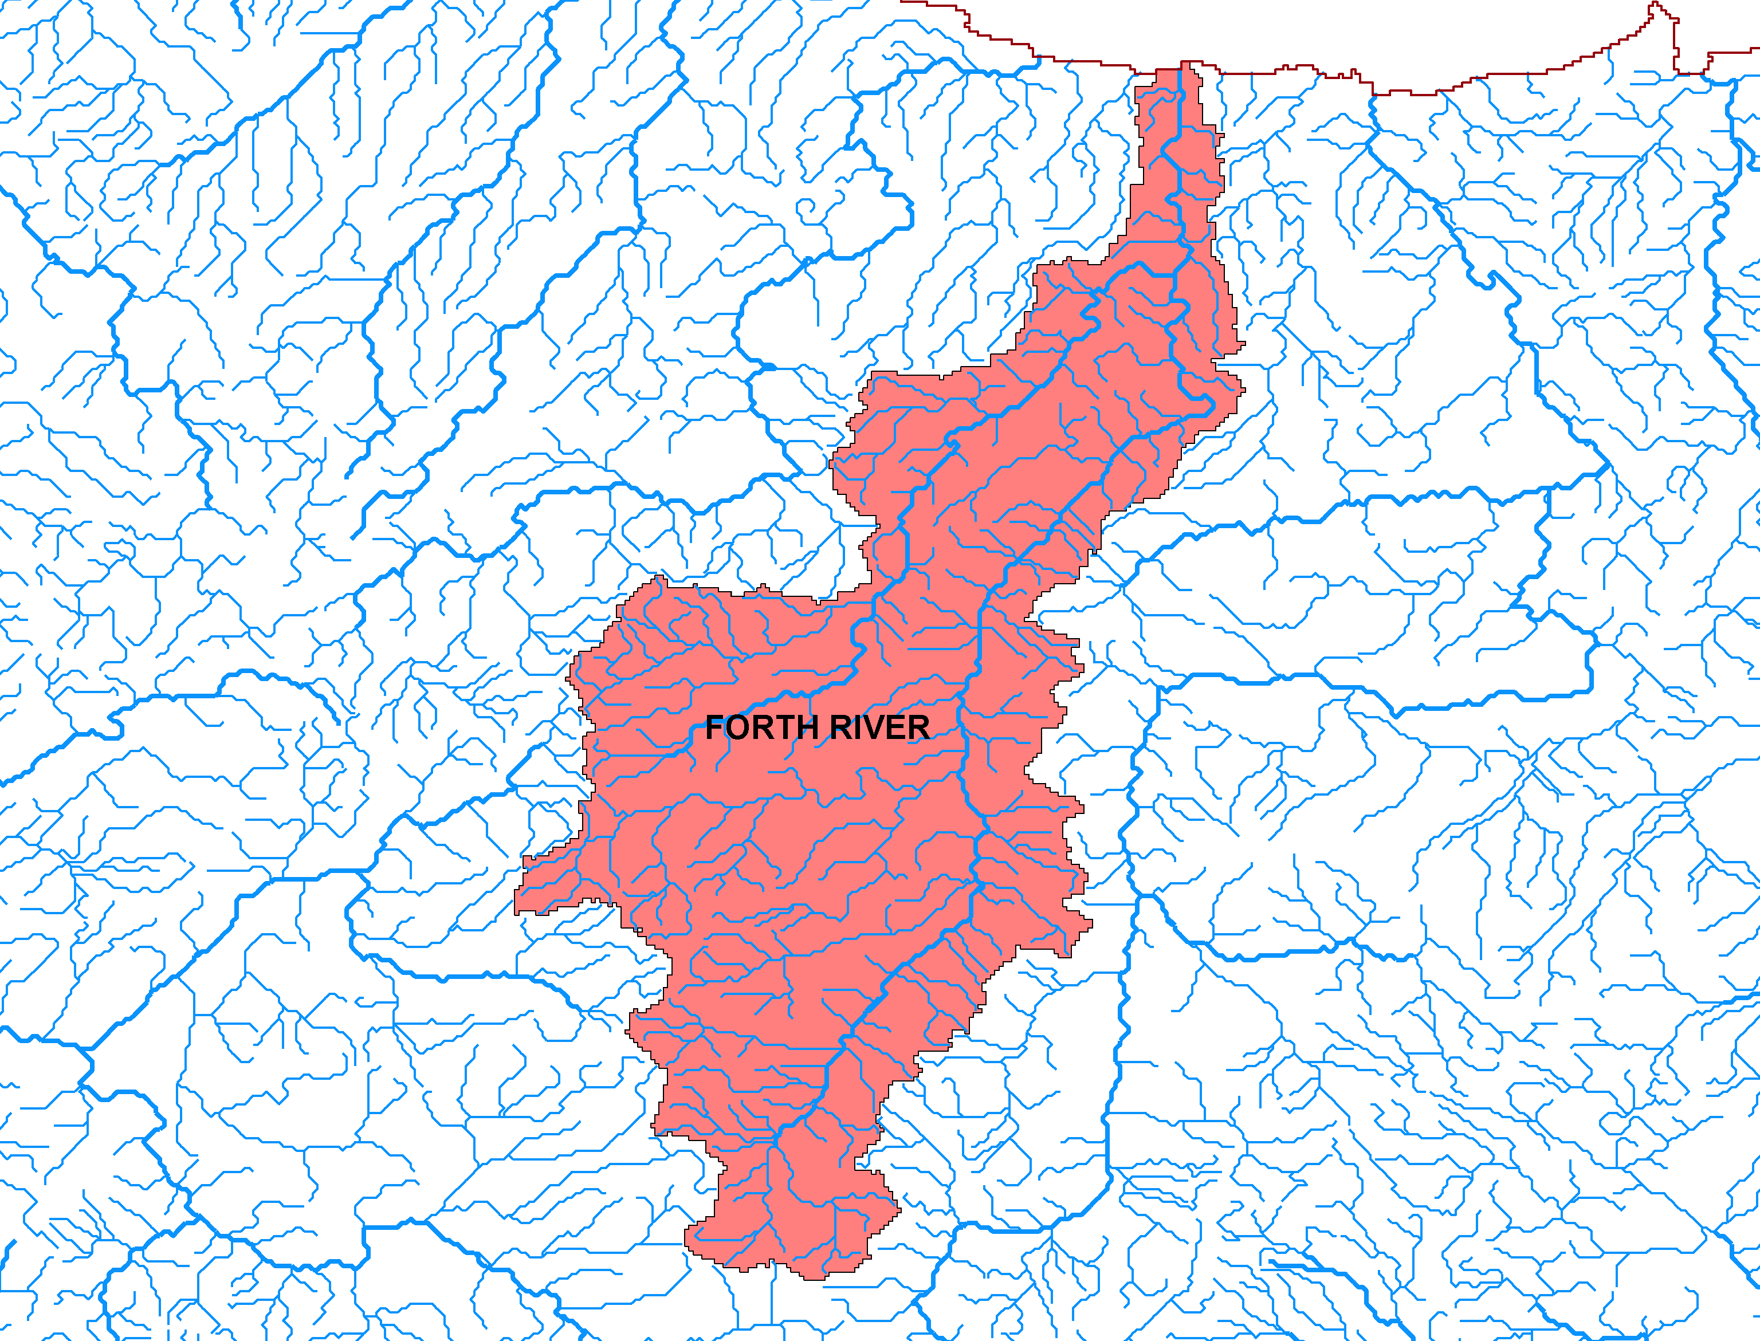
Unit of reporting – the “catchment”

Slide 5
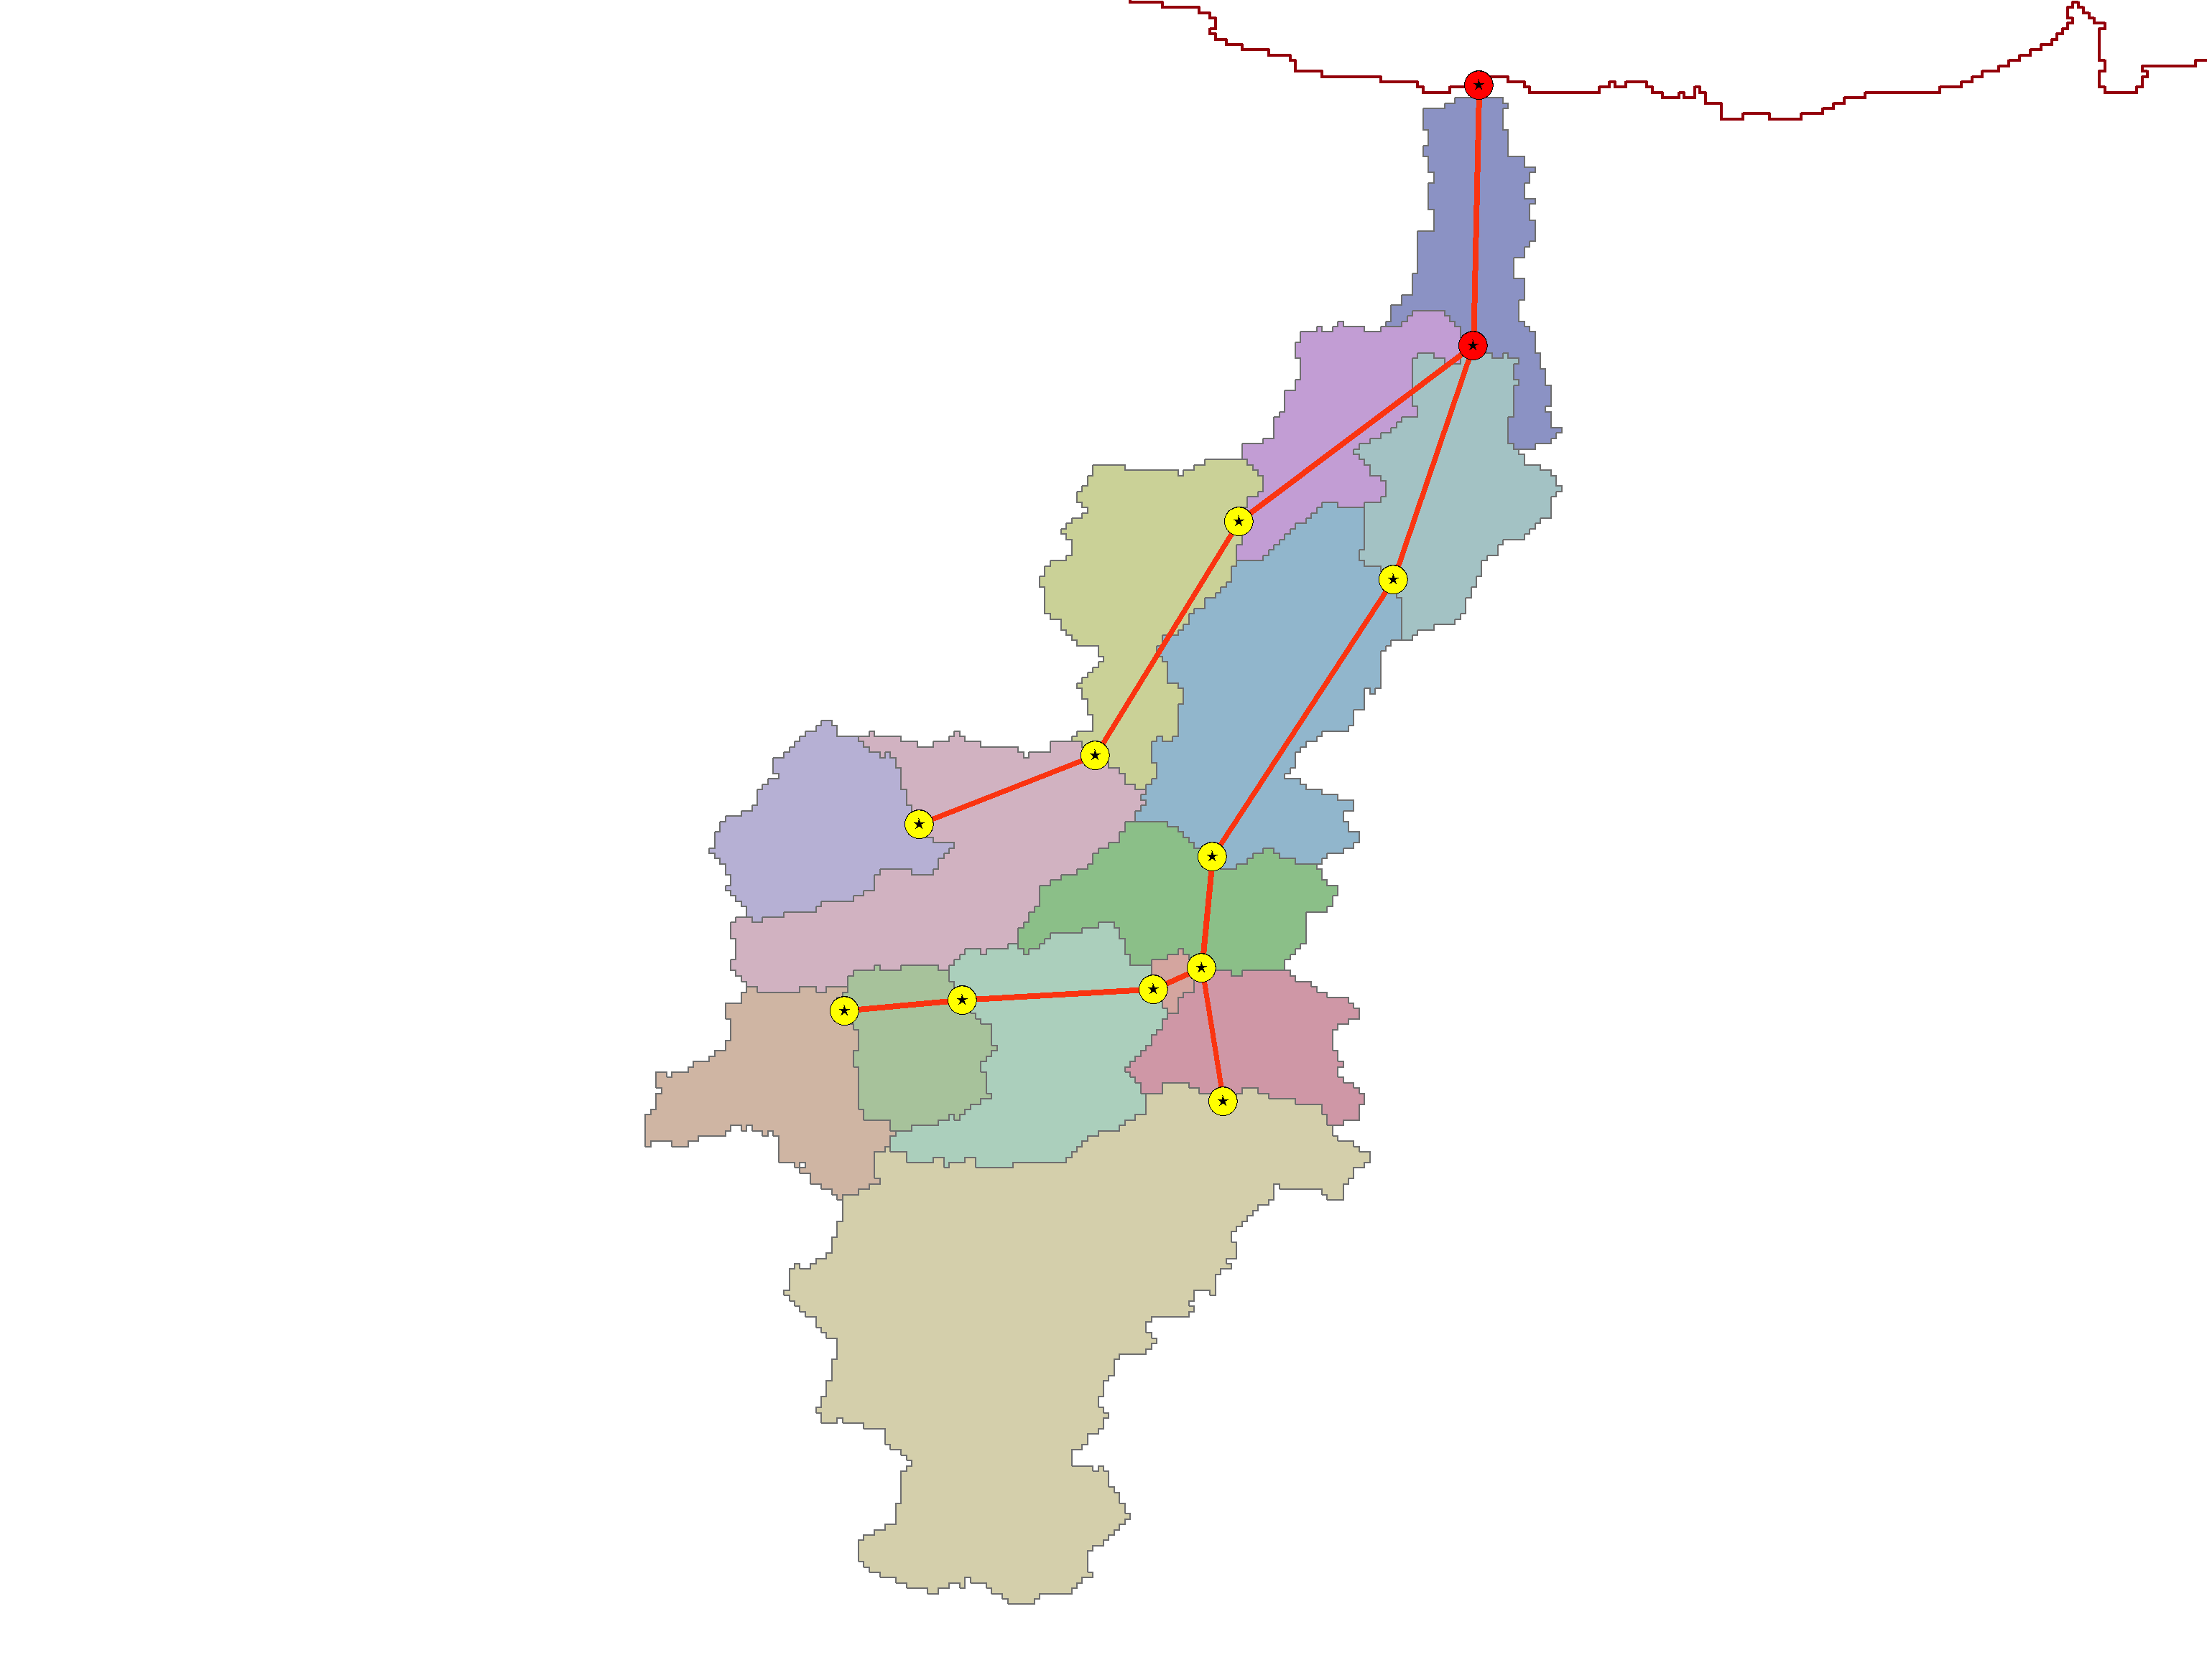
Multiple representations required

Slide 6
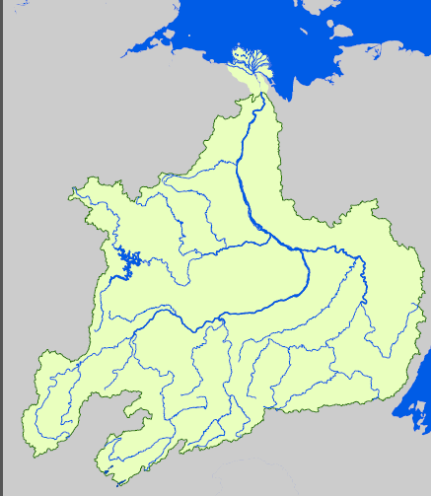
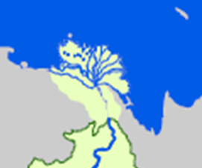
Tools have been part of the problem…
GIS tools can do this bit

Slide 7
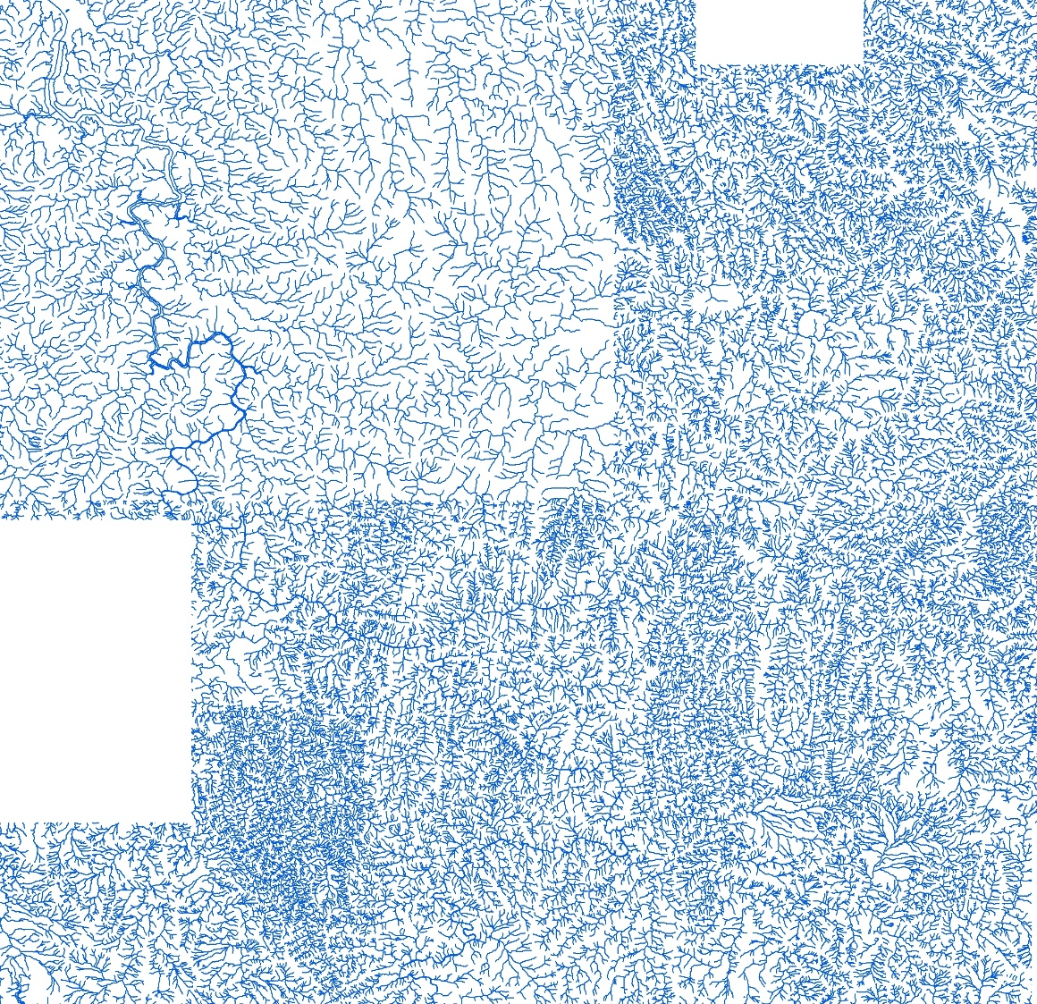
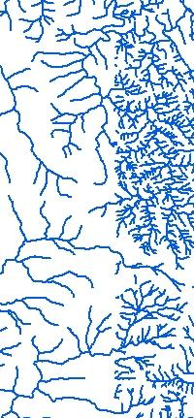
Different levels of complexity at different scales

Slide 8
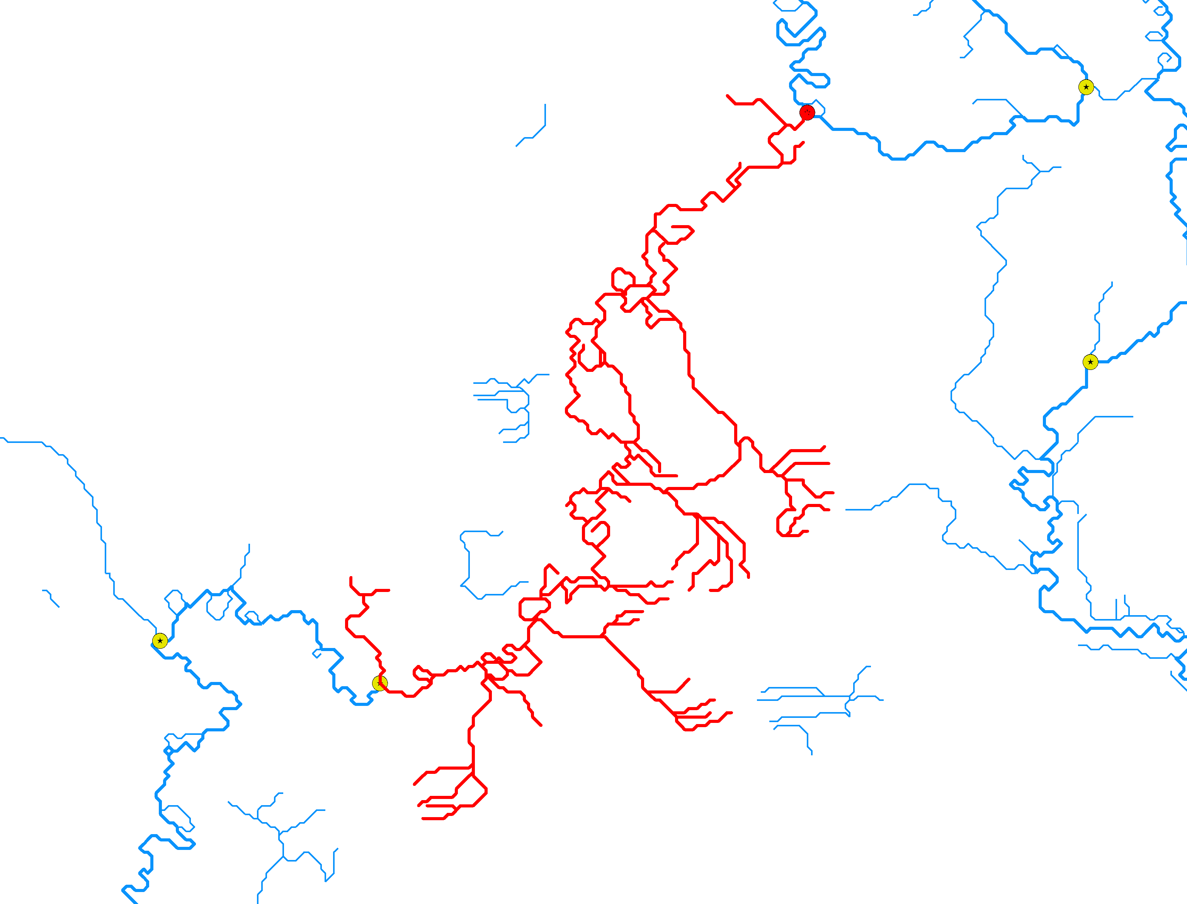
Encapsulation

Slide 9
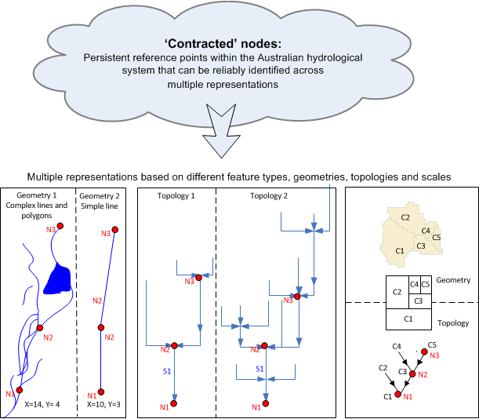
“Contracted Nodes”
CSIRO. Masterclass: Domain Modelling and Implementation - Sydney 03/12/2010

Slide 10
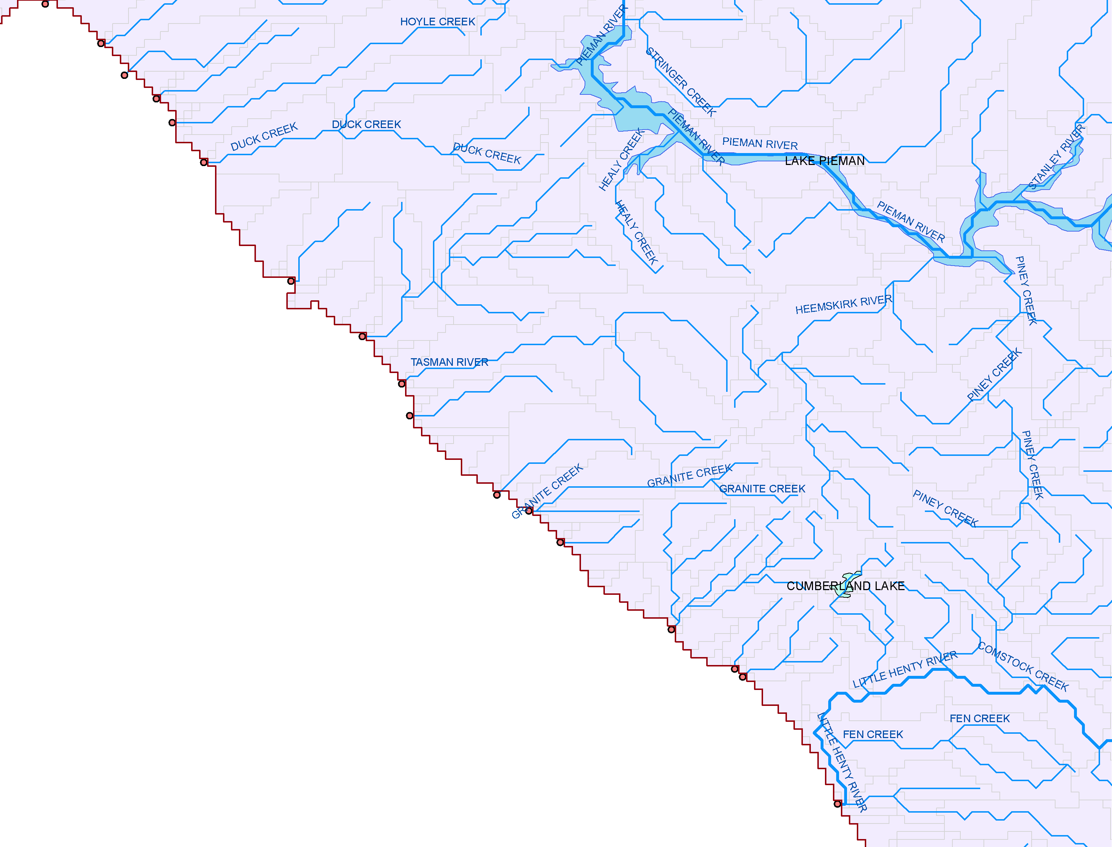
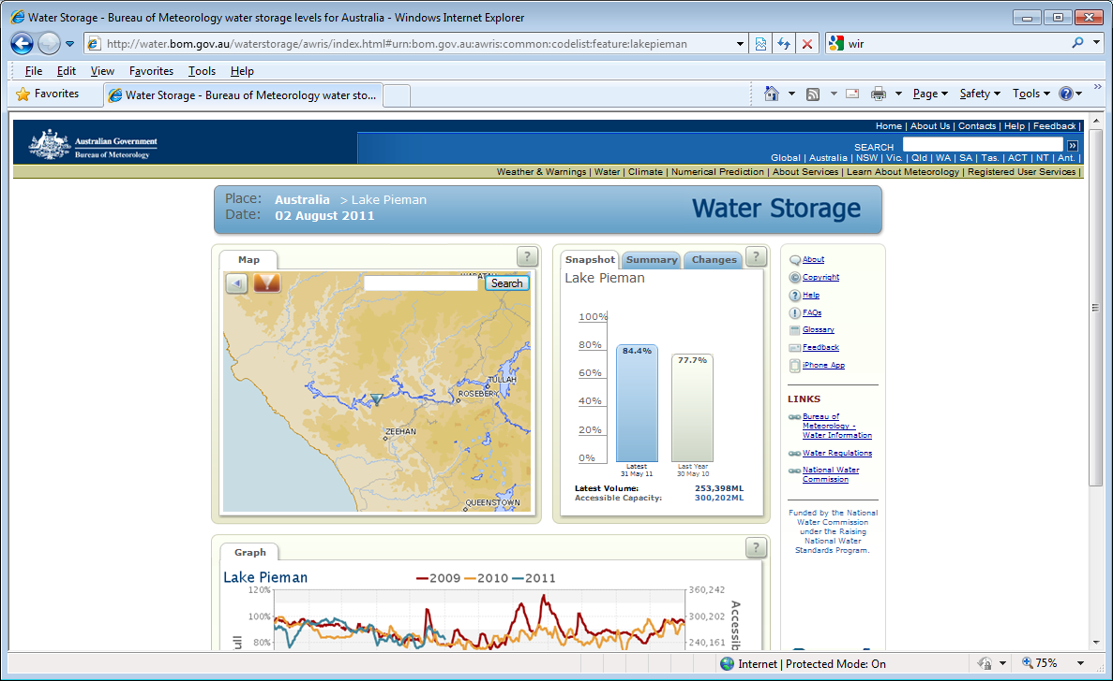
Identifiers at work…
http://water.bom.gov.au/waterstorage/awris/index.html#
urn:bom.gov.au:awris:common:codelist:feature:lakepieman

Slide 11
Identifiers
This is the “tricky part”
Vital to understand different identifiers and roles – all system functions emerge from the differences and relationships
Lets start with the practical implication…
Catchment | ExtractionRate | Storage
1123343 | 730 | 300
Catchment Boundary | Area | Geometry
1123343 | 33535.4 | 151.3344,-35.330…….

Slide 12

Distributed references
Catchment | ExtractionRate | Storage
1123343 | 730 | 300
How to ask for this entity
Internet
How to deliver this entity
Catchment Boundary | Area | Geometry
1123343 | 33535.4 | 151.3344,-35.330…….

Slide 13
Feature Identity
Identified features in multiple systems…
Without forcing all those systems to use the same physical implementation (Feature Type)
But identity requires a model, including relationships to other features that define a unique identity.
  The banks of a river cannot be defined without reference to the river (or vice versa if one had a complete model of the landscape
  But every system uses different implementation models for such related concepts
  including the “Null Model” (I don’t need to know about that aspect ☺
Copyright © 2015 Open Geospatial Consortium

Slide 14
Purpose of a model
Models should do work:
  Standardise terminology
  Document the relationships between things
  Visualise the relationships between things
  Move from a “visually enforceable” paradigm to a consistent way of encoding complex formalisms
Different models do different things
  Conceptual
  Physical implementation (data transfer)
  Physical implementation (persistence, system design
Copyright © 2015 Open Geospatial Consortium

Slide 15
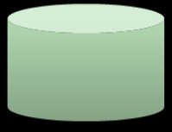
Scope of domain models?
GIS, observations
Hydrological
connectivity
Business rules
(e.g. Logical Consistency, Topology )
Dataset
Service
interface
WFS,
vocabs,
RSS feed
Dictionary,
Ontology
Model
Documentation
Transfer
standard
WaterML2 (profile!),
GeoSciML etc
Data Product Specifications

Slide 16
Points of truth and data products
“Platform Specific Models”
“Platform Independent Model”
Shared Registers
Conceptual Model
Model
compilation
Mappings
Implementation
Profile
Functional
mappings
Logical
Views
A
A | B
id | name | type | shape
Data
Products
Node-Link
Reporting Regions

Slide 17
Data Interoperability and integration
What does our model need to do?
  Allow exchange of feature identifiers, with unambiguous type definition.
  Provide a standardised terminology for relationships that exist between features.
  Support description of mappings between alternative models
  Does it need to support “feature exchange”?
HY_Features formalises the relationships explicit or implicit in an accepted glossary of definitions.
  But we need to publish it in a form suitable for
    Mappings
    Describing relationships
Copyright © 2015 Open Geospatial Consortium

Slide 18
HY_Features as OWL:
OWL :
  Can make the model work
  Less idiosyncratic than UML ☺
  Equally prone to “roll your own”
  Gives us relationships, our primary concern, as a “first class citizen” – re-usable terminology
  Immediately implementable
But we want to support mappings between data products:
  Structure – what ontology to use to describe structure mappings between different products?
  Content – binding the structures to description of the content and finding content-mappings.
Copyright © 2015 Open Geospatial Consortium

Slide 19
Is this a pipe dream?
We have seen that its possible to discover related features, and build feature-level linked data using services
What about model mappings?
Copyright © 2015 Open Geospatial Consortium

Slide 20
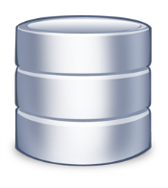


Stable
URI
Alternative representations
Semantic resources
Target
model
Multingual gazetter model
Common
Index
DESCRIBES
harvester
Model
mapping
vocab
X-walk
SDI source (WFS)
Heterogeneous
Data products
source
model
DESCRIBES
GML binding
(xpath)
Implementation
Notes:
The UNSDI will accept the reality of these different perspectives, but synthesise them through a solution to the identifier problem, by registration against the underlying potential sources of authority for location names, whilst supporting alternative representation and naming requirements.
A Linked data approach makes the different viewpoints accessible from a common identifier.

Slide 21
Tooling possible
UML
imports
GML
Classmaps
GML
API
UML
Application
Schema
encoder
GML
Classmaps
RDF
store
OWL
UML
Mapping model
encoder
RDF
Presentation title | Presenter name | Page <number>

Slide 22
And it works
http://environment.data.gov.au/water/id/riverregion/9400299
mappings via API
Copyright © 2015 Open Geospatial Consortium

Slide 23
Summary
HY_Features does a very useful job for us – gives us a language to describe (and implement) links between features
We have used model mappings, based on OWL encodings, to successfully transform data delivered using GML schemas
  Therefore, if we just wanted to transfer some basic information using HY_Features, all we would need is model mappings from existing data products and tooling
  Note that this corresponds to the evolution of systems towards broker-mediated interoperability!
Mapping idiom “home grown” in absence of a standard – but a key concern IMHO for HDWG
We can use Linked Data to physically join up the data, using traditional (and even non-standard!) services.
There is a whole bunch more about description of observation data and other information services we can describe so that feature-based links are possible
  There seems to be no reason to force interaction with catalogs explicitly – a mediator turns a rich (and extensible) metadata graph into actionable links,
  Links are annotatable with what we choose.
Copyright © 2015 Open Geospatial Consortium

