Slide 1
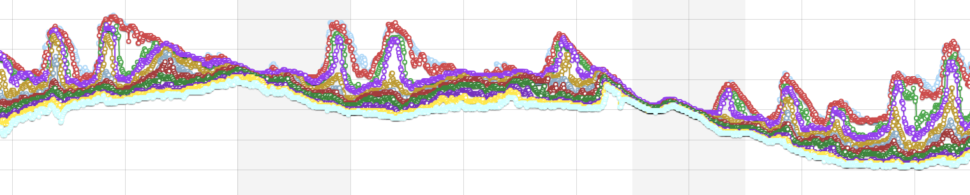
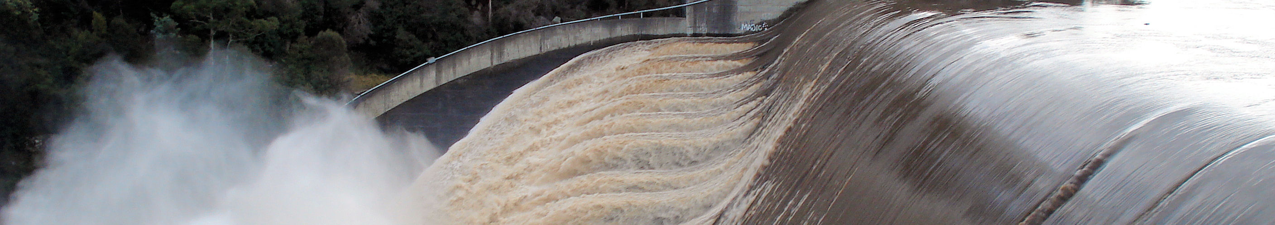
TimeseriesML update
Peter Taylor
HydroDWG Workshop, 21st Sept 2015
Data61

Slide 2
Request for Comment
Request period has recently closed
Summary of comments so far:
https://portal.opengeospatial.org/wiki/TimeSeriesMLswg/PublicCommentsAugust2015
Nothing too major received in terms of comments

Slide 3
Two documents
Timeseries Profile
TimeseriesML 1.0
Timeseries Profile of Observations and Measurements
XML Encoding of the Timeseries Profile of Observations and Measurements
Notes:
Key Design decision – the move to 2 standards
Splitting standards allows other encodings to be generated and worked on easily independently
Timeseries profile capturing the conceptual model for timeseries data
TimeseriesML 1.0 capturing the XML encoding of the timeseries profile

Slide 4
Main differences
MonitoringFeature replaces MonitoringPoint
Supports more complex spatial sampling
‘representativePoint’ for using putting on a map
Removal of some hydro-specific properties
Loosening of some restrictions
Simplification of XML types

Slide 5
Conceptual Model – Timeseries

Slide 6
Conceptual Model – Monitoring Feature
Notes:
Timeseries defines 1 specialised sampling feature, Monitoring Feature, as Feature of Interest for Timeseries observations
Monitoring Feature extends SF_SpatialSamplingFeature
NB. Was MonitoringPoint in WaterML 2.0 now MonitoringFeature
Addition of representative point – ease of visualisation

Slide 7
Example XML
<tsml:TimeseriesTVP gml:id="tsml.measurementimeseries.20001.met.soilmoist2"> <tsml:metadata> <tsml:TimeseriesMetadata> <tsml:temporalExtent xlink:href="#om.phenomenontime.20001.met.soilmoist2"/> </tsml:TimeseriesMetadata> </tsml:metadata> <tsml:defaultPointMetadata> <tsml:PointMetadata> <tsml:uom xlink:href="http://www.opengis.net/def/uom/UCUM/0/percent" code="percent"/> <tsml:interpolationType xlink:href="http://www.opengis.net/def/timeseriesml/1.0/interpolationType/AveragePrec" xlink:title="Average in Preceding Interval"/> </tsml:PointMetadata> </tsml:defaultPointMetadata> <tsml:point> <tsml:MeasurementTVP> <tsml:metadata> <tsml:PointMetadata> <tsml:aggregationDuration>PT16M</tsml:aggregationDuration> </tsml:PointMetadata> </tsml:metadata> <tsml:time>2012-06-13T00:25:00.000+12:00</tsml:time> <tsml:value>39.97</tsml:value> </tsml:MeasurementTVP> </tsml:point> …

Slide 8
Future
WaterML2.0 part 1 remains a standard
Should continue to be used
A future version could be updated to use TimeseriesML and add extensions where required
Translation/conversion between the two would be easy

Slide 9
Discussion
Any

Slide 10
Thank you
Data61
Peter Taylor Research Engineer
t +61 3 6237 5617
e peter.taylor@csiro.au
w www.csiro.au
Data61

