Slide 1

Environmental Data - Web APIs
Current practice and future directions
Peter Taylor
HydroDWG Workshop, 21st Sept 2015
Data61

Slide 2
Method and scope
Web APIs for the Bureau
Nature of environmental data
Related domain Web APIs
Web API best practices
Open standards & computing trends
User requirements

Slide 3
Some working definitions
Web APIs
Mostly associated with REpresentational State Transfer (REST)
Most use JSON encodings
The focus tends to be on web/mobile developers as consumers
Web Services
Often associated with the W3C standards
SOAP, WSDL, UDDI etc.
However, also mentions REST
Traditionally use XML encodings

Slide 4
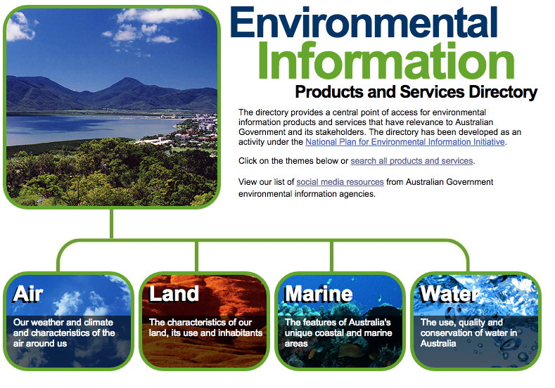
Bureau data

Slide 5
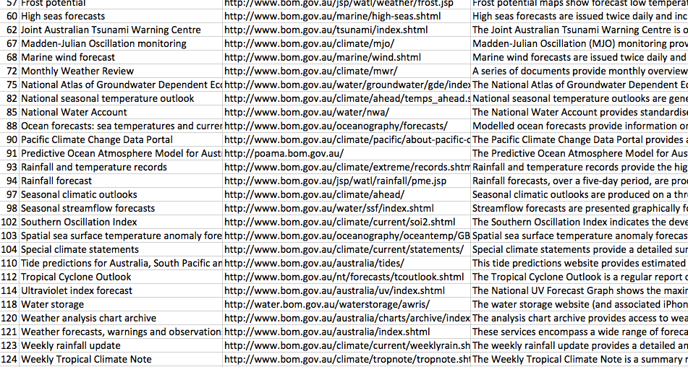
So what’s the problem?

Slide 6
Please note
These are problems that face many organisations!
The Bureau has a long history, and has recently taken on new roles (water data, environmental etc)
The aim of this work is to find out how to improve consistency, not to point out problems
Multi-disciplinary data publishing is hard!

Slide 7
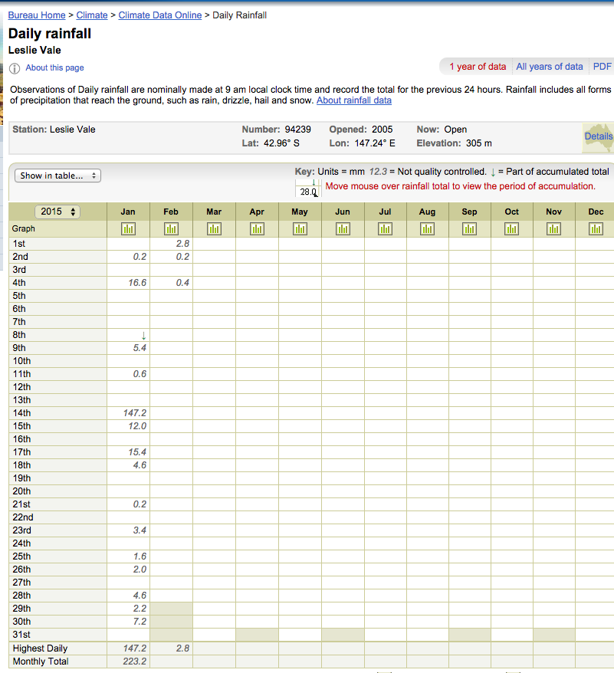
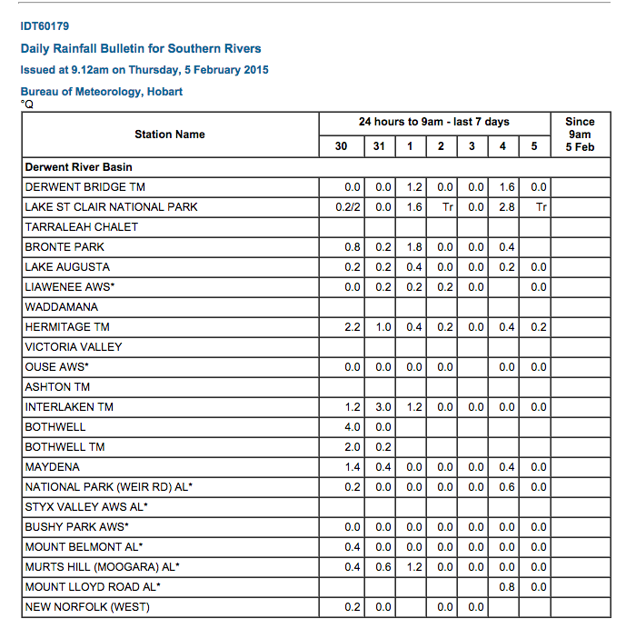
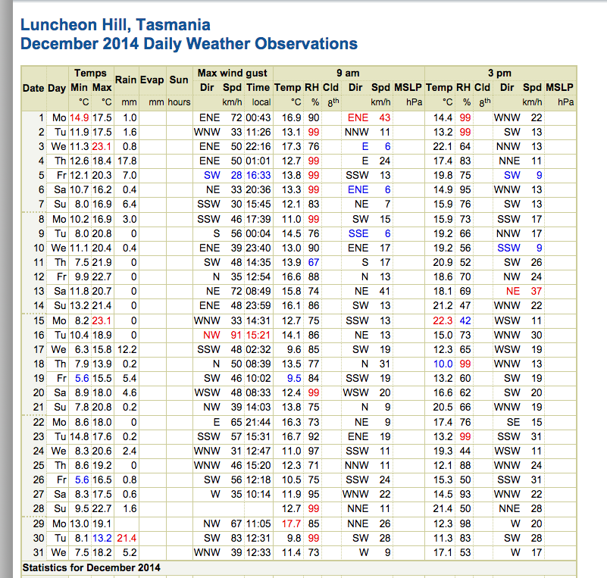
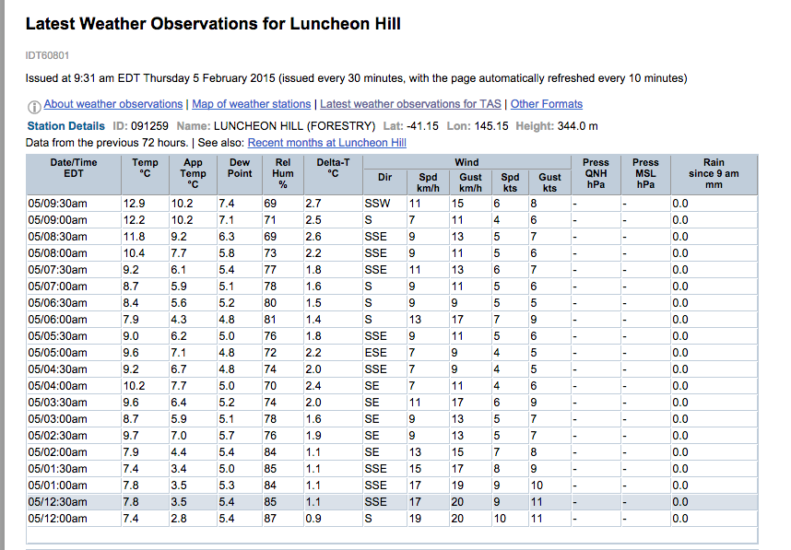
Which to use?

Slide 8
Disparate data access makes it
Hard to have organisational visibility on traffic
Hard to control traffic/load
Hard to consistently manage change
Fragmented community of developers
Hard for users to find what they need
Different ways to do the same thing
Redundant functionality
Redundant development
Data access and applications are tightly coupled
Hard to monetize (if this is what you are after)

Slide 9
Web API benefits
Can be for internal and external use
Many companies find internal use outgrows external use
Support multiple applications
Web apps
Mobile
Widgets
Etc.
Increase separation between web access and underlying information system
End up as an important part of the architecture

Slide 10
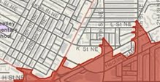


Views of data
Features exist, have attributes and can be spatially described – ‘discrete’ or ‘vector’
Features
Continuous phenomena, varying in space and time – ‘raster’.
A function: spatial, temporal or spatio-temporal domain to attribute range
Coverages
An act that results in the estimation of the value of a feature property, and involves application of a specified procedure, such as a sensor, instrument, algorithm or process chain
Observations
& Forecasts
Notes:
Discrete and vector are just common names for this type of data. Not different, just providing two commonly used names.
An example of coverage is average ocean surface temperature, or average soil moisture over spatial region. These surfaces/coverages are either interpolated from in-situ measurements, or estimated using remote sensing by analysing reflected radiation.

Slide 11
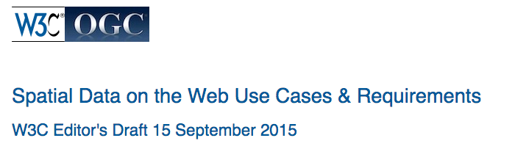
Requirements
4.1 Meteorological Data Rescue
4.2 Habitat zone verification for designation of Marine Conservation Zones
4.3 Real-time Wildfire Monitoring
4.4 Diachronic Burnt Scar Mapping
4.5 Harvesting of Local Search Content
4.6 Locating a thing
4.7 Publishing geographical data
…
5.1 Bounding box and centroid
5.2 Compatibility with existing practices
5.3 Compressible
5.4 Coverage temporal extent
5.5 Crawlability
5.6 CRS definition
5.7 Date, time and duration
…

Slide 12
Existing Web APIs

Slide 13

Content type
Data type
Product
value
observation
mountainarea
image
forecast
surfacepressure
layer
ukextremes
text
nationalpark
all

Slide 14
Example queries
Fetch three-hourly, five-day forecast for Exeter
Fetch the national park forecasts for south west England
Fetch the current UK rainfall radar map layers
And so on..
API documentation
E.g.
http://datapoint.metoffice.gov.uk/public/data/val/wxfcs/all/datatype/sitelist?key=ce54927d-e79b-4334-bf56-0da2a4f3f56c

Slide 15
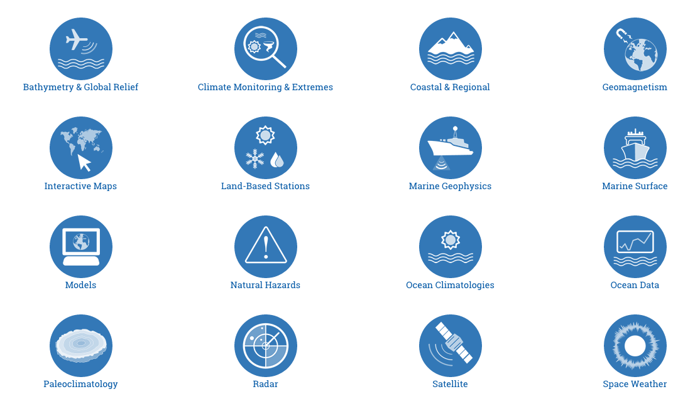
NOAA

Slide 16
NOAA – Climate Data Online
/datasets
Top level grouping
‘Annual summaries’, ‘hourly precip’
/datacategories
A logical grouping of data types
‘Sky cover & clouds’, ‘Evaporation’
/datatypes
The instance phenomenon
‘Long-term averages of annual growing degree days with base 45F’
/locationcategories
/locations
/stations
/data
Logical grouping of location types
‘Hydrologic Region’, ‘Climate Division’
Individual (point) locations
Individual US states, cities
Individual automatic weather station
Monitoring stations
Give me the data already
Fetch data from the Daily Summaries for zip code 28801, May 1st of 2010

Slide 17
Combine resources for query power
Fetch a list of stations that support a given set of data types
Fetch available locations for the Daily Summaries dataset
Fetch data types with the air temperature data category
Fetch all available datasets with the Temperature at the time of observation (TOBS) data type
Examples URLs…
/api/v2/datacategories?stationid=COOP:310301
/api/v2/locations?locationcategoryid=ST&limit=52

Slide 18
Some observations
These APIs make some core simplifications
These are handled by developers
Context is powerful
For example:
No CRS specified for location - most geo data on the web assumes EPSG4326/WGS84
Elevations with no vertical datum (likely assumes a national height datum)
Aggregated concepts for ease of use:
E.g. ‘data coverage’ – a percentage indication of time coverage of the data
They provide the minimal set of metadata
They often hide operational complexities
Minimal, or no, quality information
Difference in users

Slide 19
Spaceout
Anything that varies in space and time will have complexities
Space
The world is round
Geodesy is a science in itself
Custom and/or local reference systems
Time
Dealing with uncertain times
Different epoch/reference points
All simple APIs make large assumptions in these two areas!

Slide 20
Conflicting requirements
Taken from W3C spatial data working group requirements:
Technologies must be easy to implement for people that generally do not have a high affinity with IT. This goes for data publishing as well as data consumption.
References to time and space are often inexact or have shifting frames of reference, so simple encodings like basic geo or ISO 8601 do not suffice.
References to time and space do need to be as exact as possible, to enable automatic discovery of spatiotemporal patterns.
….

Slide 21
Linked Data API
Serves RESTful APIs from triple store
Raises the technical level
Could be a point of convergence for future APIs
A lot of JSON encodings are starting to look like linked Data

Slide 22
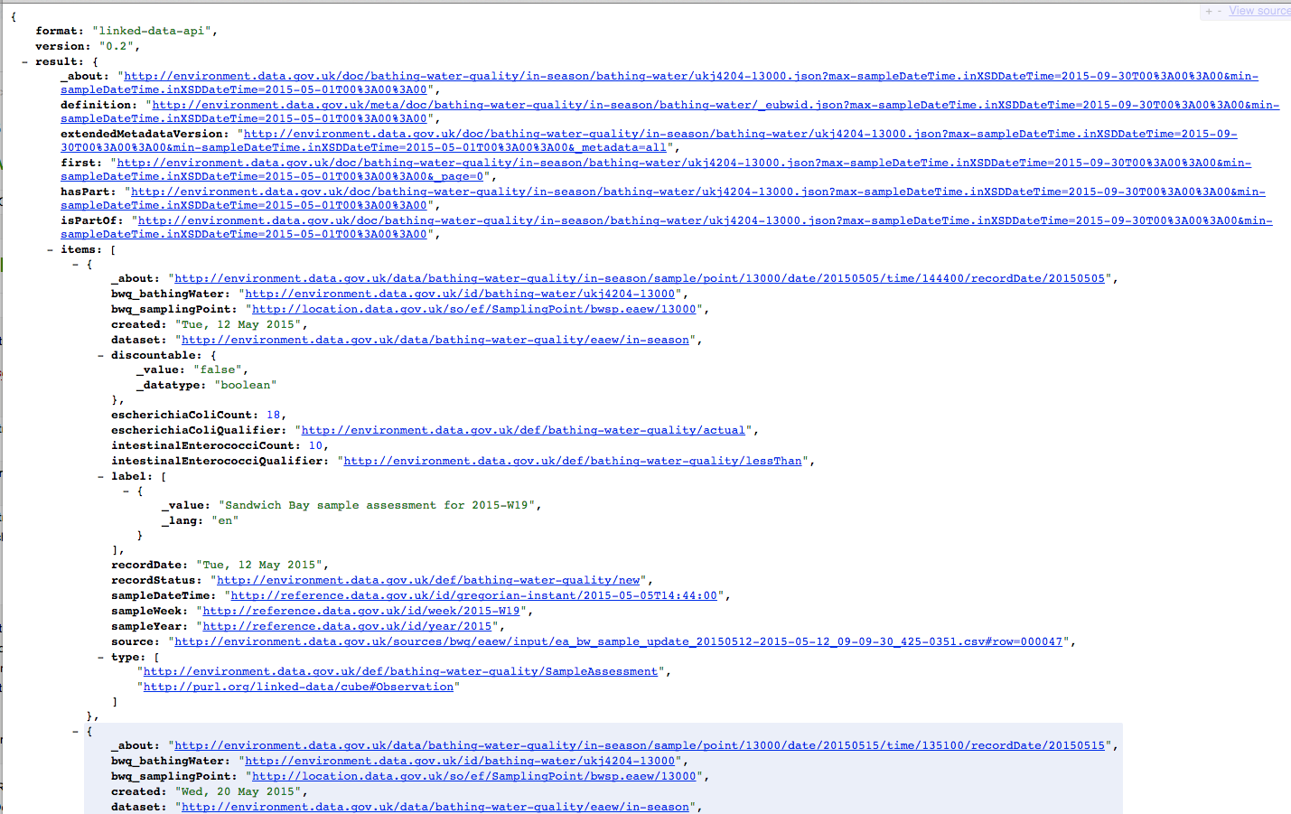
Linked Data APIs

Slide 23
Guiding principles
Deciding what features not to include
Deciding the context you can assume
What’s your 80%?
Careful of ‘over handling’ the edge cases
Can we provide a spectrum of functionality to suit different uses?
Free/open version providing simple encodings, base metadata
Pay for a fully featured, provenance enabled, vocabulary-connected service.
Notes:
Monetize using complexity – Complexity as a Service (CAOS)
Service descriptions
WADL etc.
Swagger
GBIF
Atlas of living Australia
GCIS
Global change
Provenance

Slide 24
Guiding principles II
Identify core abstractions to assist with cross-domain
E.g. point vs. gridded, values vs. images
Follow current RESTful API practices
Don’t do anything crazy!
Be consistent
Provide a platform for a community to build on
Give your APIs a product feel

Slide 25
Now your turn
Who knows of APIs that might be relevant?
Input into the review is welcome

Slide 26
Thank you
Data61
Peter Taylor Research Engineer
t +61 3 6237 5617
e peter.taylor@csiro.au
w www.csiro.au
Data61

