Slide 1
Global initiatives of WMO CHy in hydrological data sharing
Tony Boston
BOM, Australia
Silvano Pecora
ARPA, Italy
6th Hydrology DWG Workshop
Orleans, September 21-25 2015
WMO Commission for Hydrology

Slide 2
WMO COMMISSION FOR HYDROLOGY

Slide 3
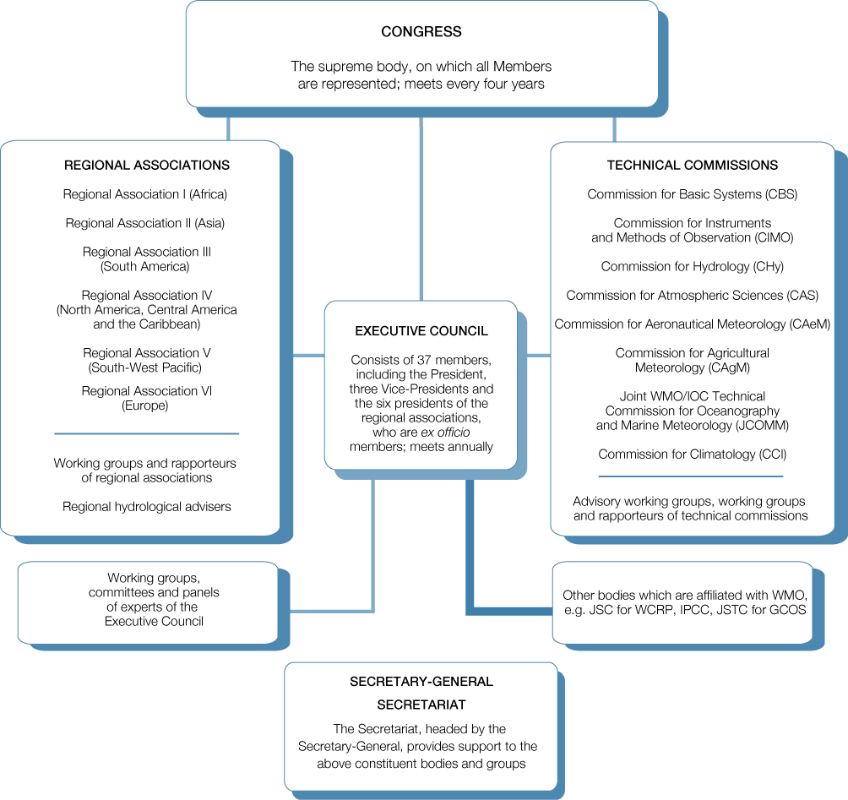

Slide 4
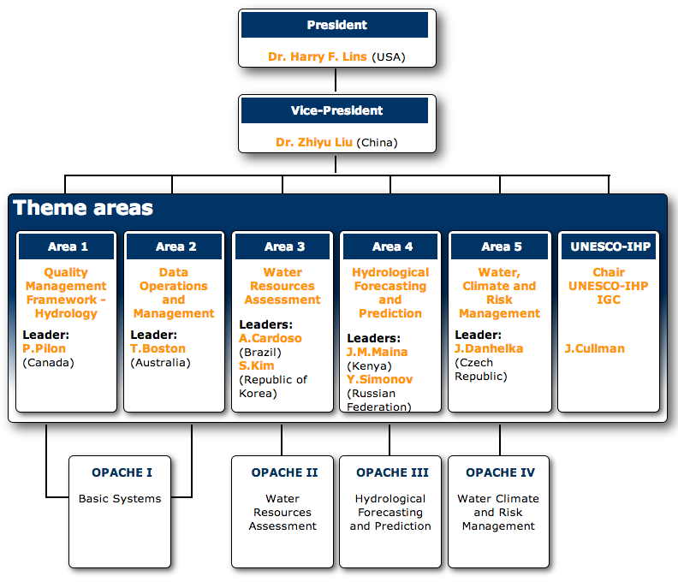
CHy Structure

Slide 5
WMO STRATEGIC PLAN 2016-2019

Slide 6
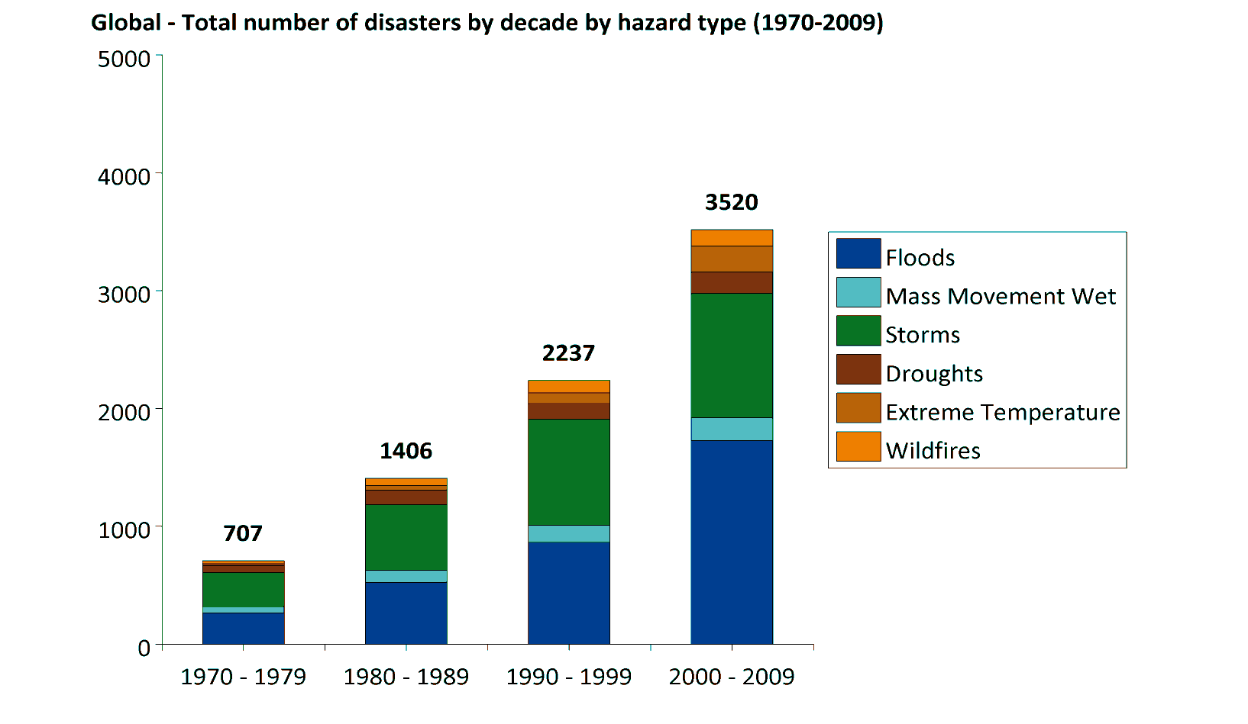
Statistics of disasters associated with weather-, water- and climate-related hazards for the period 1970 to 2009
The global total number of disasters by decade and hazard type: significant increase
from the WMO STRATEGIC PLAN 2016-2019

Slide 7
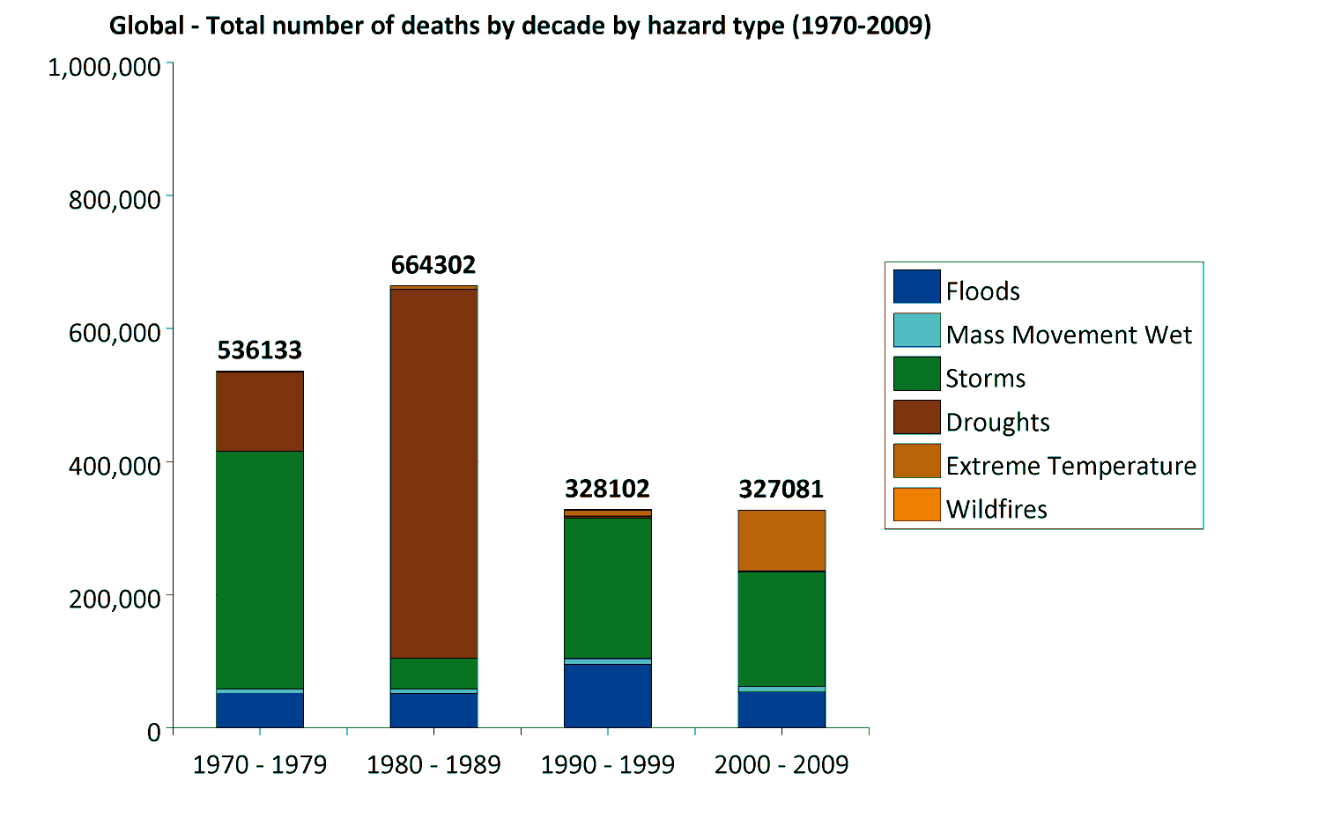
Statistics of disasters associated with weather-, water- and climate-related hazards for the period 1970 to 2009
The global total number of deaths by decade and hazard type: significant decrease
from the WMO STRATEGIC PLAN 2016-2019

Slide 8
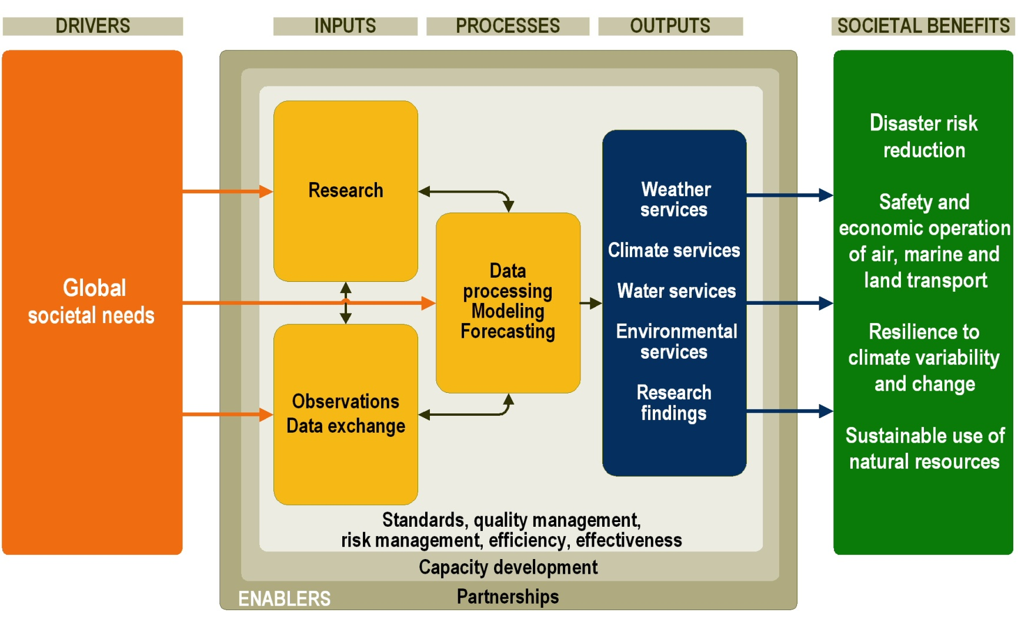
Schematic representation of the WMO Strategic Plan
Processes to achieve expected results and realize the intended societal benefits
from the WMO STRATEGIC PLAN 2016-2019

Slide 9
DEMONSTRATIONS ON
HYDROLOGIC DATA EXCHANGE

Slide 10
The Road Further Ahead
Using OGC Standards
HydroCatalog
(register)
CSW
HydroServer
WFS
SOS
(WaterML 2)
HydroDesktop

Slide 11
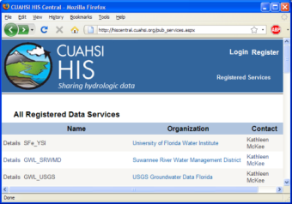
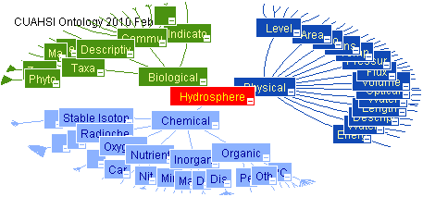
HIS System Overview
USGS
HIS Central
Metadata
Catalog
Data
Web
Service
HIS Central
Hydrologic Ontology
Data
Registration
University
Data
Data Access
Data Discovery
HydroServers
Users (HydroDesktop)

Slide 12
WaterML and WaterOneFlow
EPA
Locations
GetSites
GetSiteInfo
GetVariableInfo
GetValues
Data
Variables
UT
Date Ranges
USGS
Data
Data
WaterML
Data
Repositories
WaterOneFlow
Web Service
Client
TRANSFORM
EXTRACT
LOAD
WaterOneFlow is how you ask for data
WaterML is the format of what comes back
Notes:
Here’s the workflow. The user has some site locations and variables of interest. The user sends the request to a WaterOneFlow web service for the data using those four standard functions. The web service does the leg work of finding the data repository and extracting information from it. The web service then transforms the data into WaterML, and sends the result back to the user. Thus, no matter where the data are coming from, the user only has to know how to make those four standard queries and how to translate a single data format that comes back (WaterML).

Slide 13
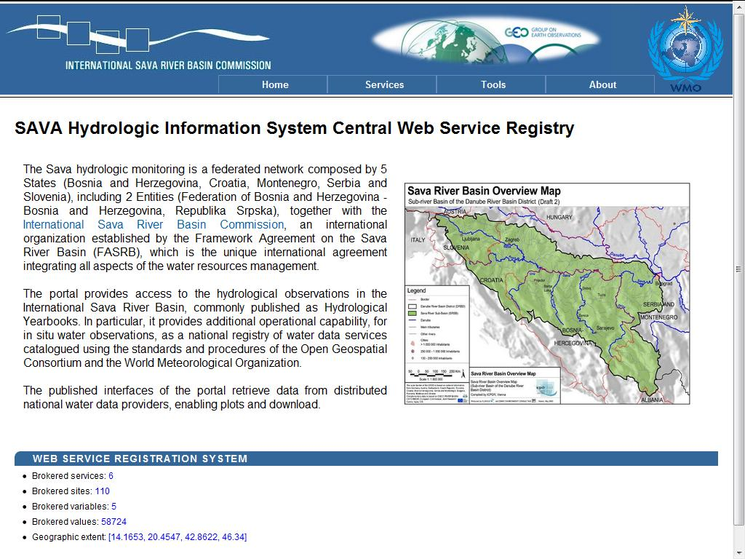
HIS in the SAVA River Basin

Slide 14
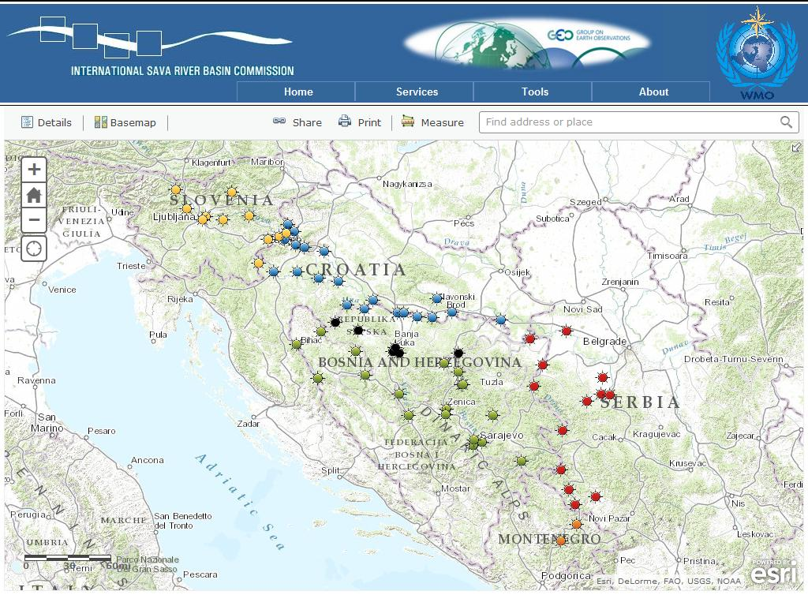
HIS in the SAVA River Basin

Slide 15
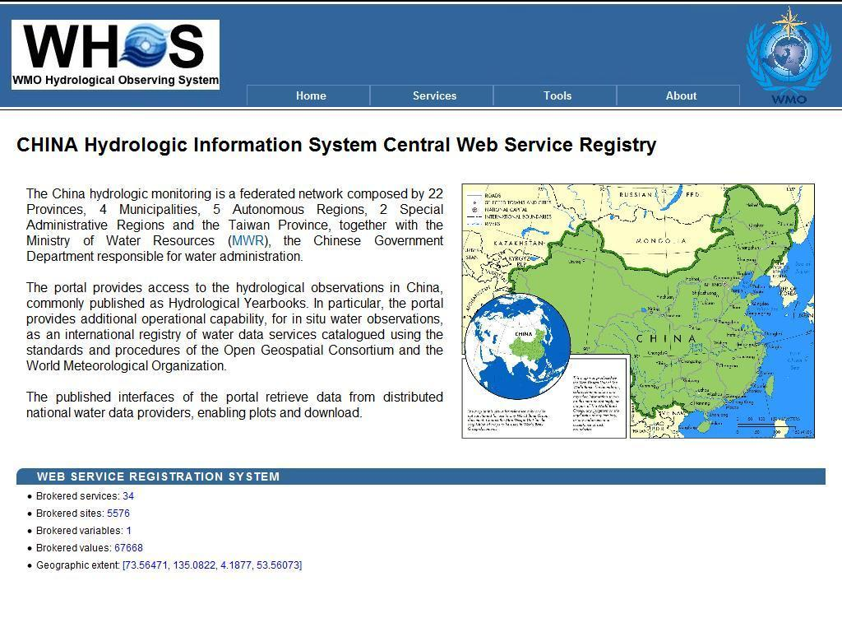
HIS in China

Slide 16
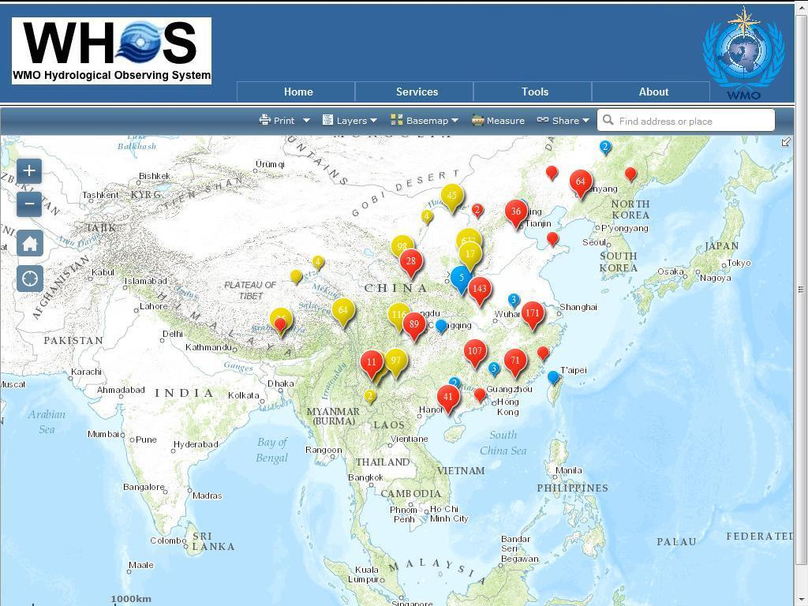

Slide 17
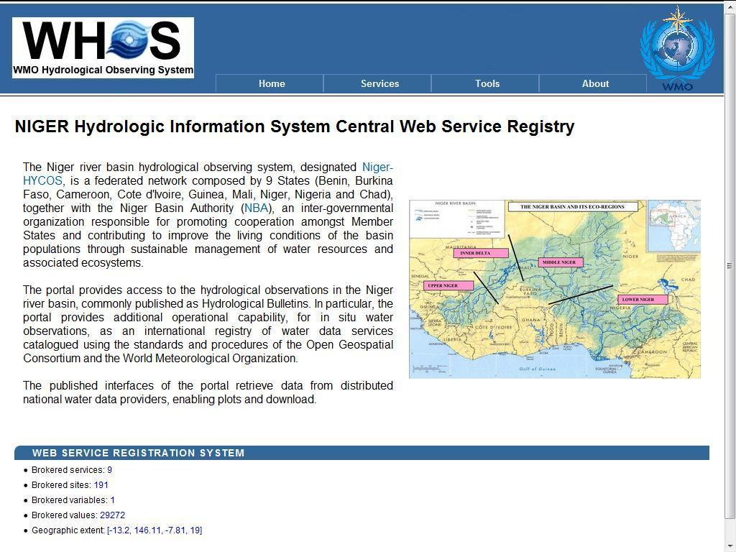
HIS in Niger River Basin

Slide 18
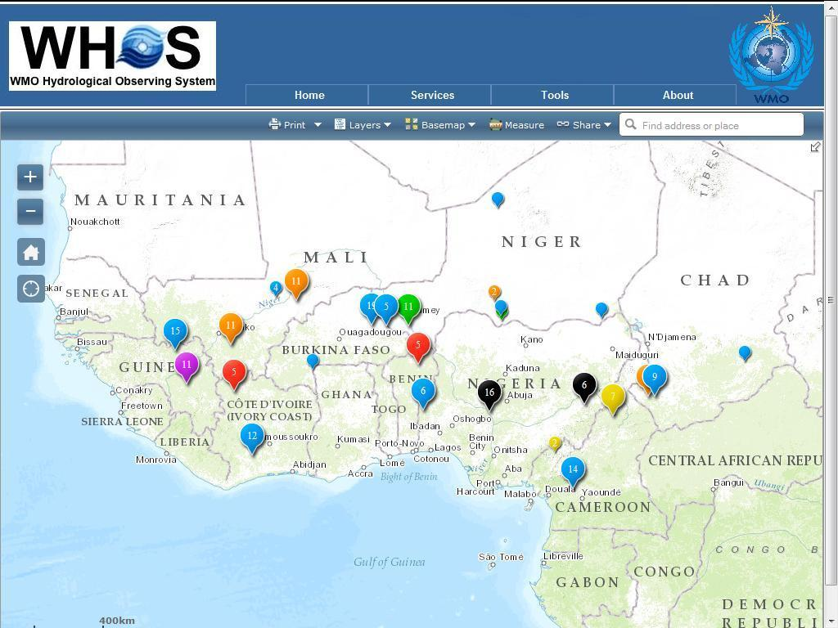

Slide 19
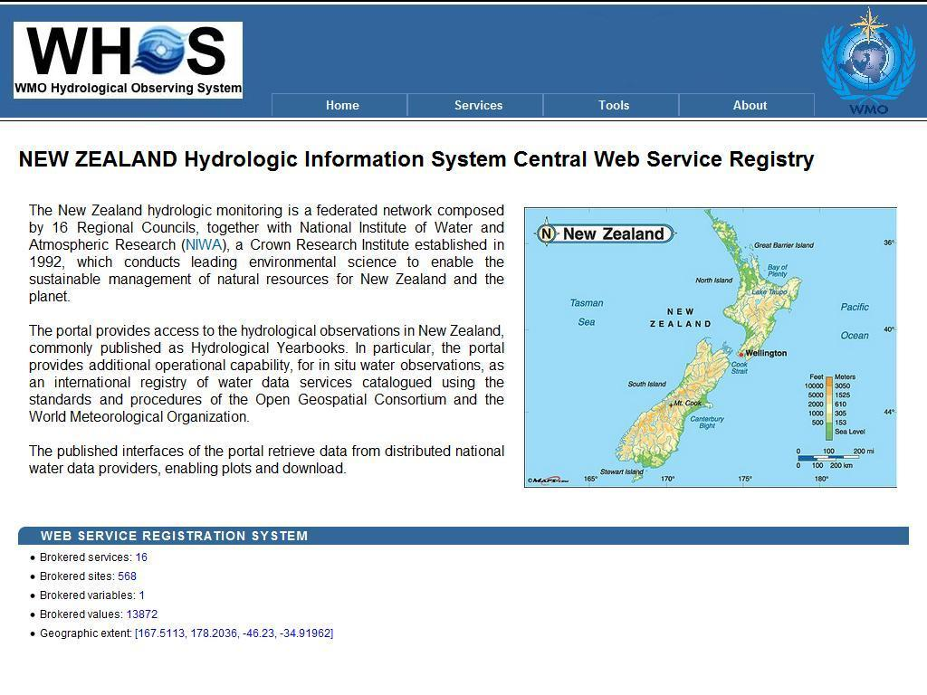
HIS in New Zealand

Slide 20
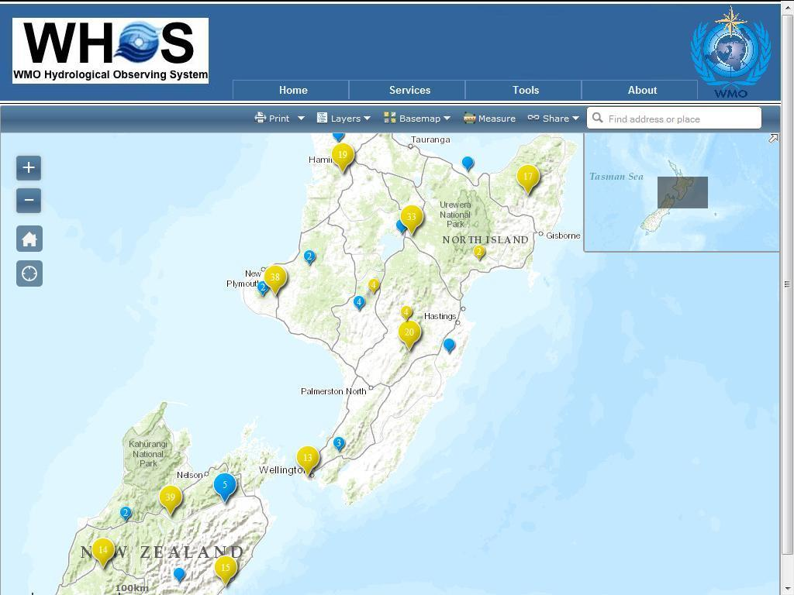

Slide 21
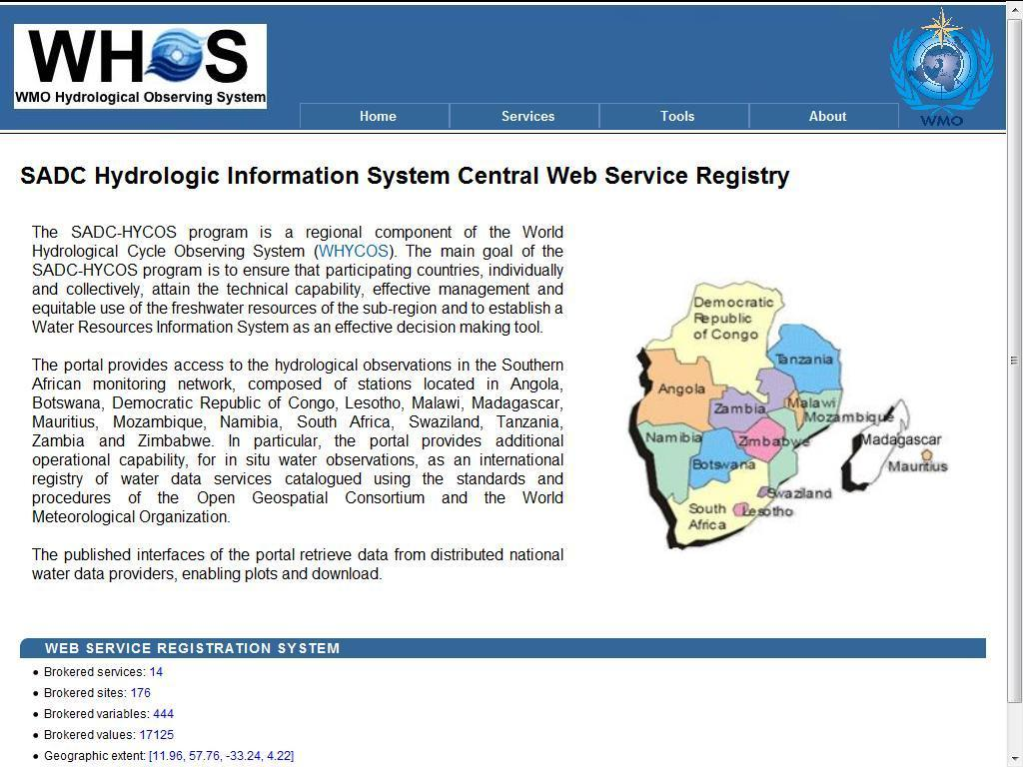
HIS in the SADC

Slide 22
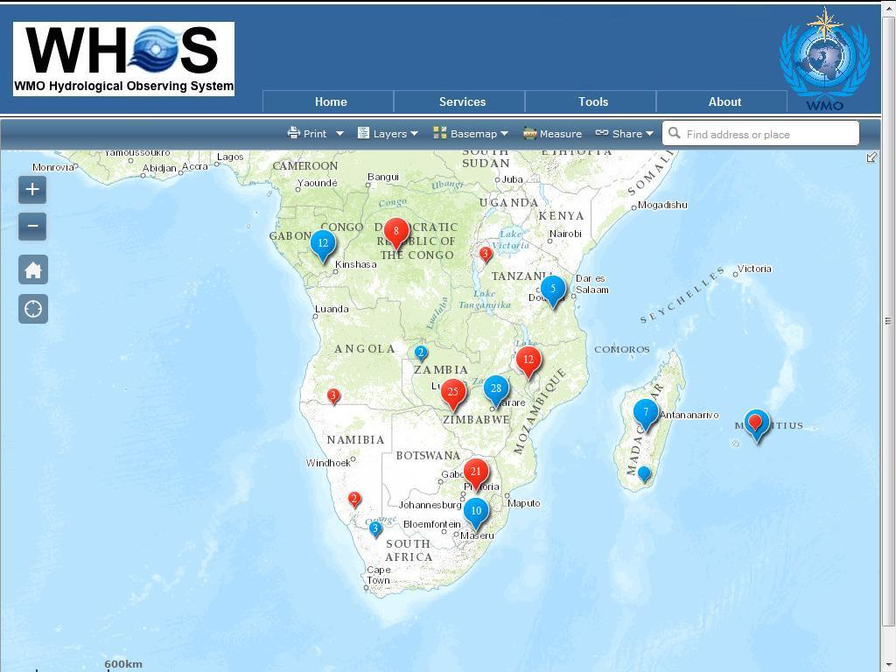

Slide 23
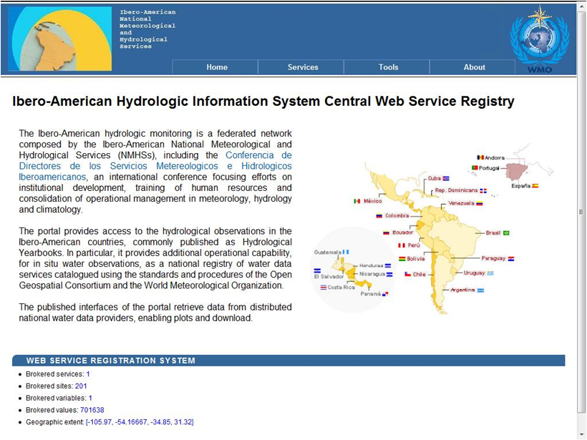
HIS in the Ibero-American Countries

Slide 24
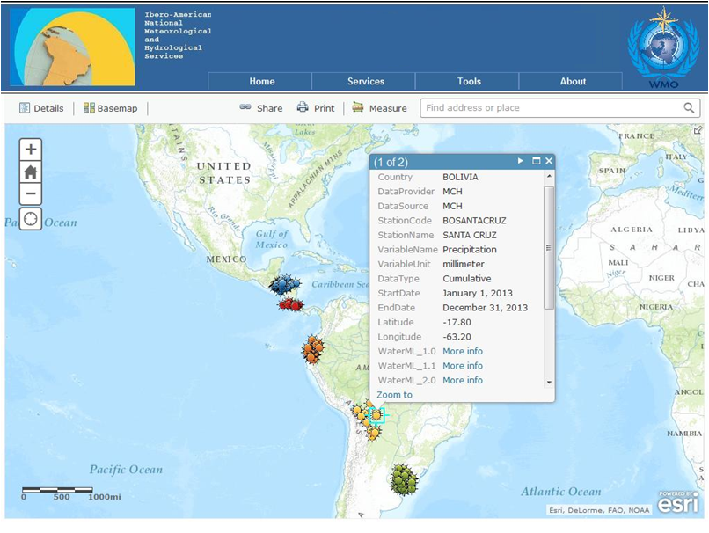
HIS in the Ibero-American Countries

Slide 25
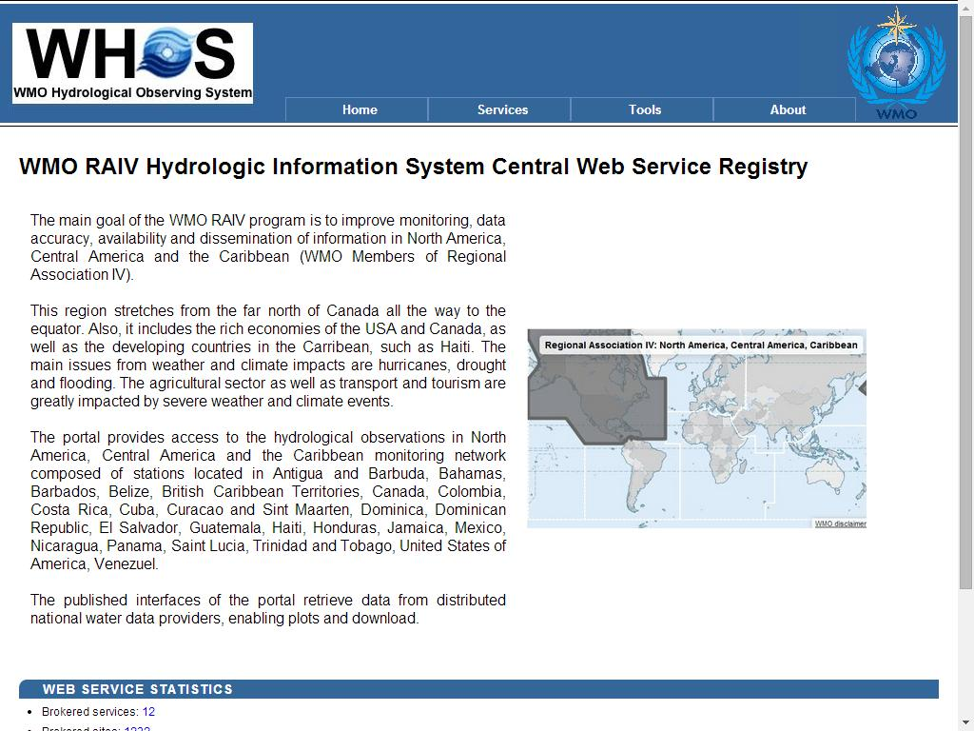
HIS in the WMO RAIV

Slide 26
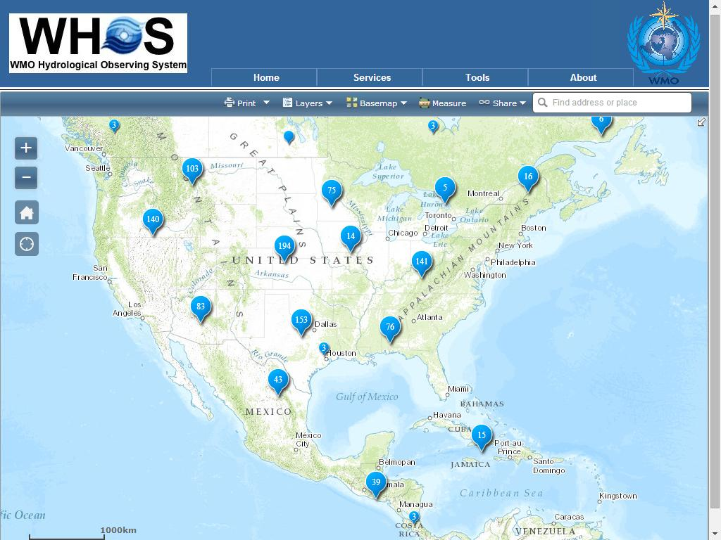

Slide 27
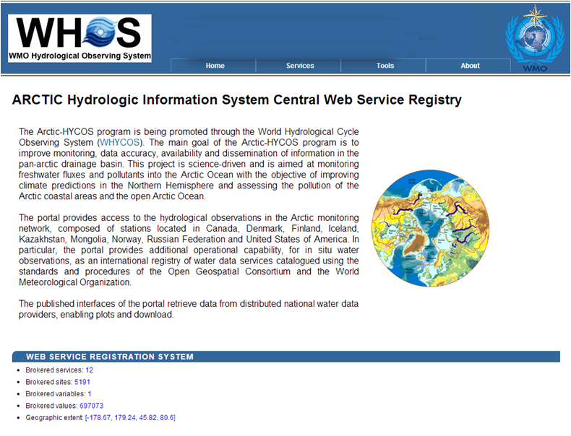
HIS in WMO Arctic-HYCOS
Notes:
27

Slide 28
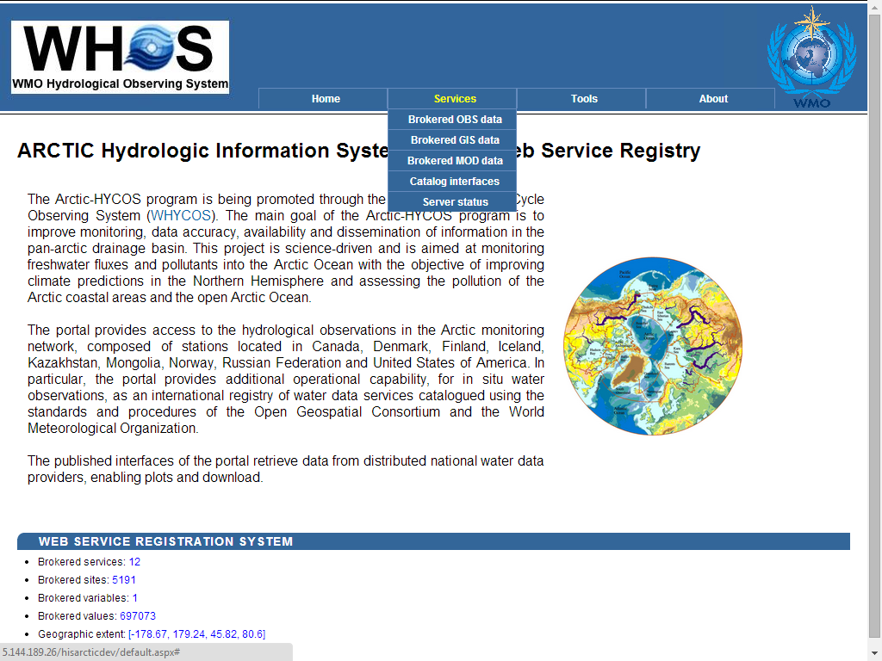
Notes:
28

Slide 29
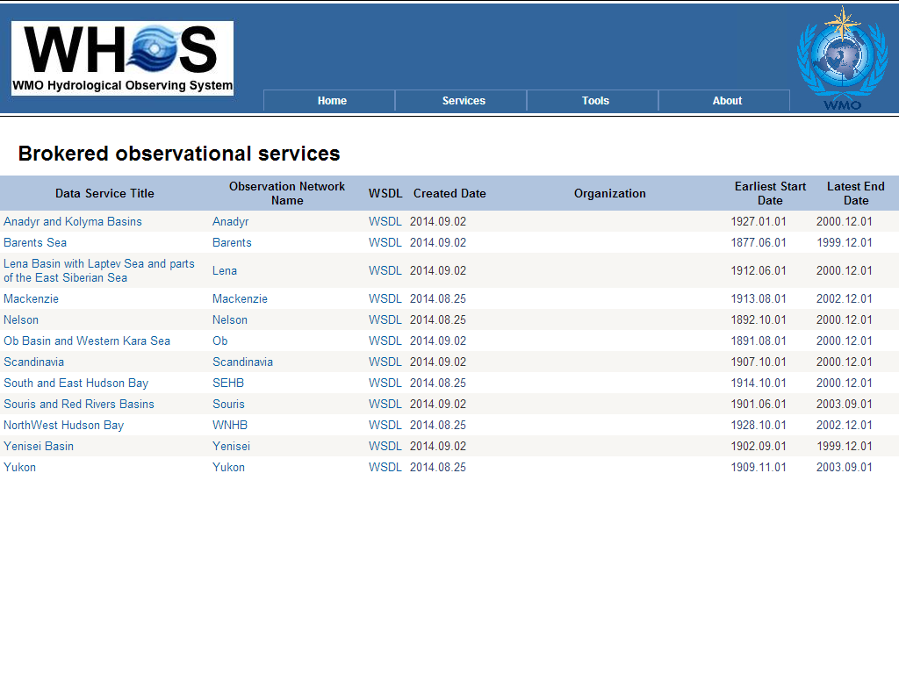
Notes:
29

Slide 30
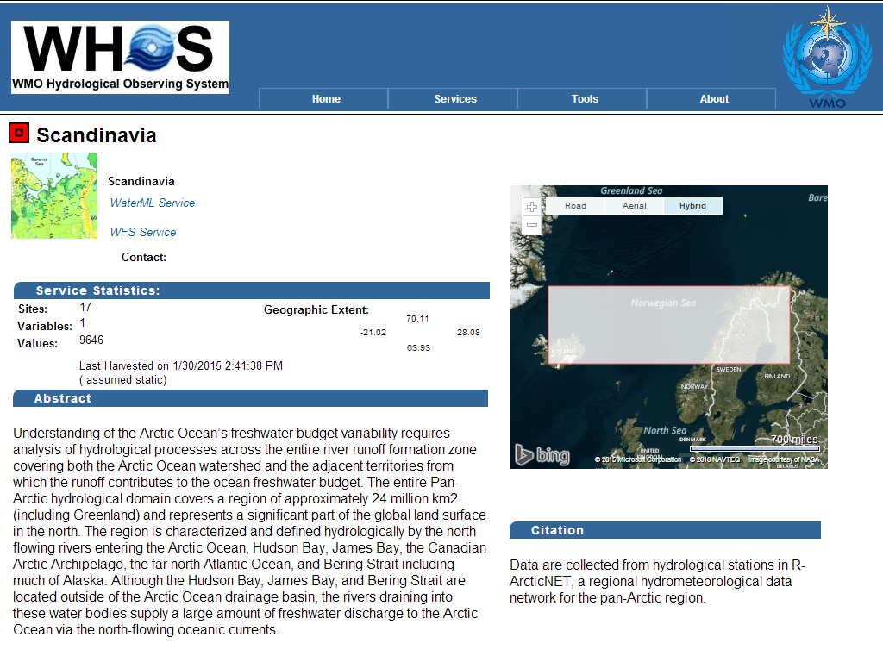
Notes:
30

Slide 31
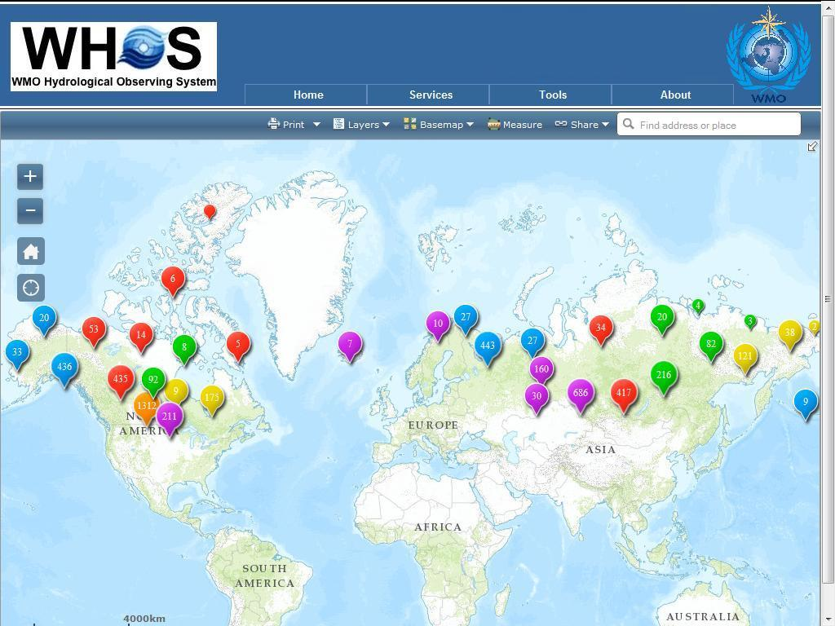
Notes:
31

Slide 32
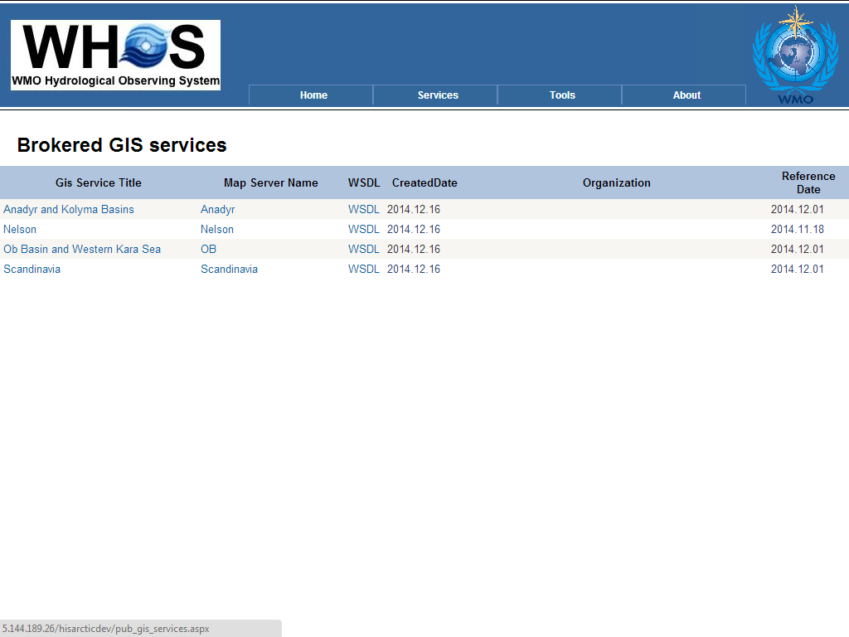
Notes:
32

Slide 33
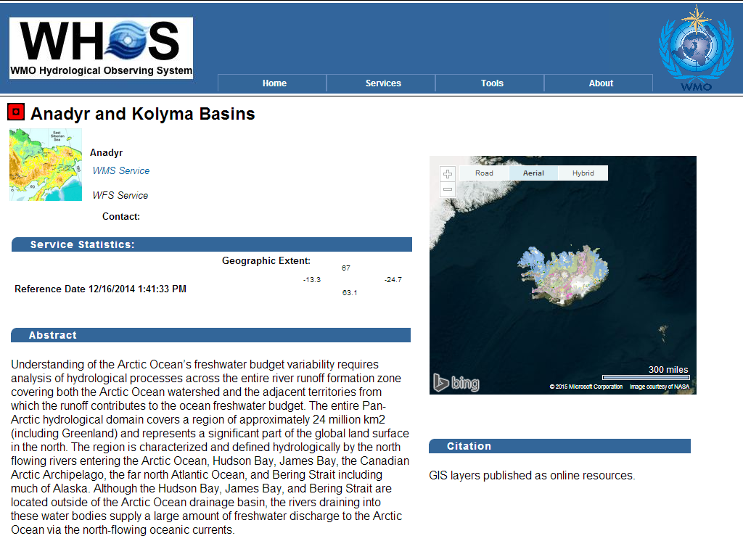
Notes:
33

Slide 34
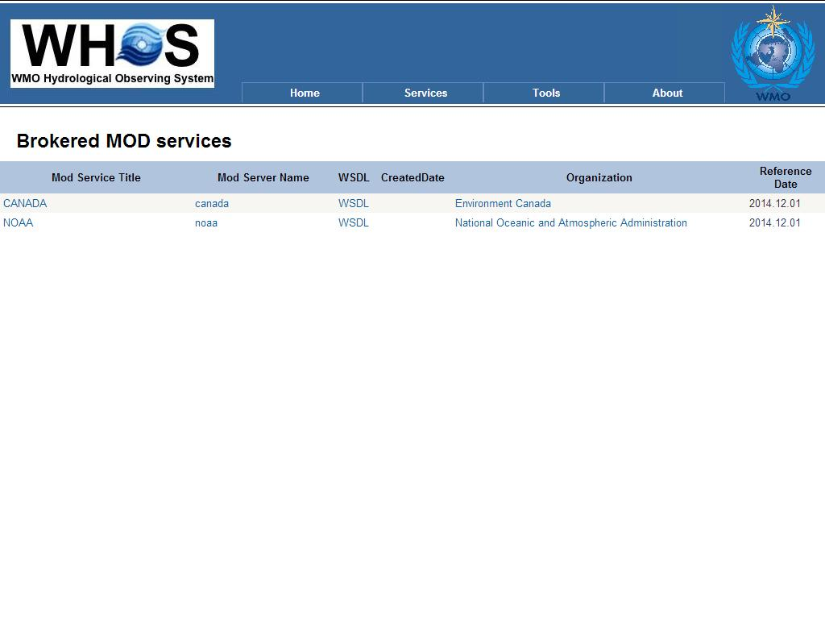
Notes:
34

Slide 35
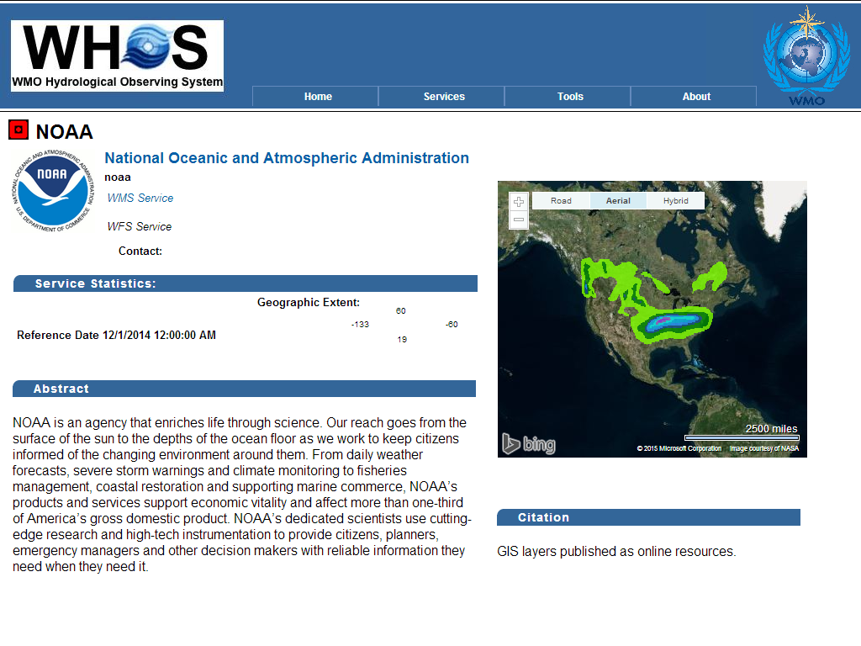
Notes:
35

Slide 36
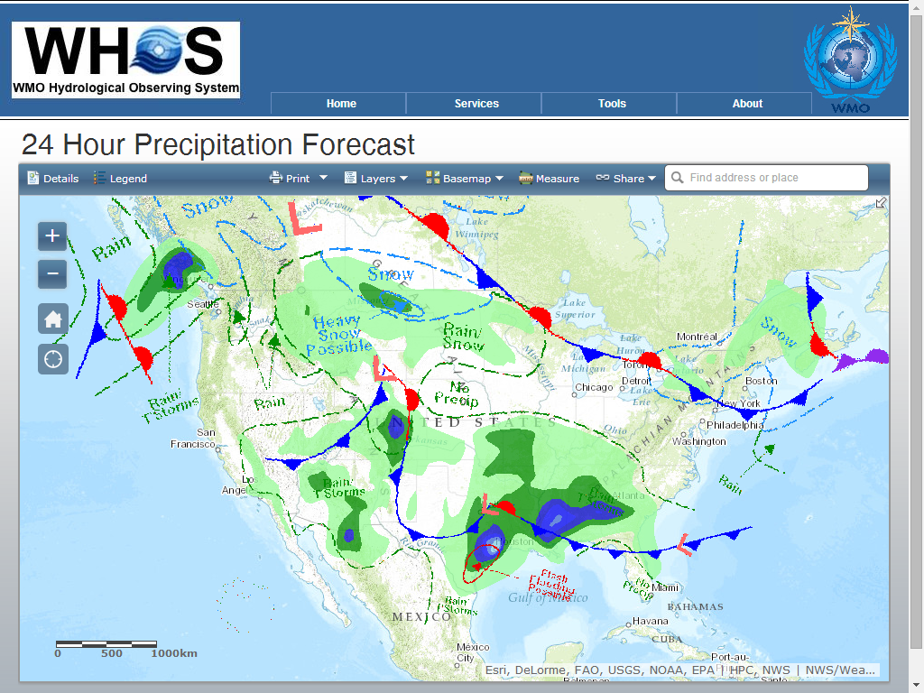
Notes:
36

Slide 37
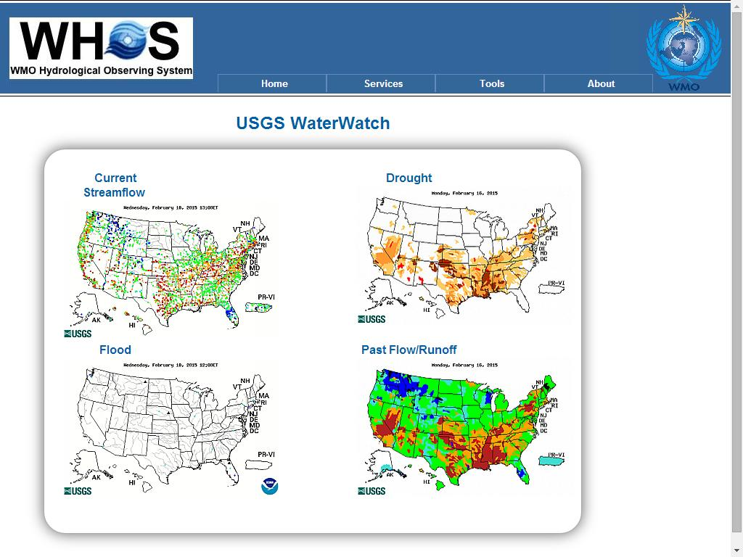
Notes:
37

Slide 38
HYDROLOGIC DATA SHARING IN WHOS

Slide 39
WMO Hydrological Observing System (WHOS)
Background:
No analogue to World Weather Watch within hydrology.
No portal to real-time hydrological data of NHSs, or direct online access to NHS historical data.
WHYCOS is capacity building, not data delivery.
Given increasing number of NHSs with real-time and
historical data available online, as well as systems that facilitate data exchange and interoperability (e.g., WaterML 2.0), improved accessibility is achievable goal.

Slide 40
WMO Hydrological Observing System (WHOS)
Proposal:
CHy Advisory Working Group has proposed the WMO
Hydrological Observing System (WHOS) as the means to
provide the most comprehensive hydrological component in
fulfillment of the WIGOS objective of “an integrated,
comprehensive, and coordinated system which is comprised
of the present WMO global observing systems.”

Slide 41
WMO Hydrological Observing System (WHOS)
Design:
WHOS is conceived as a portal to facilitate access to
already available on-line real-time and historical data,
drawing from the water information systems of countries
around the world that make their data freely and openly
available, including HYCOS projects.

Slide 42
WMO Hydrological Observing System (WHOS)
Implementation:
Phase 1:
Map interface with links to those NHSs that make their real-time and historical stage and discharge data available online. Initial implementation July 2015.
Phase 2:
A fully WIS/WIGOS compliant services-oriented framework linking hydrologic data providers and users through a hydrologic information system enabling data registration, data discovery, and data access.
Beta version for CHy-15 review and endorsement (Nov 2016)
Initial implementation for EC approval (June 2018)

Slide 43
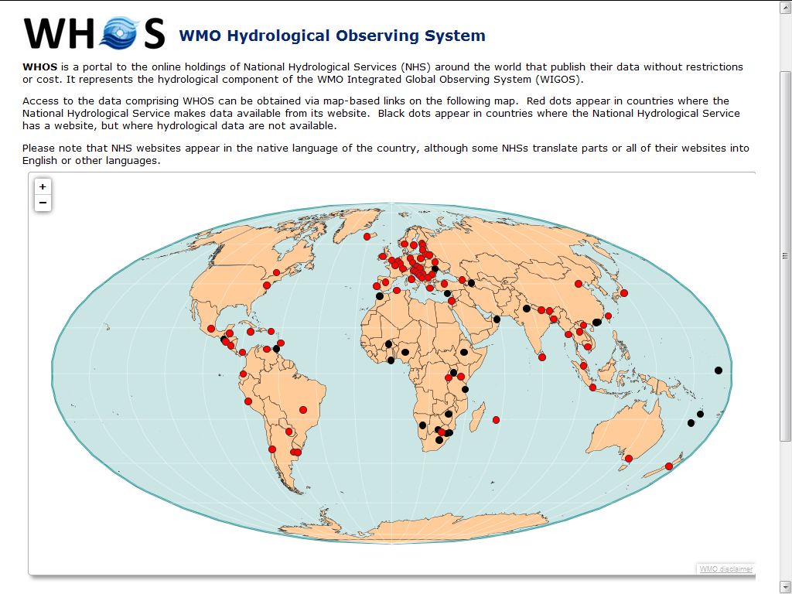
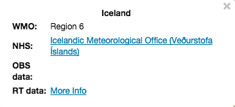
http://www.wmo.int/pages/prog/hwrp/chy/whos/index.php

Slide 44
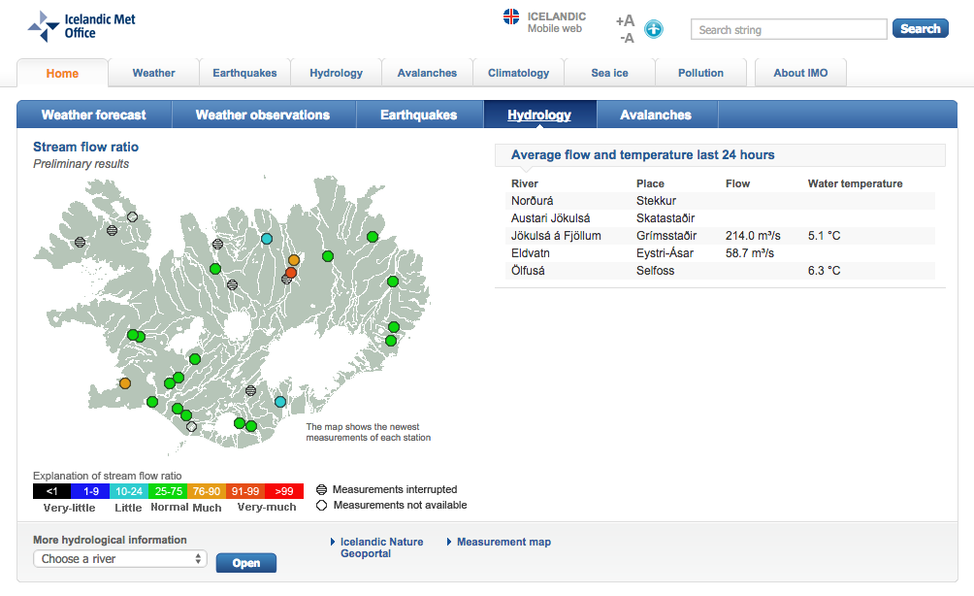

Slide 45

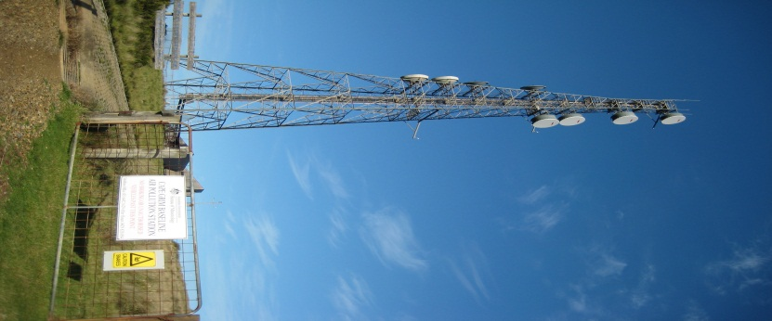
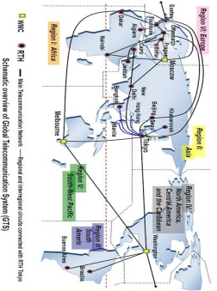
WMO INTEGRATED GLOBAL OBSERVING SYSTEM (WIGOS)
World Weather Watch
GAW
WIGOS
GCW
WHOS
GOS
GCOS
Partners
GDPFS
Co-sponsors
WIS
GTS
Notes:
The 'what'
To achieve the WIGOS Vision:
WIGOS will implement a framework for enabling the integration, interoperability, optimized evolution and best-practice operation of
WMO observing systems, and
WMO’s contribution to co-sponsored systems.
WIGOS will use and exploit the WMO Information System (WIS)
To allow continuous and reliable access to an expanded set of environmental data and products, and associated metadata

Slide 46
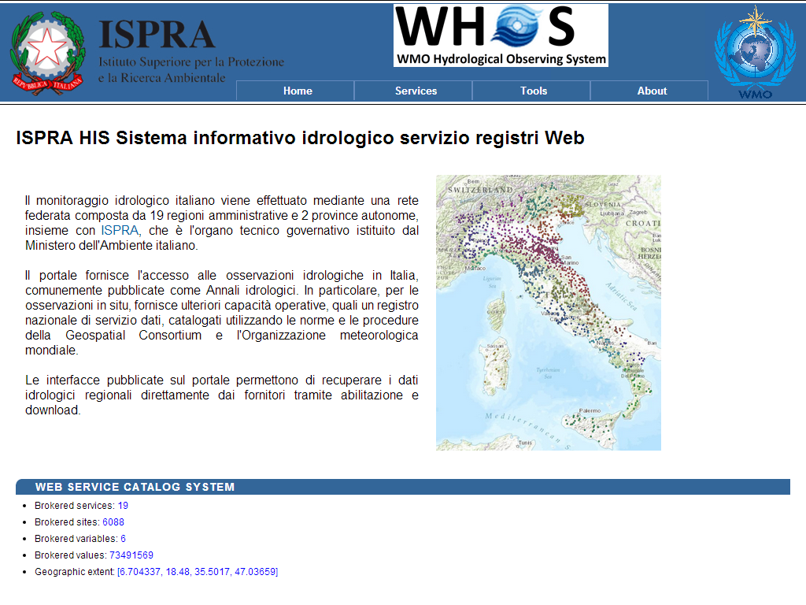
http://www.hiscentral.isprambiente.gov.it

Slide 47
WMO STANDARDS IN HYDROLOGY data formats and service types

Slide 48
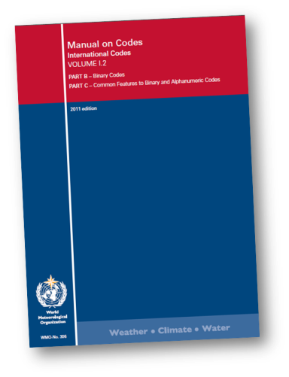
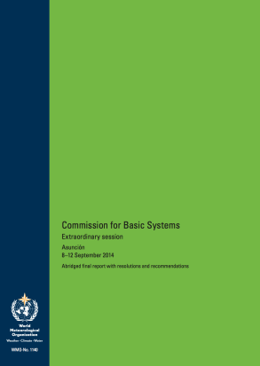

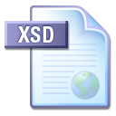
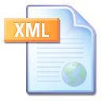
Specification to data encoding
Requirements model
WMO regulation and other specifications
Application Schema
(aka ‘conceptual model’)
XML instance documents
********
****
*******
XML Schema 1.0
Schematron .
« conforms to »
********
SCH
**
*******
**********
**
*********
« derived from »
Validatable data products
*********
Technology independent description of content and structure of information to be exchanged for a given application
Validation schema and rules

Slide 49
Two standards: Conceptual & Implementation
Timeseries Profile
TimeseriesML 1.0
Timeseries Profile of Observations and Measurements
XML Encoding of the Timeseries Profile of Observations and Measurements

Slide 50
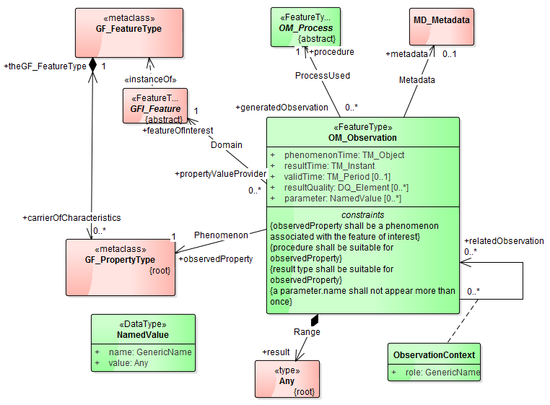
Conceptual Model - based on O&M
Timeseries is the 'result' of an Observation
Notes:
Profile of O&M: result = Timeseries

Slide 51
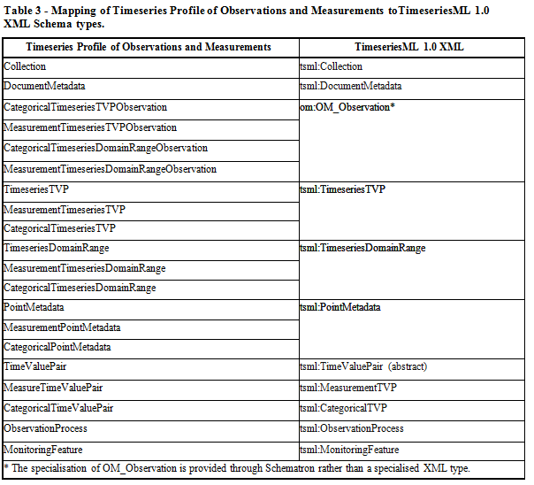
Implementation Model - Mapping to Concepts
Collection/Metadata
OM Observation
Time Value Pair Encoding
Domain Range Encoding
Point Metadata
Specialised data types
Process
Monitoring feature

Slide 52
Metadata – a much abused concept please qualify your use
Observations Metadata
Time-series data that describe how, when and where meteorological observations were made and the conditions they were made under
Discovery Metadata
Information intended to facilitate the discovery and assessment of a dataset to determine if it is fit for reuse for a purpose that may be at odds with the reason for which it was originally created
Data Provenance Metadata
Information relevant to climate data that allows end-users, including data managers, scientists and the general public, to develop trust in the integrity of the climate data
Data Intellectual Property Metadata

Slide 53
METCE: a profile of Observations and Measurements
Does the data collected (e.g. the ‘result’) from the Observation event:
Vary in space and or time?
«FeatureType»
OM_Observation
Describe multiple physical properties?
(ISO 19156)
+result
«Type»
Any
«FeatureType»
OM_ComplexObservation
«FeatureType»
OM_DiscreteCoverageObservation
(ISO 19103)
(ISO 19156)
+result
(ISO 19156)
+result
«Type»
Record
«Type»
CV_DiscreteCoverage
WMO METCE
(ISO 19103)
(ISO 19123)
«FeatureType»
SamplingObservation
«FeatureType»
ComplexSamplingMeasurement
«FeatureType»
SamplingCoverageMeasurement
No
Yes
Yes
B
A
Q
No
Notes:
Modèle pour l’Échange des informations sur le Temps, le Climate et l’Éau

Slide 54
DEFINITION OF A STRATEGIC ROADMAP

Slide 55
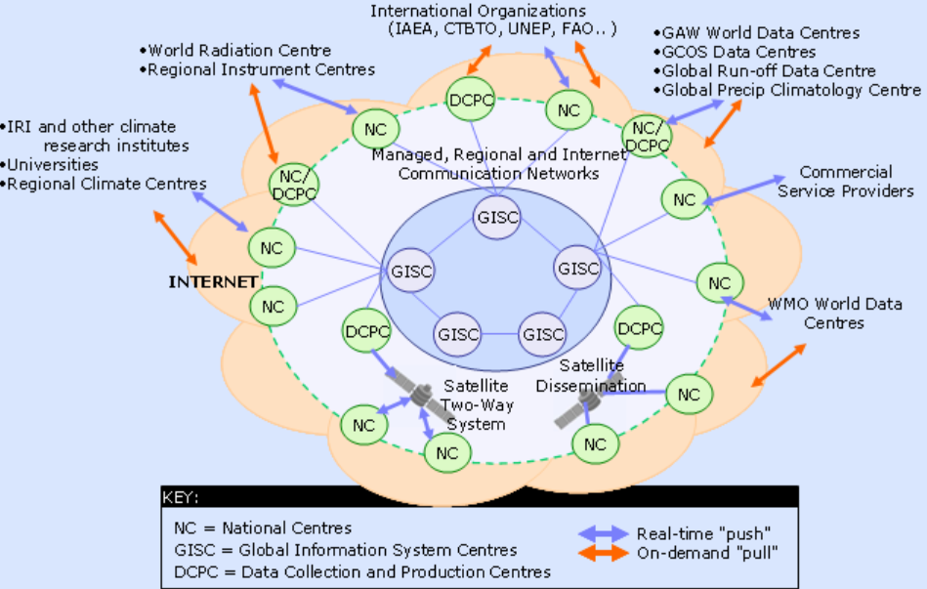


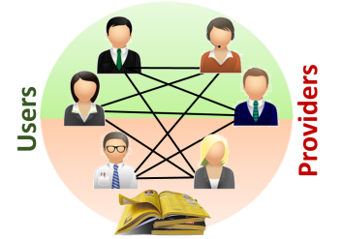
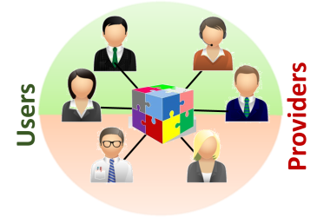
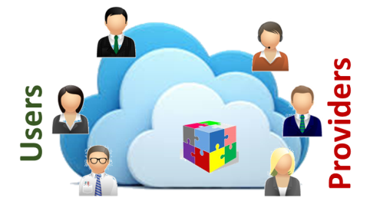
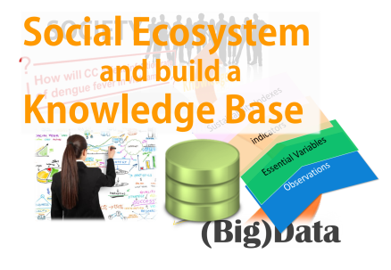
Hydrologic data exchange revolutions
2012
2013
2015
2016
1st Revolution
2nd Revolution
[Service driven]
Catalog of catalogs
3rd Revolution
[Brokering pattern]
Brokering framework
4th Revolution
[Big Data]
Cloud-based EcoSystem
[… .]
… .
Discovery
Discovery and Access
[functionality]
(re-)Use
[functionality]
[functionality]

Slide 56
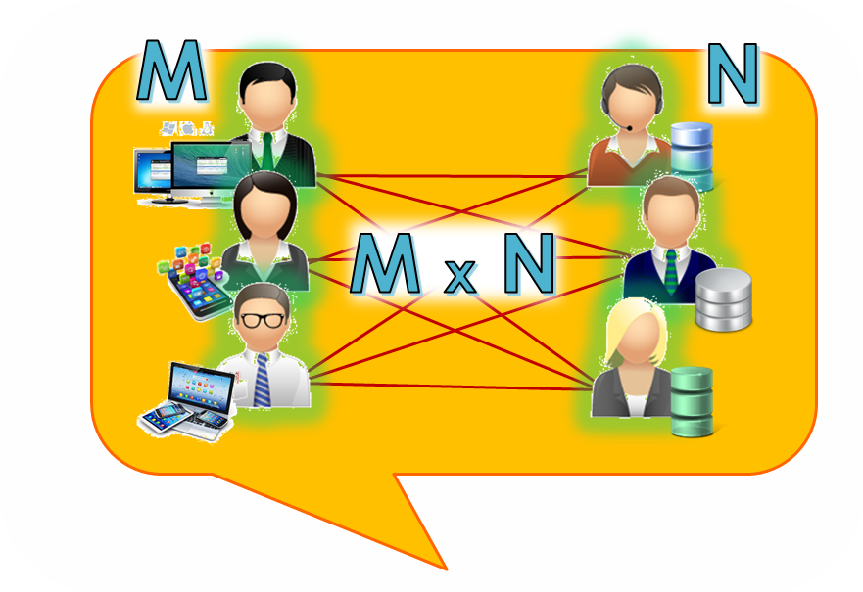








Virtual Community Approach
Service Providers
Service Users
Data Applications
Data Infrastructures
Virtual-Collaborative Management approach
Registry
[Governance]

Slide 57



Broker Approach
Service Providers
Service Users
Data Infrastructures
Data Applications
Mediation
Mediation
Mediation
Mediation
Collaborative-Acknowledged Management approach
Mediation
Mediation
[Governance]

Slide 58


Slide 59


Slide 60


Slide 61




Slide 62


Slide 63



Slide 64

Views

Slide 65


Slide 66


Slide 67


Slide 68


Slide 69
Thank you for your attention

