Slide 1
HDWG ELFIE Update
105th OGC Technical Committee
Palmerston North, New Zealand
David Blodgett
04 December 2017
Slides Credit: Alistair Ritchie (Landcare Research)

Slide 2
Presentation Plan
ELFIE Update and Review
ELFIE Preliminary Findings
Excerpted from a talk by Alistair Ritchie on Soil IEand ELFIE.
Invitation to contribute to ELFIE

Slide 3
Environmental Linked Features IE Time Line!
ELFIE kicked off at the Linking Environmental Data and Samples Symposium in June 2017.
Face to face meetings at Summer HDWG and TC as well as Spring TC.
Have been working on details after TCs and bringing demos together.
Slow going, but the end is in site!
So what did we find?
(Slides that follow created by Alistair Ritchie) Thanks!!

Slide 4
[… So how do we do that? ] What does that even mean?
Yeah, but … ‘the HTML for environmental data’?
HTML is pervasive web technology and used without thought or controversy.
OGC X(G)ML and web services are widely regarded as a Bad Thing
REST and JSON are a Good Thing
(Depending on your perspective.)
It’s a pointless argument … there’s no one way of doing things … but imagine …

Slide 5
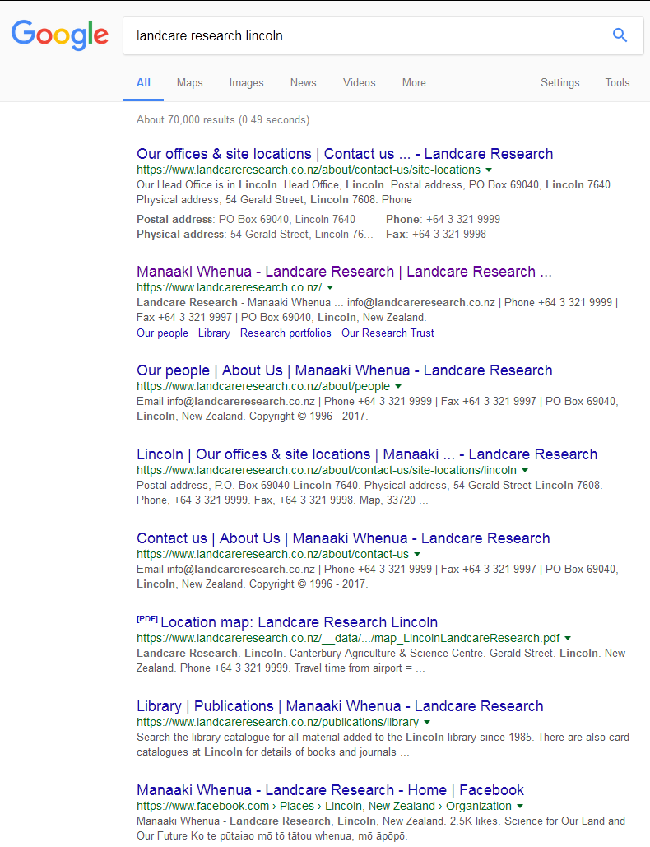
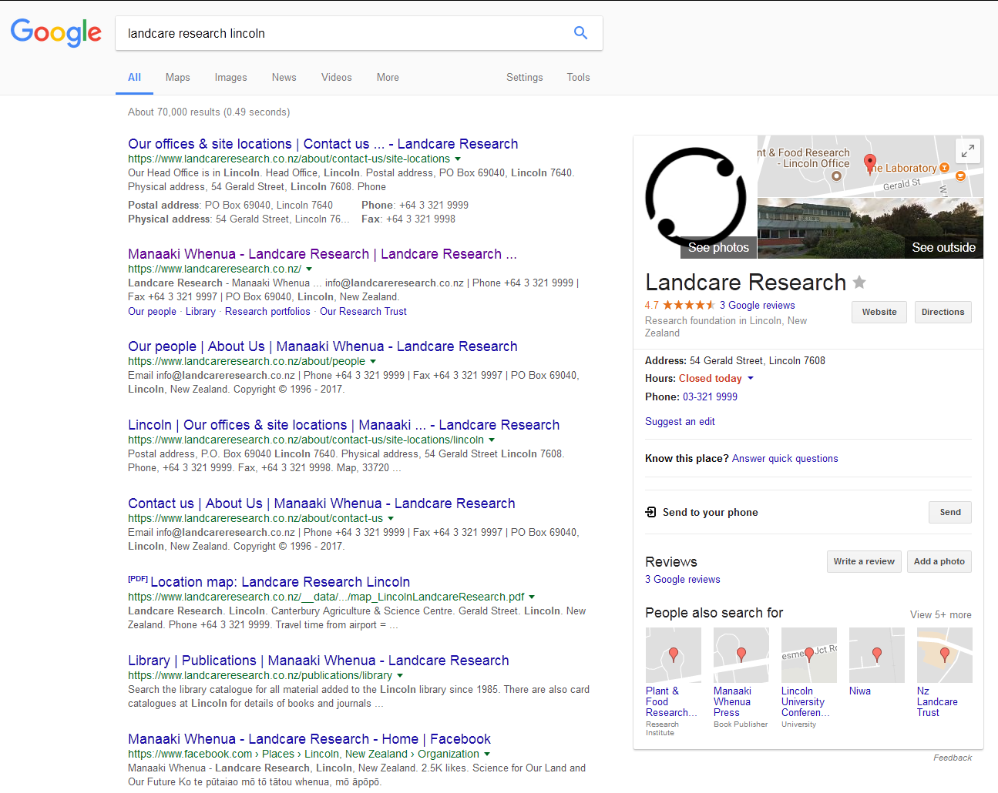
Environmental Data on the (Google-able) Web
… being able to search for a monitoring station by name (location?)
Get a summary in a Google Knowledge Panel (or equivalent)
Find out about related features
monitoring station -> reach -> river -> catchment -> …
moisture sensor -> paddock -> irrigator -> aquifer -> …
Data may be distributed across multiple
data stores/agencies
Standard interoperability problem, but …

Slide 6
Environmental Data on the Web
… needs to be solved in a way that is friendly to web developers
No strange formats, protocols or bewildering (and numerous) data structures
They like ReST and JSON and get scared and angry when dealing with anything else
But also need to maintain discipline
If you want to seamlessly link data across servers the data need to be consistent – standardized

Slide 7
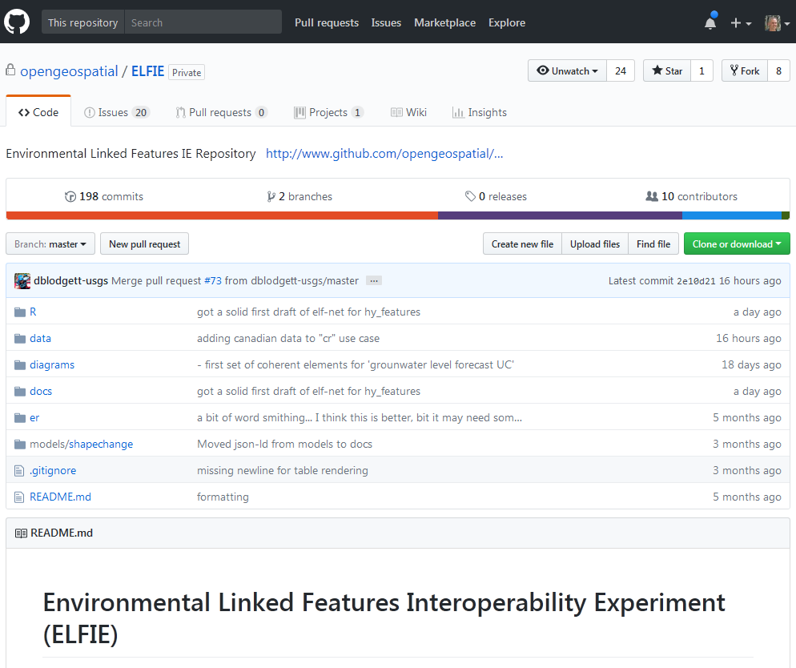
Environmental Linked Feature Interoperability Experiment
‘Demonstrate the use of existing and pending OGC standards for the encoding of environmental observation data in an integrated dataset of features linked according to ReSTful and Linked Data principles.’
From: https://github.com/opengeospatial/ELFIE
Initiators:
U.S. Geological Survey (US)
Land Information New Zealand (NZ)
BRGM (FR)
Participants
Horizons Regional Council (NZ)
Manaaki Whenua - Landcare Research (NZ)
Natural Resources Canada (CA)
ESRI (US)
Tumbling Walls (US)
Meta-linkage (AU)
INSPIRE (EU)

Slide 8
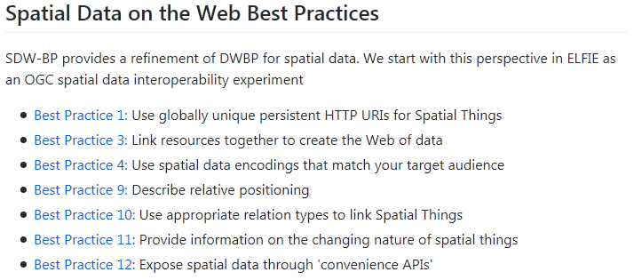

Applying OGC/W3C Best Practices
The engine … the ID and the link
https://data.example.org/id/some-thing
‘ReST with discipline’
GeoJSON, Well Known Text, …
KEEP IT SIMPLE!
HTML landing pages with structured data mark-up
Don’t rely on specialist registries or catalogue services

Slide 9
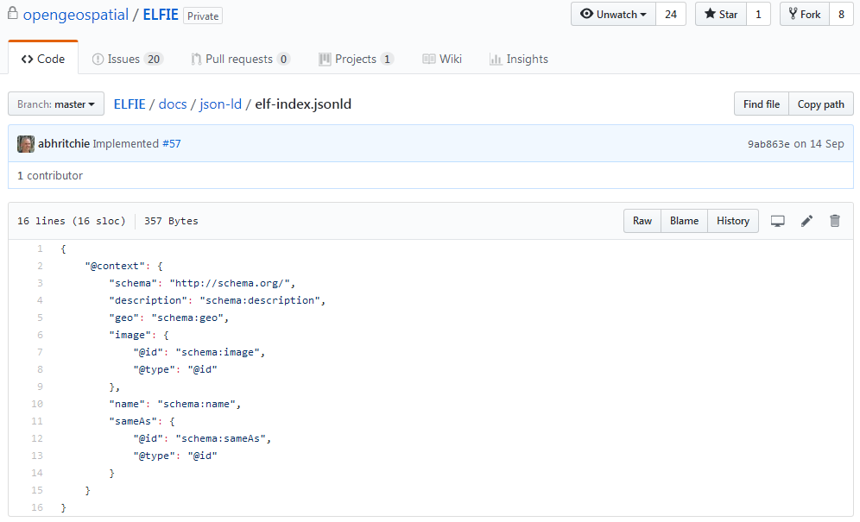
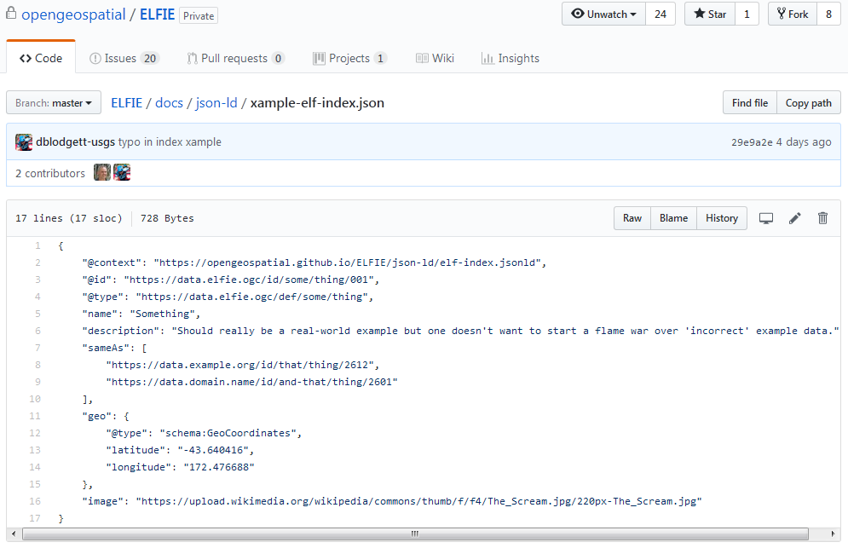
JSON-LD – JSON for the Semantic Web
Need a disciplined approach – some way of standardizing content
Properties
Defininitions
Vocabularies
Links (aka relations)
JSON-LD
Looks like JSON
Linked/embedded ‘context’
Binds to RDF Schema/
OWL ontology
Objects have @ids (URIs)
Can be converted to RDF
https://www.w3.org/TR/json-ld/

Slide 10
Use Cases
NZ: Stream Monitoring Quantity / Quality (impacts of water allocation decisions):
Monitoring sites
Existing water allocations
Diversions / discharges
Water quality
Blue line network
NZ: Agriculture (soil moisture state for irrigation application decisions)
Soil moisture time series
Allowed to pump / consent data.
Water allocation
US: Watershed Boundary Dataset Monitoring Summary
US and Canada: Monitoring Index
France: Surface/ground water interaction
France: Ground water level forecast
And a bunch more …

Slide 11
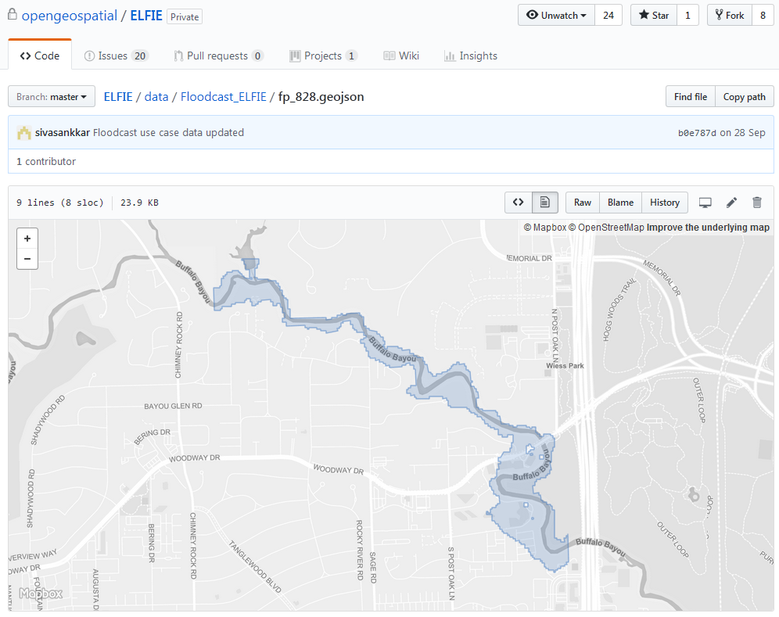
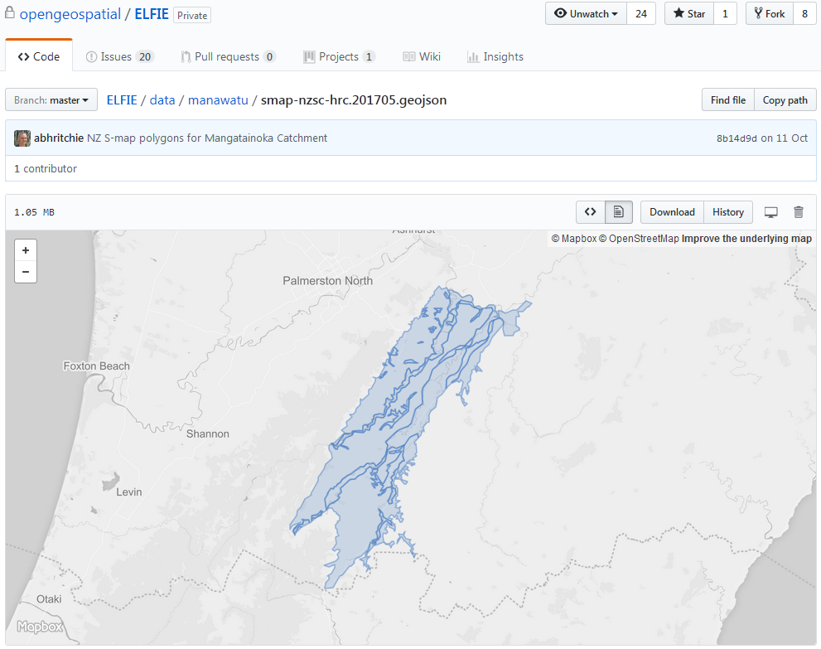
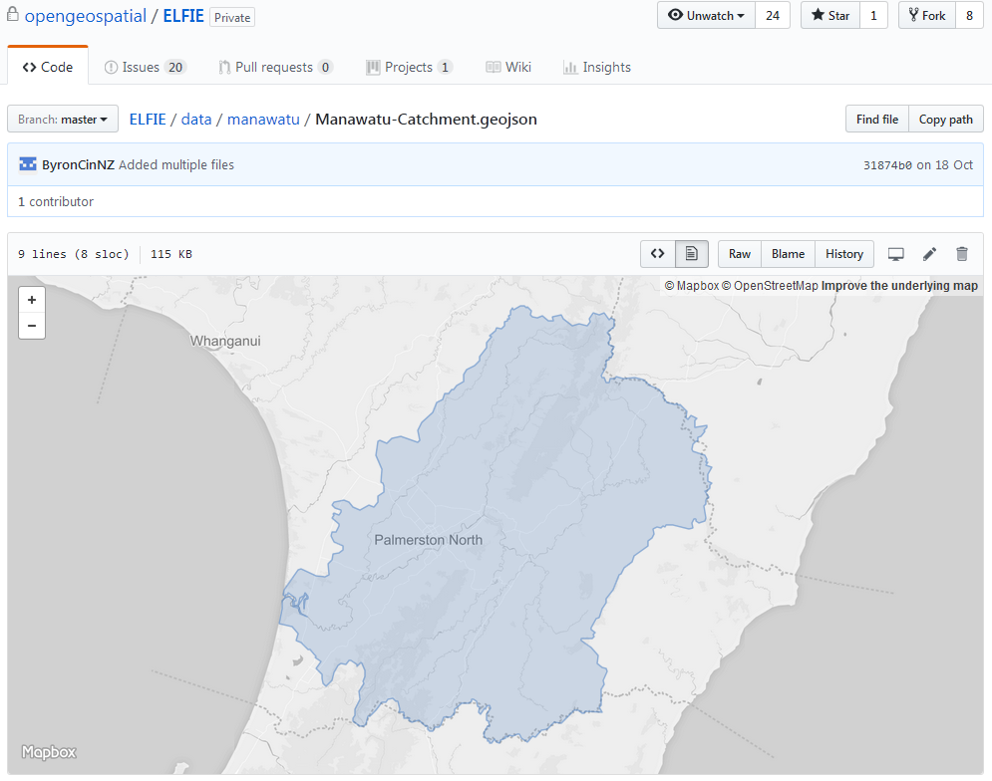
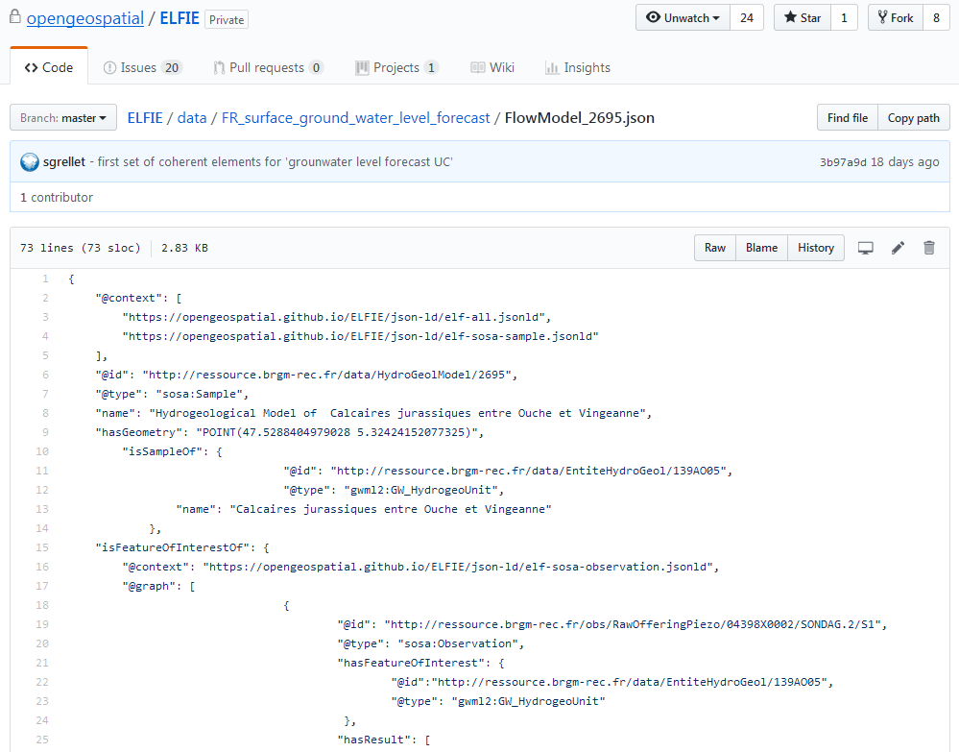
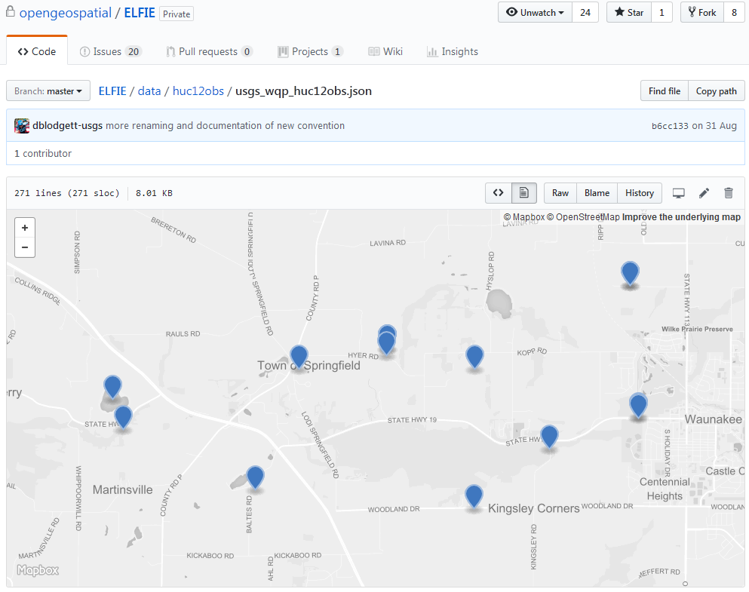
Demonstrations
Not finished, nothing to be demonstrated (could show you but would have to kill you)

Slide 12
(Preliminary) Results
Can use JSON (as JSON-LD) and ReST (as Linked Data)
Data can be linked across servers (well, it is the web)
Data can be indexed for search engines
There are useful ‘core’ ontologies to standardize basic content
SKOS, schema.org, SOSA, OWL-Time …
There are useful OGC application schema for environmental data
WaterML 2.0 Parts 1 to 3; GroundwaterML 2; HY_Features; GeoSciML, …
But … very few of them are RDF-ready (now OWL-RDF ontologies)
Solves a ‘mass-market’ problem but doesn’t meet all needs
Advanced geospatial querying
Semantic web interencing/reasons
Good entry point though

Slide 13
Environmental Linked Features IE Time Line!
ELFIE kicked off at the Linking Environmental Data and Samples Symposium in June 2017.
Face to face meetings at Summer HDWG and TC as well as Spring TC.
Have been working on details after TCs and bringing demos together.
Slow going, but the end is in site!
So what did we find?
(Slides that follow created by Alistair Ritchie) Thanks!!

Slide 14
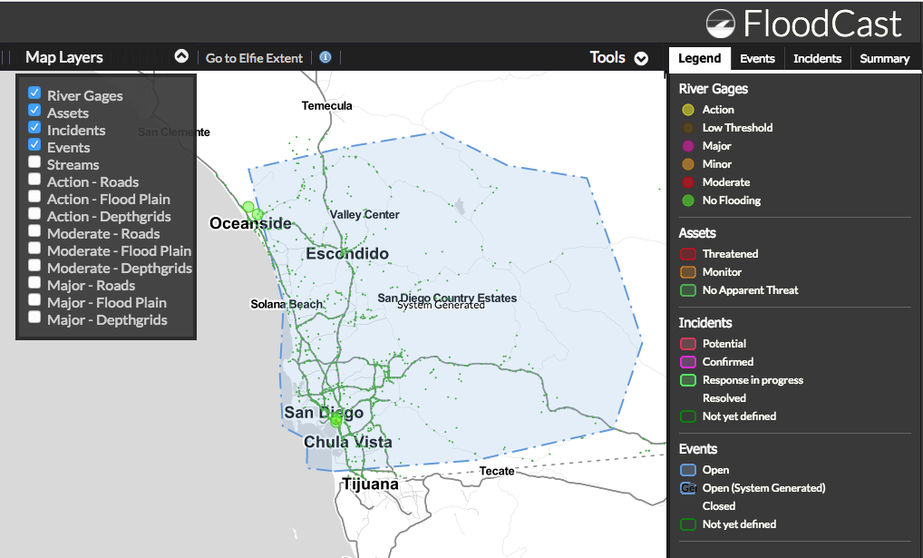
DRAFT

Slide 15
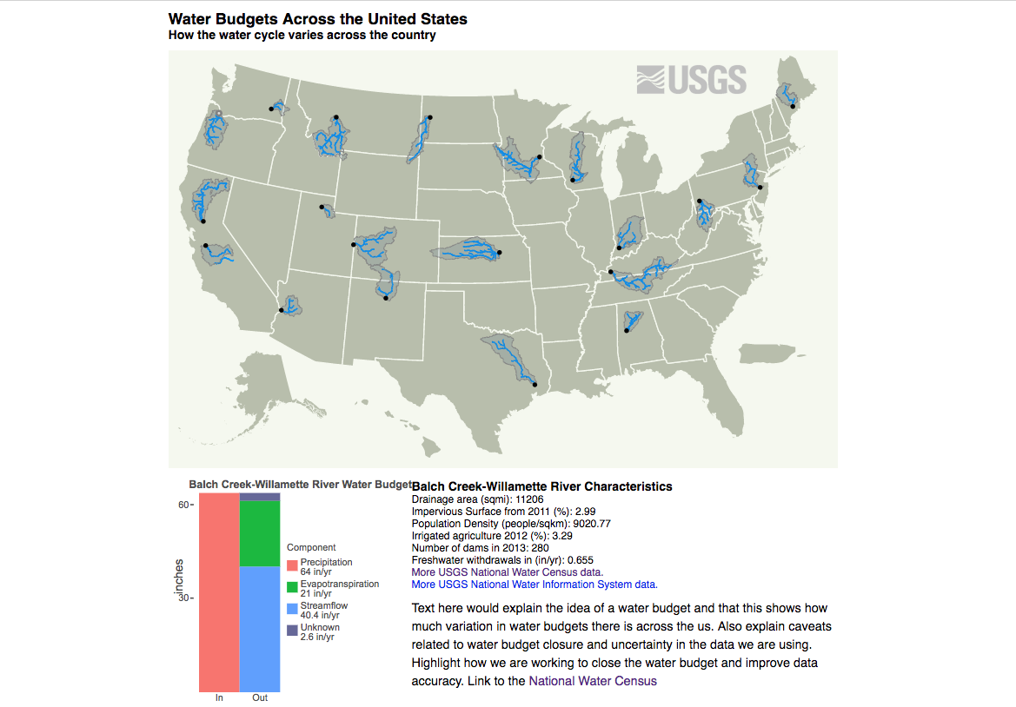
DRAFT

Slide 16
ELFIE Needs You! (to contribute)
Have GIS data that could be linked?
We have a simple template for generating ELFIE JSON-LD data
Submit some linked features (10s max)
We’ll convert them
If time allows, you can create a simple data visualization using the linked features.
If interested, contact me! dblodgett@usgs.gov

