Slide 1
HY_Features Update
105th OGC Technical Committee
Palmerston North, New Zealand
David Blodgett
04 December 2017

Slide 2
WMO/OGC Hydrology Domain Working Group WaterML2 suite
TimeseriesML 1.0
Timeseries profile
(OGC IS 15-042rX)
(OGC IS 15-043rX)
WaterML2Part2: Ratings, Gaugings, Sections
(OGC IS 15-018r2)
WaterML2Part1:
Timeseries
Observation
(OGC IS 10-126r4)
WaterML2Part3: Surface Hydrology Features
HY_Features
(OGC IS 14-111rX)
SOS 2.0
Hydrology Profile
(OGC BP 14-004r1)
Water Information Standards:
of hydrologic (water) features
WaterML2Part4: Groundwater Features
GWML2
(OGC IS 16-032rX)
Identification,
Observation,
Representation
…(RiverML)…:
Channel Geometry
(continuation tbd)
WaterML2Part5: Water Quality Observation
(OGC BP 14-003)
SoilML component:
Soil-water (collaboration tbd)
WaterML2PartX: River Network Topology
(OGC IS YY-XXX)
CSML3 component:
Atmospheric-water
(collaboration tbd)
Notes:
Note the nature of these standards – some are conceptual models with XML schema, HY_Features is a conceptual model with no encoding.

Slide 3
HY_Features Progress
Public comment review reconciliation brought about some good improvements.
Architecture Board requested rework of our conformance classes and formatting of normative content.
Huge thanks to Josh for helping us through!
Presented to TC in St. John’s NL
E-Vote and PC went smoothly

Slide 4
HY_Features Progress
We’re done!
See draft html here: http://opengeospatial.github.io/HY_Features/spec/index.html
OGC Publication Process Moving Forward

Slide 5
Observations and Measurements
Observation: Stream Gage Visit
Feature of Interest: River
Sampling Feature: Cross Section
Procedure: Manual Acoustic Velocity Measurement.
Observed Property: Flow Rate
Result: X cfs at time Y
HY_Features is a standard for the feature of interest of an observation

Slide 6

But why?!?
Notes:
We need a lingua franca for description and identification of hydrologic features.

Slide 7
Three different levels of abstraction
Feature Identity
Catchment X flows into catchment Y at nexus m.
Feature Realization
Catchment X can be described by a divide or a network of waterbodies and channels -- etc.
Feature Representation
The boundary of catchment X is represented in two datasets differently.
Notes:
Jumping right in, note that the terms used here are chosen quite carefully to allign with the HY_Features model.

Slide 8
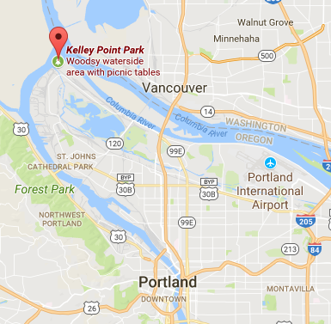
Three different levels of abstraction
Feature Identity
The Willamette River flows into the Columbia River at Kelley Point Park
Notes:
This is a bit of an oversimplification, but it is basically true. There is a small divergence that flows into the Columbia further downstream but the main channel combines here.
It is very important to consider what information is NOT being conveyed here. No topology other than flows into, no geometry, only catchment names and place names.

Slide 9
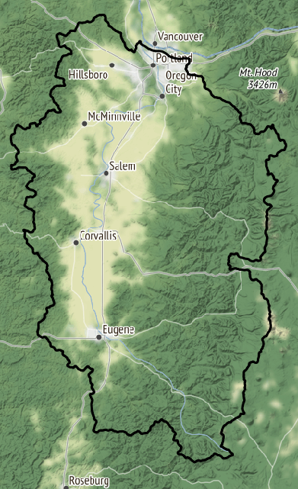
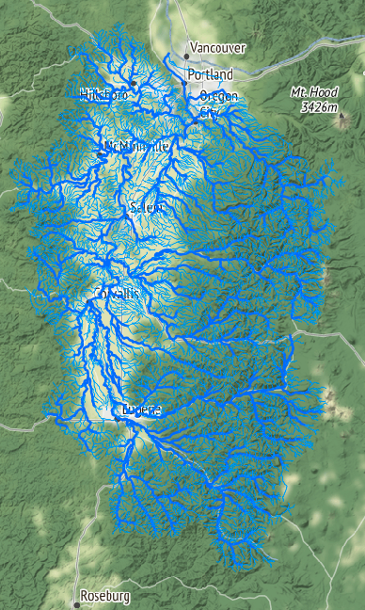
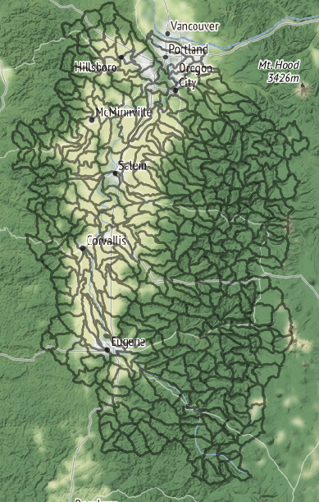
Three different levels of abstraction
Feature Realization
The Willamette is recognizable (can be realized) as a divide, or waterbody network, or catchment network …
Notes:
This slide is about the distinction between these kinds of realization – not about the particulars of the graphics. It’s nearly impossible to illustrate the idea of realization without an example representation of the realizations in question. The point here is that we have these three (and other) abstract ways of modeling (realizing) a catchment.

Slide 10
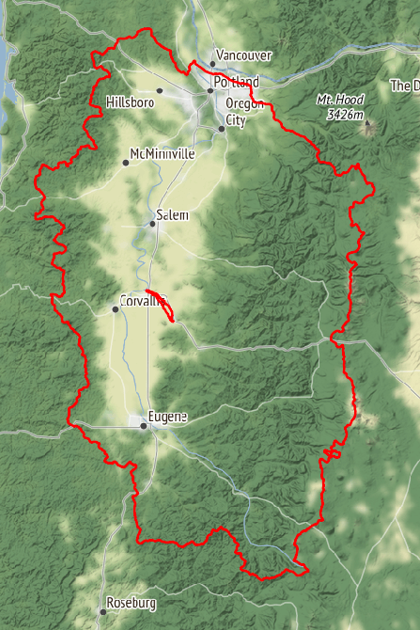
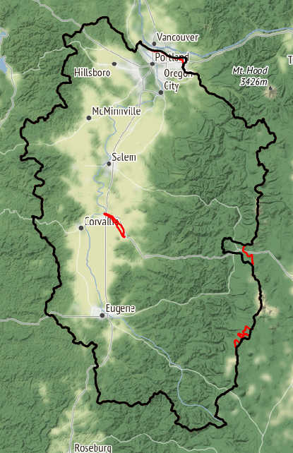
Three different levels of abstraction
Feature Representation
The Willamette River’s drainage divide is represented differently by the WBD and the NHDPlus.
NHDPlus in red
WBD in black
Notes:
For a given realization (we have divide here) there are potentially multiple representations. In this case, the WBD and NHDPlus have differing representations. That is, they’ve modeled the drainage divide of this catchment’s divide realization slightly differently.

Slide 11
How does this help decision making?
Decisions require specific information.
Source data can be interpreted by software without expert input if standards are followed.
OK, so how do we do that?
… good question!
We need “The HTML for environmental data!”

Slide 12
Environmental Linked Features Interoperability Experiment (ELFIE)
Goal: Test existing standards (like HY_Features) for publishing features on the internet.
Purpose: Set the stage for automated applications like search engines to discover and index data for decision support and other applications.

