Slide 1
Australian Geofabric implementation of HY_Features connecting observations, monitoring sites and hydrological features using Linked Data
Hydro DWG Workshop, Quebec
Rob Atkinson, CSIRO Land and Water
Tony Boston, Australian Bureau of Meteorology
June 2013

Slide 2
Overview
HY_Features scope and benefits
Implementation within the Australian Hydrological Geospatial Fabric (Geofabric)
  Geofabric development
  Methodology and key design decisions
  Connecting observations, monitoring sites and hydrological features using linked data
Demo
Summary
Copyright © 2011, Open Geospatial Consortium, Inc

Slide 3
Scope of HY_Features
Concerns of the WMO Commission for Hydrology (CHy)
  interoperability of observing systems relevant for hydrology
  exchange of hydrological data and information on a global scale
  sharing of data models and patterns in use in the hydrology domain
Abstraction of the real-world hydrology phenomena
  Features which are the object of study / reporting in hydrology
  ... that have properties usually observed in hydrology
  ... that are physically / logically connected in networks
  ... that have names in cultural, political and historical context
  ... that are assigned generally applicable characteristics
Copyright © 2011, Open Geospatial Consortium, Inc
Notes:
Concepts such as catchment, basin, watershed and river are commonly understood in many fields of
discourse, but are described differently according to the focus on various aspects of the hydrology phenomenon.
The effective exchange of hydrologic data containing references to hydrologic features requires
standardised semantics of the concepts that allow identification of these feature.
HY_Features can provide a stable and common referencing system for hydrologic feature,
assisting in the organization of observation and modelling of such features, and in the aggregation of generated
data on a global, regional, national or basin scale.

Slide 4
Benefits of HY_Features
A common hydrologic feature model
  Common terminology: definitions based on WMO standards (International Glossary of Hydrology)
  Supports multiple representations of features at different scales
Its implementation would support global linkage to hydrological features using standard patterns
  River basins and aquifers are hydrological units of study, management and reporting
    Show me all the river basins greater than area W
    What is the definition of river basin X or aquifer Y?
    What are gauging stations related to river basin Z?
And allow development of common tools for discovery, access and sharing of hydrologic information
  Realising the vision of linked data
Copyright © 2011, Open Geospatial Consortium, Inc
Notes:
Two main challenges: multiple representations
of hydrologic features at different scales, and inconsistent use
of terminology in different contexts. HY_features attempts to solve these problems by employing internationally agreed terminology from WMO’s Glossary of Hydrology and providing a scale and implementation platform-independent representation of hydrologic features.

Slide 5
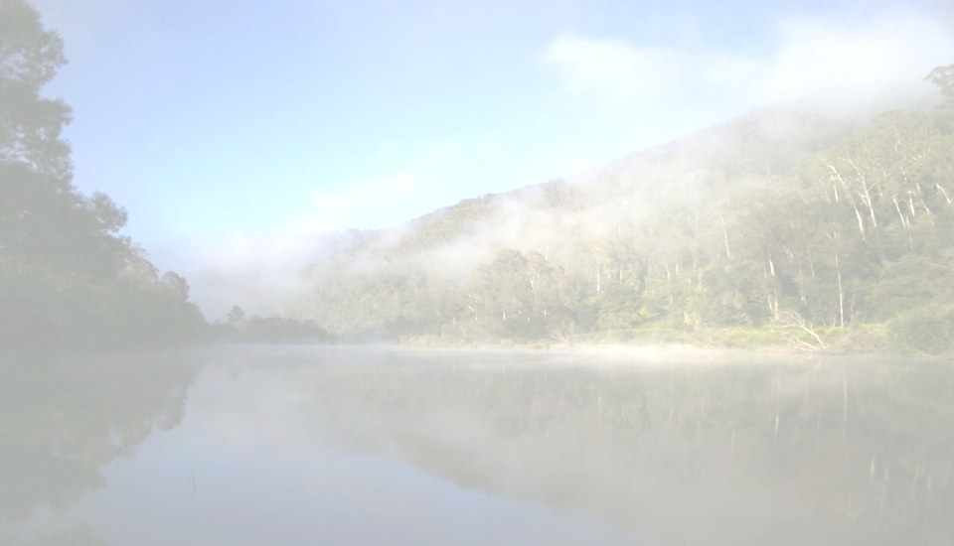
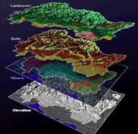
What is the Australian Hydrological Geospatial Fabric (Geofabric)?
Evolving and consistent spatial data product …
that identifies important water features in the landscape …
as well as the connections between these features …
and supports multiple representations.
It is a framework to underpin Australia’s water information activities
Collaboratively developed by the Bureau of Meteorology, CSIRO, Geoscience Australia and ANU
Notes:
What is the Geofabric
- Broadly – it provides information about our water landscape
More specifically
- it is an evolving and consistent set of spatial data products
That identifies important water features in the landscape
As well as the connections between these features
And supports multiple representations.
Most importantly
It is a framework to underpin water information activities.
An important aspect of publishing water information is the ability to present it in a spatial (map based) form. The Australian Hydrological Geospatial Fabric (Geofabric) is a specialised geographic information system (GIS) which identifies the spatial relationships of important hydrological features such as rivers, lakes, reservoirs, dams, canals, monitoring points and catchments. By detailing the spatial dimensions of these hydrofeatures and how they are connected, users are able to visualise and model how water is stored, transported and used.

Slide 6
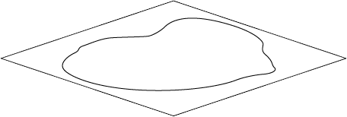
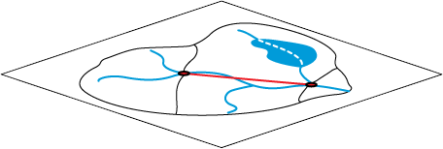
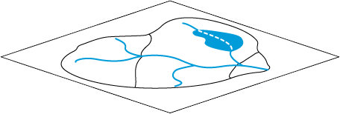
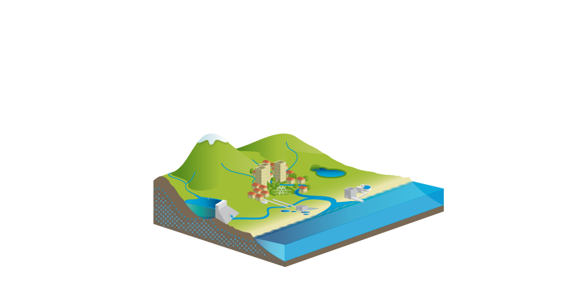
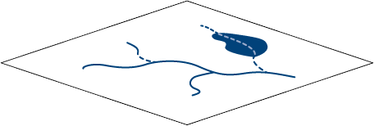
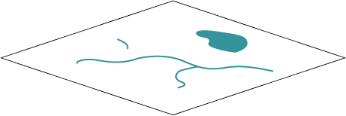
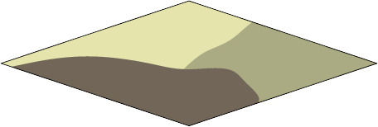
1. Evolving and consistent spatial data products
Geofabric products
Reporting Regions
Reporting
Catchments
Catchments
Network
Cartography
Groundwater
Phased release plan
Geofabric Phase 1 V1.0
  - released 2010
Geofabric Phase 2 V2.0
  - released 2011
Geofabric Phase 2 V2.1
  - released 2012
Geofabric Phase 3
  - beta release 2013
Notes:
Firstly, the Geofabric is an evolving and consistent set of spatial data products
The Geofabric is a ten year project that is evolving in phases
Geofabric V1.0 was released in 2010
Geofabric V2.0 and 2.1 provided an upgraded set of products.
Geofabric Phase 3 is a new generation of improved resolution products with a beta release available in 2013 for two catchments in the Murray-Darling Basin aiming for a full release by 2016.
The Geofabric is a set of consistent spatial data products that are stored within a Geographic information System.
These data products represent landscape models of the real world and in Geofabric V2.0 includes six products, namely
Surface Cartography
Surface Network
Surface Catchments
Surface Reporting Catchments
Surface Reporting Regions
And finally but not least
Groundwater data.
Geofabric Surface Cartography
Geofabric Surface Hydrology Cartography 1:250,000 scale 2012
SH_Cartography
Cartographic representation of hydrological features
Geofabric Surface Network
Geofabric Surface Hydrology Network 1:250,000 scale 2012
SH_Network
Network representation of hydrological features
Geofabric Surface Catchments
Geofabric 9 second Catchments 1:250,000 scale 2012
SH_Catchments
Stream segment catchments derived from DEM-9S organised into a hierarchy
Geofabric Groundwater Cartography
Geofabric Groundwater Hydrology Cartography 2012
GW_Cartography
Groundwater boundaries derived from the Interim Ground Water Data
Geofabric Hydrology Reporting Catchments
Geofabric Hydrology Reporting Catchments 1:250,000 scale 2012
HR_Catchments
Contracted nodes and contracted catchments derived from identification of
important hydrological features
Geofabric Hydrology Reporting Regions
Geofabric Hydrology Reporting Regions 1:250,000 scale 2012
HR_Regions
Topographic Drainage Division and River Region reporting units, based on
contracted catchment.

Slide 7
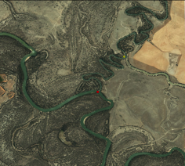
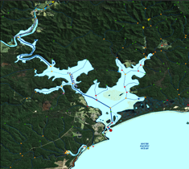
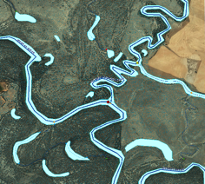
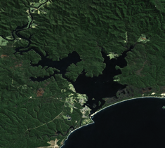
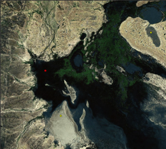
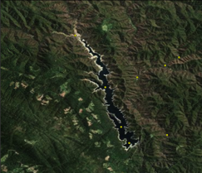
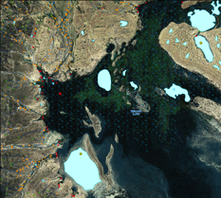
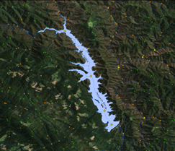
2. Identification of important water features
River confluences
River outflow to sea
Inland sink
Monitored features
Image Source: Bing Maps
Notes:
Secondly, the Geofabric identifies important water features such as…
River confluences – for example, here I am showing where the Murrumbidgee river flows into the Murray river south west of Balranald
River outflows – such as this one at Mallacoota in eastern Victoria
Inland sinks – as shown on the Bulloo River in central Australia – an important wetland habitat when inundated
And monitored features such as the Thompson Reservoir in Victoria – part of Melbourne’s water supply
AHGFNode contains contracted nodes that are points of hydrological significance
that carry identity. They include the confluence of major named streams, coastal
stream termini, waterbody inflow and outflows and inland sinks. It also contains a
new class of node called diffuse nodes that represent diffused flow from groups of
nodes at coastal, delta or inter-catchment outlets.

Slide 8
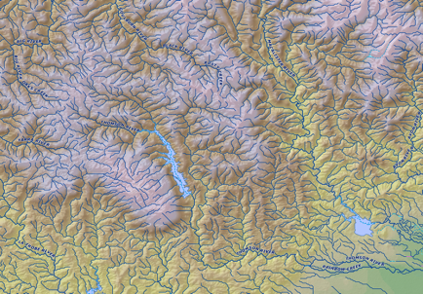
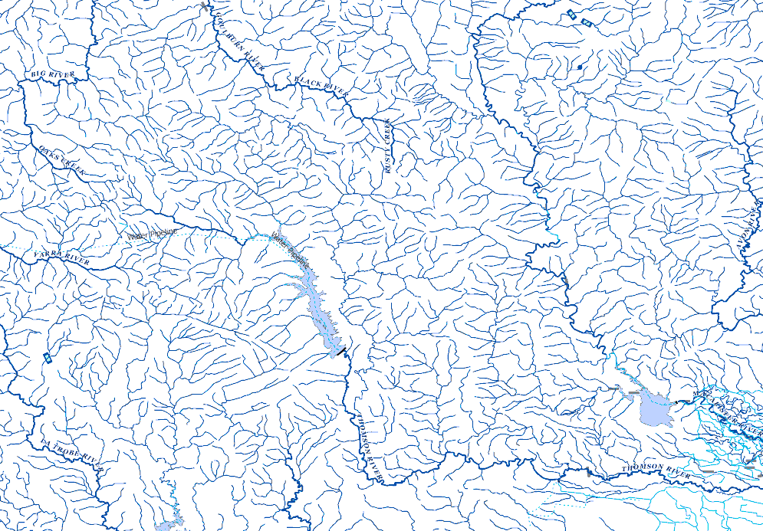
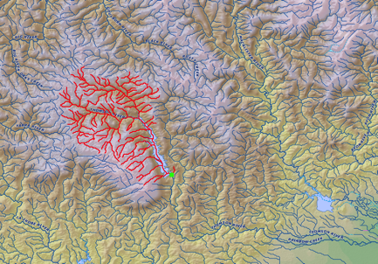
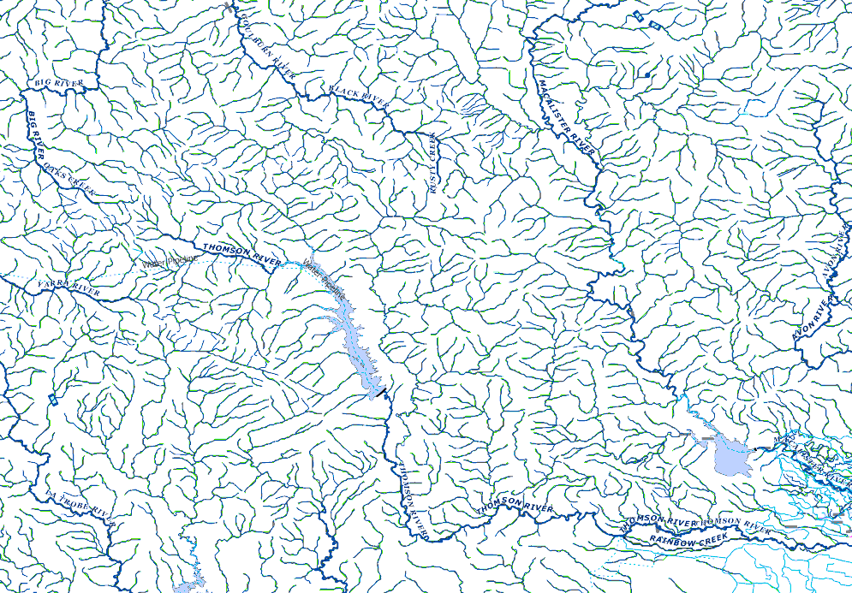
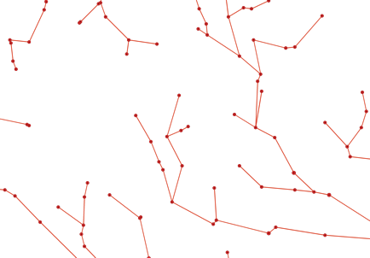
3. Connections between water features
Connected features
with different representations
Notes:
Thirdly, the Geofabric builds connections between these important water features.
Stream network surrounding the Thompson reservoir
Stream network upstream trace showing the contributing streams into the Thompson reservoir.
These connections allow us to have different representations of features such as the stream network shown here as
Mapped Streams from the Geofabric Surface Cartography product
Network Streams from the Geofabric Surface Network product
And a node-link network from the Geofabric Surface Hydrology Catchments product

Slide 9
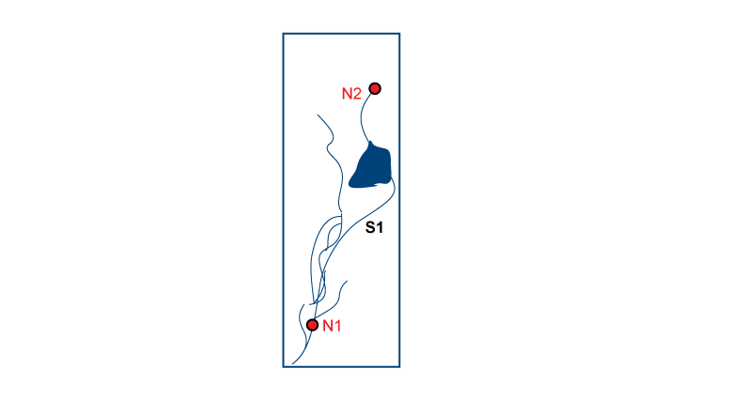
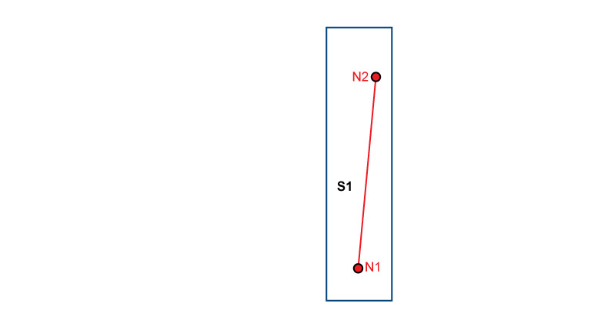
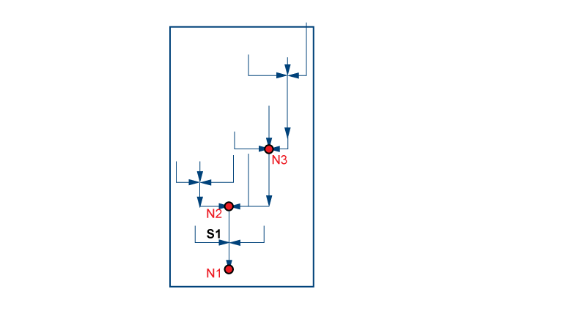
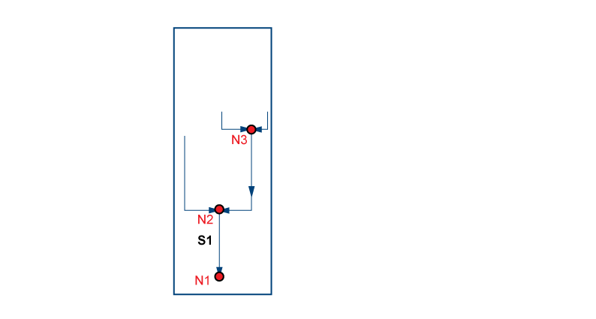
4. Supporting multiple representations of water features
Complex vs Simple Geography
Complex vs Simple Topology
Contracted Node
Notes:
The Geofabric is able to support multiple representations of features through persistant identifiers.
For example
The Geofabric can represent a stream network in its full complexity as shown in the first graphic
Alternately this network can be greatly simplified.
Likewise Geofabric features can be represented as a complex topology or
Simplified.
All of these representations are able to exist through the use of anchor points or contracted nodes. These may be outfalls of HY_Basins as defined in the HY_Feature model or other persistent hydrological features already mentioned.

Slide 10
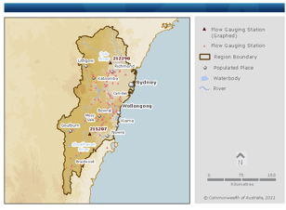
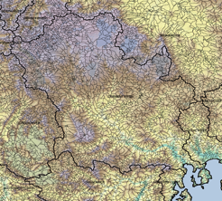
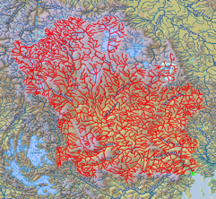
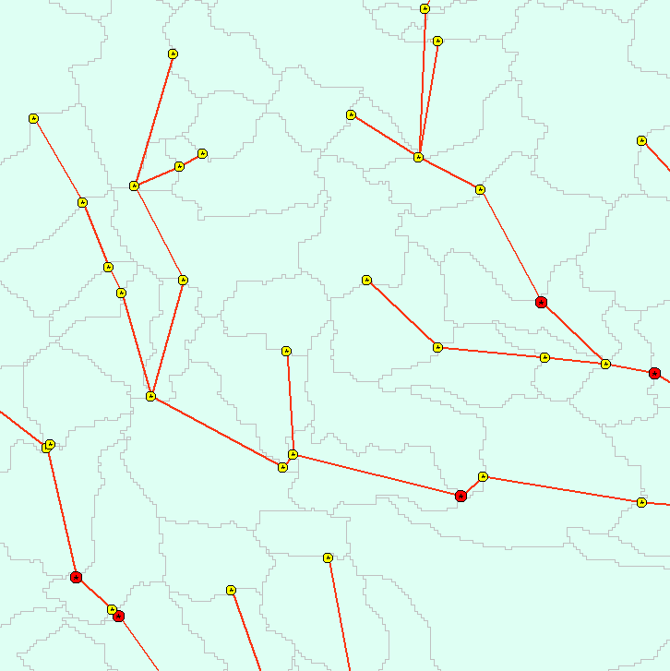
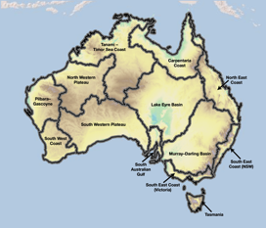
5. To underpin Australia’s water information activities
Visualisation and mapping
Catchment contributing areas
Hydrological modelling
Water reporting
Notes:
The Geofabric adds value to many applications including…
For visualisation and mapping as shown for the Bureau’s National Water Account
For calculating catchment contributing areas for water resource analysis and assessment
For hydrological modelling such as eWater’s Source for catchments and Rivers
For water reporting as shown here for the AWRA 2010 Reporting Regions.
But most importantly the Geofabric provides a landscape fabric to underpin our water information activities.

Slide 11
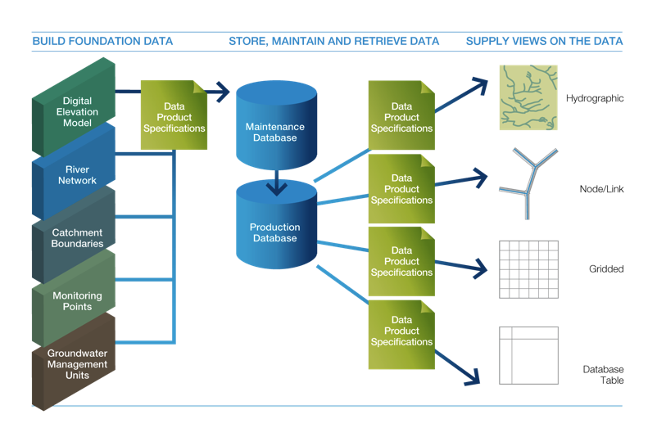
Geofabric product generation
Source: CSIRO WIRADA

Slide 12
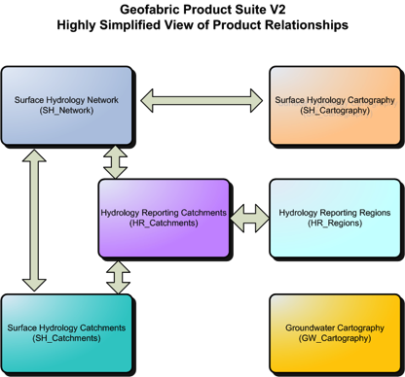
Geofabric Web Services
For each of the 34 features within six Geofabric products there is:
  a WMS
  a Simple Feature WFS
  a Complex Feature WFS using app-schema
Notes:
Geofabric web services are currently being beta tested with a full release planned for August 2013.
The Hydrology Reporting Catchments product comprises two related views of hydrological features used for analysis and
reporting purposes. Firstly, a topological network view of the hydrology represented as a
node-link network using a subset of contracted nodes (AHGFNode) and the links
(AHGFLink) between them; and secondly, a catchments view of the hydrology using the
contracted catchments (AHGFContractedCatchment).
Hydrology Reporting Regions includes two features classes, namely:
• AWRADrainageDivision: stable reporting regions at the Drainage Division level.
• RiverRegion: stable reporting regions at the River Region level.
Surface hydrology cartography: Mapped streams 1:250K
Surface hydrology network: 9 second (250m) DEM derived streams
Surface hydrology catchments: National catchment hierarchy from 12 drainage divisions down to catchments for individual stream segments. Generally 9 to 15 level hierarchy. 1.9 million catchments at the lowest level
Groundwater Cartography: 1:1M groundwater mapping

Slide 13
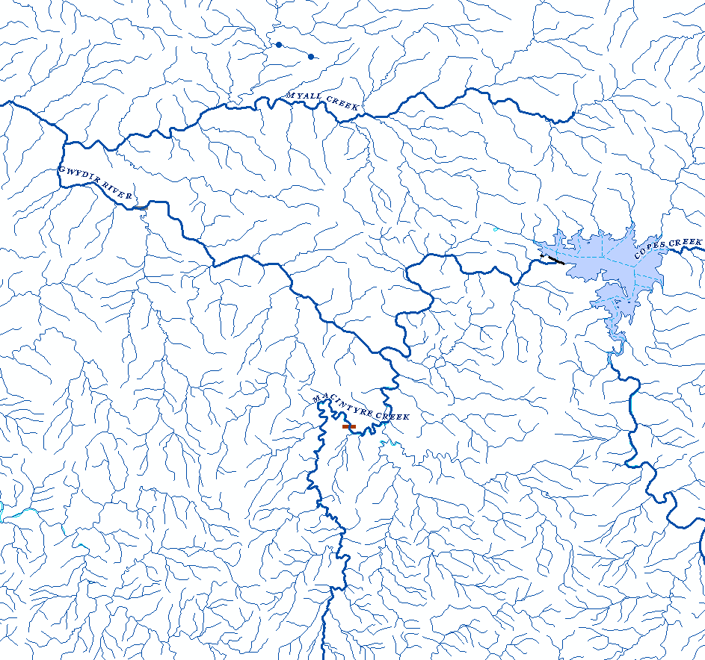
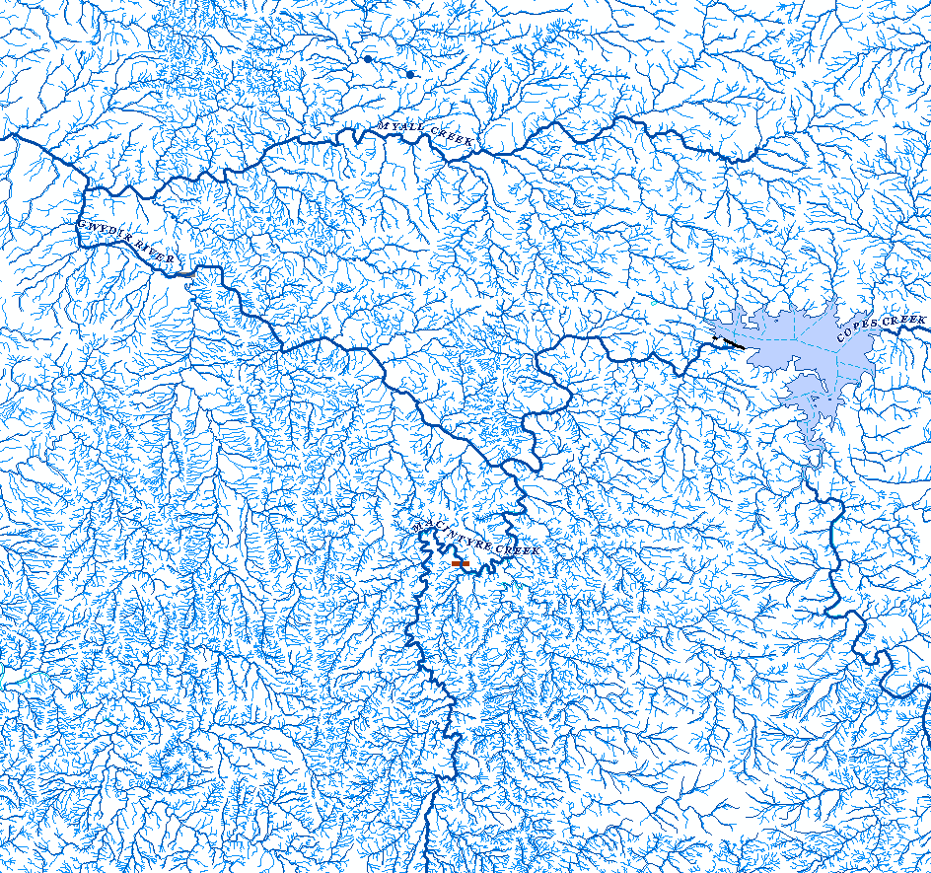
Multiple (scale) representations
Notes:
So with reference back to my first slide
In Geofabric V2.0 we have over 1.9 million stream segments and this graphic represents what this looks like when displayed for a small area of the Gwydir river in NSW.
But as mentioned we are not stopping here and in the future the Geofabric will support a database of over 12million stream segments, and associated water features.

Slide 14
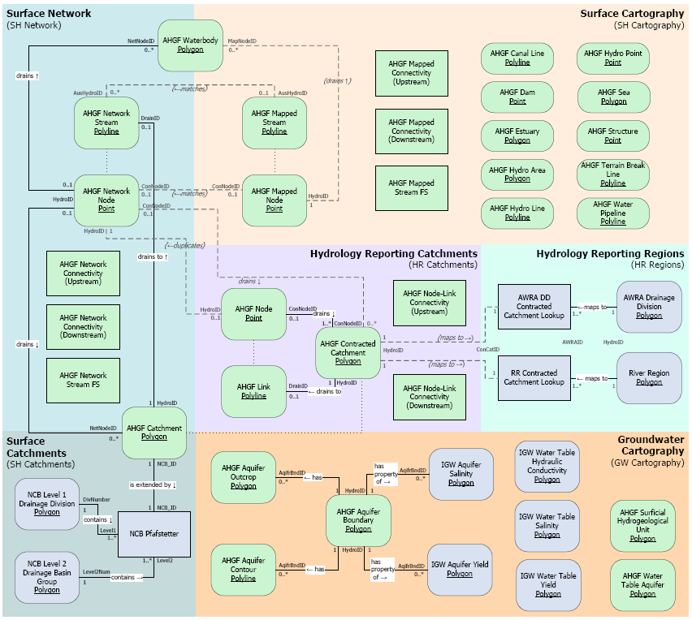





Geofabric V2.1 product relationships
Notes:
Here is a simplified version of the Geofabric data model. There is a network stream product derived from the 9 second DEM that is hydro-enforced with a set of topologically connected cartographic streams from which a hierarchical set of catchments or basins has been generated with each stream segment having a sub-catchment being the area that drains to it. The cartographic and network stream products are linked through a set of common 'contracted nodes' defined by a number of business rules. Contracted nodes are persisted between representations, versions and scales of the Geofabric products and form the foundation of a contracted hierarchy of catchments

Slide 15
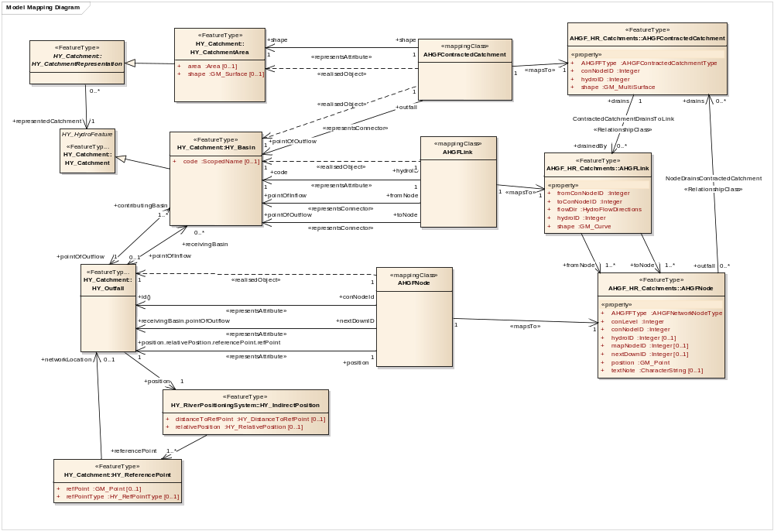
Mapping HY_Features to the Geofabric
Notes:
The conceptual HY_features model has been implemented within the Australian Geofabric. HY_catchments represented as HY_basins and HY_outfalls have been implemented in AHGF (Geofabric) HR_Catchments as AHGF Contracted Catchments and AHGF Node. HR_Catchments AHGF Link represents the topological connection between the catchment hierarchy.

Slide 16



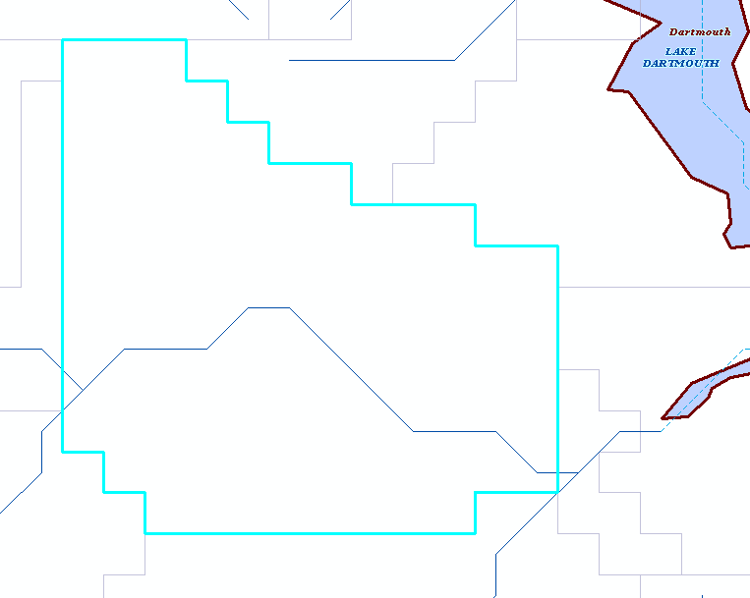
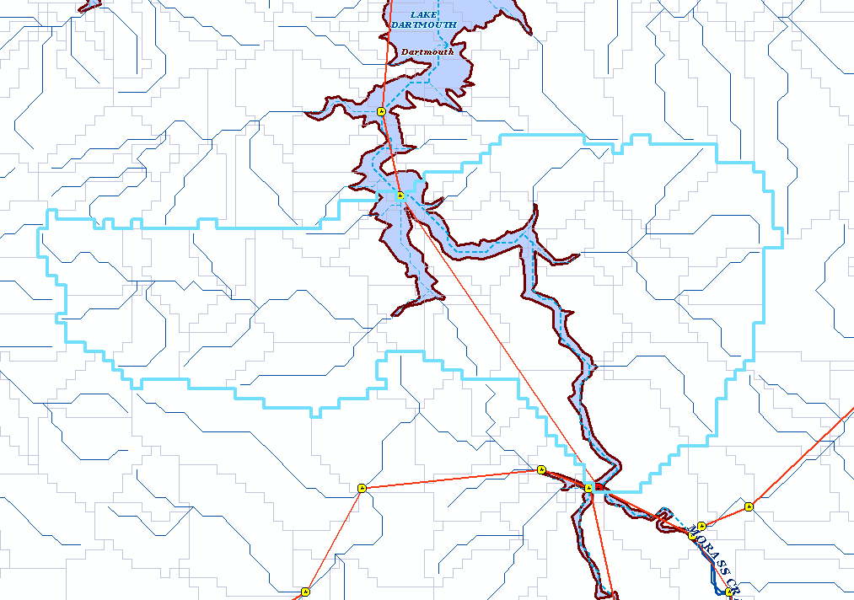
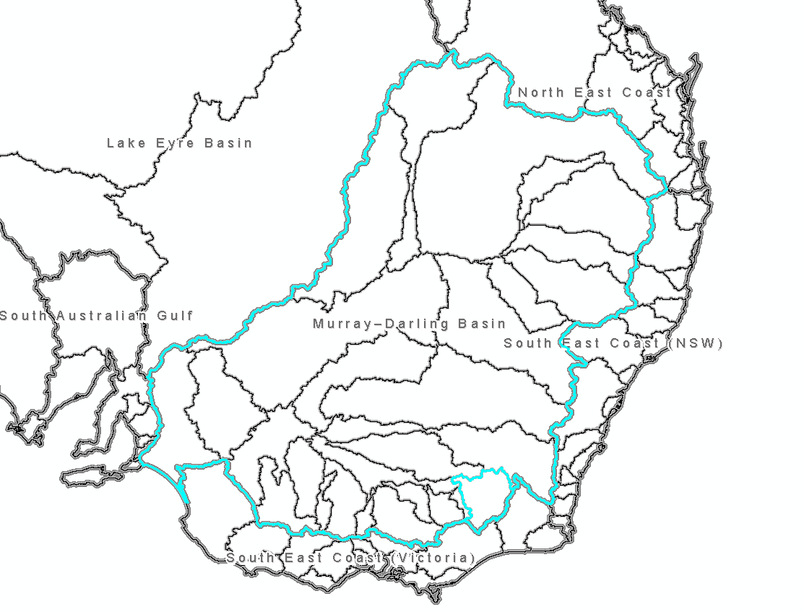
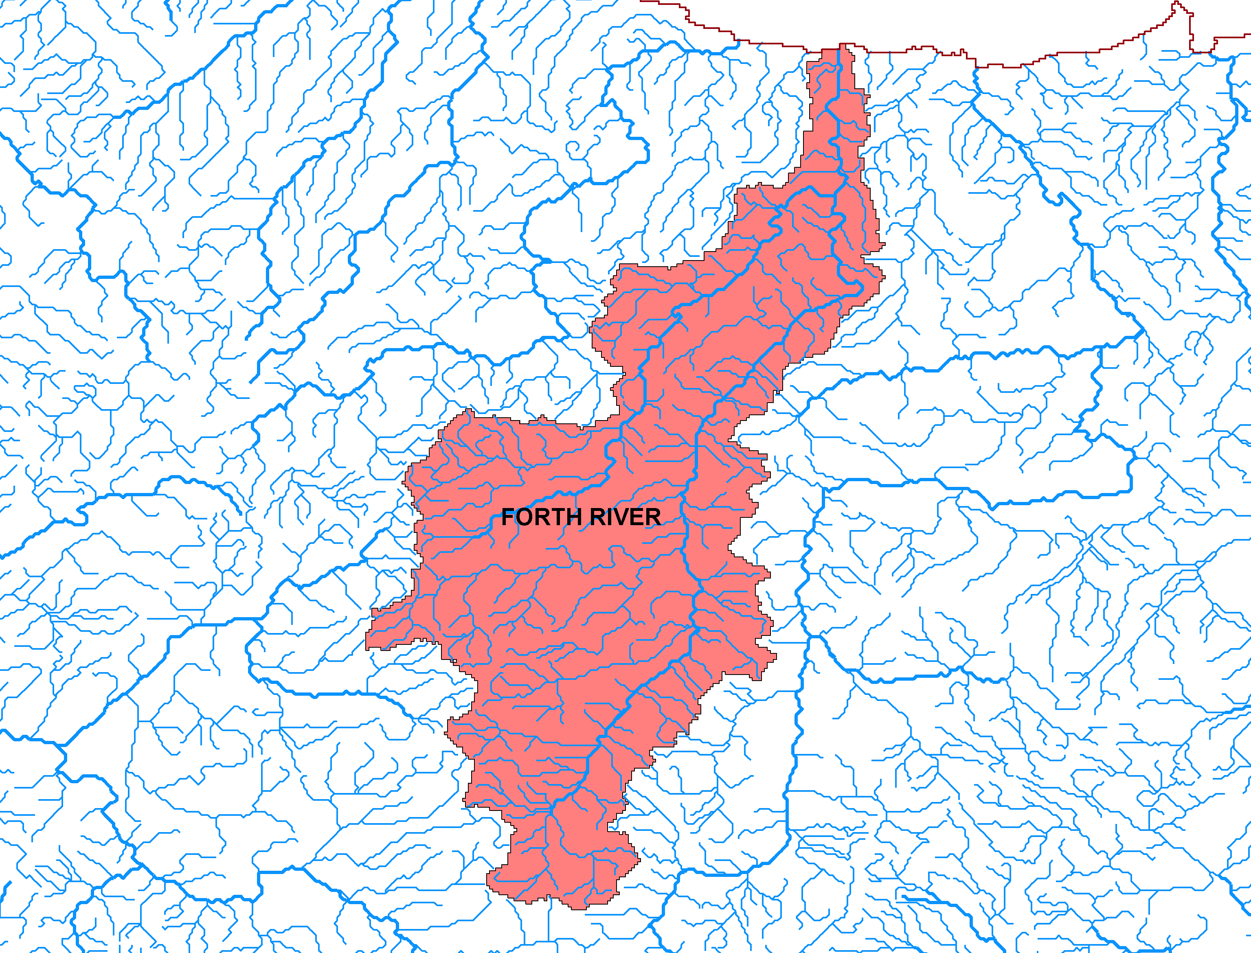
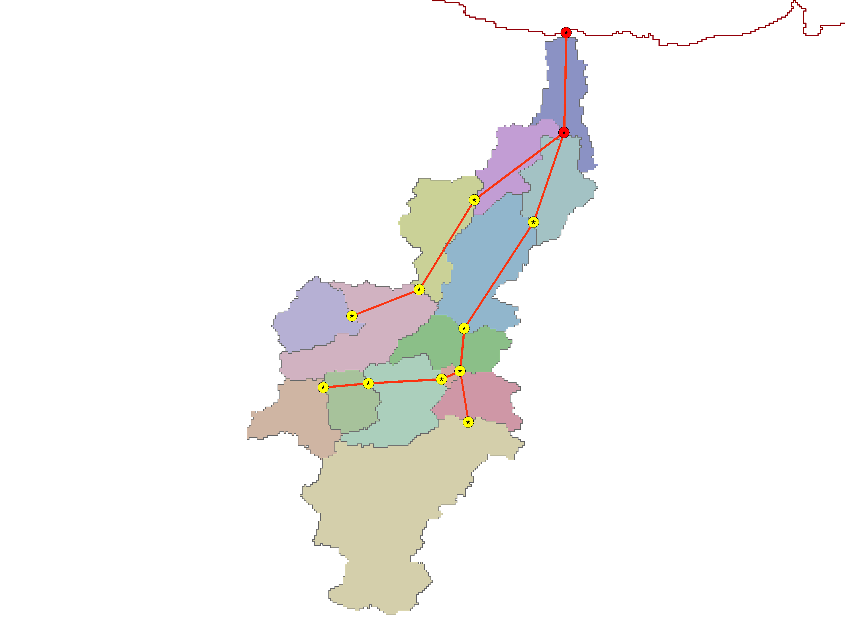
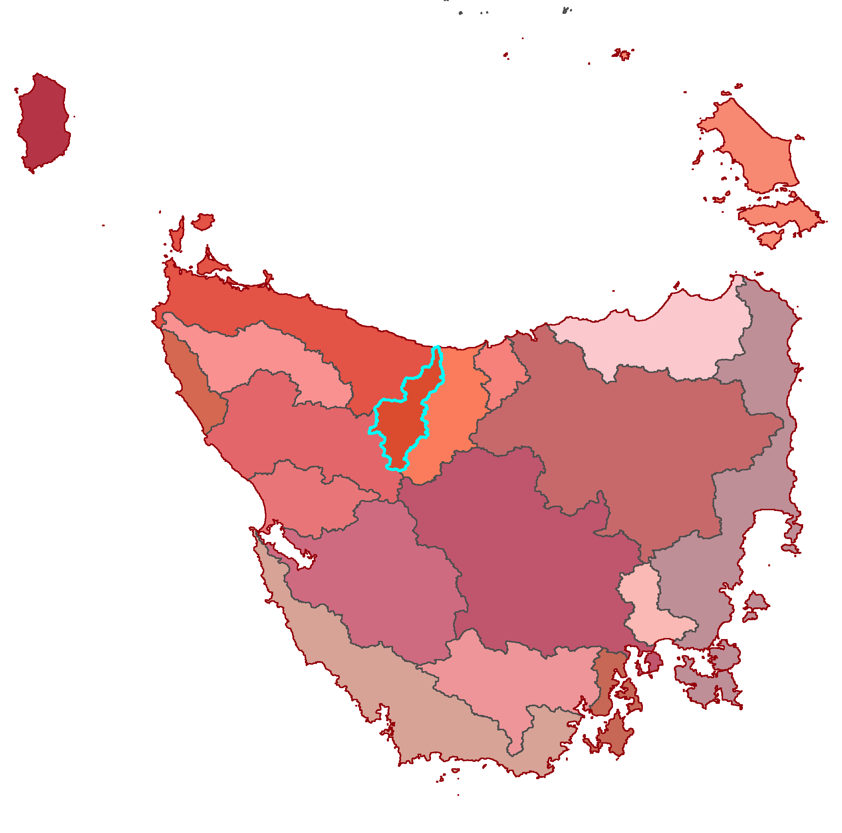
Geofabric Hydrology Reporting Catchments
Stream Catchment
Contracted Catchment
River Regions & Drainage Division
Contracted Catchments,
Nodes and Links
Stream Network
Notes:
A hierarchical set of catchments from individual stream segments to Contracted Catchments are defined in the SH_Network and HR_Catchments products with each catchment defined by a polygon shape draining to an outfall contracted node. Contracted Catchments are then aggregated to create stable reporting regions at two levels in the Geofabric, River Regions and Drainage Division. (MDB & Tassie shown)

Slide 17
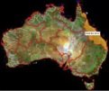

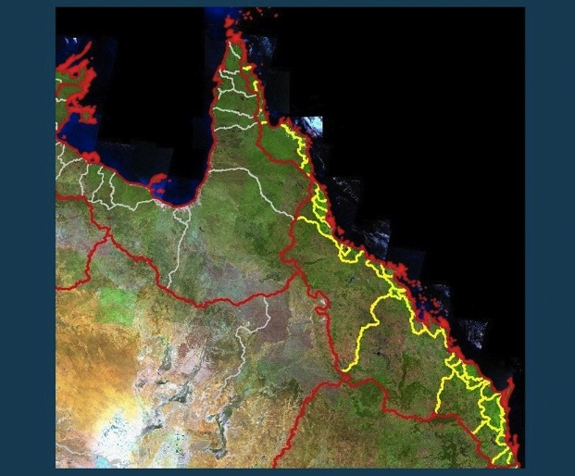
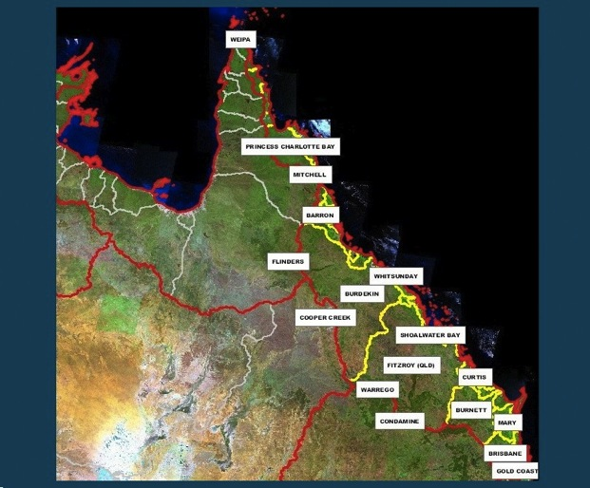
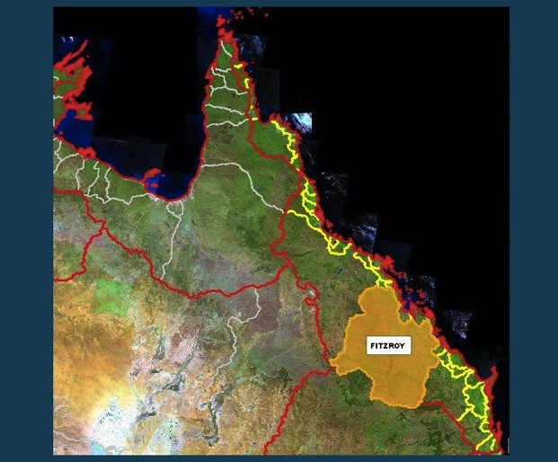
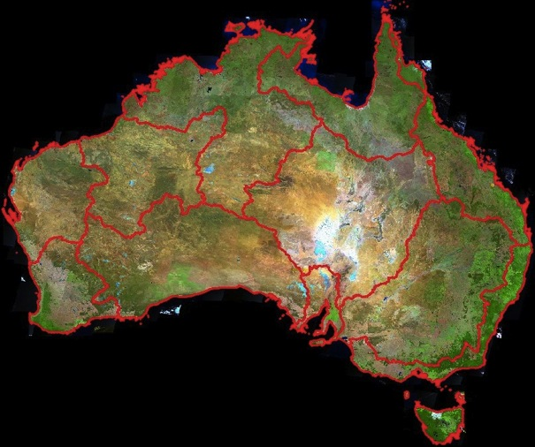
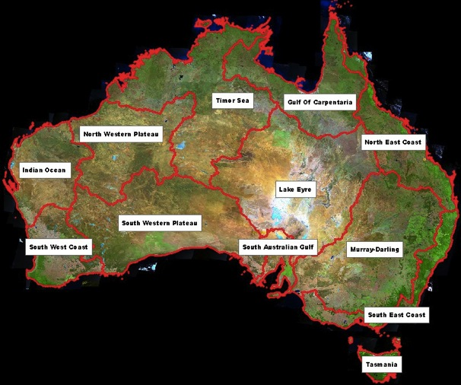
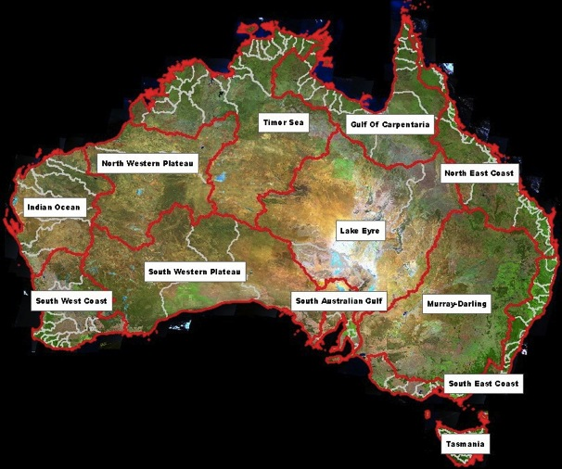






























Australian Catchment Boundaries
Notes:
National Catchment Boundaries hierarchy to level 9

Slide 18
Geofabric Practice
Requirements
Conceptual Model
Product
Implementation
Doc
Other
products
Product
Model
XSD
Services
HY_Features
Map
ID
Link
AHGF Concepts
Notes:
Requirements: reporting over stable identified areas
Conceptual Model : how to meet requirements given existing data, informed by similar products worldwide, focus on “contracted Catchments” as unifying and simplifying concept.
Product Implementation : long trial and error approach to realising requirements
Doc – larges parts of documentation could be autogenerated from product model and HY_Features semantics. Tools and Docs is doing just this for related observation data. (WDTF based on WaterML 2)
Product Models “reverse engineered” from as-implemented products
XSD: GML schemas generated from product models
Services : WFS, WMS using product models (with relationships) and simple features (feature by feature – user has to stitch it back together)
Map: Concepts in products mapped to HY_Features definitions
ID: Object identifiers (non-information resources) based on HY_Features semantics
Link: Linked back to services and data product downloads using Linked Data (LID pattern for heterogeneous resources)
HY_Features : conceptual model harmonised with International Glossary of Hydrology definitions and extended to lower level detail, groundwater, hydrometrics

Slide 19
Connecting observations, monitoring sites and hydrological features using linked data
Linking related data requires knowing what references mean
Identifiers must be bound to well-known semantics (what type of thing)
Binding to a specific data product has issues:
  Not portable (don’t do this in standards!)
  May not be best representation for user
  Fragile (systems change)
  Tempting because we probably understand real data....
  And a conceptual model not always available
Enter HY_Features
  A common hydrological feature model independent of scale and implementation
Copyright © 2011, Open Geospatial Consortium, Inc

Slide 20











Linked data and the Geofabric
Application (Online or Desktop)
http://id.unsdis/id/catchment/567
Identifier Architecture
representations
Basic properties
provenance
URL: spatial data access
URL: observation data archive access
URL: live data access
URL: virtual data product
Services
WFS
WCS
Spatial
databases
Computational
Models
Spatial Data Infrastructure
Sensor Web (image OGC 2006)
Notes:
Notional architecture of Geofabric in a System of Systems context

Slide 21



Contracted nodes and catchments
Copyright © 2011, Open Geospatial Consortium, Inc
Notes:
Contracted nodes and catchments are features in the landscape that persist and are scale/implementation independent. These features are assigned persistent identifiers which enable their reference independent of their spatial representation (which will change) and over time!

Slide 22



Multiple hydrological representations
Notes:
These are all valid representations of catchments – and in addition these will have multiple scale representations (whose boundaries will change over time as higher resolution data becomes available)

Slide 23

Of course the reality is quite messy...
Many network nodes mapped to single logical node...
Copyright © 2011, Open Geospatial Consortium, Inc
Notes:
Modelling Semantics of nodes is in fact very important, because there are lots of complex representational issues.
One “logical” node may be represented in a data product by multiple nodes in a stream network, as in a river delta. The traceability of the network is problematic due to combinations of incompleteness of data (in this case trying to map channels hidden in mangrove swamps) and sheer complexity of the network, and of little value (in most cases).

Slide 24
Semantics (1)
That messiness is inherent
Complex
Handled in the conceptual model
HY_Features used to describe how Geofabric nodes fit together
Initially through design...
  Next step UML model mappings
  OWL ontologies so we can query over relationships
Copyright © 2011, Open Geospatial Consortium, Inc

Slide 25

Semantics (2)
Waterbody
shape:GM_Polygon
Dam
area:GM_Polygon
CSIRO. UN Gazetteer - Common Semantic Framework for the UNSDI
Notes:
Each property in a data product needs careful definition
You _cannot_ infer what data means by “introspection”! The name and the datatype do not sufficiently distinguish semantics, in this case do object geometries relate to maximum, current, past water body boundaries?

Slide 26


Identifiers at work…
http://water.bom.gov.au/waterstorage/awris/index.html#urn:bom.gov.au:awris:common:codelist:feature:lakepieman
Notes:
http://water.bom.gov.au/waterstorage/awris/index.html#urn:bom.gov.au:awris:common:codelist:feature:lakepieman

Slide 27
Identifiers
This is the “tricky part”
Lets start with the practical implication…
Catchment | ExtractionRate | Storage
1123343 | 730 | 300
Catchment Boundary | Area | Geometry
1123343 | 33535.4 | 151.3344,-35.330…….
Notes:
Data products linked in practice.... The “foreign key” issue is easy if you are in a single database, because the database design typically declares such relationships.

Slide 28

“Distributed” references
Catchment | ExtractionRate | Storage
1123343 | 730 | 300
How to ask for this entity
Internet
How to deliver this entity
Catchment Boundary | Area | Geometry
1123343 | 33535.4 | 151.3344,-35.330…….
Notes:
Harder when information needs to be shared.
On the Web you may not know even know the data product you should be linking to, or where it is, or what protocol, or what specific FeatureType to ask for, using what query.

Slide 29
Hydrological Referencing
Linking hydrological data requires common semantics
  Observations apply to what?
  How are these objects hydrologically connected?
Semantics of place
  Talking about the same hydrological context
    “The catchment of the Darling River”
Hydrologic referencing
  Hydrologic references more explicit that spatial coordinates
  Names are specific, if we share understanding
  Need to “dereference” names/ids to find hydrologic context.
  Multiple products, multiple representations, same ids!
Notes:
References are by name – spatial locations are not reliable or easy to use in topological context. Reporting will use object references rather than geometry in most cases, hydrologic processes will be described in terms of object connectivity, not spatial relationships. We will also show how Ids can be used to locate and access geometry views.

Slide 30
Unstable Identifier Behaviour
URL for a service
http://bom.gov.au/ahgf/250K/wfs?featuretype=ahgf_catchment&id=213343
Data Product Feature Type
http://bom.gov.au : organisation name or custodianship changes
/ahgf/ : service name or dataset, or something else?
/250K : one view
/wfs? : one service (+ version!)
featuretype=ahgf_catchment : what if we want to add attributes or change model?
&id=213343 : is local identifier stable or database row id?
Notes:
(not even the feature type names [eg ahgf_catchment] may be persistent?) – correct. Nothing is likely to be persistent across versions of data products and/or service delivery technologies.
Issues with each part of such URLs...

Slide 31

Separation of concerns
See http://web.archive.org/web/20130411044033/http://thismodel.posterous.com/cool-uris-and-geographic-resources
Notes:
The “real world thing” (Lake Eildon) is described by digital information objects (“Spatial Objects” in this explanation) – but can be identified with a URL. Web best practice is to redirect “non-information resource” URL to “information resource URL. We note that multiple formats of the same information resource may also be available. From a post by Simon Cox on Cool URIs and geographic resources. Now only available through the Internet Archive Way Back Machine at: http://web.archive.org/web/20130411044033/http://thismodel.posterous.com/cool-uris-and-geographic-resources.
What we need is stability of identifiers over time.
Stability of identifiers means that factors that change the representation
of a feature in an information system should not change
the identifier of the feature itself. Such factors may be the improved
resolution or accuracy of representation; minor changes
to physical characteristics of the feature that occur over time;
and changes of technology platform, implementation or custodian.

Slide 32


Multiple Resources
HY_Basin common model
Notes:
Items described using common model may get mapped to specific data products. An identifier (URL) for a HY_Basin may link to a resource that provides information on what we know about an object and things that relate to the object.
For example this Basin identifier (catchment number 567) may resolve to a 1:250,000 representation of the catchment, a WFS showing how this catchment is linked to upstream and downstream catchments or a WFS providing all the mapped streams for catchment 567.

Slide 33
One URI, many resources
http://115.146.86.108/id/geo/ahgf_hrc/100862
  Get an index of resources + HY_Basin model view
ID?_view=ahgf:AHGFContractedCatchment&_format=gml
    Get HR_Catchments product in GML
ID?_view=alternates
Presentation title | Presenter name | Page <number>
Notes:
Feature Type Catalog
Linking catchments to:
Related geofab features
WMS portrayals
Observation data

Slide 34


Generalised Deployment Model
Application Architecture
AWRIS
GIS
HTML Web
Identifier Architecture
LID (Linked Data Identifier)
PIDSVC
Resource list
Item
Delivery Architecture
Services
Download
Workflow
Notes:
Linked data methods can provide a resolution mechanism to get from generalised hydrological features to particular representations. Aggregation of hydrological data into data products on a global or national, regional or basin scale requires stable and generalised feature identification and resolution mechanisms.
This deployment model or architecture includes a separation of identifier references from provisioning of specific resources.
Red objects are the things we need to add to standard SDI pattern to allow for robust object references. (and will demo)
We can realise the linked data vision – a spatial object can be cross-referenced to a concept and linked to related information, but this requires “reasoning” over some structured metadata.
The structured metadata is defined using Linked Open Data, which looks at the web as a mechanism, with self-describing resources. Context provides resolvable references. Semantic Web tech provides ability to find related resources for each reference (object ID).

Slide 35









http://water.bom.gov.au/waterstorage/awris/#urn:bom.gov.au:awris:common:codelist:feature:arthurslake
Definition derived from conceptual model.
Linkages can be made to related concepts...
Notes:
Screen snapshot of links for a given object, with a couple of examples of views
1st link is actually this view available in machine readable form so applications can use this data...
Last link links to Feature Type Catalog

Slide 36
Summary
Conceptual model allows us to have “top level” identifiers
HY_Features schema provides basic info about top level object
Linked Data approach
Multiple representations
AHGF may be delivered by
  Product models (AHGF carto etc)
  And HY_Features model
  Registered URL ids using data model from HY_Features
  alternative data products may evolve and be linked to this
Notes:
Just bullet points for the directions and benefits around use of HY_Features – recap what demo shows.
The HY_Features model is expressed in a standard, platform-independent form, and may be used as a basis for referencing the types of hydrologic features that
may have persistent identity across multiple data systems. The definitions captured in the model are based on semantics defined within WMO standards and official literature.
The model defines how features in different representations of hydrologic networks may be related. It does this by defining the
relationships that may occur between features that can be referenced via persistent identifiers linking to specific
representations of those features on a case-by-case basis.

Slide 37
Take-home...
Be careful not to overspecify references to specific information resources.
HY_Features is target for relationships in standards
  Fix and/or extend if necessary!
Semantic Web (Ontology) probably best way to traverse relationships
  Participation and review welcome.
Copyright © 2011, Open Geospatial Consortium, Inc
Notes:
See the fragile pattern (slide 13)
HY_Features – relates to object identity – which is how all the resources are linked together.
We are working on how to use inter-model relationships to automate that linkage.
WDTF tools and Doc is publishing models in a way that supports the mechanisms demonstrated.

Slide 38



Thank you
CSIRO Land and Water
Rob Atkinson
Principal Investigator
Interoperable Information Systems
Phone: +61 419 202 973
Email: rob.atkinson@csiro.au
Web: www.csiro.au
Bureau of Meteorology
Tony Boston
Branch Head
Climate and Water Data
Phone: +61 2 6232 3503
Email: t.boston@bom.gov.au
Web: www.bom.gov.au

