Slide 1
Commission for Hydrology
Data Operations and Management
Tony Boston
Bureau of Meteorology

Slide 2
Outline
Some challenges
Commission for Hydrology structure
WMO CHy-14 feedback
Data Operations and Management workplan (2013-2016)
  Goals, objectives and activities
  Opportunities for collaboration
WMO Commission for Hydrology

Slide 3
Some challenges
Reluctance of National Hydrological Services (NHSs) to share hydrological data and information
Inadequate hydrological networks, data quality and data management in many hydrological services world-wide
WMO Commission for Hydrology

Slide 4
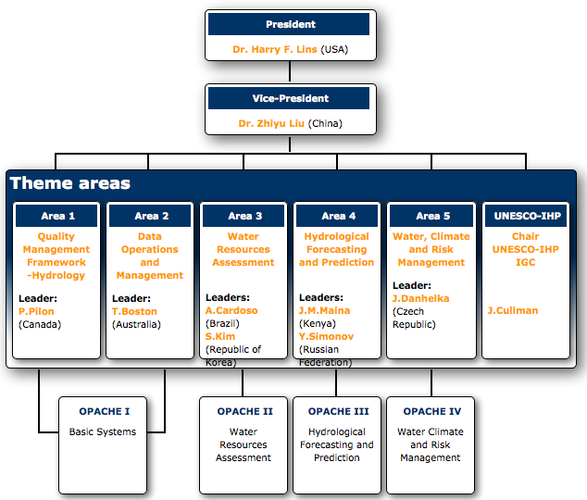
WMO Commission for Hydrology
The 14th Session of the WMO Commission for Hydrology was held in Geneva, Switzerland from 6-14 November 2012
President and Advisory Working Group (AWG) elected
WMO Commission for Hydrology

Slide 5
CHy-14 feedback (1)
The Commission has asked the Global Runoff Data Centre (GRDC) to undertake the development of an ISO 19115 metadata profile, under the overall guidance of WMO Information System (WIS)/WMO Integrated Global Observing System (WIGOS), to form part of the WMO Core Profile of ISO Metadata Standard
In October 2012, GRDC submitted a summary document of the Hydrology Metadata
The Commission urged the GRDC to finalize this review and make the report available to its members.
WMO Commission for Hydrology

Slide 6
CHy-14 feedback (2)
Considerable work being undertaken internationally with respect to the development and agreement on standards for the transfer of hydrologic data between data servers (databases) and users.
In particular, the Commission was pleased to note that the work of the Hydrology DWG of the OGC has resulted in WaterML 2.0 being adopted as an OGC Standard
WMO Commission for Hydrology

Slide 7
CHy-14 feedback (3)
Resolution 7/1:
Commence a process, including testing, that could see the potential adoption of the WaterML 2.0 as a WMO standard for information exchange managed by WMO (supported by the WMO/OGC MOU) and to register this standard as a joint WMO/ISO standard;
WMO Commission for Hydrology

Slide 8
CHy-14 feedback (4)
The Commission took note of the work being undertaken by the WMO/OGC Hydrology WG with respect to the Hydrologic Feature Model (HY_Features). It noted that the OGC Discussion Paper is available
The Commission noted the importance of emerging OGC standards to improve service delivery of key CHy programmes including WHYCOS and the WMO Flood Forecasting Initiative
WMO Commission for Hydrology
Notes:
WHYCOS = World Hydrological Cycle Observing System

Slide 9
Data Operations and Management workplan (1)
Monitor and report on new developments dealing with data management issues, such as observations, data exchange and protocols, data transfer formats, WIS and WIGOS
Provide guidance to member countries regarding data management principles for hydrological services
Promote use and uptake of appropriate technology for hydrological data management, including commercial and open source software
WMO Commission for Hydrology

Slide 10
Data Operations and Management workplan (2)
Prepare benefits statement for WaterML 2.0 and HY_Features and a glossary of terms for non-specialists
Encourage adoption of HY_Features and promote its implementation, testing and use
Review report and finalise the ISO 19115 Metadata Profile developed by GRDC
Survey hydrological advisors of WMO members to establish their progress with respect to resolution 25 regarding the free and open exchange of hydrological data (and products) and provision using web-based services
WMO Commission for Hydrology

Slide 11
Data Operations and Management workplan (3)
Resolution 7/1
  WaterML 2.0 - pilot projects in WMO member countries
  WaterML 2.0 - WMO/ISO standardisation
Establish Coordination Group
  From CHy Basic Systems OPACHE members
  Broad representation, eg NHSs, vendors, OGC HDWG, Regional Associations, other consortia
  Your involvement is welcome
WMO Commission for Hydrology
Notes:
WMO OPACHE for Basic Systems interest from UK and Australia
GEOSS AIP-6 interest from Canada, Italy and New Zealand
OGC HDWG interest from several countries

Slide 12
Thank you for your attention
Tony Boston
t.boston@bom.gov.au

