Slide 1
Hydrologic Information - Metadata (GRDC Metadata Concept)
11th meeting of GRDC SC, Koblenz, 2013, June 10 - 12

Slide 2
GRDC Hydrologic Metadata
Information about compilations of data / data products
  offered for global exchange of data, disseminated using services
  reporting physical, chemical and biological properties of waters above, on and below the Earth's surfaces (observation results)
  generated by further processing of data which are results of preceding source observations
  values are compiled in time series or displayed in maps (exemplarily those created by the GRDC)
for Discovery, Access and Retrieval services – “WIS Metadata”
associating the observational information – “WIGOS Metada
11th meeting of GRDC SC, Koblenz, 2013, June 10 - 12

Slide 3
GRDC Hydrologic Metadata
Shall be compliant to WMO Core Metadata Profile of ISO19115:Metadata
  Identification, content, lineage, … of the data set
Should provide a relation to observational information referencing/using available metadata concepts
ISO 19156 provides the basic structure for observational metadata
  Identification of the dataset as result of observation
  Observation description: sampling feature / sampled feature, procedure and observed property
WML2P1 provides time series metadata
  Description of time series, the accumulation and aggregation of time series points as well as of the annotations made to these
11th meeting of GRDC SC, Koblenz, 2013, June 10 - 12

Slide 4
GRDC Hydrologic Metadata
shall use the WMO Core Metadata profile of ISO 19115
Maintenance info
Quality info
Distribution info
Use constraints
Representation info
Lineage info
Data identification info
Content info
11th meeting of GRDC SC, Koblenz, 2013, June 10 - 12

Slide 5
GRDC Hydrologic Metadata
shall use the WMO Core Metadata profile of ISO 19115
with respect to time series
Representation info
Applicable to time series elements ?
Data identification info
WMO Core Metadata v. 1.3
Content info
Applicable to description of time series ?
11th meeting of GRDC SC, Koblenz, 2013, June 10 - 12

Slide 6
GRDC Hydrologic Metadata
shall use the WMO Core Metadata profile of ISO 19115
… resulting from observation, and processed from primary input data
Maintenance info
suitable for updated “primary” data
Quality info
suitable to reliability of “primary” data
Representation info
Applicable to time series elements ?
Lineage info
Applicable to results from observation
Data identification info
WMO Core Metadata v. 1.3
Content info
Applicable to description of time series ?
11th meeting of GRDC SC, Koblenz, 2013, June 10 - 12

Slide 7
GRDC Hydrologic Metadata
shall use the WMO Core Metadata profile of ISO 19115
… distributed by dissemination services under the conditions of data policies
Maintenance info
suitable for updated “primary” data
Quality info
suitable to reliability of “primary” data
Distribution info
Suitable for disse-mination service
Use constraints
To reflect the WMO data policy
Representation info
Applicable to time series elements ?
Lineage info
Applicable to results from observation
Data identification info
WMO Core Metadata v. 1.3
Data identification info
WMO Core Metadata v. 1.3
Content info
Applicable to description of time series ?
11th meeting of GRDC SC, Koblenz, 2013, June 10 - 12

Slide 8
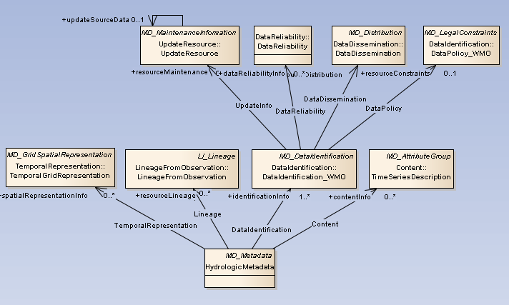
Core Concept (GRDC, June 2013)
11th meeting of GRDC SC, Koblenz, 2013, June 10 - 12

Slide 9
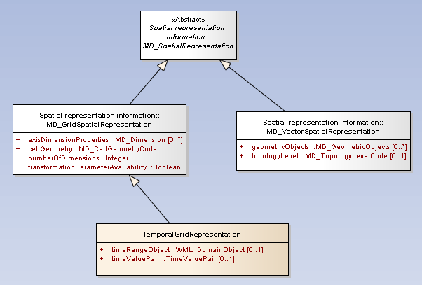
representationInfo to identify time series objects
ISO 19115-1
defined within WaterML2P1
11th meeting of GRDC SC, Koblenz, 2013, June 10 - 12

Slide 10
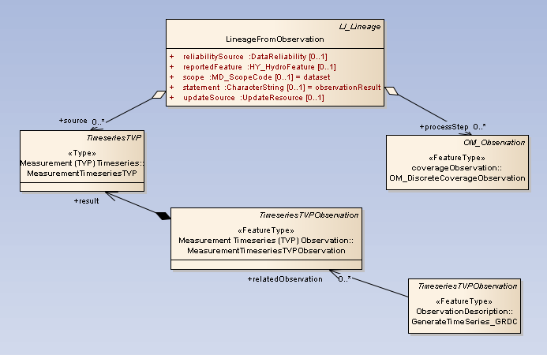
lineageInfo to relate secondary-observation results
ISO 19115-1
ISO 19156/WML2P1
11th meeting of GRDC SC, Koblenz, 2013, June 10 - 12

Slide 11
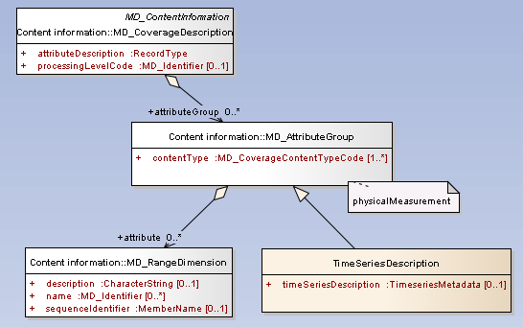
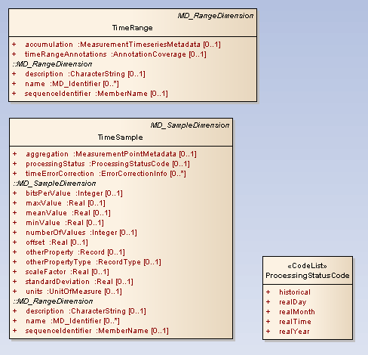
contentInfo to describe time series, accumulation and aggregation time series points
ISO 19115-1
Metadata defined in WaterML2P1
11th meeting of GRDC SC, Koblenz, 2013, June 10 - 12

Slide 12
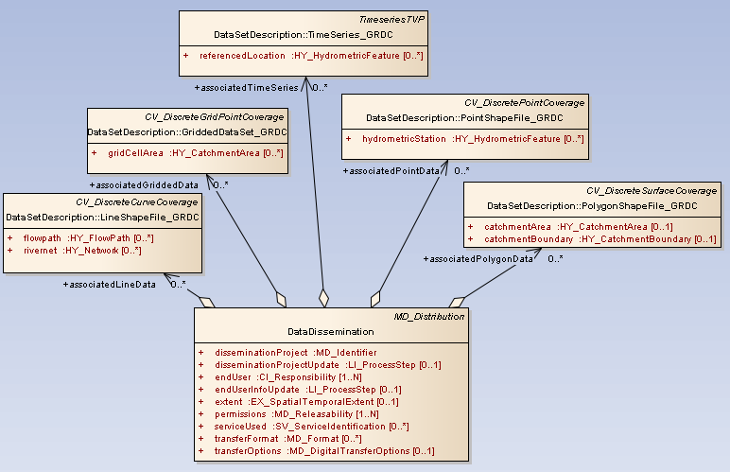
distributionInfo relate the datasets provided by service
Attributes as required by the GRDC to support data collections projects on regional or global scale
11th meeting of GRDC SC, Koblenz, 2013, June 10 - 12

Slide 13
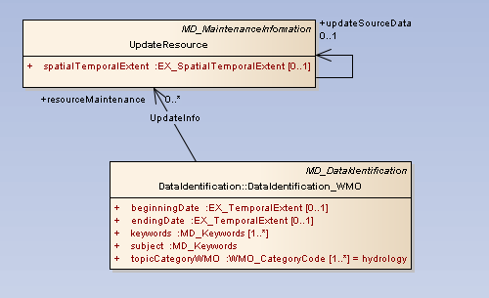
maintenanceInfo to describe updating “primary” data
Attributes as required by the GRDC to support data collections projects on regional or global scale
11th meeting of GRDC SC, Koblenz, 2013, June 10 - 12

Slide 14
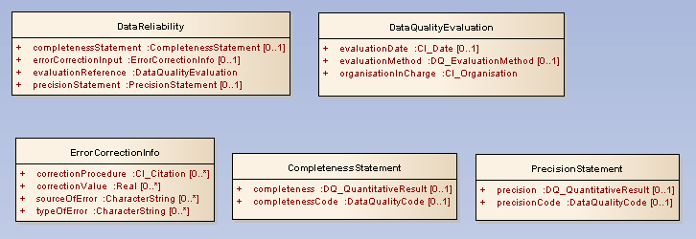
quality Info with respect to reliability of “primary” data
* expected that future evolution of ISO19157:DataQuality will provide a replacements
*
Attributes as required by the GRDC to support data collections projects on regional or global scale
11th meeting of GRDC SC, Koblenz, 2013, June 10 - 12

Slide 15
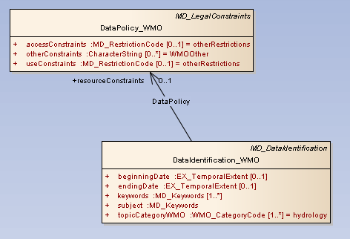
use constraints with respect to data policy
* expected that future evolution of WMO Information System will provide a replacement
*
11th meeting of GRDC SC, Koblenz, 2013, June 10 - 12

Slide 16
GRDC Hydrologic Metadata
Observational information should use
  Concepts of ISO 19156: Observation and Measurement
  requires more details concerning the observable property: hydrologic variable which is proxy for an ultimate observable property or for a water cycle process, and possibly constrained by a material, substance or organism, by procedure
  requires more details concerning the observation process: relationships between instrument and sensor, instrument and calculation
  HY_Features model
  relationship of sampled water body, e.g. river, to the basin represented by the river and reported in the data set.
11th meeting of GRDC SC, Koblenz, 2013, June 10 - 12

Slide 17
GRDC Hydrologic Metadata
Utilities, utility classes for common patterns
  required by the HydrologicMetadata model, but not specific for the hydrology domain, or the GRDC.
  may be replaced at a later stage with more general concepts as they become available
"ObservableProperty" proposing a concept of a variable observed as proxy for an ultimate observable property or a observable process performed on the sampled feature, e.g. a hydrologic feature, and
"ObservationProcess" concept of instrument or calculation used for observation and their relationship
11th meeting of GRDC SC, Koblenz, 2013, June 10 - 12

Slide 18
Next Steps
Sep/Oct 2013
  start discussion with editors of the ISO19115
  contribution (conceptual level) to WIS / WIGOS Metadata
  “Hydrologic Information - Metadata” GRDC report
  “HY_Features – …” GRDC report
  WMO-CHy Discussion Forum (eForum)
Dec 2013
  mapping to the metadata structures currently in use at GRDC
  test implementation for the new GRDC data catalogue (depending on support by the BfG)
11th meeting of GRDC SC, Koblenz, 2013, June 10 - 12

