Slide 1
HY_Features
- Concepts of Catchment and Basin -
4th, WMO/OGC Hydrology DWG
Quebec, Canada, June 17 - 21, 2013
Irina Dornblut
Copyright © 2013 Open Geospatial Consortium

Slide 2
HY-Features, common hydrologic feature model
Fundamental relationships of the basic components of the hydrosphere above, on and below the Earth’s surface
Relation to the unit of study, management or reporting shared across disciplines and domains related to water
Based on definitions endorsed by WMO and UNESCO as documented within the International Glossary of Hydrology
Means to describe the hydrologic features
  named in common usage in cultural, political and historical context
  relation to other domains (spatial, temporal and classification contexts)

Slide 3
HY-Features, reference model
Overarching model intended to relate
  concepts and models in common use in the hydrology domain,
    Water → water body → channel / aquifer (confining the water body)
    Catchment → basin → outfall (common outlet)
    “taking into account the geological conditions” (geohydrology, IGH)
    “flow of water in conduits and open channels” (hydraulics, IGH)
Reference concept for:
  sampledFeature of hydrologic observation
  → allocated features of water resources management
  → reported features in local, national, regional, global systems
  → key criteria for discovery of hydrologic data and data products

Slide 4
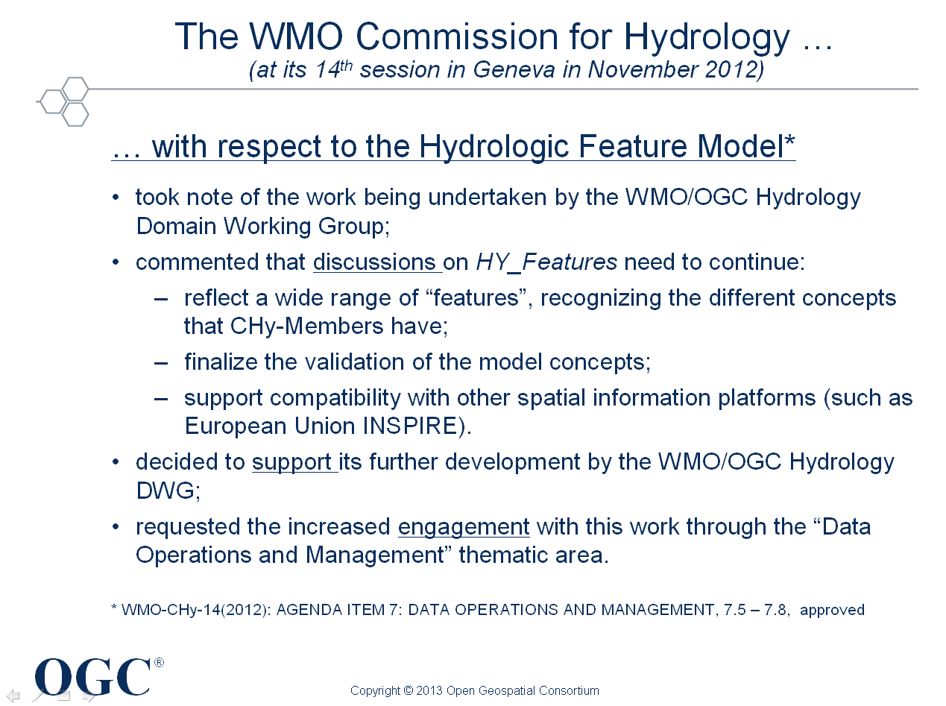
Consensus required on basic concepts of
Catchment and Basin
83rd, OGC TC, Redlands, Jan ‘13

Slide 5
Common definitions of catchment / basin
IPCC 4th Assessment Report, 2007
catchment: area that collects and drains rainwater.
basin: drainage area of a stream, river or lake.
GWML2 Consolidated Feature List, draft, 2013:
groundwater basin: large hydrogeologically defined body (unit) of ground typically consisting of hydraulically connected Hydrogeo Units
International Glossary of Hydrology, WMO/UNESCO, 2011
basin (syn. drainage basin, catchment, river basin, watershed): area having a common outlet for its surface runoff.
groundwater basin (see also aquifer system): physiographic unit encompassing one major aquifer, or several connected or interrelated aquifers, whose waters are flowing to a common outlet.
aquifer: geological formation capable of storing, transmitting and yielding exploitable quantities of water.
water body: mass of water distinct from other masses of water [refers to the liquid phase, not limited to surface water]

Slide 6
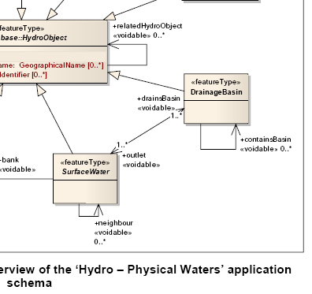
Basin definition in INSPIRE Hydrography theme
Drainage basin: area having a common outlet for its surface runoff. (=IGH)
  “possible to build basins from other basins”
  “outlet of a drainage basin may be a canal or a lake”
  refers to surface water,
  no definition with respect to
  groundwater
  containsBasin, 0..*
  outlet, 1..*

Slide 7
unit – area – water body
Definitions used within HY_Features*:
feature = abstract notion of a real world phenomenon (ISO 19109); multiple and differently represented in the real world
hydrologic feature = abstract notion of the hydrology phenomenon
unit = in sense of a distinct, separate entity; organised in hierarchies
catchment = unit catching something, e.g. water;
→ unit wherein hydrologic processes take place, the commonly recognised unit of study, management, reporting, …, in hydrology
basin = hydrologically determined catchment (inflow / outflow); organised in hierarchies of basins
area = a geometric representation of the respective unit
water = liquid phase of the chemical compound H₂O
water body = mass of [liquid] water (has volume, no shape)
* based on the definitions documented in the WMO-UNESCO Glossary of Hydrology

Slide 8
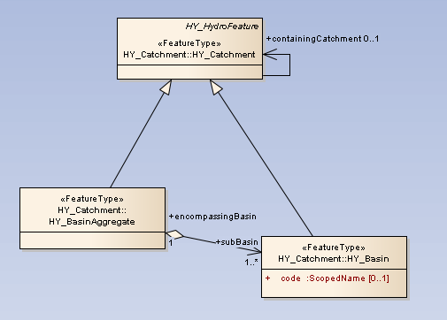
Catchment, containment hierarchy
Catchment is part of a containing catchment* in a nested or aggregate hierarchy of catchments
* typically used for high order organisation of management and reporting units.

Slide 9
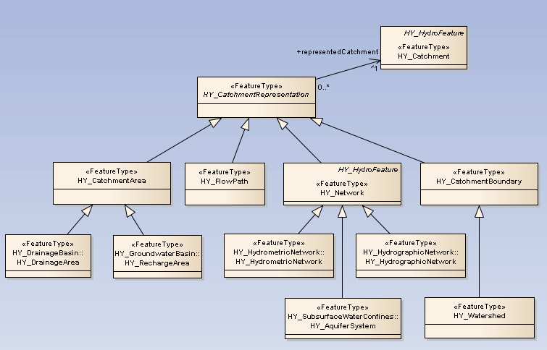
Catchment, multiple represented
each real-world object represents exactly one catchment

Slide 10
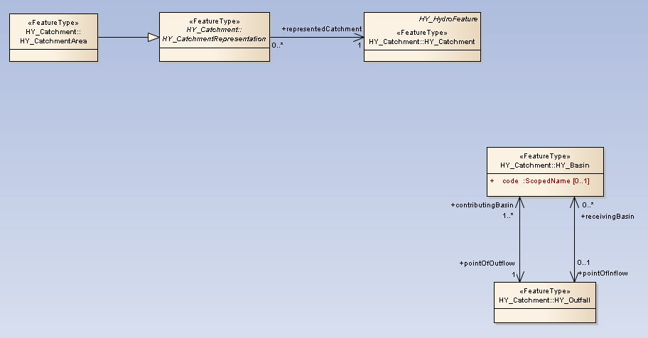
Basin, hydrologically discrete
unit (special catchment) whose waters, ie. surface and sub-surface incl. groundwater, flow to a common outlet
Inflow node
Outflow node
Outflow node
C

Slide 11
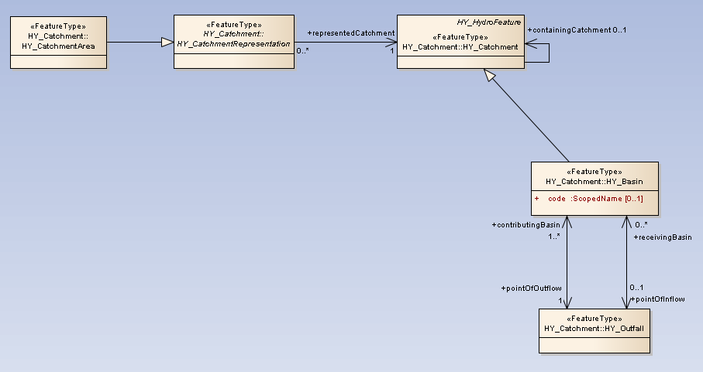
Basin as a whole
the real-world representation, e.g. catchment area, represents the basin as a whole, in sense of a “link”
A
Inflow node
Outflow node
C

Slide 12
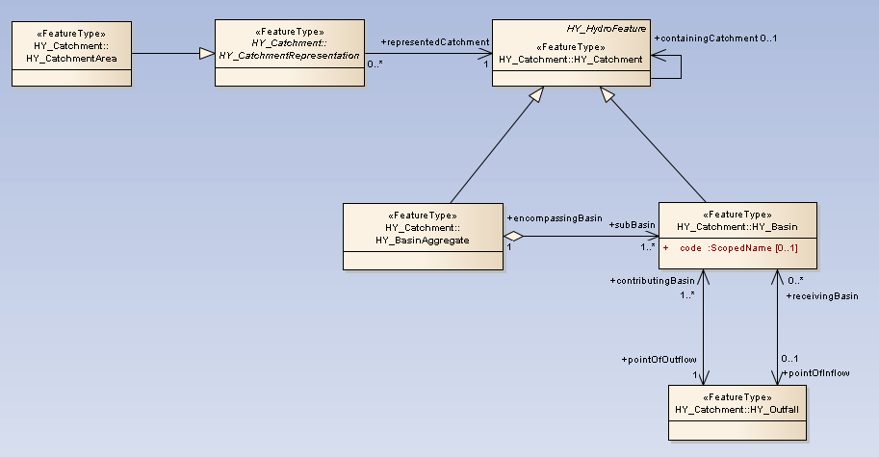
Basin as an aggregate of sub-basins
the real-world representation, e.g. catchment area, represents an encapsulated basin (one of many)
A
Inflow nodes
B
Outflow node
C

Slide 13
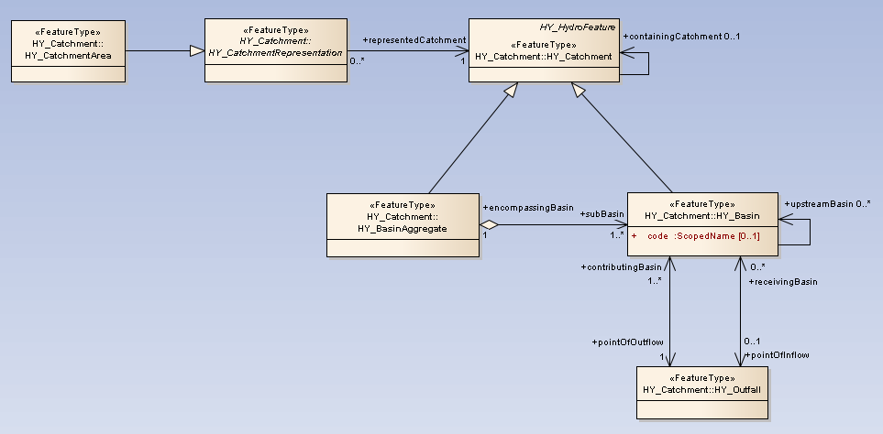
Basin as an inter-basin
Basin, or sub-basin, having inflow node/s each coincided with an outflow node of immediately upstream basin

Slide 14
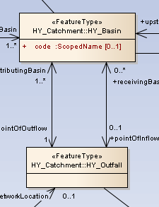
Outfall, a topological concept 1(2)
arbitrary location as outlet of a basin
  outflowNode*: supplying water into a receiving basin
  inflowNode*: catching water from a contributing basin
no explicit geometry
  needs to be defined with the representation:
  reference point, flow line, section area, …
  currently, reference point is associated with the outfall
  longitudinal section may be associated to outfall
  cross section may be associated to outfall
  * roles currently named to “pointOfOutflow/-Inflow”, may be changed into “node…” to avoid the impression of a pre-setting of the geometry

Slide 15
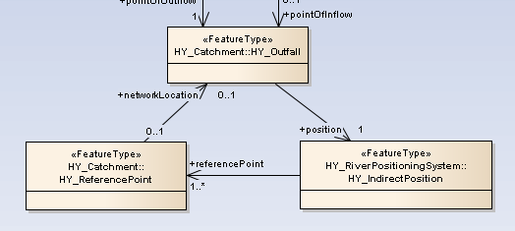
Outfall, a topological concept 2(2)
no explicit position → indirect position
  distance to a reference point, or
  relative to a reference point, or distance.
    percentage of the total distance to the reference point,
    verbal description of relationship to a reference point.

Slide 16
Relate hydrologic objects to the basin
  using catchmentRepresentation
  via outfall of the corresponding basin
    addressed using a reference location
      referencePoint (point)
      longitudinalSection (curve, polygon)
      crossSection (curve, polygon)
      ?

Slide 17
Catchment representation
each real-world object represents exactly one catchment

Slide 18
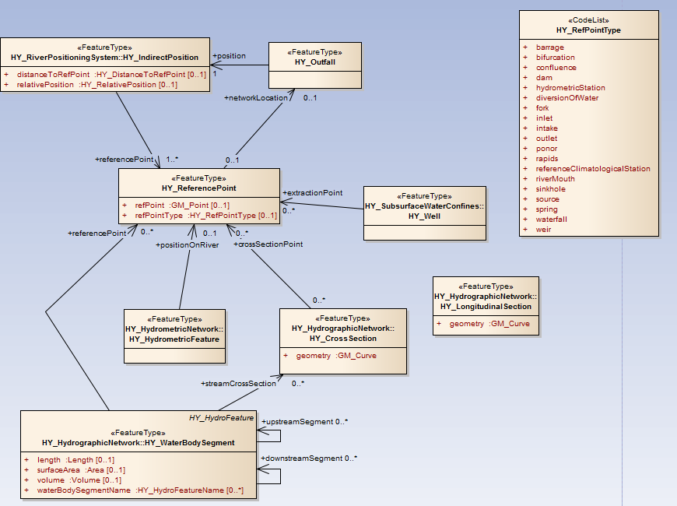
Reference Point, current relationships

Slide 19
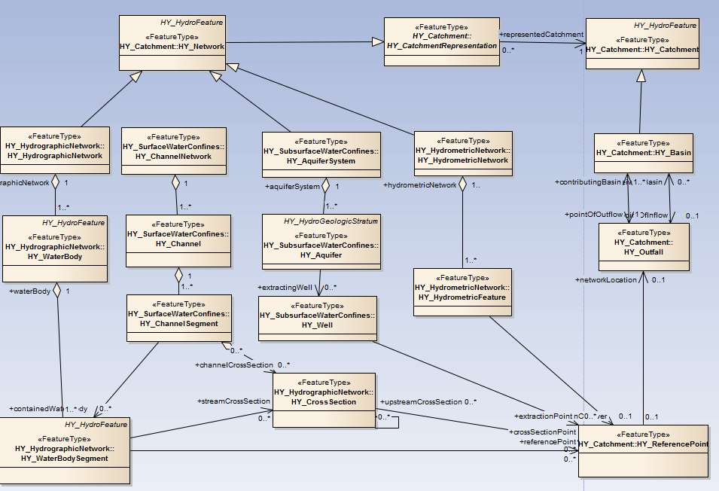

Find the way out of the maze

Slide 20
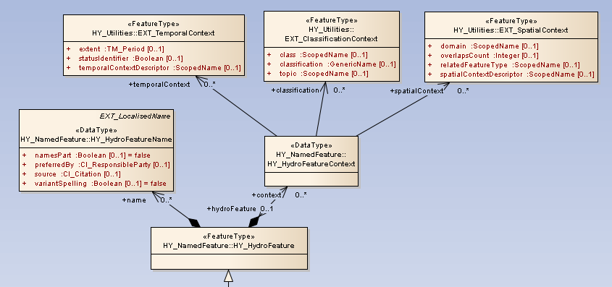
Catchment, a hydrologic feature
names are given to through common usage
characteristics with respect to related contexts
pattern to handle contextual relations with other domains
pattern to handle cultural, political and historical variability of names without necessarily have a formal model of naming

Slide 21
To do (by Sep 2013, Frascati meeting)
Finalise/consolidate the concept catchment, basin, outfall
Review of concepts of channel, channel segment, channel sections

Slide 22
Thank you !
Contact:
I. Dornblut
Global Runoff Data Centre (GRDC)
Federal Institute of Hydrology (BfG), Koblenz, Germany
grdc@bafg.de; dornblut@bafg.de
Copyright © 2013 Open Geospatial Consortium

