Slide 1

A Hydrology Profile For The SOS
Michael Utech, Software Developer, KISTERS
Québec June 2013

Slide 2
GEOWOW
GEO – Group on Earth Observations
GEOWOW is a project co-funded under the European Community's Seventh Framework Programme
Work packages for domains are Weather, Ocean and Water
Within WP5 - Water the profile will be specified and compliant services and clients be developed
Done by BFG, Uni Bonn, 52North, and KISTERS
waterml waterml2 time series server encoding standard hydrological information system sos sensor observation service measurements gml geography markup language water kisters wiski his
© KISTERS AG KISTERS Partner Week 2011 <number> 07/11/26

Slide 3
Hydrology Profile Objectives
Intended for SOS2 and maybe partly usable for SOS1
Specifies WaterML2.0 as the language for timeseries data
Results in a technically and semantically interoperable hydrological SOS
Guide developers to ONE specific way of doing (instead supporting multiple variants)
© KISTERS AG KISTERS Partner Week 2011 <number> 07/11/26

Slide 4
Profile Structure
Terms and Definitions will cover all entity related topics
Requests and Responses will cover all topics related to the querying and retrieving data with the available requests
Technical issues will cover purely technical topics like what to respond if e.g. a client requests half the database content
Where possible, definitions will also be expressed through e.g. extensions or schemas
Definition 1
The profile shall announce itself in the ServiceIdentification section as attribute profile with the value ‘http://www.opengis.net/spec/SOS_application-profile_hydrology/1.0/req/hydrosos ’.
© KISTERS AG KISTERS Partner Week 2011 <number> 07/11/26

Slide 5
Terms and Definitions
FeatureOfInterest
Procedure
  In general the procedure is to be seen as an algorithm, sensor type or timeseries type, NOT as a timeseries instance
Definition 2
All sampling features within the scope of this profile shall be restricted to the type wml2:MonitoringPoint.
Definition 3
All procedures within the scope of this profile shall be restricted to the type wml2:ObservationProcess.
© KISTERS AG KISTERS Partner Week 2011 <number> 07/11/26
Notes:
Change Def. 2 to sampling feature with recommendation of MonitoringPoint
Check hosted procedures for sampling features to get to a sensor instance

Slide 6
Terms and Definitions
Identification of entities
  exactly one URI pointer for an object
  at least one human readable name which serves for labelling that object
  Current plan is:
  These definitions ensure unique identification (within the service) and provide readable labels too
Definition 4
Identification of entities shall refer to the gml:identifier field of the entity wherever possible, while the gml:name field shall hold a label name for it.
Definition 5
If the entity is not listed as a complex element and therefore does not feature a gml:identifier, the xlink:href attribute shall be used as identifier, while the xlink:title attribute shall hold a label name for it.
© KISTERS AG KISTERS Partner Week 2011 <number> 07/11/26

Slide 7
Requests and Responses
GetCapabilities
  (falsely) indicates homegeneous distribution of timeseries
  This will be overcome with a GetDataAvailability extension (more about that later)
  The list of sampling features often is too large to be provided in GetCapabilities
Definition 6
The GetCapabilities content section shall not expose any features.
© KISTERS AG KISTERS Partner Week 2011 <number> 07/11/26

Slide 8
Requests and Responses
GetFeatureOfInterest
  More about feature handling including sampled features later…
DescribeSensor
  -
Definition 7
The GetFeatureOfInterest request shall be mandatory.
Definition 8
The GetFeatureOfInterest response shall return sampling features as wml2:MonitoringPoint only.
Definition 9
The procedure description format http://www.opengis.net/waterml/2.0/observationProcess shall be mandatory and shall be announced in the GetCapabilities response.
Definition 10
The DescribeSensor request shall return procedures as http://www.opengis.net/waterml/2.0/observationProcess.
© KISTERS AG KISTERS Partner Week 2011 <number> 07/11/26

Slide 9
Requests and Responses
GetObservation
  SOS spec requires a service to return all timeseries values if no temporal filter is provided
  With this definition one overcomes unintended large requests plus gets a new feature to return the most current value of a timeseries
Definition 11
The GetObservation request shall return metadata of all existing timeseries in form of the wml2:Timeseries element even if they do not contain any values for the requested time range.
Definition 12
If the GetObservation request does not contain a temporal filter the service shall only return the last value of each timeseries instead of the full content.
© KISTERS AG KISTERS Partner Week 2011 <number> 07/11/26
Notes:
Def. 11: define it one level above wml2:Timeseries

Slide 10
Technical Issues
Simple versus complex elements
  A simple element is a one-liner using href/title from gml:referenceType
  A complex element is more detailed (like wml2:MonitoringPoint) but does NOT have the referenceType
  Mostly relevant for the ID handling
SOAP binding
  Basic (but useless WSDL) for SOS2
  Maybe a specific WSDL could be defined for a SOS2 with this profile later
  Would there be interest in this for dynamic generation of clients e.g. with SoapUI?
© KISTERS AG KISTERS Partner Week 2011 <number> 07/11/26
Notes:
Alva Couch will look into the WSDL issue, timeline 3-6 months
Pete Taylor will send RESTful information for WML2
Check if SOAP binding is mandatory in SOS2 -> no
If not set KVP binding mandatory in profile

Slide 11
Technical Issues
Procedure and observedProperty in GetCapabilities
  Single field only, either ID or label possible but not both
  Make change request to SOS2 SWG?
Response limits
  SOS is too open for making accidental or intended bulk requests
  A GetObservation call with one property and offering could easily have to return 1000+ timeseries
  Two desirable limits:
    Sum of all returned values for a request (e.g. 100.000)
    Sum of timeseries per response (e.g. 1000)
  No limitation for feature requests
  The actual numbers can be set by the service operator
© KISTERS AG KISTERS Partner Week 2011 <number> 07/11/26
Notes:
Pete Taylor will check the GetCapabilities issue above
GetCapabilities should provide response limit information
Recommendation that the value count limit should be higher than the single longest timeseries?

Slide 12
GetDataAvailability Status At OGC
Work has not continued within SOS2 SWG
Currently (to our knowledge) no plans to develope this extension any time soon
Possibilty for us to step in
  Develope a useful extension for our profile
  Adjust with CHISP-1 results
  Try to get it accepted as official SOS2 extension at OGC

Slide 13
GetDataAvailability
Purpose: To provide a filterable timeseries list
Including data coverage (from and to timestamps)
Will be mandatory
As SOS2 extension including schemas
Use Case Examples:
  Return the timeseries for a specific property and procedure at all locations
  Get data coverage for a specific timeseries
  Return all timeseries for all properties at a specific measuring location
Notes:
Use case count per timeseries

Slide 14

GetDataAvailability Request
Allow filtering by:
  featureOfInterest (sampling features only!)
  observedProperty
  procedure
  (Offering ?)
  (Time ???)
Example:
Notes:
Offering should be added to be complete

Slide 15
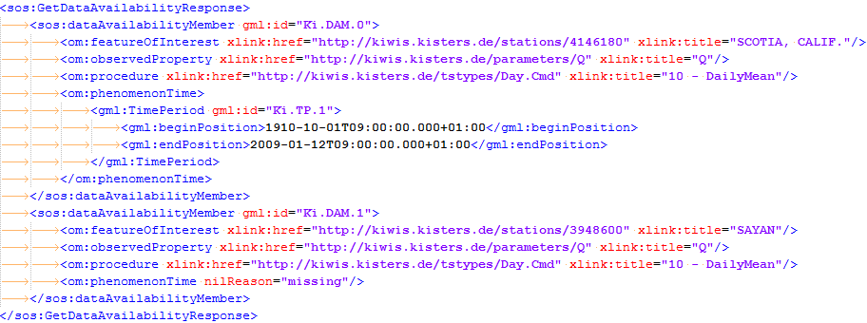
GetDataAvailability Response
Return all matching timeseries as dataAvailabilityMember
with identifying metadata and coverage
Example:
Notes:
Add definition that foi+obsProp+proc have to be unique in the service

Slide 16
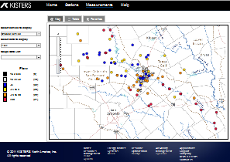


Outlook - SOS for basic systems
Client App
Browser
Time Series Information
Observations and Derived Series
SiteList (FOI list)
Time Series List (via getDataAvailability)
getCapabilities
getFeatureOfInterest
getObservation
getDataAvailability
SOS
(core profile)
Server

Slide 17
SOS2 & WFS
WFS should be optional (SOS still has GetFeatureOfInterest mandatory)
Previous thoughts went to a WFS supplying:
  Better filters
  Domain/Sampled feature handling
  Provide a timeseries feature class (unnecessary with a SOS GDA extension)
Long discussion at a recent meeting with 52° North and BfG
Use Cases:
  Find MonitoringPoints for a catchment or a river
  List catchments, rivers etc
  Get geometry data of catchments to show them in a map

Slide 18
SOS2 & WFS – Proposed solution
SOS2 takes care of everything related to timeseries, values and basic sampling feature handling
SOS2 does not include domain/sampled features
WFS is fully optional (Clients may or may not be able to use WFS additional functionality)
Define a few domain feature types by name, e.g. catchments or rivers (WFS provider can add additional non-standard types freely)
These types are meant for discovery, NOT as an ML description like e.g. RiverML

Slide 19
SOS2 & WFS – Proposed solution
The domain feature IDs of the standardized feature types can then be added as attributes to the actual sampling features (in the WFS, e.g. catchment_id = 123)
This allows easy discovery of MonitoringPoints for domain features with standard WFS functionality
Disadvantage: leads to a n:1 relationship - one MonitoringPoint can only be connected to one catchment but a catchment may contain many MPs (background system would need to have transitive filtering)
Notes:
Disadvantag was accepted
WFS feature types should be as simple as possible and close to what current clients understand (simple features?)

Slide 20
SOS2 & WFS – Proposed solution
Open questions:
  Is the n:1 relationship solvable at all apart from using geometry filters?
  Can we make use of HY_Features?
  How will WFS GetCapabilities be linked from SOS (e.g. extension point)?
Conclusion:
  Proposed solution provides
    additional feature discovery for a SOS2
    Listing and filtering of domain features
  A simple basis to build a high level WFS covering several Hydro-Profile WFS instances

Slide 21
Outlook - SOS & WFS in medium/large systems
Client App
Browser
Time Series Information
Observations and Derived Series
Time Series List (via getDataAvailability)
SiteList (FOI list)
Predefined domain feature types
Filtering for domain features
getCapabilities
getFeatureOfInterest
getObservation
getDataAvailability
getCapabilities
getFeatures
Using flexible filter criteria
SOS
(core profile)
WFS
(extension for
larger systems)
Server

Slide 22
Outlook - Next steps / Roadmap
Q3/2013 Geowow: Provide updated profile document considering Hydro.DWG comments
Q4/2013 Geowow: Provide necessary schemas and extension specs
Q1/2014 Geowow: Possibly get getDataAvailability accepted as official extension
2014 OGC: Introduce Best Practices paper (or at least discussion paper)

Slide 23
Thank you for your attention…
Any questions?

Slide 24
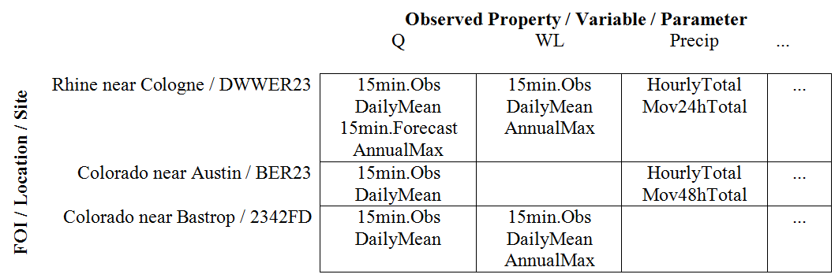
Real World Time Series do not occur homogeneous
Processes /
Time Series Types

Slide 25
Previously identified problems
Within the scope of the Groundwater and Surface Water IEs, several difficulties in the usage of SOS for hydrological data have been identified
They mainly led to several different semantic mappings that we listed as SOS types A to C
These SOS setups were mostly interoperable from a technical point of view, but not regarding semantics
© KISTERS AG KISTERS Partner Week 2011 <number> 07/11/26

Slide 26
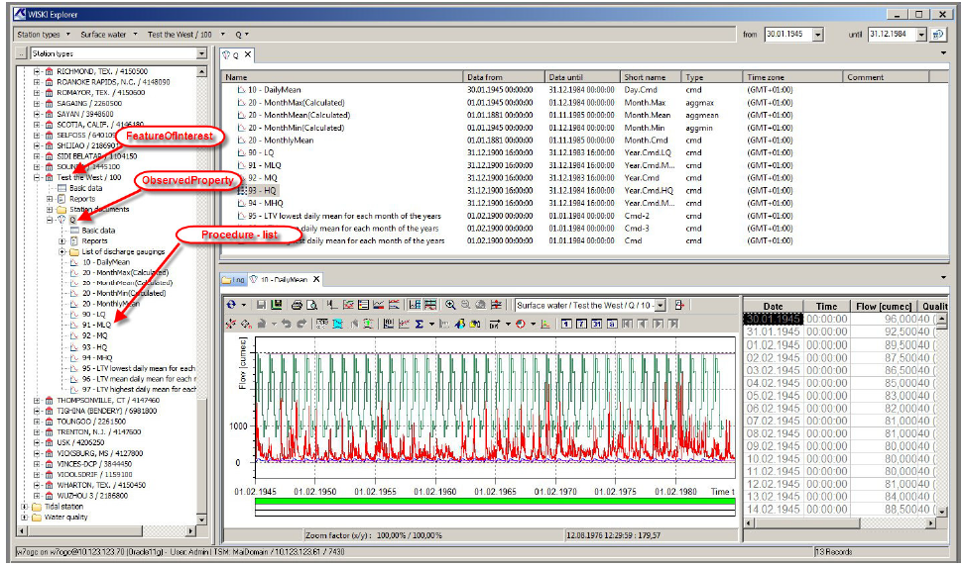
Entities in WISKI7 Hydrological Information Management
(with full support of WaterML 1 and 2)
© KISTERS AG Fachausschuss GIS & GDI, 22. November 2011 <number> 07/11/26

