Slide 1



RiverML: A River Geometry and Observation Exchange Language
OGC Hydro DWG Workshop Quebec City 2013
17 June 2013
Stephen R. Jackson
David K. Arctur
David R. Maidment
Center for Research in Water Resources
University of Texas at Austin
OCI-1148453 (2012-2017)
OCI-1148090 (2012-2017)

Slide 2
Overview
River Geometry
River Observations
Prototype Exchange Format: HEC-GeoRAS
Proposed Exchange Format: RiverML
Implications for Standard Workflow
Implications for Innovation
Discussion

Slide 3
River Geometry
How do we store and view river terrain information?

Slide 4
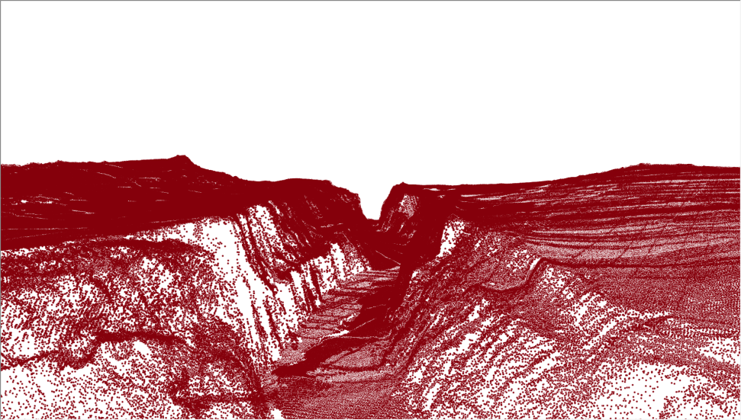
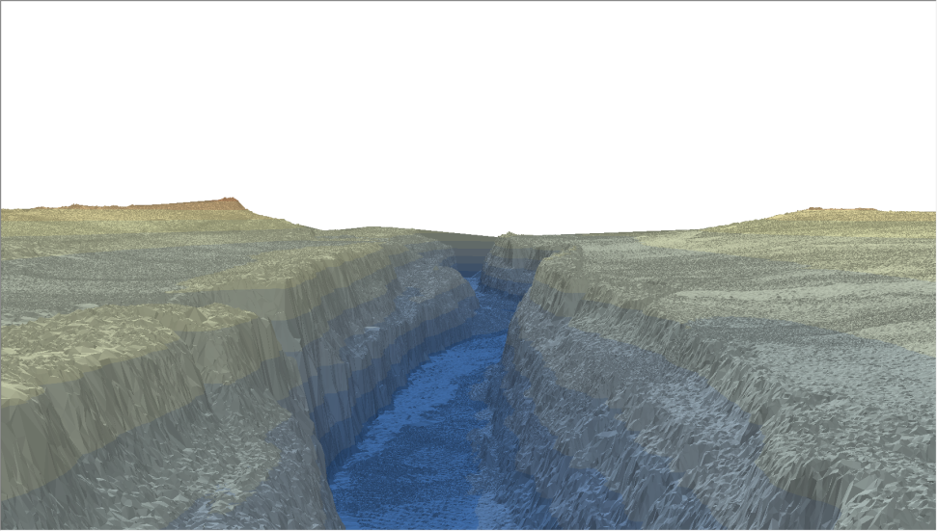
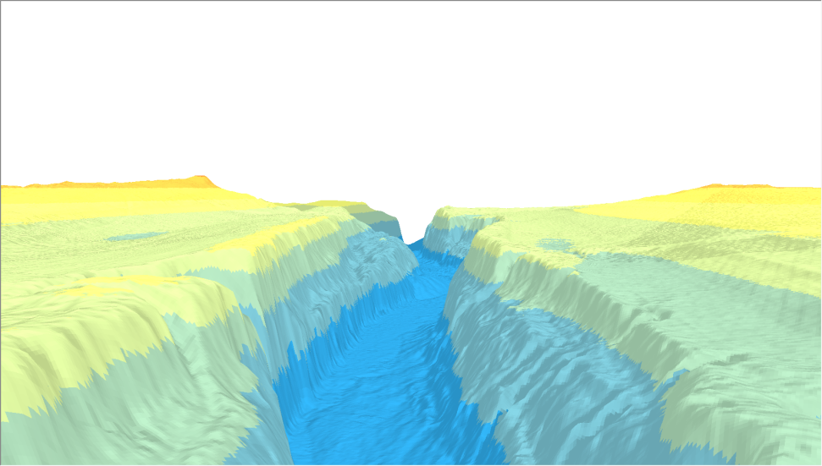
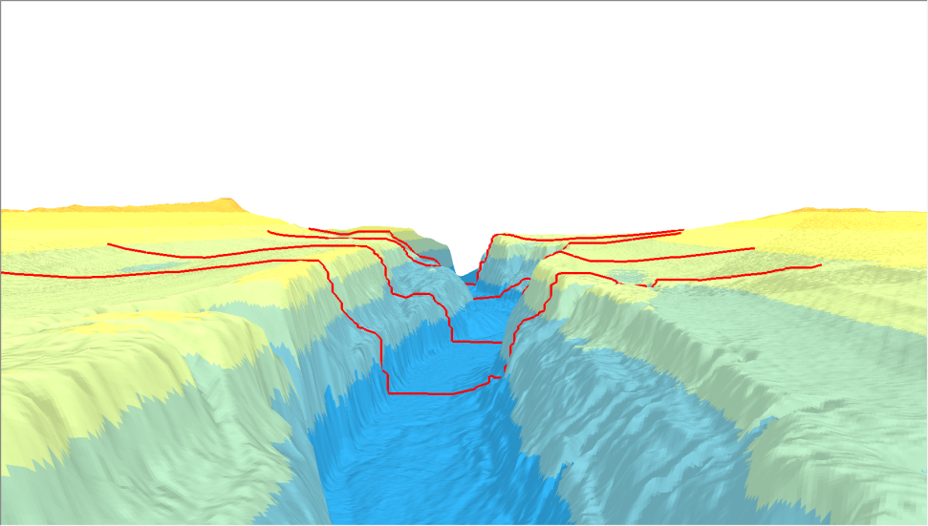
Typical Terrain Representations
Raw LiDAR Points
Triangulated Irregular Network (TIN)
Raster
Cross Sections

Slide 5
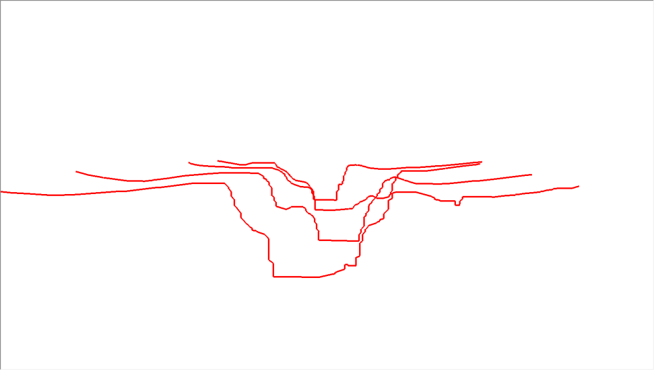
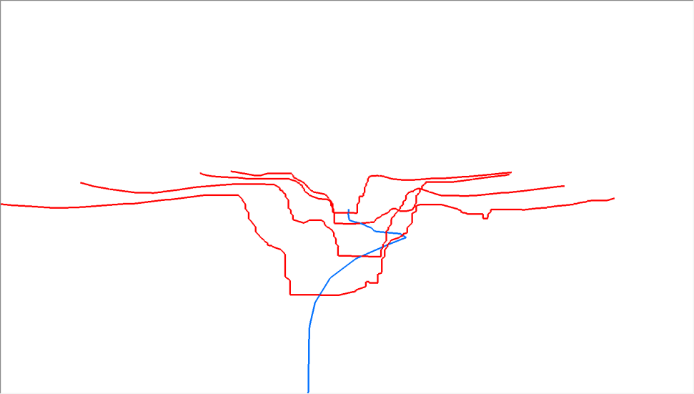
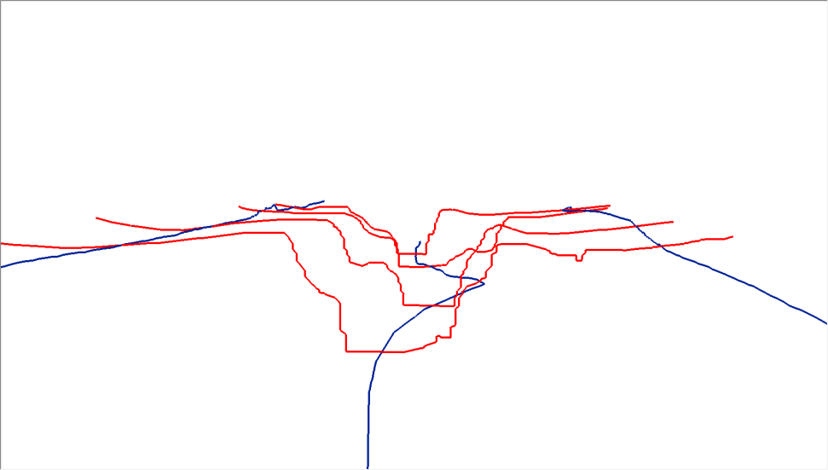
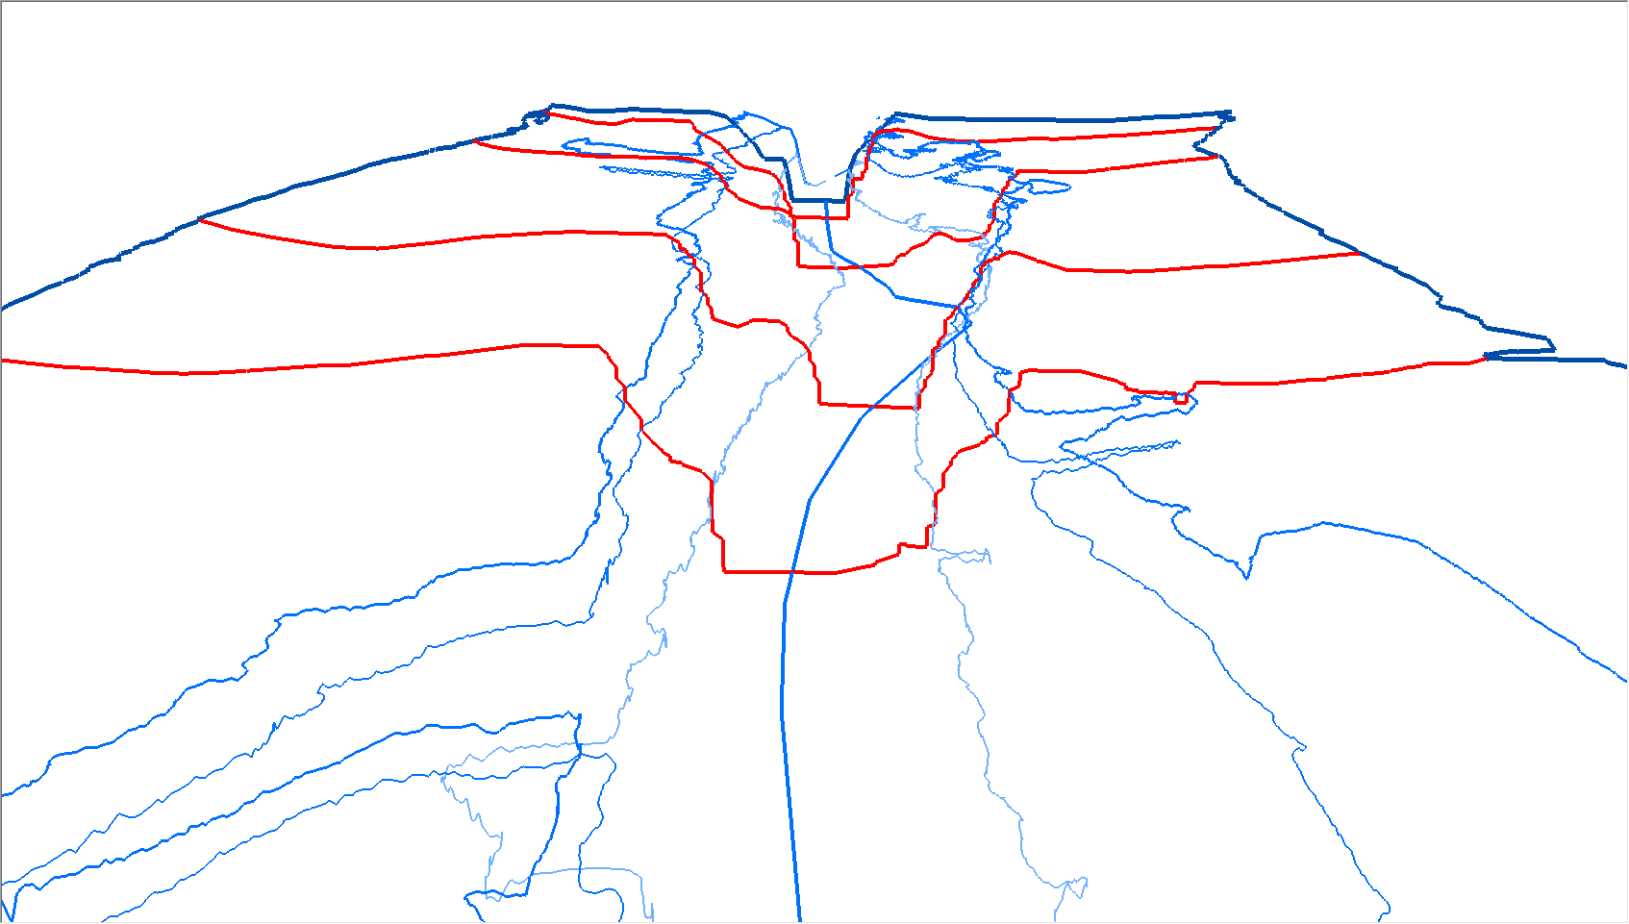
Cross Sections and Flow Lines
Cross Sections
Center Flow Line
Overbank Flow Lines
Topological Flow Lines

Slide 6
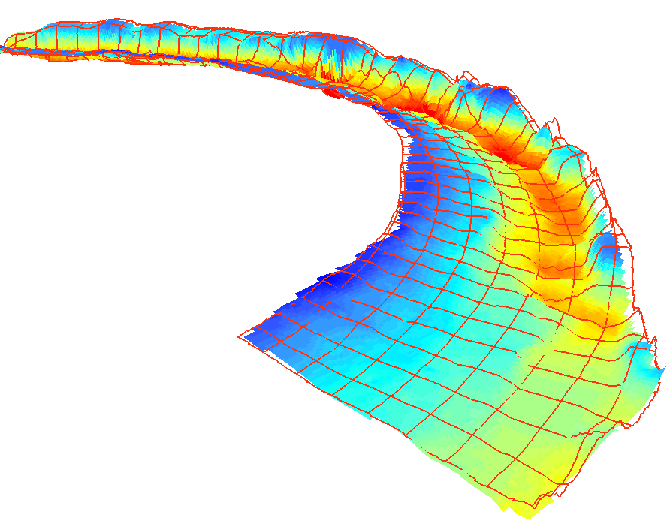
Finite Element Models
Advanced computational approaches use various forms of a dense mesh for finite element analysis.
From a data format perspective, this fits with a Cross Section & Flow Line model
Geospatial Representation of River Channels by Venkatesh Merwade

Slide 7
River Observations
What form do model results typically take?

Slide 8
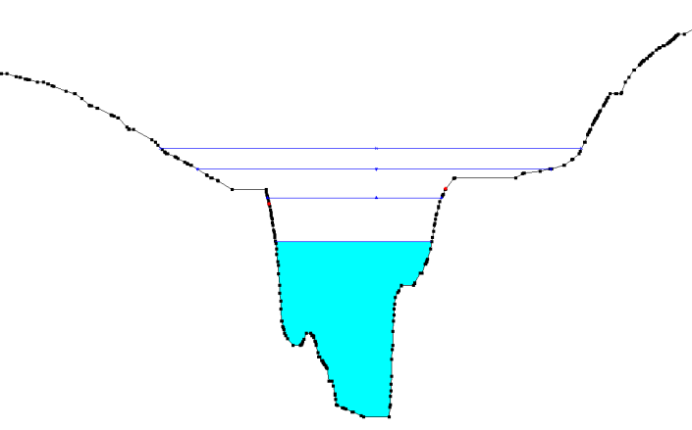
Cross Section Observations
Single Value (Steady State)
 | 10-Year | 25-Year | 50-Year | 100-Year
Flow Rate (m³/s) | 10.7 | 22.4 | 42.9 | 68.7
Water Surface Elevation (m) | 2.8 | 4.1 | 6.2 | 7.4
Scenario Names
Time Series (Hydrograph)
Time | Flow Rate (m³/s) | Water Surface Elevation (m)
2002-07-12 01:00 | 20.1 | 3.8
2002-07-12 02:00 | 22.6 | 4.1
2002-07-12 03:00 | 27.3 | 5.0
2002-07-12 04:00 | 42.8 | 6.2
2002-07-12 05:00 | 31.9 | 5.3
Scenario Name:
“July 2002 Flood”
Flow
Time

Slide 9
Prototype Exchange Format:
HEC-GeoRAS
What existing strategies have been developed to handle river data exchange?

Slide 10
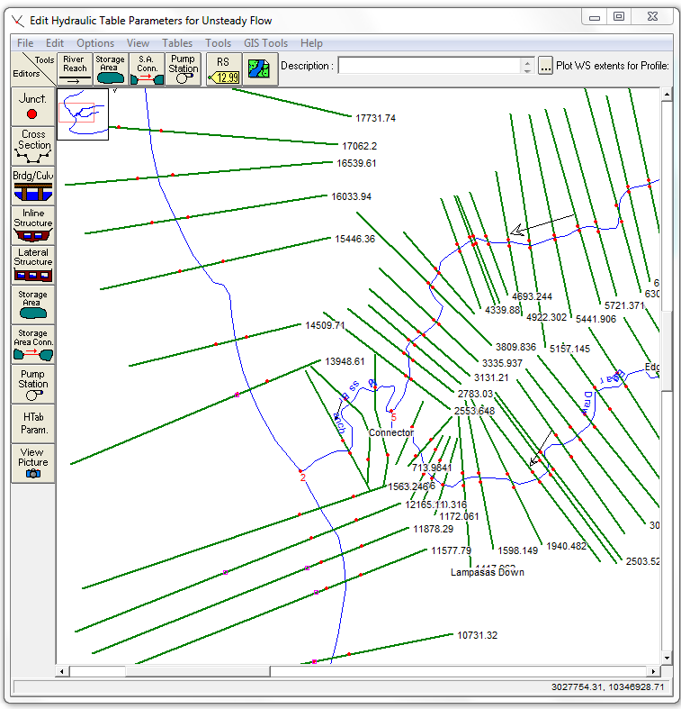
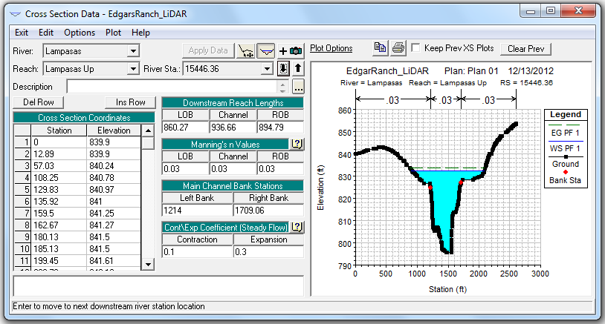
HEC-RAS Model
Cross Section Data
Given Flow Rate at each Cross Section for multiple scenarios, calculates a Water Surface Elevation for each scenario.
Georeferenced Cross Sections

Slide 11
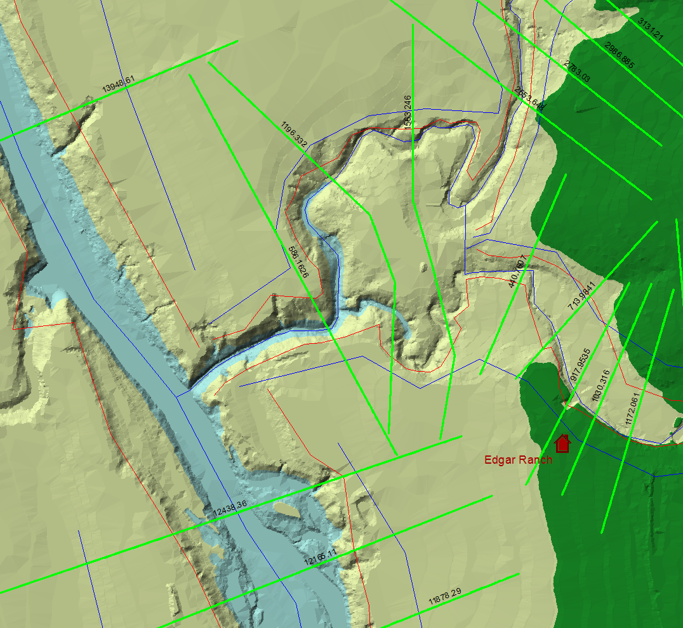
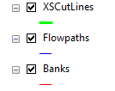
ArcGIS with HEC-GeoRAS Extension
Uses graphical tools to extract geometry data from Raster or TIN
Interpolates calculated Water Surface Elevation between cross sections

Slide 12
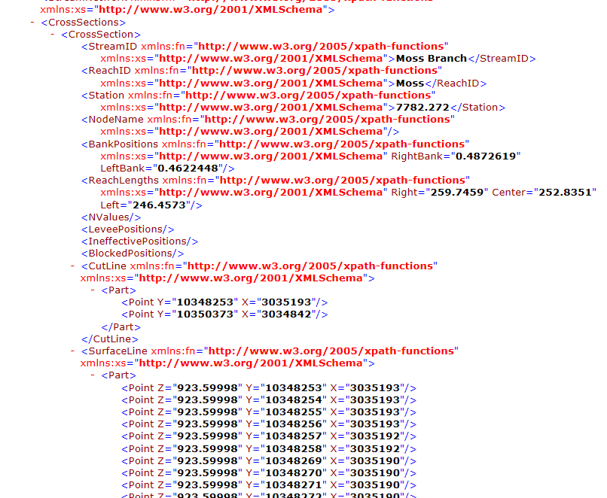
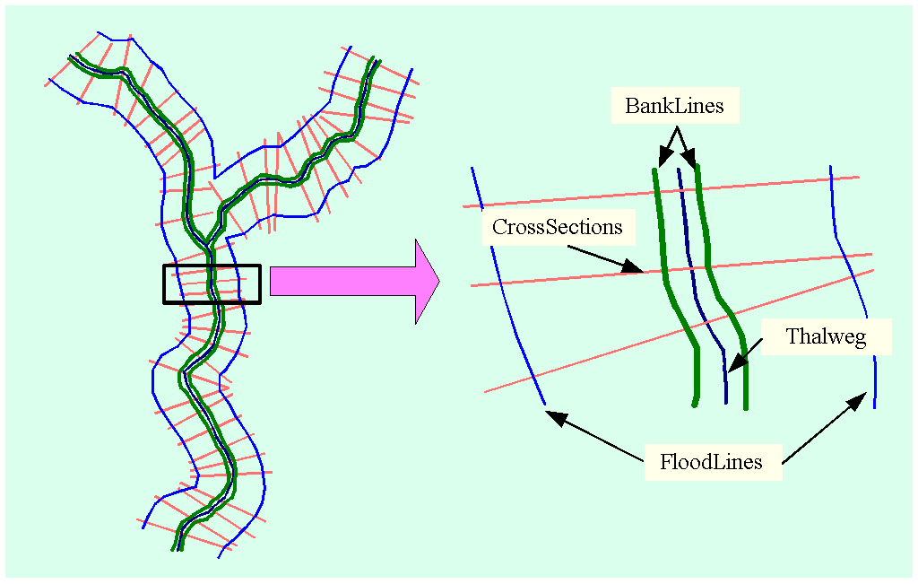
GIS to HEC-RAS: XML Geometry Exchange
Header
Spatial Extent
Network
Reach Names
Reach Center Lines
Reach Connectivity
Cross Sections
Station
Roughness
Additional Attributes
Geometry

Slide 13
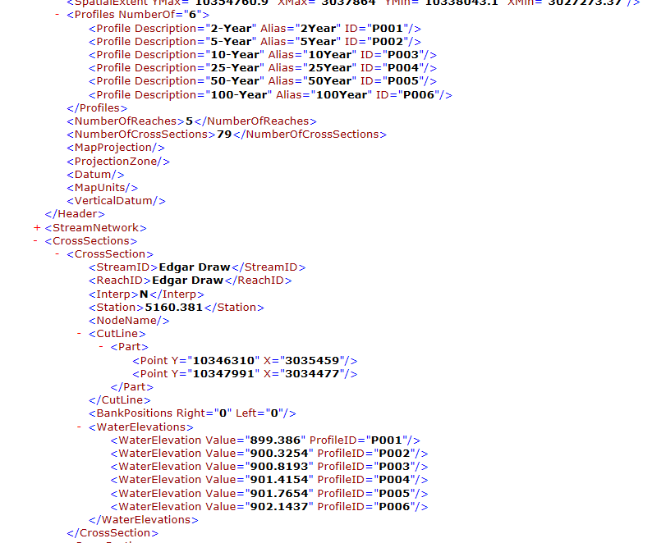
HEC-RAS to GIS: XML Observation Exchange
Header
Spatial Extent
Profiles (Scenarios)
Network
Reach Names
Reach Center Lines
Reach Connectivity
Cross Sections
Station
Water Surface Elevation
Flow
Time

Slide 14
Proposed Exchange Format: RiverML
How do we generalize the HEC-GeoRAS XML to form an adaptable standard?

Slide 15
HY_Features Class: Reach-Outfall-Basin
Hydraulic
Hydrologic
Figure 10, OGC 11-039r2

Slide 16
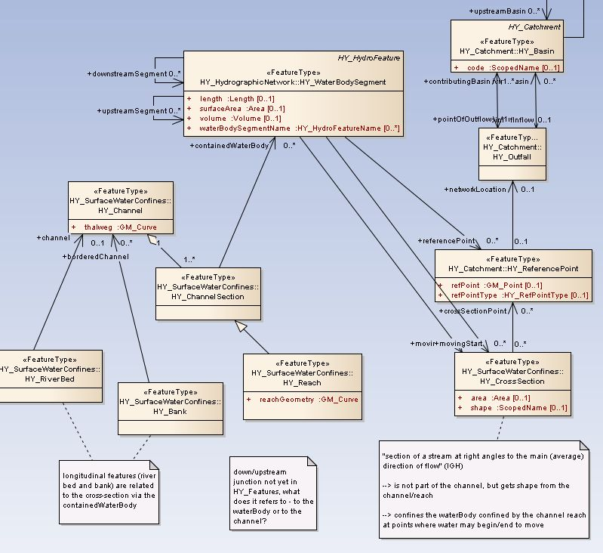
RiverML & HY_Features
by Irina Dornblut

Slide 17
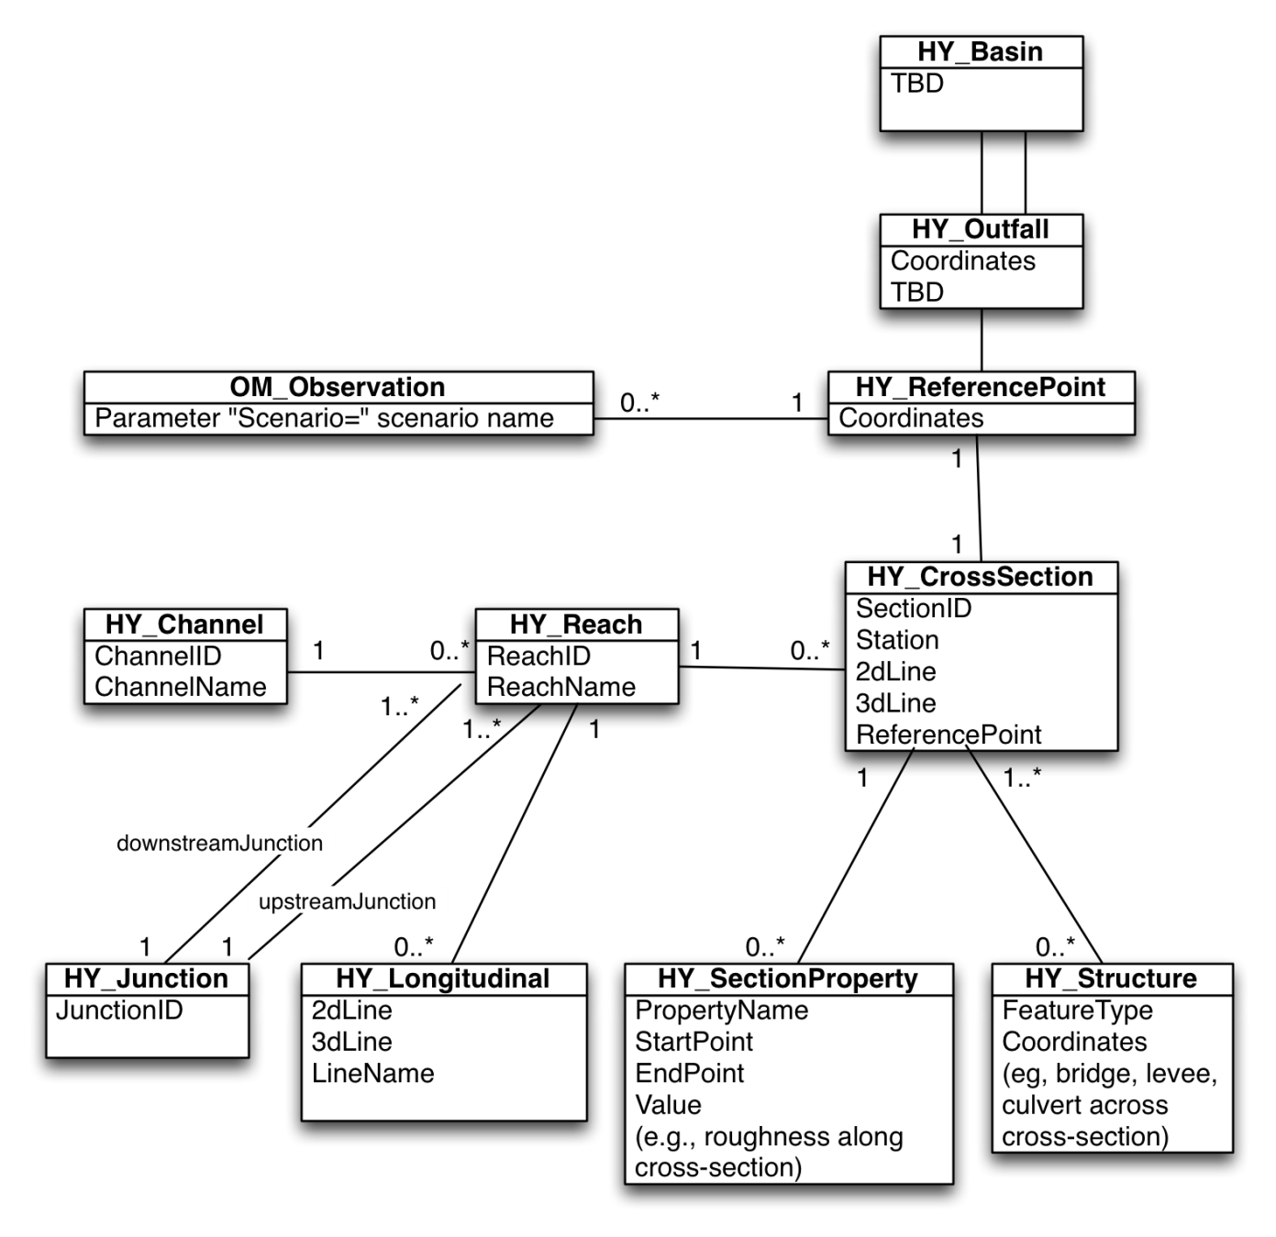
RiverML Templates
Geometry
Reach
Flow Line
Cross Section
Section Property
Structure
Reference Point
A consistent set of RiverML files shares the same set of Cross Section Reference Points. This allows models to be created modularly and joined unambiguously.
River Network
Channel
Reach
Junction
Cross Section
Reference Point
Catchments
Basin
Outfall
Reference Point
Observations
Observation
Reference Point

Slide 18
Implications for Standard Workflows
How does RiverML improve the status quo?

Slide 19









Software Buffet
AutoCAD
MicroStation & PondPack
Flo-2D
ArcGIS
MIKE Flood HD
XP-SWMM
HEC-RAS & HEC-HMS
ICPR
FESWMS-2DH

Slide 20
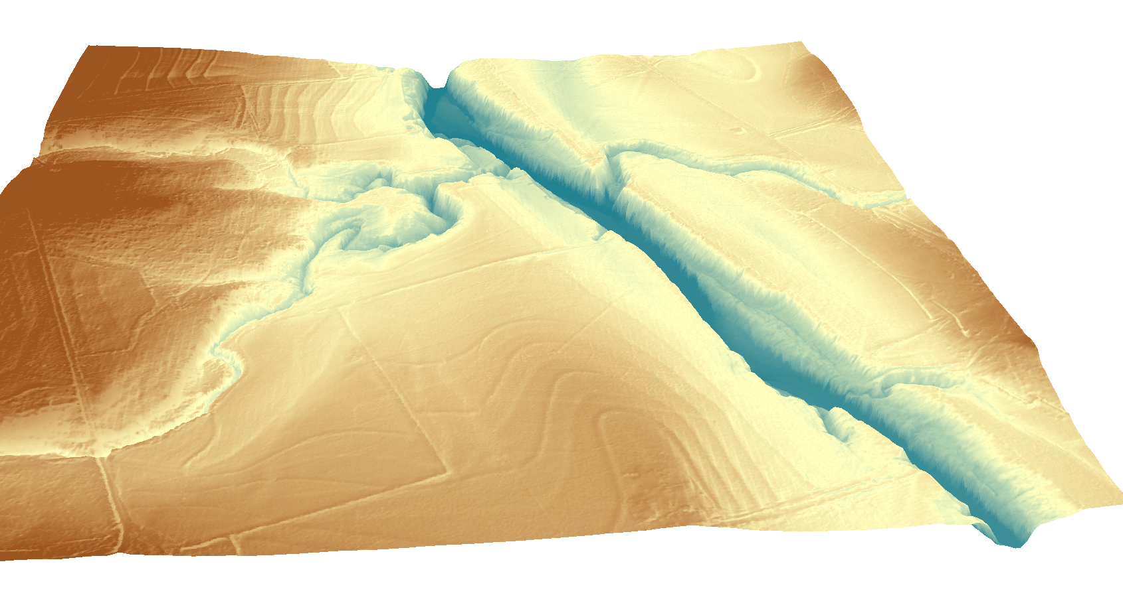
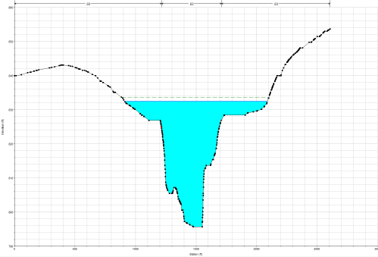
River Modeling: Existing Workflow
Simplified Cross Sections for Routing
Terrain Processing Software
(ArcGIS, AutoCAD, etc.)
Hydrologic Calculation Software
(HEC-HMS, PondPack, etc.)
Depth
Time
Translate WSEL results to format
suitable for mapping
Flow
Time
Extract Cross Section Geometry
Translate to Hydraulic Software Format
Translate flow rate at watershed outlet
to flow rate at Cross Sections
Hydraulic Calculation Software
(HEC-RAS, MIKE Flood HD, etc)

Slide 21
River Modeling: Proposed Workflow
RiverML
(Geometry, Catchment, River Network)
Terrain Processing Software
(ArcGIS, AutoCAD, etc.)
Hydrologic Calculation Software
(HEC-HMS, PondPack, etc.)
RiverML
(Water Surface
Elevation Observations)
RiverML
(Flow Rate Observations)
RiverML
(Geometry, River Network)
Hydraulic Calculation Software
(HEC-RAS, MIKE Flood HD, etc)

Slide 22
Discussion
Where do we go from here?

Slide 23
Discussion: Technical
How to handle differing taxonomies of diversions, barriers, flow lines, and roughness?
Would it be useful to support multiple templates for simple versus complex river characteristics (culverts, bridges, levees, etc.)?
How to handle provenance through workflows ?
Generating Software
Author
Scenario
How to reference other RiverML Geometry files
How to handle error ranges and other measures of uncertainty?
How to handle different units of measure and languages?
How to encode standard coordinate reference systems?
How to handle coordinate reference systems which are not in EPSG?

Slide 24
Discussion: Standards Adoption
Where does RiverML fit within the existing standards landscape?
HY_Features
OM_Observations
GML Simple Features Profile
Can RiverML be considered consistent with GML Simple Features Profile?
In other words, could this be immediately consumable with ArcGIS software?
Does the inclusion of OM_Observations inhibit this?
Would it be better for these to be Application Schemas of:
GML Simple Features Profile?
GeoSciML?
CityGML?
What assertions are needed to define the standard for compliance purposes?
Who wants to help charter a working group to finish this for OGC adoption?

Slide 25
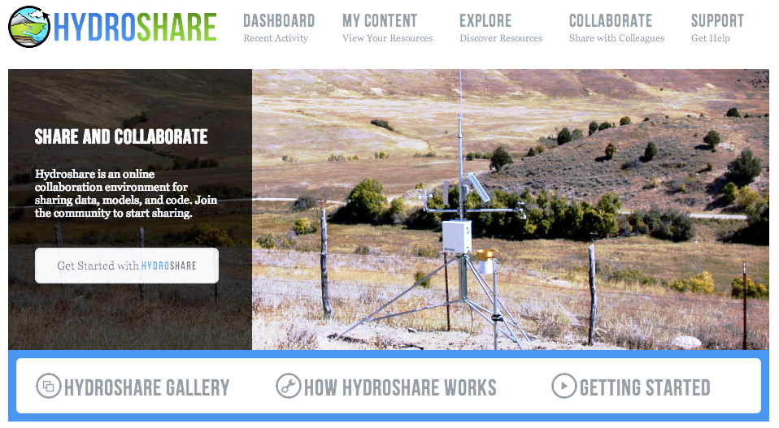
HydroShare.org: Web-based collaborative
environment for sharing data & models

Slide 27
Supplemental Information

Slide 28
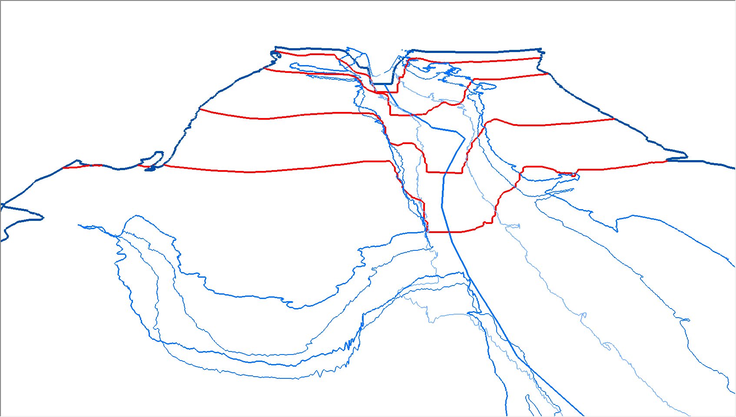
Wireframe Models
River wireframe models can readily be built either using lines of constant elevation (contours) or lines of constant risk (100-Year floodplain)
Advantages of Wireframe:
Low data density compared to TIN or Raster
Low file size for transfer
Rapid rendering time
High Information content
Reveals features such as tributaries and islands which are not visible with cross sections alone.
Allows additional cross sections to be interpolated with much higher accuracy than possible with cross sections alone.

Slide 29
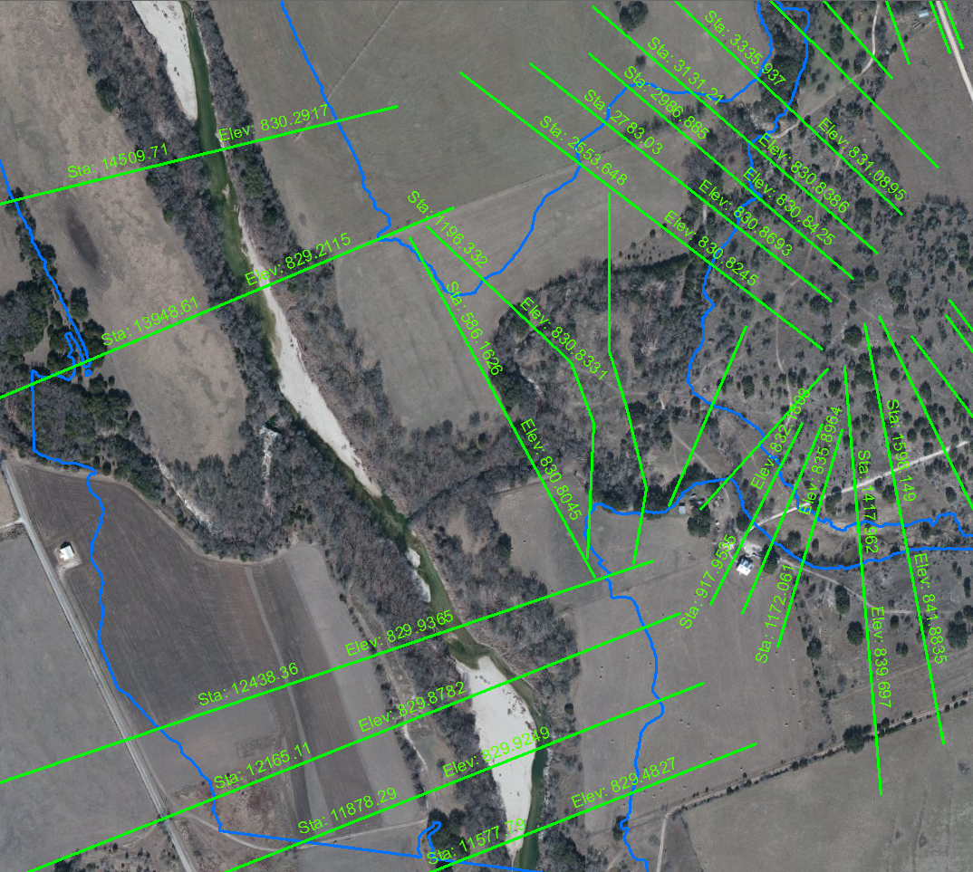
Floodplain Results
Results of interpolated Water Surface Elevation for a single Scenario (100-Year Floodplain)

Slide 30
Implications for Innovation
How does RiverML impact emerging technologies?

Slide 31
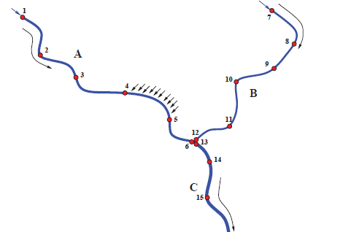
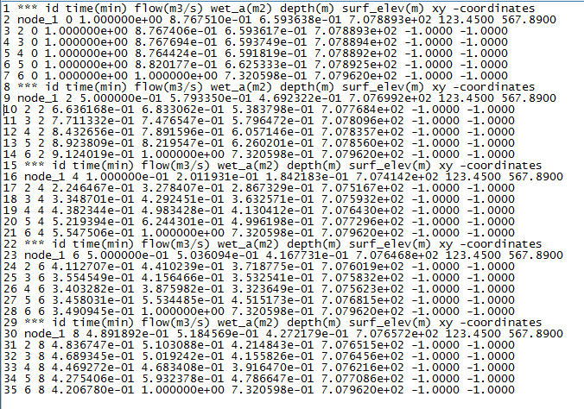
Use Case: SPRINT
SPRINT (Simulation Program for RIver NeTworks) is an high performance river network simulator developed at IBM Research Austin. Based on the similarities between river networks and microprocessor design, it provides fully dynamic solutions to St Venant equations for very large networks of river branches.
Network of Nodes
SPRINT Output
(Water Depth at each node at each time step)

Slide 32
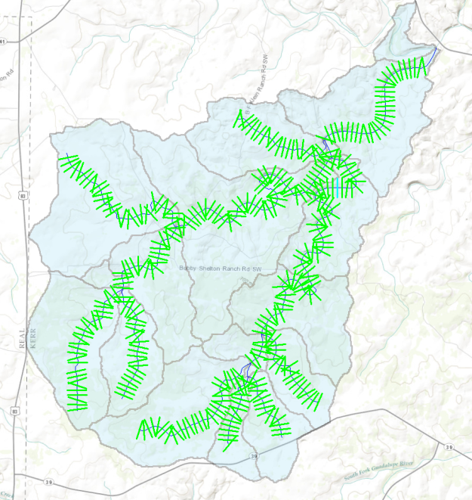
Benefits of RiverML
Accelerates the development of research tools such as SPRINT
Developers can focus on innovative computational methods rather than continually reinventing input/output formats
Allows simple data exchange between both common and customized software
RiverML Geometry
SPRINT
Node Network
ArcGIS
River Network
RiverML Observations
With RiverML, the feature extraction and visualization capabilities of GIS could readily be used by specialized calculation packages such as SPRINT

