Slide 1

Hydroinformatics of
watershed hydrology at INRS
Development framework and examples of
data processing, editing, display, and transfer algorithms implemented in our software
ALAIN N. ROUSSEAU, ALAIN ROYER AND
SÉBASTIEN TREMBLAY
Open Geospatial Consortium
Hydrology Domain Working Group
20 June, 2013
INRS-ETE, Quebec City, QC,

Slide 2

Scope of the presentation
Our software
Development framework and strategy
A few examples of data processing, editing, display and transfer algorithms
Summary

Slide 3
Our software

Slide 4
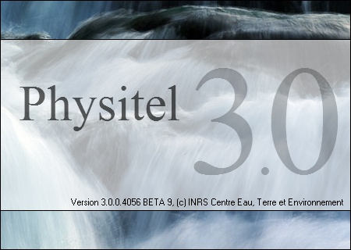

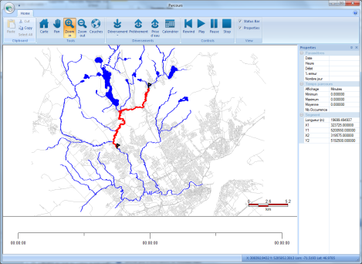
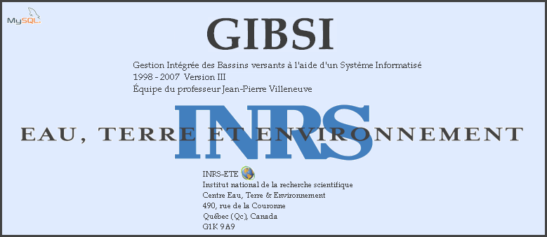
Software = Mathematical models + GUI
+ DB(geographic & attribute data)
+ public-domain/free tools

Slide 5
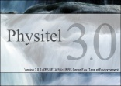
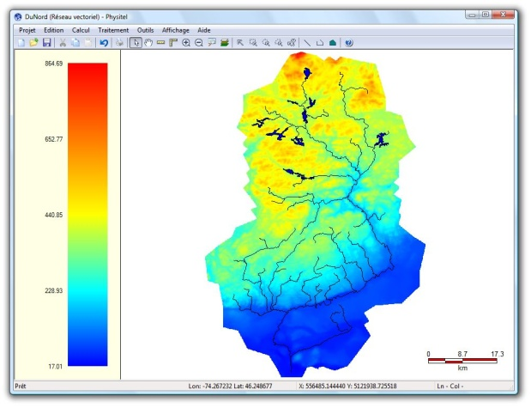
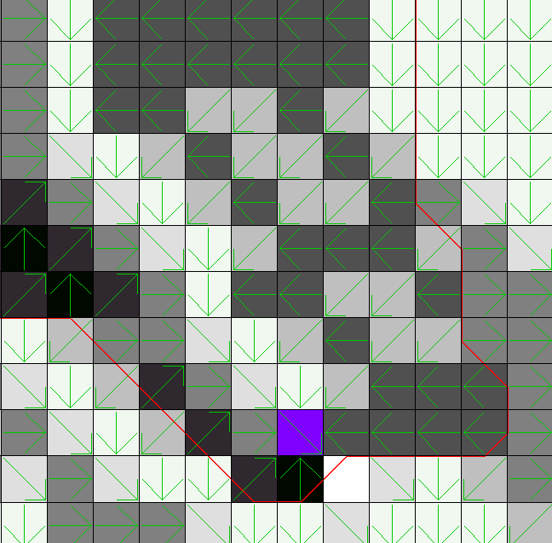
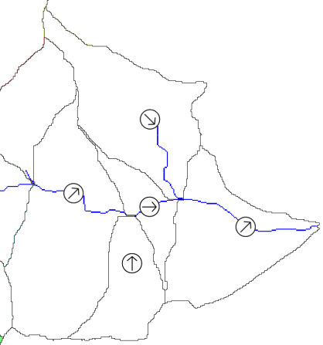
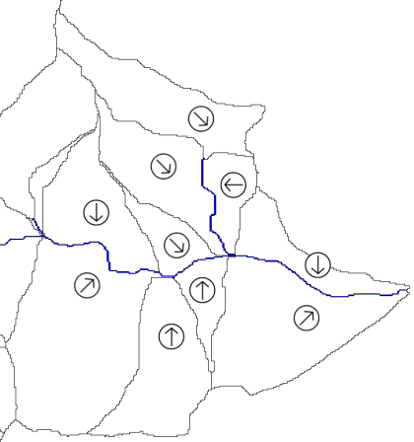
PHYSITEL
Specialized GIS for Constructing DBs of Distributed Hydrological Models
Using a DEM & a DRLN
  Watershed delineation (D8-LTD, Flow Matrix)
  Discretization into RHHUs, either sub-watersheds or hillslopes
  Geomorphological caraterization of hillslopes (Profile and plan curvatures : concave, convex, plane, divergent, convergent)
Using land cover and soil type maps
  Physiographic caracterization of RHHUs for HYDROTEL (% land covers, dominant soil, slope & aspect)

Slide 6

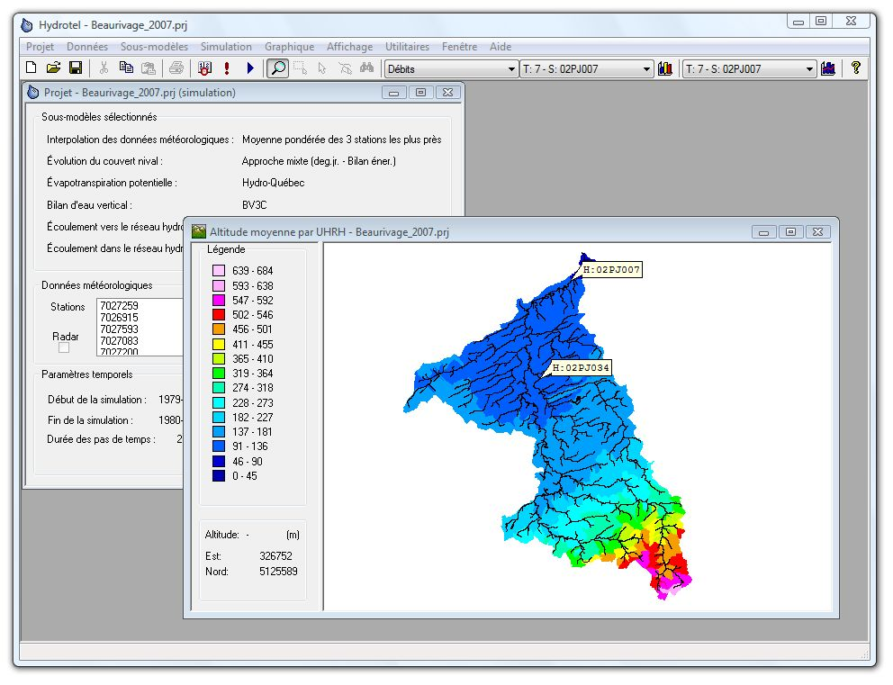
HYDROTEL
Distributed hydrological model using remote sensing and GIS data
State variables
  % soil saturation
  Snow water equivalent
Decision variables
  Stremaflows, inflows, recharge
Simulation modules (Interpolation of precipitations, snow accumulation & melt, potential evapotranspiration, vertical water budget, overland stream flow routing, isolated & riparian wetland)
Construction of Input/Output data files for all simulation models
GUI for manual calibration
Coupling with UNCSIM for SA & UA

Slide 7

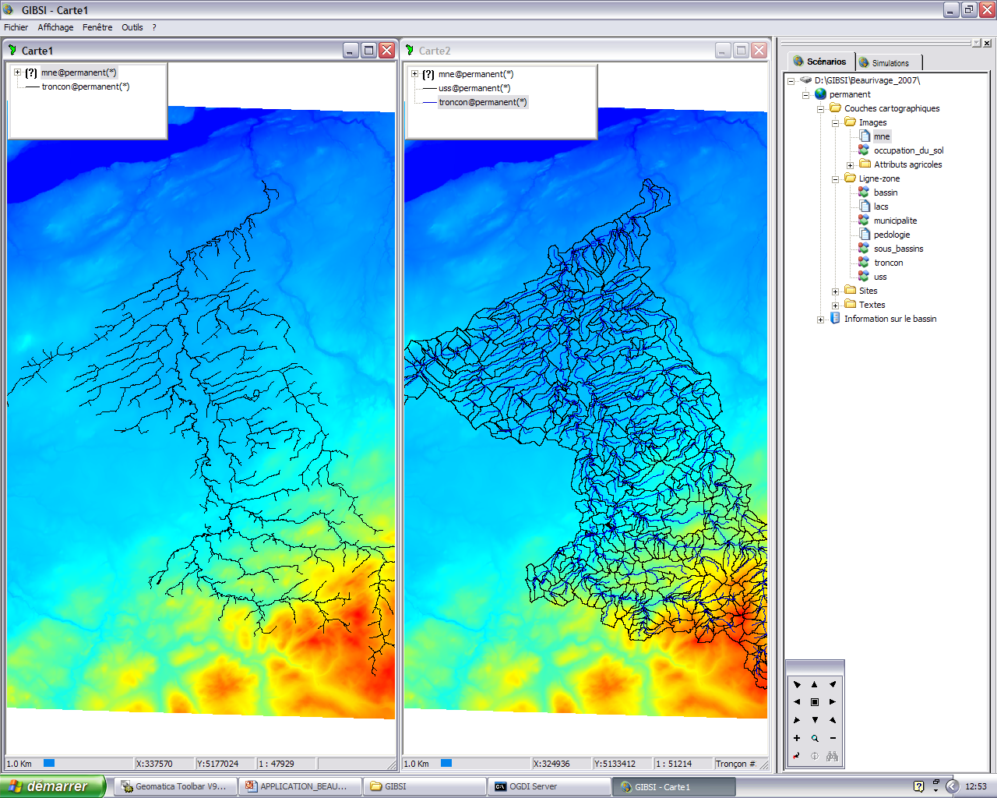
GIBSI
Integrated Watershed Management using an Integrated Modelling System
Environmental Information System
  Spatial & attribute DB
  Graphs, maps, tables
Simulation models (rainfall-runoff, soil erosion, agricultural-pollutants, water quality, biological integrity, valuation of EG&S, on-farm economics model)
Management Modules (agricultural BMPs, WWTP, land cover, reservoir)
Construction of Input/Output data files for all simulation models
Post-processing of simulated data

Slide 8
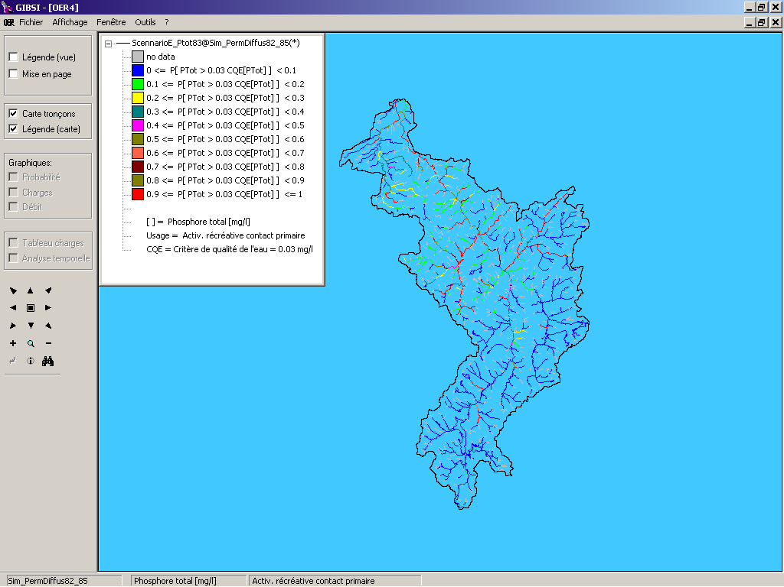
GIBSI
Integrated Watershed Management using an Integrated Modelling System
Decision variables
  Probability of Exceeding WQs
    Water Uses
      Period of Interest
      Point & NonPoint Sources
    Biological Integrity
  Environnemental G&S/Costs of BMPs
    Valuation of Environnemental G&S
    Differential Costs of BMP Scenarios (Reference & BMP Scenarios)
    B/C Ratios

Slide 9
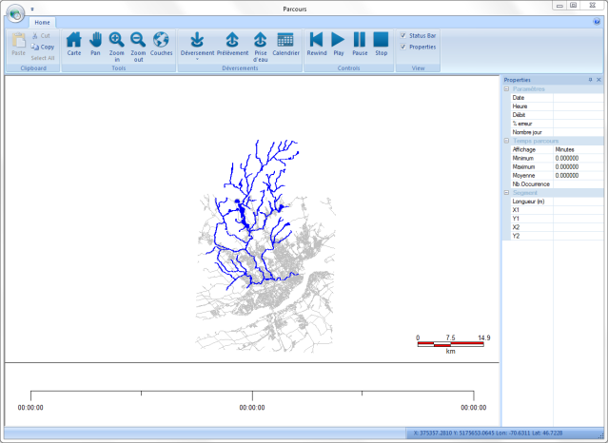

Determination of conservative pollutant travel time and required intervention time for source water protection and public safety
Based on current streamflow conditions at a hydrometric gauge station
  Prediction of the most conservative travel time between a discharged point of a conservative pollutant and any downstream location of interest (e.g., surface water intake point)
  Operational use by Quebec City
    Diagnostic tool not a real-time prediction tool
Main components
  40-year DB of simulated streamflow conditions on all river segments of a watershed (PHYSITEL/HYDROTEL)

Slide 10
Development framework and strategy

Slide 11
Framework and strategy
Programming environment and style
  Visual studio C++ (v11 - 2012) + Sourcesafe
  Defensive – explicit variable names C++11

Slide 12
Framework and strategy
Programming environment and style
  Visual studio C++ (v11 - 2012) + Sourcesafe
  Defensive – explicit variable names C++11
Use of public domain and free components for data archiving, display and transfer
  MySQL, boost, GDAL-OGR, GRASS, MSChart

Slide 13
Framework and strategy
Programming environment and style
  Visual studio C++ (v11 - 2012) + Sourcesafe
  Defensive – explicit variable names C++11
Use of public domain and free components for data archiving, display and transfer
  MySQL, boost, GDAL-OGR, GRASS, MSChart
Operating system (32 and 64 bits)
  MSWindows,UNIX (HYDROTEL/command line)

Slide 14
Framework and strategy
Input data formats
  ASCII grid data, .csv, NetCDF, HDF5, GRASS, shapefile, GeoTIFF, etc.
Output data formats
  .csv, NetCDF & HDF5 (soon), GRASS, shapefile, GeoTIFF, ASCII grid, etc.

Slide 15
Framework and strategy
Software distribution
  LGPL - CodePlex (HYDROTEL without GUI)
  Commercial licence (USB key)

Slide 16
A few examples of
data processing, editing, display and
transfer algorithms

Slide 17
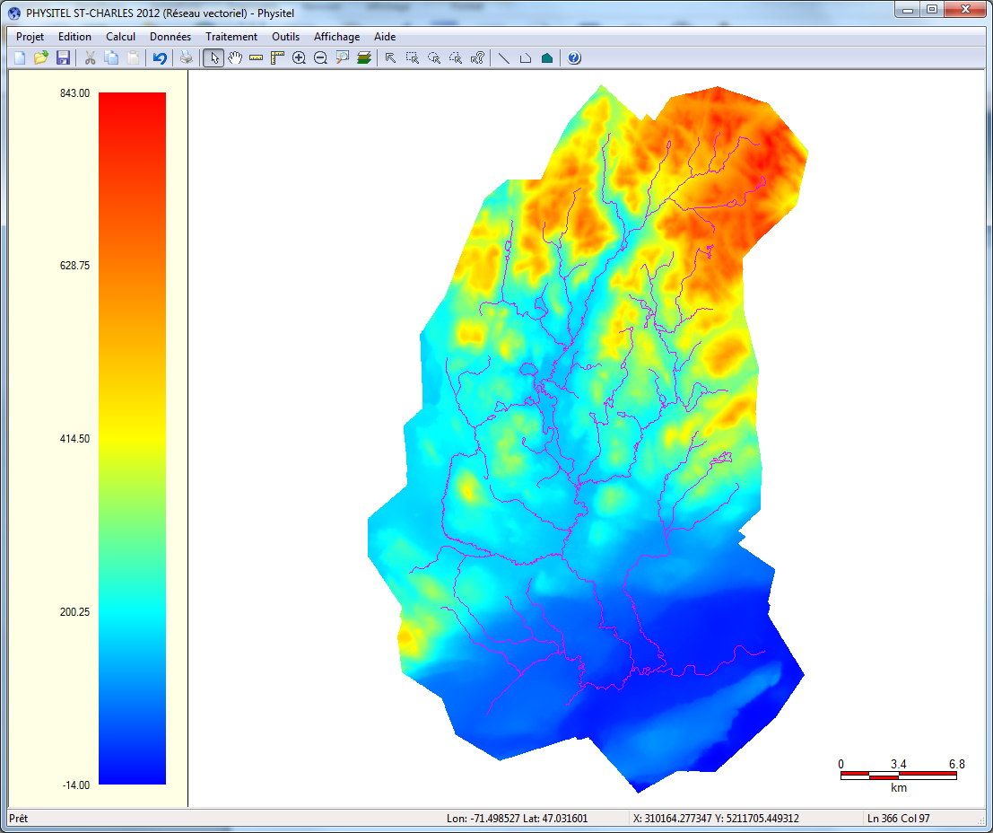
PHYSITEL
Use of GDAL to import DEM, land cover map, soil type map (raster data)
  Multiple formats and projections (e.g., ASCII Grid, GeoTIFF, Arc/Info Binary Grid, etc.)

Slide 18
PHYSITEL
Use of GDAL to import DEM, land cover map, soil type map (raster data)
  Multiple formats and projections (e.g., ASCII Grid, GeoTIFF, Arc/Info Binary Grid, etc.)
Use of OGR to import river network (vector data)
  Multiple formats and projections (e.g., shapefile, MapInfo, etc.)

Slide 19
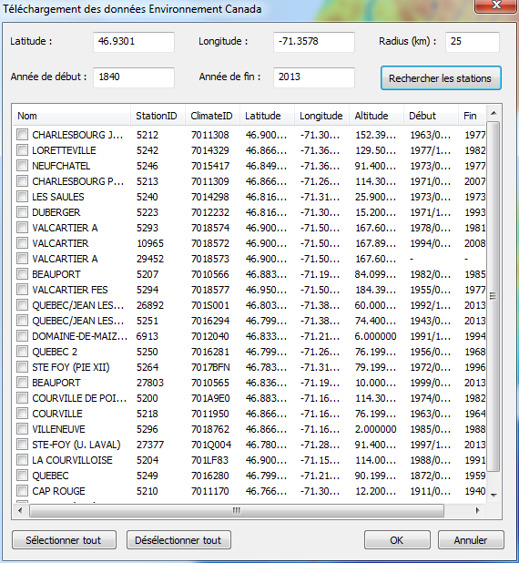
PHYSITEL
EnvCan weather stations
  Supply lat/long and radius of interest Download HTML pages using CInternetSession and parse with regex

Slide 20
PHYSITEL
EnvCan weather stations
  Supply lat/long and radius of interest Download HTML pages using CInternetSession and parse with regex
  Transfer data (tmin/tmax/precip) from selected stations
    Supply web server station IDs (ClimateID)

Slide 21
PHYSITEL
EnvCan weather stations
  Supply lat/long and radius of interest Download HTML pages using CInternetSession and parse with regex
  Transfer data (tmin/tmax/precip) from selected stations
    Supply web server station IDs (ClimateID)
  Download data in XML format using CInternetSession and parse with regex
  Save data in GIBSI/HYDROTEL format

Slide 22
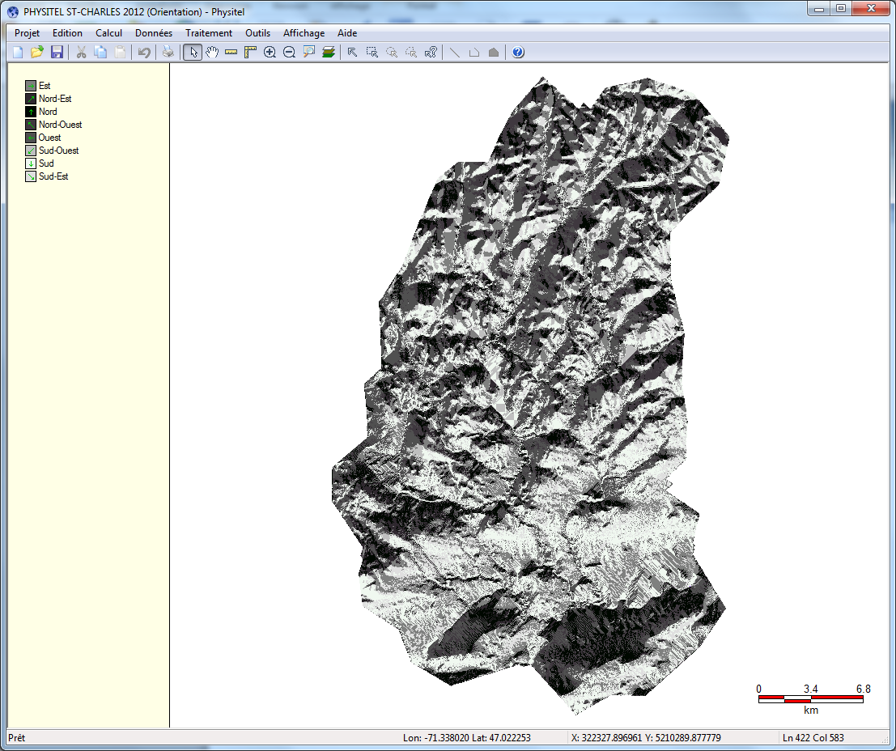
PHYSITEL
Editing of « raster » data
  DEM, slope, aspect
    Saving modified data using GDAL

Slide 23
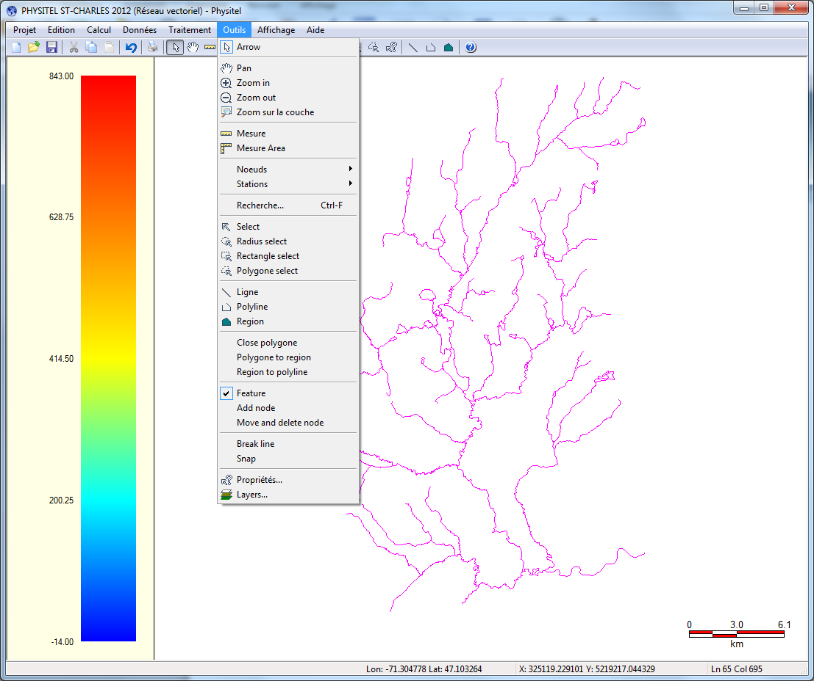
PHYSITEL
Editing of « vector » data, namely the digitized river network
    Add/modify/delete lines, polygons and vector nodes

Slide 24
PHYSITEL
Editing of « vector » data, namely the digitized river network
    Add/modify/delete lines, polygons and vector nodes
    Perform connectivity test of vector network
    Modify flow direction manually or automatically
    Connect river segments

Slide 25
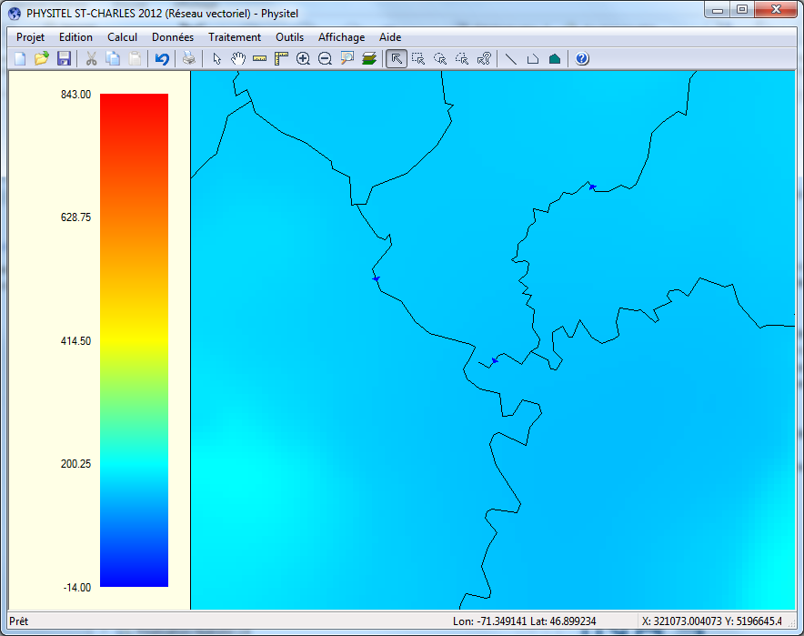
PHYSITEL
    Connecting river segments

Slide 26
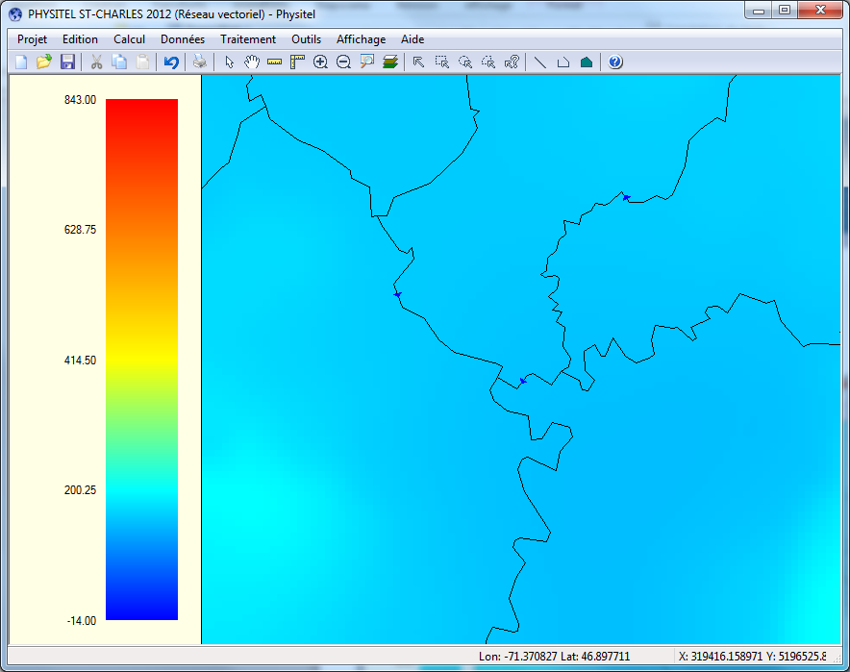
PHYSITEL
    Connecting river segments

Slide 27
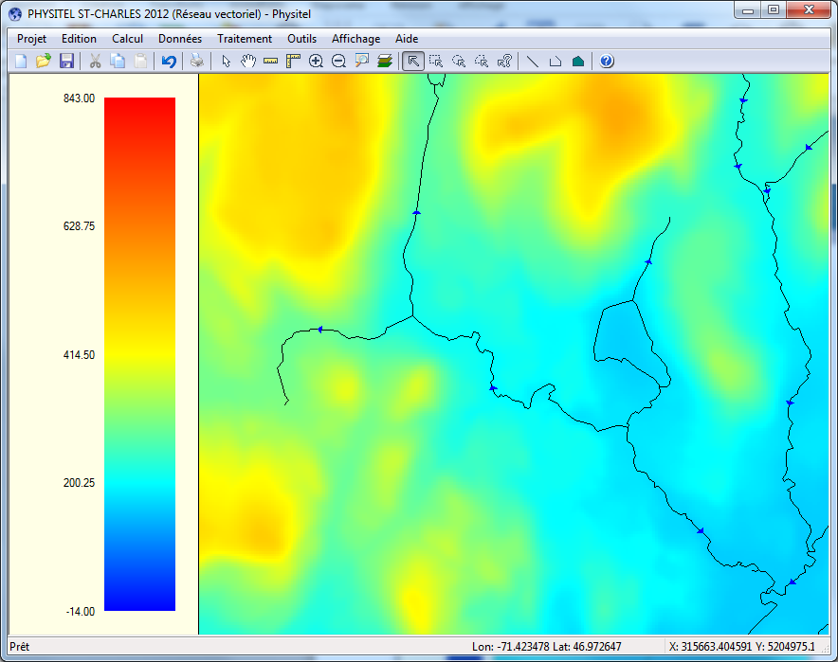
PHYSITEL
    Modifying flow direction manually

Slide 28
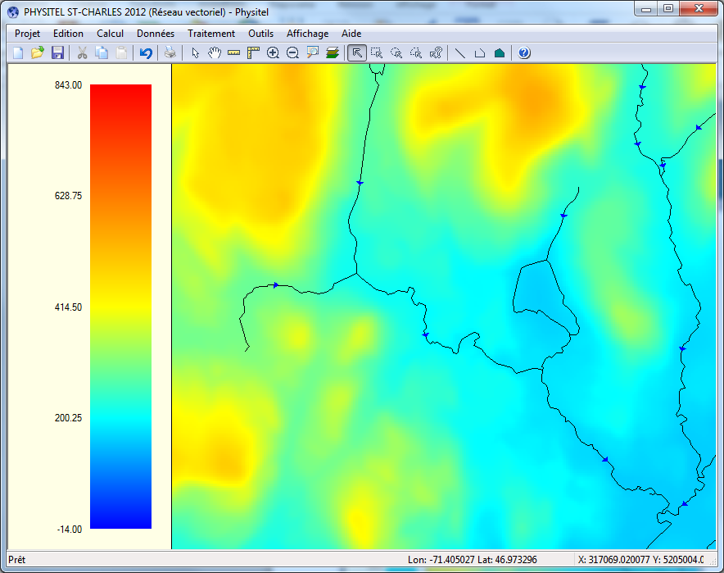
PHYSITEL
    Modifying flow direction manually

Slide 29
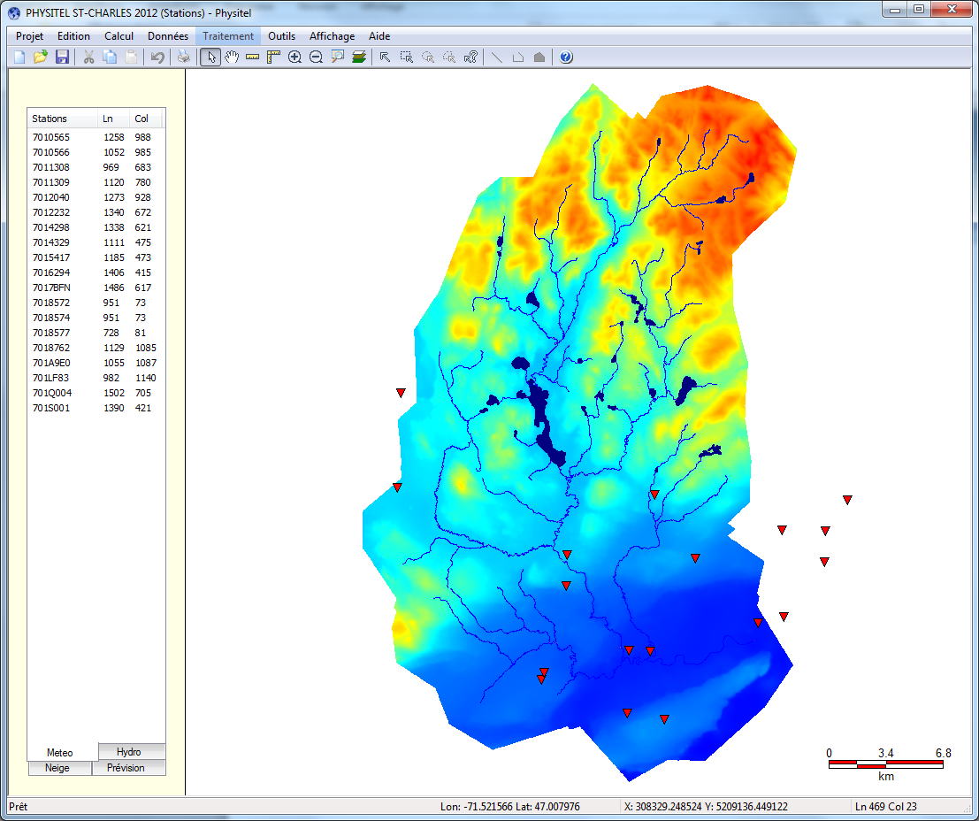
PHYSITEL
Editing point data (e.g., locations of weather stations and gauge stations, etc.)
  Add/modify/delete stations

Slide 30
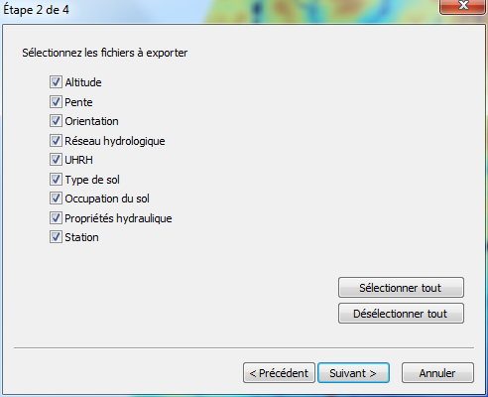
PHYSITEL
Data transfer and exportation
    Raster data in ASCII Grid format
    Watershed data in HYDROTEL2.6 and GIBSI formats
  Stream flows simulated by HYDROTEL river network to Quebec filamentary network

Slide 31
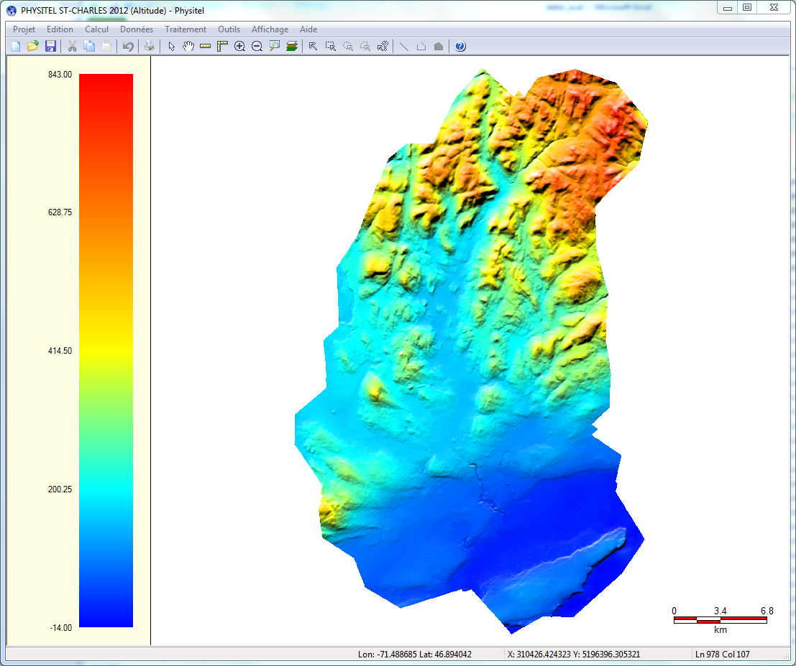
PHYSITEL
GUI for data display and editing (MFC/GDI+)

Slide 32
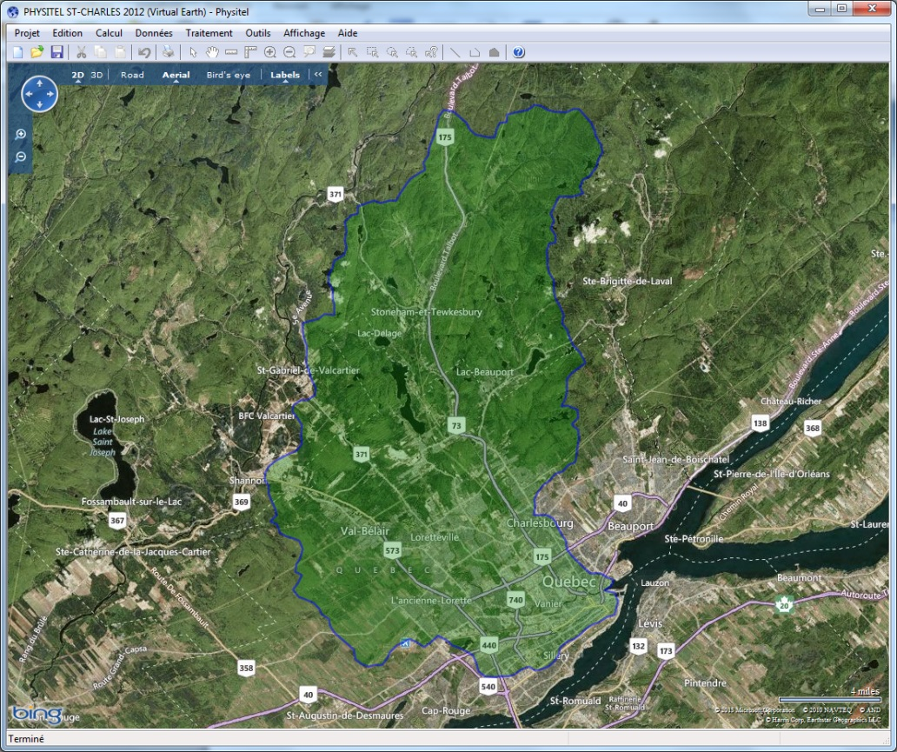
PHYSITEL
Other tools/options
  Display watershed on Bing Map
  Open Google Map using study site coordinates

Slide 33
PHYSITEL
Other tools/options
  Display watershed on Bing Map
  Open Google Map using study site coordinates
  Calculation of contour lines, topographic index
  3D image of maps (DirectX)
  « Hill shading »
  Hillslopes profile curvature and plan shape

Slide 34
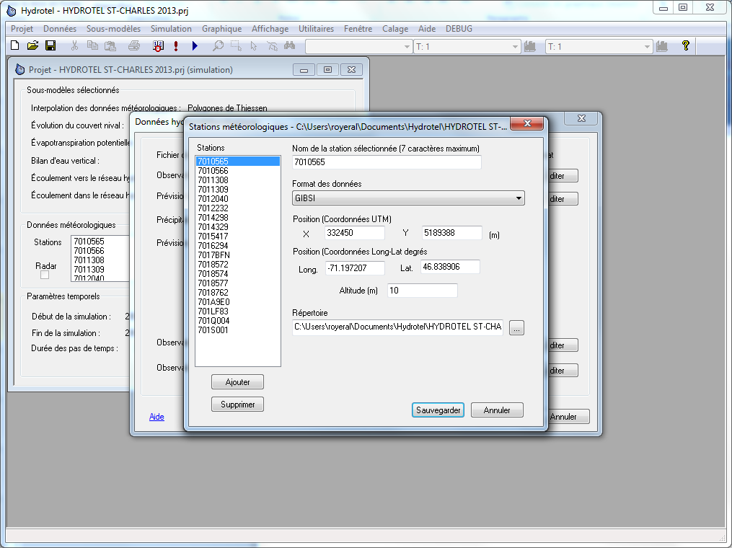
HYDROTEL
Read EnvCan, HYDRO-QUÉBEC hydro/meteo data, etc. (text, netCDF, HDF5)
    Read watershed data in HYDROTEL2.6 format

Slide 35
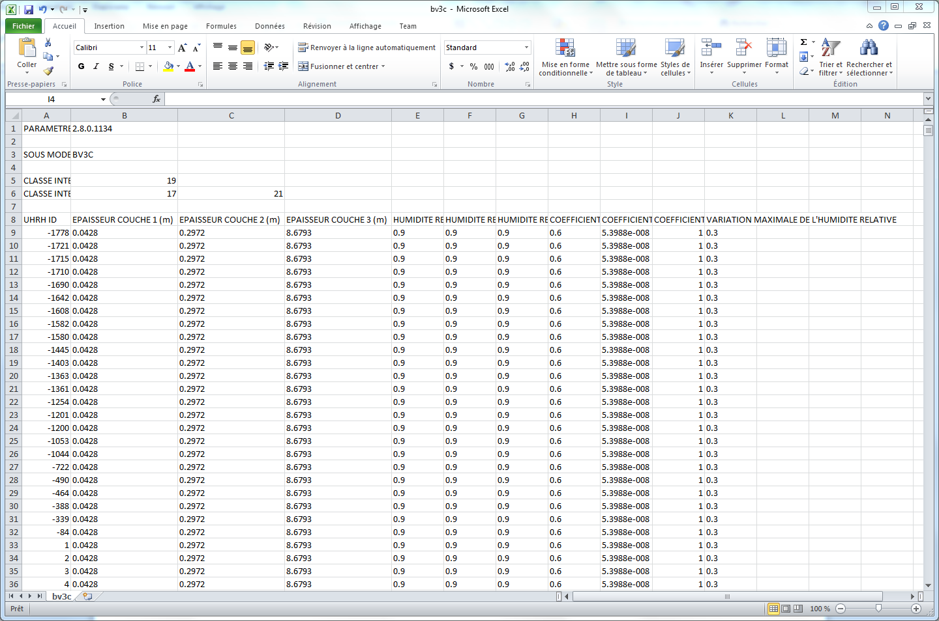
HYDROTEL
Watershed data and model parameters in csv format

Slide 36
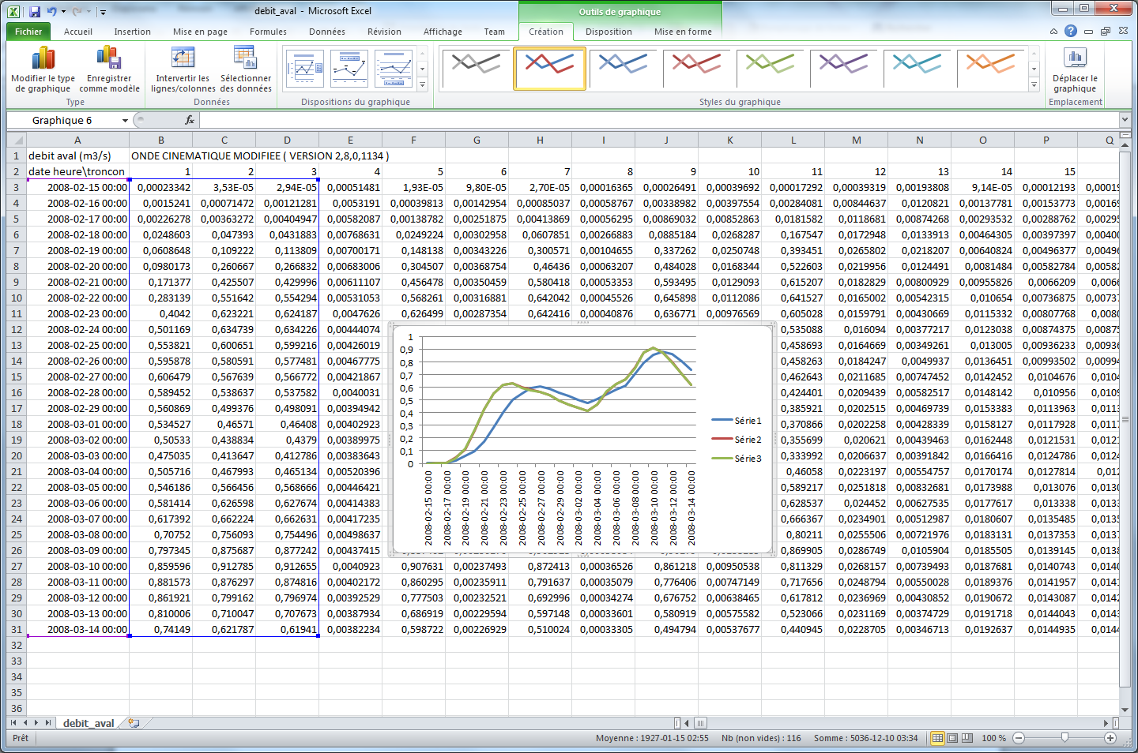
HYDROTEL
Save results in .csv format

Slide 37
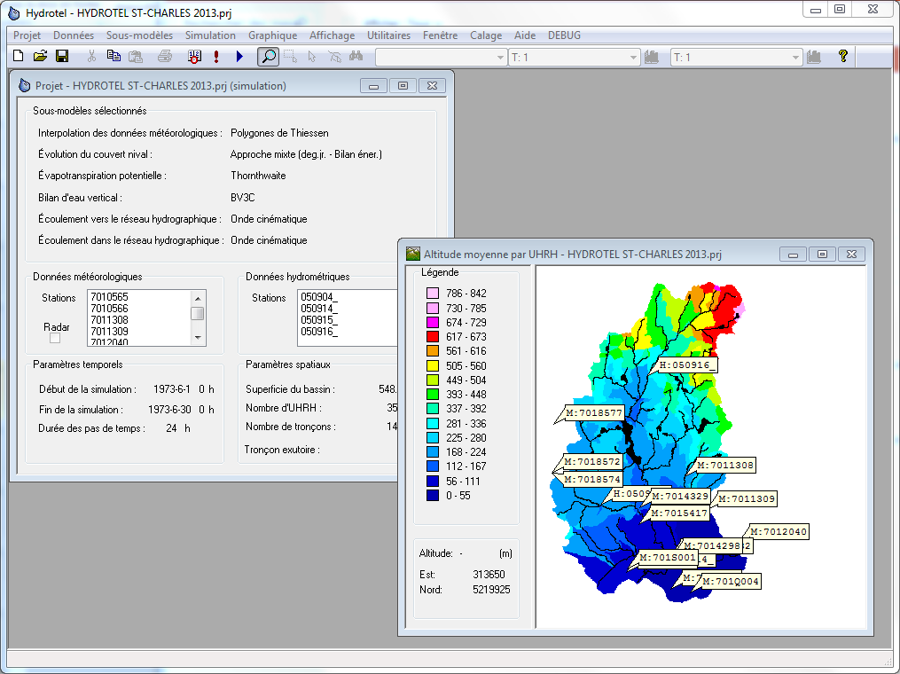
HYDROTEL
GUI for data display (MFC/GDI)

Slide 38
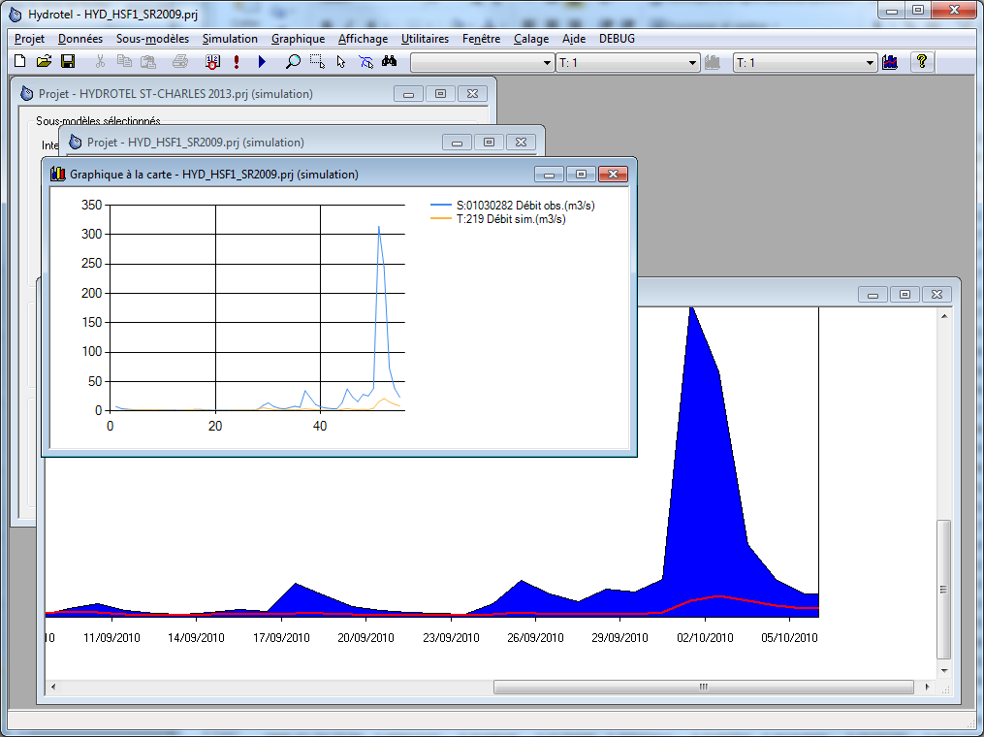
HYDROTEL
Data display - Graphs (MSChart, GDI)

Slide 39
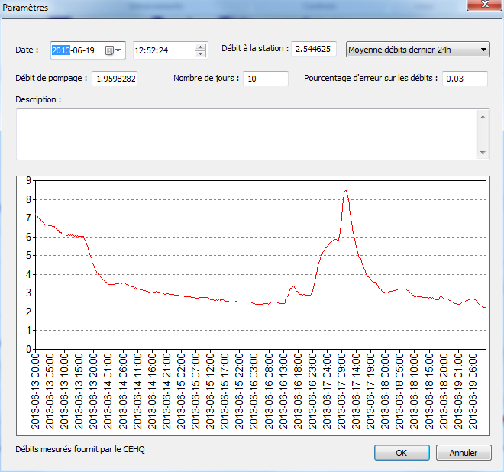
Conservative Pollutant Travel Time Tool
CEHQ gauge station data (real time monitoring)
  Download data (text) using CInternetSession

Slide 40
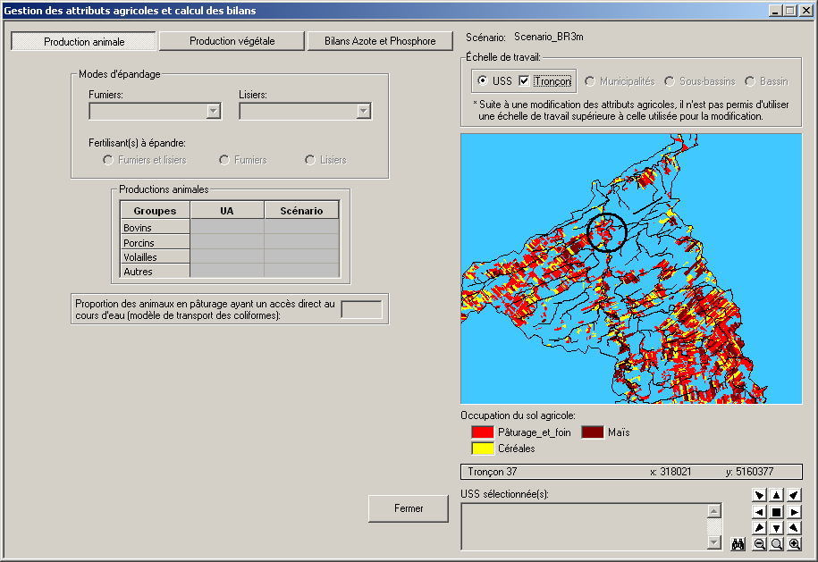
GIBSI
Modification of agricultural attributes (MySQL queries) –
  Selection of a region drained by a river segment of interest

Slide 41
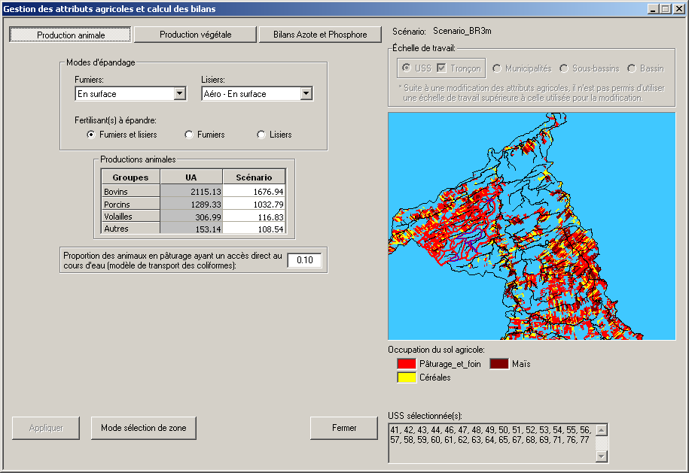
GIBSI
Modification of agricultural attributes (MySQL queries) –
  Selection of a region drained by a river segment of interest

Slide 42
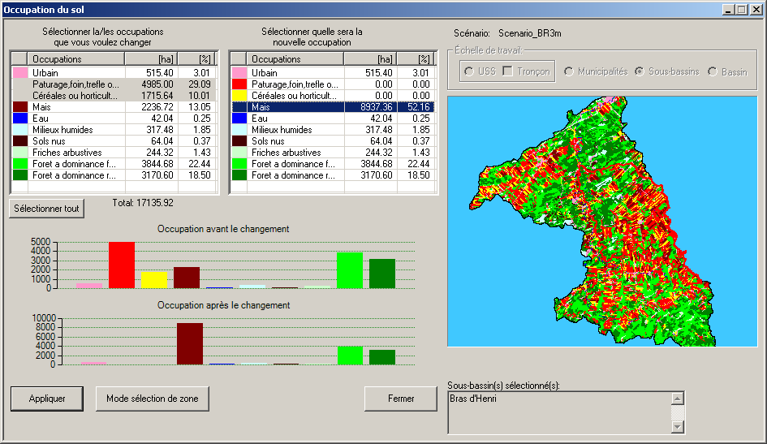
GIBSI
Modification of land cover data (MySQL, GDAL, GRASS command)

Slide 43
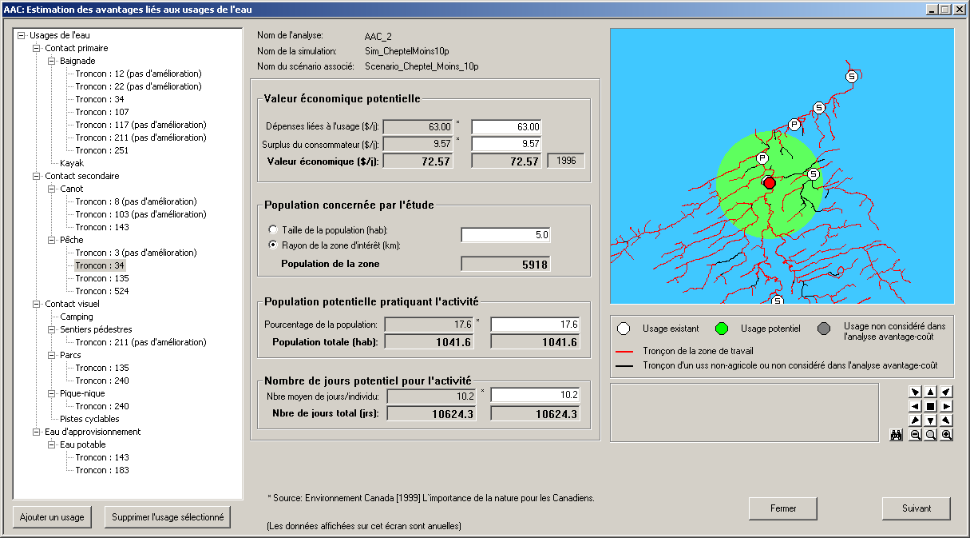
GIBSI
Environmental G&Ss Benefit/Cost analysis
  Potential population within a radius of interest (GRASS command)

Slide 44
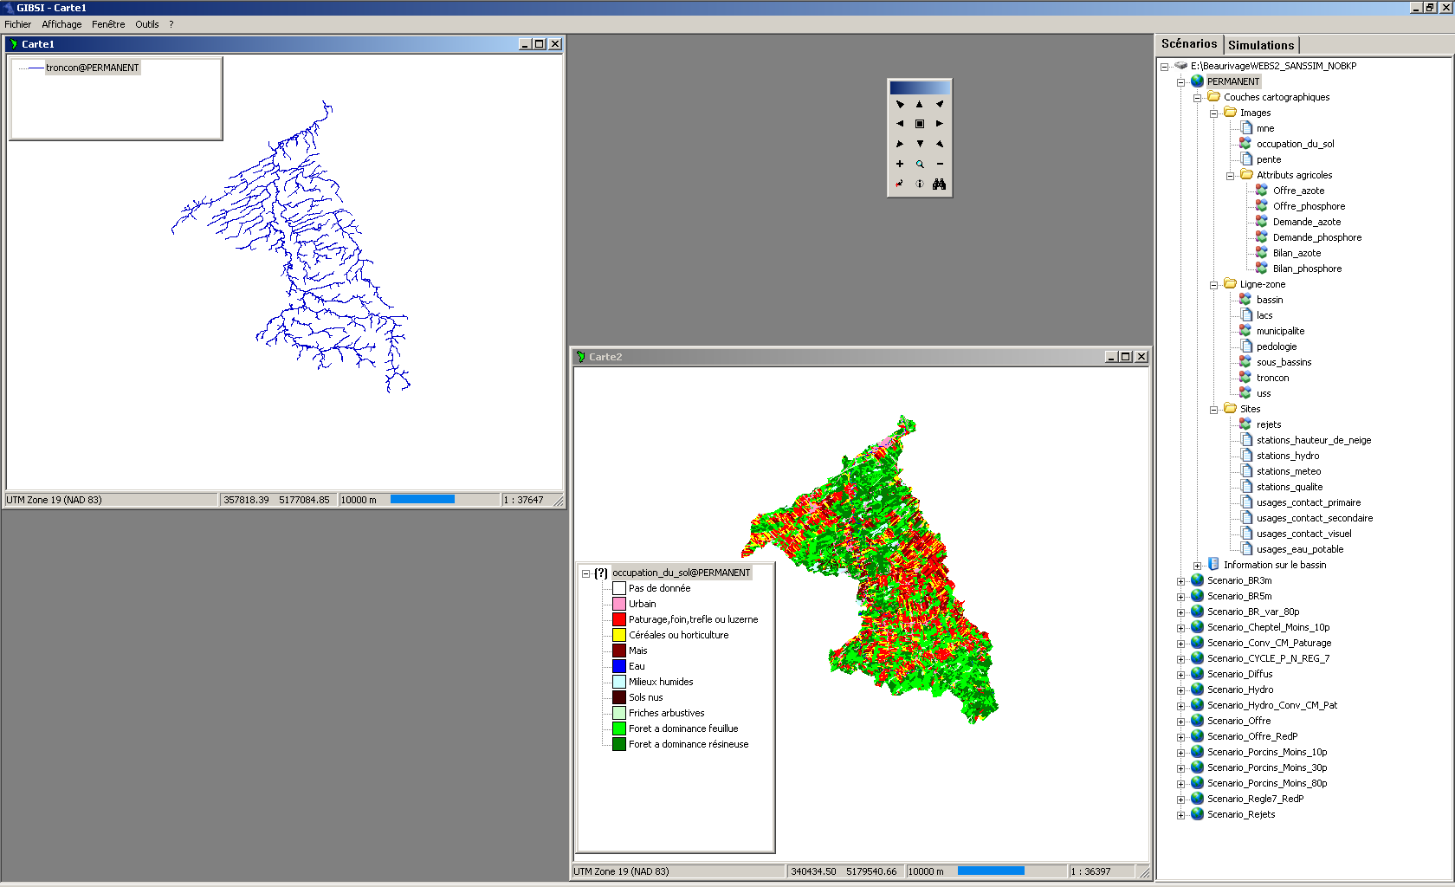
GIBSI
Display of vector and raster maps (OGR/GDAL, MFC, GDI)

Slide 45
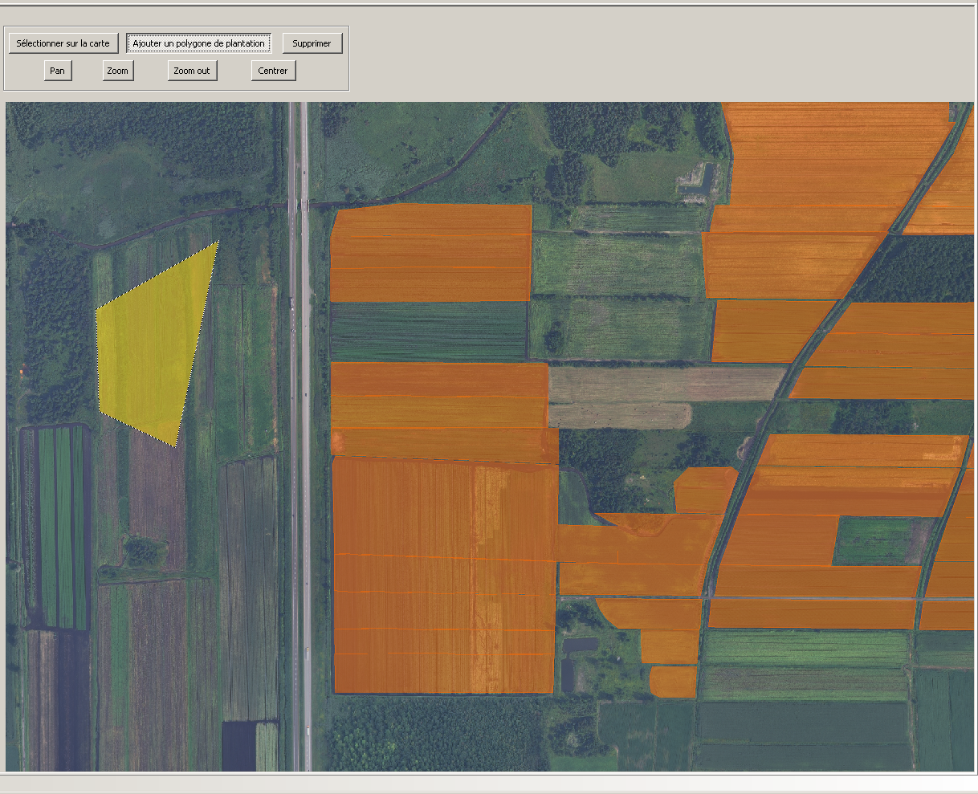
Ongoing project
Interactive edition of Arc/Info Shapefile
Display GeoTIFF aerial photography in background
GDAL/OGR, GDI+

Slide 46
Summary

Slide 47
Hydroinformatics of
watershed hydrology at INRS
Programming environment and style
Use of public domain components for data archiving, editing, display and transfer
Operating system (32 and 64 bits)
Multiple input/ouput data formats
Software distribution

Slide 48
References - PHYSITEL
Denault, J.T., A.N. Rousseau, E. Van Bochove, F. Dechmi. 2008. Evaluating the propensity to saturation excess runoff using a topographic index (wetness index) with NHN and DEM GeoBase data/Évaluation de la propension au ruissellement sur des sols saturés à l'aide d'un indice topographique (index de Beven-Kirkby) utilisant les données du Réseau hydro national (RHN) et des MNA de GéoBase. GeoBase National Hydro Network (NHN) and Canadian Digital Elevation Data (CDED) Use Case, December 2008: 1-20/ Cas d’utilisation du Réseau hydro national (RHN) et des Données numériques d’élévation du Canada (DNEC) de GéoBase, Décembre 2008: 1-22. http://www.geobase.ca/doc/specs/pdf/GeoBase_RHN_Utilisation_INRS_AAFC.pdf / http://www.geobase.ca/doc/specs/pdf/GeoBase_NHN_Use_Case_INRS_AAFC.pdf.
Rousseau, A.N., J.-P. Fortin, R. Turcotte, A. Royer, S. Savary, F. Quévy, P. Noël,C. Paniconi. 2011. PHYSITEL, a specialized GIS for supporting the implementation of distributed hydrological models. Water News - Official Magazine of the Canadian Water Resources Association, 31(1): 18-20.
Noël, P., A.N. Rousseau, C. Paniconi, D.F. Nadeau. 2013. An algorithm for delineating and extracting hillslopes and hillslope width functions from gridded elevation data. Journal of Hydrologic Engineering doi: 10.1061/(ASCE)HE.1943-5584.0000783
Turcotte, R., J.-P. Fortin, A. N. Rousseau, S. Massicotte, J.-P. Villeneuve. 2001. Determination of the drainage structure of a watershed using a digital elevation model and a digital river and lake network. Journal of Hydrology, 240: 225-242.

Slide 49
References - HYDROTEL
Bouda, M., A.N. Rousseau, B. Konan, P. Gagnon, S.J. Gumiere. 2012. Case study: Bayesian uncertainty analysis of the distributed hydrological model HYDROTEL. Journal of Hydrologic Engineering 17(9), September 1, 2012. doi: 10.1061/(ASCE)HE.1943-5584.0000550
Bouda, M., A.N. Rousseau, S.J. Gumiere, P. Gagnon, B. Konan, R. Moussa. 2013. Implementation of an automatic calibration procedure for HYDROTEL based on sensitivity and identifiability analyses. Hydrological Processes doi:10.1002
Bourdillon, R., A.N. Rousseau, Y. Secretan. 2010. Modification of the lake flow algorithm of the distributed hydrological model HYDROTEL when modelling lakes with multiple outlets. Journal of Hydrologic Engineering, 15(12): 955-962.
Jutras, S., A.N. Rousseau, C. Clerc. 2009. Implementation of a peatland-specific water budget algorithm in HYDROTEL. Canadian Water Resources Journal, 34(4): 349-361.
Savary, S., A.N. Rousseau, R. Quilbé. 2009. Assessing the effects of historical land cover changes on runoff and low flows using remote sensing and hydrological modeling. Journal of Hydrologic Engineering, 14(6): 575-587 DOI: 10.1061/(ASCE)HE.1943-5584.0000024.
Quilbé, R., A. N. Rousseau, J.-S. Moquet, N. B. Trinh, Y. Dikibi, P. Gachon, D. Chaumont. 2008. Assessing the effect of climate change on river flow using general circulation models and hydrological modelling - Application to the Chaudière River (Québec, Canada). Canadian Water Resources Journal, 33(1): 73-94.
Quilbé, R., A.N. Rousseau, J.-S. Moquet, S. Savary, S. Ricard, M.S. Garbouj. 2008. Hydrological response of a watershed to historical land use evolution and future land use scenarios under climate change conditions. Hydrology and Earth System Sciences, 12:101-110.

Slide 50
References - HYDROTEL
Fortin, J.P, R. Turcotte, S. Massicotte, R. Moussa, J. Fitzback, and J.P. Villeneuve. 2001a. A distributed watershed model compatible with remote sensing and GIS data. Part I: Description of model. J. of Hydrologic Eng., American Society of Civil Eng. 6 (2):91-99.
Fortin, J.P, R. Turcotte, S. Massicotte, R. Moussa, J. Fitzback, and J.P. Villeneuve. 2001b. A distributed watershed model compatible with remote sensing and GIS data. Part II: Application to Chaudière watershed. J. of Hydrologic Eng., American Society of Civil Eng. 6 (2):100-108.
Turcotte, R., A. N. Rousseau, J.-P. Fortin, J.-P. Villeneuve. 2003. Development of a process-oriented, multiple-objective, hydrological calibration strategy accounting for model structure. Dans Duan, Q., S. Sorooshian, H. Gupta, A. N. Rousseau, R. Turcotte, Advances in Calibration of Watershed Models, Water Science & Application 6, AGU: 153-163.
Turcotte, R., L.G. Fortin, V. Fortin, J.P Fortin, and J.P. Villeneuve. 2007. Operational analysis of the spatial distribution and the temporal evolution of the snowpack water equivalent in southern Québec, Canada. Nordic Hydrology 38 (3):211-234.
Turcotte, R., P. Lacombe, C. Dimnik, and J.P. Villeneuve. 2004. Distributed hydrological prediction for the management of Quebec's public dams. Canadian J. of Civil Engineering 31 (2):308-320.

Slide 51
References - GIBSI
Simon, A., A.N. Rousseau, S. Savary, M. Bigras-Poulin, N.H. Ogden. 2013. Hydrological modelling of Toxoplasma gondii oocysts transport to investigate contaminated snowmelt runoff as a potential source of infection for marine mammals in the Canadian Arctic. Journal of Environmental Management, 127: 150-161 (doi:10.1016/j.jenvman.2013.04.031)
Quilbé, R., A. N. Rousseau. 2007. GIBSI : An integrated modelling system for watershed management - Sample applications and current developments. Hydrology and Earth System Sciences, 11:1785-1795.
Rousseau, A.N. P. Lafrance, Lavigne, M.-P., S. Savary,B. Konan, R. Quilbé, M. Amrani, P. Jiapizan. 2012. A hydrological modelling framework for defining watershed-scale achievable performance standards of pesticides beneficial management practices. Journal of Environmental Quality 2012 41: 1: 52-63 DOI10.2134/jeq2010.0281
Rousseau, A.N., S. Savary, Dennis W. Hallema, S.J. Gumiere, E. Foulon. 2013. Modeling the effects of agricultural BMPs on sediments, nutrients and water quality of the Beaurivage River watershed (Quebec, Canada) (article proposé le 10/07/2012, révision demandée 10/16/2012, retourné le 31/12/2012, accepté le 6/01/2013 Canadian Water Resources Journal, DOI:10.1080/07011784.2013.780792)
Terrado M., M.-P. Lavigne, S. Tremblay, S. Duchesne, J.-P. Villeneuve, A. N. Rousseau, D. Barcelóa, R. Tauler. 2009. Distribution and assessment of surface water contamination by application of chemometric and deterministic models. Journal of Hydrology 369: 416-426.

Slide 52
References - GIBSI
Salvano, E., A. N. Rousseau, G. Debailleul, J.-P. Villeneuve. 2006. An environmental benefit-cost analysis case study of nutrient management in an agricultural watershed. Canadian Water Resources Journal 31(2): 105-122.
Rousseau, A. N., A. Mailhot, R. Quilbé , J.-P. Villeneuve. 2005. Information technologies in the wider perspective: integrating management functions across the urban-rural interface. Environmental Modelling & Software 20: 443-455.
Rousseau, A. N., A. Mailhot, S. Gariépy, E. Salvano, J.-P. Villeneuve. 2002. Calcul de probabilités de dépassement d’objectifs environnementaux de rejet de sources ponctuelle et diffuse à l’aide du système de modélisation intégrée GIBSI. Revue des Sciences de l’Eau, 15(no spécial): 121-148.
Rousseau, A. N., A. Mailhot, J.-P. Villeneuve. 2002. Development of a risk-based TMDL assessment approach using the integrated modeling system GIBSI. Water Science & Technology, 45(9): 317-324.
Mailhot, A., A. N. Rousseau, E. Salvano, R. Turcotte, J.-P. Villeneuve. 2002. Évaluation de l’impact de l’assainissement urbain sur la qualité des eaux du bassin versant de la rivière Chaudière à l’aide du système de modélisation intégrée GIBSI. Revue des Sciences de l’Eau, 15(no spécial): 149-172. Rousseau, A. N., A. Mailhot, R. Turcotte, M. Duchemin, C. Blanchette, M. Roux, J. Dupont, J.-P. Villeneuve. 2000. GIBSI: an integrated modelling system prototype for river basin management. Hydrobiologia 422/423: 465-475.
Mailhot, A., Rousseau, A. N., S. Massicotte, J. Dupont, J.-P. Villeneuve. 1997. A watershed-based system for the integrated management of surface water quality: The GIBSI System. Water Science & Technology, 36(5): 381-387.

Slide 53
References
Conservative Pollutant Travel Time Tool
Rousseau, A.N., Savary, S. et Royer, A. 2010. Étude de risques de contamination de la prise d'eau de Château-d'Eau, bassin versant de la rivière Saint-Charles, Ville de Québec. Politique de gestion durable de l'eau potable. Protection des prises d'eau et de leur bassin versant. Rapport de recherche 1181, Centre Eau, Terre et Environnement, Institut national de la recherche scientifique, INRS-ETE. Québec, PQ 118 pages incluant 3 annexes.

Slide 54


