Slide 1
WMO – OGC
Hydrology Domain Working Group
4th Annual Workshop
Agenda (update 18 June 2013)
Quebec City, Canada
17 – 21 June 2013
Copyright © 2013 Open Geospatial Consortium

Slide 2
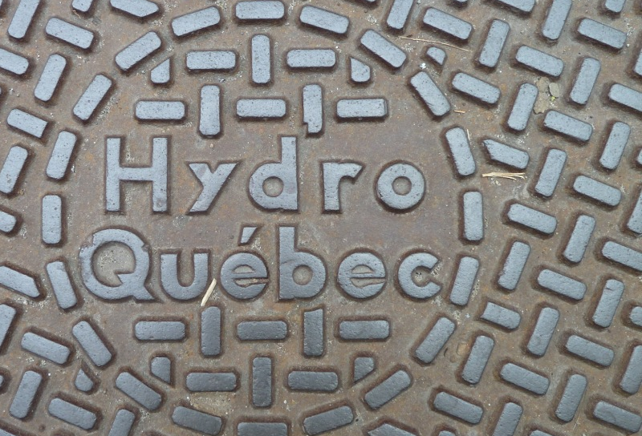
WMO - OGC
DWG
2013
Agenda

Slide 3
Monday: 17 June 2013
Virtual OGC TC Closing Plenary, Introduction, AIP 6, RiverML
10:00 – 13:00 | Online OGC Virtual TC Closing Plenary with presentation of planned activities at 4th Hydro DWG Workshop | OGC | 3 hrs
13:00 – 14:00 | Lunch |  | 1 hr
14:00 – 14:30 | Welcome, Logistics, Security, Introduction and Agenda | Co-Chairs, Eric Boivert, Boyan Brodaric | 30 min
14:30 – 15:00 | Feedback from WMO CHy Advisory Working Group | Tony Boston | 30 min
15:00 – 16:00 | AIP 6 | David Arctur | 1 hr
16:00 – 16:30 | Break |  | 30 min
16:30 – 17:30 | RiverML, a language for the exchange of river information | Stephen Jackson, David Arctur | 1 hr
17:30 | Close

Slide 4
Tuesday: 18 June 2013
Groundwater IE 2, CEH, SOS Profile, HY_Features & RiverML
08:00 – 10:00 | GWIE2, Model development and discussion | Boyan Brodaric | 2 hrs
10:00 – 10:30 | Break |  | 30 min
10:30 – 12:30 | GWIE2, Model development and discussion | Boyan Brodaric | 2 hrs
12:30 – 13:30 | Lunch |  | 1 hr
13:30 – 13:40 | Welcome message from directors of INRS-ETE and Geological Survey of Canada (Québec division) | Yves Bégin Yves Michaud | 10 min
13:40 – 14:10 | Current developments at the Centre for Ecology and Hydrology (UK) | Matt Fry | 30 min
14:10 – 15:00 | SOS Profile; Presentation and Discussion | Michael Utech | 50 min
15:00 – 15:30 | Break |  | 30 min
15:30 – 16:30 | SOS Profile Discussion | Michael Utech | 1 hr
16:30 – 17:00 | Discussion on RiverML and implementing HY_Features |  | 30 min
17:00 | Close

Slide 5
Wednesday: 19 June 2013
HY_Features, CHISP-1, Visit to INRS Hydraulic labs
09:00 – 09:30 | HY_Features: applicability of the concept of catchment, basin and outfall | Irina Dornblut | 30 min
09:30 – 10:00 | Implementation of HY_Features in Geofabric context (Australian example) | Tony Boston | 30 min
10:00 – 11:00 | HY_Features discussion | All | 1 hr
11:00 – 11:30 | Break |  | 30 min
11:30 – 12:30 | CHISP-1 Pilot; Presentation and Demo | Peter Vretanos, Lewis Leinenweber | 1 hr
12:30 – 13:30 | Lunch |  | 60 min
13:30 – 16:00 | Visit to Hydraulic Labs |  | 2,5 hr
16:00 – 17:00 | CHISP-1 Pilot Presentation of Results | Peter Vretanos, Lewis Leinenweber | 1 hr
17:00 – 17:30 | Discussion |  | 30 min
17:30 | Close

Slide 6
Thursday: 20 June 2013
Presentations by USGS & INRS, WaterML2 Part 2
09:00 – 09:40 | 1.) US Integrated Water Resources Science and Services (IWRSS) – Overview 2.) Analysis of ratings, gagings use and needs between USGS and NWS | Dave Briar, Ed Clark, Nate Both Dave Blodgett | 40 min
09:40 – 10:00 | Presentation WaterML 2.0 Part 2 Ratings, Gaugings and Sections (RGS) | Pete Taylor Paul Sheahan | 20 min
10:00 – 11:00 | WaterML 2.0 Part 2 (RGS) Discussion | Pete Taylor Paul Sheahan | 1 hr
11:00 – | Break |  | 30 min
11:30 – 12:30 | WaterML 2.0 Part 2 (RGS) Discussion | Pete Taylor Paul Sheahan | 1 hr
12:30 – | Lunch |  | 1 hr
13:30 – 14:30 | Hydro-informatics of watershed hydrology at INRS | Alain N. Rousseau, Alain Royer, Sebastien Tremblay | 1 hr
14:30 – 15:00 | WaterML 2.0 Part 2 (RGS) Discussion | Pete Taylor Paul Sheahan | 30 min
15:00 – | Break |  | 30 min
15:30 – 17:30 | Separation of concerns, RiverML, WaterML2 Part 2, GWML and HY_Features | All | 2 hrs
17:30 | Close

Slide 7
Friday: 21 June 2013
GRDC Metadata; NAWW; Report back
09:00 – 09:30 | GRDC Metadata Concept | Irina Dornblut | 30 min
09:30 – 10:00 | North American Water Watch: Data integration | Jean-Michel Fiset | 30 min
10:00 – 11:00 | Report back from working groups |  | 1 hr
11:00 – 11:30 | Break |  | 30 min
11:30 – 12:30 | Report back from working groups and discussions | All | 1 hr
12:30 – 13:30 | Lunch |  | 60 min
13:30 – 15:00 | Final discussions, way forward and closing | All | 1,5 hrs
15:00 | Close

Slide 8
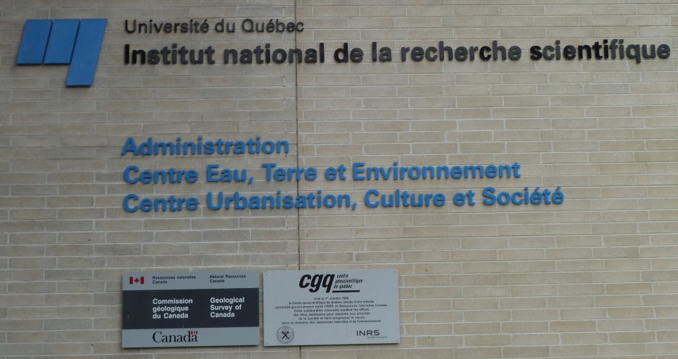
Thanks to our hosts
INRS-ETE
Geological Survey of Canada (Québec division)

