Slide 1
WMO – OGC
Hydrology Domain Working Group
4th Annual Workshop
Agenda (update 18 June 2013)
Quebec City, Canada
17 – 21 June 2013
Copyright © 2013 Open Geospatial Consortium

Slide 2
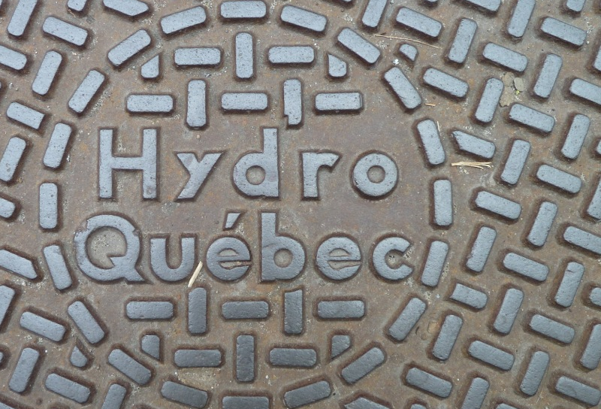
WMO - OGC
DWG
2013
Agenda

Slide 3
Monday: 17 June 2013
Virtual OGC TC Closing Plenary, Introduction, AIP 6, RiverML
10:00 – 13:00 | Online OGC Virtual TC Closing Plenary with presentation of planned activities at 4th Hydro DWG Workshop | OGC | 3 hrs
13:00 – 14:00 | Lunch |  | 1 hr
14:00 – 14:30 | Welcome, Logistics, Security, Introduction and Agenda | Co-Chairs, Eric Boivert, Boyan Brodaric | 30 min
14:30 – 15:00 | Feedback from WMO CHy Advisory Working Group | Tony Boston | 30 min
15:00 – 16:00 | AIP 6 | David Arctur | 1 hr
16:00 – 16:30 | Break |  | 30 min
16:30 – 17:30 | RiverML, a language for the exchange of river information | Stephen Jackson, David Arctur | 1 hr
17:30 | Close

Slide 4
Tuesday: 18 June 2013
Groundwater IE 2, CEH, SOS Profile, HY_Features & RiverML
08:00 – 10:00 | GWIE2, Model development and discussion | Boyan Brodaric | 2 hrs
10:00 – 10:30 | Break |  | 30 min
10:30 – 12:30 | GWIE2, Model development and discussion | Boyan Brodaric | 2 hrs
12:30 – 13:30 | Lunch |  | 1 hr
13:30 – 13:40 | Welcome message from directors of INRS-ETE and Geological Survey of Canada (Québec division) | Yves Bégin Yves Michaud | 10 min
13:40 – 14:10 | Current developments at the Centre for Ecology and Hydrology (UK) | Matt Fry | 30 min
14:10 – 15:00 | SOS Profile; Presentation and Discussion | Michael Utech | 50 min
15:00 – 15:30 | Break |  | 30 min
15:30 – 16:30 | SOS Profile Discussion | Michael Utech | 1 hr
16:30 – 17:00 | Discussion on RiverML and implementing HY_Features |  | 30 min
17:00 | Close

Slide 5
Wednesday: 19 June 2013
HY_Features, CHISP-1, Visit to INRS Hydraulic labs
09:00 – 09:30 | HY_Features: applicability of the concept of catchment, basin and outfall | Irina Dornblut | 30 min
09:30 – 10:00 | Implementation of HY_Features in Geofabric context (Australian example) | Tony Boston | 30 min
10:00 – 11:00 | HY_Features discussion | All | 1 hr
11:00 – 11:30 | Break |  | 30 min
11:30 – 12:30 | CHISP-1 Pilot; Presentation and Demo | Peter Vretanos, Lewis Leinenweber | 1 hr
12:30 – 13:30 | Lunch |  | 60 min
13:30 – 16:00 | Visit to Hydraulic Labs |  | 2,5 hr
16:00 – 17:00 | CHISP-1 Pilot Presentation of Results | Peter Vretanos, Lewis Leinenweber | 1 hr
17:00 – 17:30 | Discussion |  | 30 min
17:30 | Close

Slide 6
Thursday: 20 June 2013
Presentations by USGS & INRS, WaterML2 Part 2
09:00 – 09:40 | 1.) US Integrated Water Resources Science and Services (IWRSS) – Overview 2.) Analysis of ratings, gagings use and needs between USGS and NWS | Dave Briar, Ed Clark, Nate Both Dave Blodgett | 40 min
09:40 – 10:00 | Presentation WaterML 2.0 Part 2 Ratings, Gaugings and Sections (RGS) | Pete Taylor Paul Sheahan | 20 min
10:00 – 11:00 | WaterML 2.0 Part 2 (RGS) Discussion | Pete Taylor Paul Sheahan | 1 hr
11:00 – | Break |  | 30 min
11:30 – 12:30 | WaterML 2.0 Part 2 (RGS) Discussion | Pete Taylor Paul Sheahan | 1 hr
12:30 – | Lunch |  | 1 hr
13:30 – 14:30 | Hydro-informatics of watershed hydrology at INRS | Alain N. Rousseau, Alain Royer, Sebastien Tremblay | 1 hr
14:30 – 15:00 | WaterML 2.0 Part 2 (RGS) Discussion | Pete Taylor Paul Sheahan | 30 min
15:00 – | Break |  | 30 min
15:30 – 17:30 | Separation of concerns, RiverML, WaterML2 Part 2, GWML and HY_Features | All | 2 hrs
17:30 | Close

Slide 7
Friday: 21 June 2013
GRDC Metadata; NAWW; Report back
09:00 – 09:30 | GRDC Metadata Concept | Irina Dornblut | 30 min
09:30 – 10:00 | North American Water Watch: Data integration | Jean-Michel Fiset | 30 min
10:00 – 11:00 | Report back from working groups |  | 1 hr
11:00 – 11:30 | Break |  | 30 min
11:30 – 12:30 | Report back from working groups and discussions | All | 1 hr
12:30 – 13:30 | Lunch |  | 60 min
13:30 – 15:00 | Final discussions, way forward and closing | All | 1,5 hrs
15:00 | Close

Slide 8
Summary and Actions
RiverML
Harmonisation Paper on current implementations and use cases
RiverML Version 0.1 prototype deferred pending harmonisation paper
RiverML IE to follow
Outreach to stakeholders (agendcies, developers, engineers)
GWIE2
Scoping completed (99%)
Conceptual modelling to begin

Slide 9
Summary and Actions
WML2 Part 2
IE Planning well underway (US; AU; GB; CA; DE)
Draft Schema
Engineering report
Standard development (2014/15)
Harmonising RiverML and HY_Features
SOS2
Compare CHISP SOS Profile and SOS2 for use with WaterML2.0 – Publish best practice paper
Acceptance of getDataAvailability as official OGC extension to SOS2
SOS2 Profile: Best practice paper in 2014
Intermediate profile document to be circulated

Slide 10
Summary and Actions
HY_Features
Review with respect to RiverML and WML2P2
Review with respect to Groundwater
Revise discussion paper for Frascati OGC/TC
Possible testing of HY_Features in N-America through OGC/OWS-10 CCI
Others
CUAHSI survey to support the harmonisation paper for RiverML
  Define Survey goals
  Draft survey
  Target CUAHSI Conf. 18-19 July 2013

Slide 11
WaterML2 Suite (Idea to be pursue?)
Part 1 Time series
Part 2 Ratings, Gaugings and Sections
Part 3 River channel and floodplain geometry
Part 4 Water Quality?
Part 5 ??
HY_Features
GWML2

Slide 12
Upcoming OGC/TC Meeting(s)
Frascati 23-27 September 2013
Mumbai 2-6 December 2013
??
Next HydroDWG Workshop yes, when, where
CUNY New York back to back with the 11th International Conference on Hydroinformatics, 17-21 August 2014
Vancouver; Date??

Slide 13
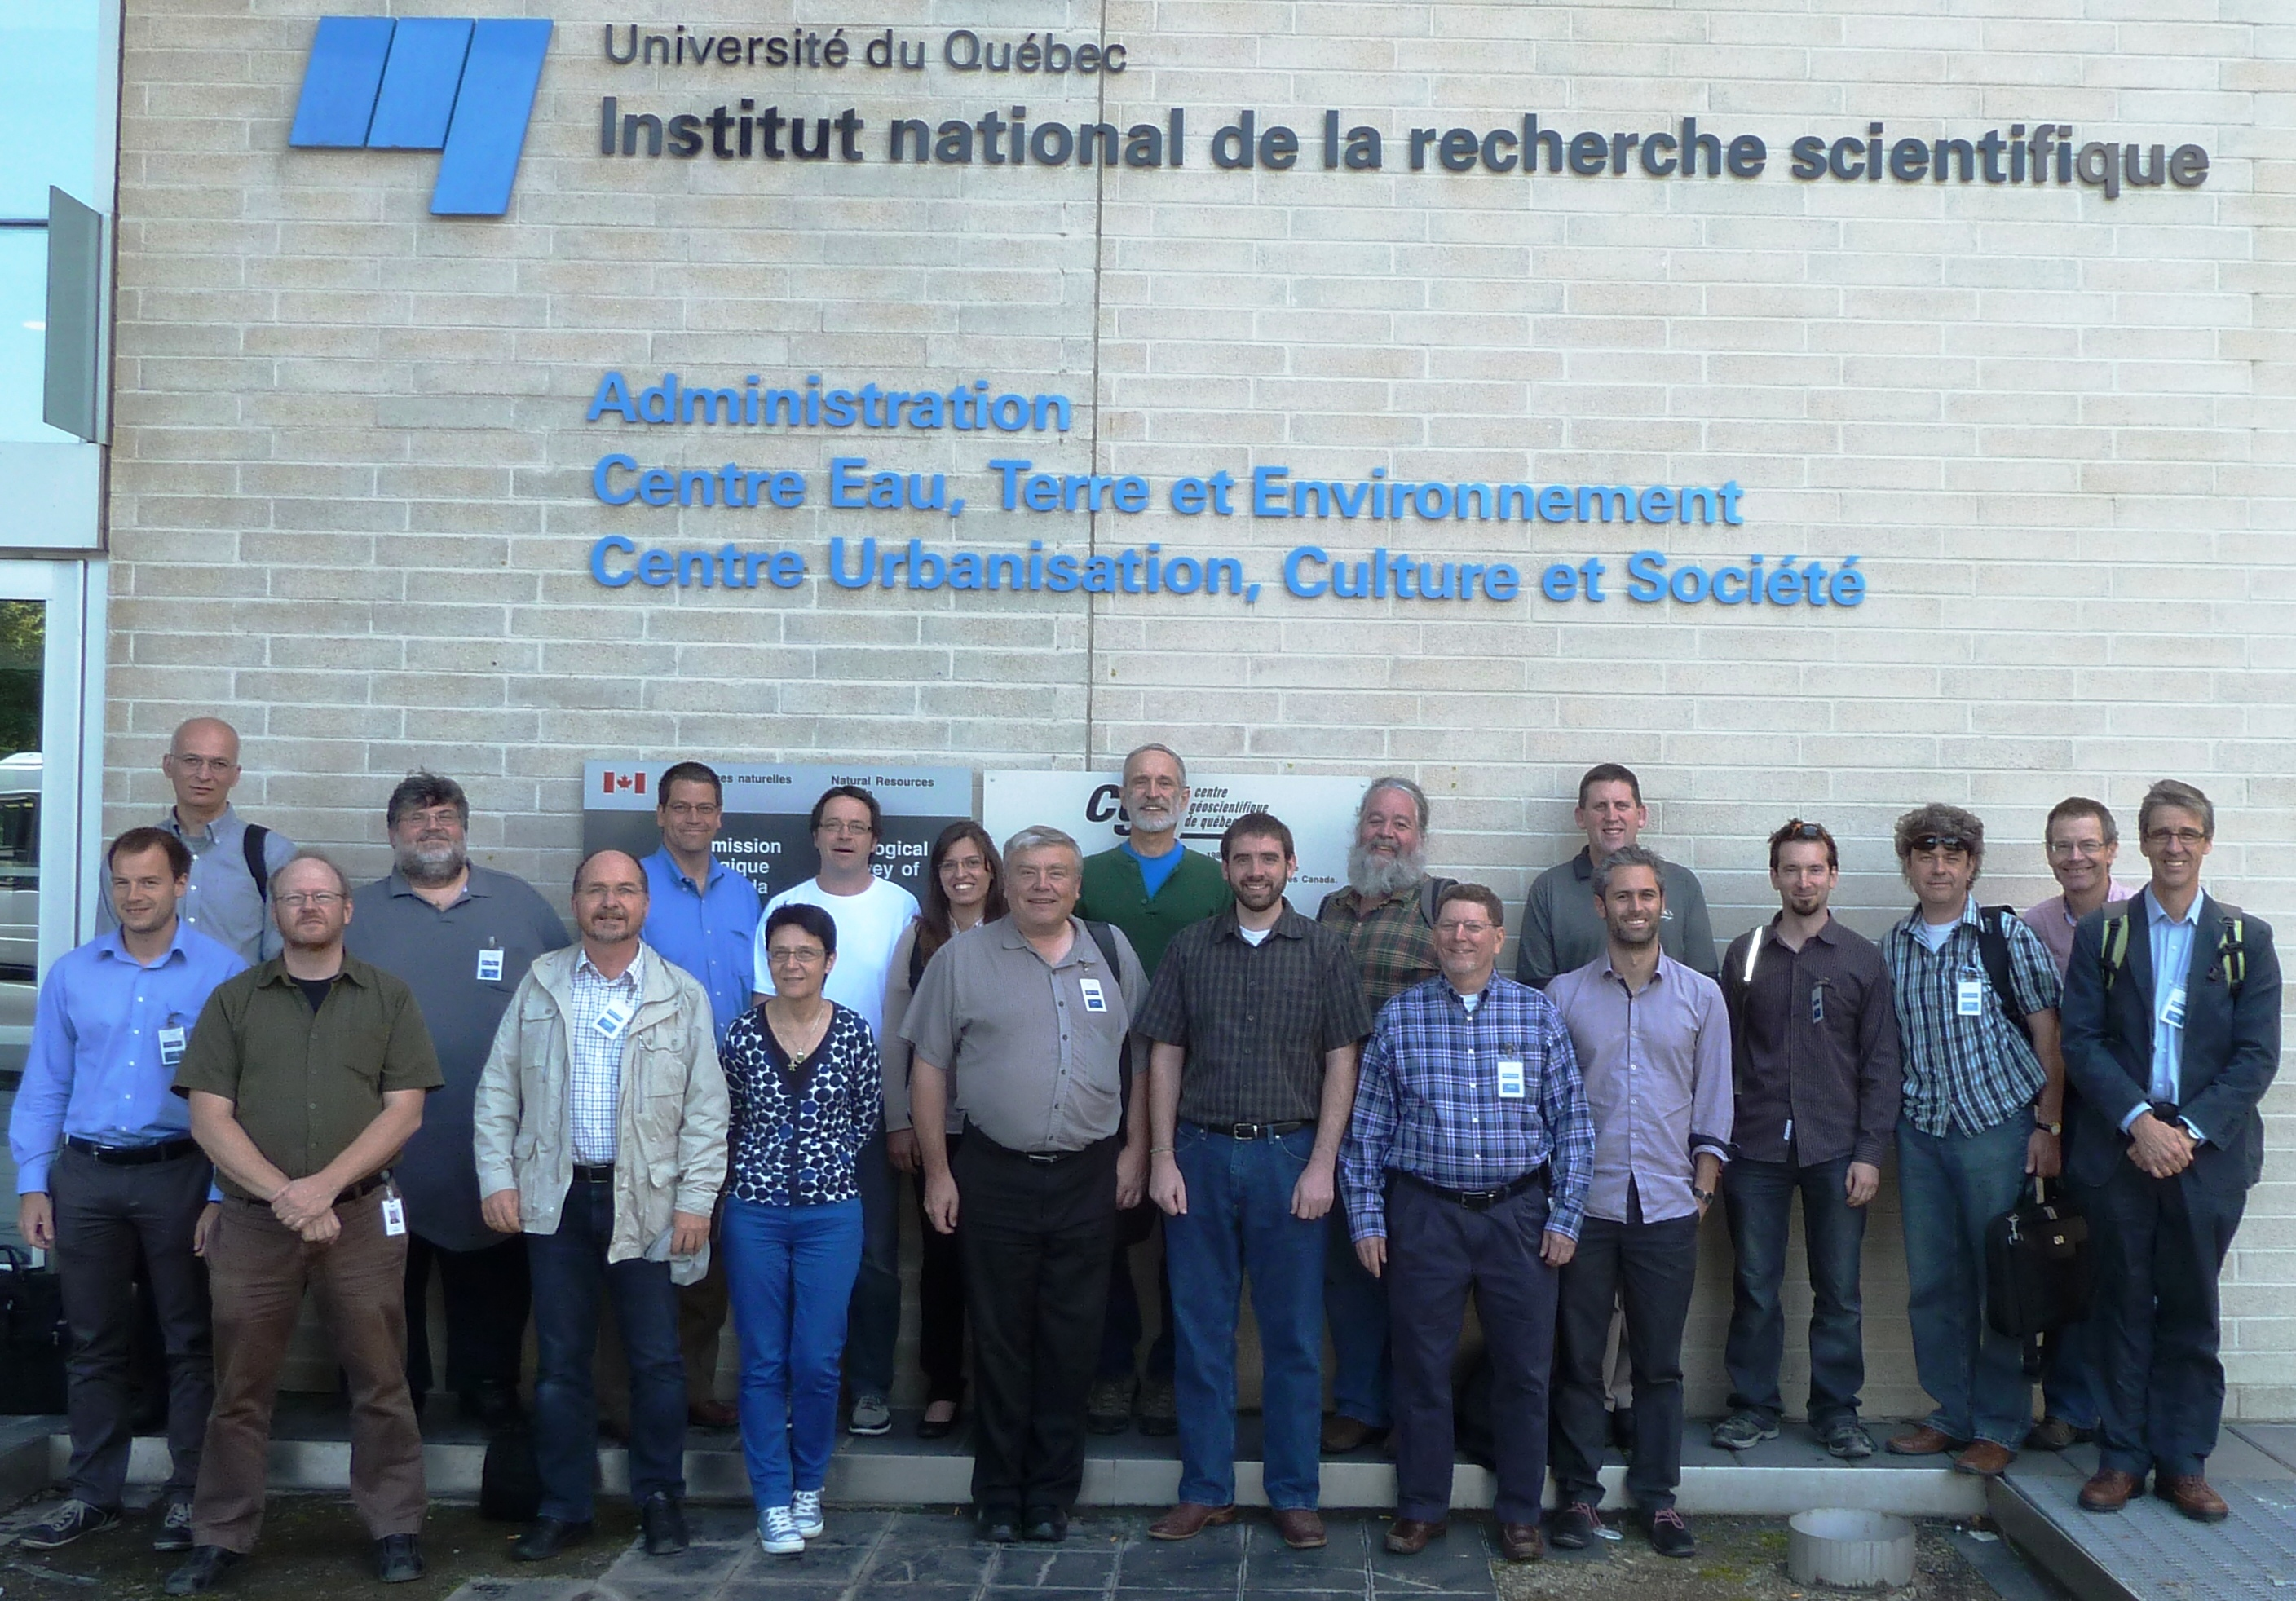
Thanks to our hosts
INRS-ETE
Geological Survey of Canada (Québec division)

