Slide 1


WaterML2, Part 2
Ratings, Gaugings and Sections
Activity update and forward planning
OGC Hydro Domain Working Group Workshop Quebec City 2013

Slide 2
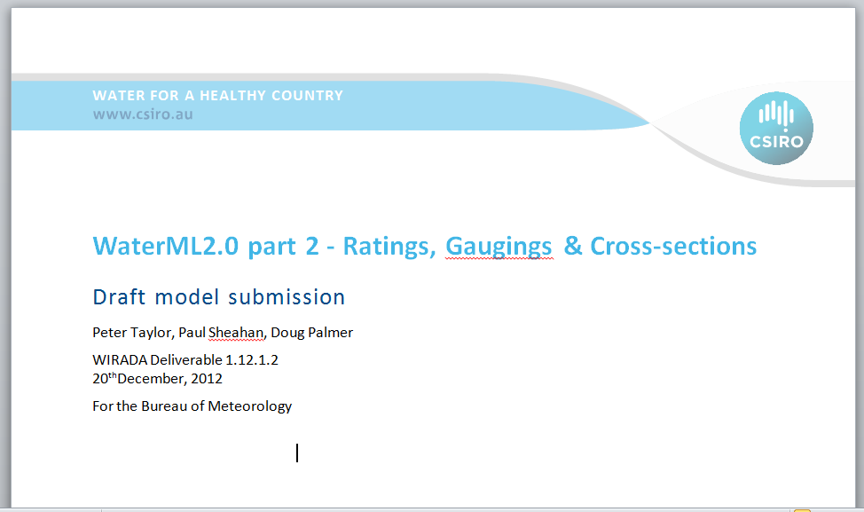
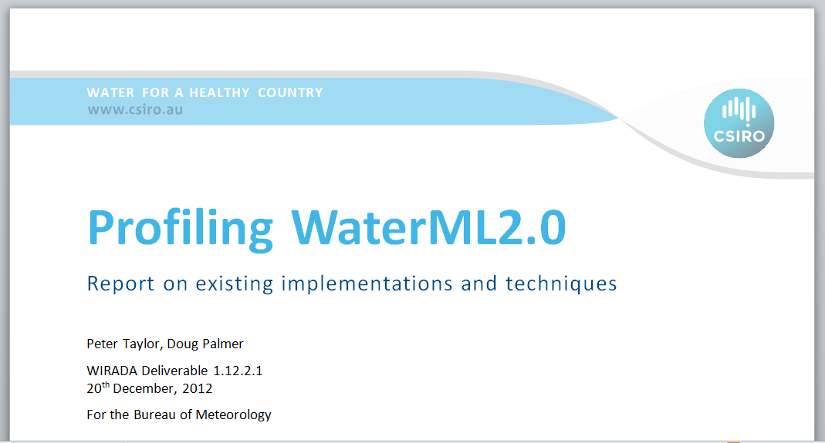

Summary of activity to date
RGS - Reading and post Reading work
WIRADA II - WML2P2 status
Domain and information modelling
Model walk through
Draft model submission
WaterML2 Profiling Method Report
ST
Notes:
A few telecons, probably not as much as we would like.
Simple domain models related to requirements
Information models related to requirements
Outputs
WaterML2.0 - part 2: Ratings, Gaugings and Sections : Discussion Paper
Profiling WaterML2.0 Report on existing implementations and techniques
http://sc.water.usgs.gov/infodata/shift_adjusted_rating.html
http://waterdata.usgs.gov/nwisweb/get_ratings?file_type=exsa&site_no=02160700
Stage shirt - A rating implementation or a range value implementation? http://external.opengis.org/twiki_public/HydrologyDWG/RGSRangeValues

Slide 3
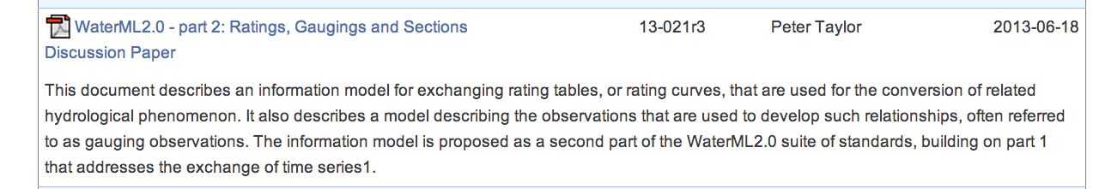
Discussion paper
Public discussion paper now available: http://www.opengeospatial.org/standards/dp

Slide 4
The path to a standard
OGC Process
Interoperability experiment
SWIG formation
Standard development
Submit RFC for OAB review
Public RFC
Adoption vote
S

Slide 5
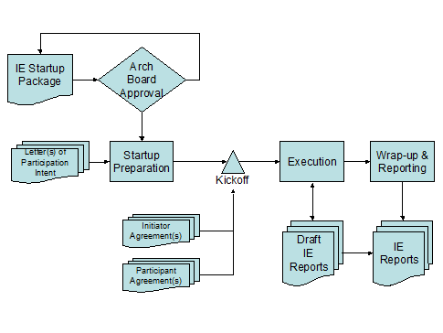
The path to a standard
Interoperability Experiment
S

Slide 6
The path to a standard
IE Execution
Activity Plan
IE execution
Deliverables
Engineering report
Demo at 2014 Hydro DWG
S

Slide 7
IE Activity plan development
Initiator organisations
Participant organisations
Description
Technical approach
Deliverables
S
Notes:
Session objective is to work through the inputs required for building the IE Activity plan

Slide 8
IE Activity plan development
- Description
Objectives
Demonstrate on demand retrieval and analysis of rating and gauging data
Use cases
Public / Researcher data user
Corporate data users
Current rating
Family of ratings
Stretch use case
Notification on update of changed rating
ST

Slide 9
IE Activity plan development
- Initiator organisations
CSIRO
BOM
?
S

Slide 10
IE Activity plan development
- Participant organisations
CSIRO
Standard drafting
HTML client - public user use case
BOM
IE coordination
Enterprise data serving?
Data consuming client
?
S

Slide 11
IE Activity plan development
- Participant organisations
Non-OGC Member Observers
DPIPWE
Department of Primary Industries, Parks, Water and Environment
Ratings service provision
NOW
New South Wales Office of Water
Ratings service provision
MDBA
Murray Darling Basin Authority
Current rating consumer
S

Slide 12
IE Activity plan development
- Discussion
Currently only the public/researcher use case makes use of gauging observations
Ideas (and participation) are welcome for more
e.g. including cross-sections
S

Slide 13
Interoperability Experiment
NSW hydro operators
Bureau
MDBA
CSIRO/Researchers
NSW state water
Scenario 1: Bureau retrieving data from agencies
Scenario 2: MDBA latest rating from NOW
WaterML2.0 part 2
WaterML2.0 part 2
Scenario 3: Web analysis tool accessing all ratings
KISTERS products
Aquatic Informatics
NSW Office of Water
TAS DPIPWE
Notes:
Scenario 1: Bureau on demand retrieving of rating tables
Scenario 2: MDBA getting latest rating from NOW. Sub-scenario: NSW hydro operators and state water also retrieving.
Scenario 3: Data scrutiny/analysis by researchers and/or educational purposes.

Slide 14
IE Activity plan development
- Technical approach
RGS model components
Model component | Service interface | Comments
Rating tables | WFS and/or RESTful API | Query support needs investigation
Gaugings/Conversion Observations | SOS and/or RESTful API
Cross sections | WFS
Monitoring Points | WFS and/or SOS
Catalog | CS/W? | Any learnings from CHISP-1 may help here
T

Slide 15
Quick demo client
For online quick analysis/scrutiny use cases

Slide 16
RESTful API for RGS
Returns | URL | Description
MonitoringPoints | /monitoring-point/ | Returns a list of all monitoring points. Current returns fully encoded descriptions rather than simple references.
MonitoringPoints | /monitoring-point/<mp-id> | Returns description of a specific monitoring point by ID.
ConversionGroup | /conversion-group/ | Returns a list of all available conversion groups (combinations of monitoring-points/paramFrom/paramTo
ConversionGroup | /conversion-group/<cg-id> | Returns a specific conversion group description.
Conversion | /conversion/ | Returns a list of all available conversions.
Conversion | /conversion/<conv-id> | Returns a specific conversion by its identifier.
ConversionPeriod | /conversion-period/ | Returns a list of all available conversion periods.
ConversionPeriod | /conversion-period/<conv-period-id> | Returns a specific conversion period.
Gauging | /gauging/ | Returns all available gauging observations.
Gauging | /gauging/<gauging-id> | Returns a specific gauging observation by its identifier.
T

Slide 17
IE Activity plan development
- Technical approach
Running software...
OGC Engineering Report
Demo to HydroDWG meeting in 2014
T

Slide 18
Risk
Organisational IT policies and practices
Software vendors
release cycles
ability for test/beta releases

Slide 19
IE Activity plan development
- Methodology
Software vendor deployment vs. deployment at an agency
Vendor can serve an agencies data
Versioning lifecycle - production vs development
How to support short development cycles?
Tools:
Hydro DWG wiki
JIRA
T

Slide 20
IE Activity plan development
- Schedule
Work though WIRADA draft planning schedule
S

Slide 21
Methodology
Break into specific use case/work packages
Freeze a version of draft mode & schema
Meetings
Regular for each use case
Less regular whole of IE catchup
Goto meeting
T

Slide 22
Australian Hydrogrpahers Association
Data TRG
Objective :
To investigate and recommend method(s) that:
Enable 'fit for use' assessment of a data set, particularly for secondary users of data.
Enable a data set to contain information that will enable 'fit for use' assessment.
Are well defined semantically and able to be applied nationally with constancy.
Are useful, pragmatic and sustainable in their application
Look to make use of WML2.p2 range values

