Slide 1
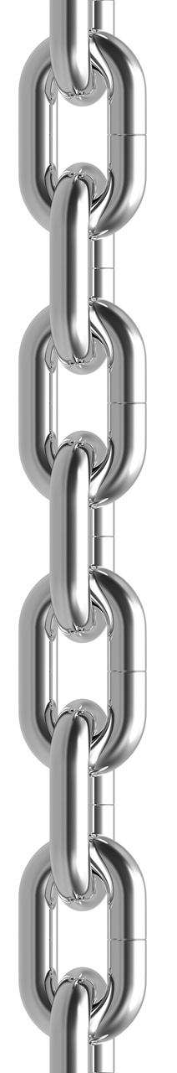
Calculating flow using shifts
A chained conversion
Raw gauge height
Datum and Quality corrections
Computed gauge height
Rating shifts to stage
Effective gauge height
Discharge rating
Computed flow

Slide 2
A conversion period index's multiple conversions
Symbol Index
Conversion Period
ConversionApplicationTime
Conversion Table
Effective gauge -> Flow
Computed -> Effective Height
Computed -> Effective Height
Computed -> Effective Height
Effective gauge -> Flow
Computed -> Effective Height
Computed -> Effective Height
Effective gauge -> Flow

