Slide 1

Observations & Measurements & SWE in Inspire
OGC Hydro DWG Workshop – Reading – 2012-06-26
  Sylvain Grellet
Office International de l’Eau

Slide 2

Table of content
Cross-Thematic Working Group on O&M
O&M design patterns
O&M extensions to Inspire
Provision of O&M encoded data

Slide 3


Cross-Thematic Working Group on O&M
Scope : Several Inspire themes included measured / modeled / simulated data
Inspire themes directly concerned
  Geology
  Oceanographic geographical features
  Atmospheric conditions and Meteorological geographical features
  Environmental monitoring facilities
  Soil
Other themes indirectly evoke Observations
  Land Cover, Habitats and biotopes & Species distribution, Human Health & Safety …

Slide 4
Cross-Thematic Working Group on O&M
Goals :
  Determine requirements for O&M within INSPIRE
  Provide recommendations for
    Observations on INSPIRE features,
    Referencing of observations from INSPIRE features,
    Use of elements of Sensor Web Enablement.
  D2.9 Guidelines for the use of Observations & Measurements and Sensor Web Enablement-related standards in INSPIRE Annex II and III data specification development
  Link to V1.0 (06-2011). Final version expected around September.

Slide 5
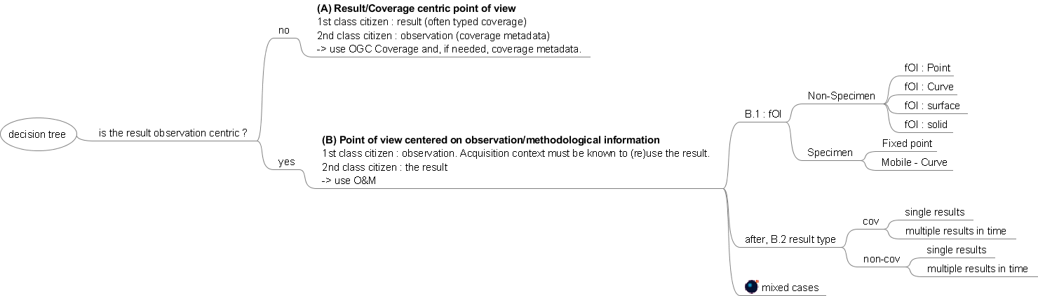
O&M design patterns
Decision tree :

Slide 6
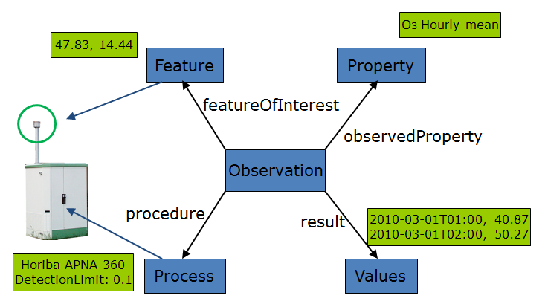
O&M design patterns
Example : Observation centric
  Feature of Interest Point – Multiple Result in Time
in this case, we show an air quality monitoring station providing hourly ozone measurements. The featureOfInterest represents the direct surrounds of the air intake (i.e. the air bubble surrounding the air intake, to be modelled as a sampling point (SF_SamplingPoint)) and is modelled as a samplingFeature. The location for the measurements is provided through the FoI. As this design patters usually provides a time series (temporal coverage) result, the phenomenonTime and/or resultTime will often be provided together with the result values. Administrative information relevant to the facility is stored in the EnvironmentalMonitoringFacility Class from the Environmental Monitoring Facilities Application Model.

Slide 7
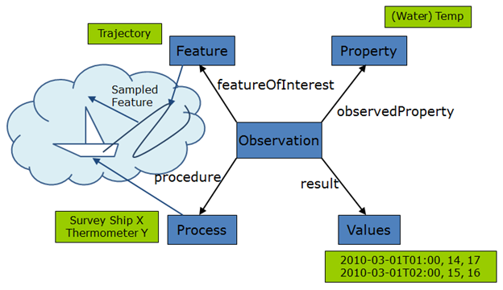
O&M design patterns
Example : Observation centric
  Feature of Interest Curve – Multiple Result in Time
In this design pattern the featureOfInterest represents the trajectory of a moving facility, for example a moving ship making sea surface temperature measurements. The trajectory is modelled as a samplingFeature, with the spatial sampling feature (e.g. a SF_SamplingCurve in O&M) being the media referred to, in this case, the ocean (or a further chain of samplingFeatures finally referring to the media). The actual locations of individual measurements along the trajectory are provided with the results. All measurement locations should be located within the trajectory described by the featureOfInterest; depending on the encoding of the result the actual location within the featureOfInterest as well as phenomenonTime and resultTime may be provided as a relative (i.e. 5m from start of trajectory) or absolute (i.e. coordinates) position.

Slide 8
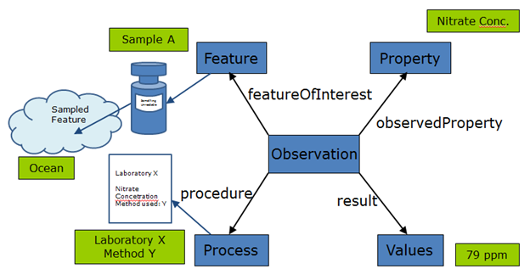
O&M design patterns
Example : Observation centric
  Specimen – Single Result in Time
In this design pattern the featureOfInterest represents a sample or specimen taken from the sampled feature and analysed ex situ in an external laboratory. The featureOfInterest is modeled as a SF_Specimen; the location pertaining to the measurement is provided by the attribute samplingLocation, the current location of the specimen is provided by the attribute currentLocation. Procedural information is provided through a laboratory report, the location of the laboratory is not relevant. In this design pattern, phenomenonTime and resultTime will both be required, as phenomenonTime provides the time the sample was taken whereas resultTime provides the time the results of the laboratory analysis were made available.

Slide 9
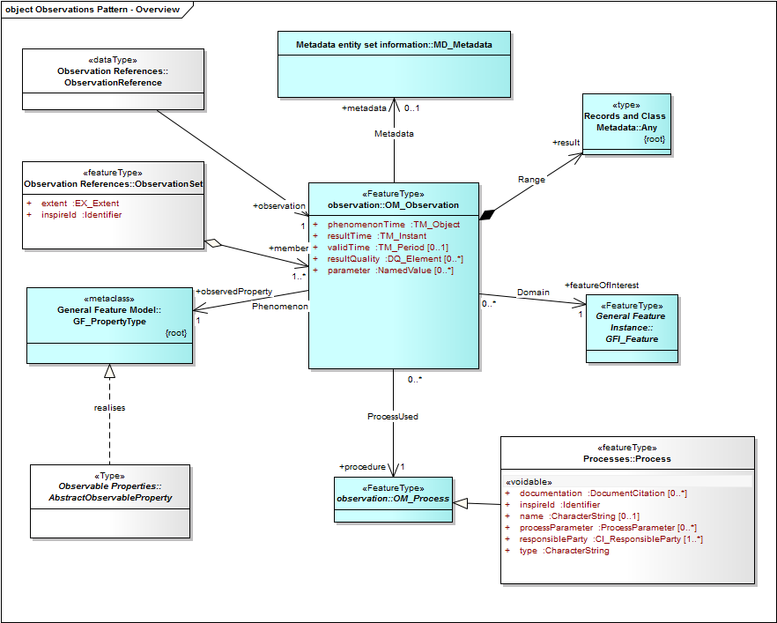
O&M extensions to Inspire
The observations Package

Slide 10
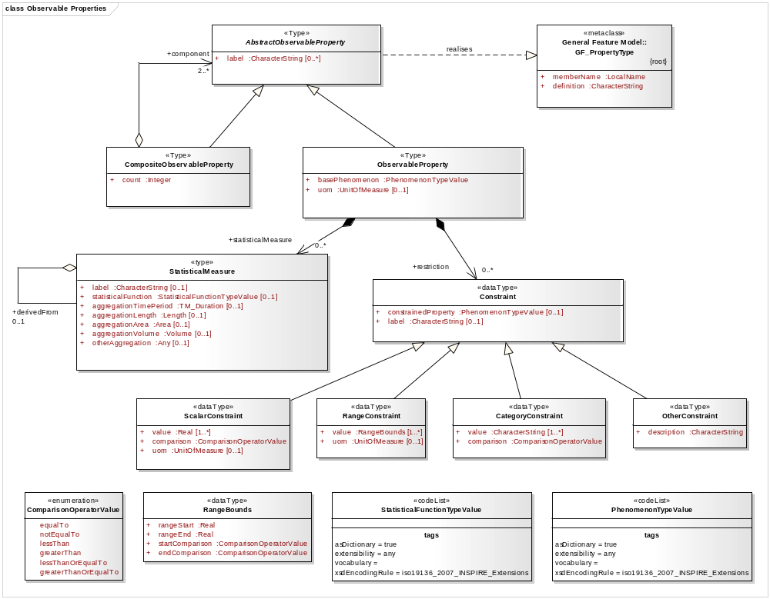
O&M extensions to Inspire
Ex : ObservableProperty : Dominic Lowe (British Atmospheric Data Centre - BADC)

Slide 11
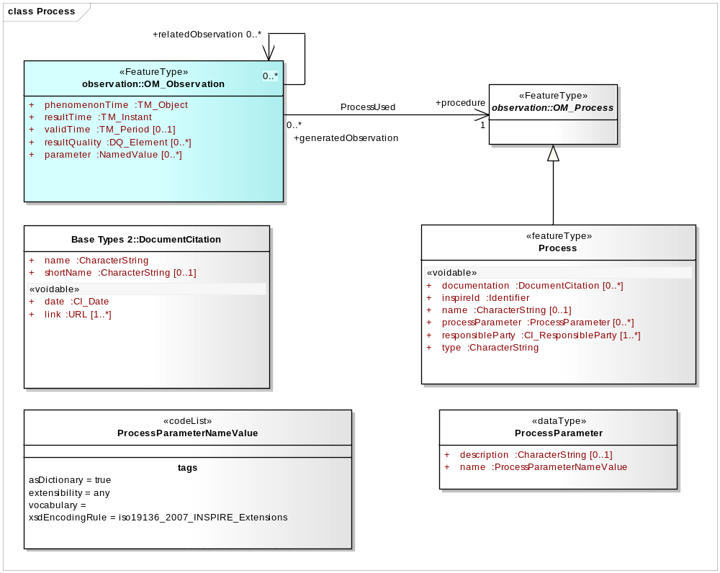
O&M extensions to Inspire
Ex : Process :

Slide 12
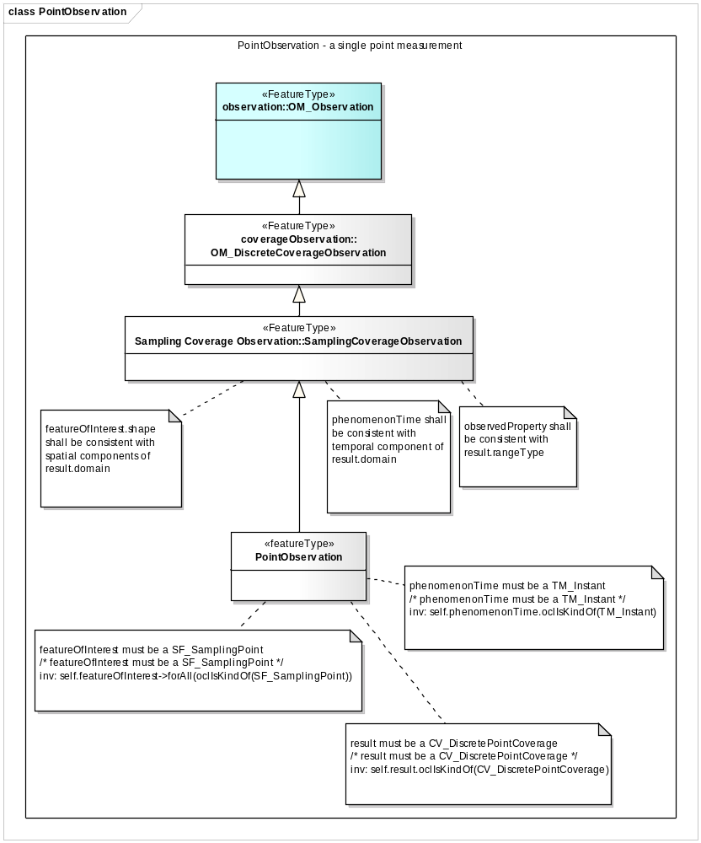
O&M extensions to Inspire
Ex : Specialised Observations
  Same rationale as CSML
  Ex : PointObservation

Slide 13
O&M extensions to Inspire
Result encoding
  No clear consensus on State of the Art across thematic domains on result encoding.
  Examples presented :
    SWE Result Encoding,
    WaterML 2.0,
    GML Feature,
    GML Coverage,
    Linking to external file containing the result encoded in proprietary, binary format : NetCDF, SEG-Y, LAS, WITSML…
    Discussion paper in annex to D 2.9

Slide 14
Provision of O&M encoded data
Services for the Provision of O&M Encoded Data
  SOS recommended but other solution evoked (WFS, WCS)
Registers/Registries
  Need structured registers,
  Stress the fact that this is a very strong requirement for the clear provision of reusable observational data.

Slide 15
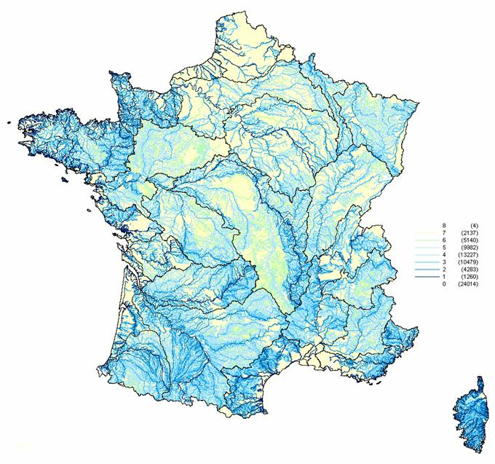

Thank you
Katharina Schleidt (coordinator) : katharina.schleidt@umweltbundesamt.at
Sylvain Grellet : s.grellet@oieau.fr

